Slide 1
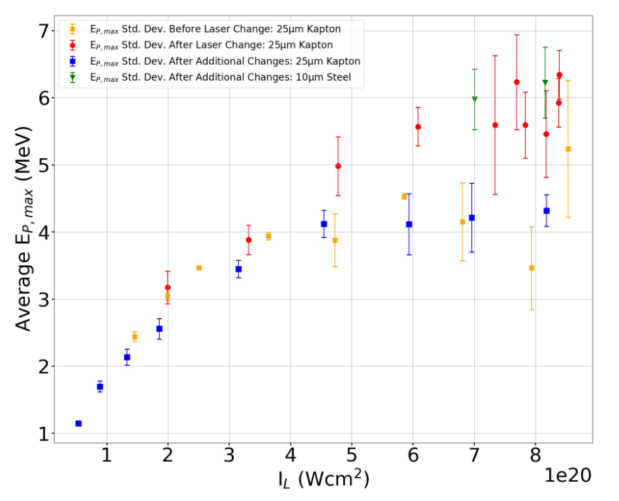
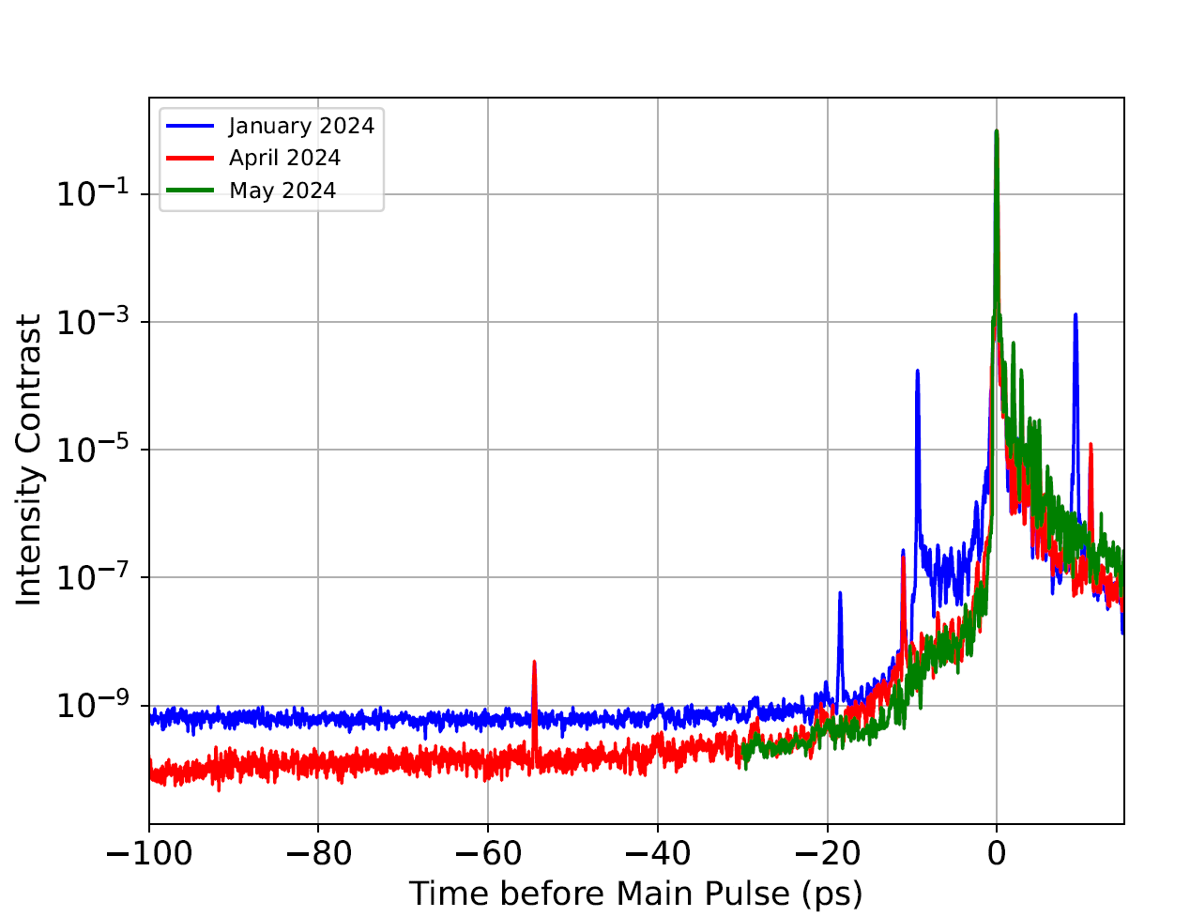
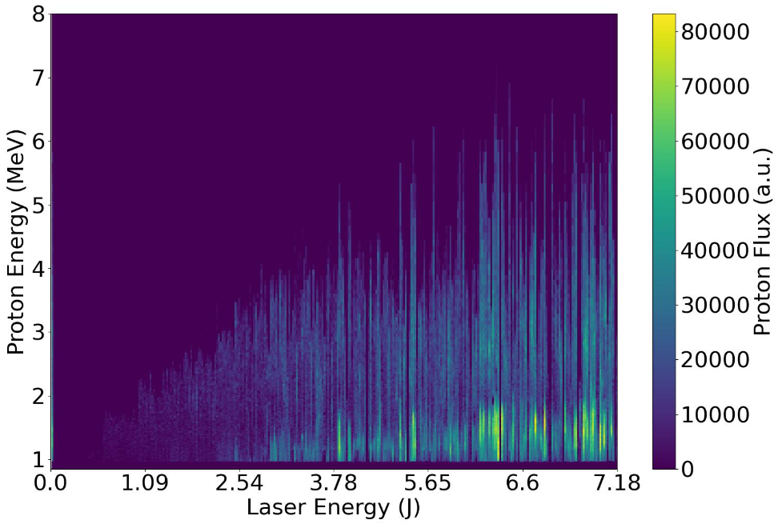
WP2 Source Development Updates
As reported at the CM, during the March experiment we were limited to around 7 MeV protons from 25 um tape targets.
This was likely to be related to the laser temporal intensity contrast. Significant work was undertaken in recent months to remove prepulses in the system.

Slide 2
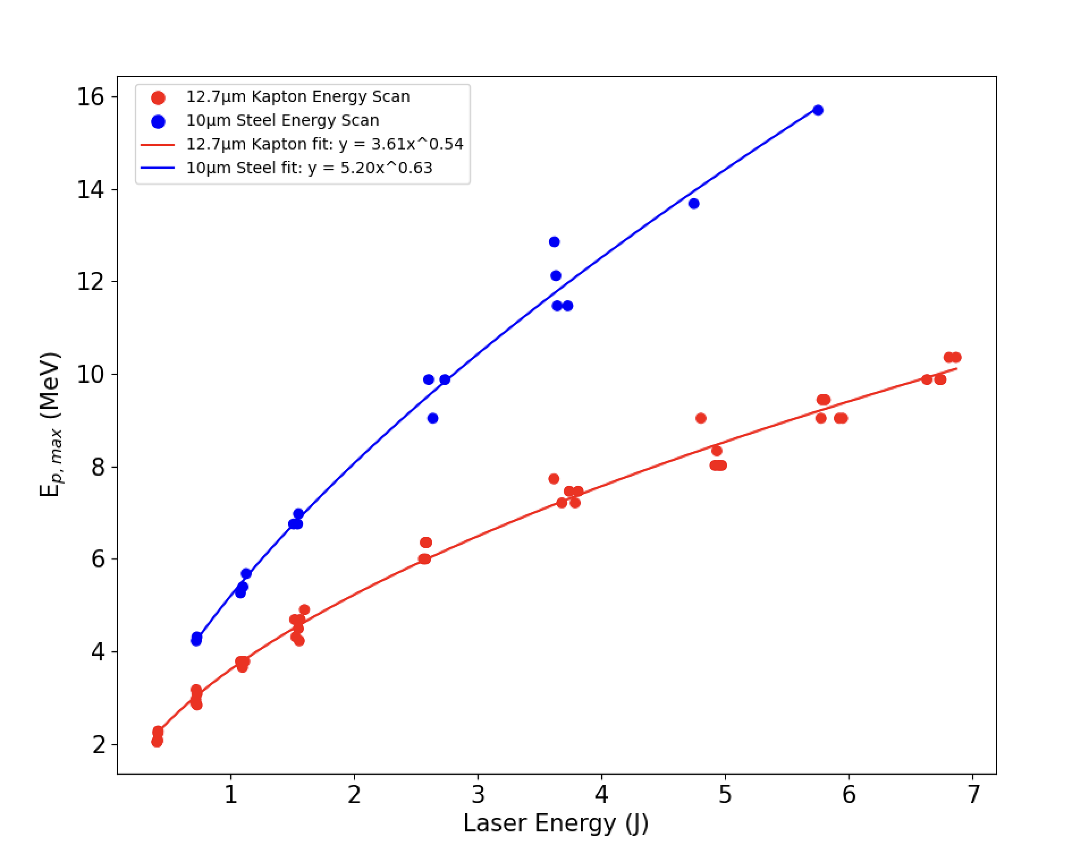
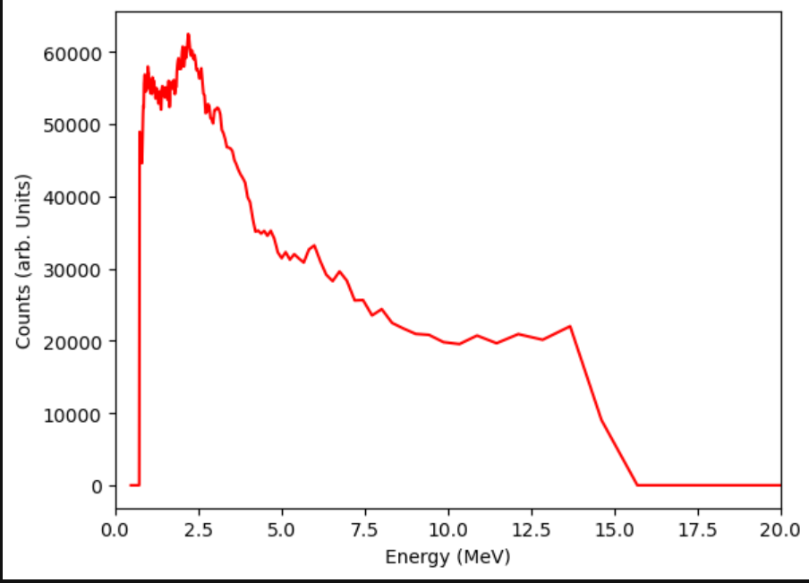
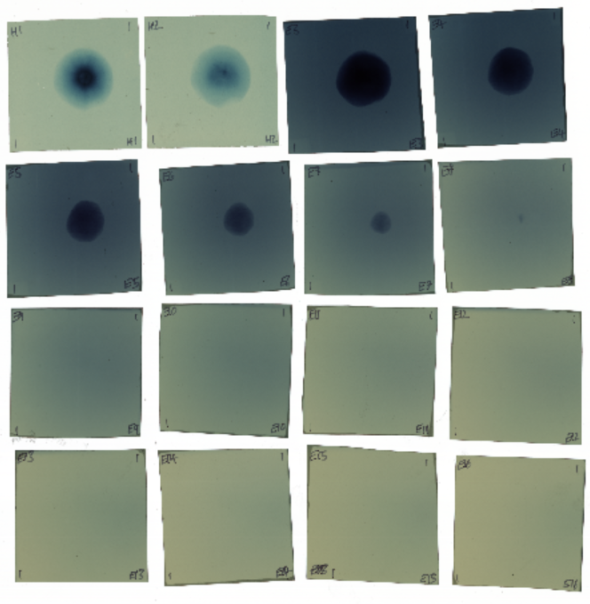
WP2 Source Development Updates
Very recent results (from 13th/14th June) show much improved energies up to 15 MeV both on the Thomson parabola and RCF diagnostics.
There have been improvements to the laser focal spot but the contrast change is likely the major factor here.
The experiment continues: We are aiming to optimise the preplasma with a second pulse which will should increase the proton energies further. We will also be doing some detector calibrations in the next days to support the PoPLaR effort.
RCF Stack
TP Spectrometer
Energy Scan

