Slide 1
Update and news

Slide 2
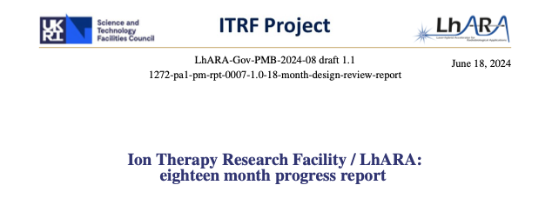
A good read, coming soon …

Slide 3
Bridging period update
Yesterday (sic!) received copy of award letter from UKRI:
  Award to M. Noro, H. Owen et al @ STFC
  £2M over two years, starting 01Oct24:
    Explicitly refer to award being made on basis that UKRI contribution will be 80% and that partners will contribute 20%:
      For HEIs this seems to be ”business as usual” as the FeC/dual-funding model means that 80% of a grant’s value is paid to the HEI by the research council;
      The source of the 20% contribution to the lab-based allocation remains to be understood
Priorities (as before):
  Bio programme, including PoPLaR
  Risk management for ITRF/LhARA
  Managenent
Planning now begins in earnest!

Slide 4
Some more background:
Indication that future development of ITRF/LhARA programme requires closer engagement of MRC:
  Some discussions understood to be going on within the research councils;
  Engagement goals for us:
    Led by PatP as part of WP8 outreach and engagement:
      Seek to bring forward “biological/clinical expert advisory group”
      Seek to organise a bio/clinical peer-group meeting in the autumn sponsored by MRC
  Clear opportunity to engage locally with life science or medical departments/faculties

Slide 5
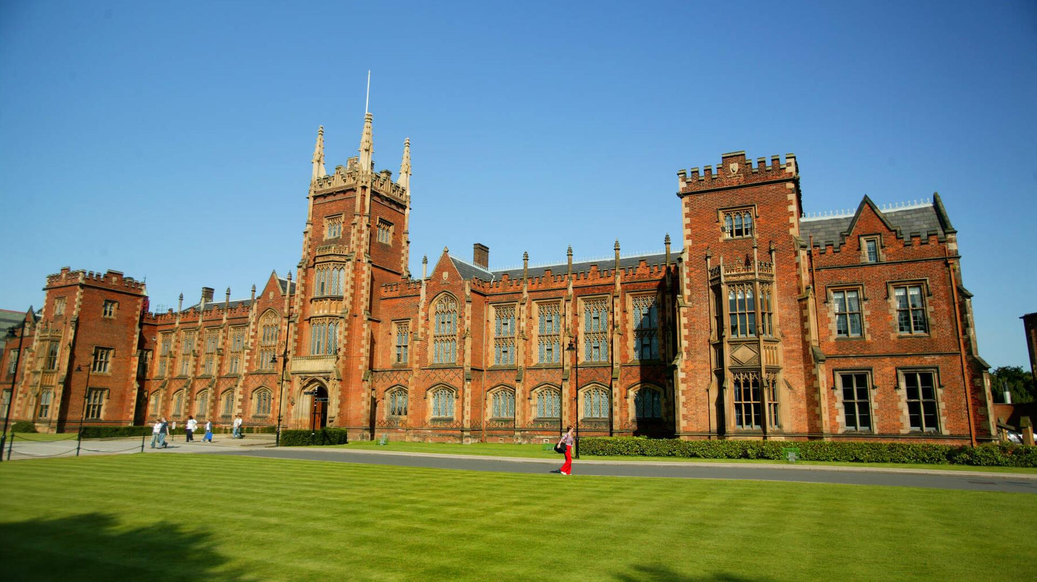


September collaboration meeting
Queens University Belfast:
  02/03Sep 2024
Excellent meeting this morning; Charlotte Palmer taking the reins!
https://indico.stfc.ac.uk/event/1060/
Registration will go live 01Jul24

Slide 6
Going forward
Rolling w/p reports:
  Next time:
    Ion acoustic (WP4)

