Slide 1
Update and news

Slide 2
Bridging period update
Planning continues:
Priorities (as before):
  Bio programme, including PoPLaR
  Risk management for ITRF/LhARA
  Managenent
Now packaging as:
  £1m/yr
  Programme: 2 + 1

Slide 3

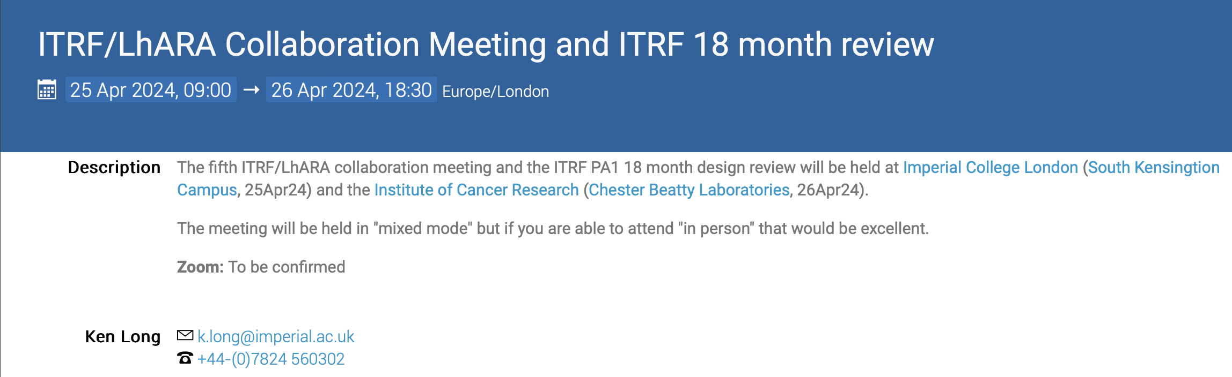
Next collaboration meeting
25/26Apr24;
  25APR:
    IC, Sth Kensington
      Rm 539, Blackett
  26APR:
    ICR, Chelsea

Slide 4
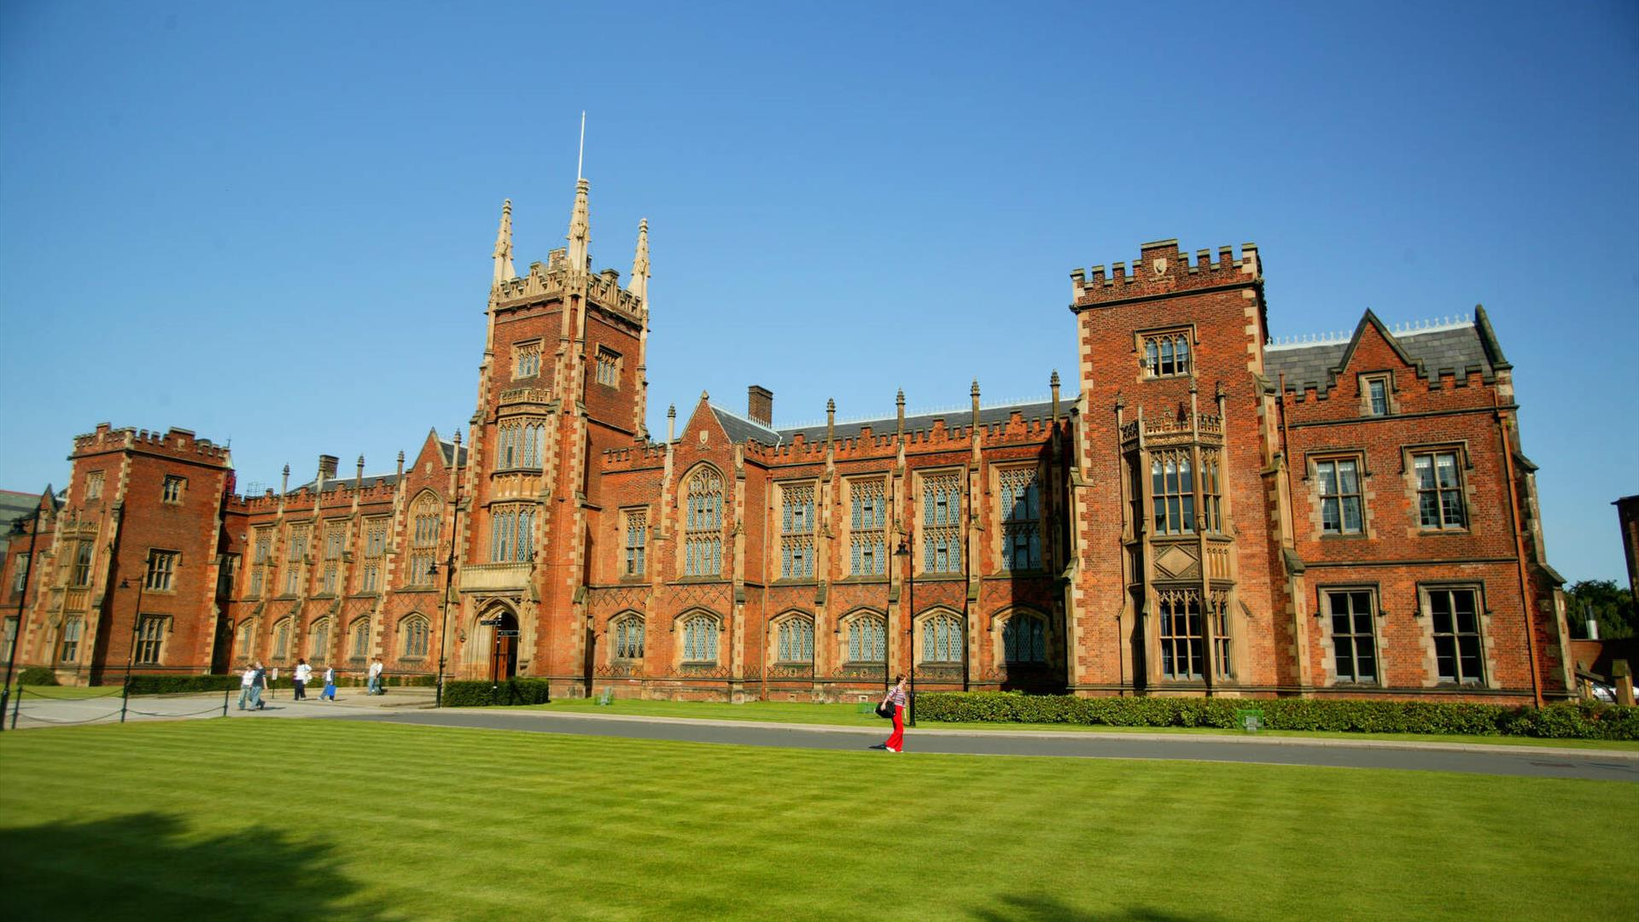

September collaboration meeting
Queens University Belfast:
  02/03Sep 2024

Slide 5
Going forward
Rolling w/p reports:
  Next time:
    Source (WP2)?

