Slide 1
Update and news

Slide 2
ITRF/LhARA next steps
Report on meeting at DL 23Jan24:
  J. Clarke, A. Giacca, A. Goulden, KL, M. Noro, H. Owen
Going forward:
  Prepare request for bridging funds:
    Request 2 years at £2M/year
    Plan for 2 years at £1M/year
    Recognise change in schedule:
      Prioritise work on Stage 1
      Prioritise investment in risk management
      Detailed plan to be developed;
        Needs to be presented as part of overall project, so still some pressure to complete 5-year plan
  Likely develop bid into Wave 5 of IF:
    Deadline October 2024
    Funding from October 2025

Slide 3
There is only one project!
The LhARA initiative:
The ITRF/LhARA project will deliver LhARA to serve the ITRF
“Context sensitive”, perhaps, but, the ITRF will be served by LhARA and LhARA will serve the ITRF!

Slide 4
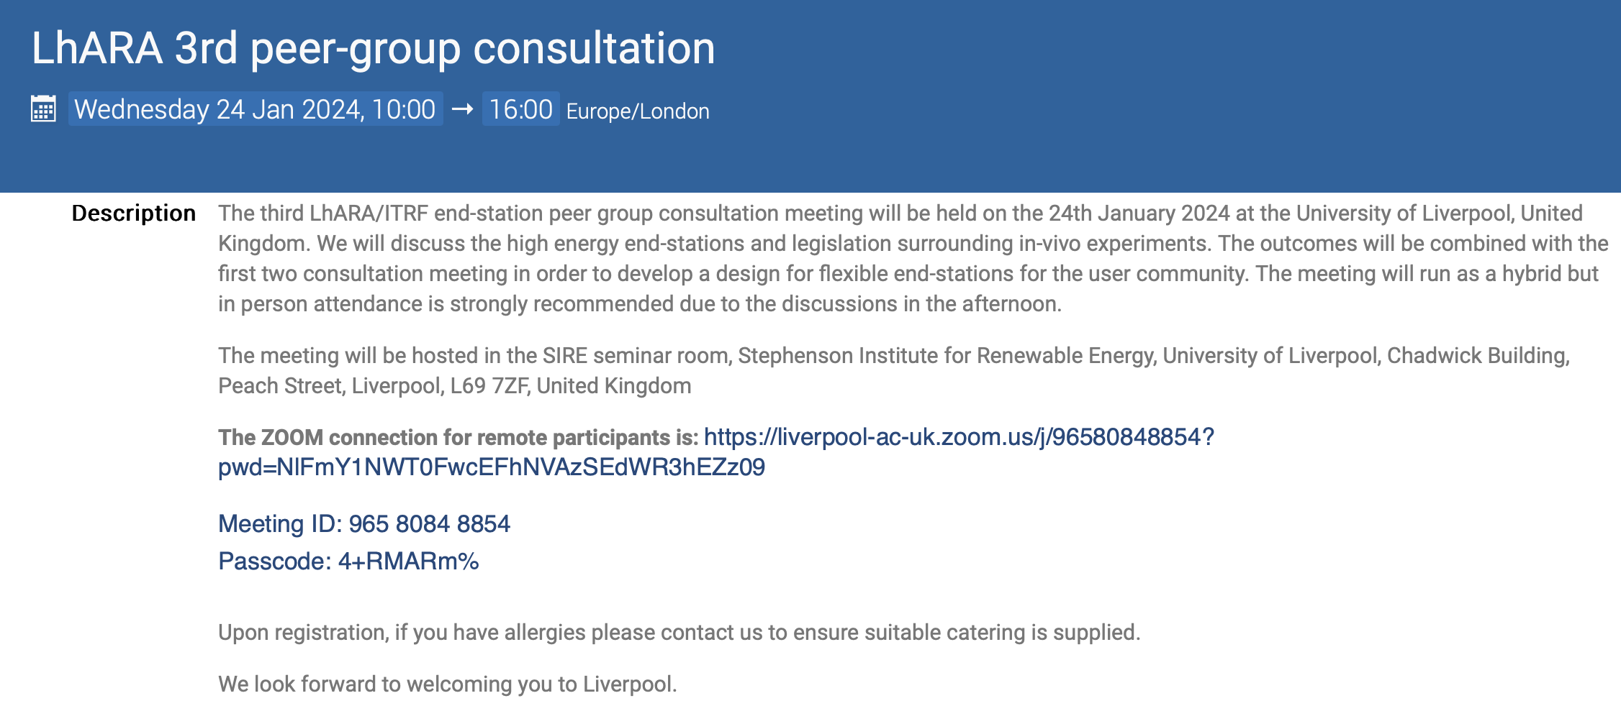
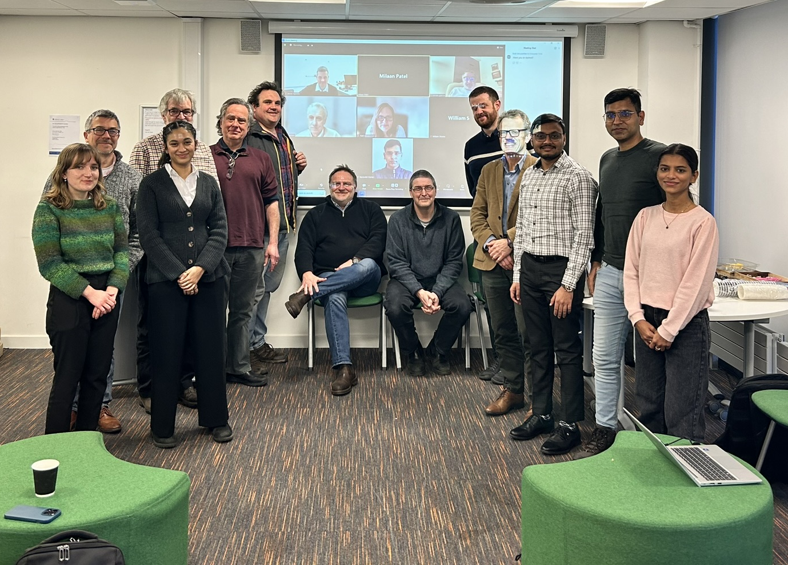
Events:
24Jan24: Peer-group consultation #3: Liverpool University
Excellent meeting;
  TP/RMcL will prepare summary for future Fortnighly … but …
Clear conclusions:
  An Animal House/Animal Husbandry facility will be required;
  Strong requirement to engage with in-vivo community to plan
    Potential to exploit MRC offer of support
https://indico.stfc.ac.uk/event/923/

Slide 5
BioPoP
BioPoP-0:
  First incarnation of biological proof-of-principle experiment
    Goal: execute so that we can be preparation a publication in the autumn of 2024
Subsequent development to deliver LhARA BioPoP facility
https://ccap.hep.ph.ic.ac.uk/trac/raw-attachment/wiki/Research/LhARA/Documents/LhARA-Gov-PMB-2024-07.pdf

Slide 7
BioPoP-0
Beamline design and simulation:
  Josie McGarrigle & Alfredo Fernandez-Rodriguez
    Please contact to be added to mailing list and get involved
Next steps in bioprep specification and experiment development
  Jason Parsons: through Jason’s Bio W/p meetings
    Please contact to be added to mailing list and get involved
  Working towards meeting at Strathclyde to progress:
    Requirements
    Workflow(s)
    …

Slide 8


Next collaboration meetings
26Apr24; ICR, London
Sep24, Queens University Belfast

Slide 9
Going forward
Rolling w/p reports:
  Next time:
    Capture (WP3)
    …
    And … report on Consultation #3

