Slide 1
Update and news

Slide 2
Feedback on PA2 proposal to STFC Visions Team
Broad support
  High impact potential
  Could deliver step change
  Potential for broad reach
  Ambitious
But not selected
  Fit with international landscape unclear
  Potential for target community unclear
  Progress of first preliminary activity unclear (but only 9 months into 2 year project when written)
Now seeking access to bridging funds

Slide 3
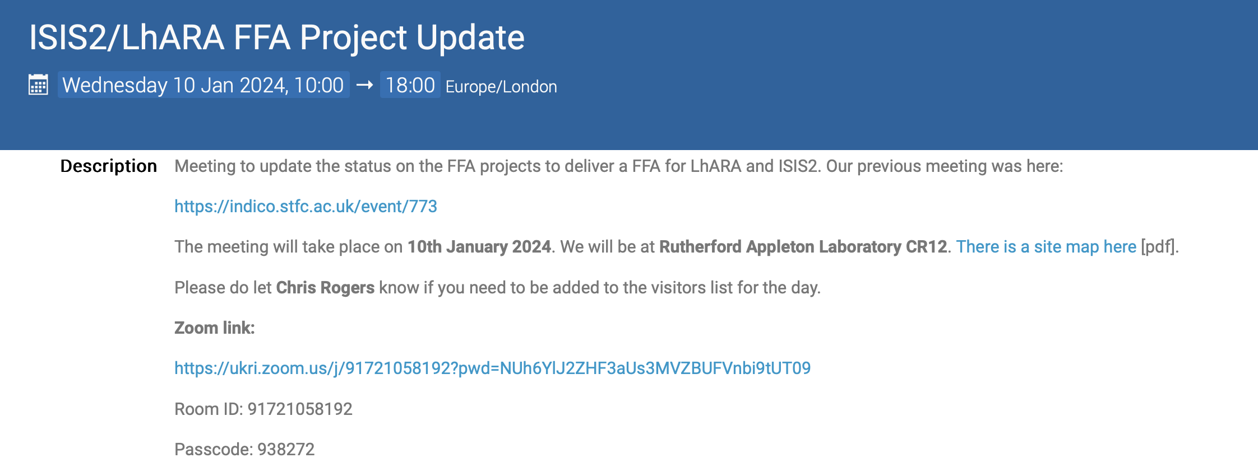
Joint LhARA/ISIS FFA meeting, 10Jan24
Excellent meeting:
  Covered a lot of material
Clear synergies, clear differences!
Concrete outcome:
  Initiate engineering design of:
    FFA magnet:
      In particular coil geometry
    MA cavity
Very valuable!
https://indico.stfc.ac.uk/event/933/

Slide 4
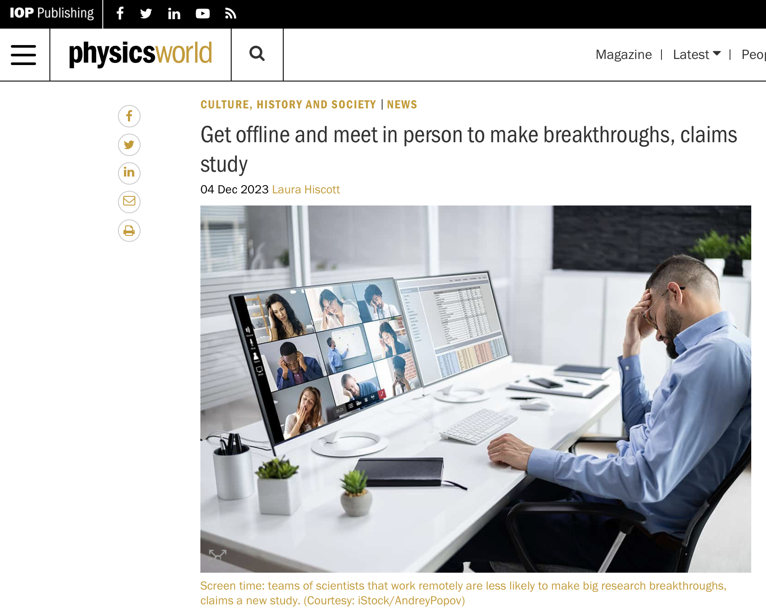
https://physicsworld.com/a/get-offline-and-meet-in-person-to-make-breakthroughs-claims-study/#:~:text=That%20is%20according%20to%20a,technology%20(Nature%20623%20987)

Slide 5
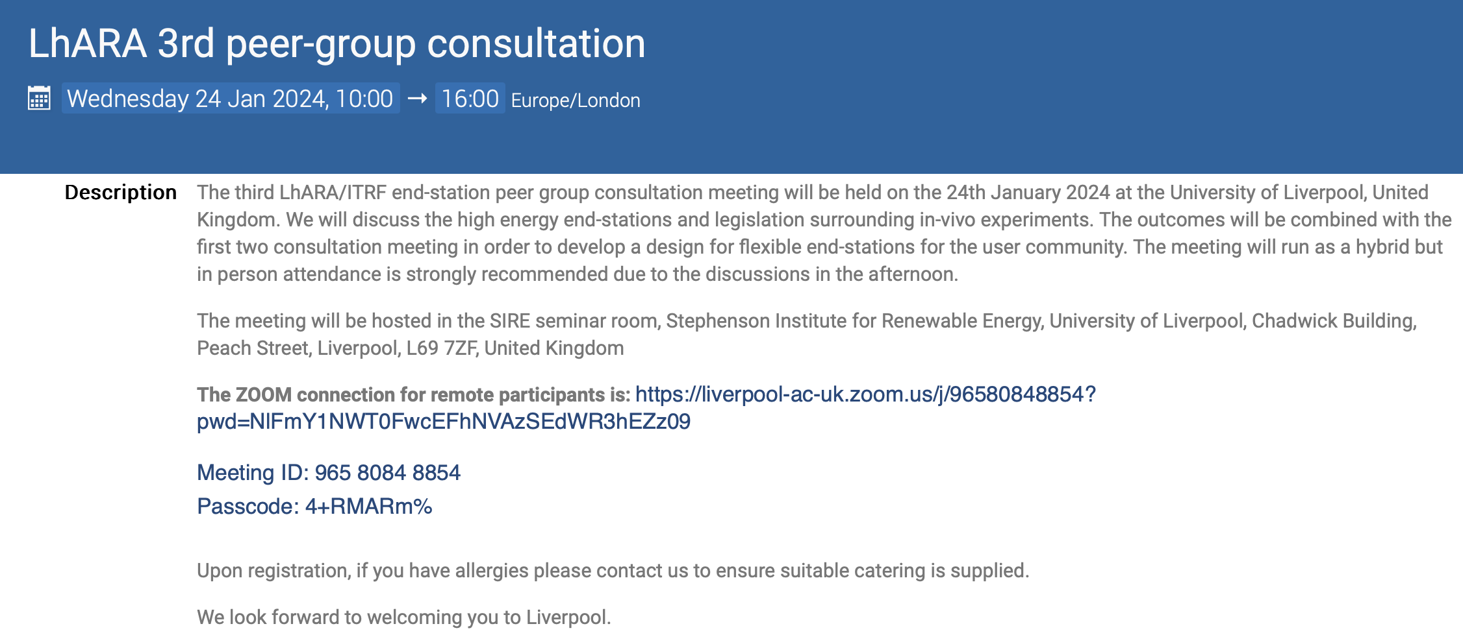
Upcoming events:
24Jan24: Peer-group consultation #3: Liverpool University
  Focus on in vivo end station and its requirements …
    Not on wiki, need to get advertising going again
https://indico.stfc.ac.uk/event/923/

Slide 6
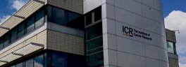

Next collaboration meetings
26Apr24; ICR, London
Sep24, Queens University Belfast

Slide 7
Going forward
Will solicit reports by w/p on a rolling basis for 2024:
  Need to watch progress in preparation for CDR!

