Slide 1
Update and news

Slide 2
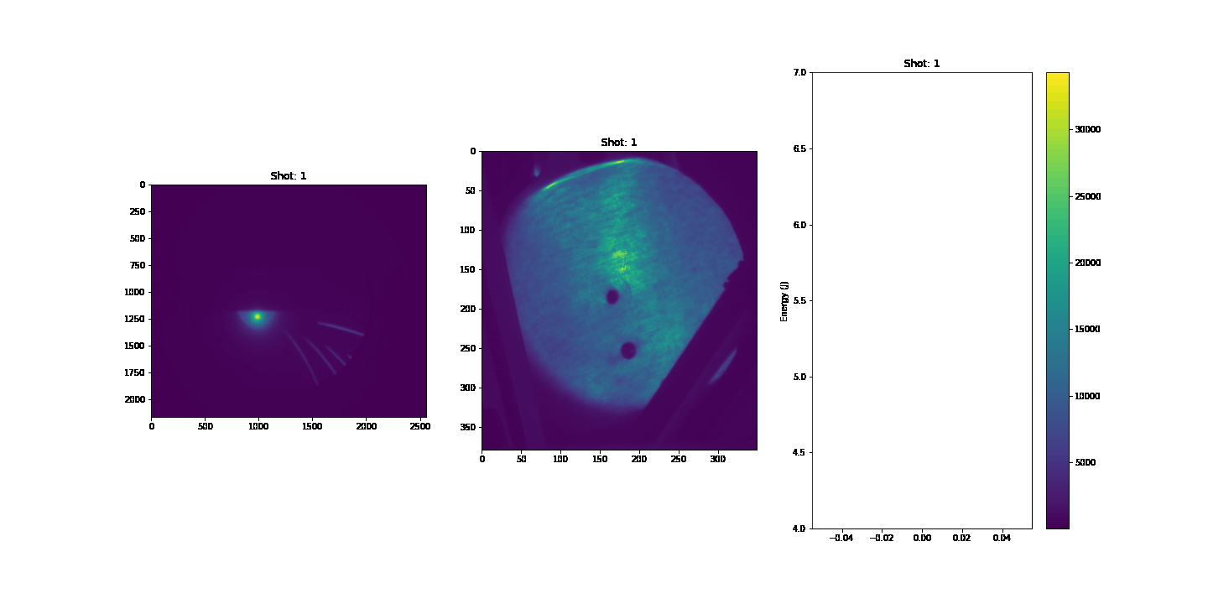
2023

Slide 3
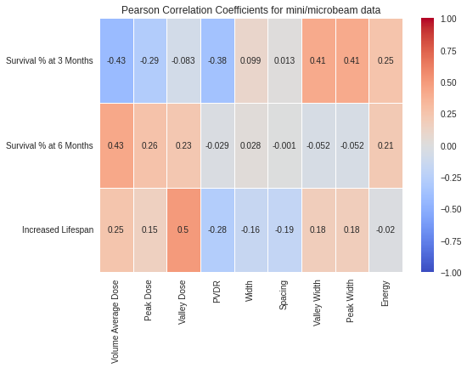
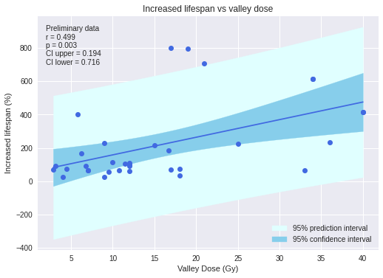
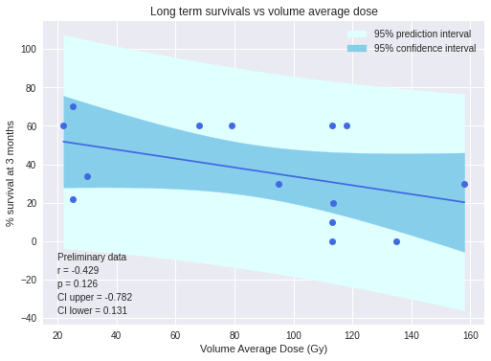
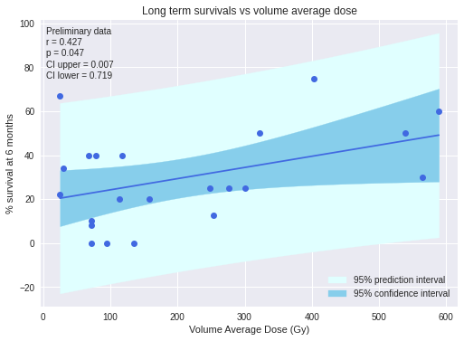
Minibeam & Microbeam result
J. McGarrigle
Increased Lifespan vs Valley Dose
Valley Dose had most prominent influence on Increased Lifespan
Reduced Ꭓ² = 175.81
Reduced Ꭓ² for 0 correlation = 1582.29
LTS % at 3 MONTHS vs Volume Average Dose
LTS % at 6 MONTHS vs Volume Average Dose
Volume Average Dose had most prominent influence on Long Term Survivors
Volume Average Dose had most prominent influence on Long Term Survivors
Reduced Ꭓ² = 15.78
Reduced Ꭓ² for 0 correlation = 18.18
Reduced Ꭓ² = 15.32
Reduced Ꭓ² for 0 correlation = 30.05
Plots of the highest correlation coefficients for each analysis method for the combined data.
Notes:
Fernandez -No strong correlation was found between ILS and any of the dosimetric parameters when all data were included in the analysis (ALL), regardless of the preclinical SFRT mode used. However, strong correlations appeared when MRT and MBRT were analyzed separately.
MBRT > 100 micrometers wide
MRT <= 100 micrometers wide

Slide 4


Slide 5
Collaboration building
Update since last AC meeting:
  CERN Accelerator Beam Physics Group:
    Active collaboration W. Shields/A.Lattina on space charge simulation
    Progressing discussion with M.Turner on plasma lens
      Hope can fold in collaboration with, e.g., BELLA
  ISIS Intense Beams Group:
    Active collaboration on FFA
Seeking to continue and enhance communication with:
  Institut Curie; perhaps CNRS more broadly:
    Working on joint meeting on biology in London on 08Nov23
    Will meet IN2P3 personnel week of 02Oct23
  HZDR:
    Will visit week of 19Oct23
  LMU:
    Next meeting on ion-acoustic proof of principle experiment 04Oct23
Two new groups have expressed wish to join LhARA collaboration:
  UK and US

Slide 6
Moving forward
Jason
Pat

Slide 7
Quads available at Strathclyde
If used as
triplet as
foreseen

Slide 8
Strathclyde quads used as doublets

Slide 9
Development of radiation biology programme:
  At existing facilities:
    Novel (e.g. laser driven)
    Conventional
LhARA proof-of-principle experiment:
  CW: “… include as many of key LhARA elements as possible …”

Slide 10
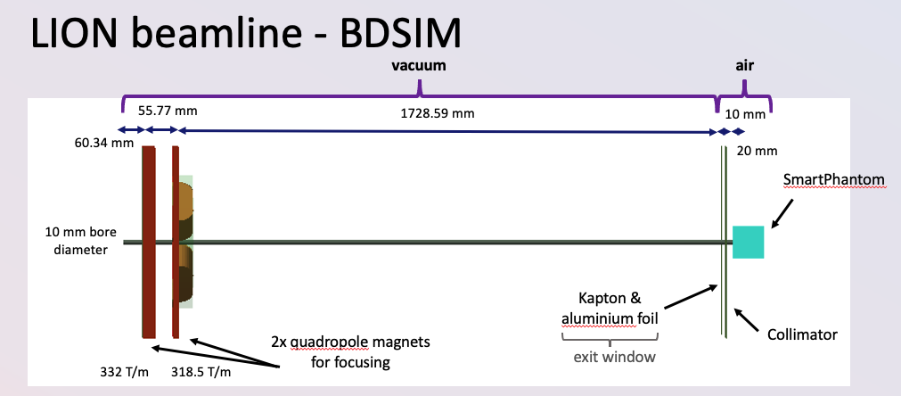
Options – 1
SCAPA; R.Gray
0th order outline

Slide 11
Triplet 3
Doublet 7
20 mm
5 mm
5 mm
5 mm
Point
source
Point to
parallel
Focus onto
sample
Sample
Doublet 7
or new doublet
Doublet 7
20 mm
5 mm
5 mm
A. Fernandez Rodrigues simulating …

