Slide 1
Update and news

Slide 2
Timeline
Target for full
programme
definition
mid Oct23

Slide 3
Review of PA2 project plan
Chris Townsley (PPD, PM office) now engaged in “rolling review”
Review by independent, external (international) experts:
  Mike Lamont agreed to chair:
    Review under the auspices of CCAP IAC as for the pre-CDR review
  Timetable:
    Goal for review proper is March/April 2024
  Three sub-panels:
    Radiobiology programme
    Machine and technology-development programme
    Project Management

Slide 4
Draft ToR

Slide 5
Development of radiation biology programme:
  At existing facilities:
    Novel (e.g. laser driven)
    Conventional
LhARA proof-of-principle experiment:
  CW: “… include as many of key LhARA elements as possible …”

Slide 6
SCAPA
Ross’ 0th order layout:
  As mentioned at CM4
Looks like space of 4—5m might be available

Slide 7
What could the basis for a plan be?
Incremental development, a starter for discussion:
  Source alone directed into “LhARA-style” diagnostics, perhaps some cell exposures (depends on Jason et al);
  Source + quad doublet and collimators:
    Now can do some rbio I would expect;
  Plot an upgrade path to incorporate Gabor lens(es) as appropriate.

Slide 8
LION-style beam line would fit:
Riddhi Pullan
Re-simulate with “SCAPA” source simulation from E.Boella

Slide 9
DRACO-like solution would fit:
Re-simulate with “SCAPA” source simulation from E.Boella
Not sure pulsed solenoids are a favoured way forward

Slide 10
Upgrade path
Need to discuss; Jaroslaw made an option for 4 room temperature quads:
Need to start structured discussion:
  Start when Ross Gray back from holiday (next week or so)
Would fit, need power etc.
Re-simulate with “SCAPA” source simulation from E.Boella

Slide 11

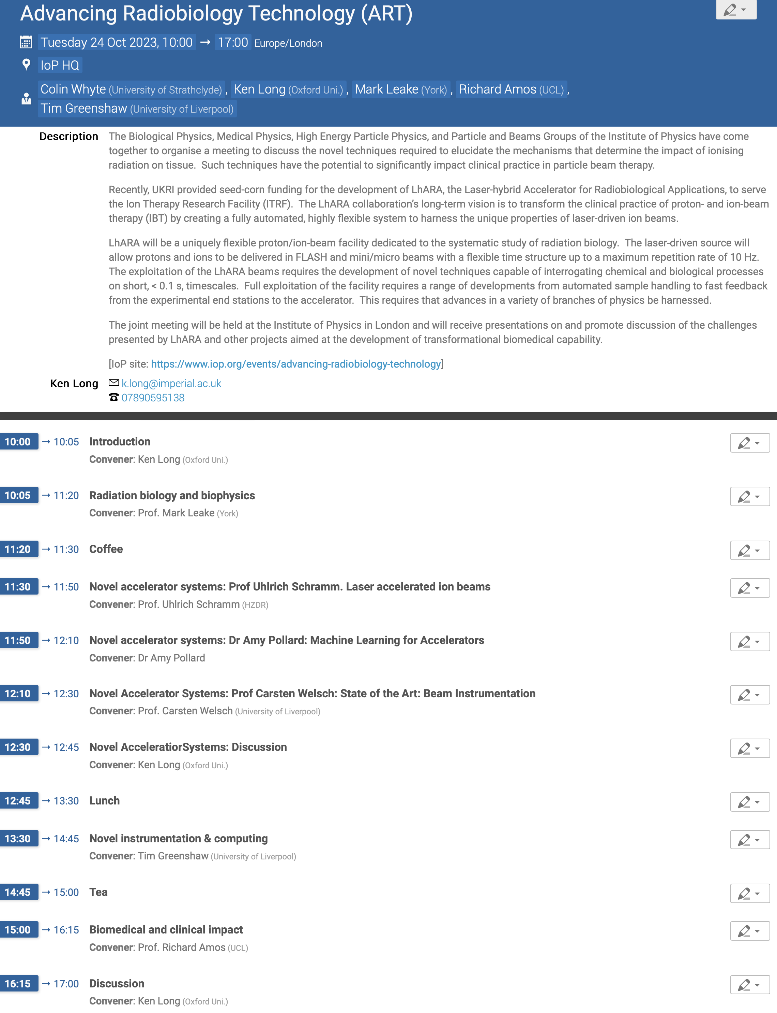
https://indico.stfc.ac.uk/event/915/
Expect a further announcement very soon!

