Slide 1
Update and news

Slide 2
Timeline
Target for full
programme
definition
mid Oct23

Slide 3
Visions Panel feedback
…
Proposal Feedback: Ion Therapy Research Facility (ITRF)
The Visions Panel found the ITRF proposal to provide evidence of the project’s potential to deliver of a step-change in capability and understood that such a facility would allow experimentation that does not currently exist elsewhere.
In terms of strategic drivers and the timeliness of the proposal within the current strategic landscape, the panel considered the proposal to be timely but felt that the proposal may benefit from clarifying the existing level of community support for the proposal. It was also noted that as the collaboration involved in the proposal is wide-reaching the proposal may benefit from including further information on the level of engagement from all members of the collaboration.
Please let us know if you have any queries.
Kind regards,
STFC Visions Team
… also discussing whether to revise the
“total infrastructure cost”.

Slide 4
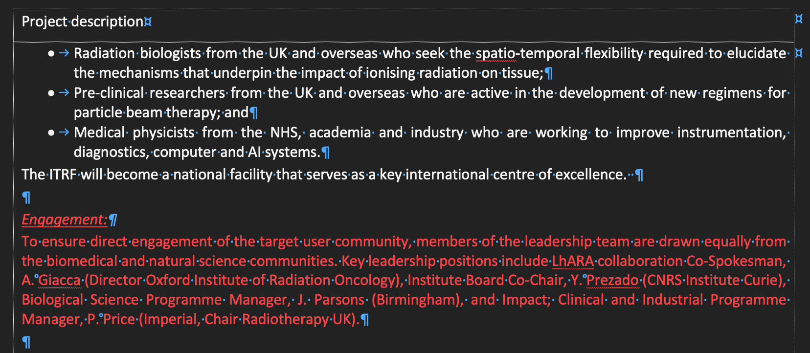
Updates to our proposal

Slide 5
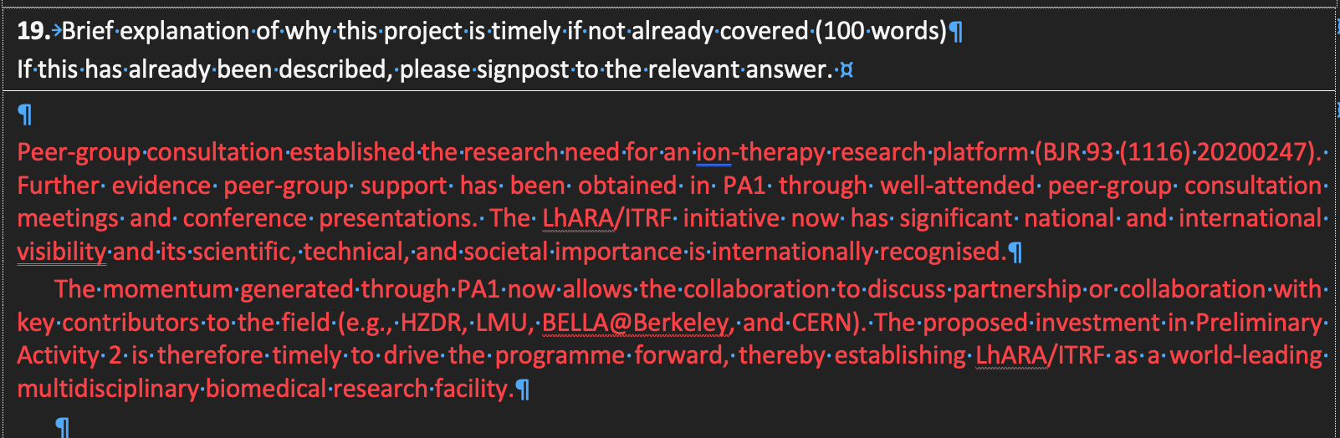
Updates to our proposal

Slide 6
Process document and progress
Updated following EB comments, shared with WPMs and LhARA collaboration, no further comments
Still awaiting comments from ITRF management
Will share with attendees at STFC Bid Review: 04Sep23
Hoped to have presentation from Colin on risk register today:
  NATS issues mean he is stranded abroad …
  Need to deal with review of risk register when he is back

Slide 7
PA2 detailed project plan
Rolling and formal reviews:
  Chris Townsley; STFC, RAL (PPD) Proj. Man. Off. has agreed to provide “rolling independent review” as we prepare the PA2 project plan
  Mike Lamon (CERN Dir Acc. + Tech.) has agreed to organize second independent international review of PA2 programme:
    Will have greater focus on biomedical parts of programme than first review
    Will discuss with ML early October
    Target date for review Feb/Mar 2024

Slide 8


