Slide 1
Update and news

Slide 2


Upcoming conference and Abstract
I have a LhARA talk in accelerator session.
Will share slides for comment
K.Prise: need to send LhARA abstract; also consider others?

Slide 3


Slide 4

UKRI Infrastructure Fund
Following a variety of discussions, now committed to:
  Proposal a second UKRI Infrastructure Fund Preliminary Activity
IF Proforma Deadline, 21Jul23
  Build on our 5-year plan:
    Full-five year proposal
    Annex defining work to be carried out in Preliminary Activity
Wave 4:
Call opens: 02Oct23
Decision. : 01Mar24
Funding : 01Oct24

Slide 5
Timeline
Target for full
programme
definition
mid Oct23

Slide 6
Draft!

Slide 7
Laser-driven beams for rbio: example 1
On Draco @ HZDR
DOI: 10.1038/s41598-020-65775-7
Draco:
  Petawatt laser
    E = 13 J, τ = 30 fs, 3 μm FWHM
Beam line:
  Target Normal Sheath Acceleration (TNSA)
  Pulsed solenoid focusing
    19.5T, 2 or 3 pulses/min.
    S1, S2: 40 mm bore
    Half angle acceptance 14º
  Measured transmission
  (18.6 MeV p)
    50.6% (dual solenoid)
    28.6% (single solenoid)

Slide 8
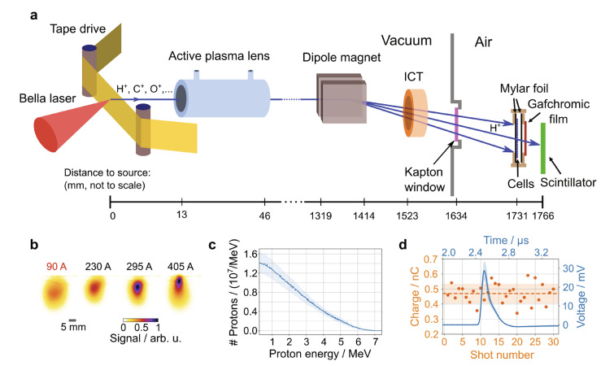
Laser-driven beams for rbio: example 2
On BELLA @ Berkeley
DOI 10.1038/s41598-022-05181-3
Berkeley Lab Laser Accelerator (BELLA):
  Petawatt laser
    E = 35 J, τ = 35 fs, 52 μm FWHM
Beam line:
  Target Normal Sheath Acceleration (TNSA)
  Active plasma lens focusing
    1 mm diameter Ar gas filled capillary
    33 mm length
    13 mm behind the tape drive target
    ~0.2% transport efficiency for protons with E > 1.5 MeV

Slide 9
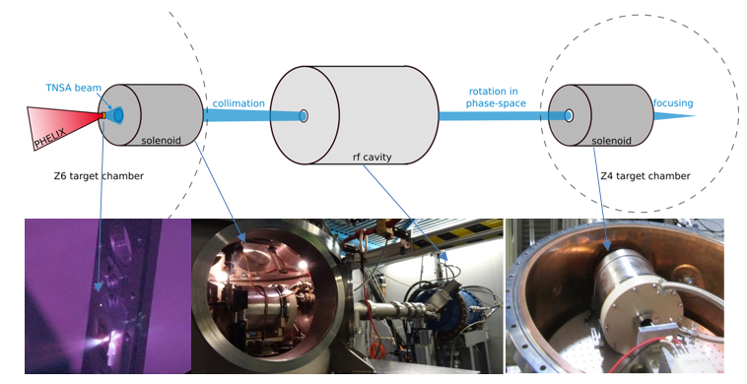
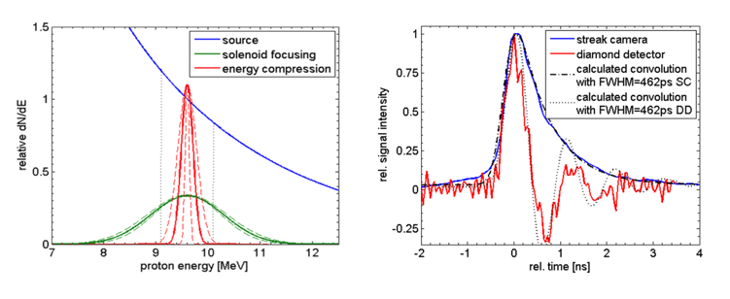
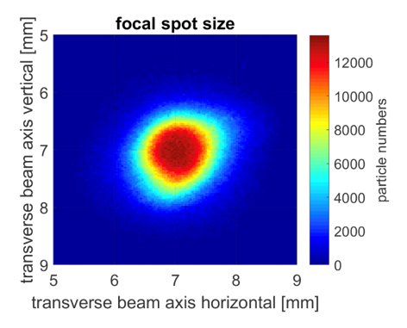
Capture
Variety of initiatives; some key examples
On PHELIX @ GSI
LIGHT – Laser Ion Generation, Handling and Transport
DOI: 10.1063/1.3299391
DOI: 10.1103/PhysRevSTAB.14.121301
DOI: 10.1103/PhysRevSTAB.16.101302
DOI: 10.1103/PhysRevSTAB.17.031302
NIMA 909 (2018) 173–176
PHELIX:
  Petawatt High-Energy Laser for Heavy Ion EXperiments
    E < 25 J, τ = 500 fs, I > 10¹⁹ J/cm2
LIGHT:
  Target Normal Sheath Acceleration (TNSA)
  Ion beam is collimated by a pulsed high-field solenoid
  Phase rotation in RF cavity
  Final focus with a second pulsed high-field solenoid
https://www.gsi.de/work/forschung/appamml/plasmaphysikphelix/experimente/light

Slide 10
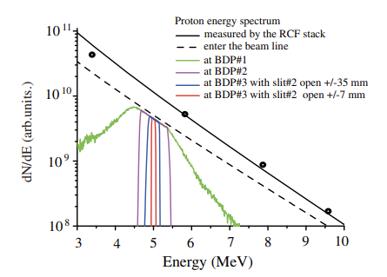
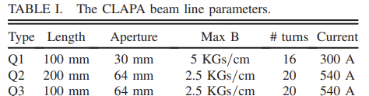
Capture
Variety of initiatives; some key examples
On CLAPA @ Peking University
DOI: 10.1103/PhysRevAccelBeams.22.061302
DOI: 10.1103/PhysRevAccelBeams.23.121304
Compact Laser Plasma Accelerator (CLAPA):
  Petawatt laser
    E = 1.3 J, τ = 30 fs, 5 μm FWHM
Beam line:
  Target Normal Sheath Acceleration (TNSA)
  Quadrupole triplet focusing
  Measured transmission:
    88% transmission through triplet
    ±50 mrad collection angle @ 5 MeV

Slide 11
ELIMAIA-ELIMED
Quantum Beam Sci. 2018, 2, 8; doi:10.3390/qubs2020008
Frontiers in Phys. Med. Phys. & Imag. – doi: 10.3389/fphy.2020.564907
Extreme Light Infrastructure, Prague, Czech Republic:
ELI Multidisciplinary Applications of laser-Ion Acceleration (ELIMAIA)
  ELI MEDical and multidisciplinary applications (ELIMED)
    ELIMAIA section dedicated to ion focusing, selection, characterization, and irradiation
  Proton energies from 5 to 250 MeV transported to in-air section

Slide 12
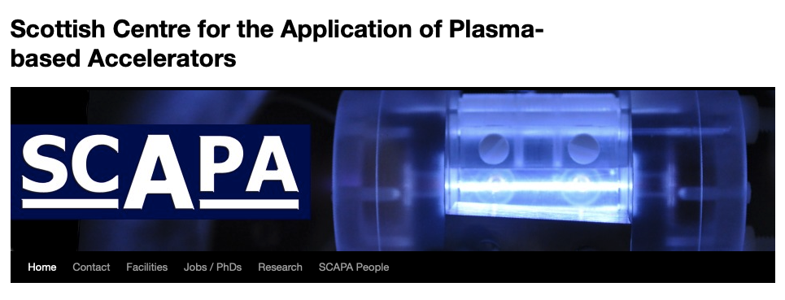
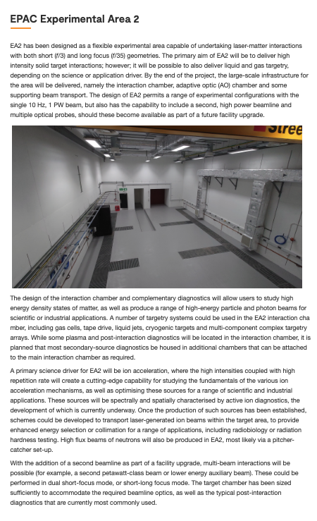
Prepare for discussion of PoP experiment in September
We are generating interest!
  Natural hosts: SCAPA, perhaps EPAC/EA2
    But also, perhaps, European labs?
Biological programme
  Complementarity of different sources?
Doodle for a date in September

Slide 13
Skeleton project plan document
Work starting now;
Revision of Management Plan:
  “Low hanging fruit”, and
  Important to check/revise management arrangements in anticipation of significant uplift
Proof of principle experiment
Management plan left in as it was

Slide 14
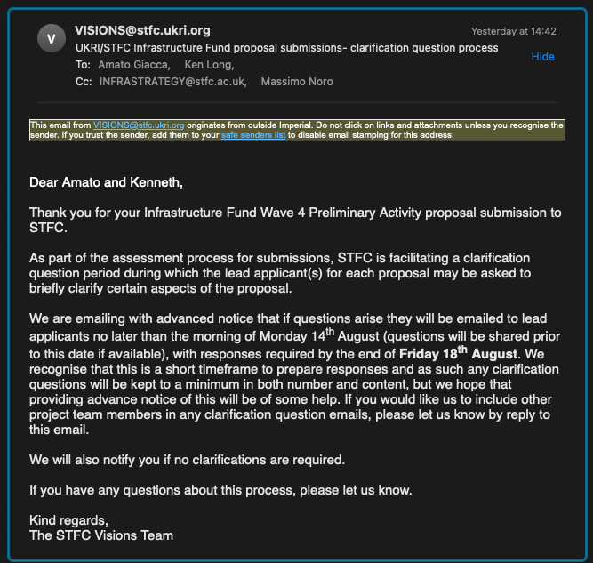
Process document
In preparation, short document to:
  Note PA2 bid defined an envelope for the PA2 programme
    Based on years 3—5 in LhARA proposal for a 5-year pre-construction R&D programme (CCAP-TN-10)
  Process to define and agree final allocation by work package:
    Driven by analysis of risk register:
      Initiated at last weeks Project Board meeting
    WP programmes developed to mitigate risks:
      Will start as soon as first pass review of risk register is complete
    Review of total budget, and contributions by work package:
      Allocations prioritized against project risk register
  Allocations and programme to be presented for collaboration review at Fortnighly meeting of CM4 in Strathclyde
  Submit completed plan to independent expert and c/s review

Slide 15
Old slides/backup

Slide 16
Activities
Preparation 1:
ASTeC:
  Clear partner!
  Contacts:
    Jim Clarke (Director) Massimo Noro, Hywel Owen
CLF & EPAC (new news):
  Discussion with John Collier:
    06Jul23: (KL, R. Pattathil);
      JC indicated support and encouraged us to find the way forward together
      Synergy: LhARA source and capture and EPAC short focal length:
        EPAC short focal length would like permanent magnet quadrupole transport lattice
        I offered our help; we need to look at permanent magnet solution as due diligence
  Contacts:
    Hamad Ahmed (short focal length b/line lead)
    Rajeev Pattathil
Mary Lyon Centre:
  Contact (Director):
    S. Wells
  Strong support in recent discussions
  I contacted SW once more to initiate discussion of what resources may be required
Preparation 2:
ISIS:
  Ongoing relationship, lead contact John Thomason:
  Synergy FETS FFA / LhARA FFA
  Now building on discussions from last month or two:
    Stronger collaboration under development
PPD:
  Contacts:
    KL, Ben Smart
  Expertise in instrumentation, diagnostics, DAQ, trigger, real-time processing
  Contribution being developed to ion-acoustic imaging
Technology Department:
  Contact (Director): A. Orlowska
  I contacted AO to set up a meeting to discuss
  Import to plan work with TD
LhARA collaboration:
  Author and institute refresh underway:
    KL/T. Greenshaw

Slide 17
5-year plan (CCAP-TN-10; Jun22)
Preliminary Activity “1”
Preliminary Activity “2”

Slide 18
Activities cont.
Initial discussion of project planning:
  Second Preliminary Activity; project years 3, 4, 5, (&6):
    1st three years of second LhARA five-year plan
    NEW! Propose 2 principal milestones:
      End Yr 4:
        Prototype experiment milestones and advancement:
          Source, Gabor lens, ion-acoustic, magnet/cavity design, TDR progress, …
        Proof-of-principle experiment #1:
          Can we agree an appropriate set of components to allow initial, “meaningful” biological experts to be carried out
      End Yr 5/6:
        Prototype advancement milestones
        First results from PoP experiment
C. Whyte:
  Initiated review of project plan
    Significant step up in resources and activity
    We have a good plan, now we need to develop it …

Slide 19
Update and immediate next step
Friday 07Jul23: DL:
  J. Clarke, H. Owen, M. Noro, KL, C. Whyte met:
    Agreed:
      To pitch Preliminary Activity 2 to UKRI Infrastructure Fund
      To pitch 3 or 4 year programme with a value of £18M--£20M
        J. Clarke encouraged consideration of 4 year plan that delivered years 3—5 of our initial 5-year plan
Proforma preparation:
  Started, then stalled for this meeting preparation!
    Call it “ongoing”!
18Jul23 meeting with D. Newbold:
  J.Clarke, A.Giacca, M.Noro, KL:
    Goal is to get advice on 3 vs 4 years, feedback on pitch, …

Slide 20
Planning:
Will deliver proforma by 21Jul23:
  Implies block financial profile
Second 5-year project plan/proposal then will be developed:
  To be ready Sep/Oct ’23
EB/PMB:
  Will bring forward a short document to supplement proforma laying out the steps for the collaboration

