Slide 1

News/Update

Slide 2
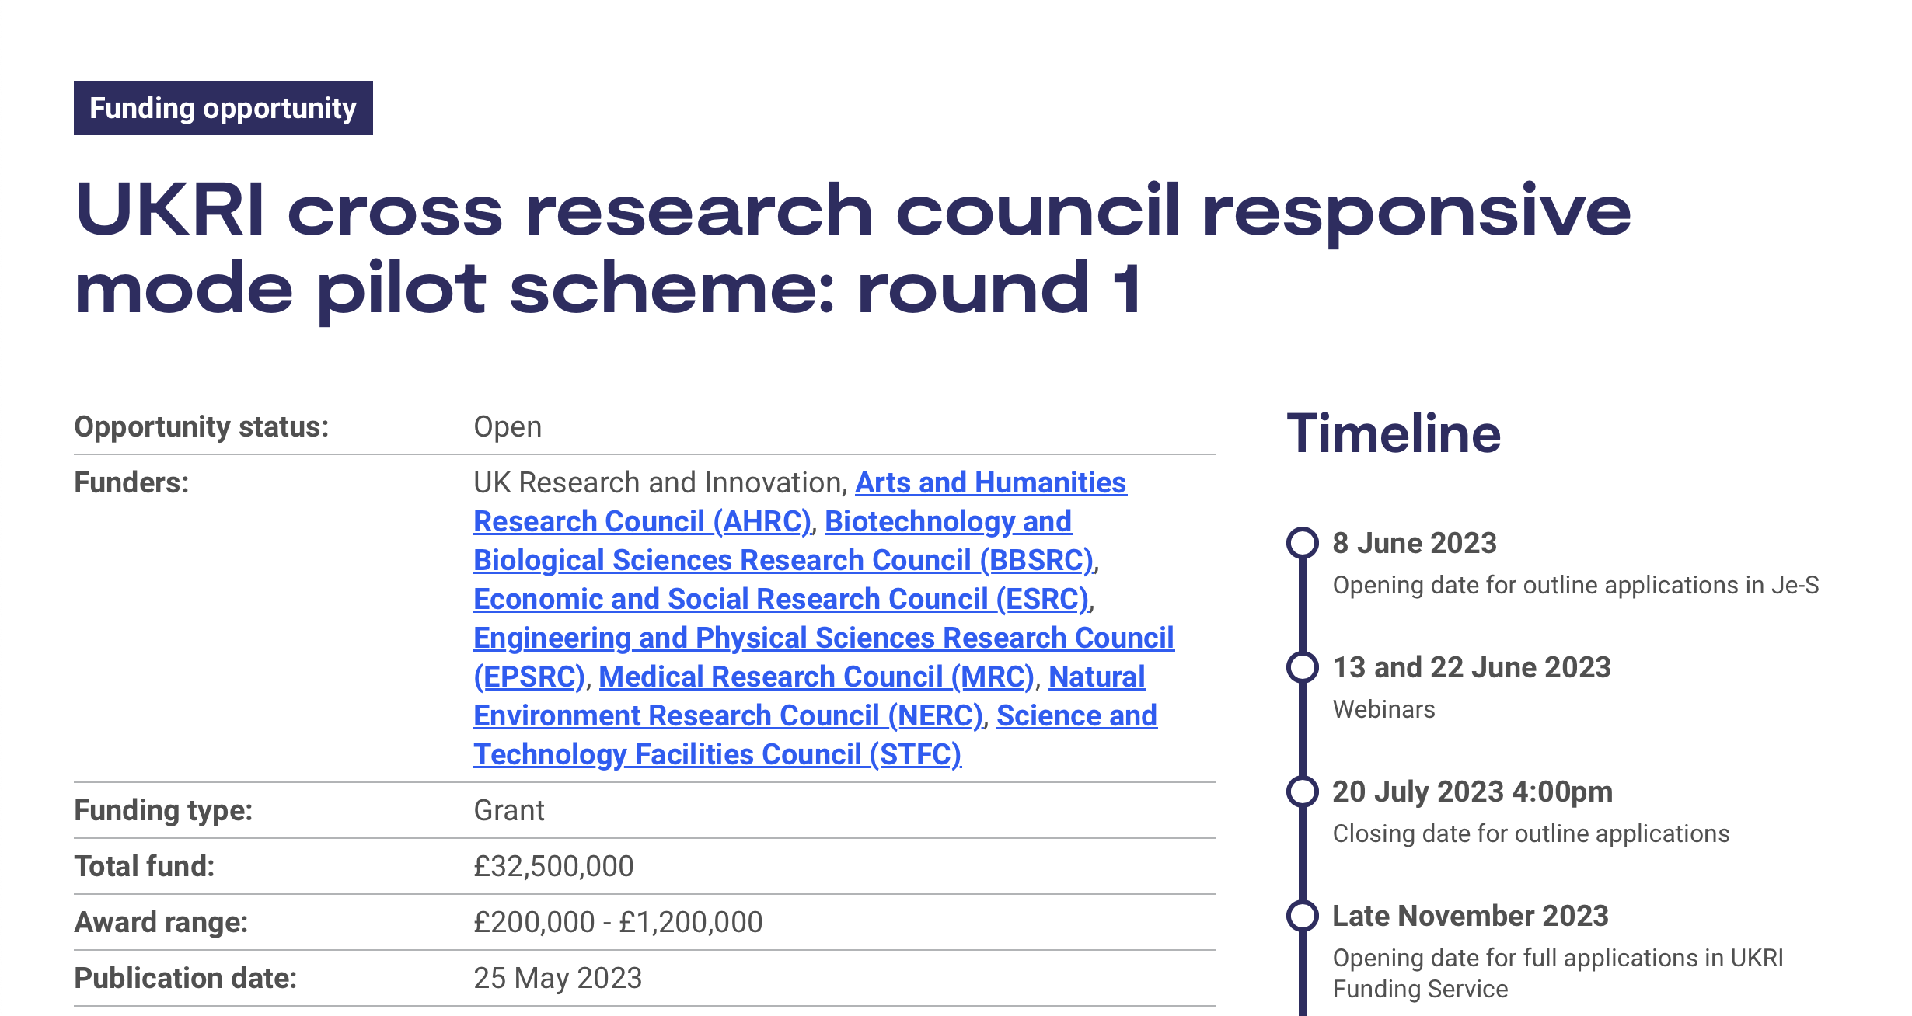
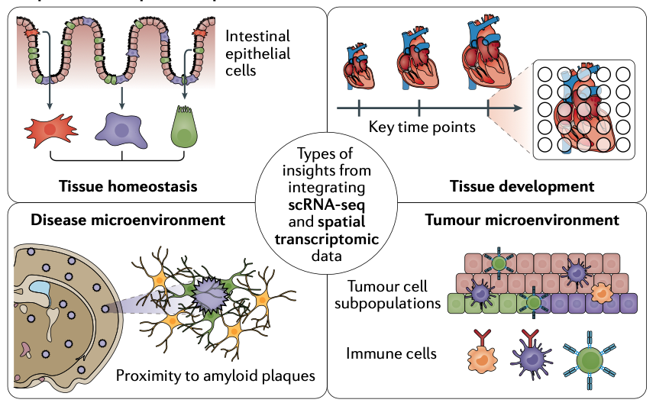
UKRI x-council call
Clear opportunity!
Ideas:
  Spacial transcriptomics in
  instrumented cell cultures
    Prove principle of ion acoustic w\ culture
  Capture; the future of radiation biology and PBT
  Advanced spectroscopic techniques (!), TG, PW
  …

Slide 3

Bid for continuation …
Discussions initiated:
  Submit request for follow-on funding to
  Infrastructure Fund
  Wave 4?
Recent update:
  Likely that there will be:
  Preliminary +
    This has access to larger resource
Next steps; build on our 5-year plan:
    Full-five year proposal
    Annex defining work to be carried out in Preliminary Activity
  Assuming we need to hand in an “intention to submit” in Jul23:
    KL & CW: preparing a “2-pager” to be ready before 18Jul23:
      Reminder of headlines of years 3—5 of 5-year plan
      Project for next 2 years (i.e. years 6 and 7)
      Timeline for us to bring forward our next 5-year plan and proposal to IF Preliminary+
    Likely to need to be rapid!
Wave 4:
Call opens: 02Oct23
Decision. : 01Mar24
Funding : 01Oct24

Slide 4
5-year plan (CCAP-TN-10; Jun22)
Best plan we’ve got!
  Need to digest into “Visions Proforma”
    Highlight proof-of-principle milestones

Slide 5
Context
Looked at this “for scale”
  The LhARA initiative is the long-term vision …
    Obviously rough and ready …

Slide 6

UKRI Moonshots
We were asked to submit (23Jun23) to STFC consideration
  Unclear what happened to it!
Deadline for submission to UKRI:
  10Jul23, next Monday
    Text prepared
Now in consultation with STFC:
  Not viewed as hugely likely
    Some feedback about likely resource
    availability
My view:
  Watch this space, may need to submit in any case
    Doesn’t replace the day job!

Slide 7
Next collaboration meetings
Now working towards:
CM4 Date 20 September 2023 Glasgow
In parallel with 6-month design review.
CM5 Date 26 April 2024 ICR, Fulham Road, London

