Slide 1
News/Update

Slide 2

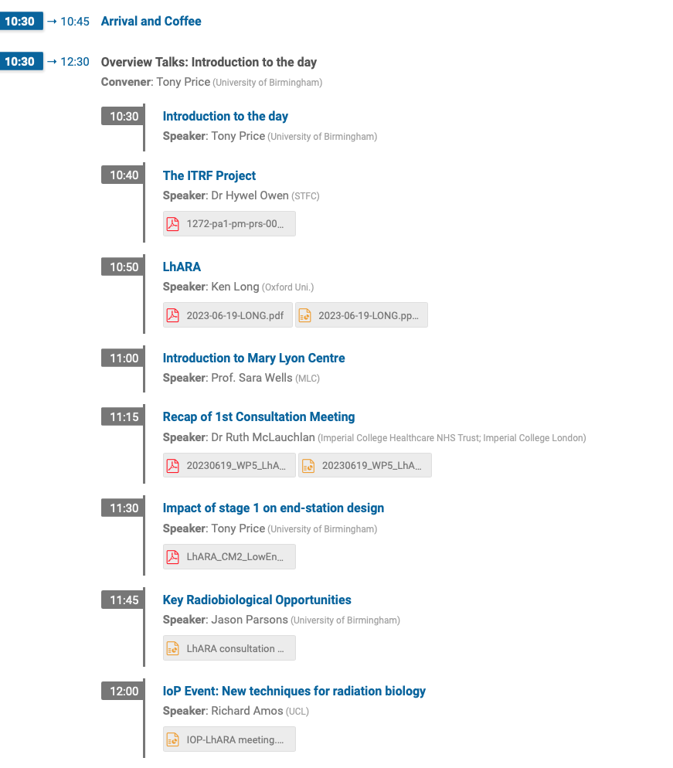
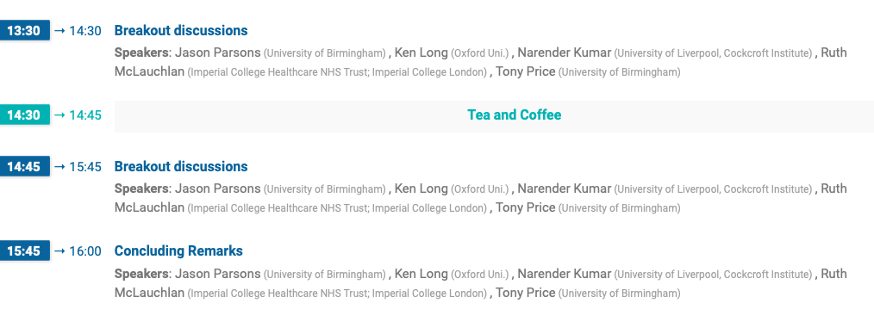
Host: Tony Price
Report from RMcL

Slide 3
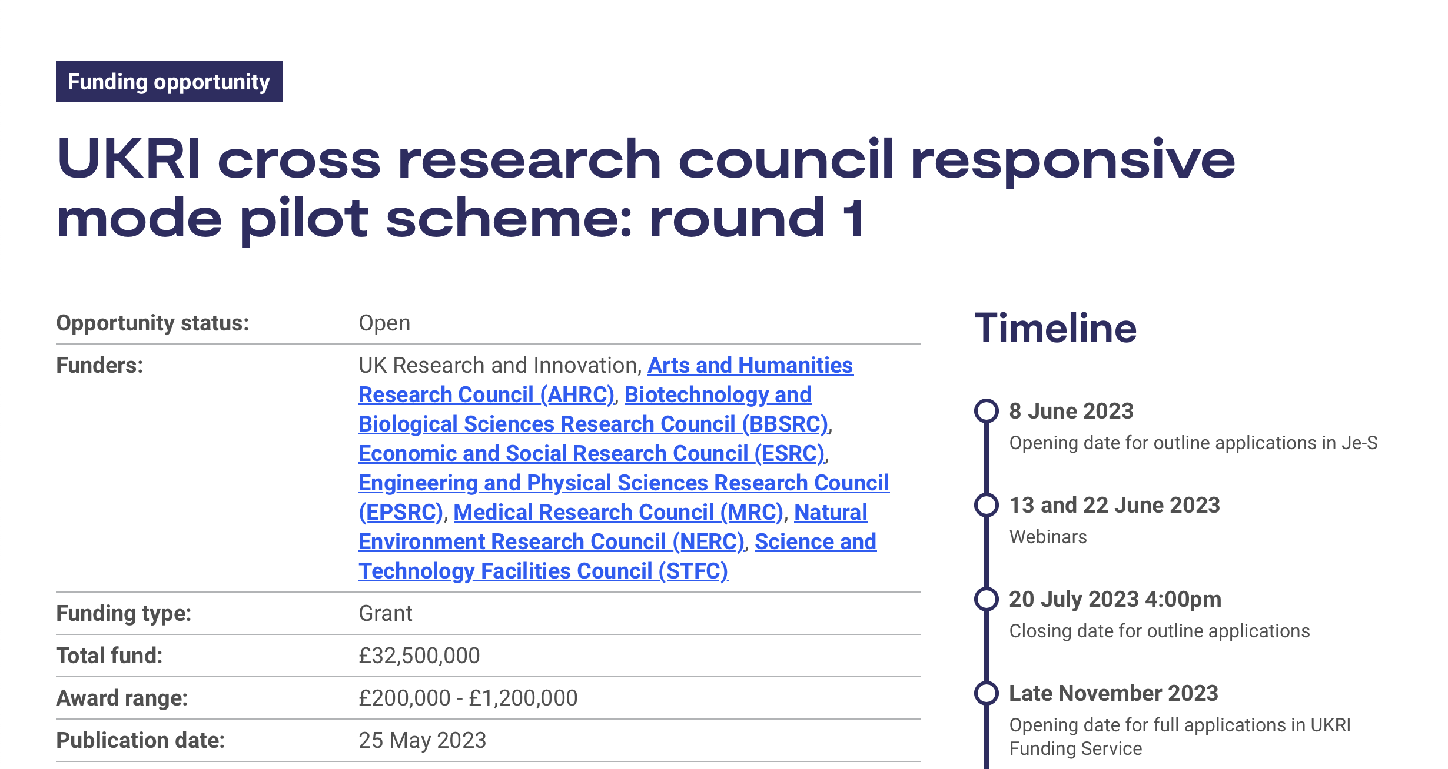
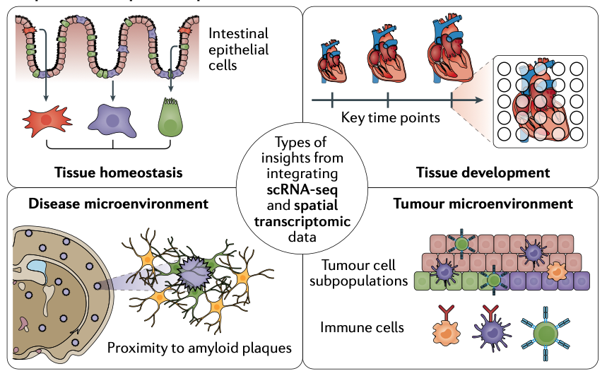
UKRI x-council call
Clear opportunity!
Ideas:
  Spacial transcriptomics in
  instrumented cell cultures
    Prove principle of ion acoustic w\ culture
  Capture; the future of radiation biology and PBT
  Advanced spectroscopic techniques (!), TG, PW
  …

Slide 4

Bid for continuation …
Discussions initiated:
  Submit request for follow-on funding to
  Infrastructure Fund
  Wave 4?
Wave 4:
Call opens: 02Oct23
Decision. : 01Mar24
Funding : 01Oct24

Slide 5
Next collaboration meetings
Now working towards:
CM4 Date 20 September 2023 Glasgow
CM5 Date 26 April 2024 ICR, Fulham Road, London

