Slide 1
News/Update

Slide 2

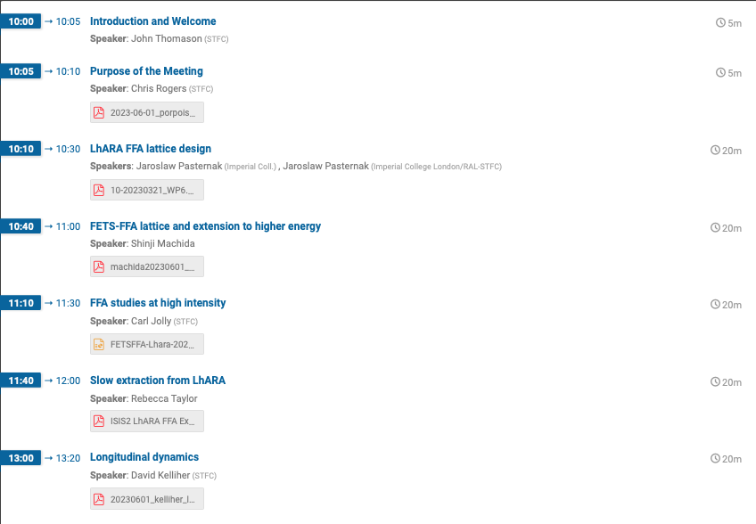
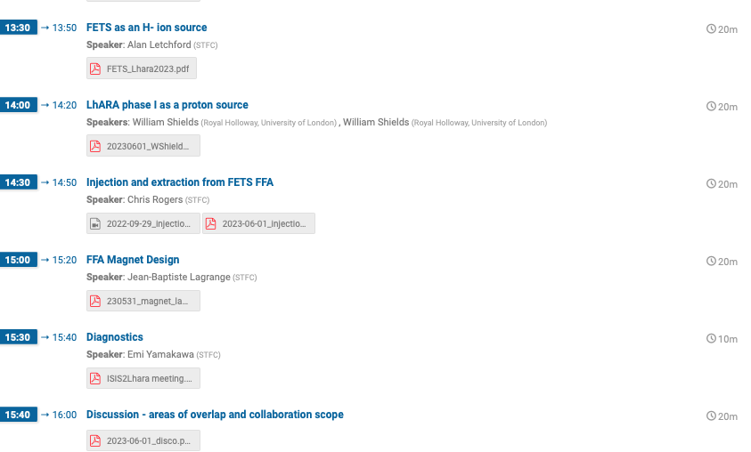
Host: Chris Rogers et al.
Lots of opportunity for collaborative working

Slide 3
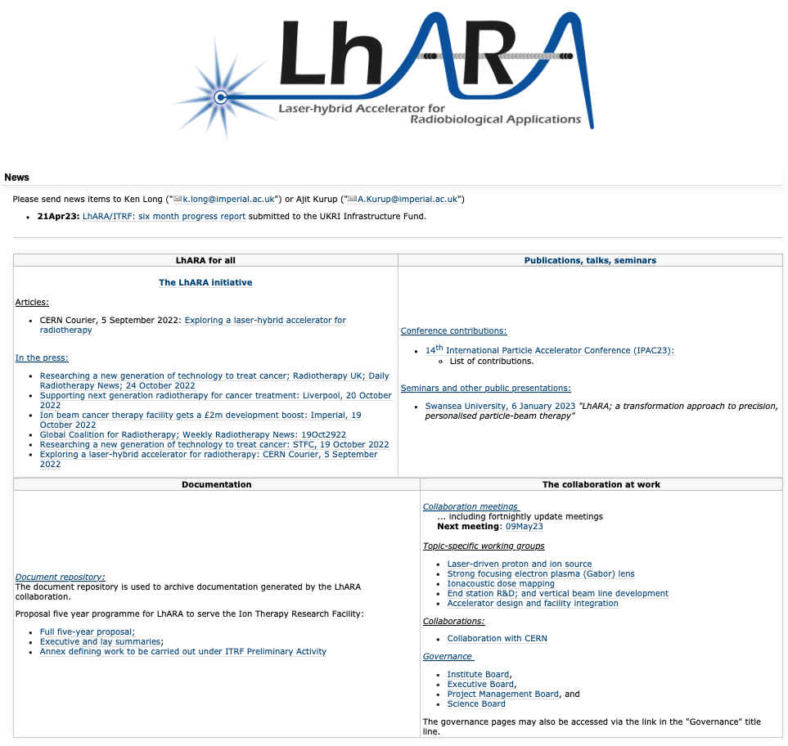
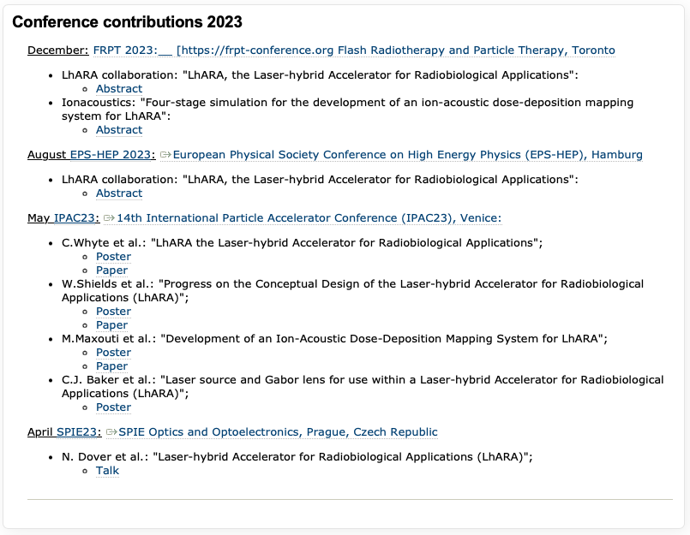
Conference contributions 2023
https://ccap.hep.ph.ic.ac.uk/trac/wiki/Research/LhARA

Slide 4
Next collaboration meetings
Now working towards:
CM4 Date 20 September 2023 Glasgow
CM5 Date 26 April 2024 ICR, Fulham Road, London

