Slide 1
News/Update

Slide 2
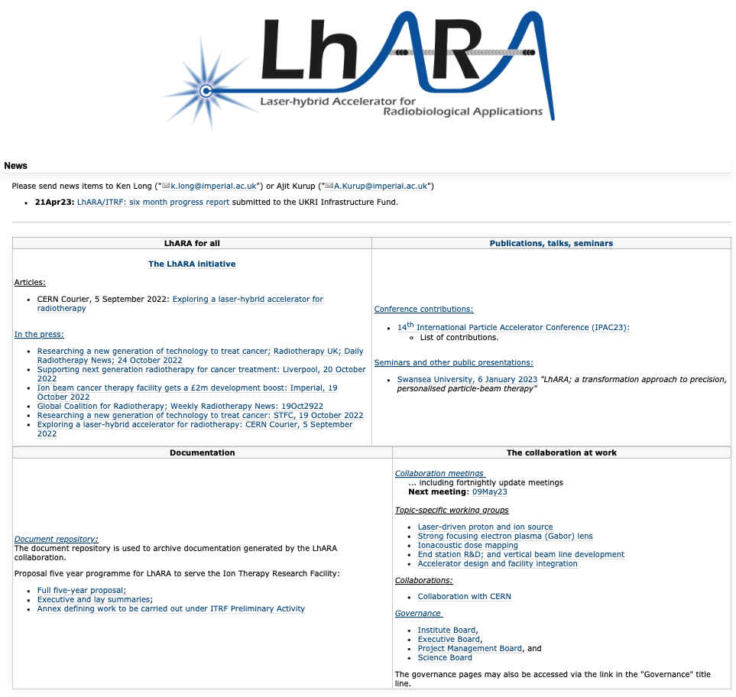
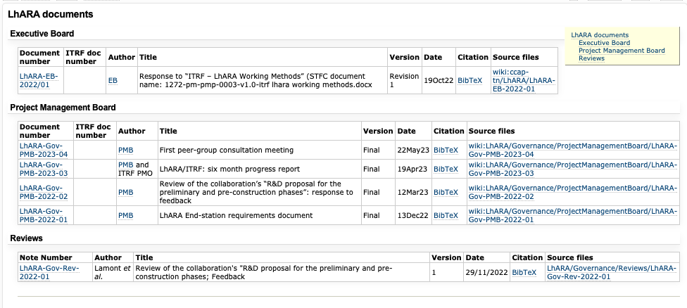
Document repository
https://ccap.hep.ph.ic.ac.uk/trac/wiki/Research/LhARA
Conference contributions

Slide 3
Peer-group consultation; meeting 1
https://ccap.hep.ph.ic.ac.uk/trac/raw-attachment/wiki/Research/LhARA/Documents/LhARA-Gov-PMB-2023-04.pdf

Slide 4

Peer-group consultation 2
Target date: 19Jun23
  Venue Birmingham University
Preparations underway:
  Invitations to:
    LhARA of course!
    Attendees at previous meeting
    Networks, e.g. ENLIGHT, RADNET, …
  Additional communities who’ve expressed an interest:
    MBRT conference
    attendees (invite via Y.Prezado)
    Prof. Reindl, Uni München;
    in-vitro automation
    Sara Wells, et al; Mary Lyon Centre at MRC Harwell

Slide 5
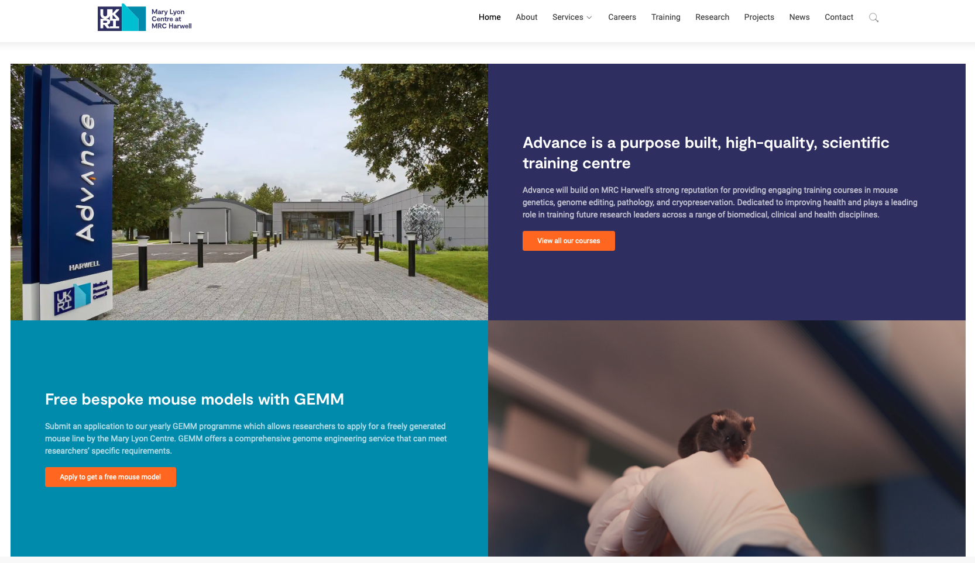
https://www.har.mrc.ac.uk

Slide 6
Next collaboration meetings
Now working towards:
CM4 Date 20th Sept 2023 Glasgow
CM5 Date 17—24 April 2024 ICR, Fulham Road, London

