Slide 1
News/Update

Slide 2

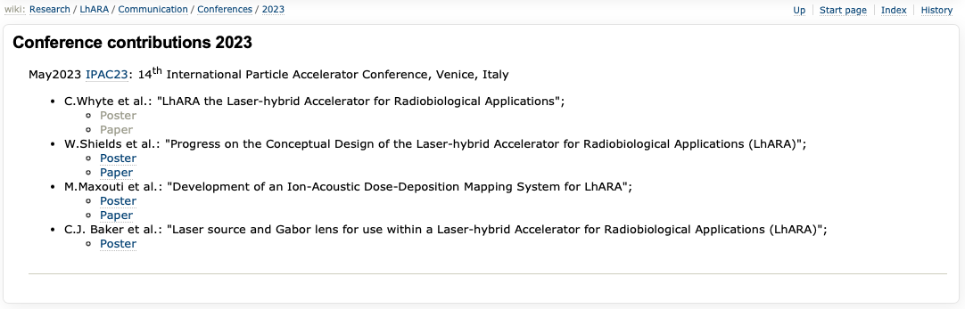
https://ccap.hep.ph.ic.ac.uk/trac/wiki/Research/LhARA/Communication/Conferences/2023

Slide 3
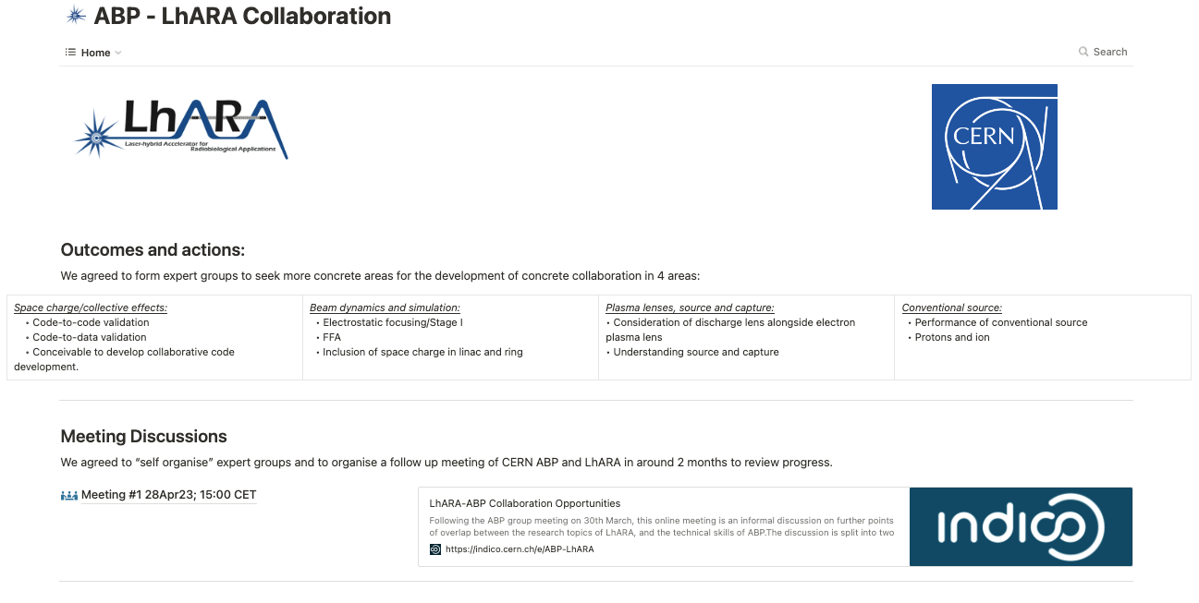
CERN Accelerator and Beam Physics Group/LhARA collaboration
https://lhara-abp.notion.site/lhara-abp/1a32dbfe63cf4ffcba567f079b31d206?v=8fc266b2cc6c4d9aac52ebc7707ce700

Slide 4
Next collaboration meetings
Now working towards:
CM4 Date 20th Sept 2023 Glasgow
CM5 Date 17th April 2024 London (ICR)

