Slide 1
News/Update

Slide 2
6-month progress report
Asd
A good read!
Submitted by N. Bliss to UKRI
https://ccap.hep.ph.ic.ac.uk/trac/raw-attachment/wiki/Research/LhARA/Documents/LhARA-Gov-PMB-2023-03.pdf

Slide 3
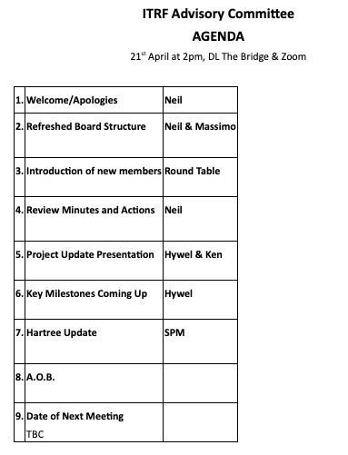
ITRF Advisory Committee
https://ccap.hep.ph.ic.ac.uk/trac/raw-attachment/wiki/Research/LhARA/Governance/ITRF/AC/2023/2023-04-21-LhARA-ITRFwp1-LONG.pdf
Advisory Committee:
Neil Burnet (Chair)
Anthony Chalmers
Jim Clarke (ASTeC Director; LhARA author)
Adrian Crellin
Marco Durante
Robert Huddart
Ranald MACKAY
T.R. Mackie
Peter Ratoff (LhARA author)
In attendance:
Neil Bliss (ITRF Project Manager)
Amato Giacca (LhARA co-spoke)
Stuart Green (LhARA author)
Massimo Noro (ITRF Project Sponsor)
Karen Kirkby (ITRF WP3 Manager, LhARA author)
Ken Long (LhARA co-spoke)
Uwe Oelfke (LhARA author)
Hywel Owen (ITRF PI, LhARA author)
Jason Parsons (LhARA Biological Science Programme Manager)

Slide 4
Next collaboration meetingd
Proposal:
CM4 Date 20th Sept 2023 Glasgow
CM5 Date 17th April 2024 London (ICR?)

