Slide 1
News/Update

Slide 2
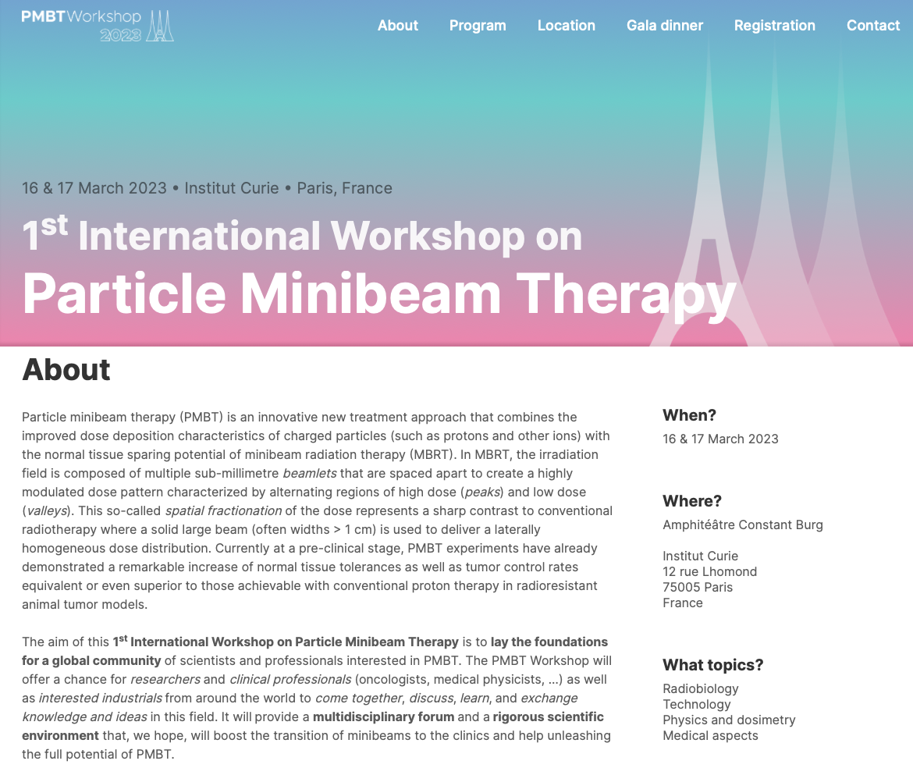
Excellent workshop:
Sessions on:
  Radiobiology
  Technologies
  Physics and dosimetry
  Medical aspects
  Clinical perspectives and multidisciplinarity
https://www.pmbt-group.org/workshop/overview
Josie’s talk, later, presented in the
technologies session

Slide 3
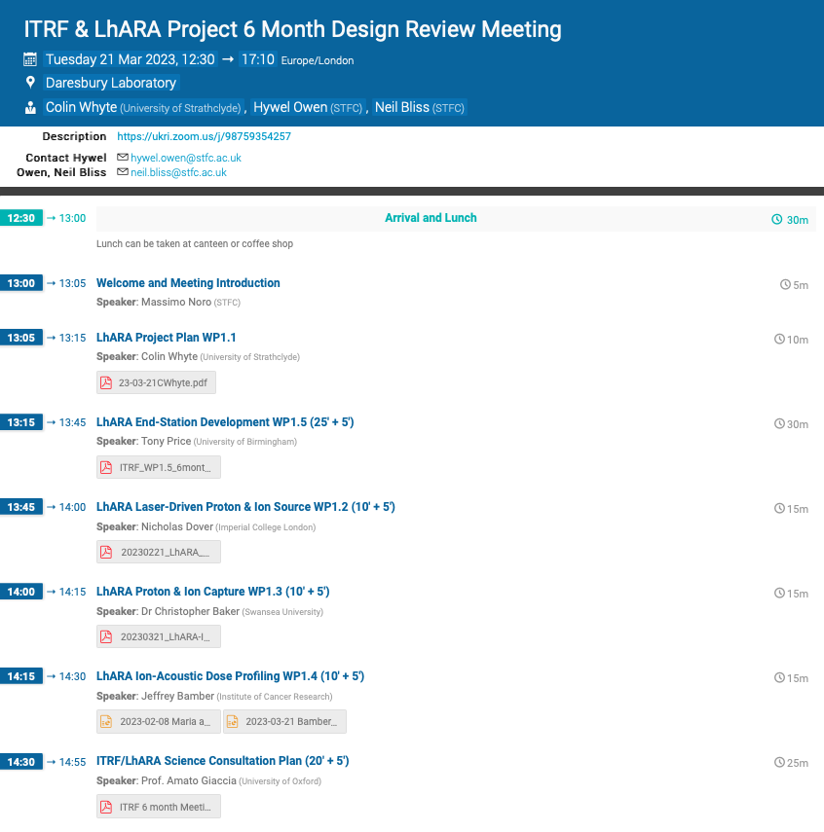
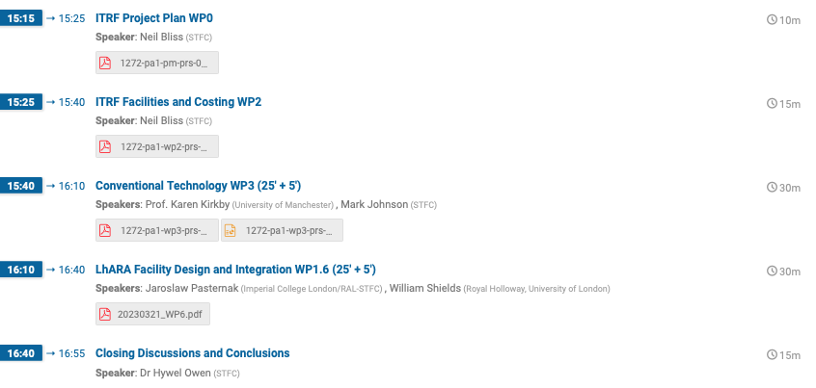
ITRF 6 month review
https://indico.stfc.ac.uk/event/722/
Progress report getting there:
Only one w/p outstanding!
Amato Giacca:
Good summary of
biological science
drivers

Slide 4
6-month review continued
Review excellent:
  Substantial progress; largely on track
  Issues identified (we knew/pointed to each of these):
    Acceleration of ions other than proton; need to consider simulation?
    Advancement of timetable for Gabor lens work; requires additional resource
    Advancement of peer-group consultation
    Advancement of articulation of biological science programme
Need now to continue to deliver our programme!

Slide 5
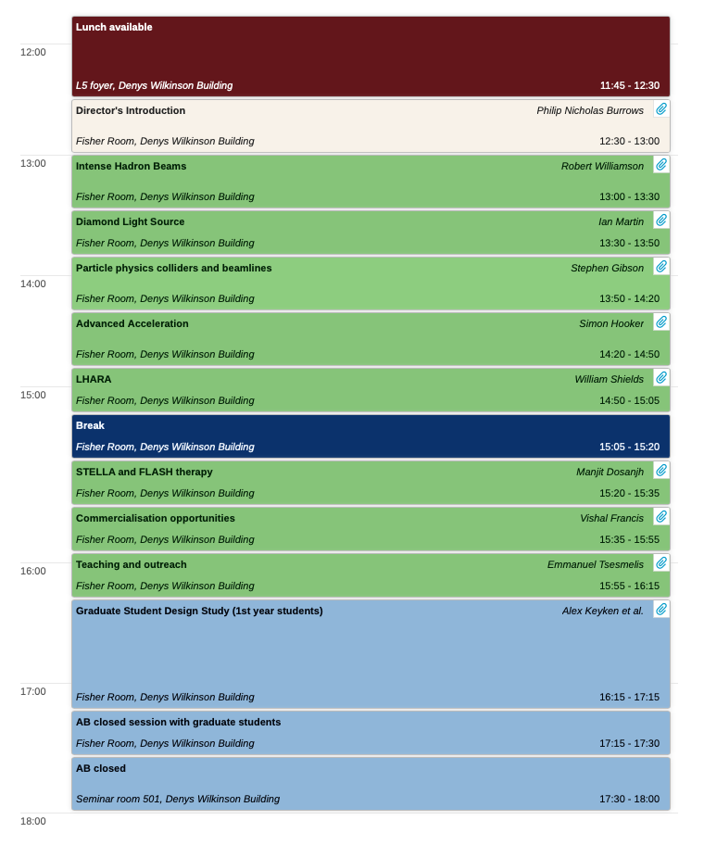
JAI Advisory Board, 27/28 March 2023
https://indico.cern.ch/event/1262793/timetable/#20230327.detailed
27Mar23:
Excellent contribution from Will!

