Slide 1


ITRF WP3 Radiobiology
Synchrotron Study
Mark Johnson | LhARA Fortnightly
14/03/2023
Mark Johnson | Accelerator Physicist (ASTeC)
Office A50 | STFC Daresbury Laboratory | Warrington WA4 4AD
mark.johnson@stfc.ac.uk

Slide 2
Introduction
ITRF WP3 Context
ITRF WP3 aims to compare options based on conventional
technologies against the baseline LhARA facility design
This includes the evaluation of a synchrotron, with a injector based on
established ion sources and pre-acceleration methods
Currently parameterising a small synchrotron design, adapted from
work published by the CERN NIMMS project
At present, we are not considering the
synchrotron as a drop-in replacement for the LhARA FFA

Slide 3
Design Basis
Compact, Room Temperature Synchrotron
Key Requirements:
  Synchrotron is primarily designed for the most likely radiotherapy ions (H⁺, ⁴He²⁺ and ¹²C⁶⁺)
  Aim for stored intensities compatible with FLASH regimes,
  of order 10¹⁰ ions per spill
  Machine fits within the circumference of the LhARA FFA
  (21.86 m) with similar beam energies
  Use accessible, conventional technologies
  e.g. room temperature magnets

Slide 4
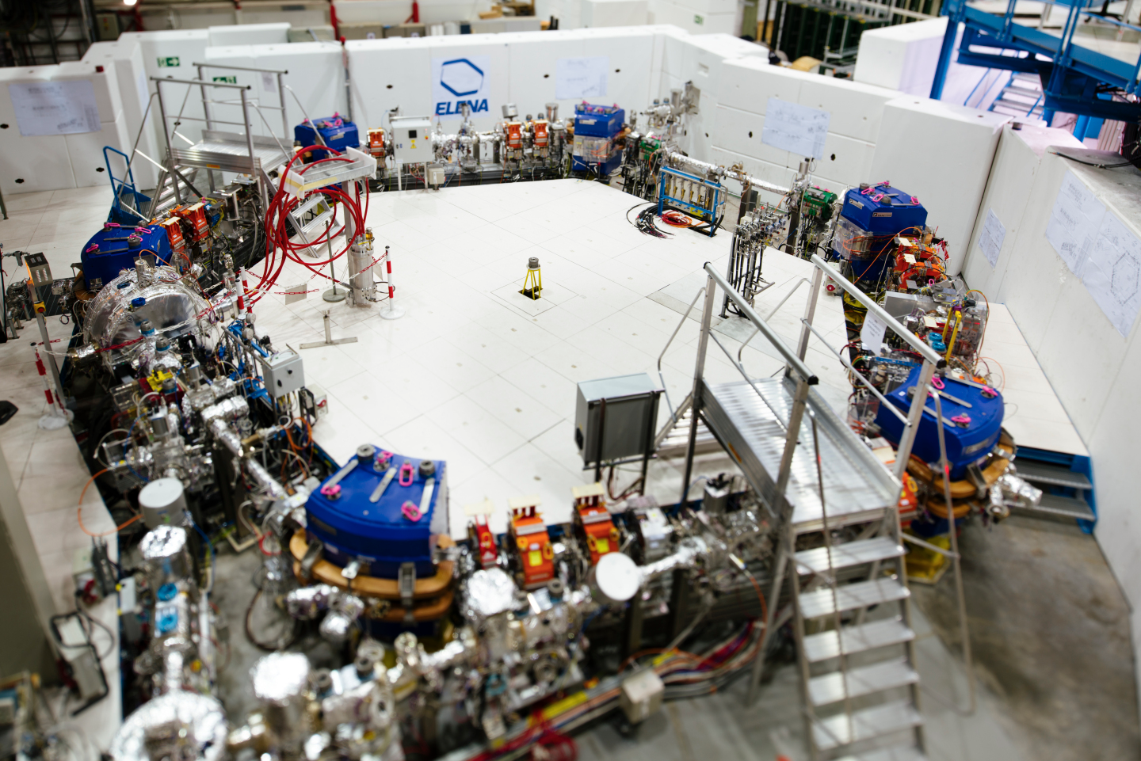
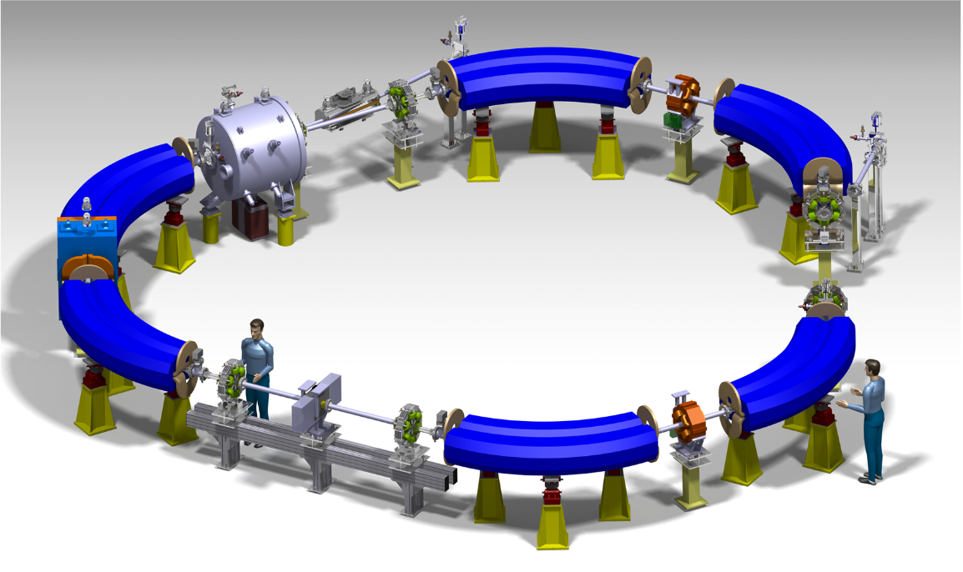
[1] H.X.Q. Norman et al., Proc. IPAC ‘22, THPOMS028 (2022)
[2] M. Vretenar et al., J. Phys.: Conf. Ser. 2420 012103 (2023)
[3] V. Chohan et al., Extra Low Energy Antiproton Ring (ELENA) and its Transfer Lines – Design Report, CERN-2014-002 (2014)
Examples
CERN NIMMS and ELENA
NIMMS have proposed compact synchrotron designs
for ¹²C⁶⁺ and ⁴He²⁺ ions [1,2]
Designs target FLASH dose rates, at relatively high energies
(430 MeV/u for ¹²C⁶⁺) relevant to clinical treatment
NIMMS designs build on CERN experience with
small hadron synchrotrons like ELENA [3]
Slow-cycling synchrotron designs (~1 Hz)
Above: ELENA decelerator at the CERN AD
Below: Render of the NIMMS ⁴He²⁺ synchrotron design

Slide 5
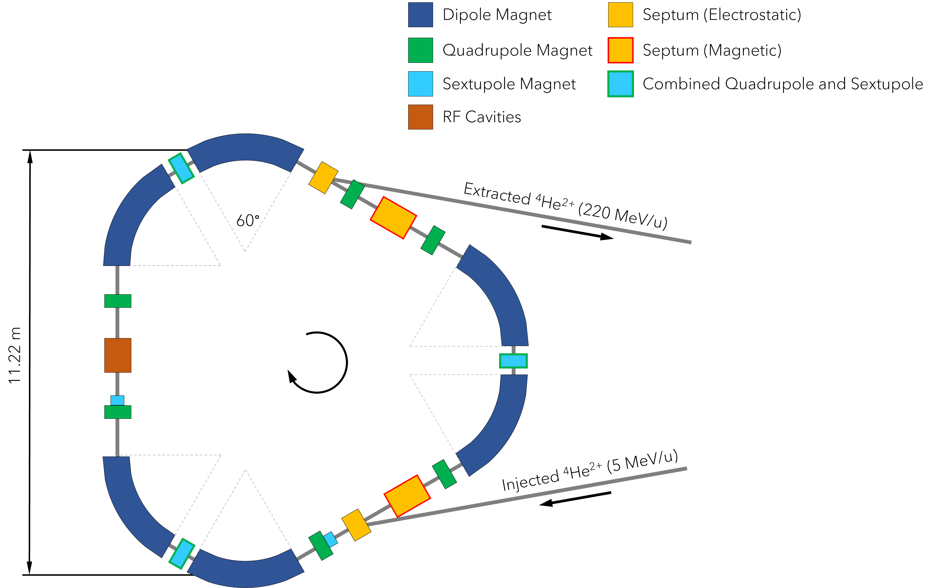
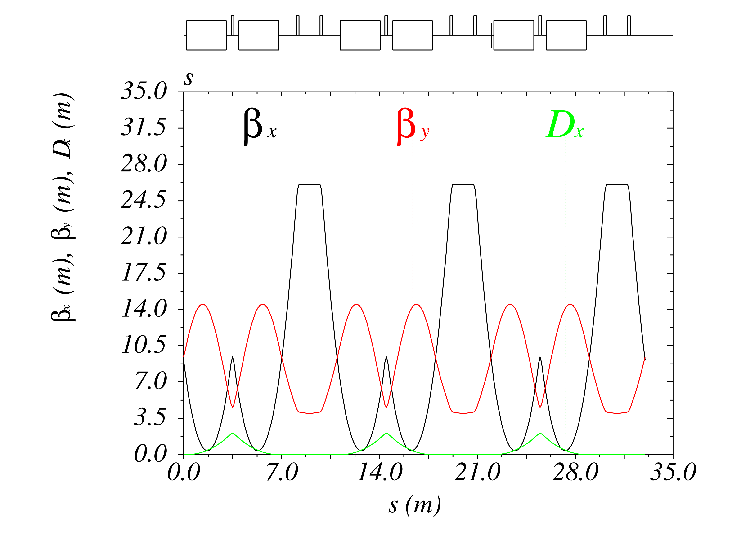
[1] M. Vretenar et al., J. Phys.: Conf. Ser. 2420 012103 (2023)
[2] X. Zhang, arXiv:2007.11787 [physics.acc-ph] (2020)
NIMMS ⁴He²⁺ Design
Helium Ion Synchrotron
Small (~33 m circumference) synchrotron [1] comprised of
three achromat lattice cells [2]
Room-temperature 60° sector dipoles operating up to
1.65 T, enable ⁴He²⁺ acceleration to 250 MeV/u
Dispersion-free straights accommodate injection,
extraction and RF hardware

Slide 6
ITRF Synchrotron Design
[1] M. Vretenar et al., J. Phys.: Conf. Ser. 2420 012103 (2023)
Scaled NIMMS Layout
Synchrotron (~21.3 m circumference) based on a scaled version of the NIMMS synchrotron design [1]
  1.30 T sector dipole magnets with
  a small defocusing gradient
  QF1 quadrupoles used for
  working point adjustment
  QF2 quadrupoles used for
  dispersion cancellation
Parameter | Value
Dipole radius [m] | 1.45
Dipole field [T] | 1.30
Max. Rigidity [T m] | 1.89
Ion Species | H⁺ | ⁴He²⁺, ¹²C⁶⁺
Max. Energy [MeV/u] | 80* | 33.4
Orbital Frequency [MHz] | 5.48 | 3.67
*Limited by assumed RF cavity bandwidth (1.5 – 5.5 MHz)
Dipoles can accommodate protons up to 155 MeV

Slide 7
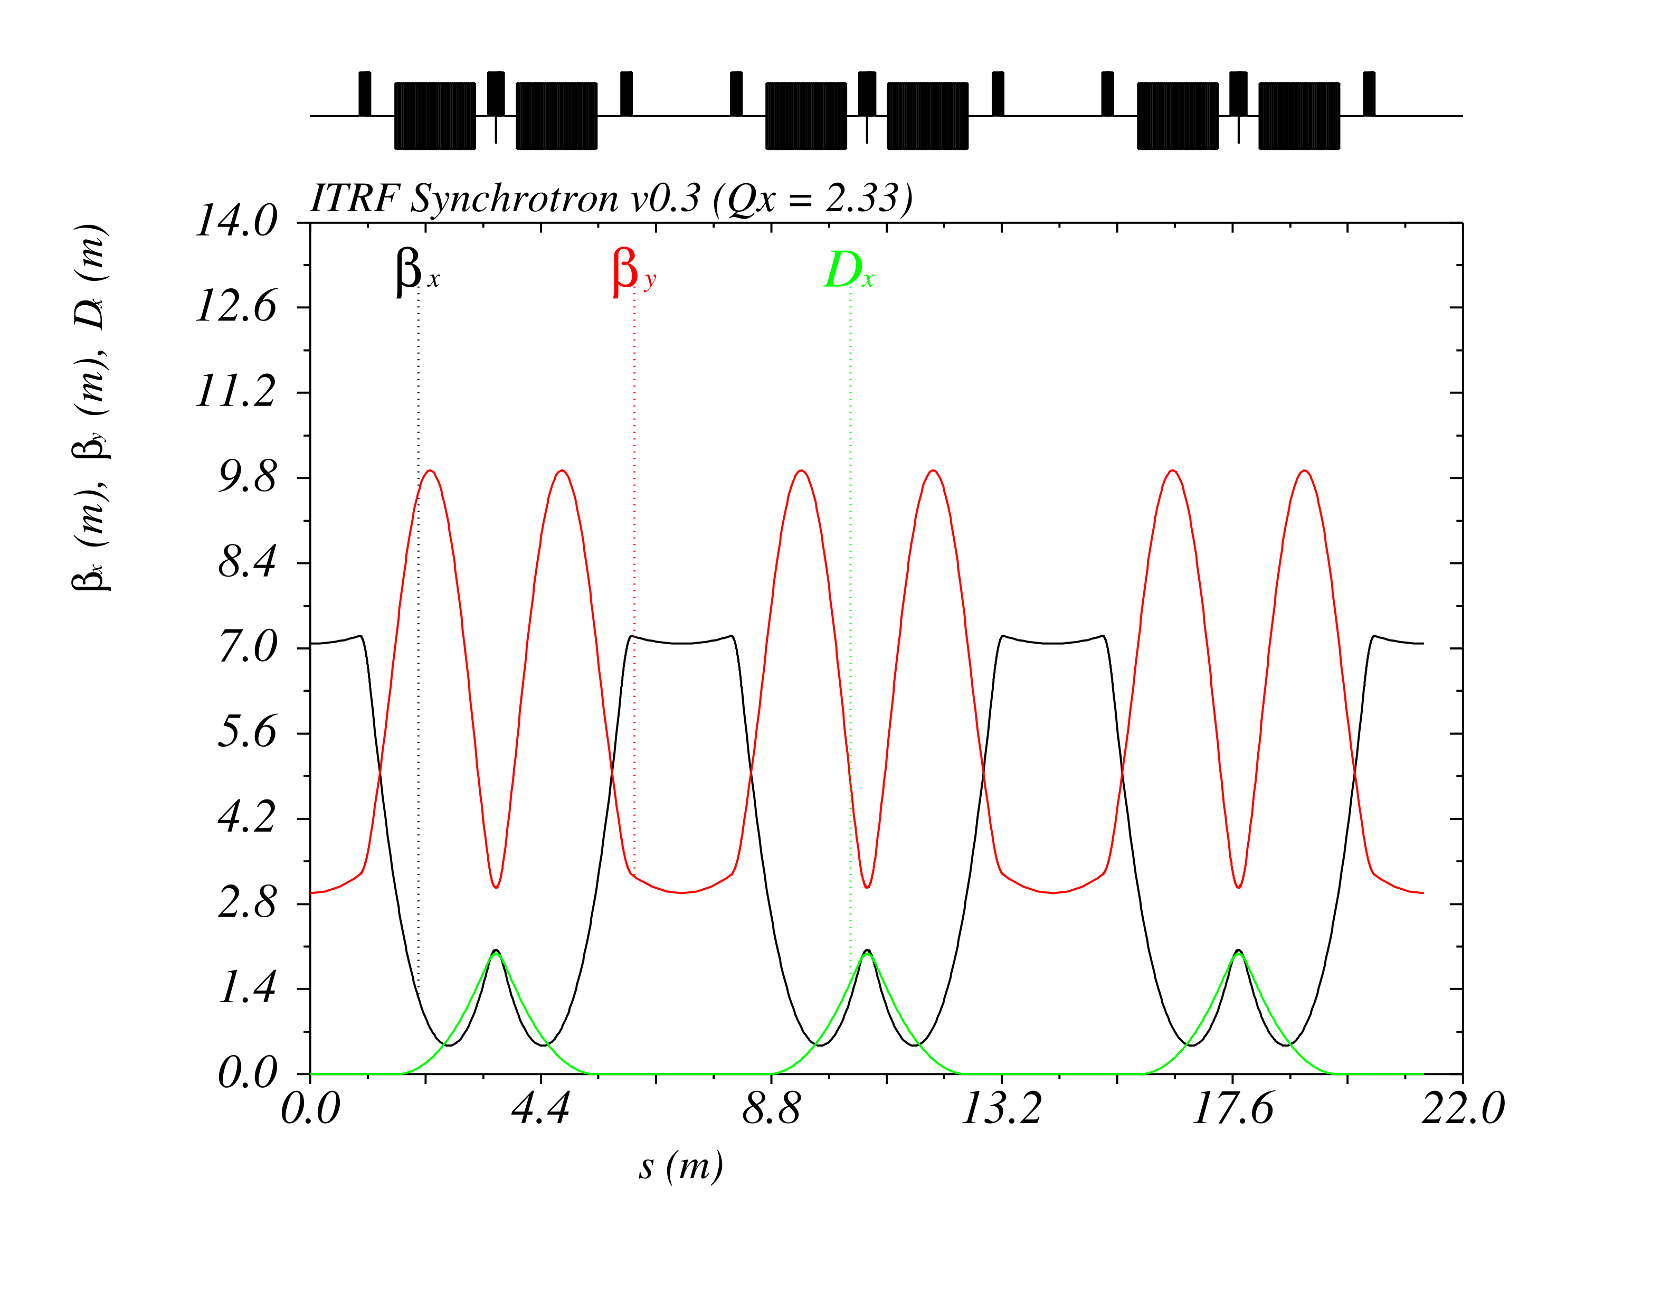
ITRF Synchrotron Design
[1] R. Taylor et al., J. Phys.: Conf. Ser 2420 012101 (2023)
Optics and Key Parameters
Optimised the lattice using a semi-analytic model to maximise the accessible range of working points
Optics are tuned near a third-order betatron resonance to enable RF knockout beam extraction [1]
Parameter | Value
QF1 strength [m⁻²] | 3.23
Maximum β_{x}, β_{y} [m] | 7.20, 9.92
Maximum D_{x} [m] | 1.98
Betatron Tunes Q_{x}, Q_{y} | 2.33, 0.71
Natural Chromaticities ξ_{x}, ξ_{y} | -4.36, -5.10

Slide 8
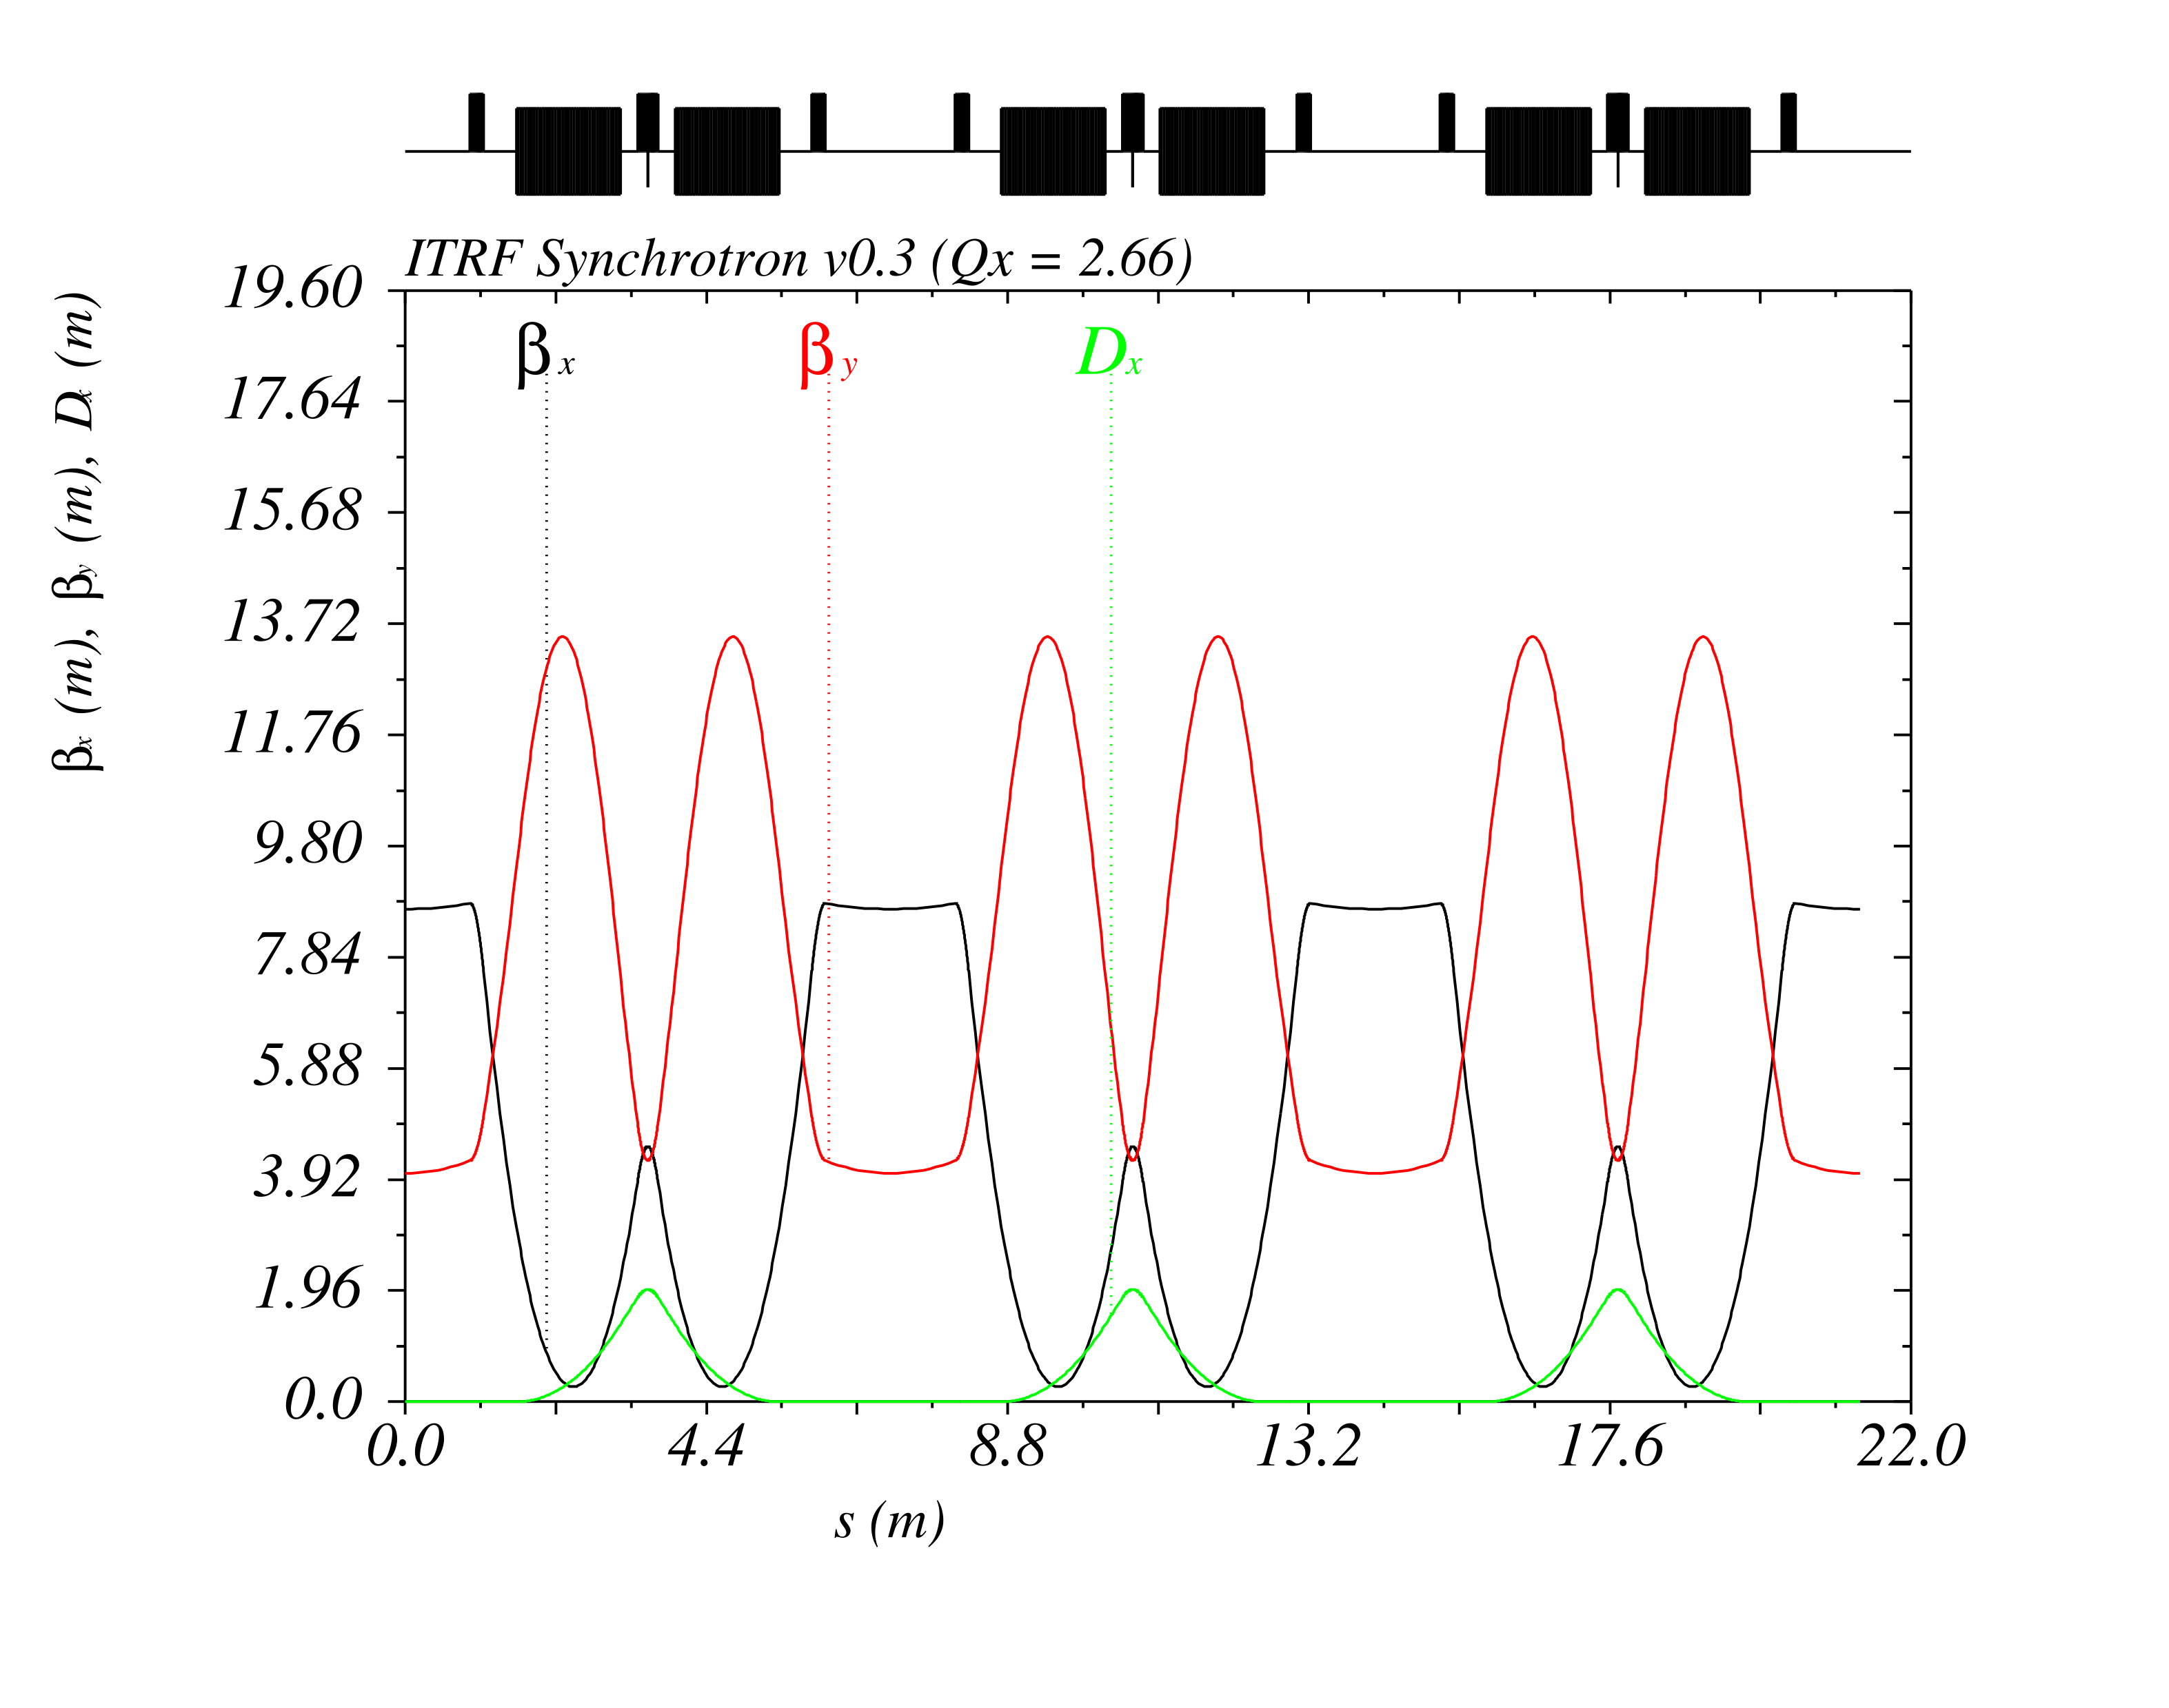
ITRF Synchrotron Design
[1] R. Taylor et al., J. Phys.: Conf. Ser 2420 012101 (2023)
Optics and Key Parameters
Optimised the lattice using a semi-analytic model to maximise the accessible range of working points
Optics are tuned near a third-order betatron resonance to enable RF knockout beam extraction [1]
Synchrotron tuning range includes
two viable working points
Parameter | Value
QF1 strength [m⁻²] | 3.72
Maximum β_{x}, β_{y} [m] | 8.95, 13.63
Maximum D_{x} [m] | 1.98
Betatron Tunes Q_{x}, Q_{y} | 2.67, 0.52
Natural Chromaticities ξ_{x}, ξ_{y} | -6.66, -6.80

Slide 9
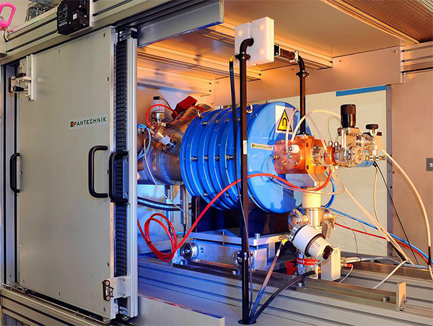
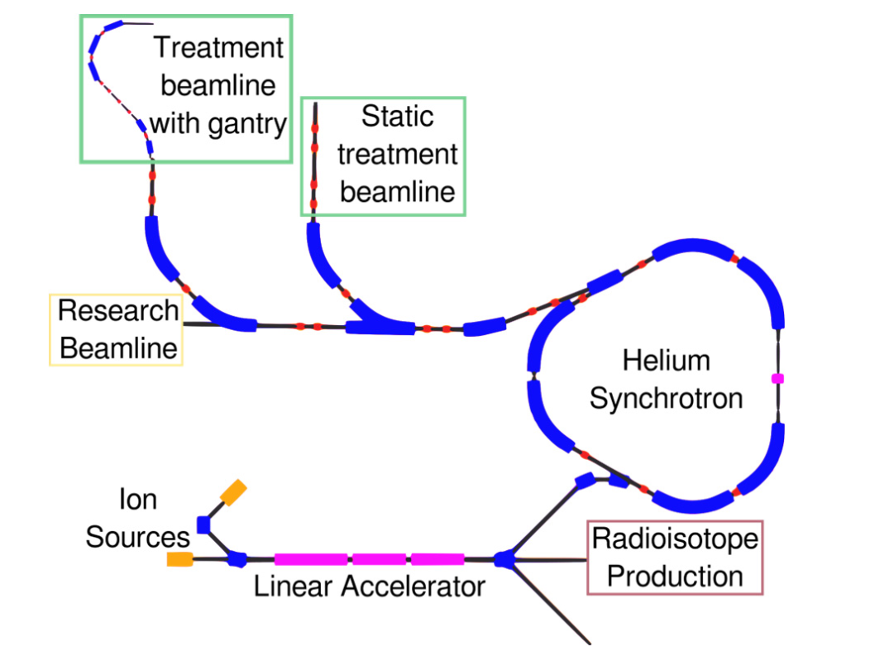
[1] M. Vretenar et al., J. Phys.: Conf. Ser. 2420 012103 (2023)
[2] U. Amaldi et al., A Facility for Tumour Therapy and Biomedical Research in South-Eastern Europe, Vol. 2 (2019)
[3] E. Benedetto, CERN-NIMMS-Note-008 (2022)
Beam Injection
Injector Chain
NIMMS propose [1] a conventional injector chain
based on CERN Linac 4
  Multiple ECR sources are envisioned, based on the
  SEEIST [2] injector and commercial Supernanogan source
  RFQ followed by one (two) DTL tanks to inject ions
  (protons) at 5 MeV/u (10 MeV)
Injection energies are primarily influenced by [3]
  Multi turn injection dynamics
  Space charge tune shift
  Stripping foil efficiency
Above: Commercial Supernanogan ECR source
generating up to 2 mA H⁺ or 200 µA C⁴⁺
Below: Schematic layout of NIMMS He
synchrotron and injector

Slide 10
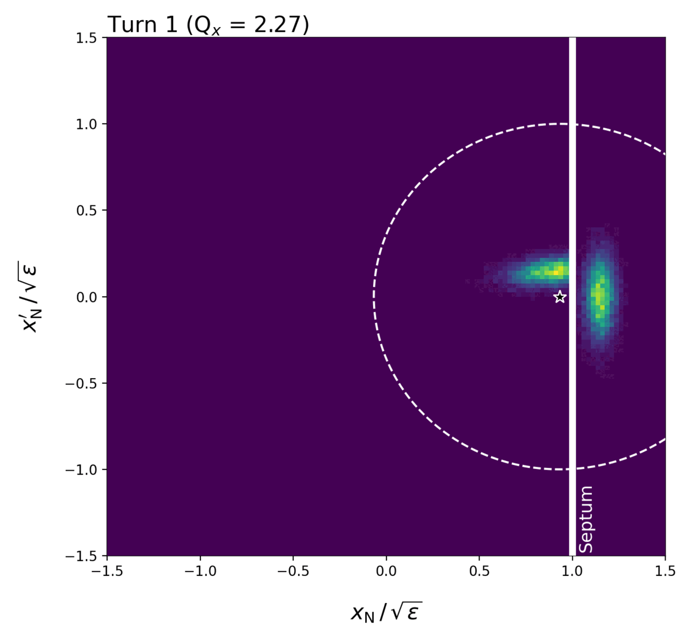
[1] U. Amaldi et al., A Facility for Tumour Therapy and Biomedical Research in South-Eastern Europe, Vol. 2 (2019)
Beam Injection
Multi Turn Injection
Ions are accumulated over several turns via MT injection
or “phase space painting”.
Injection is typically limited to 15 – 20 turns, ~60% efficiency
Estimate the maximum stored intensity based on the SEEIST
injector parameters [1] and Supernanogan ECR source.
Injection is not thought to be space charge limited.
Parameter | Values
 | H⁺ | ⁴He²⁺ | ¹²C⁶⁺
Linac Current [mA] | 2.00 | 1.00 | 0.20
Injection Energy [MeV/u] | 10 | 5 | 5
Orbital Period [µs] | 0.49 | 0.69 | 0.69
Ions after 15 Turns [10¹⁰] | 5.51 | 1.94 | 0.13
Space Charge Tune Shift | -0.15 | -0.02 | < 0.01

Slide 11
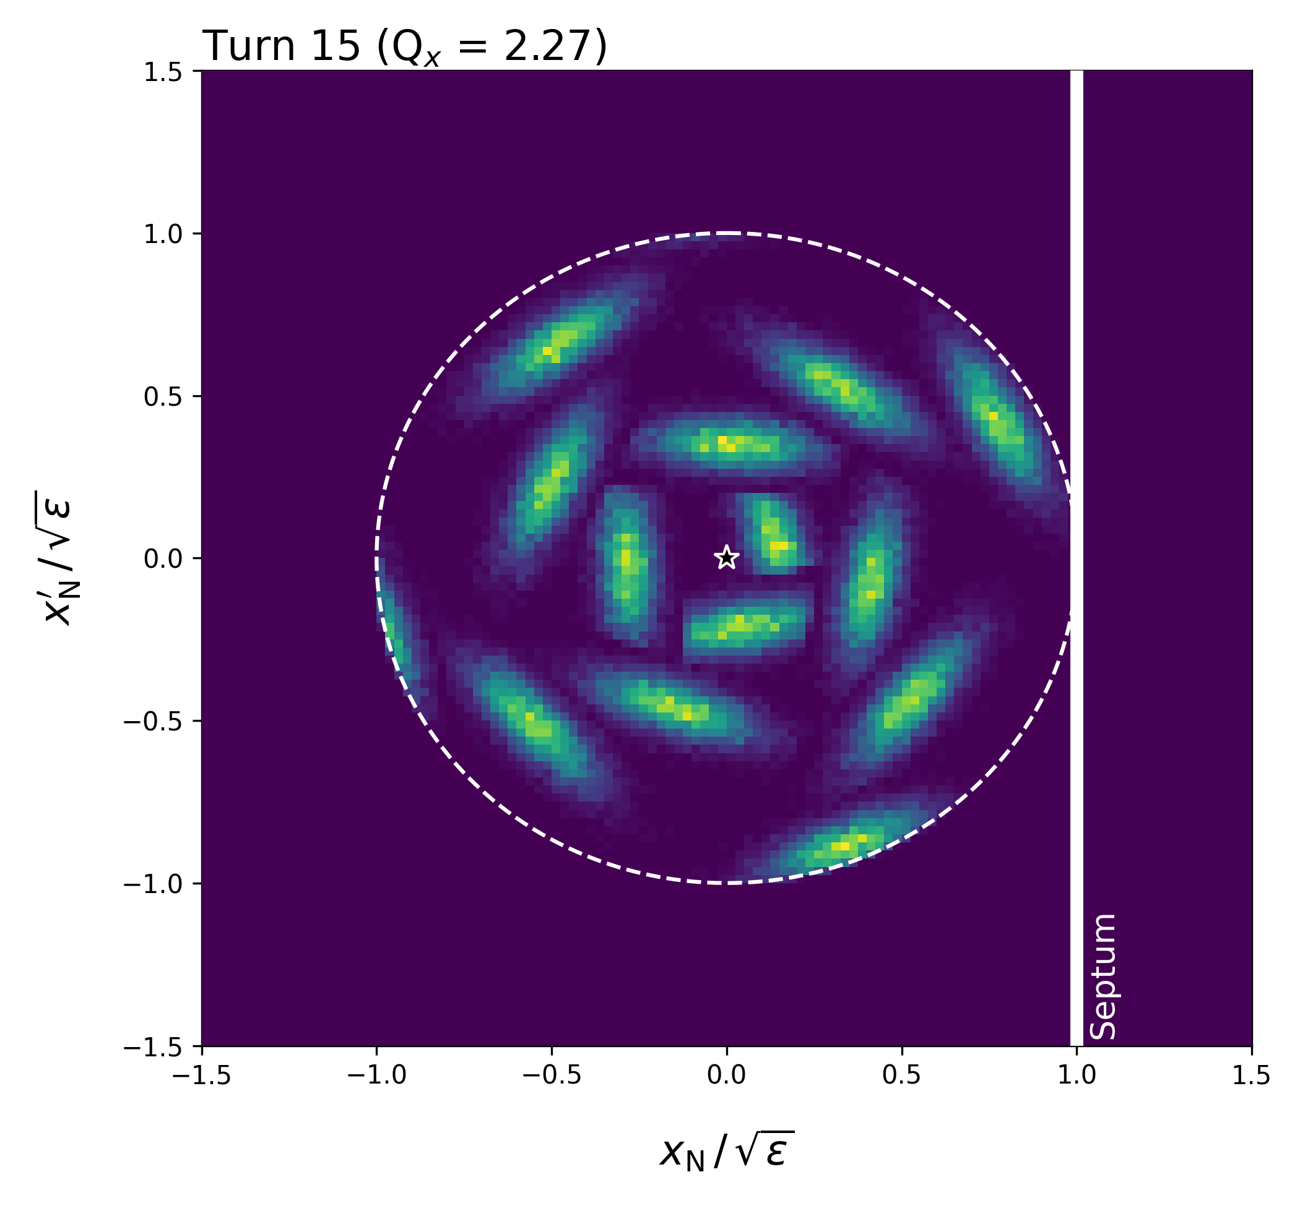
[1] U. Amaldi et al., A Facility for Tumour Therapy and Biomedical Research in South-Eastern Europe, Vol. 2 (2019)
Beam Injection
Multi Turn Injection
Ions are accumulated over several turns via MT injection
or “phase space painting”.
Injection is typically limited to 15 – 20 turns, ~60% efficiency
Estimate the maximum stored intensity based on the SEEIST
injector parameters [1] and Supernanogan ECR source.
Injection is not thought to be space charge limited.
Parameter | Values
 | H⁺ | ⁴He²⁺ | ¹²C⁶⁺
Linac Current [mA] | 2.00 | 1.00 | 0.20
Injection Energy [MeV/u] | 10 | 5 | 5
Orbital Period [µs] | 0.49 | 0.69 | 0.69
Ions after 15 Turns [10¹⁰] | 5.51 | 1.94 | 0.13
Space Charge Tune Shift | -0.15 | -0.02 | < 0.01

Slide 12
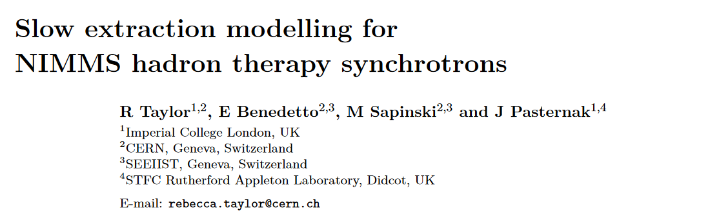
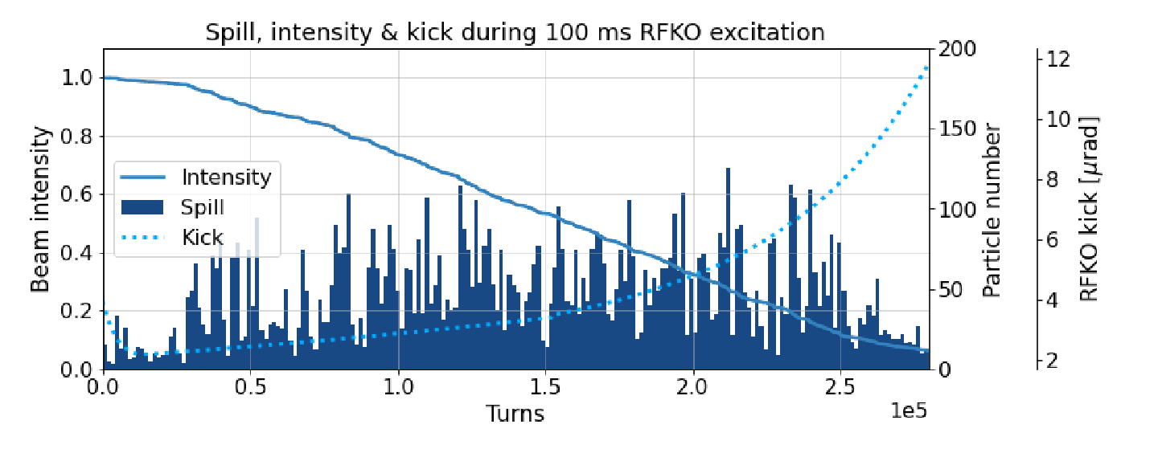
Beam Extraction
[1] M. Vretenar et al., J. Phys.: Conf. Ser. 2420 012103 (2023)
[2] R. Taylor et al., J. Phys.: Conf. Ser 2420 012101 (2023)
Work in Progress
Like NIMMS [1], we expect to use slow extraction using
RF knockout (RFKO) at the third order resonance.
Extensive simulations have been carried out for the
NIMMS and PIMMS (CNAO, MedAustron) designs [1].
Typical extraction timescale of ~100 ms to 1 s
Figure: Simulation of 10⁴ particles extracted via
RFKO over 100 ms [1]

Slide 13
Conclusions
Thank you for listening
A preliminary synchrotron design for ITRF WP3
has been established
Layout is adapted from well-developed designs
proposed by CERN NIMMS
Synchrotron optics, beam energies and intensities
are increasingly well defined
Currently assessing beam extraction and
corresponding dose rates
ITRF WP3 Contributors:
Hywel Owen (STFC ASTeC)
Karen Kirkby (Univ. Manchester)
Elena Benedetto (CERN and SEEIST)
Mark Johnson | Accelerator Physicist (ASTeC)
Office A50 | STFC Daresbury Laboratory | Warrington WA4 4AD
mark.johnson@stfc.ac.uk

