Slide 1
News/Update

Slide 2
https://ccap.hep.ph.ic.ac.uk/trac/raw-attachment/wiki/Research/LhARA/Documentation/TN/Governance/LhARA-Gov-Rev-2022-01.pdf
Done!
https://ccap.hep.ph.ic.ac.uk/trac/raw-attachment/wiki/Research/LhARA/Documentation/TN/Governance/LhARA-Gov-Rev-2022-02.pdf

Slide 3
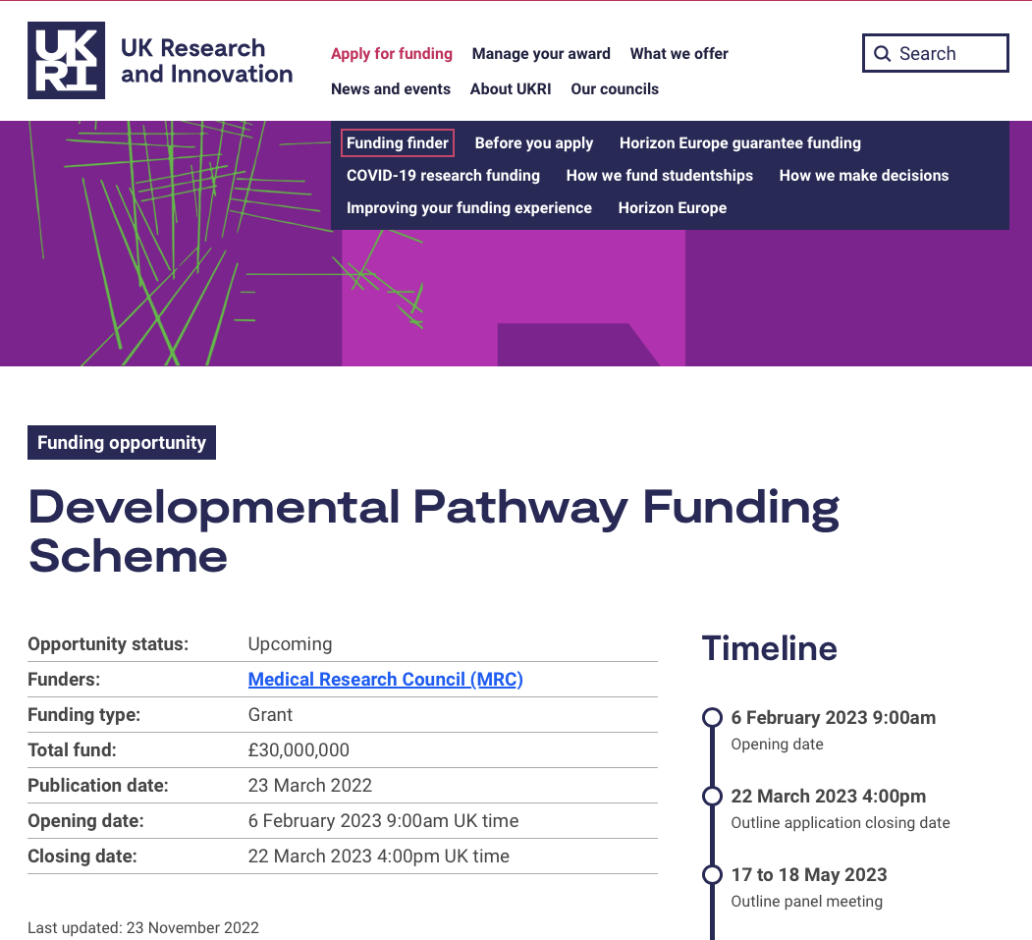
MRC: Developmental Pathway Funding Scheme
“Radiobiology linked with LhARA”
Structure of bid now agreed
In process …

Slide 4
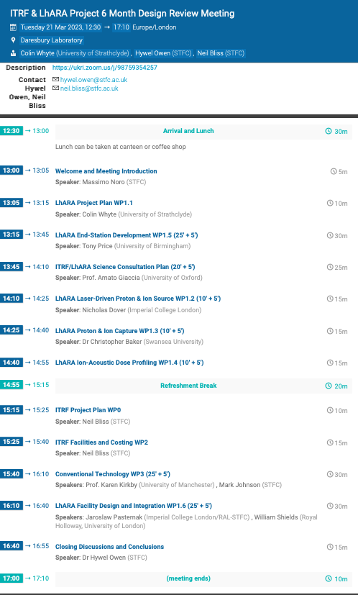
ITRF 6 month review
https://indico.stfc.ac.uk/event/722/
Progress report in preparation

