Slide 1
Ionacoustic Work Package
LhARA Fortnightly Meeting
28th February 2023

Slide 2
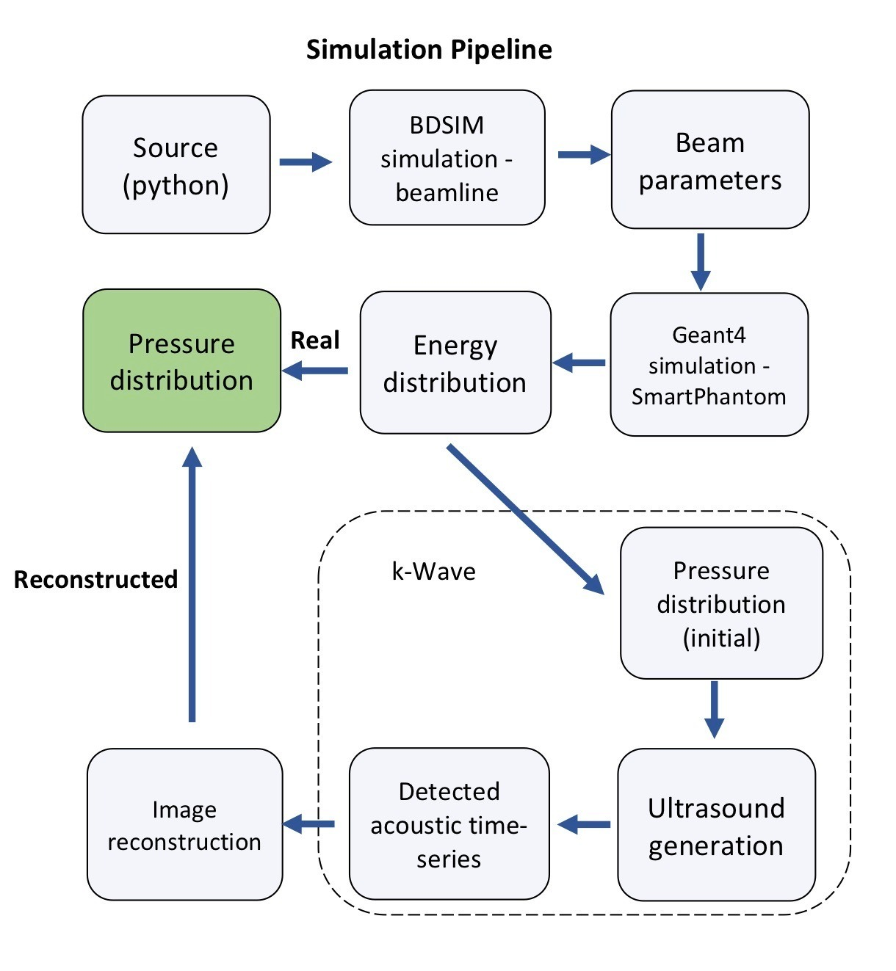


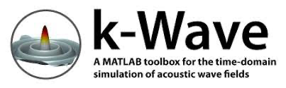
Simulation Pipeline

Slide 3

BDSIM

Slide 4
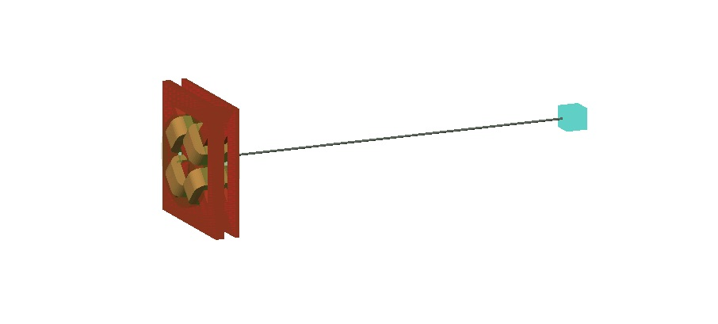
LION beamline - BDSIM
2x quadropole magnets for focusing
source
(python file)
SmartPhantom
Figure 1: Render of LION beamline at Ludwig-Maximillian University Munich in BDSIM

Slide 5
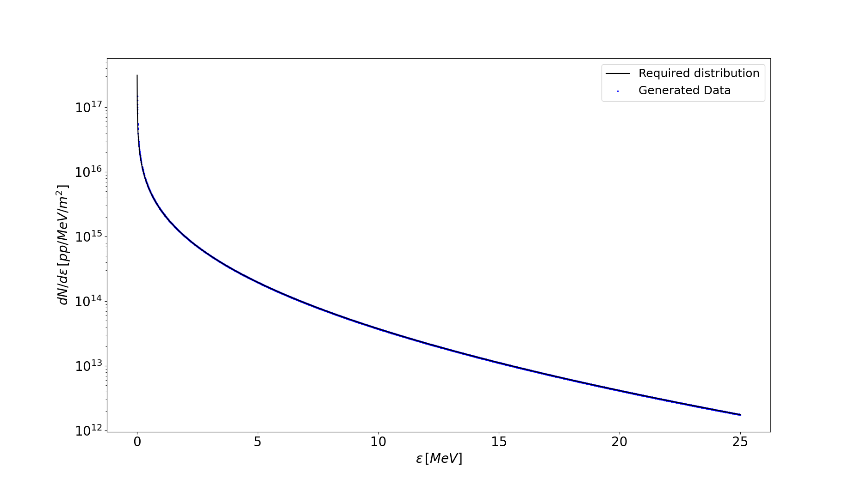
Source – Energy Distribution
Figure 2: Energy distribution of protons from source – simulated and analytic closely match

Slide 6
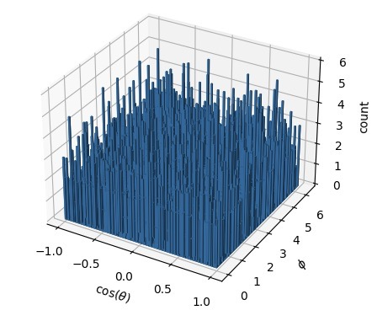

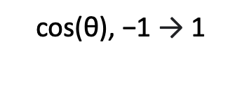




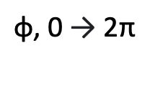
Source – Angular Distribution
$$\text{cos}\text{(}\text{θ}\text{), −1 }\text{→}\text{ 1}$$
$$\text{φ}\text{, 0 }\text{→}\text{ 2}\text{π}$$
$$p_{x}=psin\left(θ\right)cos⁡(φ)$$
$$p_{y}=psin\left(θ\right)sin⁡(φ)$$
$$p_{z}=pcos\left(θ\right)$$
$$x^{′}= \frac{p_{x}}{p_{z}}$$
$$y^{′}= \frac{p_{y}}{p_{z}}$$
Figure 3: Angular distribution of protons from source

Slide 7
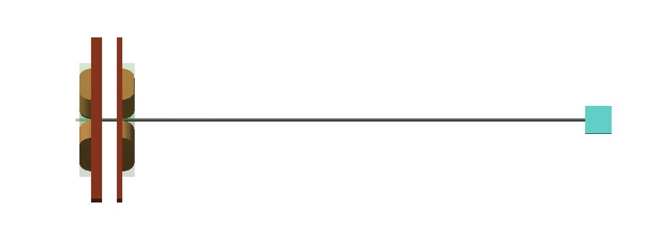
LION beamline - BDSIM
55.77 mm
1728.59 mm
60.34 mm
10 mm bore diameter
2x quadropole magnets for focusing
332 T/m
318.5 T/m
Figure 4: Side-on view of LION beamline in BDSIM

Slide 8

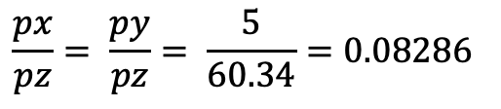
Quadrupole Acceptance
5 mm
$$\frac{px}{pz}= \frac{py}{pz}= \frac{5}{60.34}=0.08286$$
source
60.34 mm
Figure 5: Diagram to show the accepted particles for the BDSIM simulation of the LION beamline

Slide 9
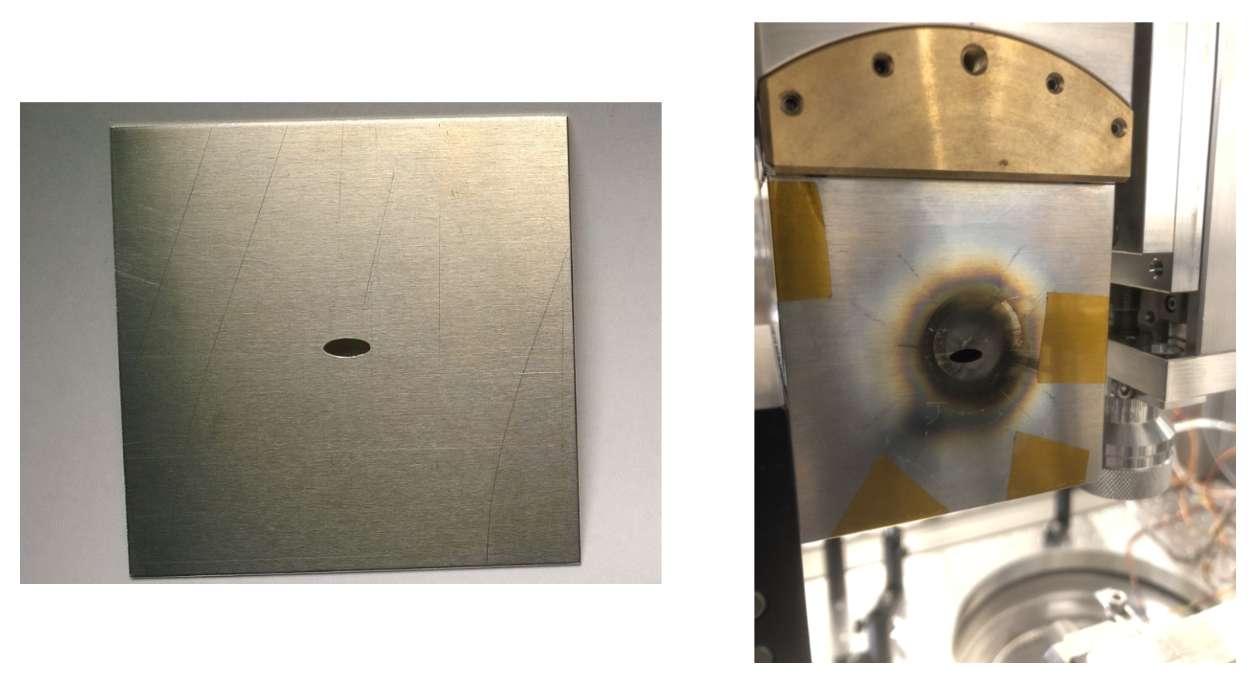

Shielding
6 mm
acceptance_{x} $= \frac{3}{60.34}=0.04972$
acceptance_{y} $= \frac{1.5}{60.34}=0.02486$
3 mm
Figure 6: Aluminium shielding with elliptical aperture for quadrupole magnet protection
(taken from Thomas Roesch’s thesis)

Slide 10
Running the Simulation
5e5 protons at the source
Exponential energy distribution
Flat angular distribution
49.72 mrad acceptance in the x-direction
24.86 mrad acceptance in the y-direction

Slide 11
Particle depth
SmartPhantom
quadropoles
shielding
Figure 7: Particle depletion through simulated beamline
85883
∼1/6 particles enter phantom

Slide 12
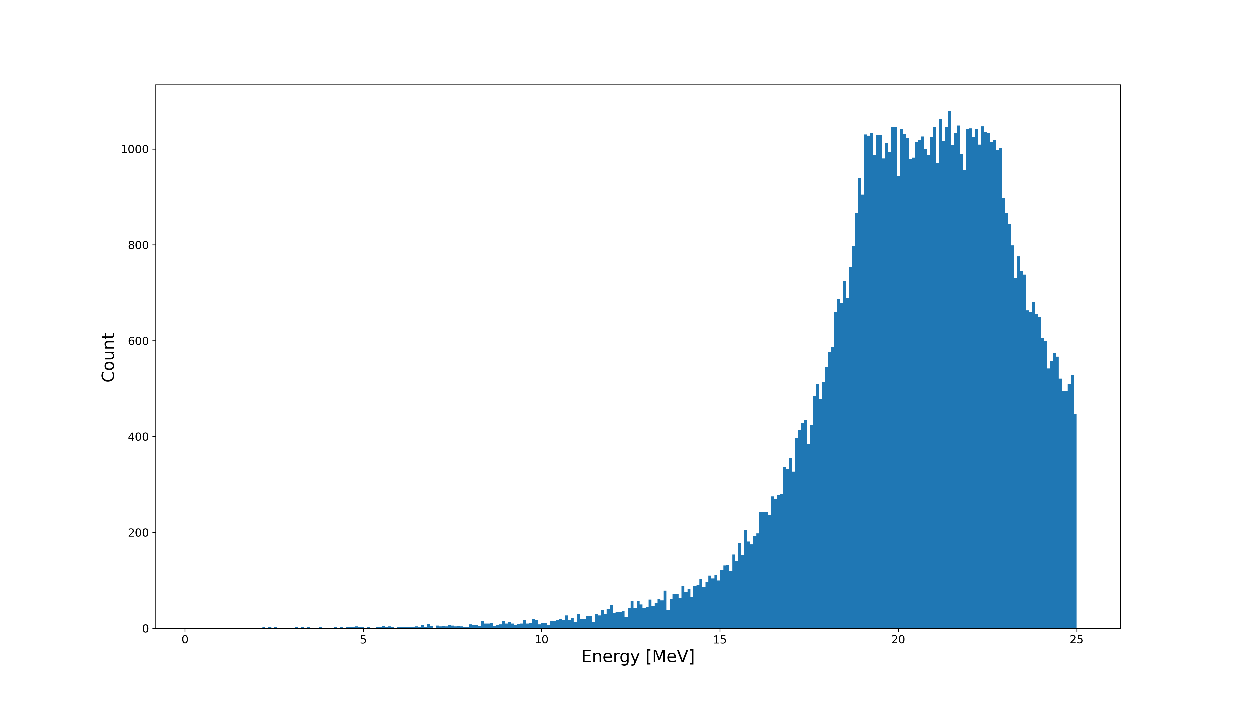
Energy Distribution – end of beamline
Figure 8: Energy spectrum of the particles that arrive at the end of the LION beamline

Slide 13
BDSIM Dose Deposition Profile
Figure 9: Dose depositions in SmartPhantom, as simulated in BDSIM

Slide 14
Output File
test_file.dat
Accept x & y coordinate particles that fall into the entrance window hole (15 mm diameter)
Figure 10: Side-on view of LION beamline in BDSIM

Slide 15

GEANT4

Slide 16
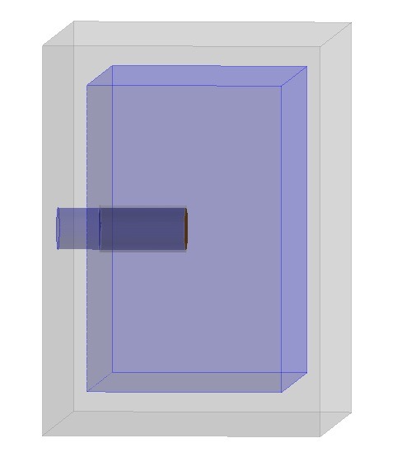
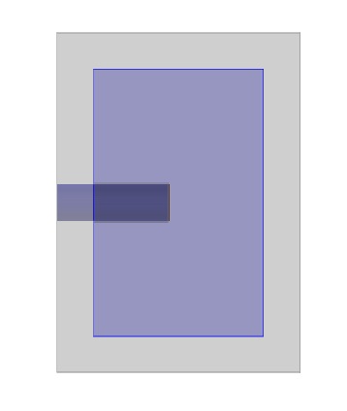
SmartPhantom in Geant4
Aluminium
Water
15 mm
Kapton entry window
Beam
(test_file.dat)
160 mm
15 mm
100 mm
140 mm
Figure 11: Geant4 simulation of the SmartPhantom. Angled view (left), cross-section view (right)

Slide 17
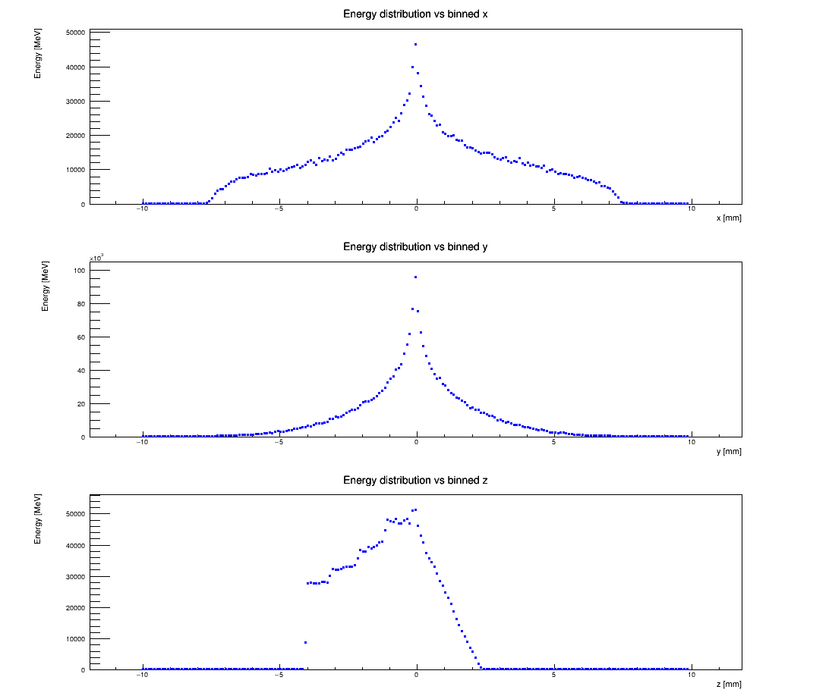
Geant4 Energy Distribution
FWHM ~ 2.1 mm
FWHM ~ 1.2 mm
Figure 12: Binned energy depositions along the three axis (0.1 mm voxels)

Slide 18
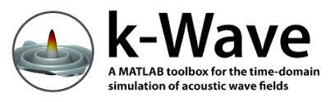
k-Wave

Slide 19
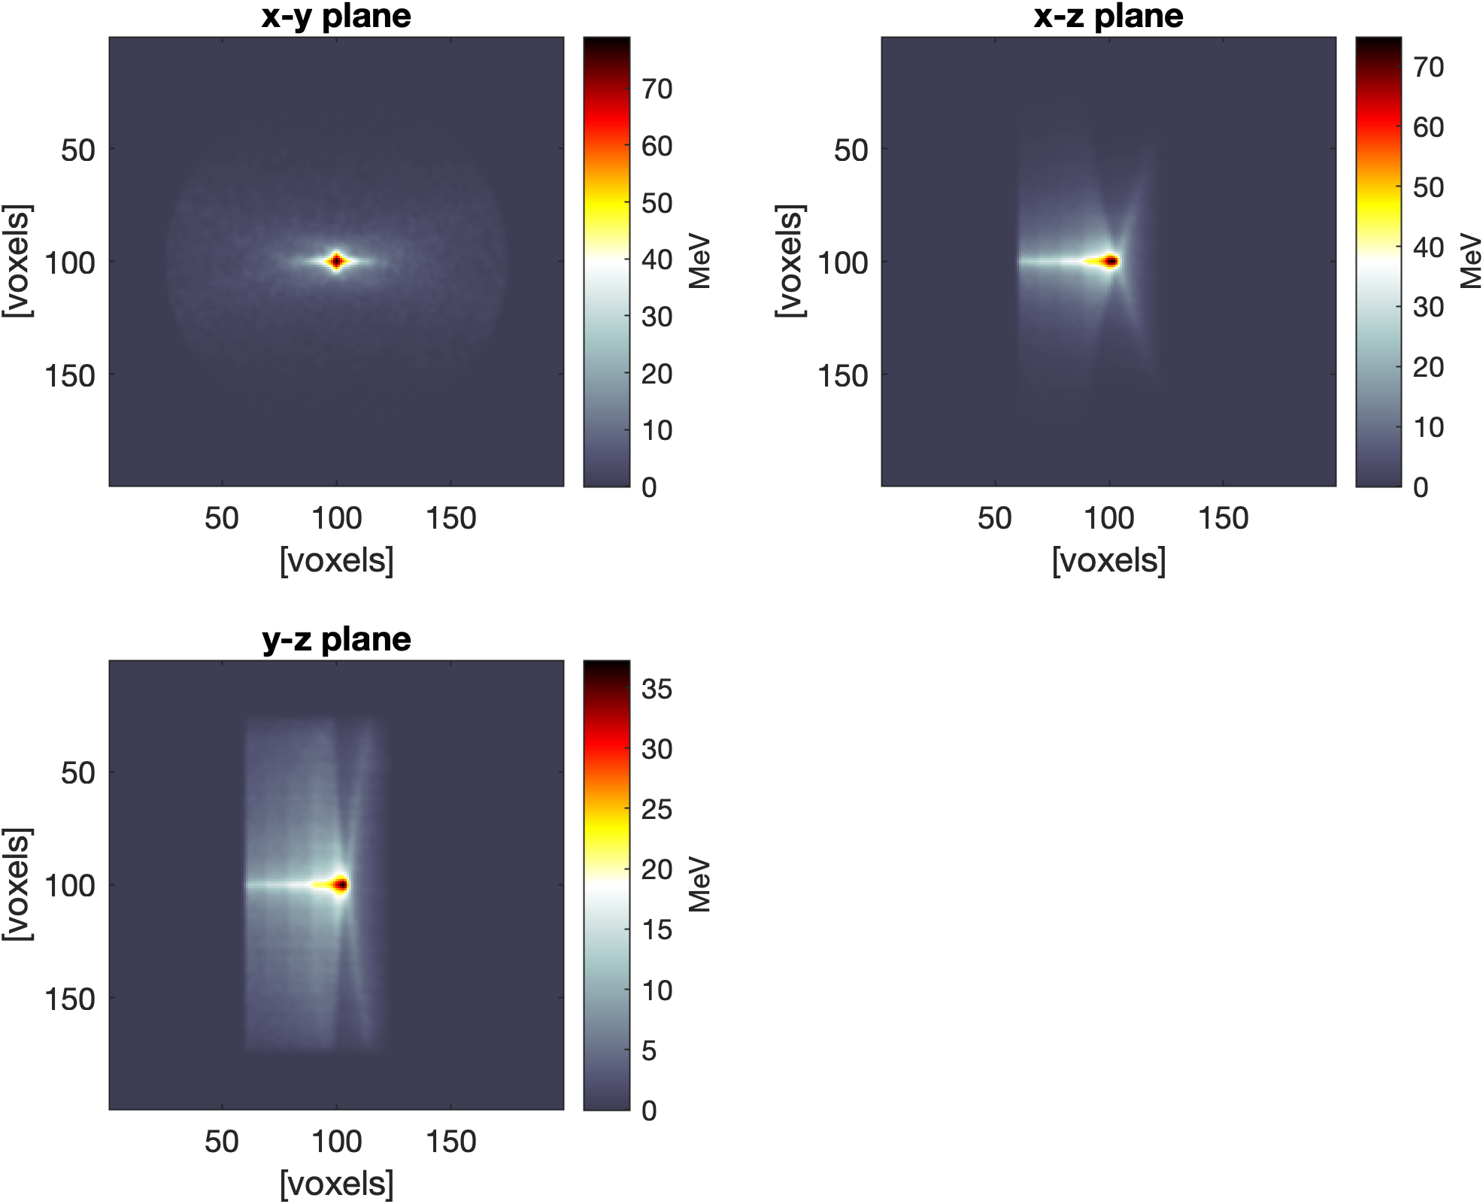
3D Energy Distribution
Figure 13: Distribution caused by the proton beam energy depositions

Slide 20
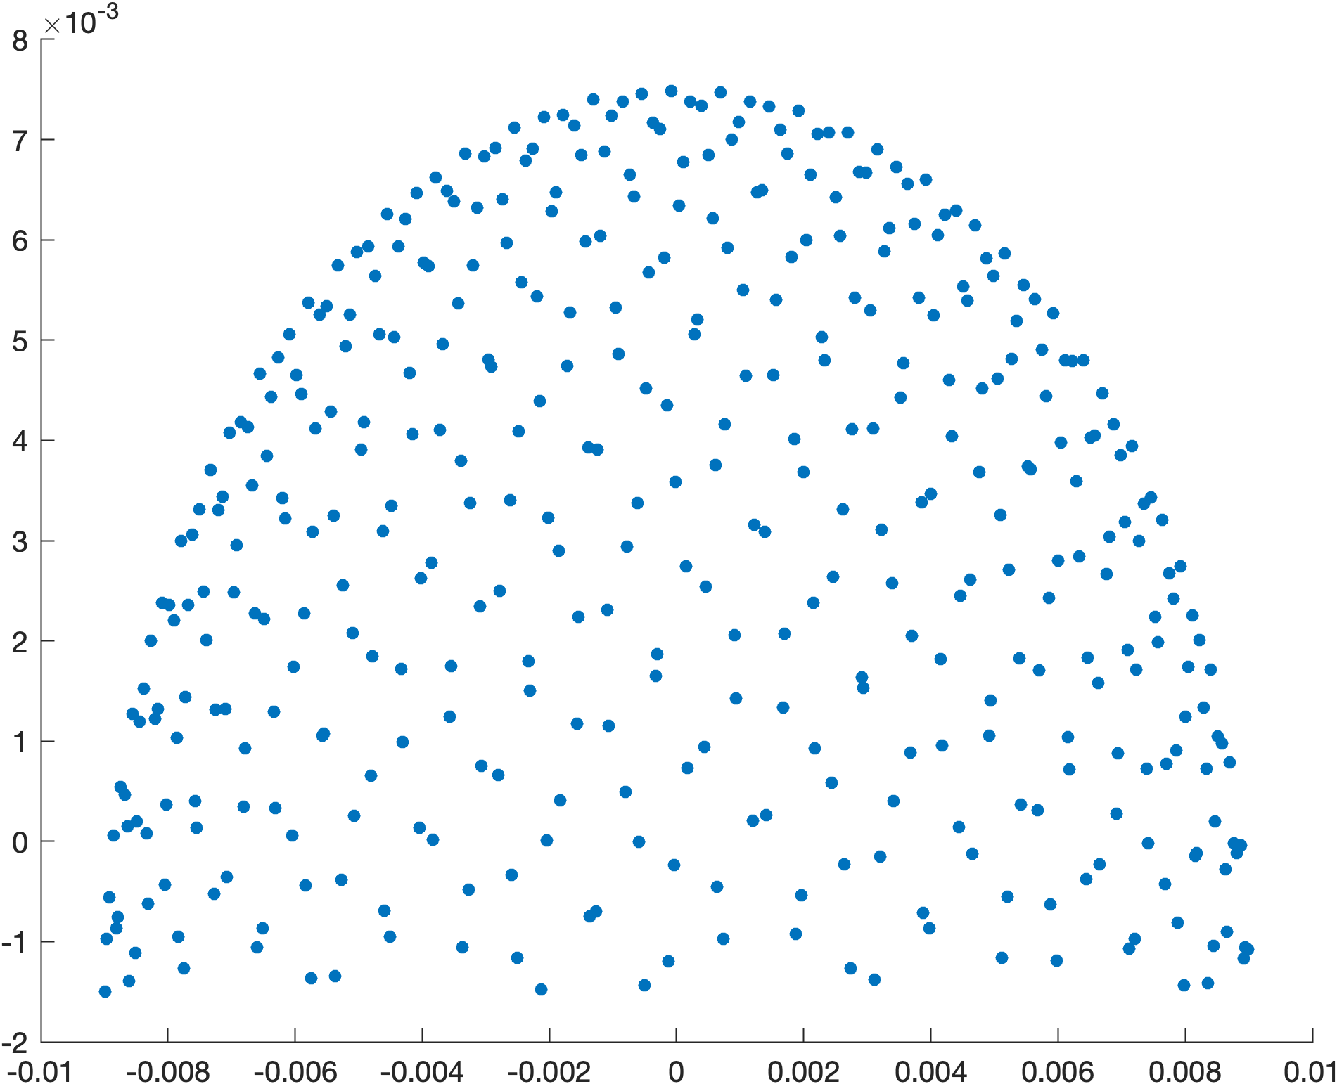
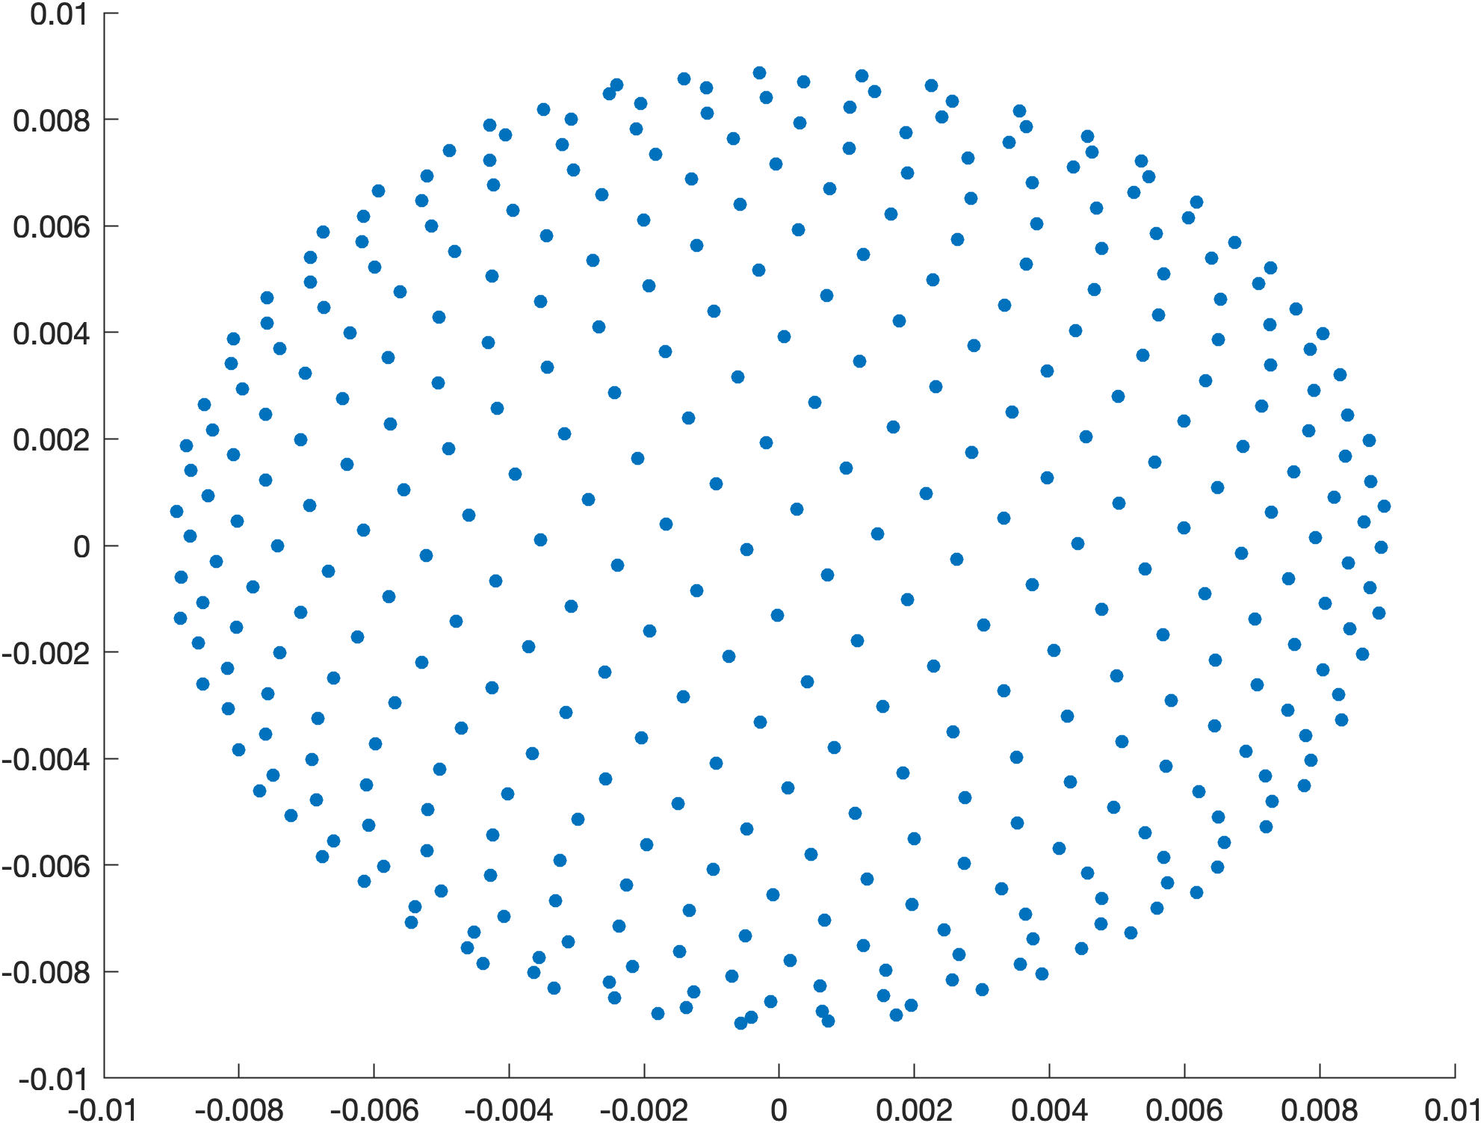
Acoustic Detector Array
Figure 14: 18mm diameter acoustic sensor with 400 disc elements each with 0.3mm diameter. Side view (left) and top view (right).

Slide 21
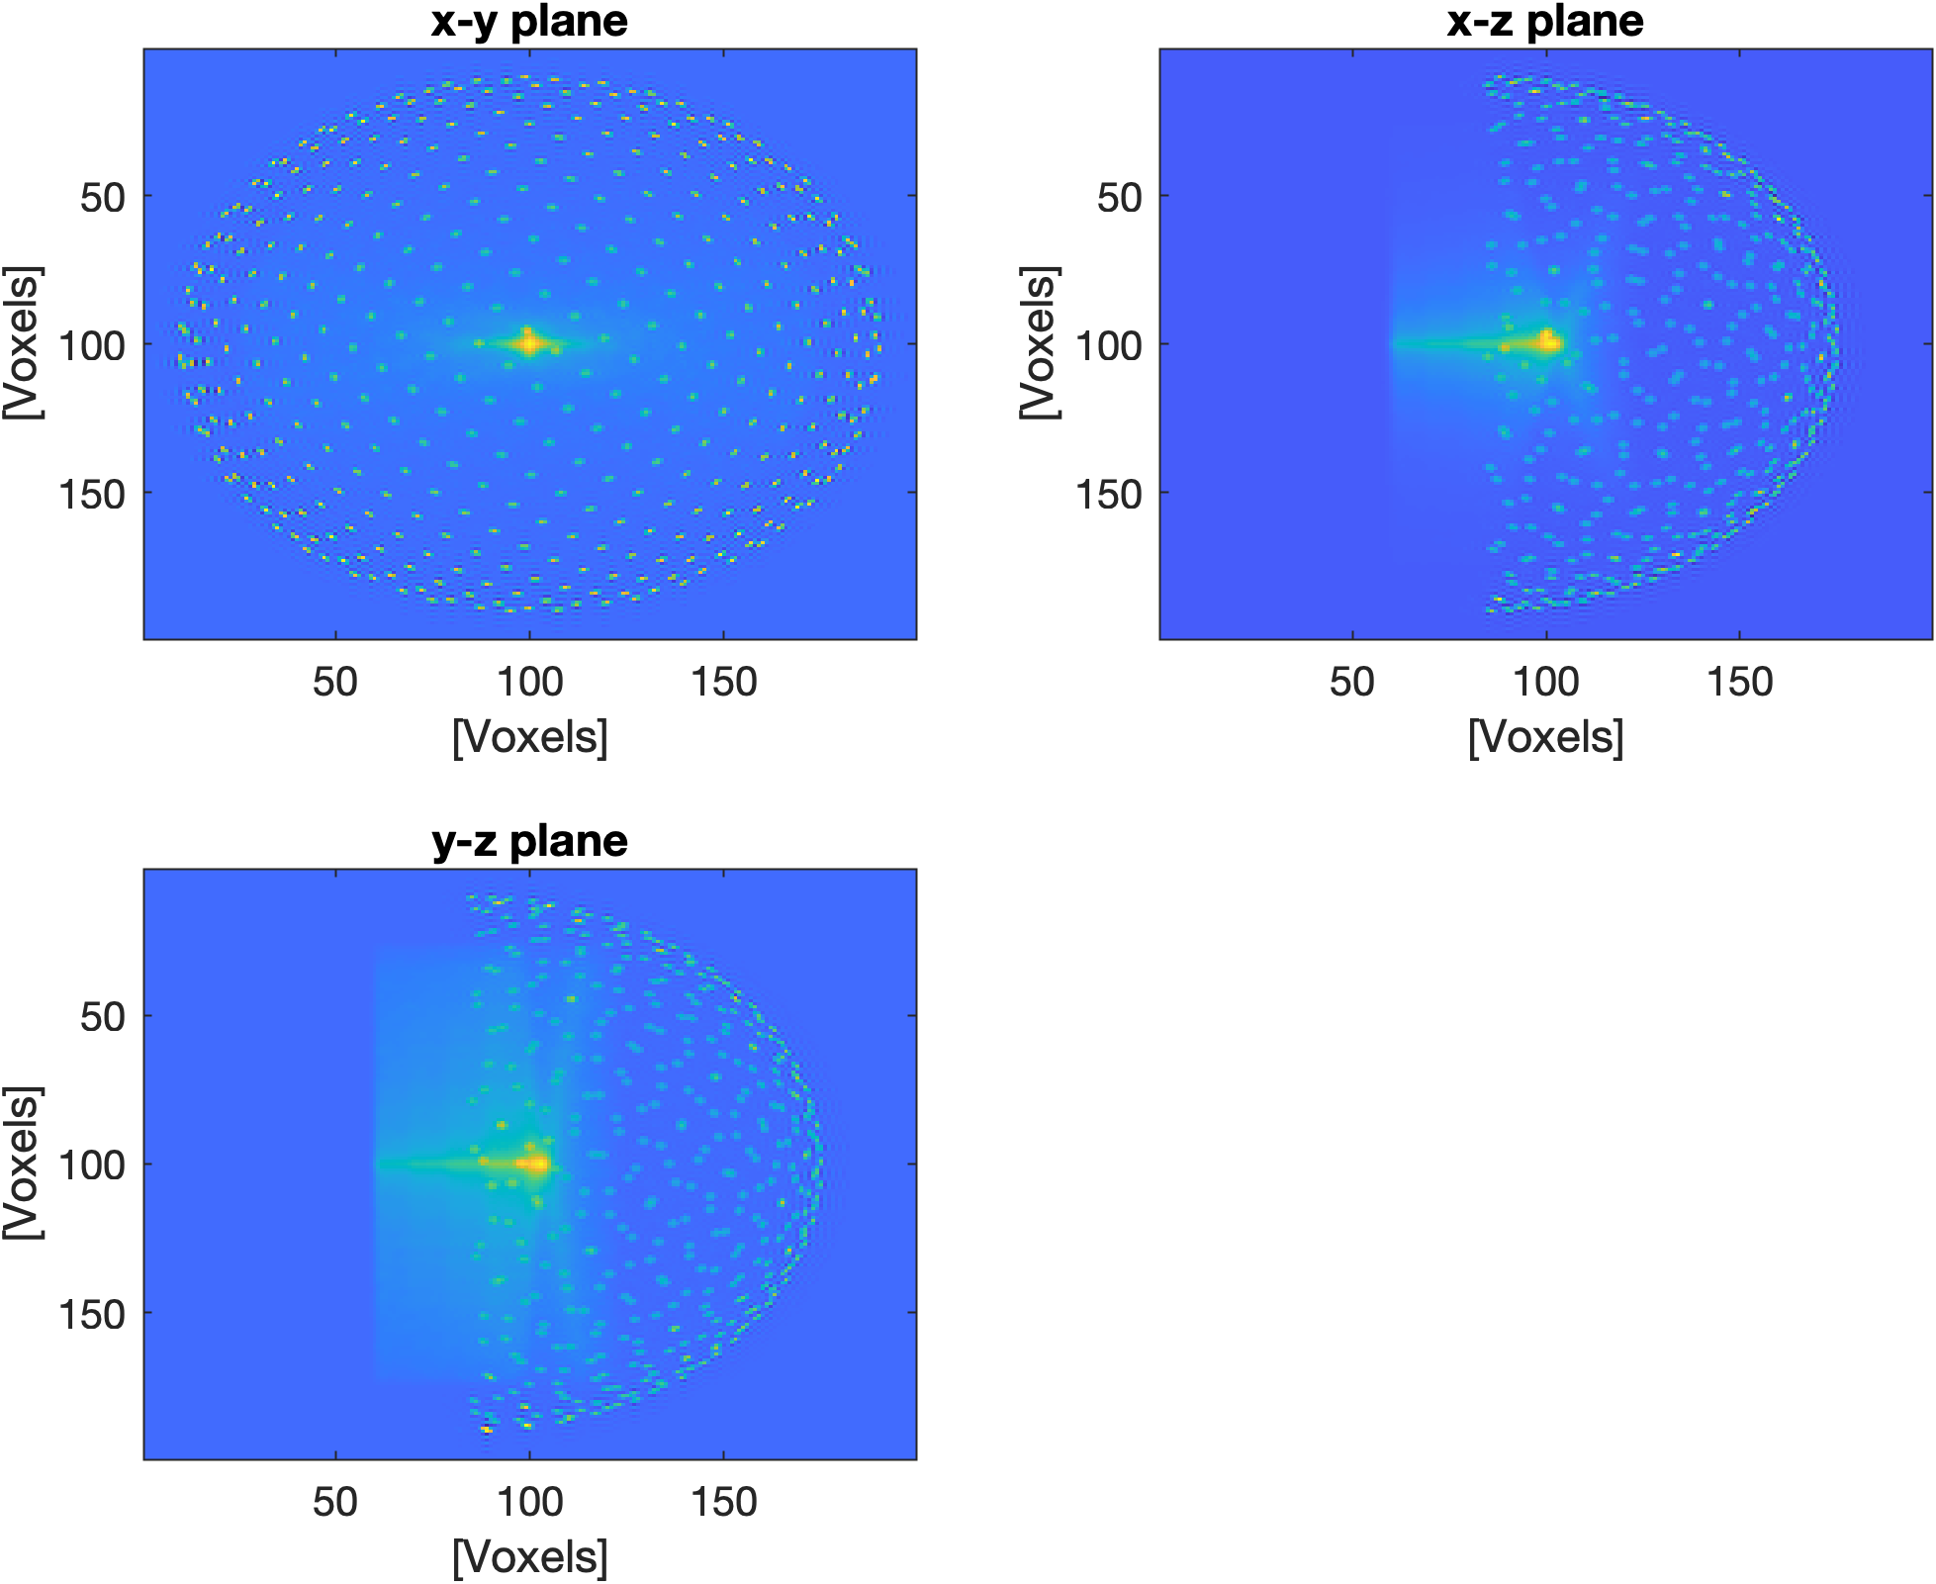
k-Wave set-up
proton beam
sensor array
Figure 15: Sensor geometry and proton beam energy deposition in k-Wave simulation with 0.1mm voxels

Slide 22
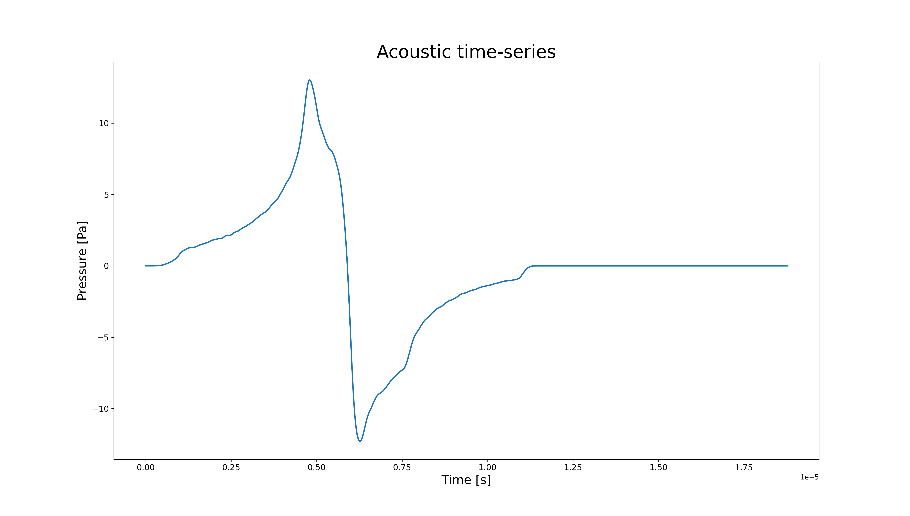
Acoustic Time Series
Figure 16: Acoustic time-series from the data received by the acoustic sensor

Slide 23
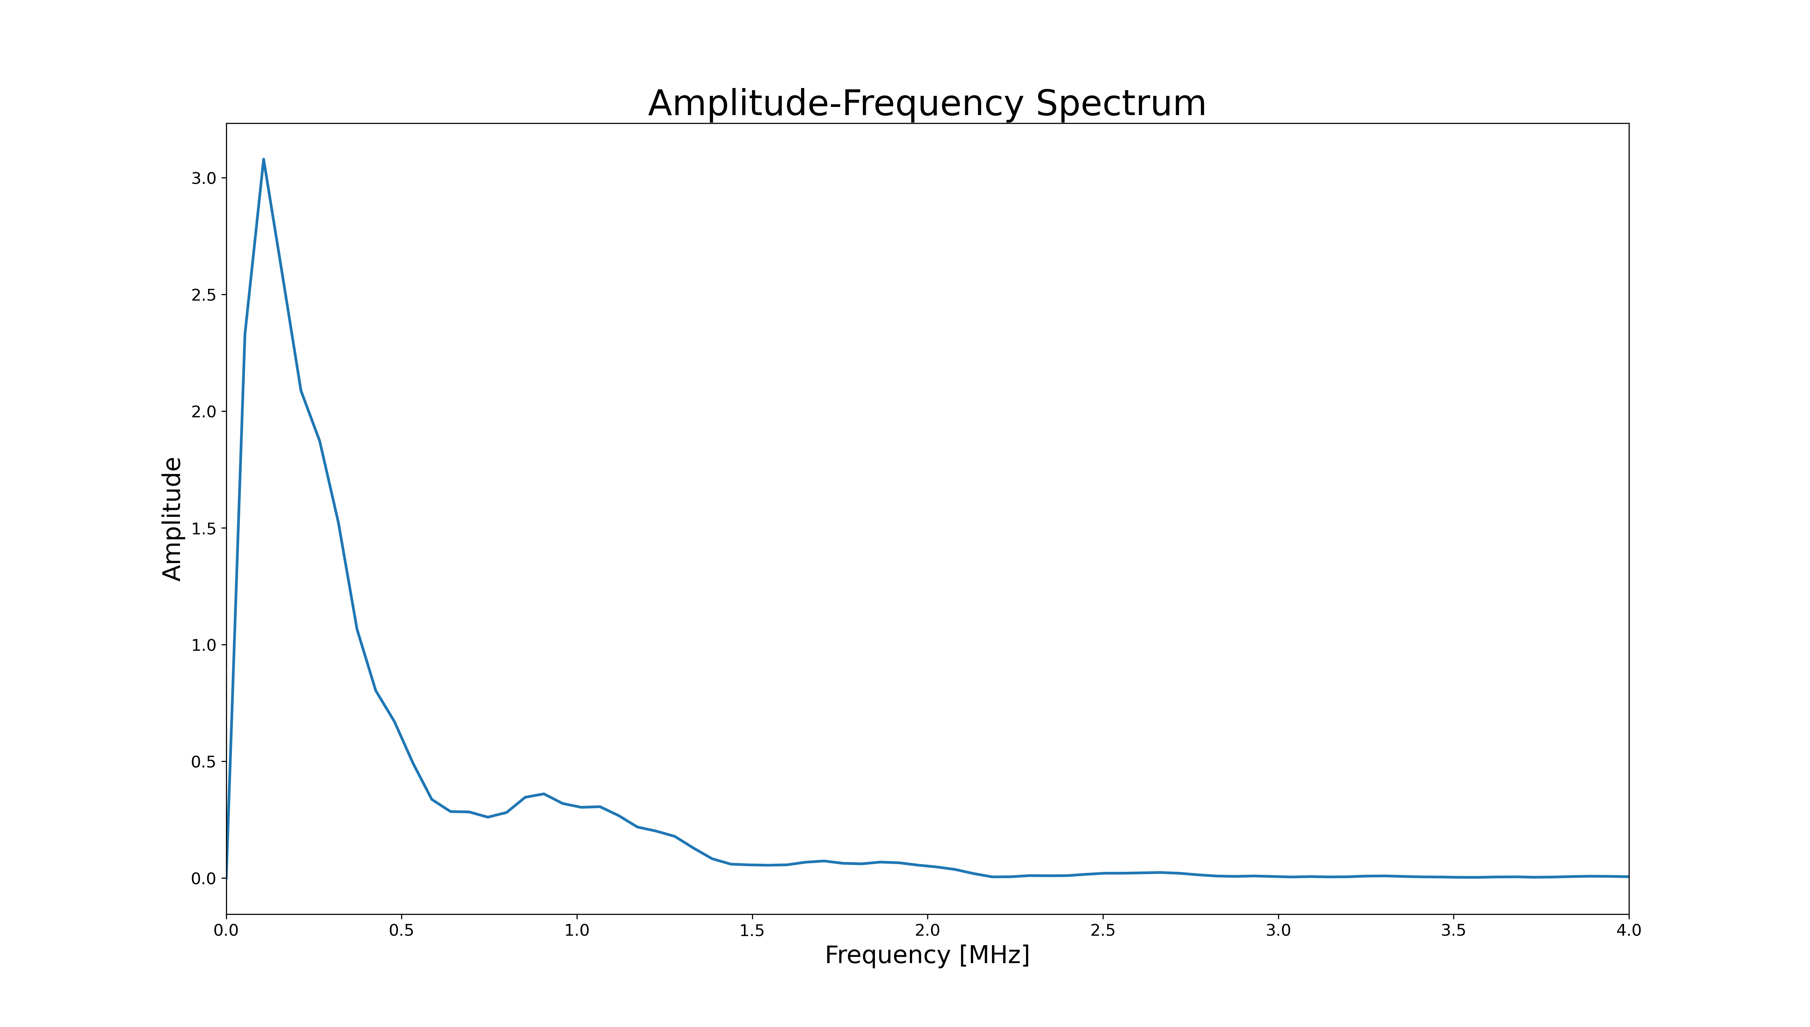
Frequency Spectrum
Figure 17: Frequency spectrum from the data received by the acoustic sensor

Slide 24
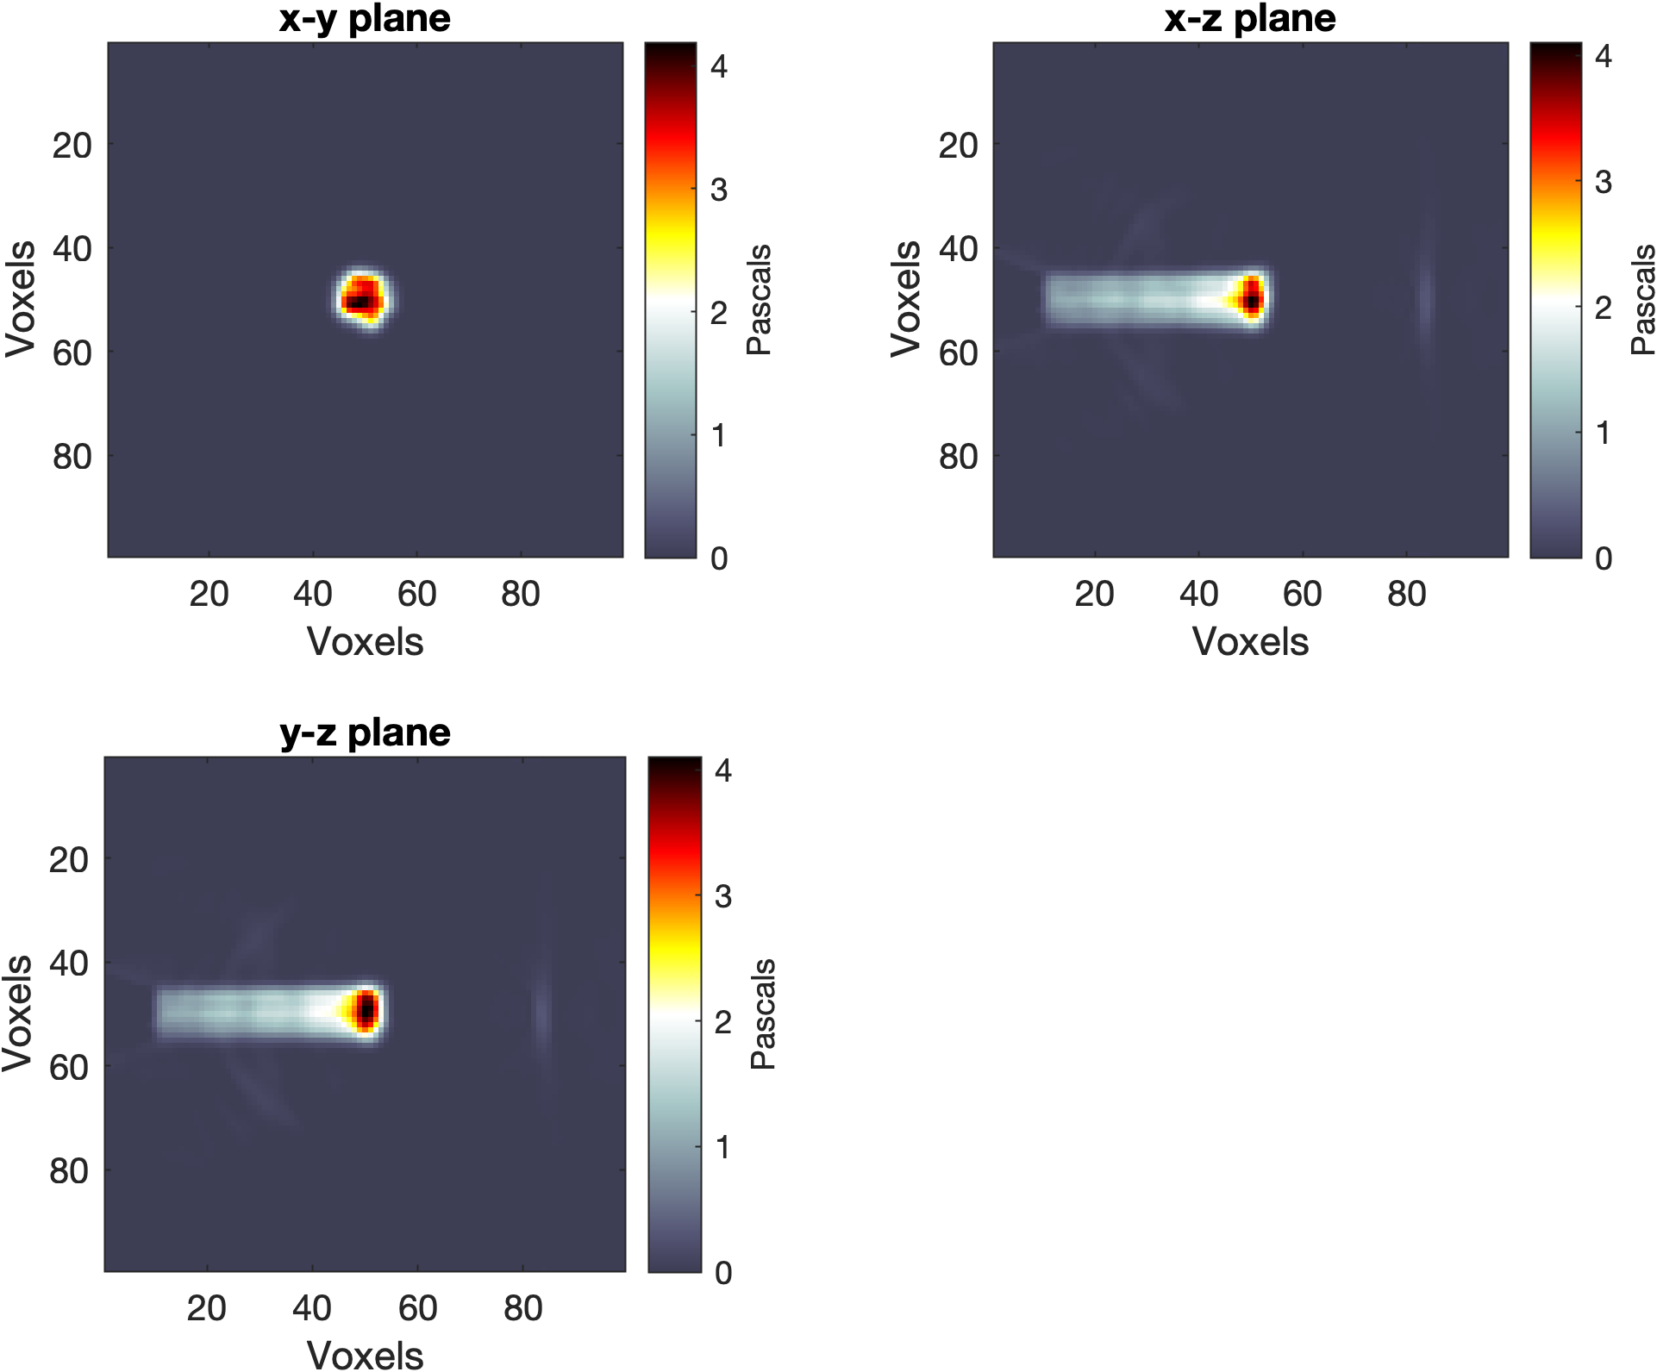
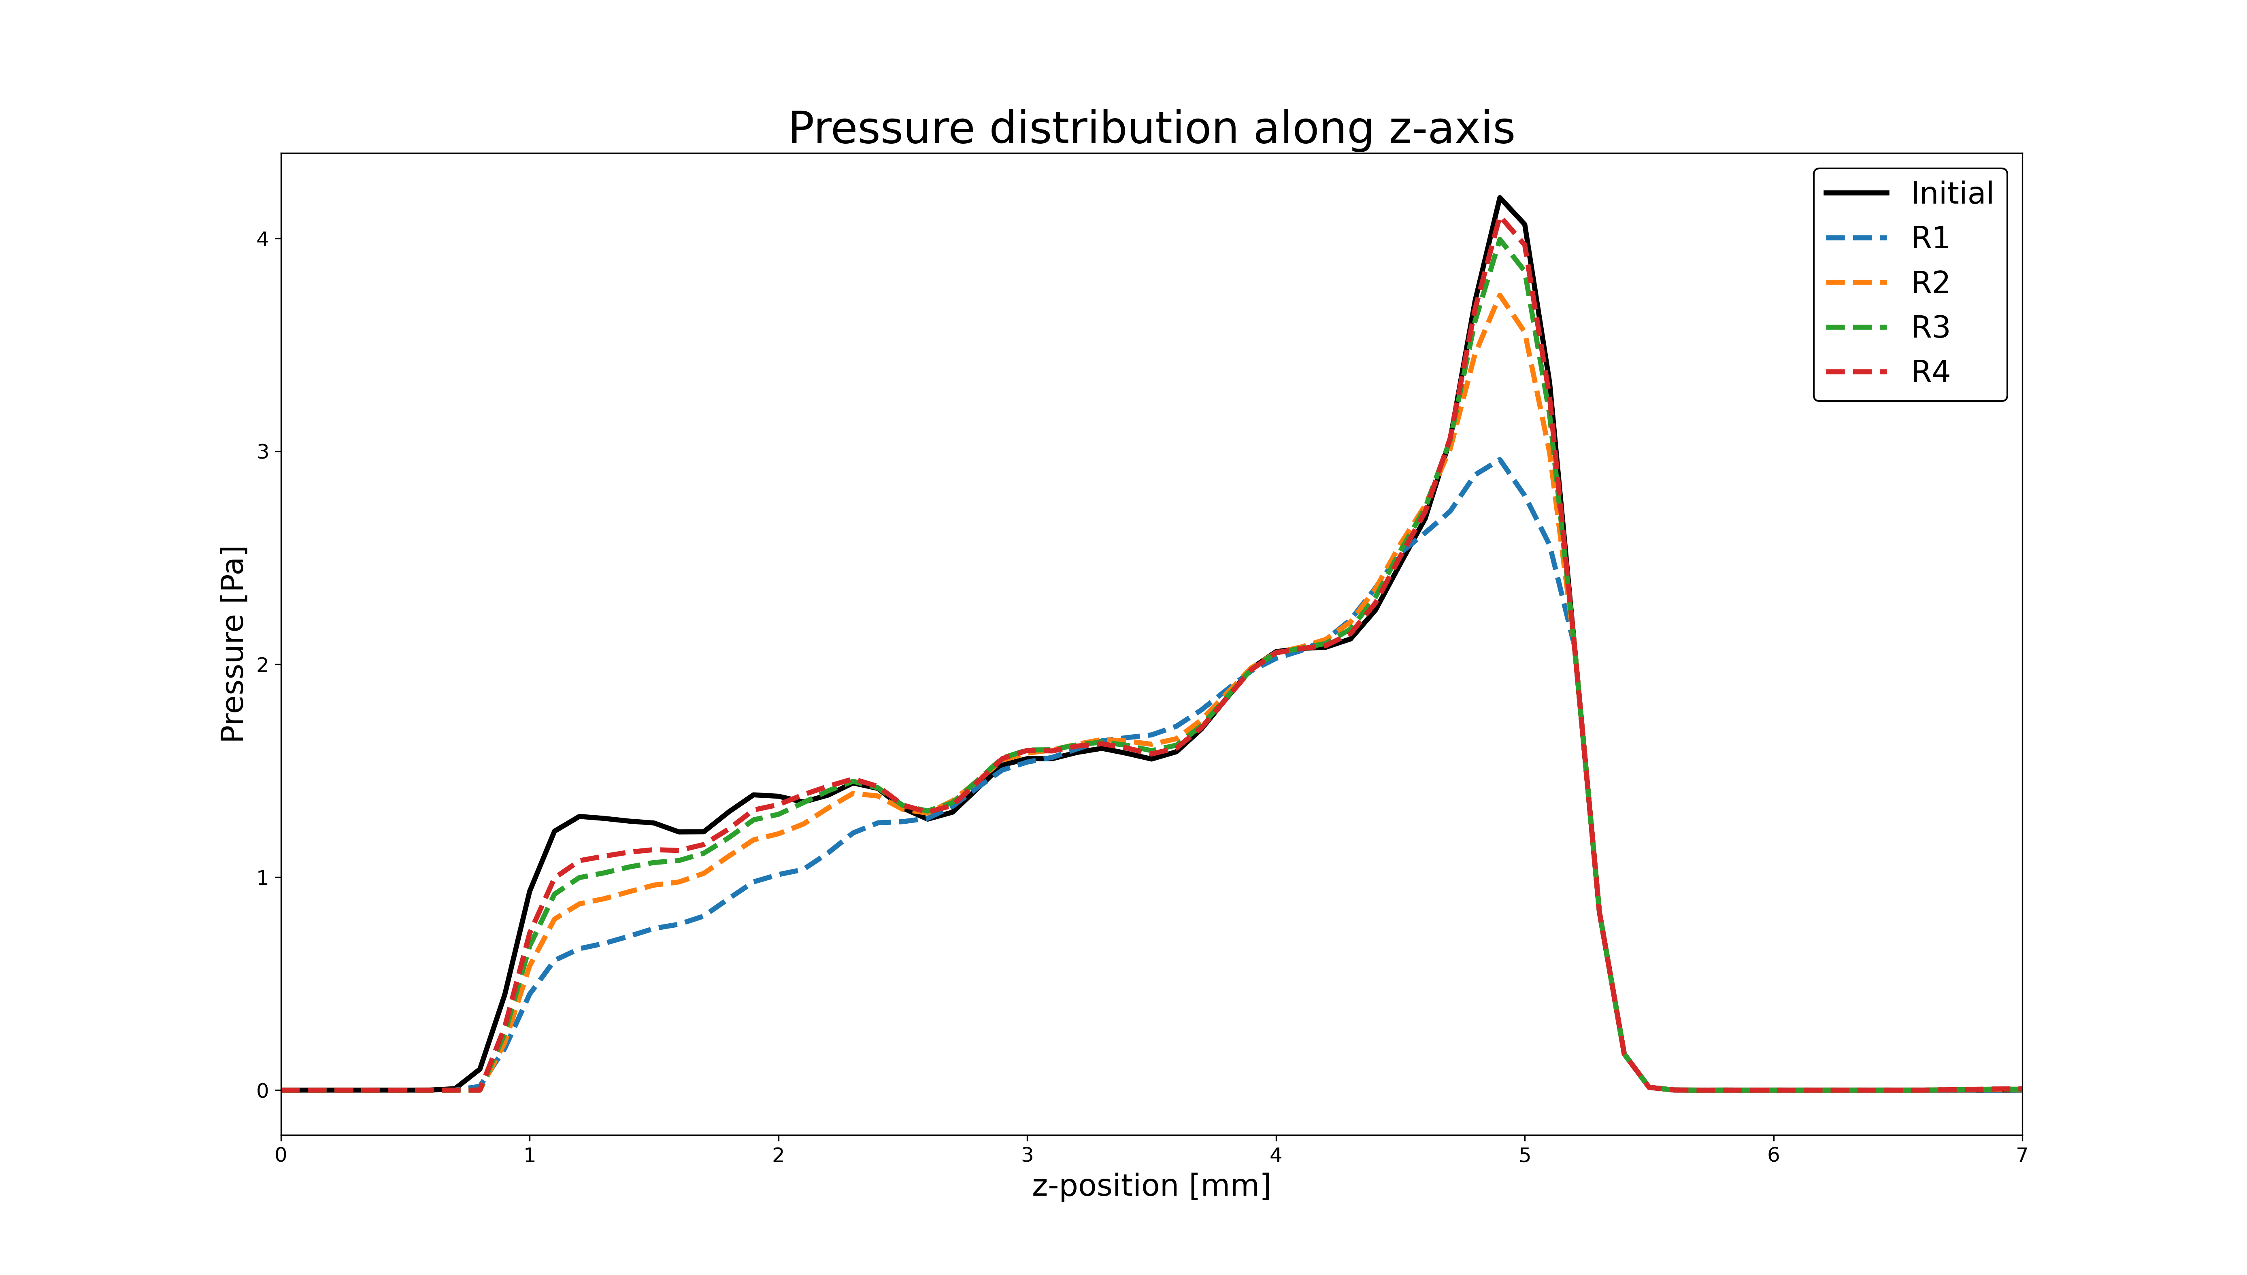
Image Reconstruction: Iterative time-reversal
Figure 18: Reconstructed pressure distribution using an iterative time reversal algorithm

