Slide 1
News/Update
My apologies!
I have a teaching commitment I could not move.

Slide 2
LhARA organisation
CM#3:
  Institute Board endorsed draft “collaboration agreement”:
    IB Chairs, T. Greenshaw & Y. Prezado, finalising and moving to contact institute PIs for “signature”
  Collaboration agreement provides for “Science Board”:
    Remit:
      Overview of collaborations publication strategy, promotion of conference presentations, seminar opportunities, perhaps outreach more generally
    “Inaugural co-chairs”:
      Bob Bingham (STFC, RAL / Strathclyde)
      Kevin Prise (QUB)
    Next steps:
      Co-chairs to draft ToR, modus operandi
      Populate board, begin task of developing and communicating our science programme

Slide 3
Now in editing
phase!
Need to complete
“in next week”
https://ccap.hep.ph.ic.ac.uk/trac/raw-attachment/wiki/Research/LhARA/Documentation/TN/Governance/LhARA-Gov-Rev-2022-01.pdf

Slide 4
STFC accelerator consortia call
Meeting on 15Feb23:
  Laser-wakefield consortium management and content had been restructured;
  In discussion, concluded that there was no home for the target/ion production and capture work we had proposed
  Agreed to create “Laser-driven proton and ion consortium” and develop vision, roadmap etc. for subsequent calls
  KL delegated to organise next meeting and work towards SoI to STFC
Regrouping now, need to look for responsive-mode funding opportunities.

Slide 5
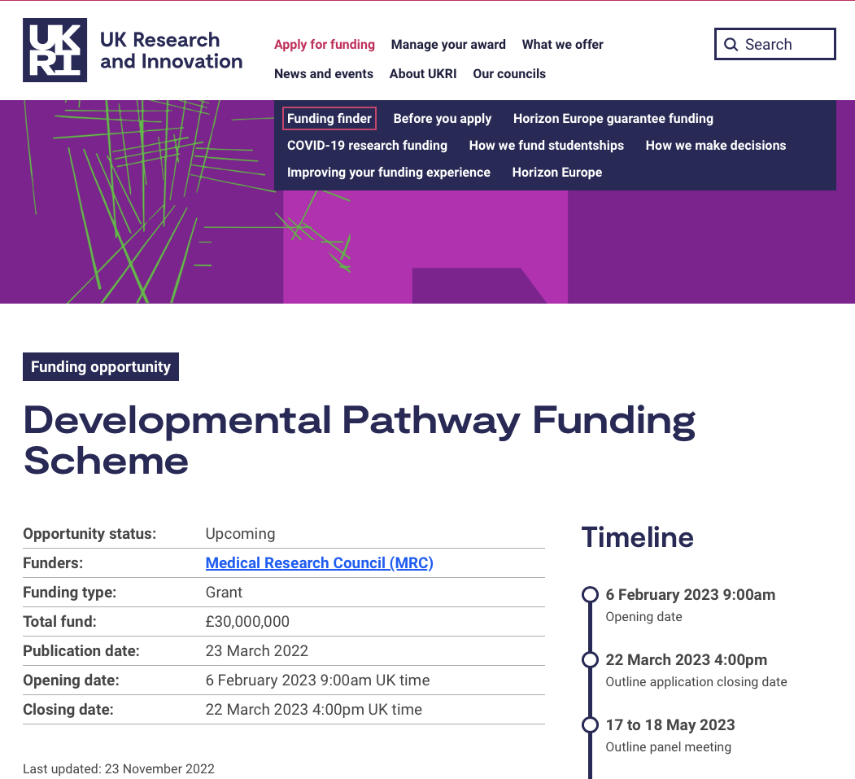
MRC: Developmental Pathway Funding Scheme
“Radiobiology linked with LhARA”
Structure of bid now agreed
  Biology of ionizing-radiation/tissue interaction
  Comparison of conventional and novel (FLASH, MBRT, laser-driven, …)
  Three work packages
More details J. Parsons

