Slide 1
News/Update
Breaking news:
General LhARA abstract and ion-acoustic abstract accepted at IPAC’23

Slide 2
Some progress, but,
Needing to push on this now!
https://ccap.hep.ph.ic.ac.uk/trac/raw-attachment/wiki/Research/LhARA/Documentation/TN/Governance/LhARA-Gov-Rev-2022-01.pdf

Slide 3
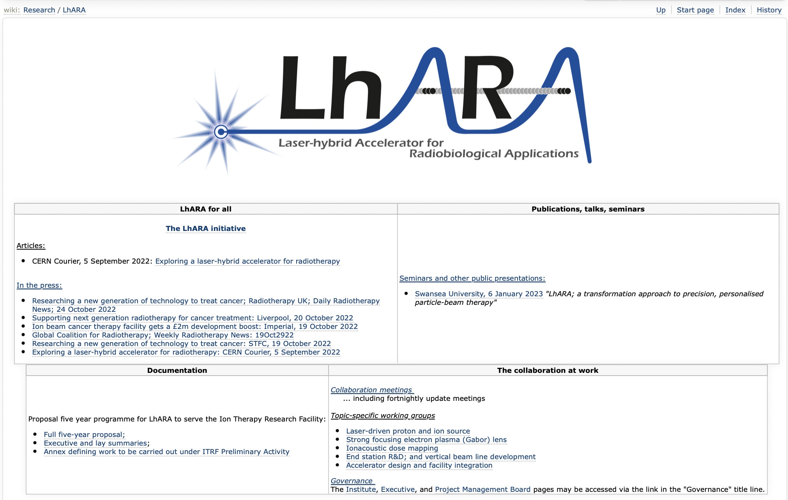
Reorganisation/streamlining of wiki in continues …

Slide 4
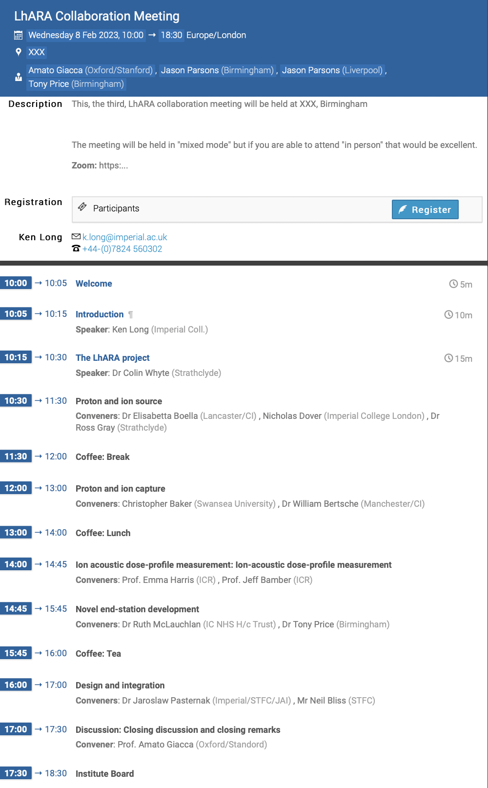
Collaboration meeting #3; Birmingham
CM Brm 08Feb23
Hosts: Tony and Jason
Registration open:
  Will send reminder …
Great if you can attend “in person”;
patient representatives have access to
travel support; rules as usual for universities

Slide 5
STFC accelerator consortia call
Call for R&D, not for projects
How can we contribute and benefit?
  Negotiating:
    Contribution to laser-acceleration consortium:
      Ion production (QUB, …)
      Proton & ion capture (Swansea, Manch/CI, …)
    Contribution to muon consortium:
      Fixed field accelerator
    Sustainable accelerators consortium:
      Normal conducting magnet option analysis; at least for Stage 1
Update:
  Brokered a meeting of interested parties, 10Feb
  Will prepare

Slide 6
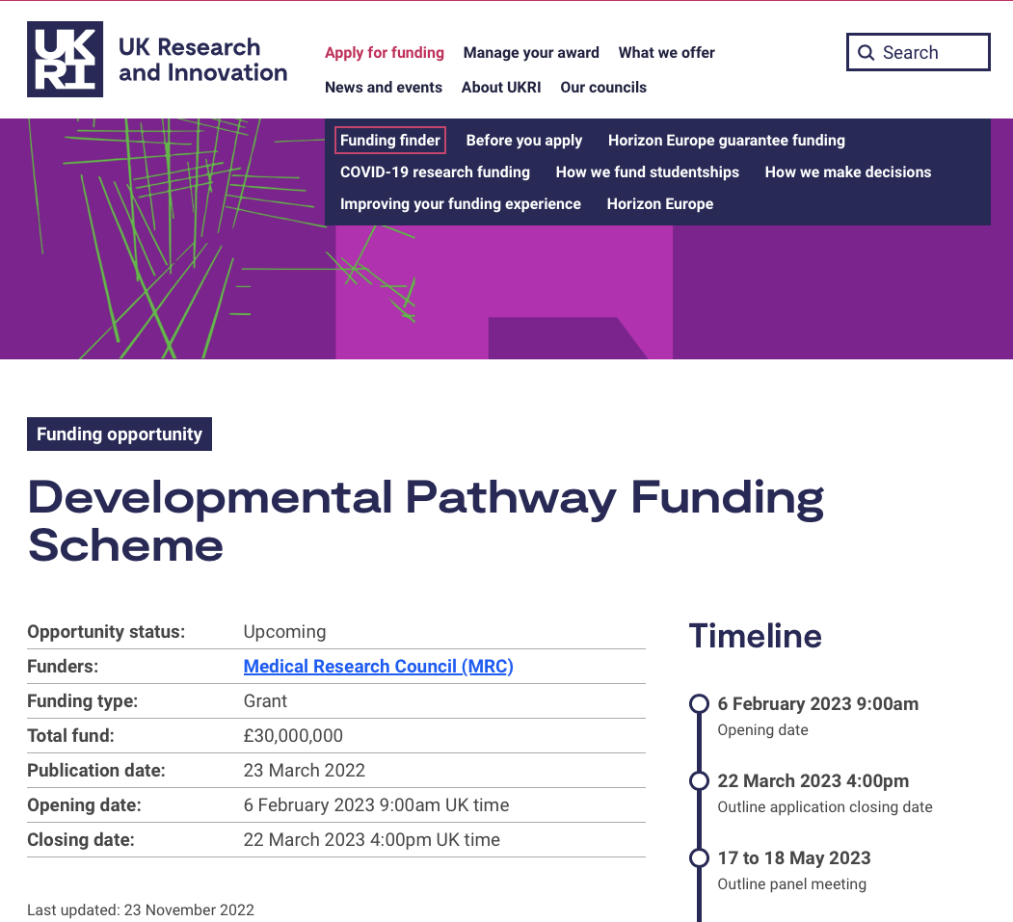
MRC: Developmental Pathway Funding Scheme
Amato/Jason leading,
initial meeting to discuss on
Thursday this week

