Slide 1
News/Update

Slide 2
https://ccap.hep.ph.ic.ac.uk/trac/raw-attachment/wiki/Research/LhARA/Documentation/TN/Governance/LhARA-Gov-Rev-2022-01.pdf

Slide 3
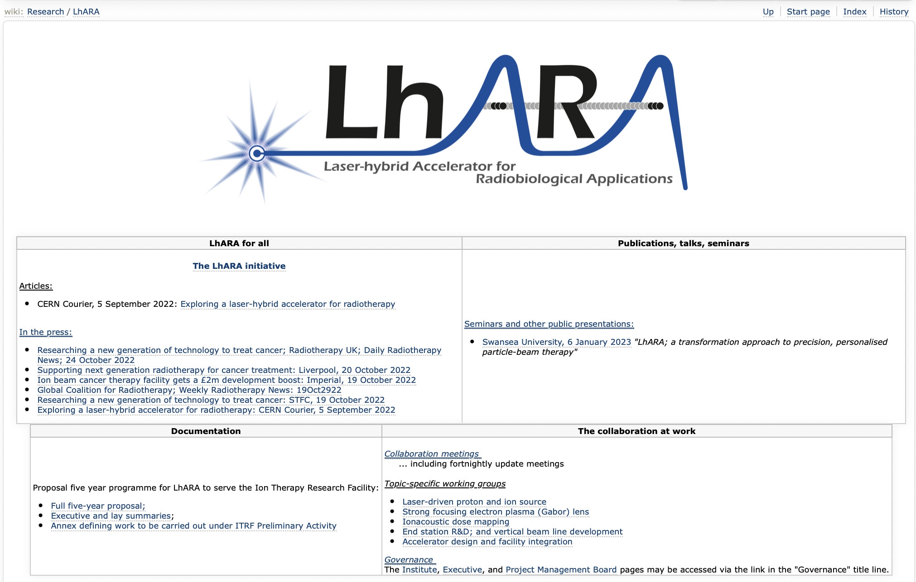
Reorganisation/streamlining of wiki in continues …

Slide 4
STFC accelerator consortia call
Call for R&D, not for projects
How can we contribute and benefit?
  Negotiating:
    Contribution to laser-acceleration consortium:
      Ion production (QUB, …)
      Proton & ion capture (Swansea, Manch/CI, …)
    Contribution to muon consortium:
      Fixed field accelerator
    Sustainable accelerators consortium:
      Normal conducting magnet option analysis; at least for Stage 1
Will continue to update as process evolves

Slide 5
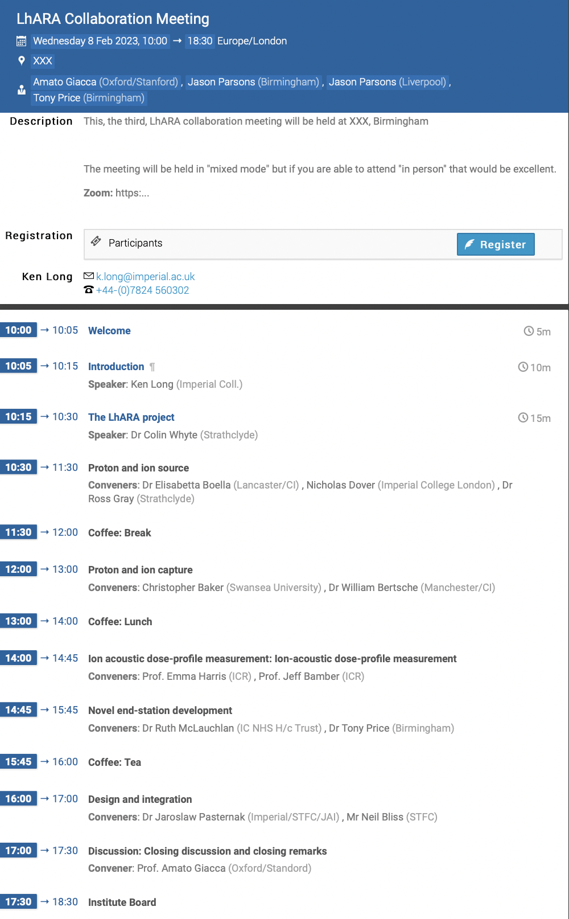
Collaboration meeting #3; Birmingham
CM Brm 08Feb23
Hosts: Tony and Jason
Registration open:
  Will send announcement …

