Slide 1

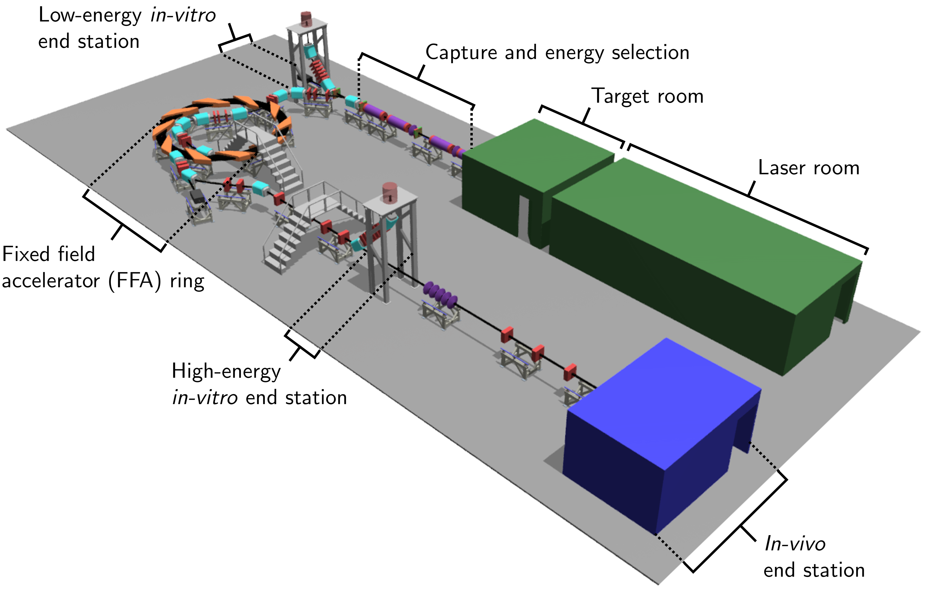
LhARA - Project organisation
WP1 – Project management
WP2 – Laser Driven proton and ion source
WP3 – Proton and Ion Capture
WP4 – Real-time dose-deposition profiling
WP5 – End station development & Instrumentation
WP6 – Facility design and integration

Slide 2
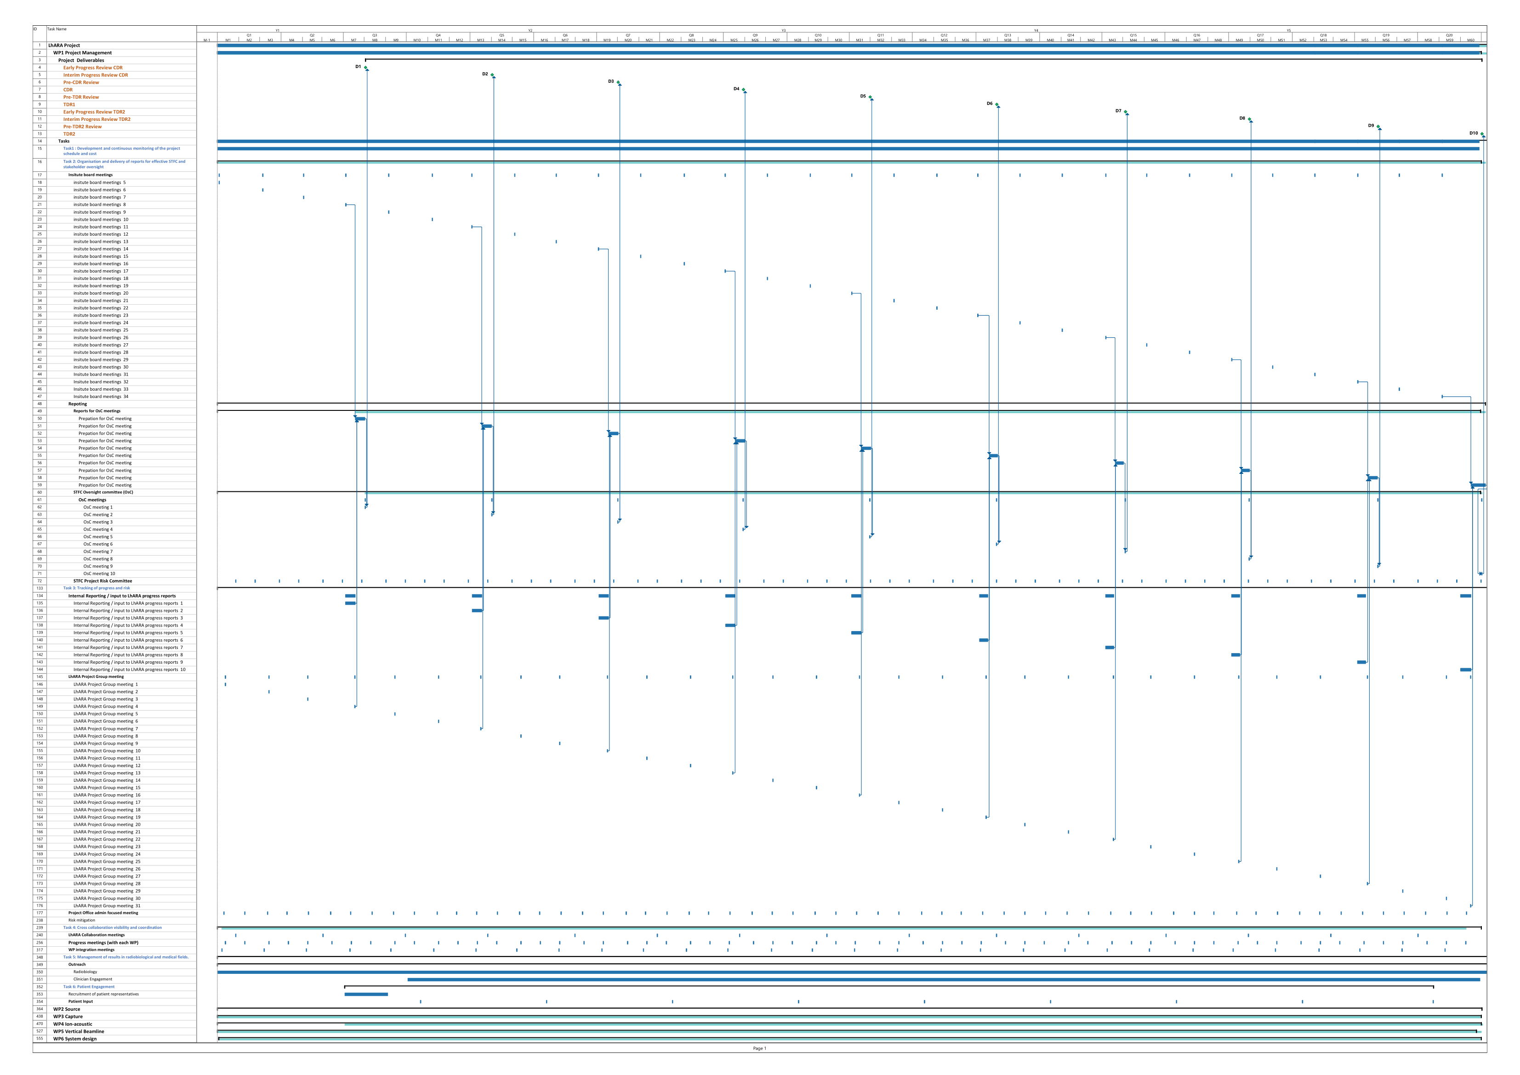
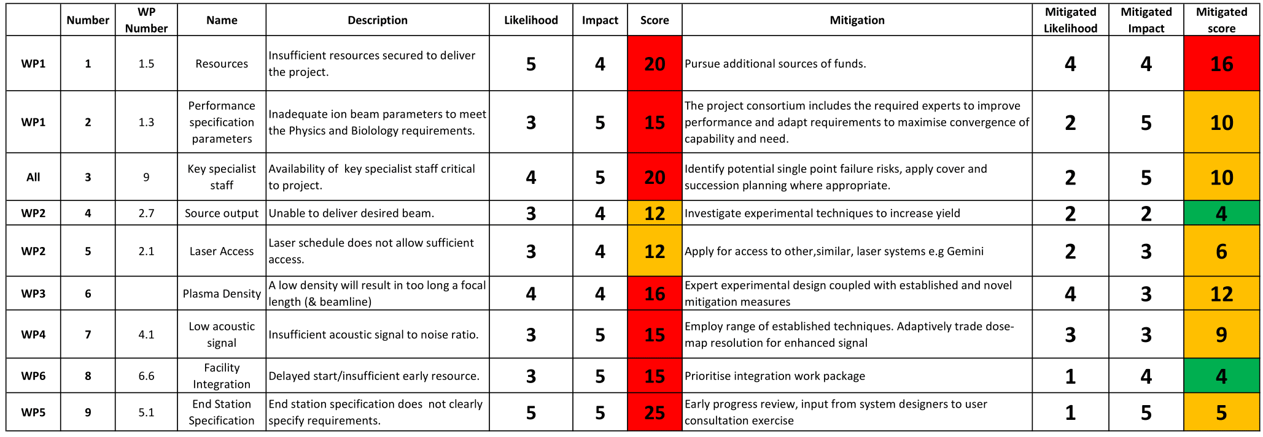
Project management
All the boring but essential planning and organisation, but also..
Engagement and outreach:
Stakeholder
Peer group
User community
Public
Patient
Diversification of LhARA funding

Slide 3
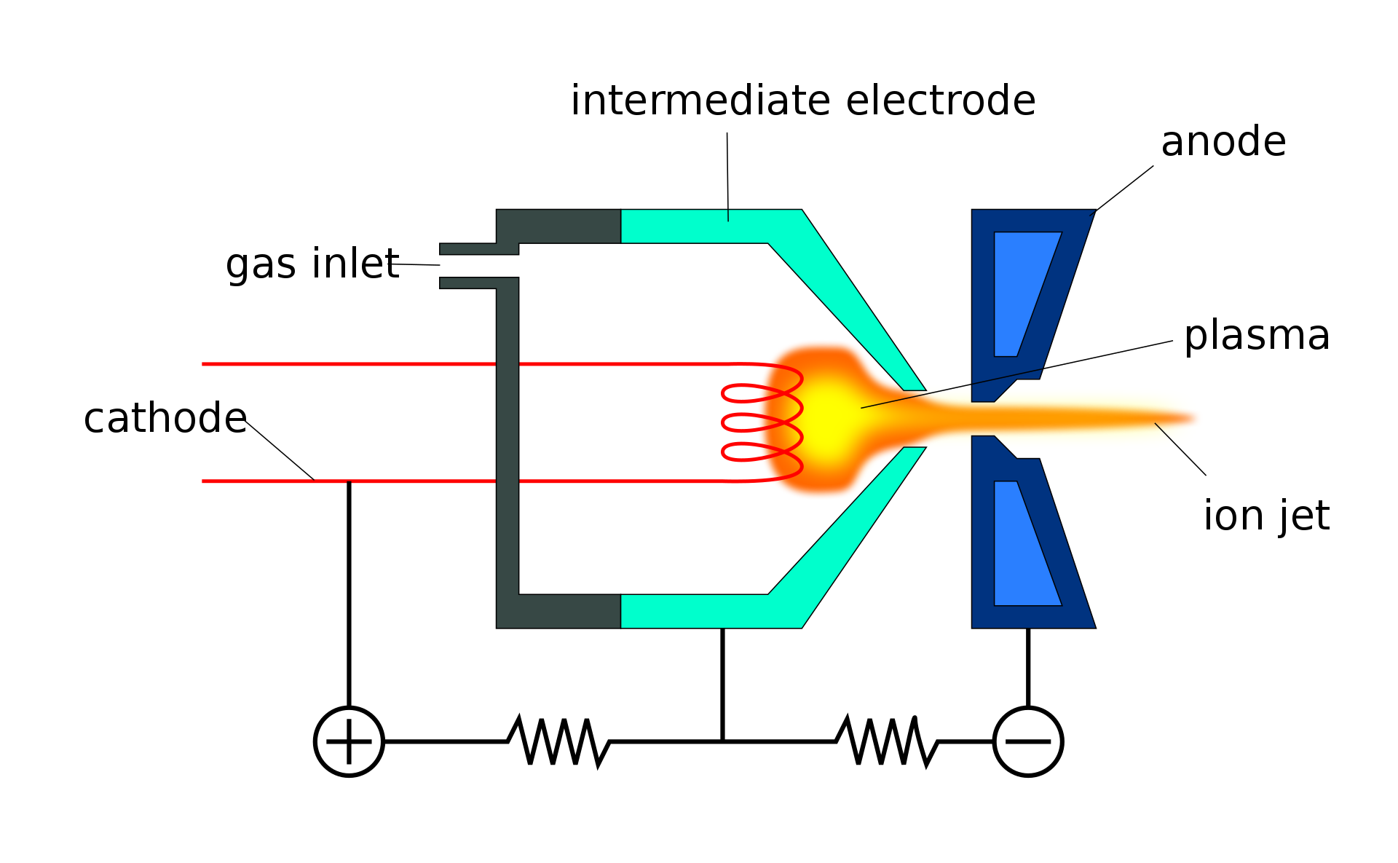
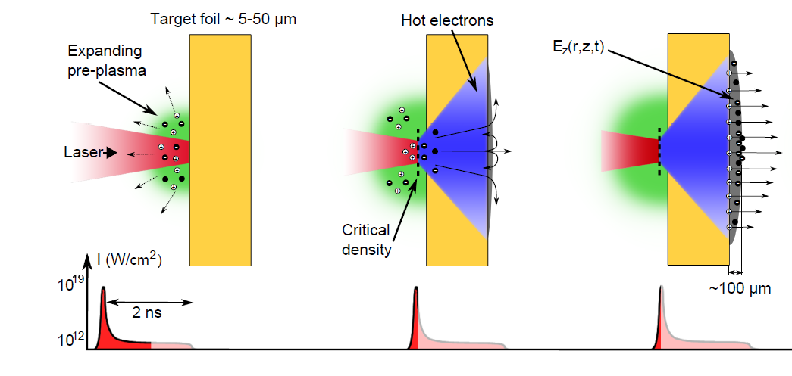
Ion production space charge
Ions experience the electric field due to their neighbours – space charge – and repel each other.
Effect is worst when ions have low energy – faster acceleration = better beam.
Conventional ion sources extract ions with energies of a few 10’s of keV and accelerate that beam over several m.
Laser-target system accelerates ions to MeV energies over distance of 100’s of μm – space charge effect is much reduced.
Duoplasmatron – source Evan Mason 7/7/16

Slide 4
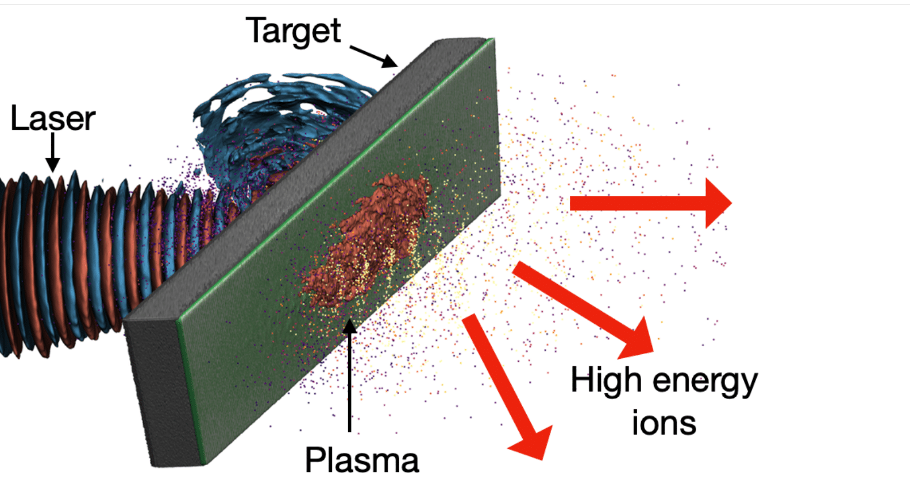
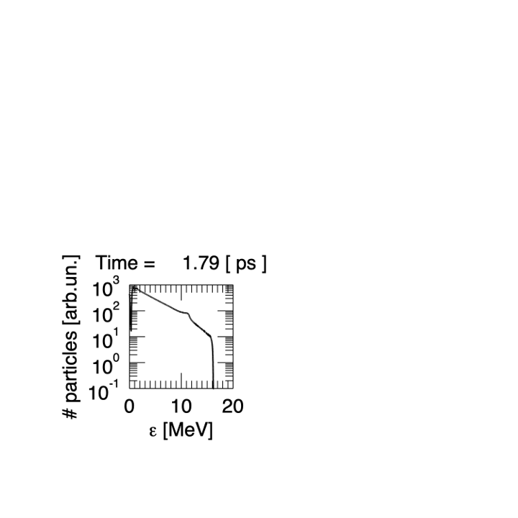
WP Laser Driven proton and ion source

Slide 5
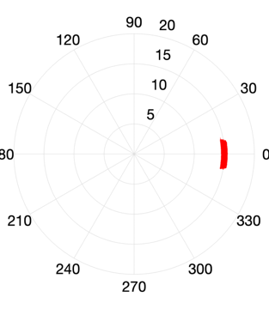
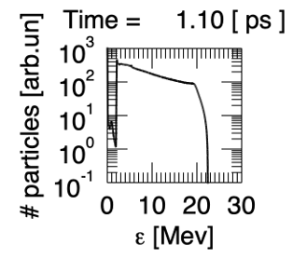
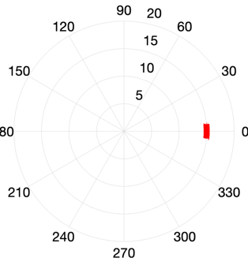
4 Objectives
Simulation
Scapa
Diagnostics
Tests
High rate tests

Slide 6
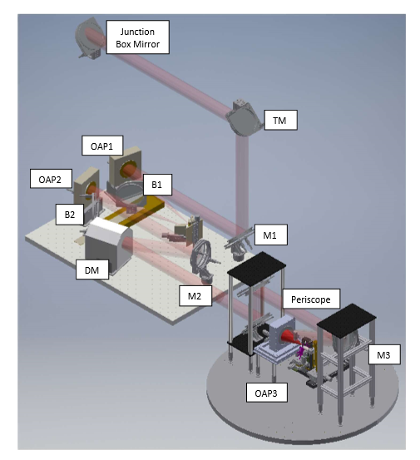
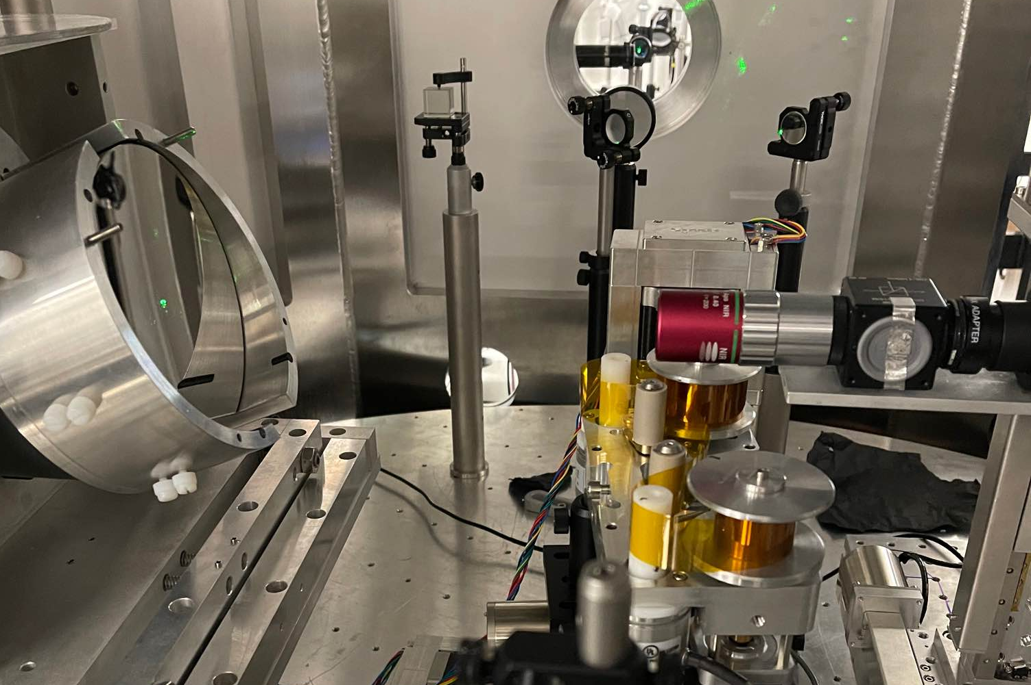
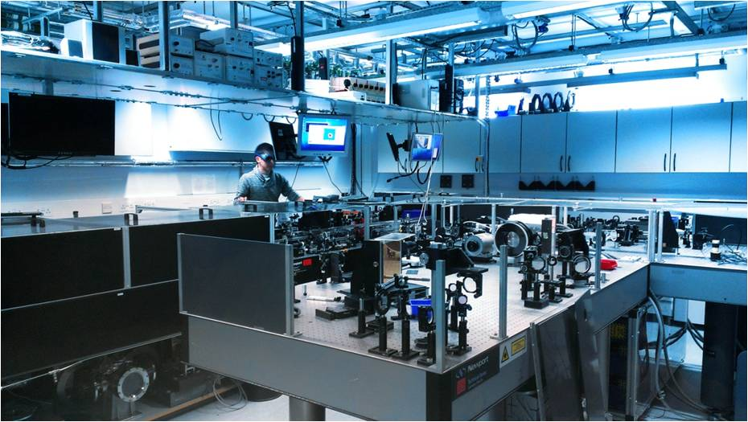
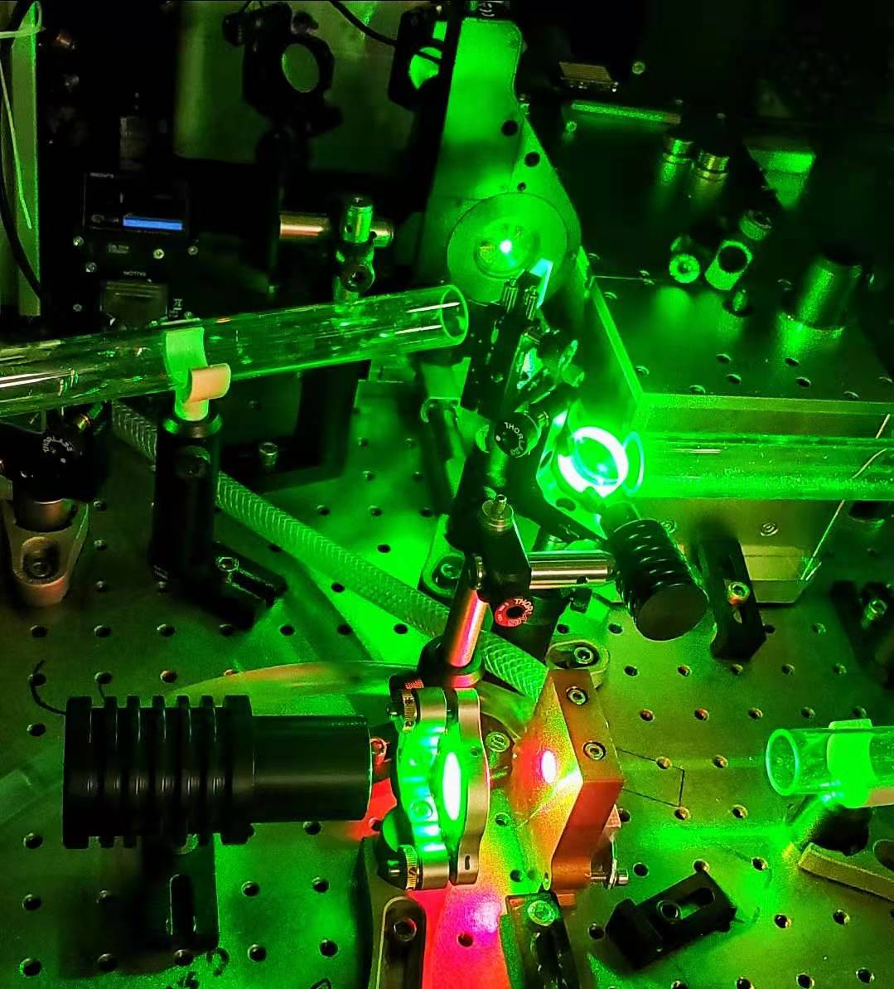
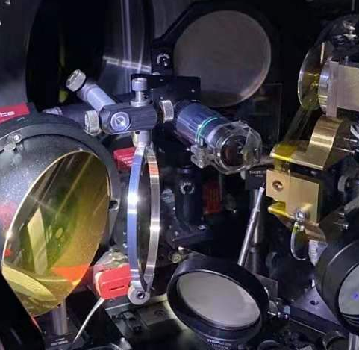
SCAPA
Cerberus
Zhi

Slide 7
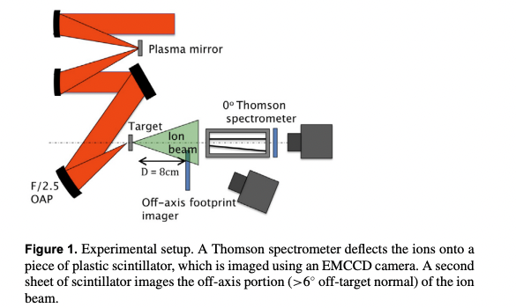
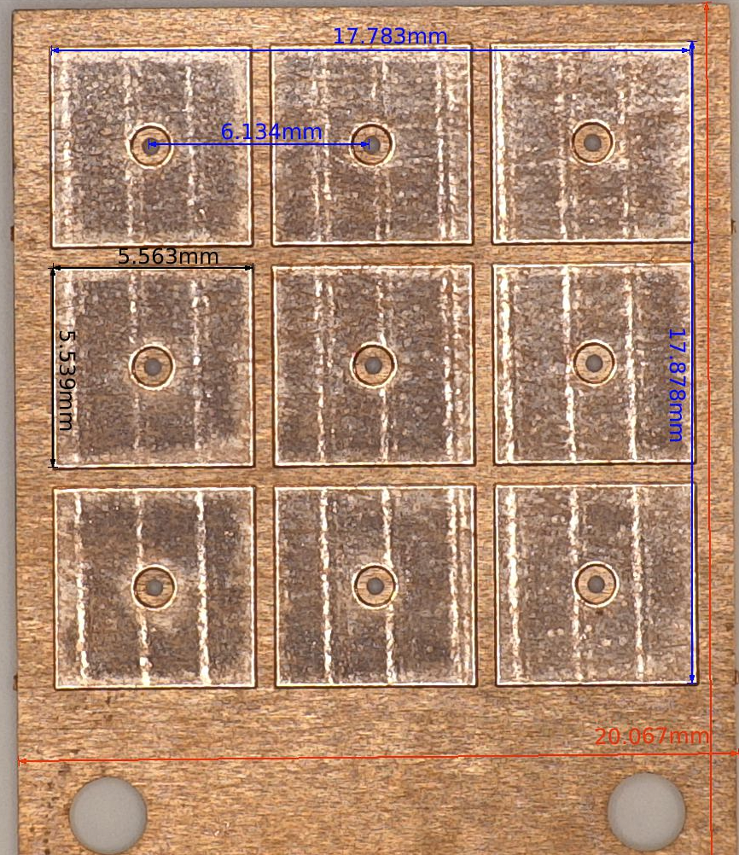
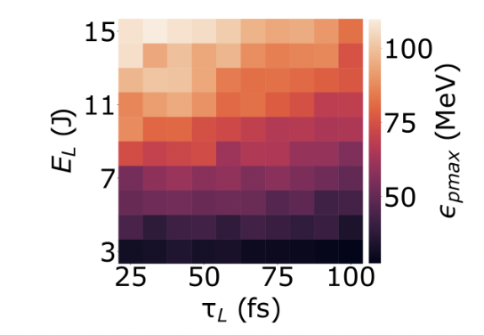
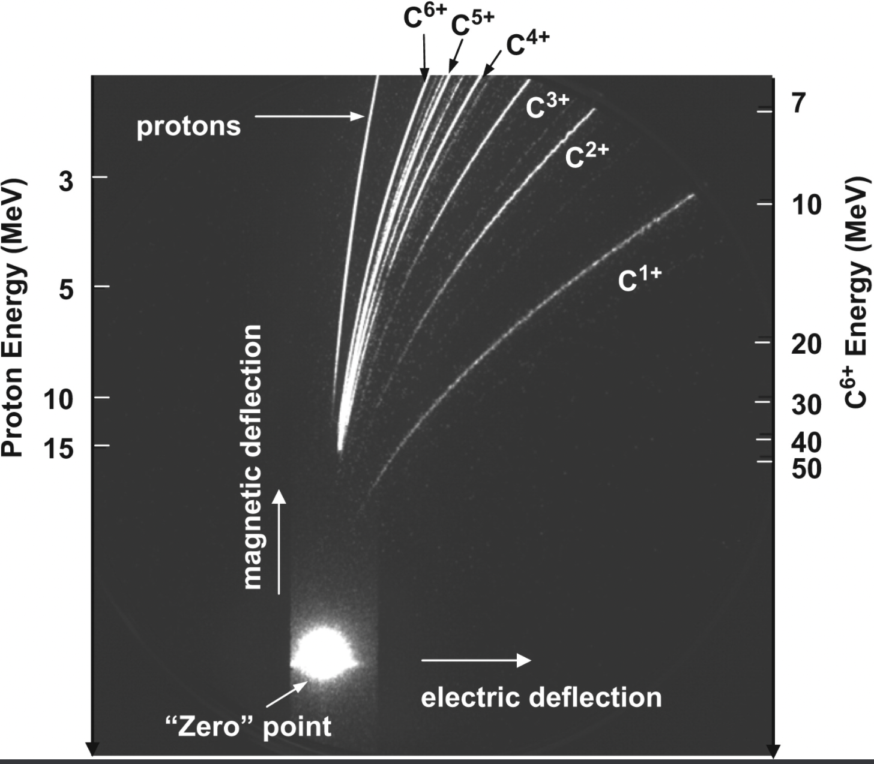
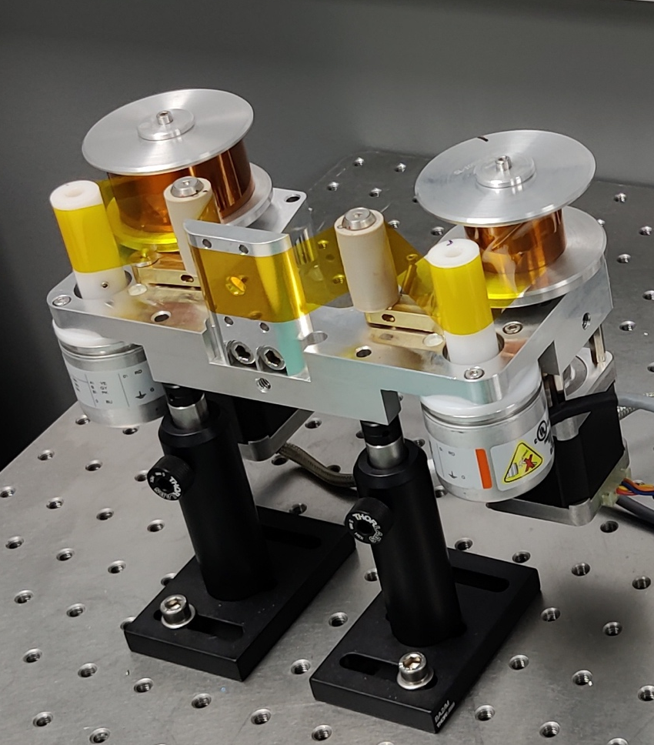
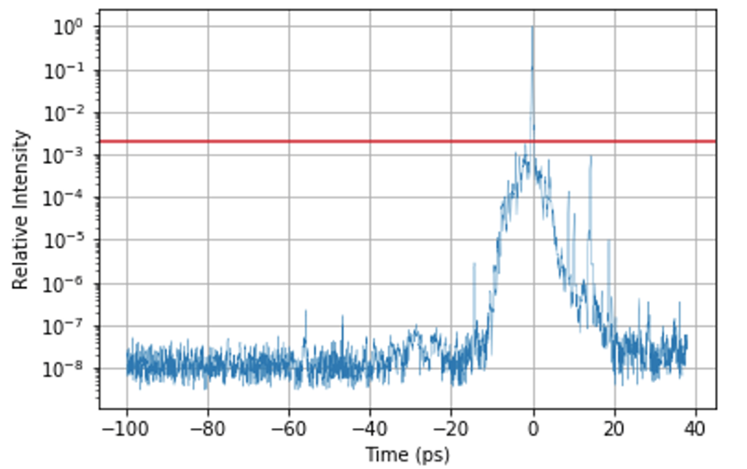
Experiments & Technology Development in 2-year Programme: Characterising Source and Benchmarking Simulations
Established Diagnostics…
Established Targetry…moving toward Hz-level targetry
….to build a systematic parameter space map of the source performance
Energy, Flux, Divergence across multiple ion species
Typical 9-target array
J.S Green et al., NJP. 12 (2010) 085012
..but also need to consider some other experimental contributions like temporal contrast
R. Prasad et al., Nucl. Instrum. Methods. 623.2 (2010): 712-715.
Tape targetry system (online in SCAPA 2022)

Slide 8
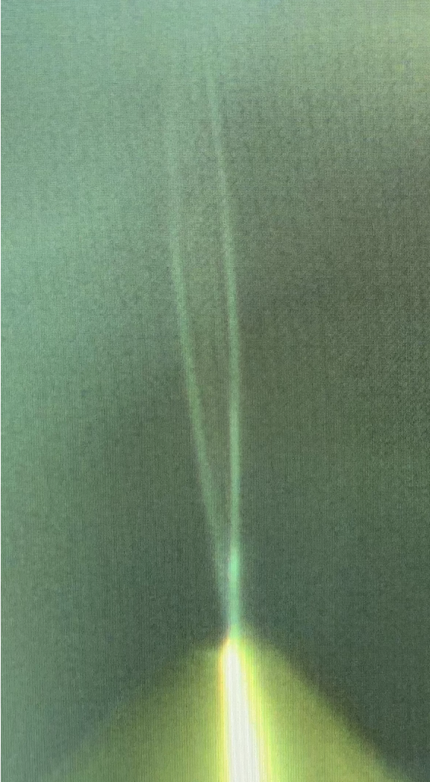
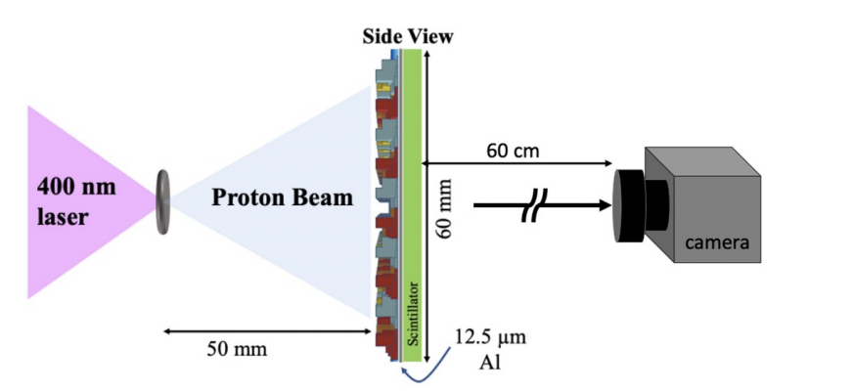
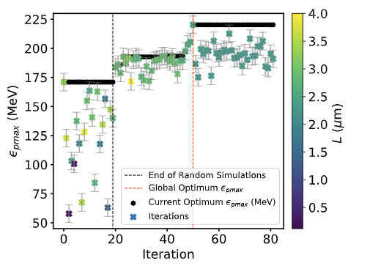
Experiments & Technology Development in 3-year Programme: Producing a stable, high-rep source
Novel Liquid Targetry
Advanced Particle & Laser Diagnostics
ML/AI Control & Optimisation
D. Marsical et al. , Plasma Phys. Control. Fusion 63 (2021) 114003
Courtesy of C. Palmer
Application of ML techniques (e.g Bayesian Optimisation) for parameter space
Application of AI techniques (DNNs, CNNs) for system control and virtual diagnostics
Reduces production of debris
Increases operational time and possible rep rate
Implementation of advanced (existing) particle diagnostics, taking account of long term operation.
Implementation of full laser diagnostic suite to support automation, stabilisation.

Slide 9
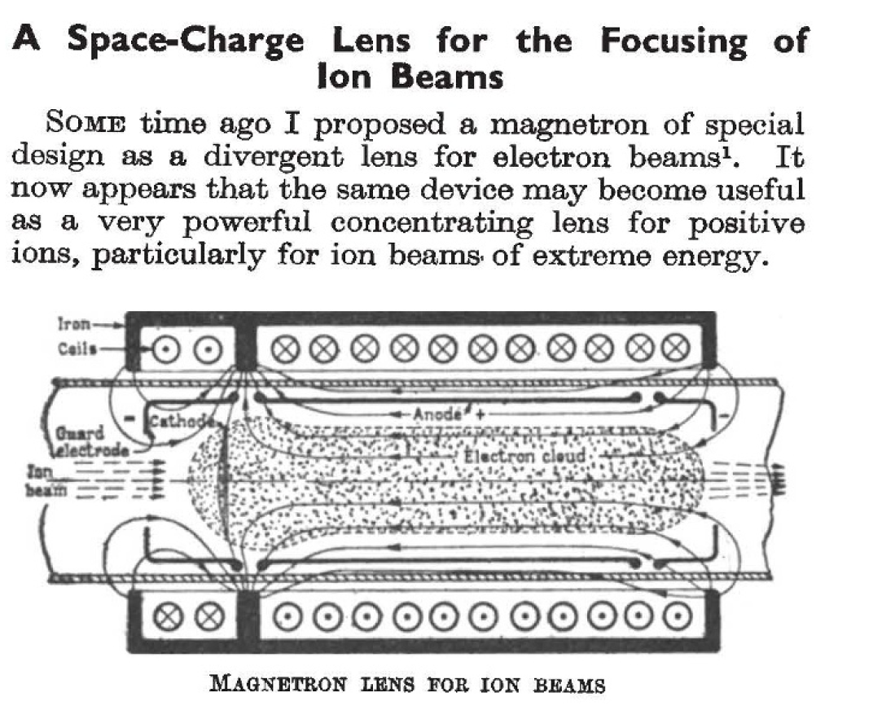
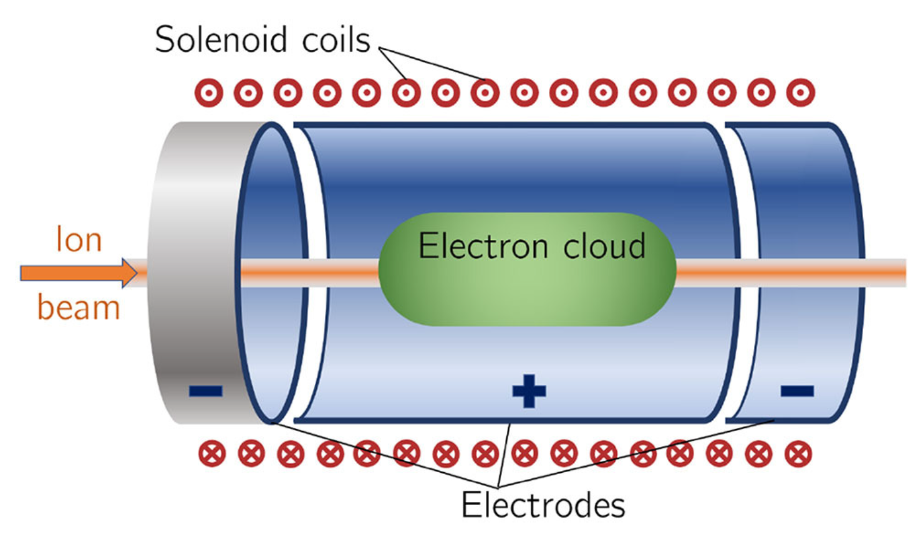
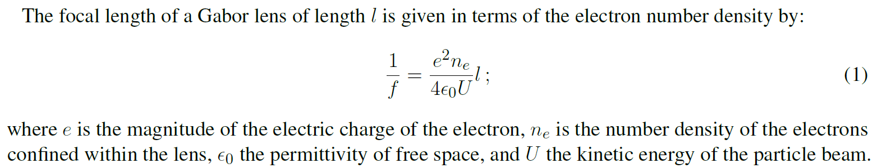
WP3 - Proton and Ion Capture Gabor lens
Plasma
E_{r}
doi: 10.1038/160089b0
doi: 10.3389/fphy.2020.567738
Notes:
Little Gabor detail to be given.
Non-neutral plasma confined by electric and magnetic fields.
Non-neutral plasma generates radial electric field, which focuses ion beam.
Focal length a function of plasma parameters (& ion beam)

Slide 10
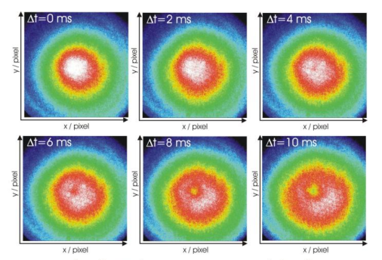
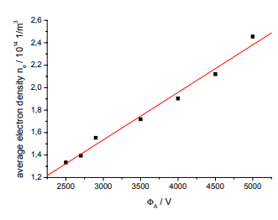
Stability Density
Objectives.
Initial experiments – establish stable high ‘fill factor’ plasmas
Phase 2. New apparatus to access higher densities - Tests at SCAPA

Slide 11



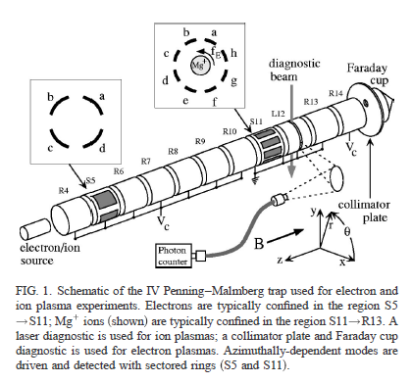
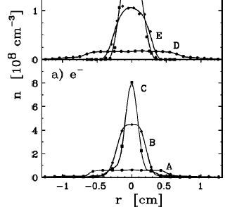
Rw = 2.86cm
(Rp/Rw < 0.2)
10¹⁴ – 10¹⁵ m⁻³
Notes:
Lower densities (10^14 m^-3), and <20% fill factors, but stored for ‘weeks’. Tesla level fields. 5-20cm length.

Slide 12
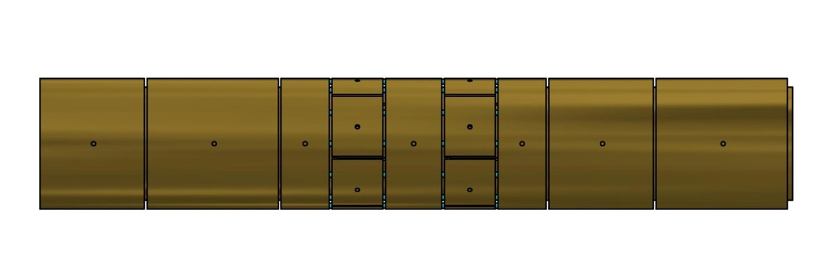
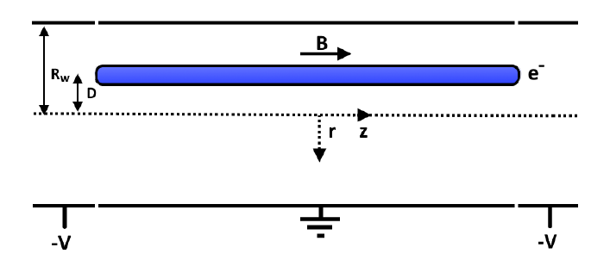
Storage trap assembly - current
1 mm
Two, 6-way segmented electrodes
4.1 cm
28.1 cm
For Example:
Monitor azimuthal image charge induced on 1 segment
Monitor axial image charge induced on 1 ring electrode
Notes:
As currently installed the electrode configurations is as shown (to scale).

Slide 13
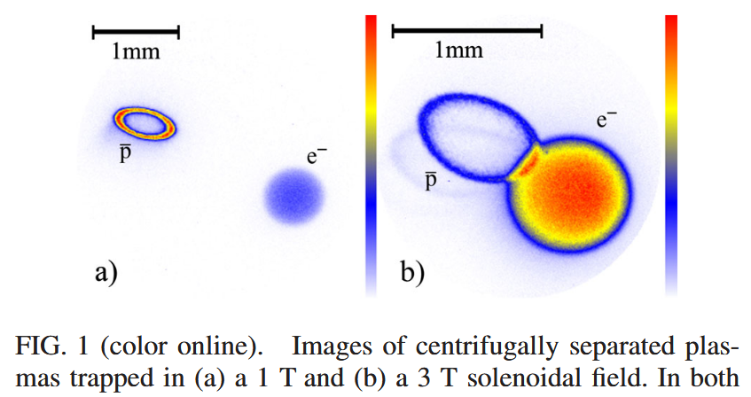
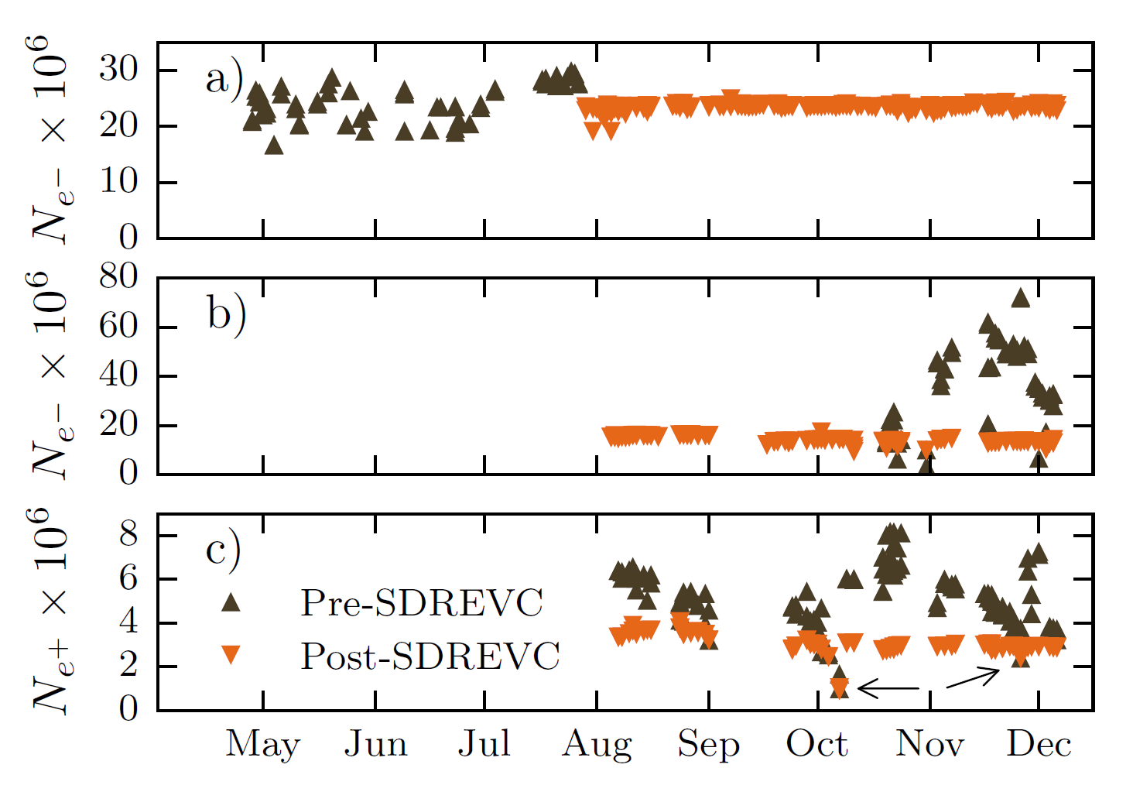
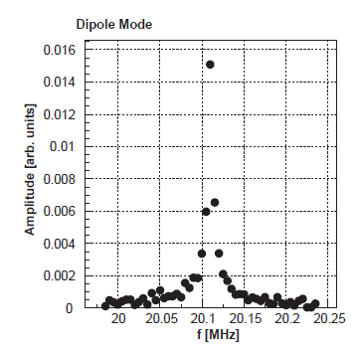
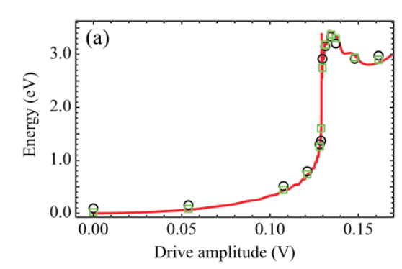
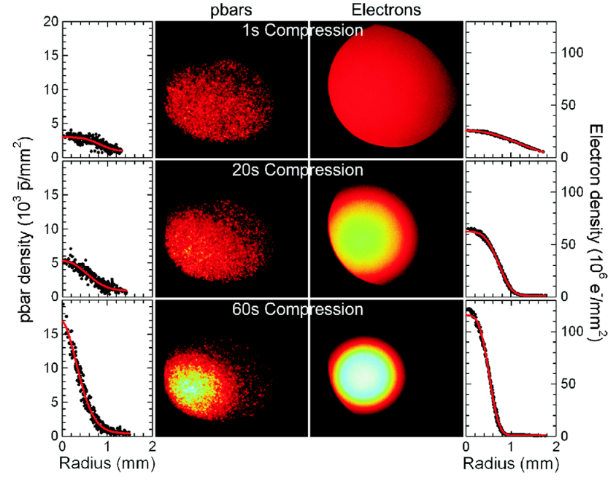

Plasma in ALPHA for $\overline{\text{H}}$ production
E-field & large radius deleterious
  Low density
  Small radius
Experimental diagnosis
  MCP imaging
  Mode analysis
Modelling
Manipulation techniques
  Cooling (evaporative)
  Rotating wall
  Feedback/damping
doi: 10.1103/PhysRevLett.120.025001 doi: 10.1016/j.nima.2003.09.052
doi: 10.1063/1.4801067 doi: 10.1103/PhysRevLett.106.145001
doi: 10.1103/PhysRevLett.100.203401
Notes:
ALPHA want’s near axis particles/plasma with low fields/energies.
Opposite to Gabor lens but control & understanding is is critical to achieving success
Heavily diagnosed experiment with powerful e.g. MCP imaging & modes analysis of trapped plasma
Experimental diagnosis backed up with theory & computational modelling
These diagnosis have enabled manipulation techniques to be implemented – such as RW (see plasma density increases) & SDREVC (notice reproducibility of plasma)
Significantly improving study of systematics & subsequent improvements

Slide 14
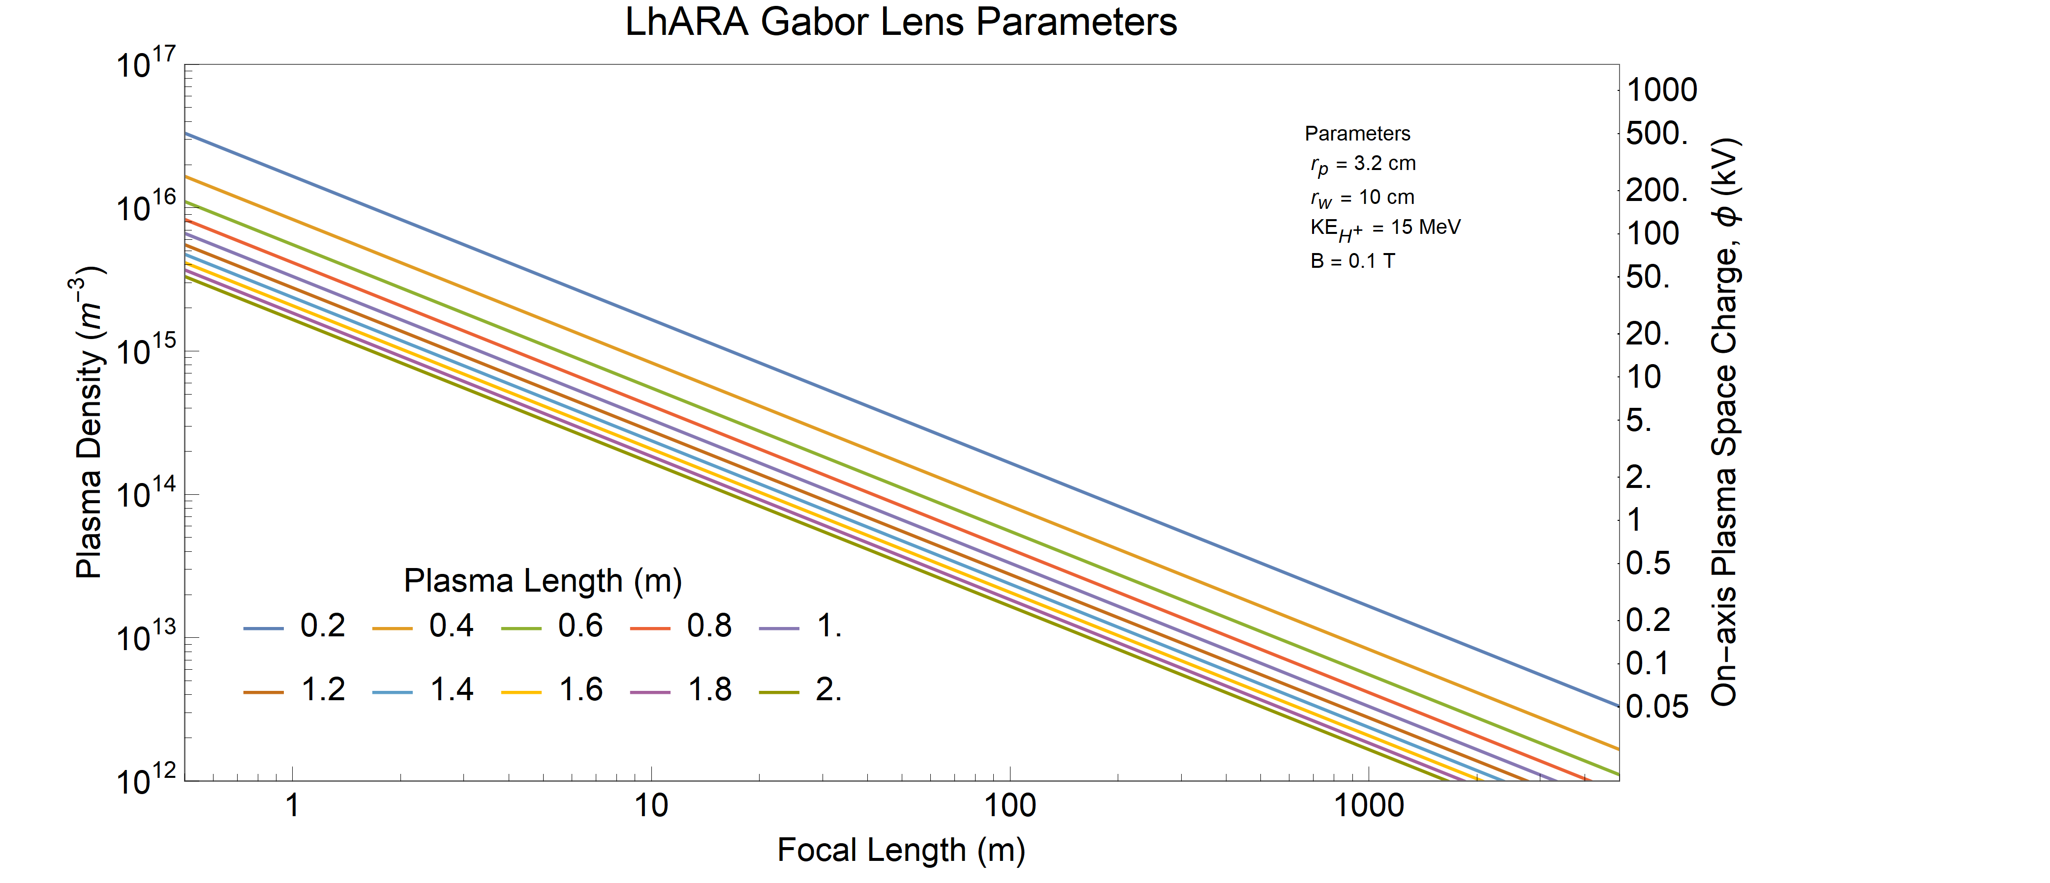
Year 5 milestone
Current
Year 2
Year 5
Final
Notes:
End of 5th year milestone is to have studied plasma that have focal lengths of a few metres, comparable to many of the lens elements.
Know which 1-2 parameters need to be improved by x2 to reach final ~1m focal length lens. This is opposed to the decades improvement of many parameters needed to reach here.

Slide 15
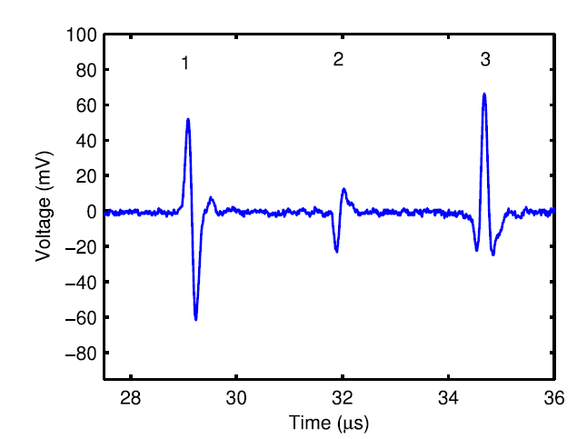
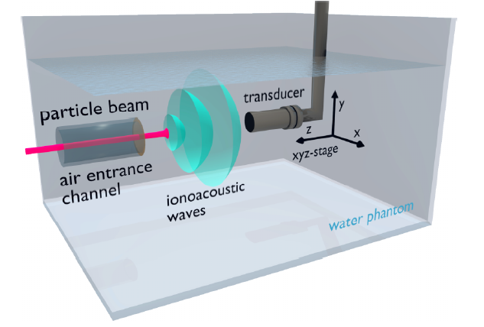
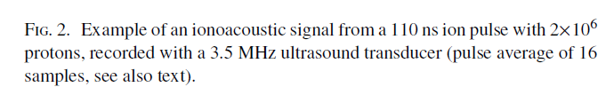
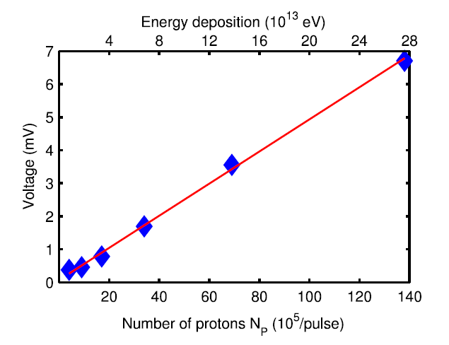
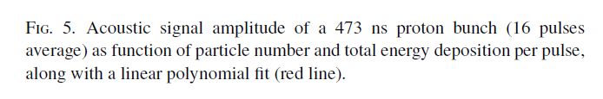
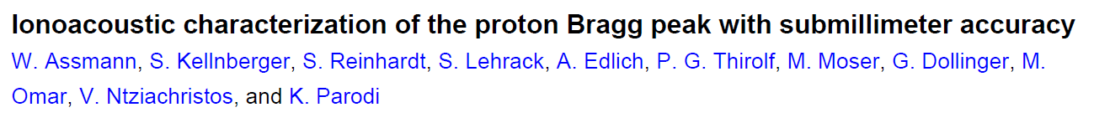
Ion Acoustic Dose Mapping
Is it possible to get the deposited dose using acoustic measurements ?
Compatibility with medical ultrasound and possibility of use in vivo

Slide 16
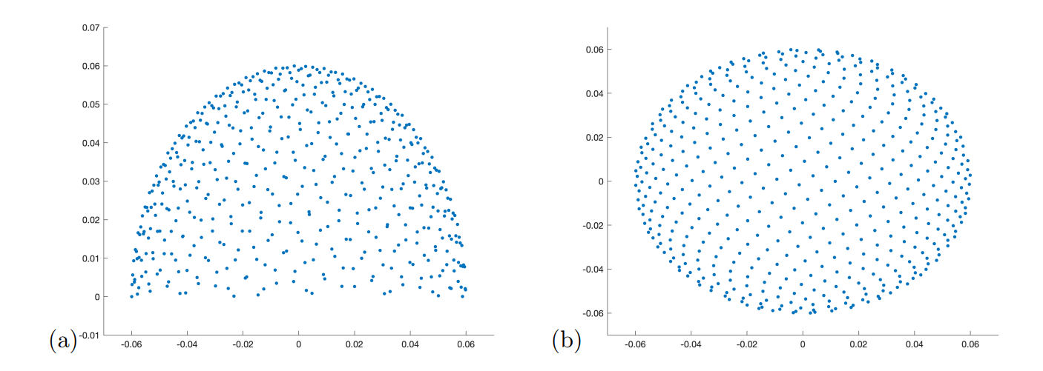
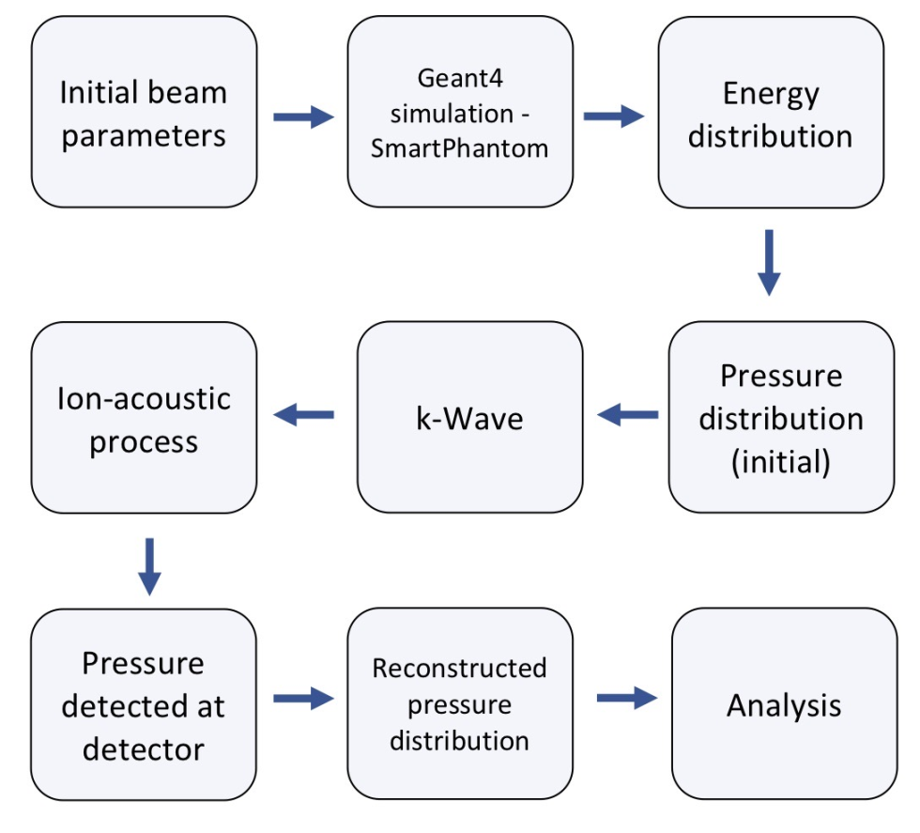
Ion Acoustic imaging
Time reversal
Model based minimisation
Back projection

Slide 17
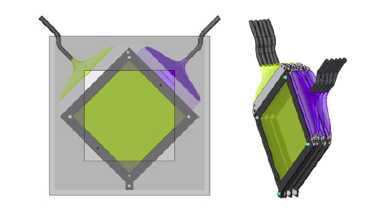
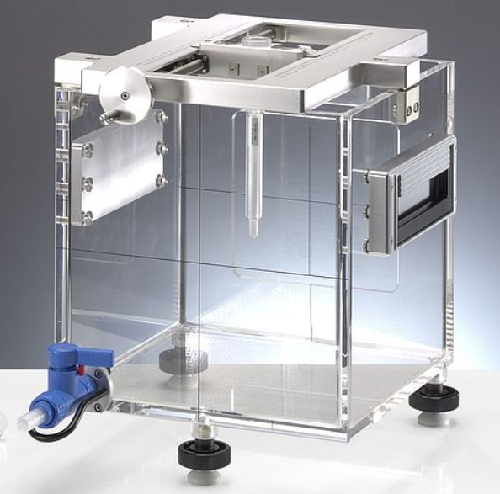


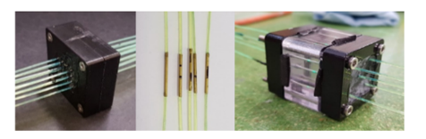
The SmartPhantom
Aim is to compare measurements:
proton acoustic
scintillating fibre
dosimetry
Compare measurements & simulations:
protons in water (GEANT4)
protons in detectors (GEANT4)
acoustic signals (k-Wave)
Beam is measured using scintillating fibre planes
Scintillating fibre -> clear fibre -> detector
Aiming to use the edge of the plane as a connector
Clear fibres bundled and sent to CMOS camera
For faster readout, could use photodiodes
Water-filled phantom useful for protons, few 10s of MeV up
SmartPhantom is a tool go on the endstations, to compare simulations of beam interactions with experiment
www.ptwdosimetry.com
http://www.k-wave.org/
https://geant4.web.cern.ch/
From: Medical Applications for Particle Physics (PhD Thesis), H.T.Lau, Imperial College (2021)
Methods of joining fibres – Jeff Sykora, ISIS

Slide 18

WP5 – End station development & Instrumentation

Slide 19

User engagement – Peer group consultation.
Automated Handling
Controlled atmosphere
Acoustic Imaging
Cellular imaging
In-vivo irradiation
MC40 cyclotron operation for testing and de-risking.
Beamline instrumentation
Gas jet beam profiler.
Dosimetry verification

Slide 20
WP6 – Facility design and integration

Slide 22


Facility – planning - development
Ion therapy Research Facility ITRF
£2M budget, of which
£1.5M LhARA – as presented
£500k Facility Engineering plus alternative technologies. 3.35FTE: Mechanical, Electrical, Controls, Tech Services, Vacuum, Radiation Protection

Slide 23


