Slide 1
LION Update
12/02/26

Slide 2
Plan Outlined
Optimise for shifts and tilts using Bayesian Optimisation
Generate a realistic Quadrupole Field in FEMM
Obtain a full understanding of the effects of both shifts and tilts, and a realistic quad field
Use a combination to create the RCF seen in experiment at LION
Use the output of that beam in Maria’s simulations

Slide 3







Experimental RCF

Slide 4







Default Beamline RCF

Slide 5
Bayesian Optimisation
Ran 5 independent searches with 500 iterations each
Searching over a 12D search space
Running 1e5 particles in each simulation took about a week

Slide 6
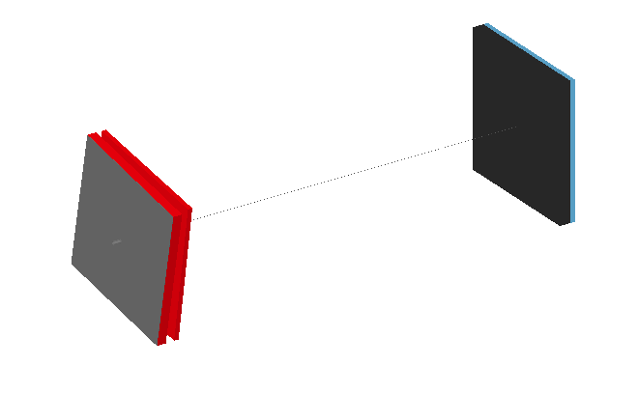
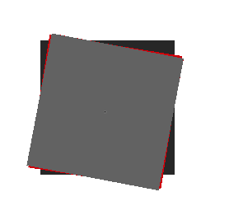
Optimal Shifts and Tilts
X₁: 7um
Y₁: 26um
Z₁:-4mm
RotX₁: -182urad
RotY₁: 197urad
RotZ₁: 188mrad
X₂: -29um
Y₂: 23um
Z₂:-5mm
RotX₂: 156urad
RotY₂: 136urad
RotZ₂: 159mrad

Slide 7







Optimal Shifts and Tilts RCF

Slide 16
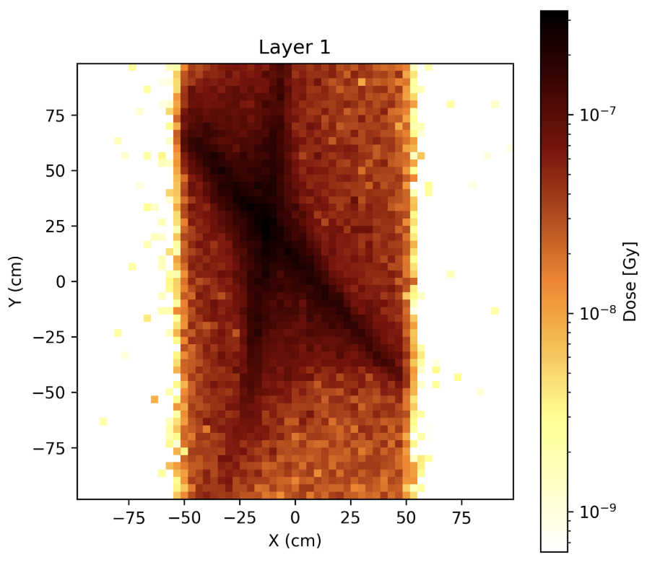
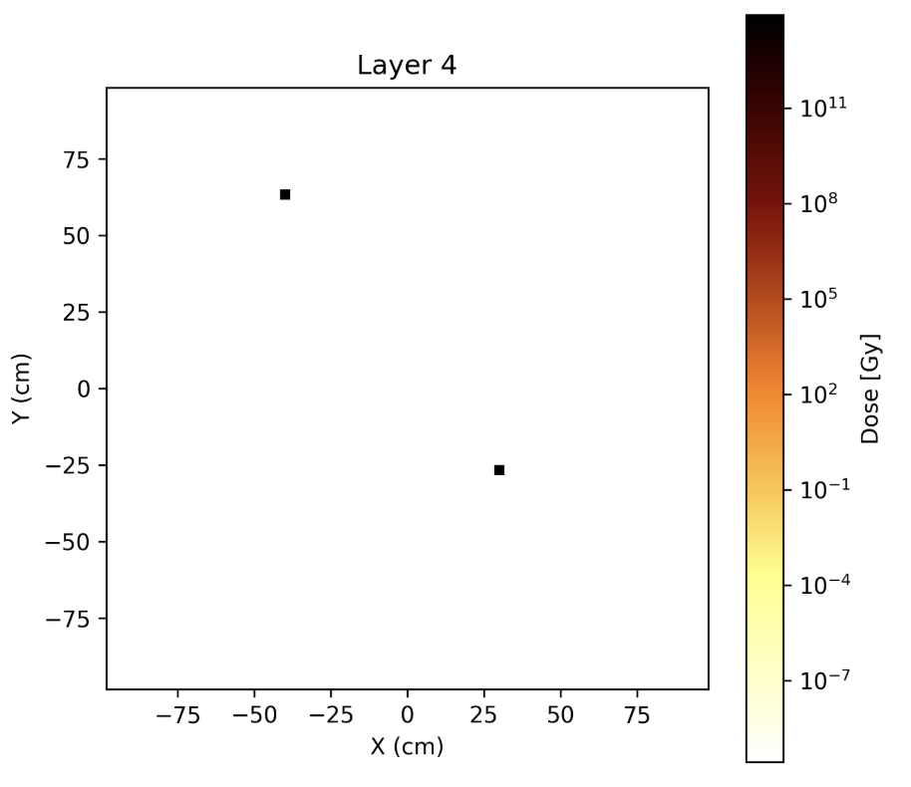
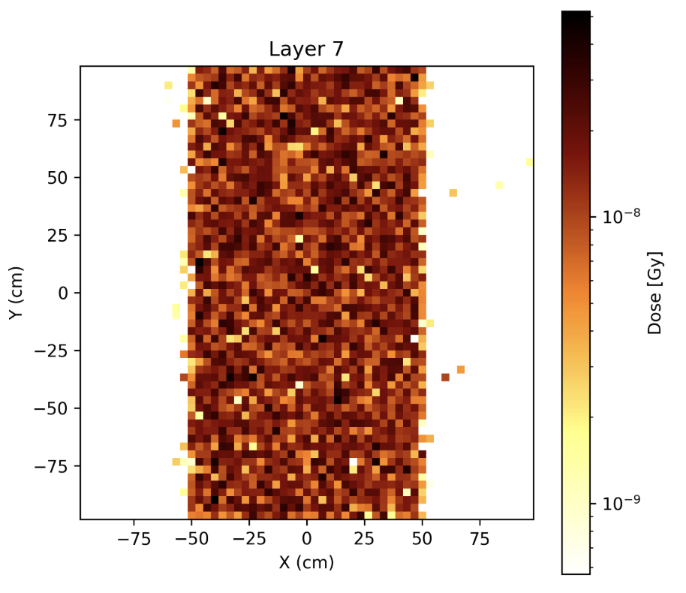

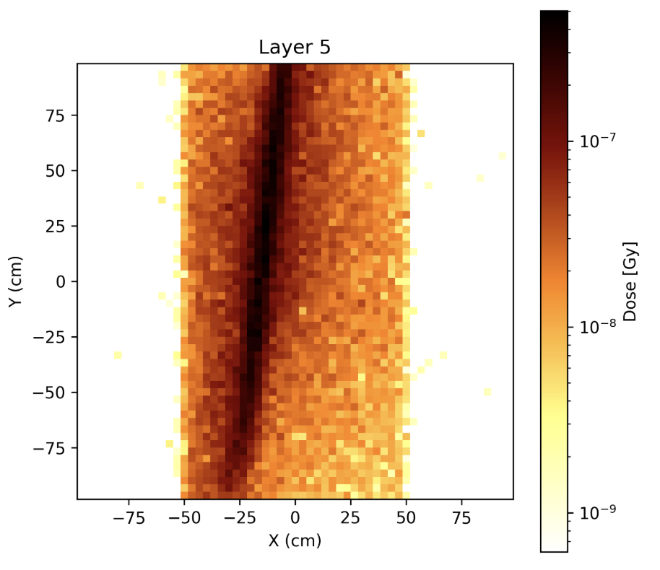
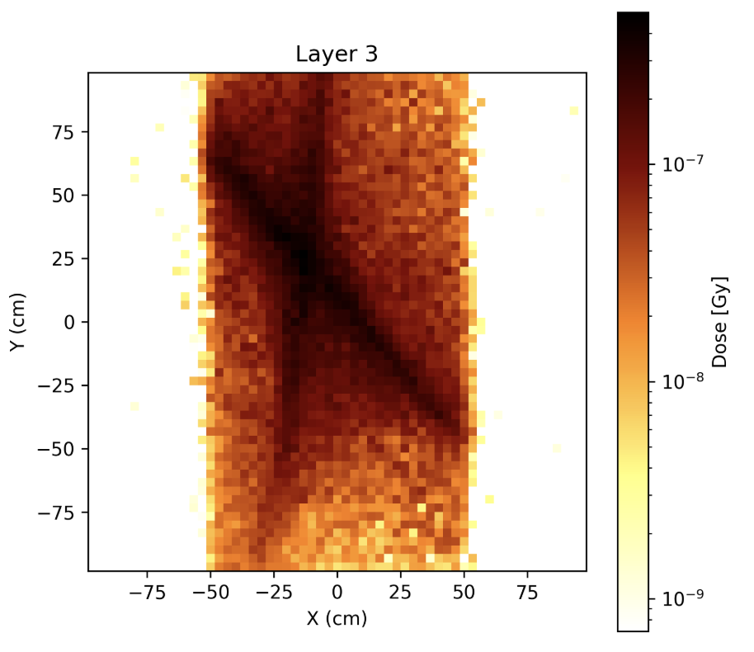
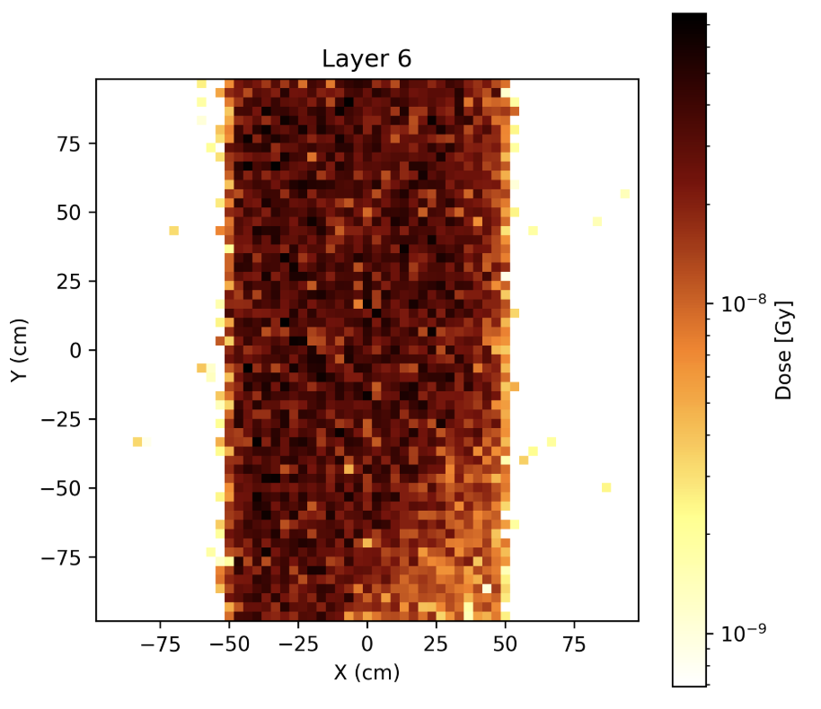
Verify BDSim (Effect of Scattering)
LLO
BDSim
LLO
BDSim
LLO
BDSim

Slide 17
FEMM Field

Slide 18
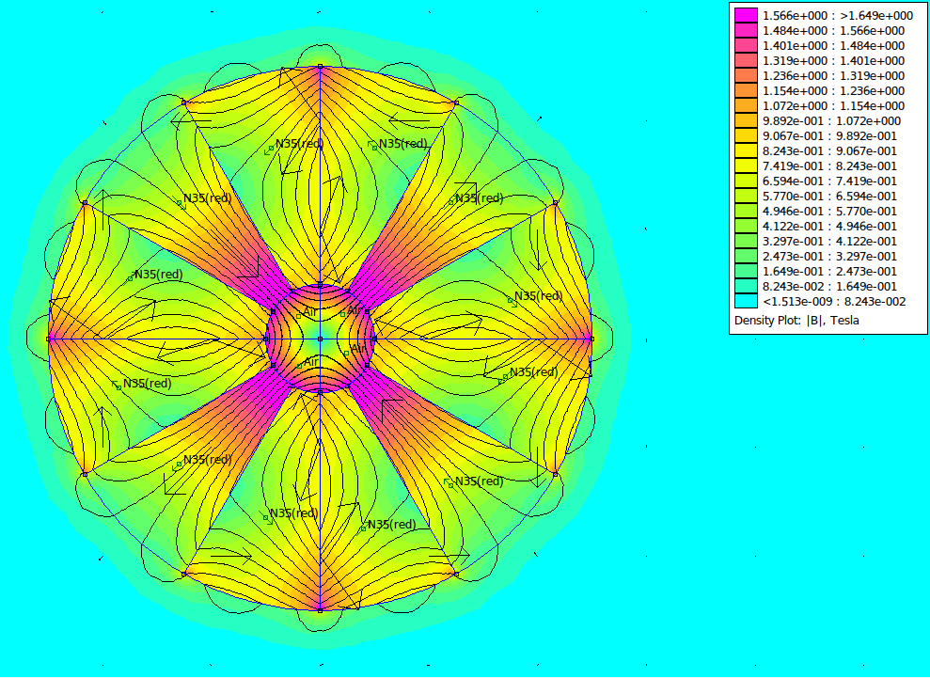
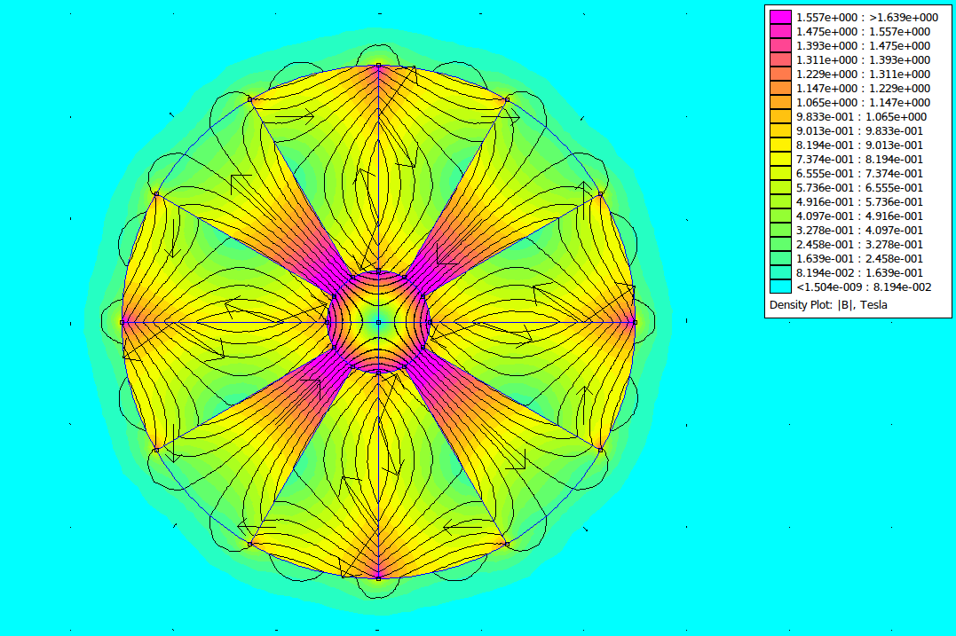
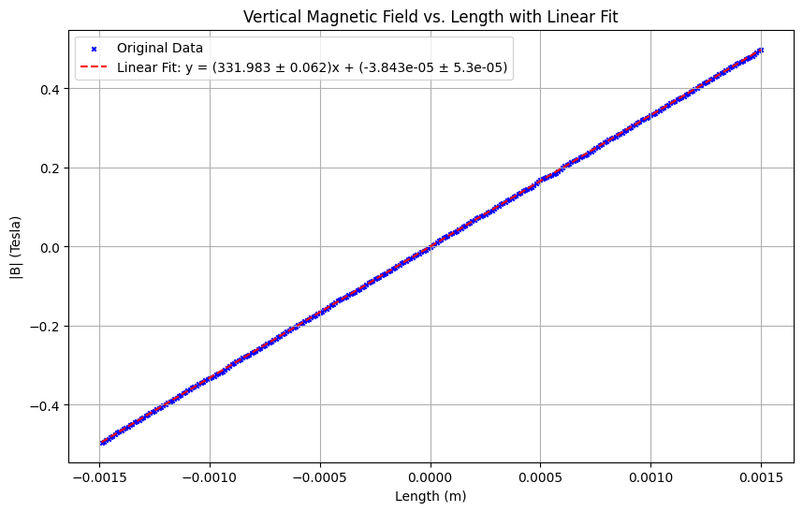

FEMM Field
FQ
334 T/m
DQ
332 T/m

Slide 19
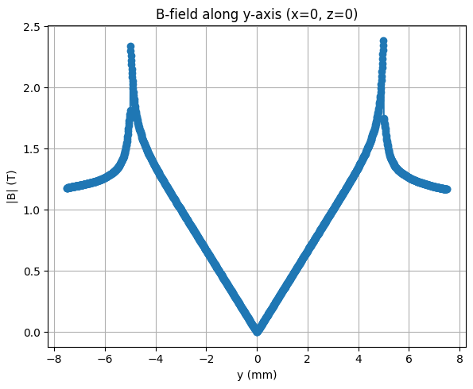
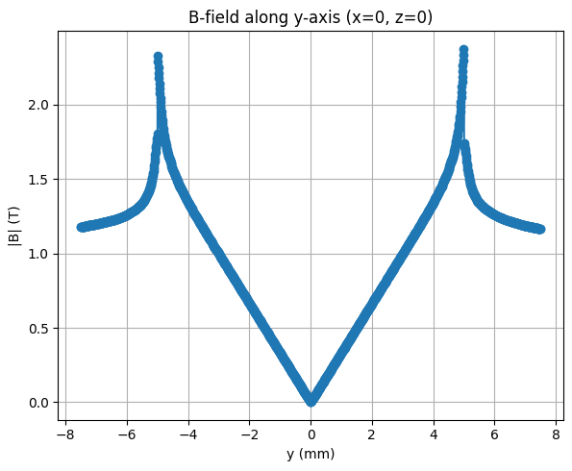
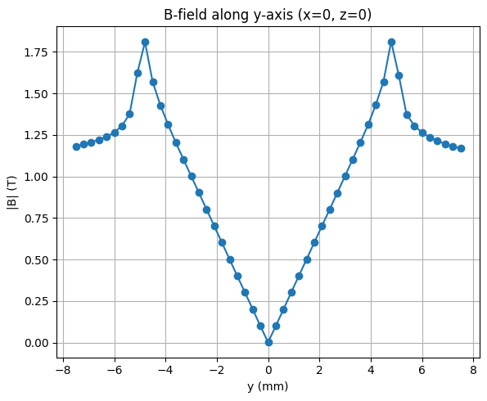
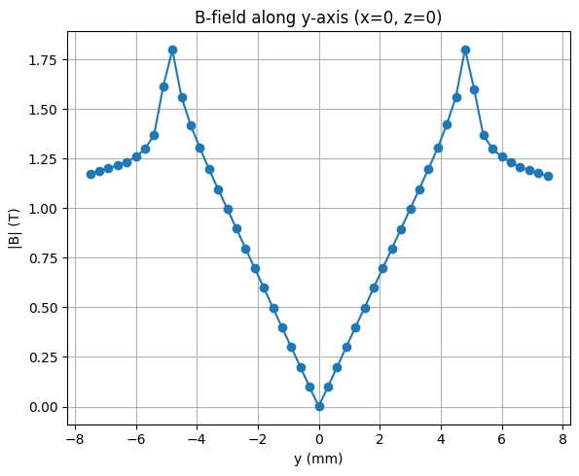
FEMM Field
(Downsampling)
FQ
DQ
1501x1501:
50x50:

Slide 20
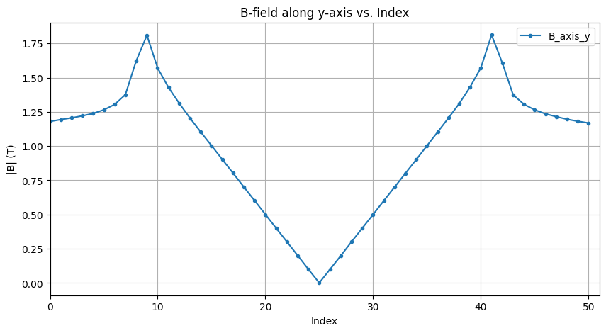
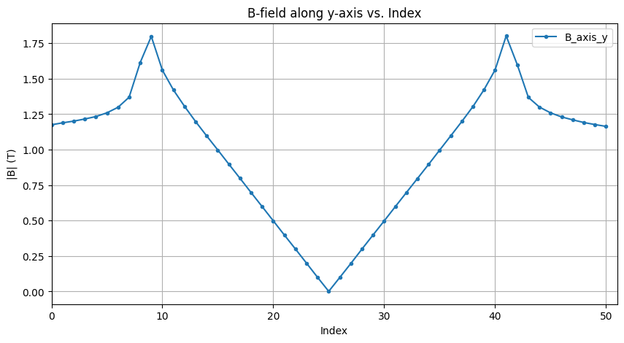
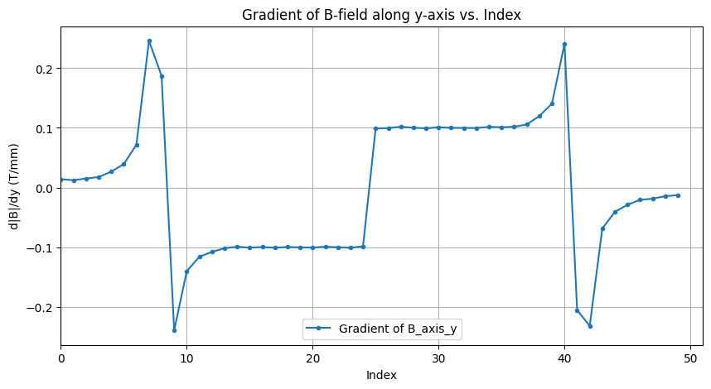
FEMM Field (Downsampling)
FQ
DQ
Field:
Change in Field:

Slide 21
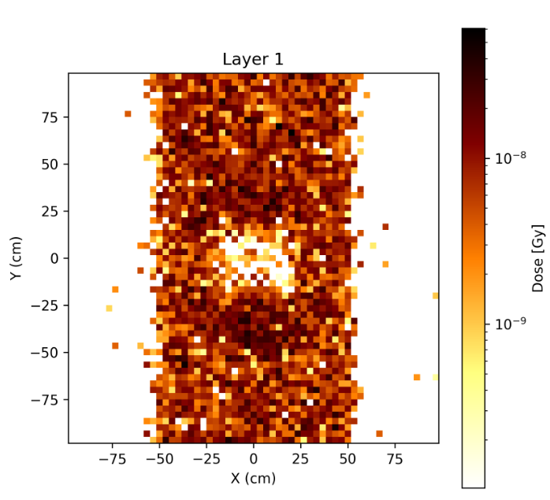
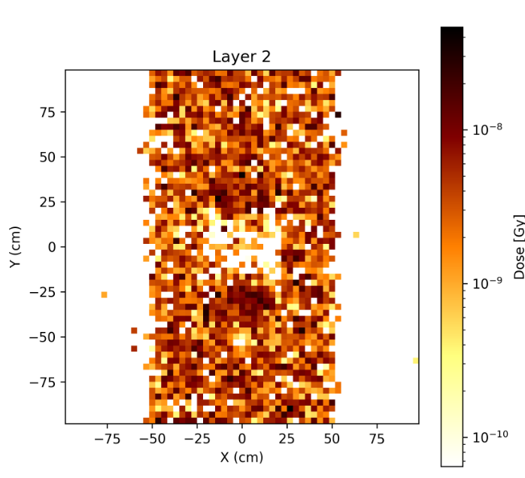
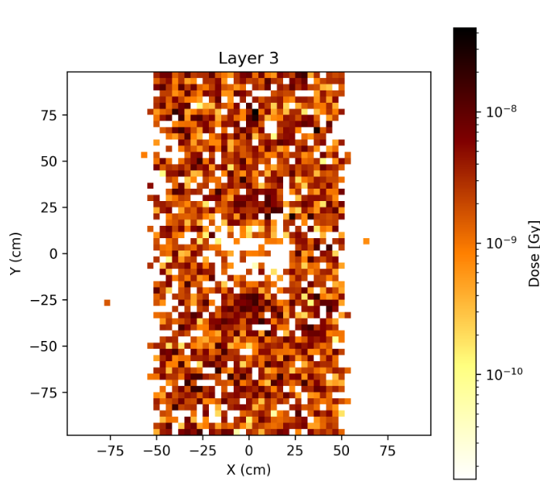
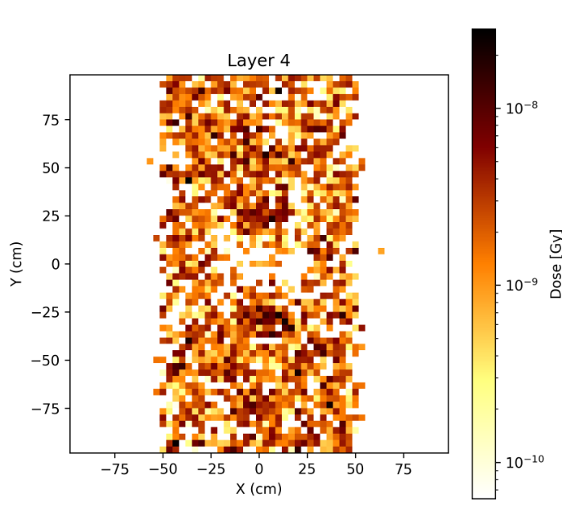
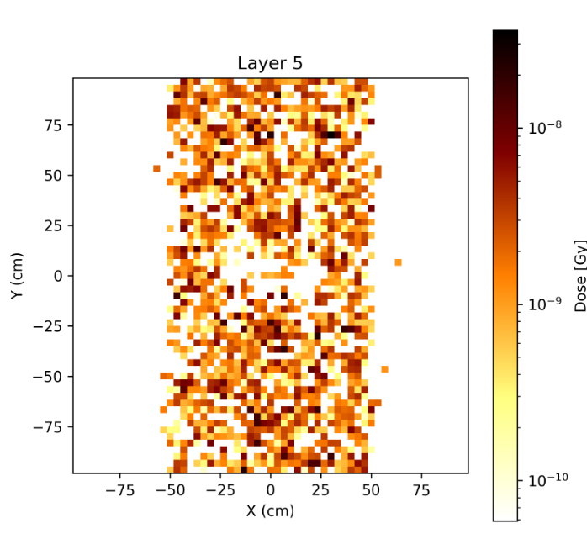
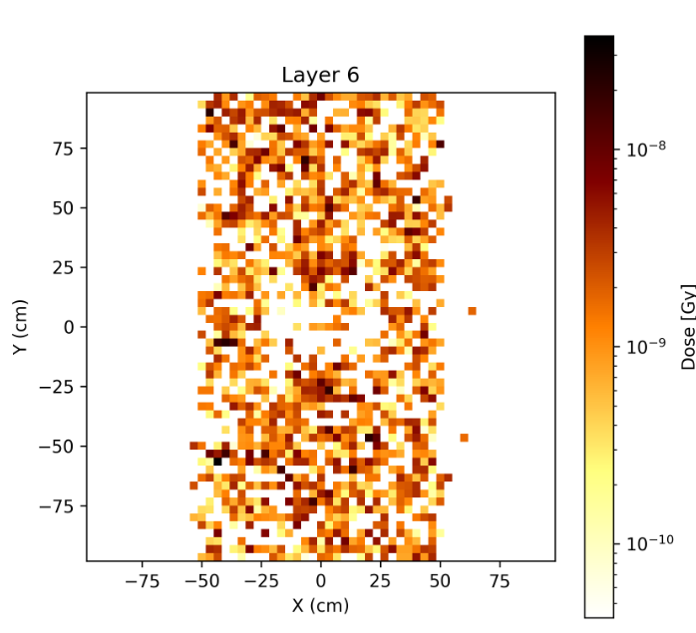
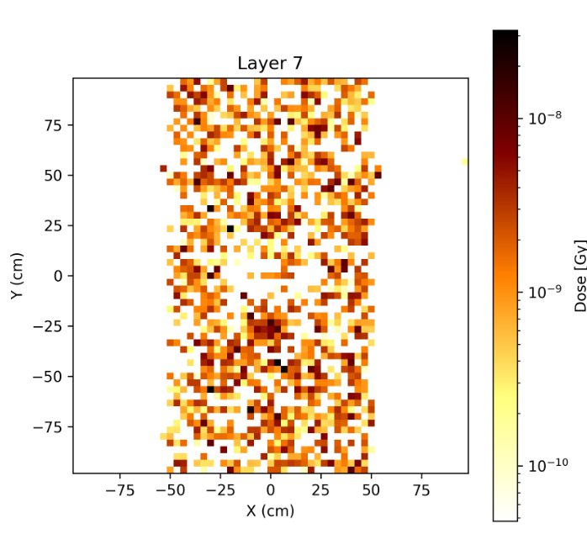
FEMM Field RCF

Slide 22
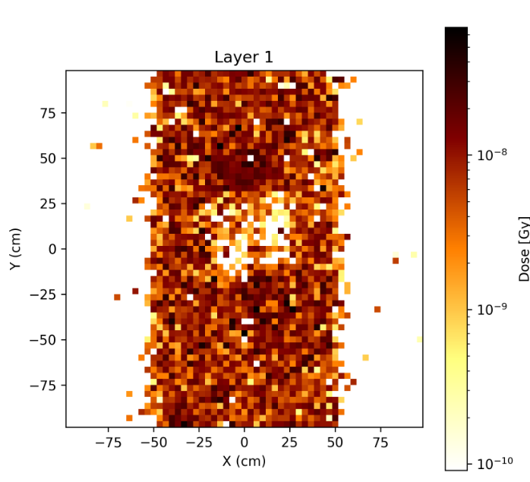
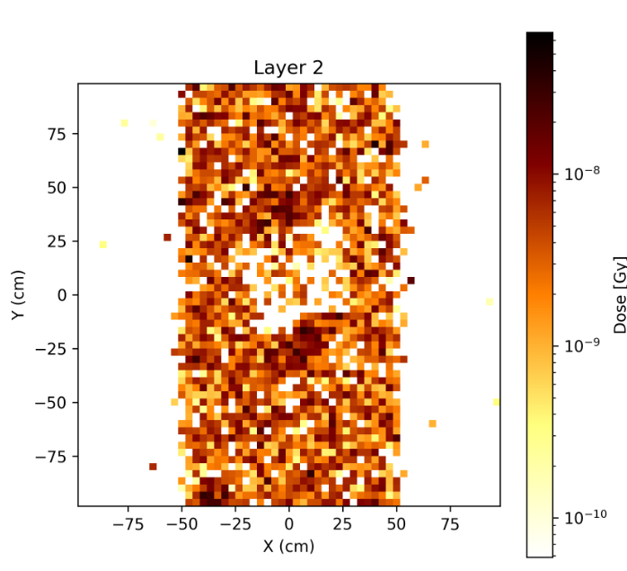
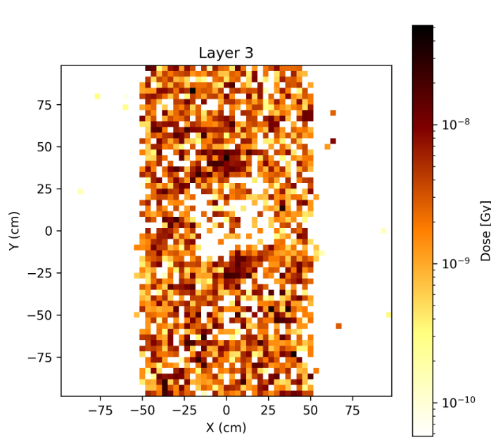
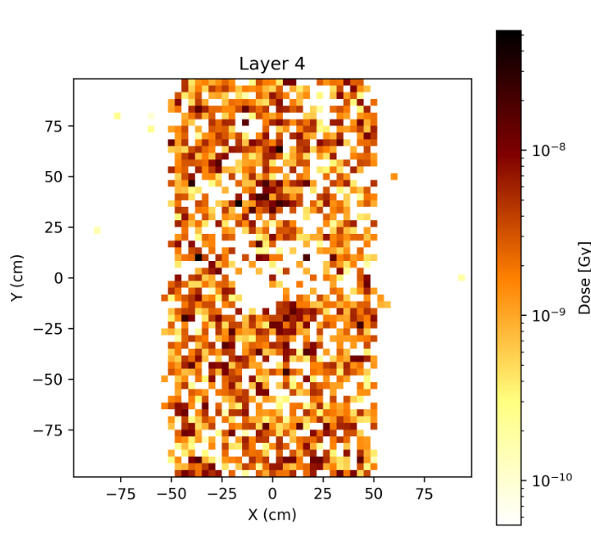
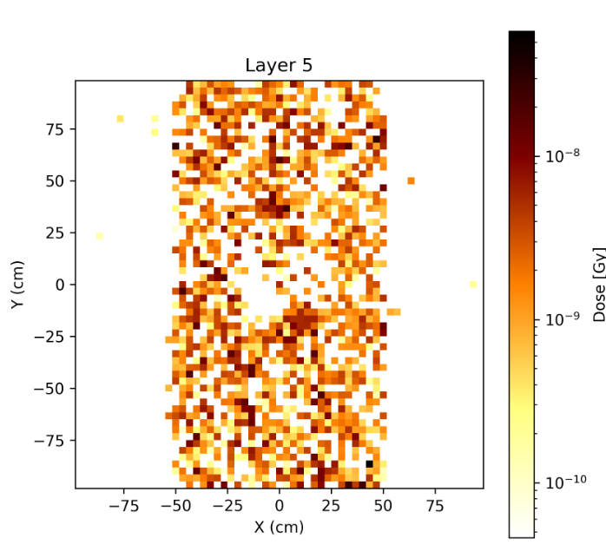
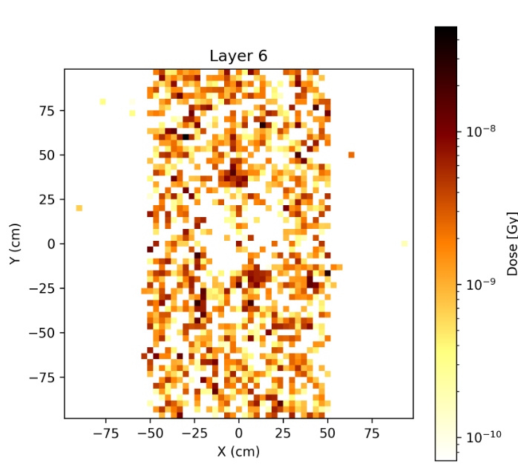
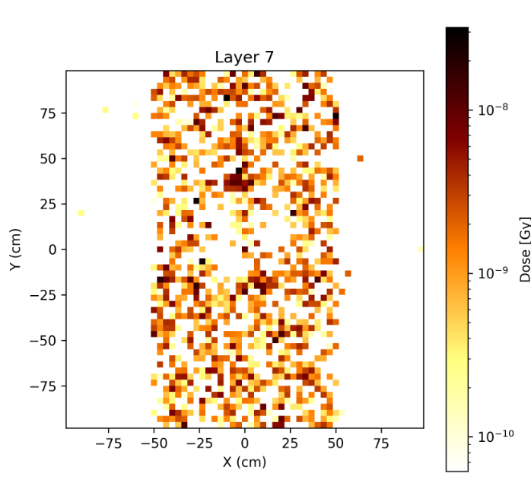
Combination of FEMM Field and Optimal Shifts and Tilts

Slide 23
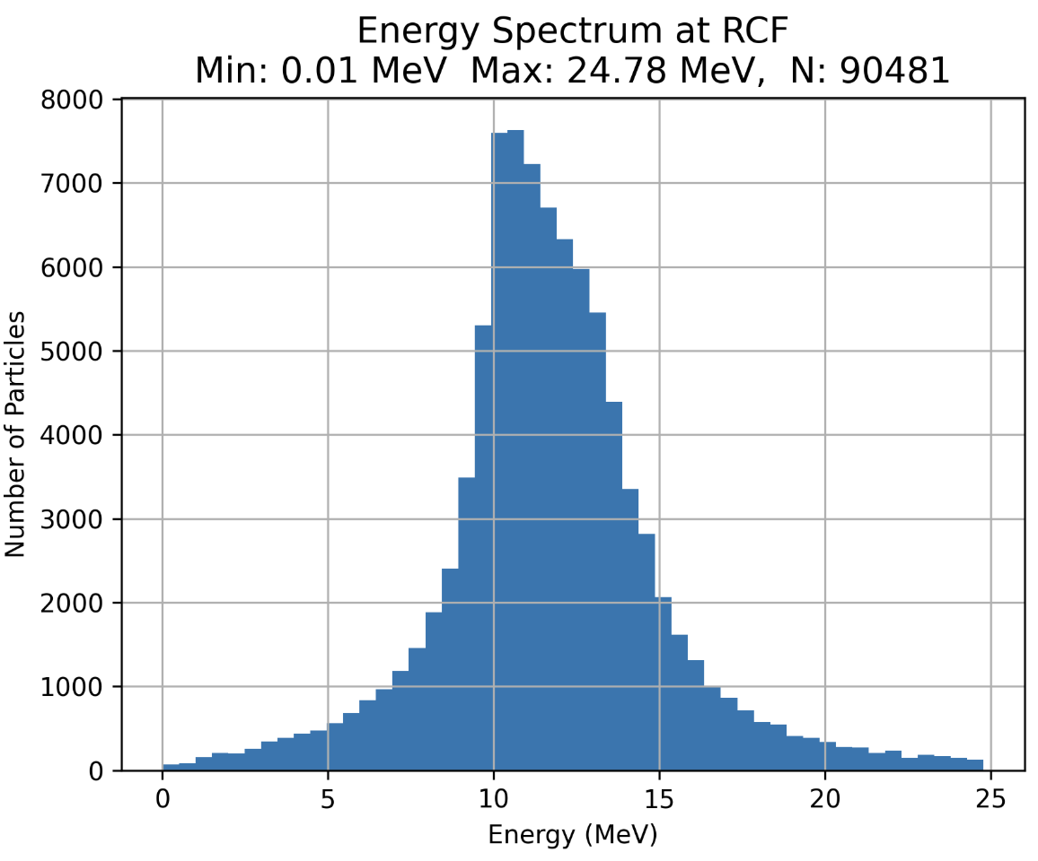
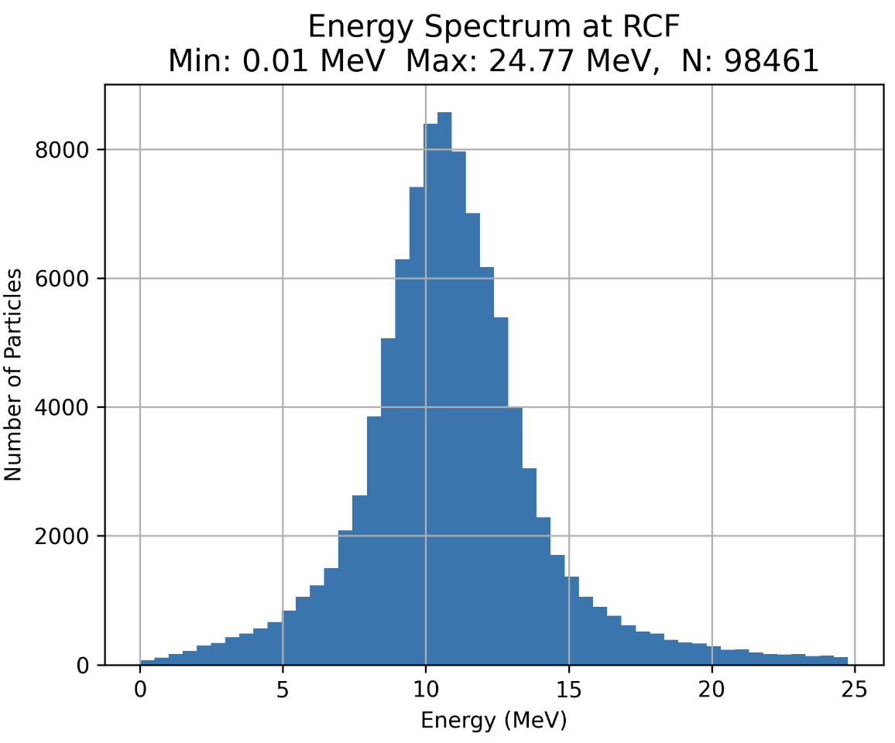
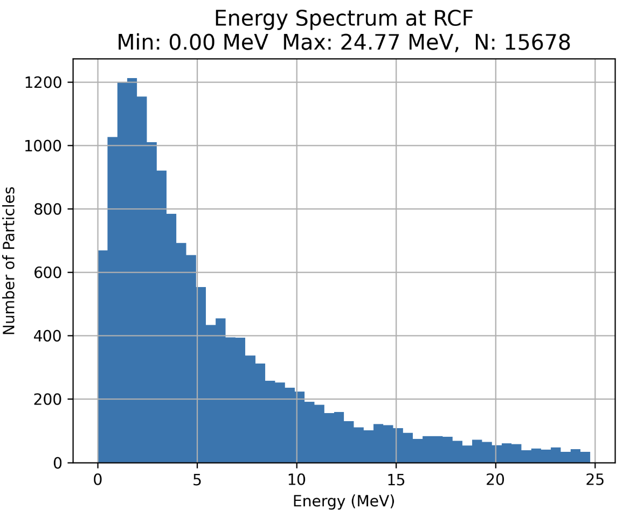
Energy Spectra
No Shifts/Tilts and Fields Implemented
Optimised Shifts/Tilts
No Shifts/Tilts

