Slide 1
LION Update
12/02/26

Slide 2
Plan Outlined
Optimise for shifts and tilts using Bayesian Optimisation
Generate a realistic Quadrupole Field in FEMM
Obtain a full understanding of the effects of both shifts and tilts, and a realistic quad field
Use a combination to create the RCF seen in experiment at LION
Use the output of that beam in Maria’s simulations

Slide 3







Experimental RCF

Slide 4







Default Beamline RCF

Slide 5
Bayesian Optimisation
Ran 5 independent searches with 500 iterations each
Searching over a 12D search space
Running 1e5 particles in each simulation took about a week

Slide 6
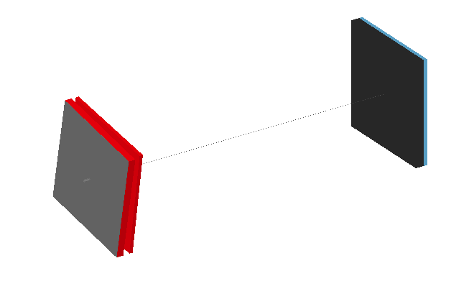
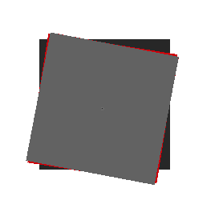
Optimal Shifts and Tilts
X₁: 7um
Y₁: 26um
Z₁:-4mm
RotX₁: -182urad
RotY₁: 197urad
RotZ₁: 188mrad
X₂: -29um
Y₂: 23um
Z₂:-5mm
RotX₂: 156urad
RotY₂: 136urad
RotZ₂: 159mrad

Slide 7







Optimal Shifts and Tilts RCF

Slide 8
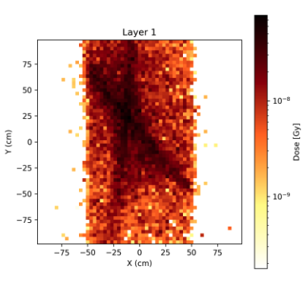
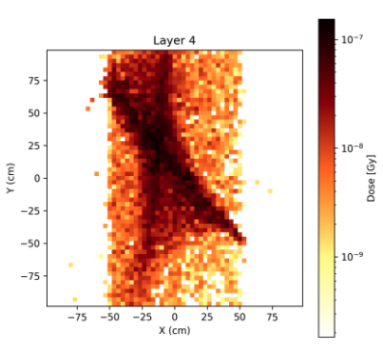
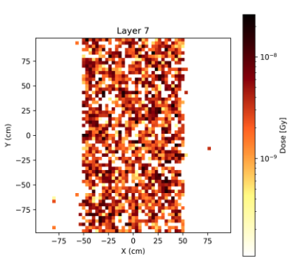

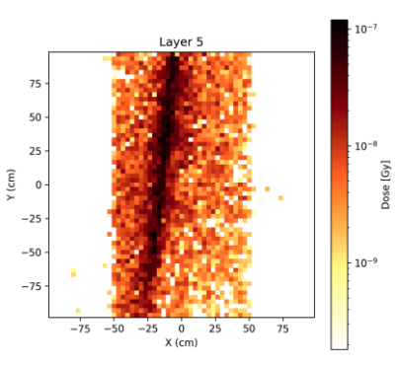
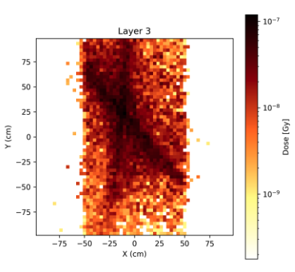
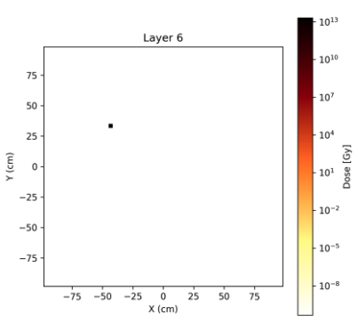
Verify BDSim (Effect of Scattering)
LLO
BDSim
LLO
BDSim
LLO
BDSim

Slide 9
FEMM Field

Slide 10
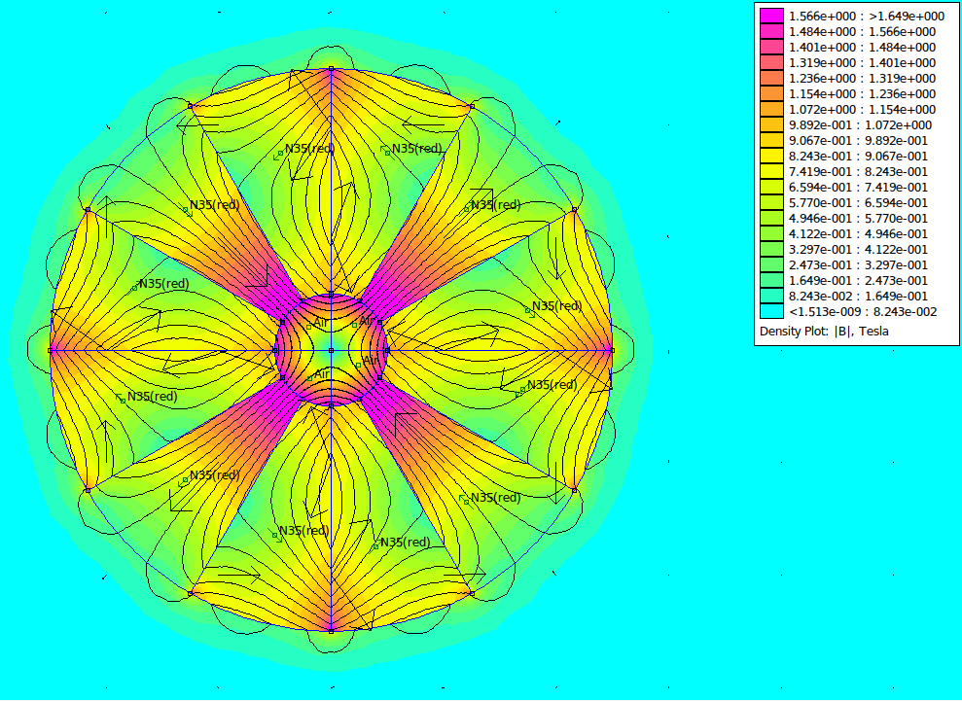
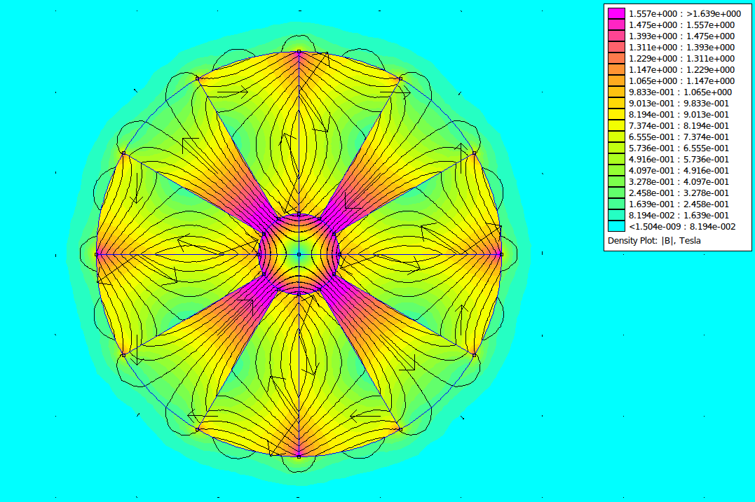
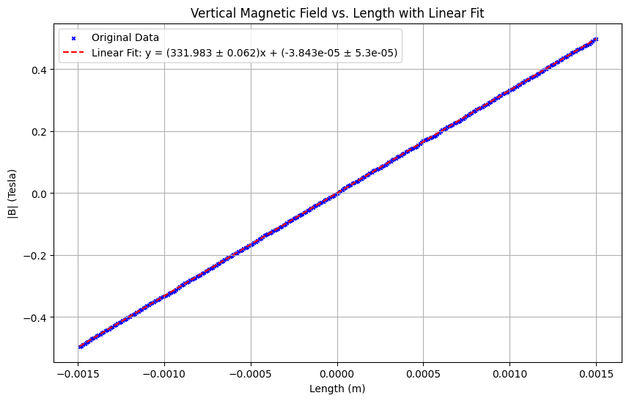

FEMM Field
FQ
334 T/m
DQ
332 T/m

Slide 11
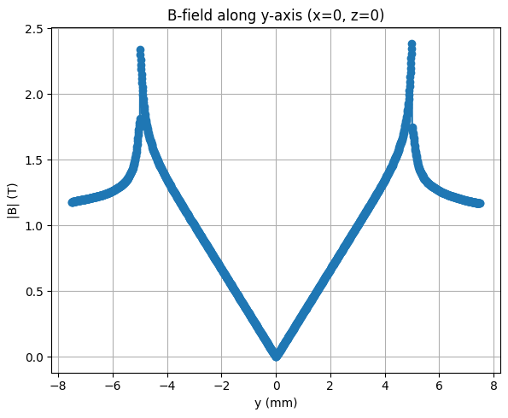
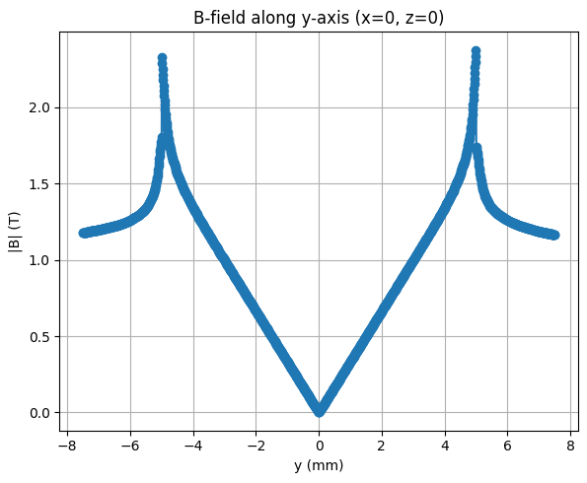
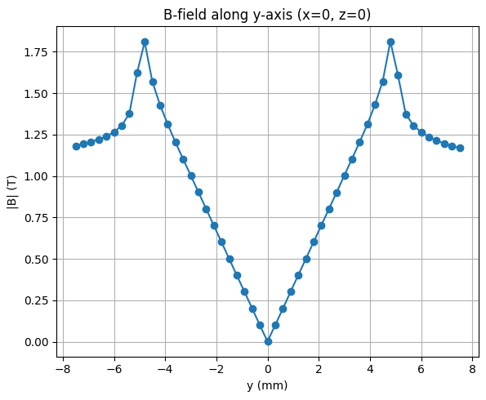
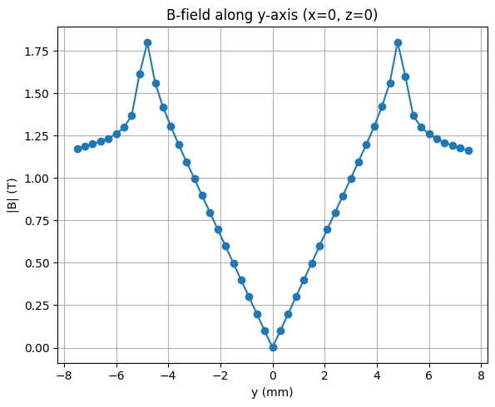
FEMM Field
(Downsampling)
FQ
DQ
1501x1501:
50x50:

Slide 12
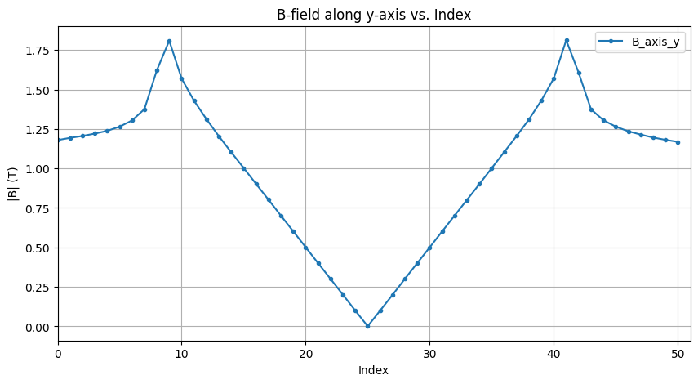
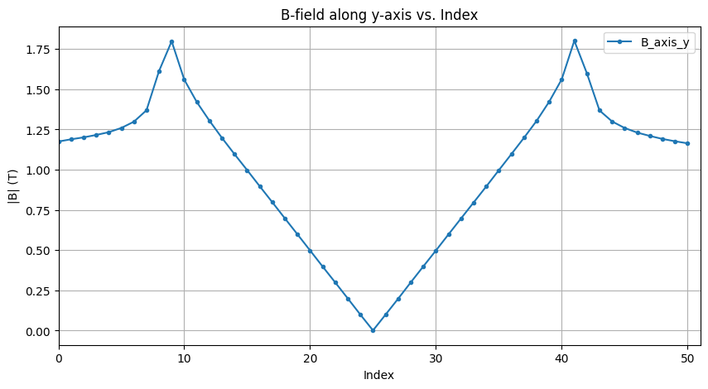
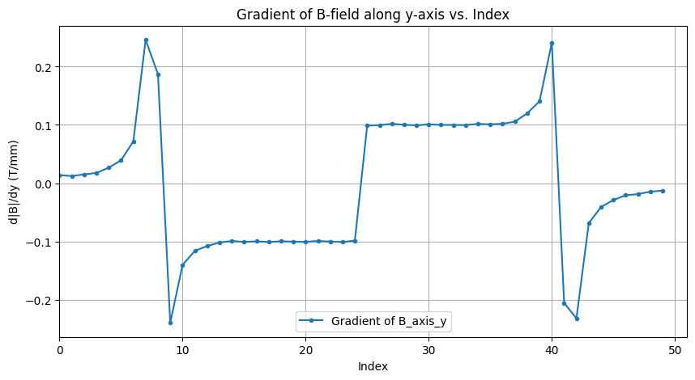
FEMM Field (Downsampling)
FQ
DQ
Field:
Change in Field:

Slide 13
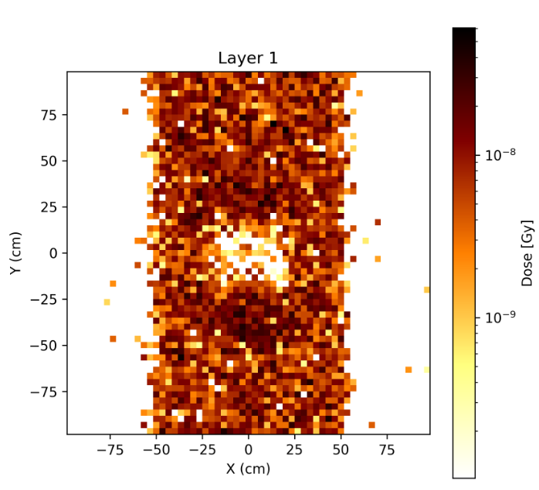
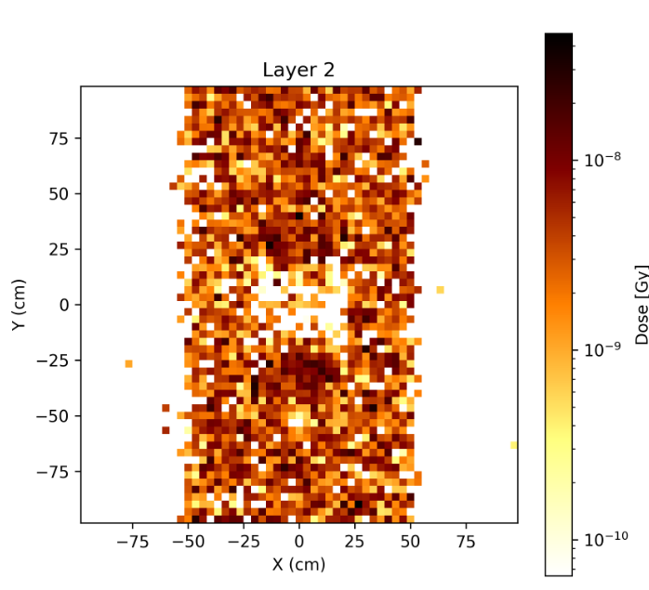
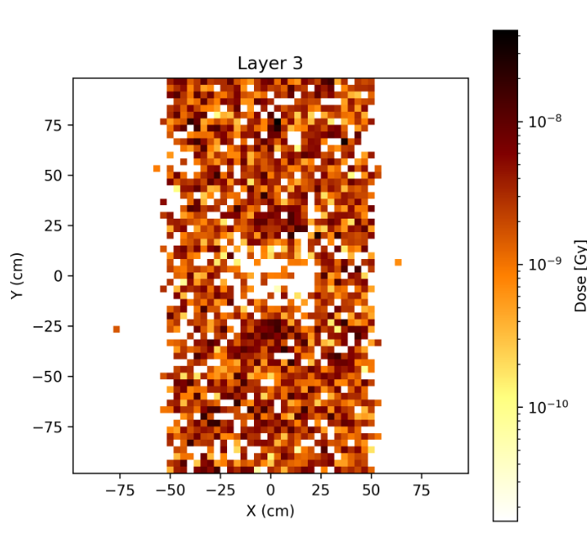
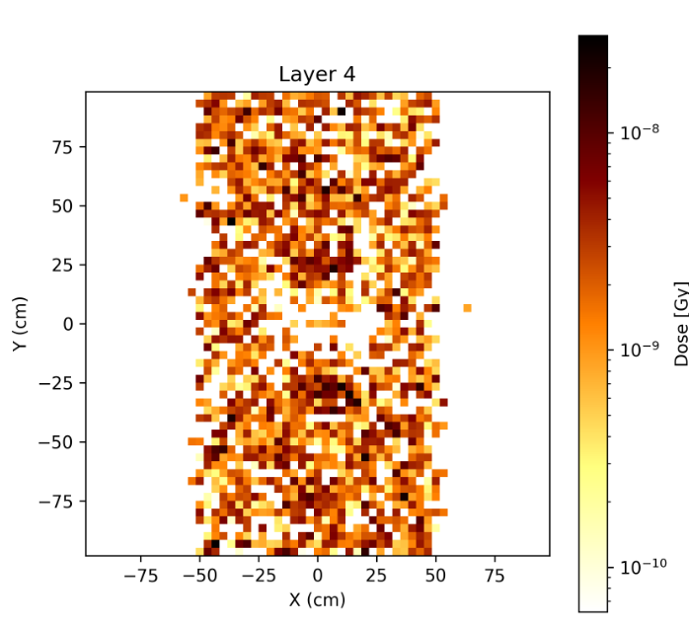
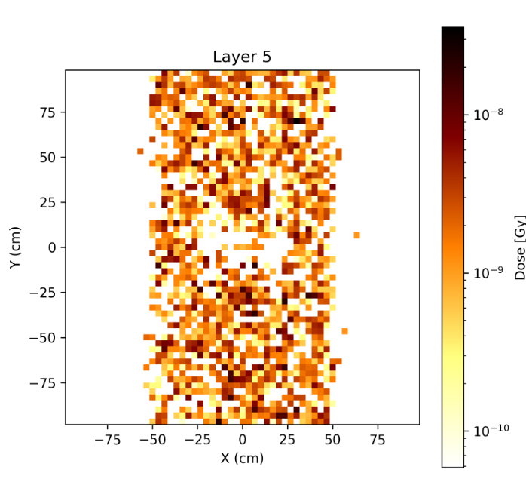
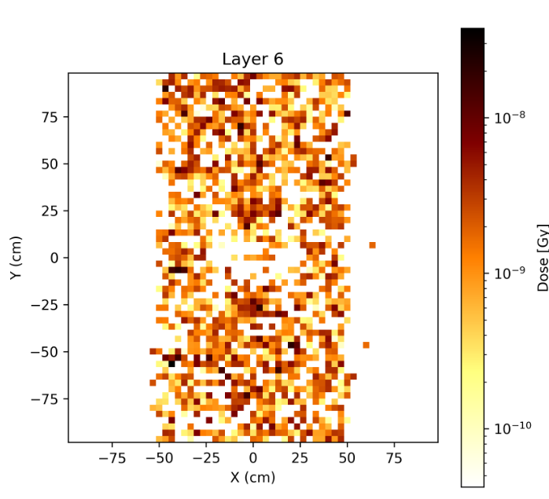
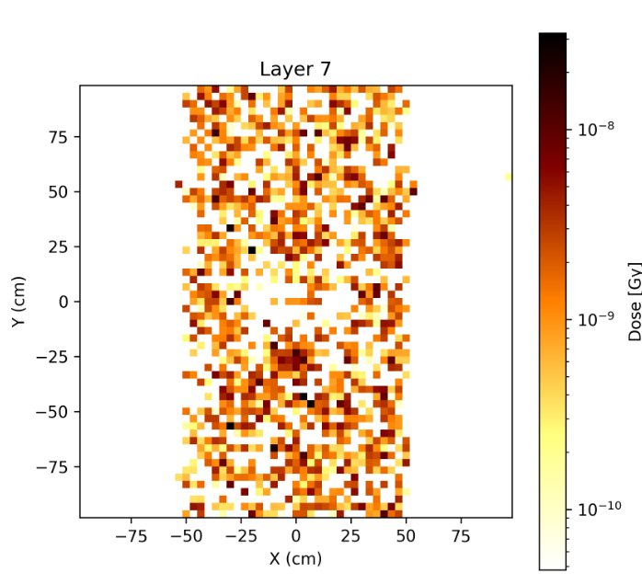
FEMM Field RCF

Slide 14
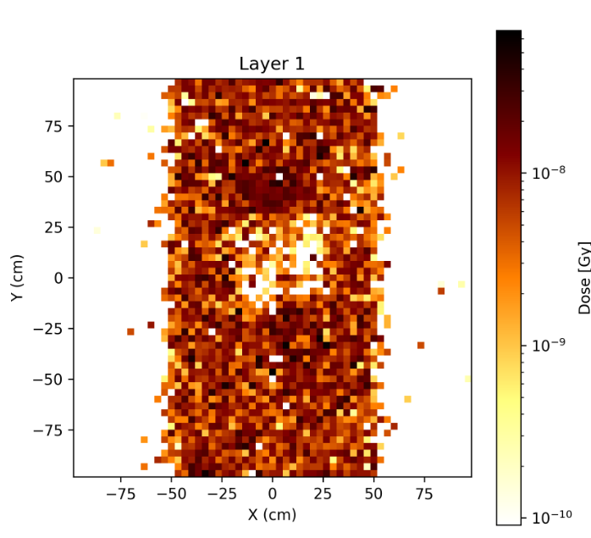
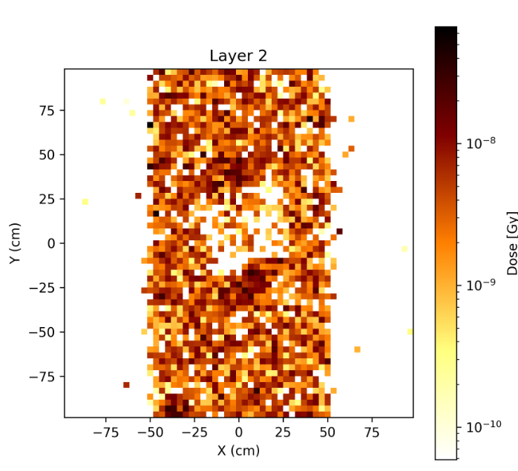
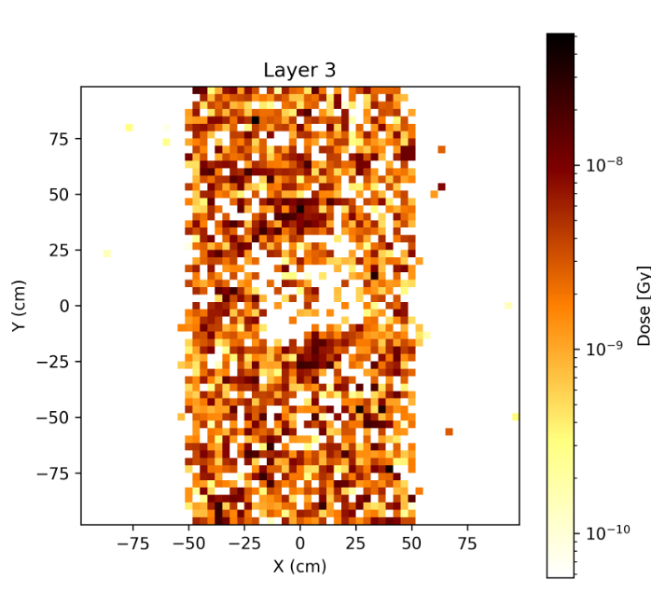
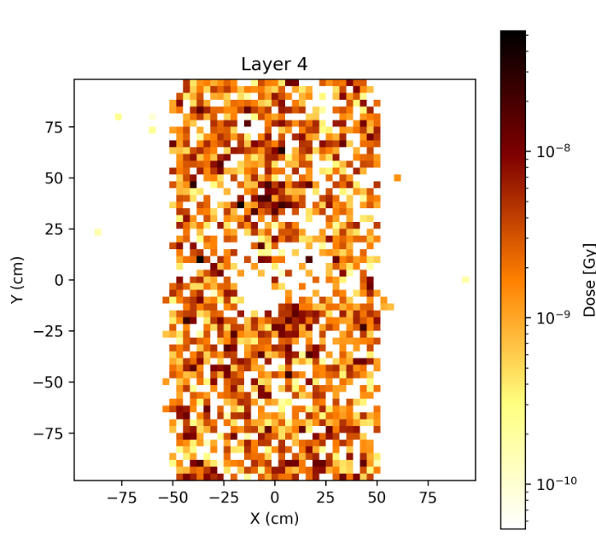
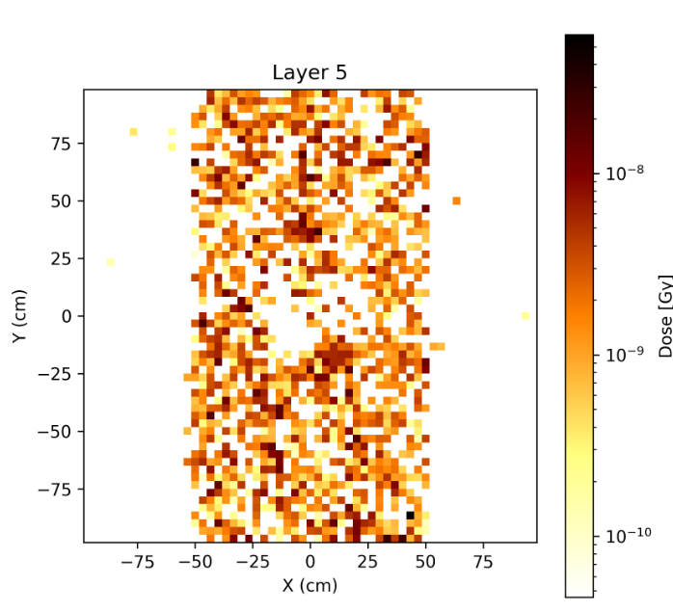
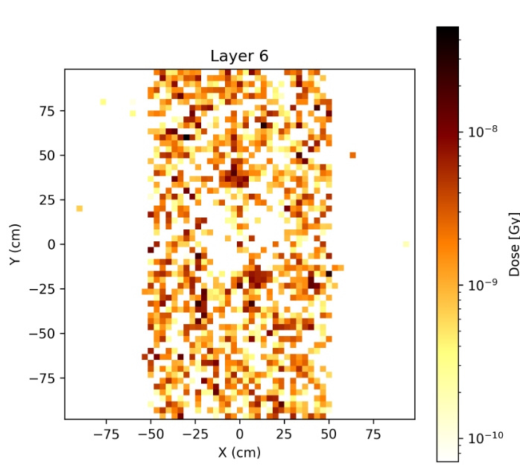
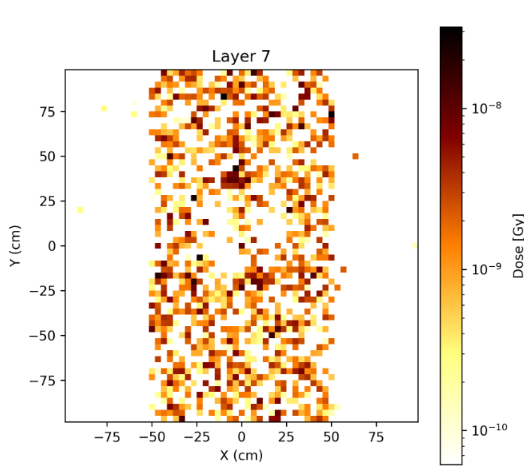
Combination of FEMM Field and Optimal Shifts and Tilts

Slide 15
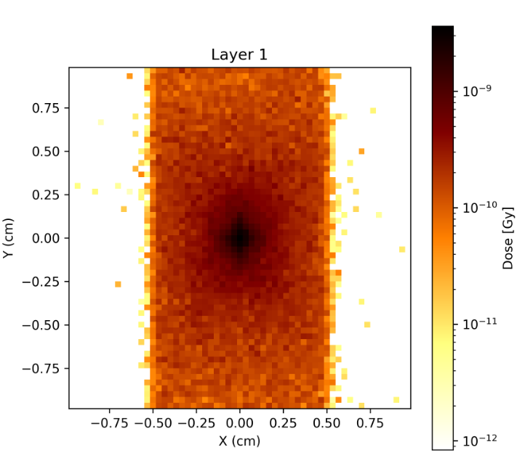
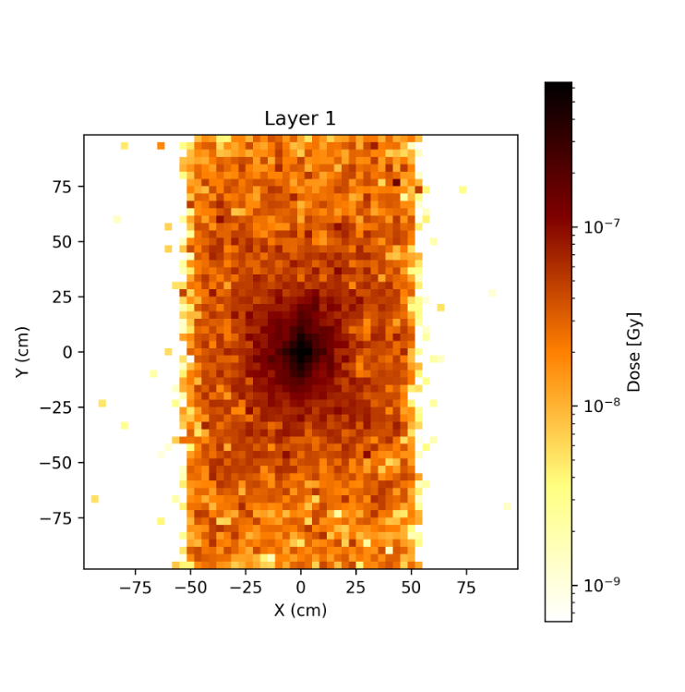
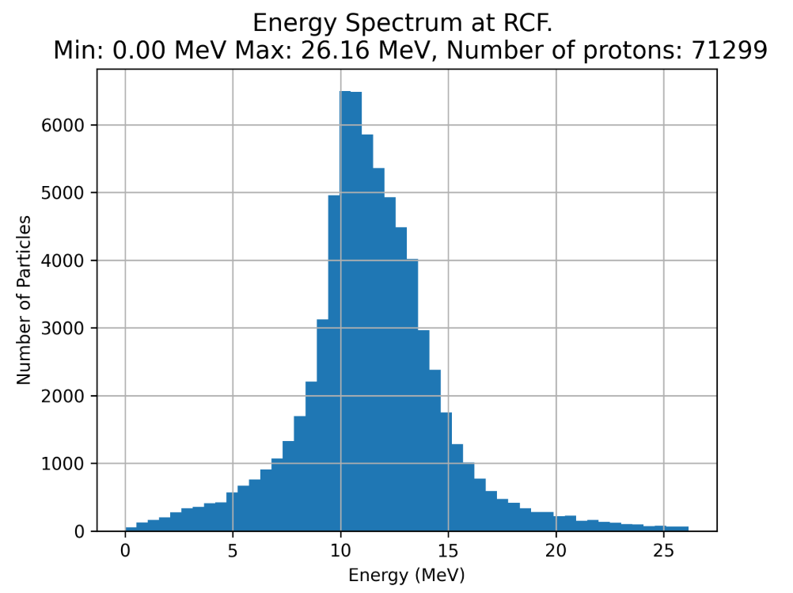
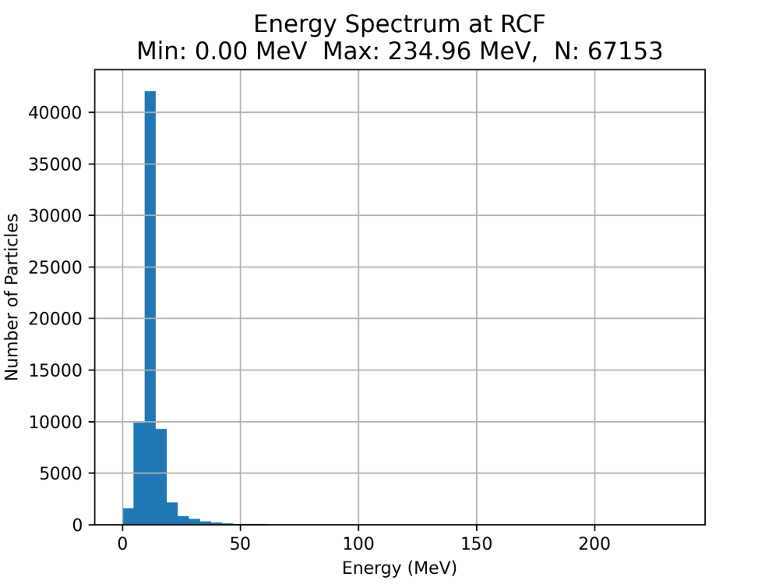
Bugs in Parallel BDSim
BDSim (One Run)
BDSim (Parallel Run)
Repeated Data
  Either seeding or overwriting
200MeV Protons?
Particle Loss?
LLO
BDSim (Parallel)

