Slide 1
Initial runs with PMQ fieldmaps
12/02/2026- Josie McGarrigle

Slide 2
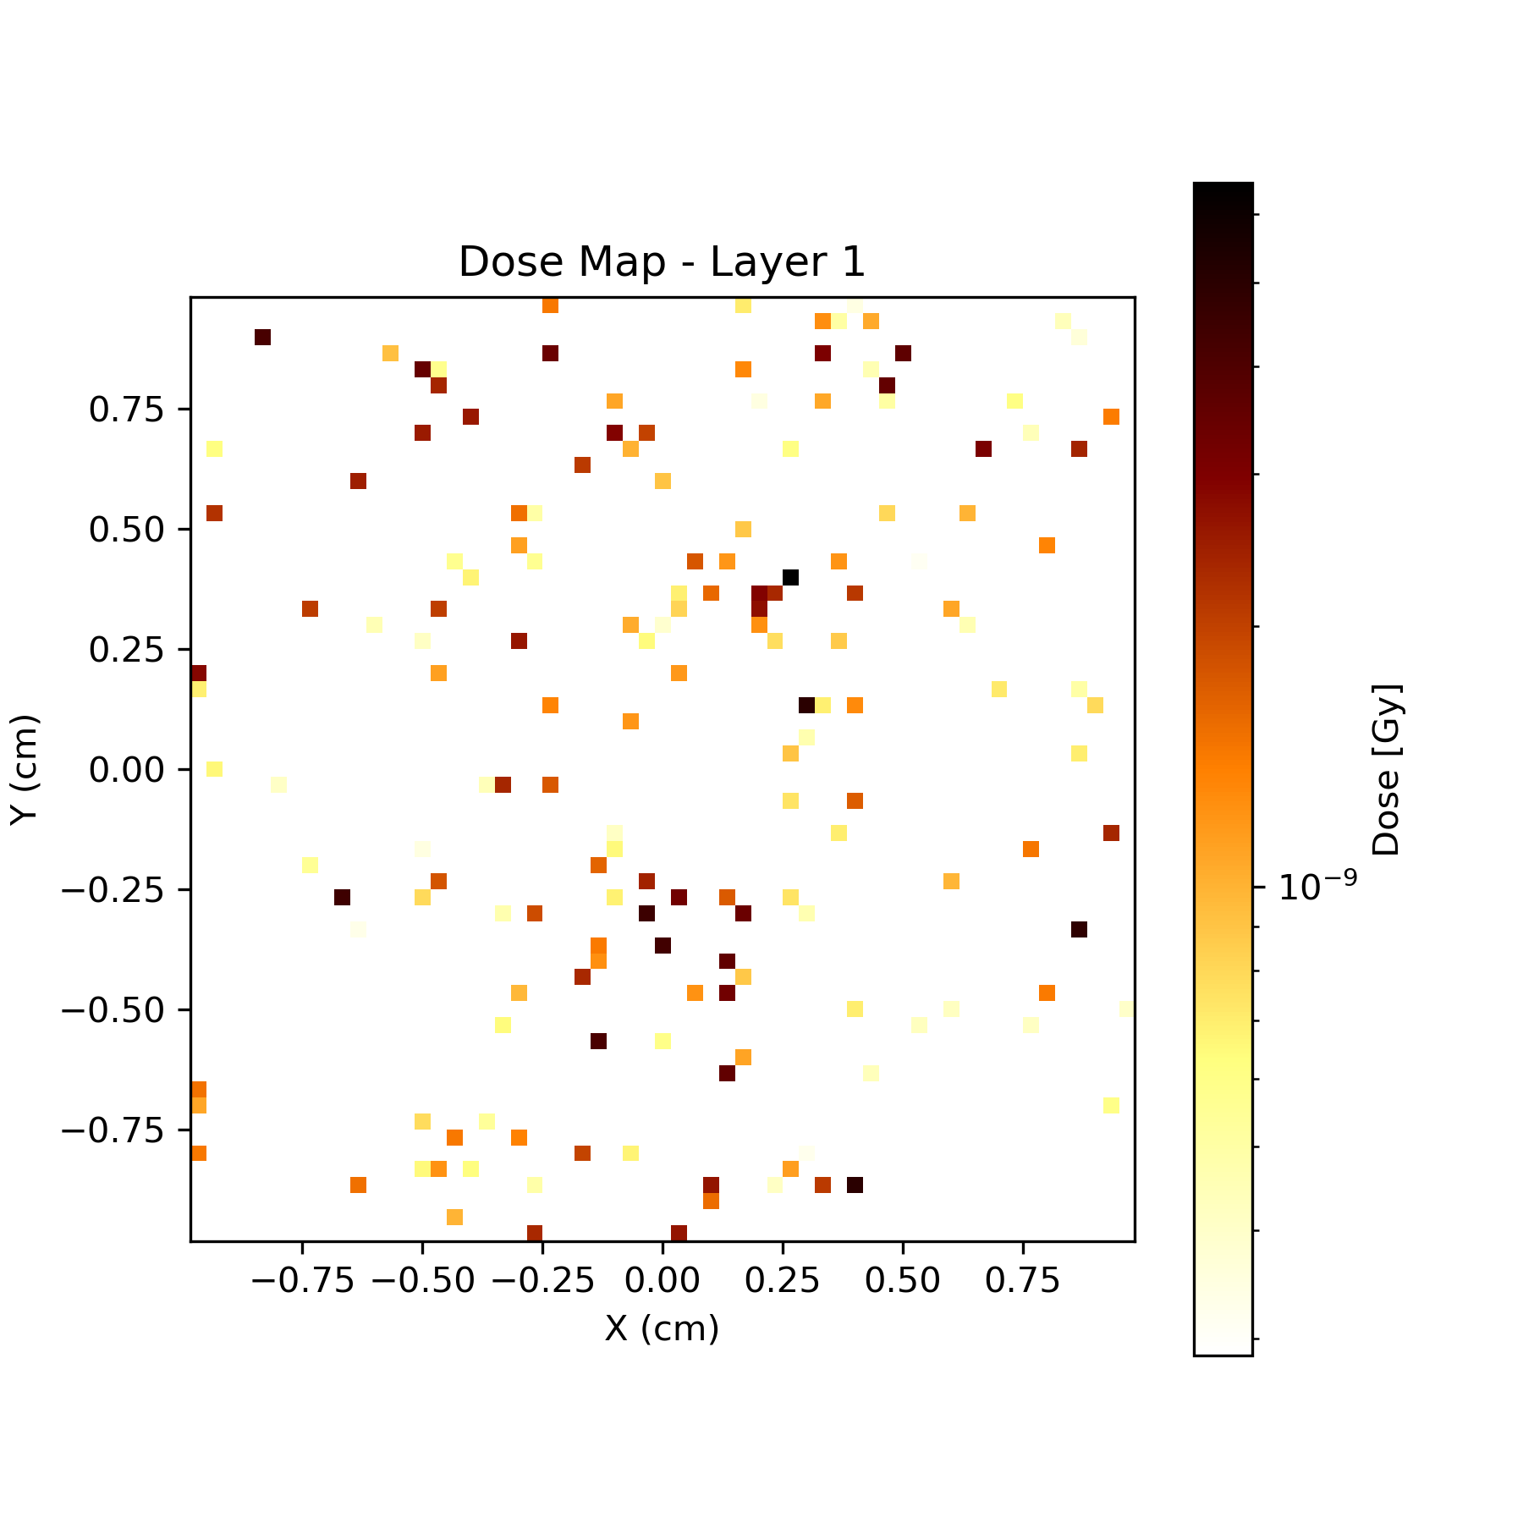
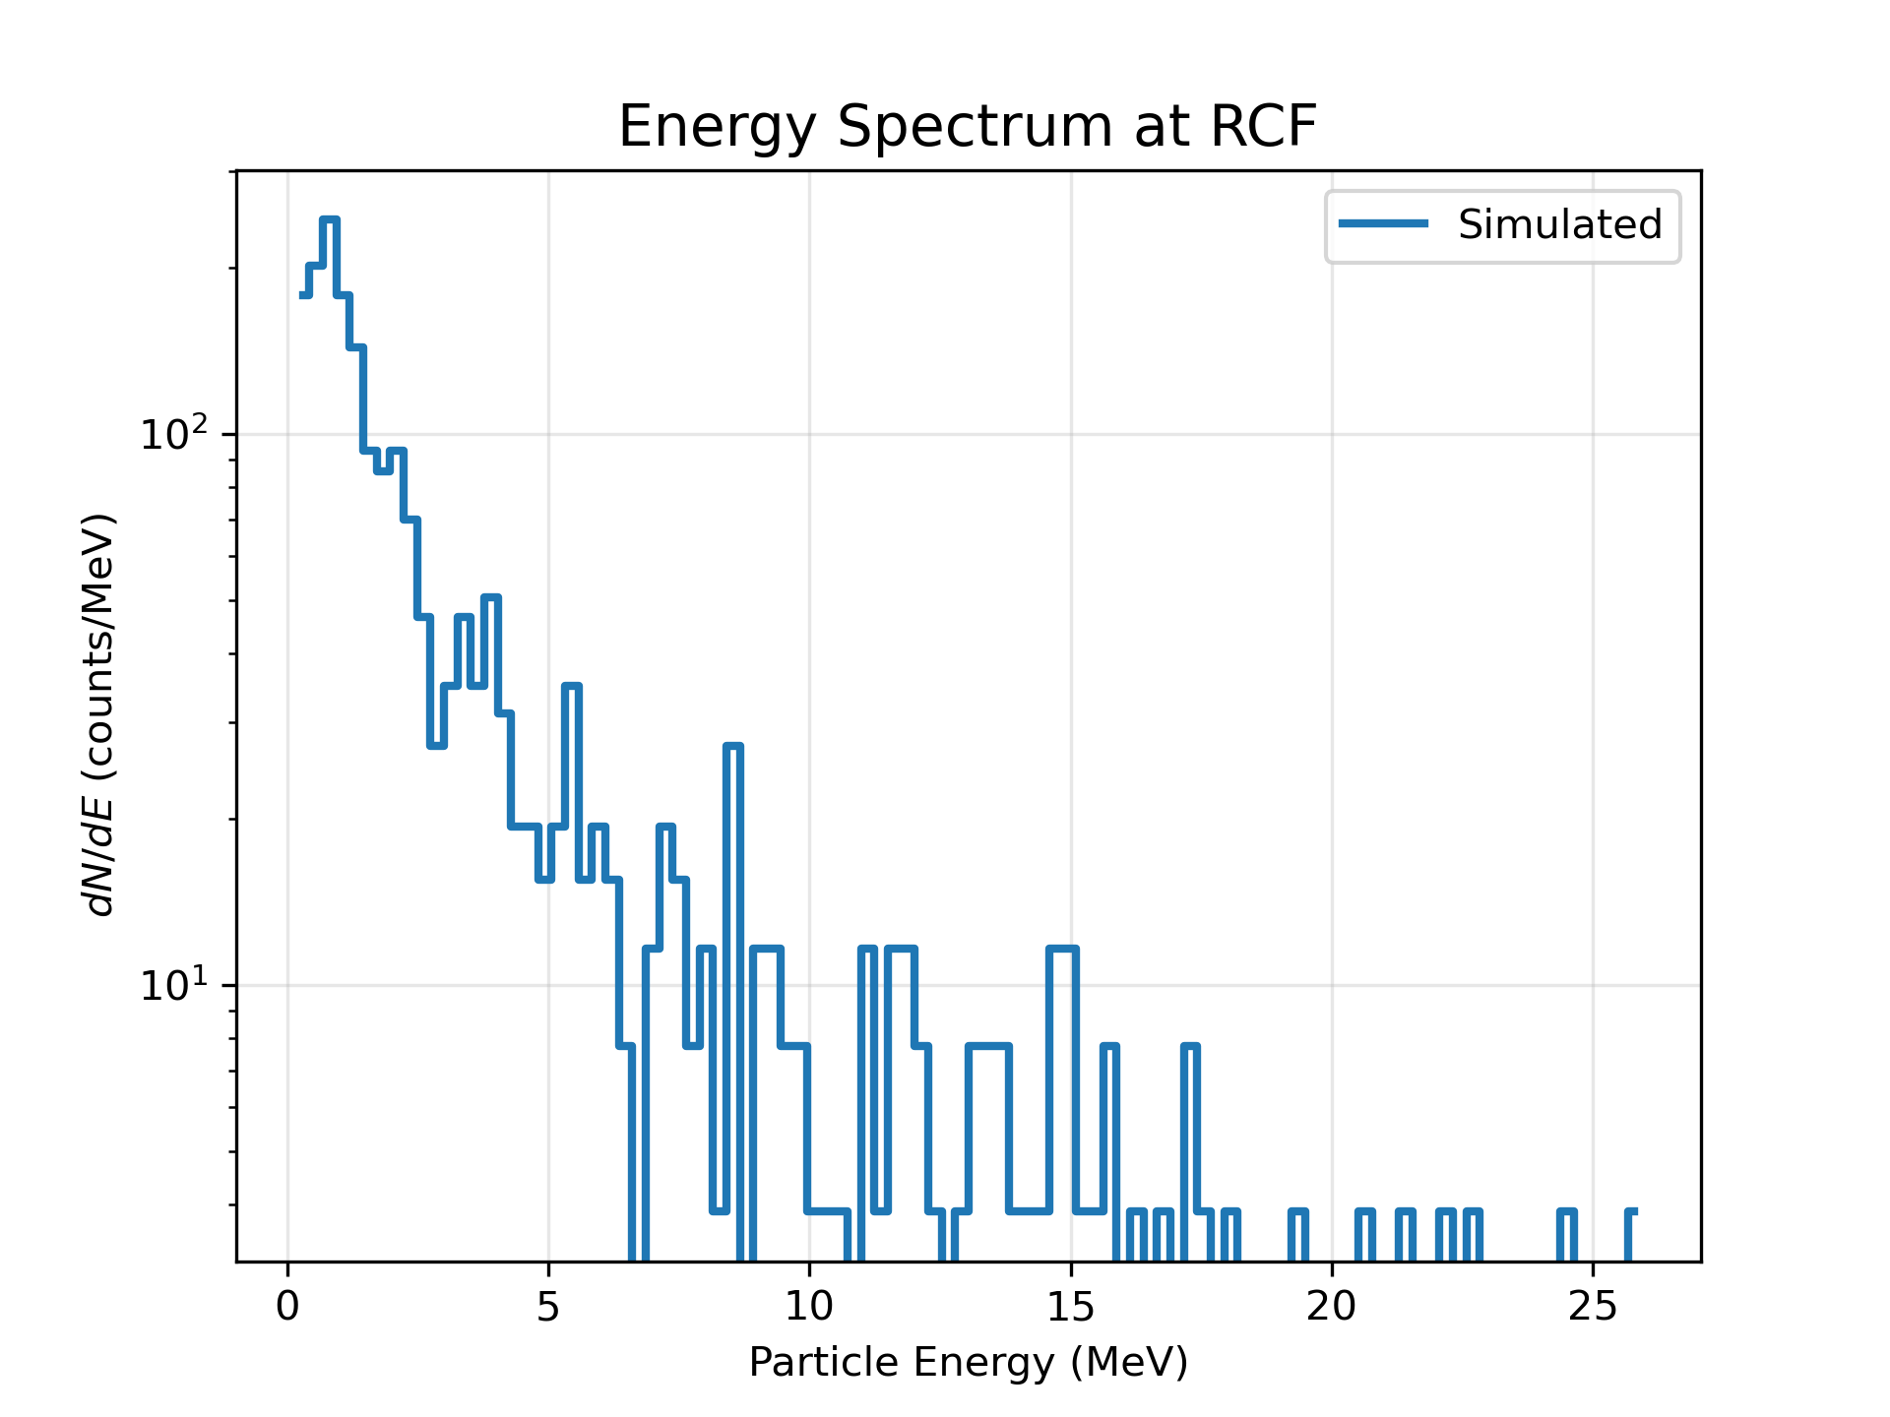
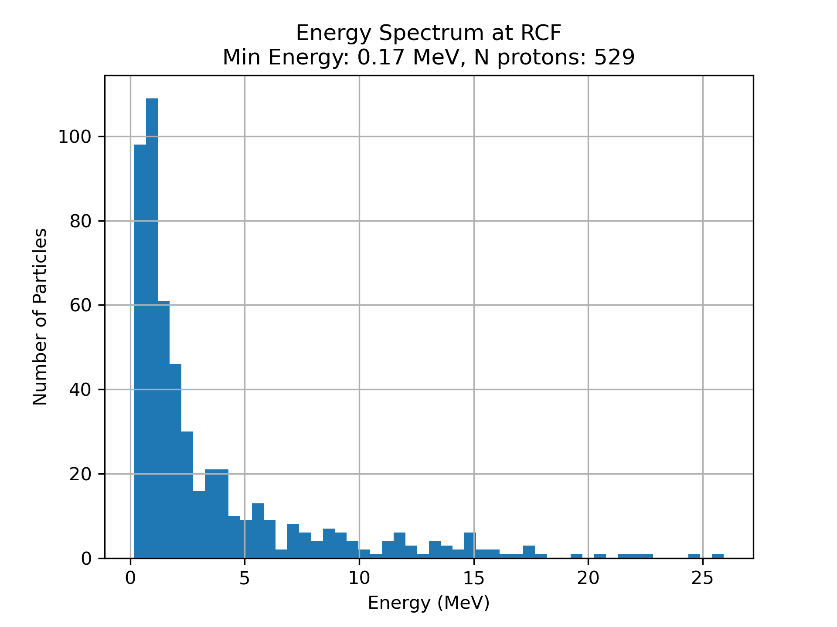
10,000 particles for 151x151
Time = ~6000s

Slide 3
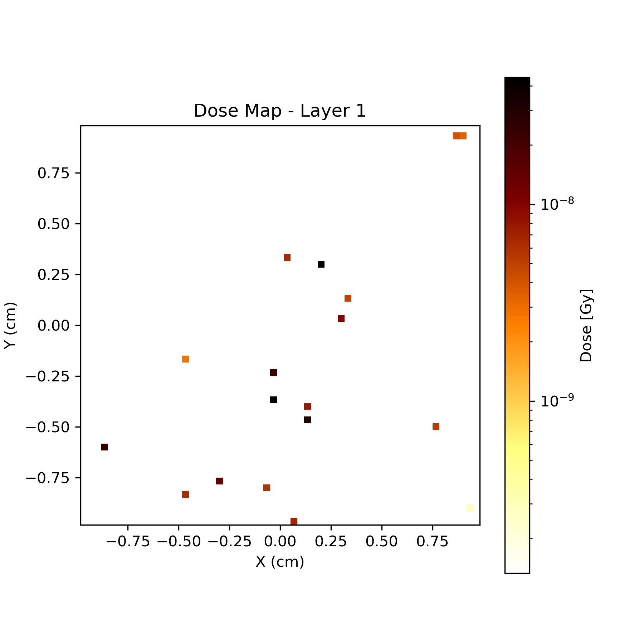
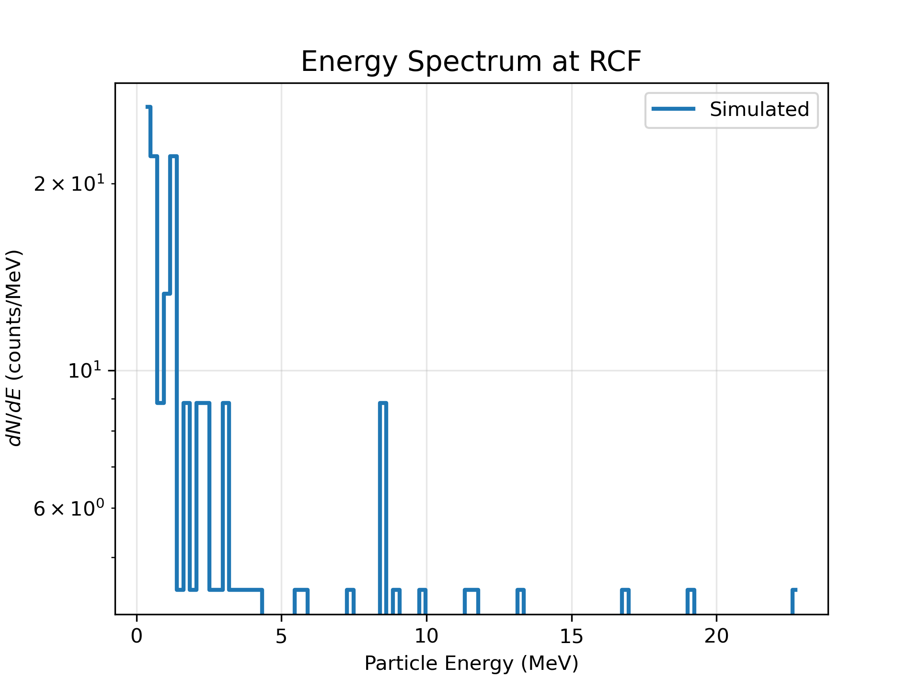
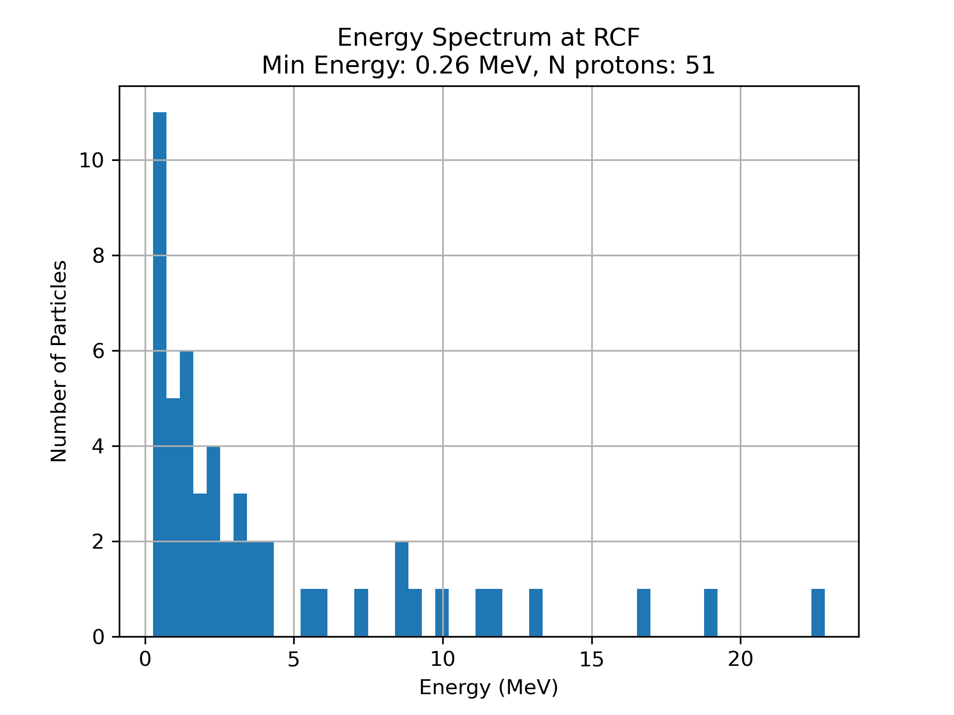
1,000 particles for 1501x1501 (Full)
Time = ~6000s

Slide 4
Tried
Turning off Eloss scoring
Turning on minimal scoring
Both only decrease time by a few seconds
Next tries
Using simpler physics model
Asking Will

