Slide 1

Simulation of LION Beam
Presenter: Calvin Dyson
Work in collaboration with Alfredo Fernadez Rodriguez, Xiangyi Chen, Zaynab Sadur and Nadirah Zakhir
Notes:
Calvin Dyson

Slide 2
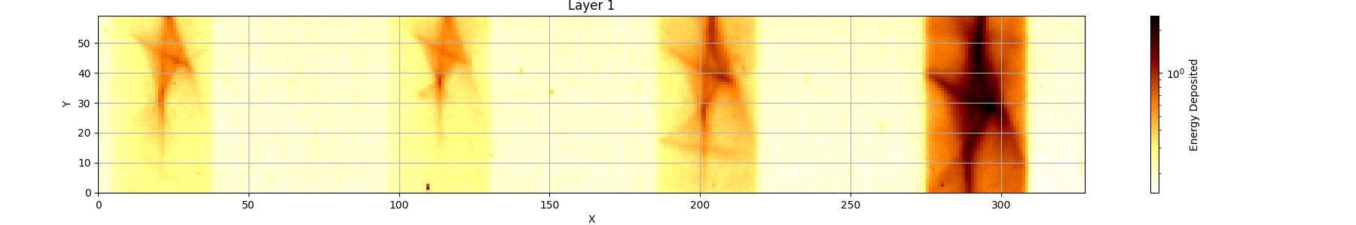
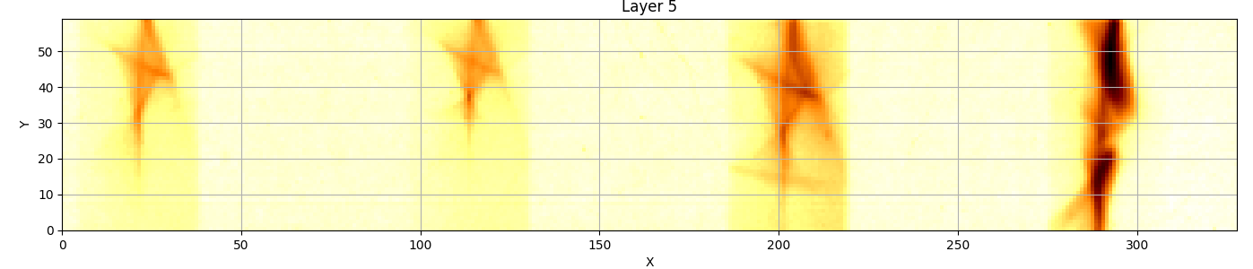
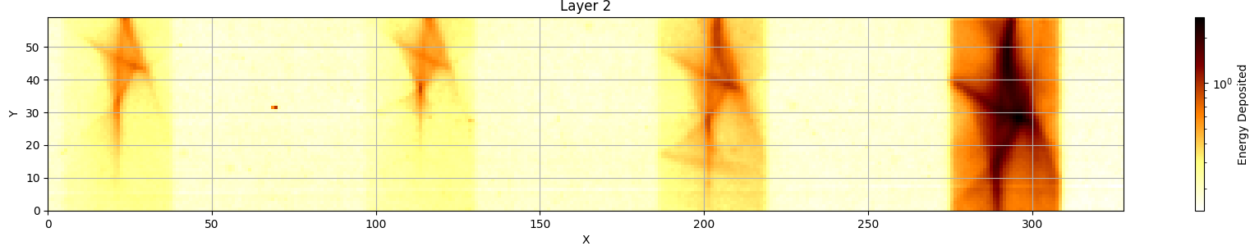
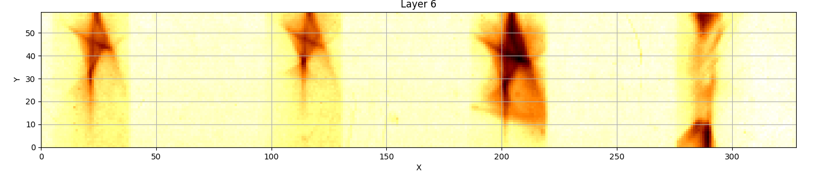
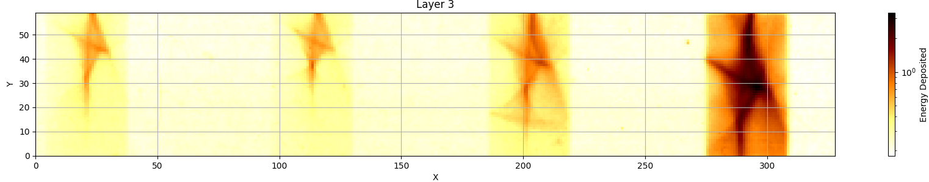
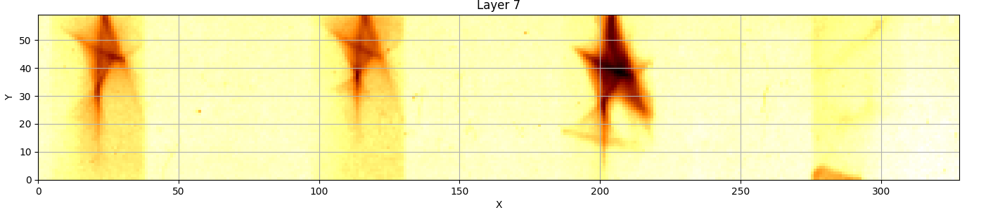
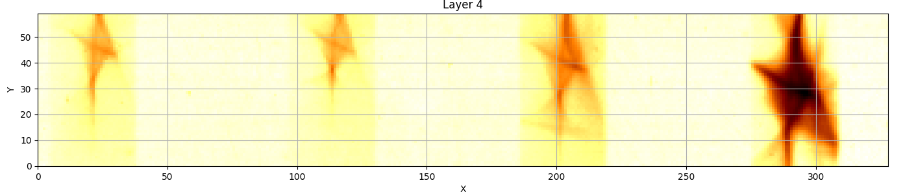
LION Beamline
20MeV
20MeV
16MeV
12MeV
20MeV
20MeV
16MeV
12MeV
2

Slide 3
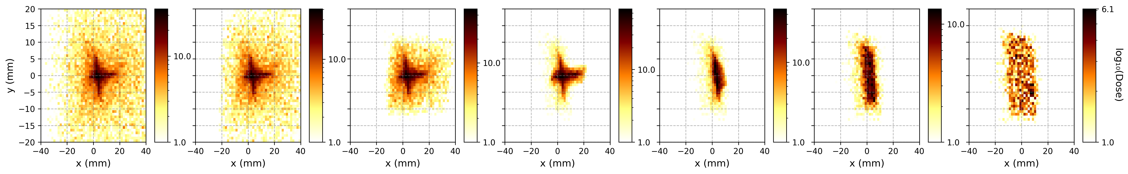
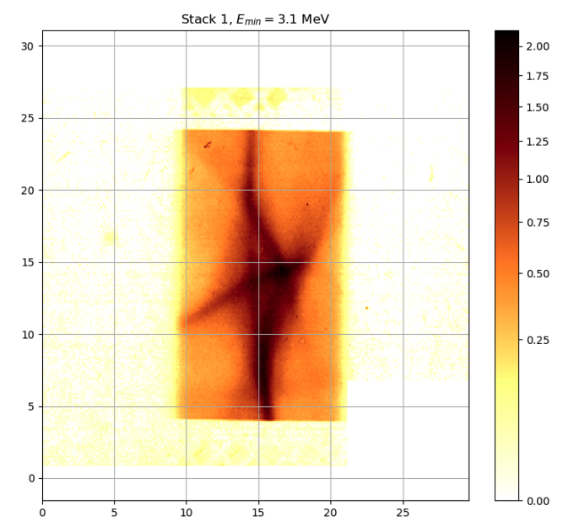
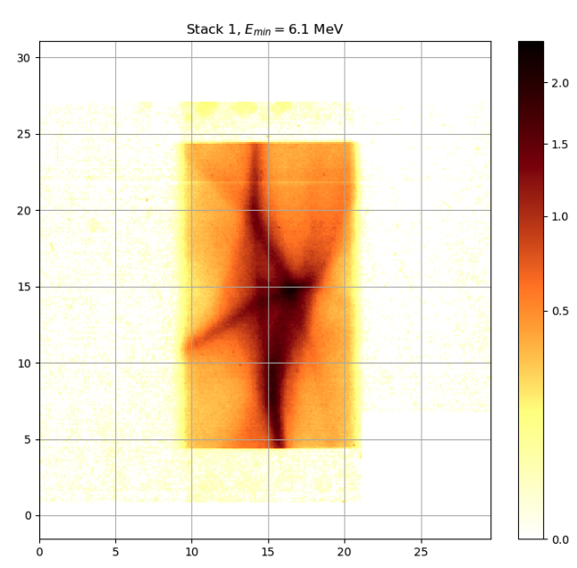
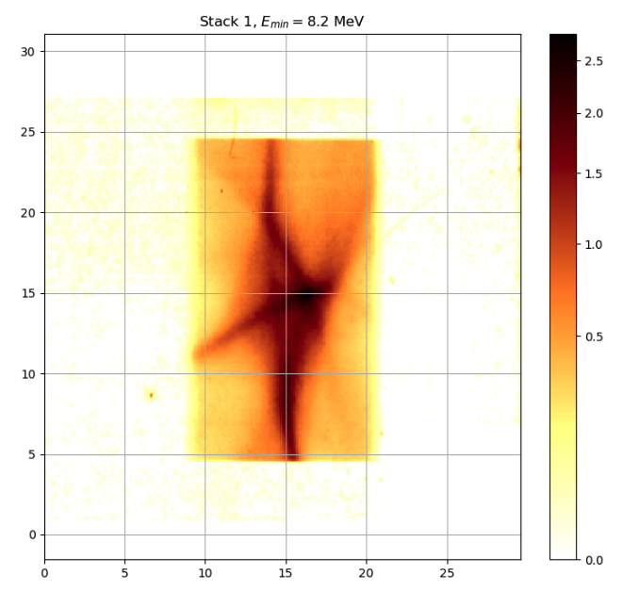
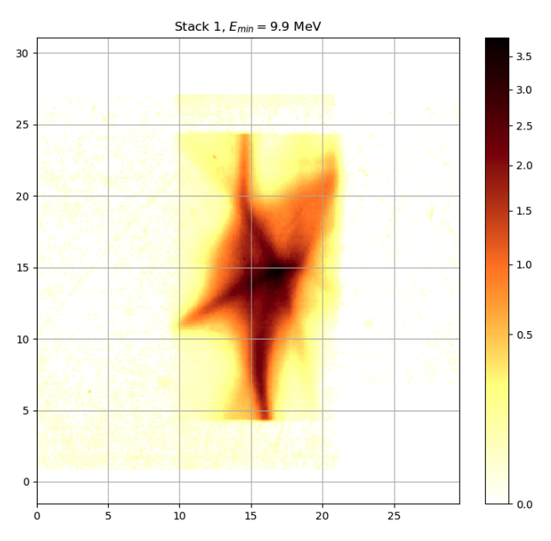
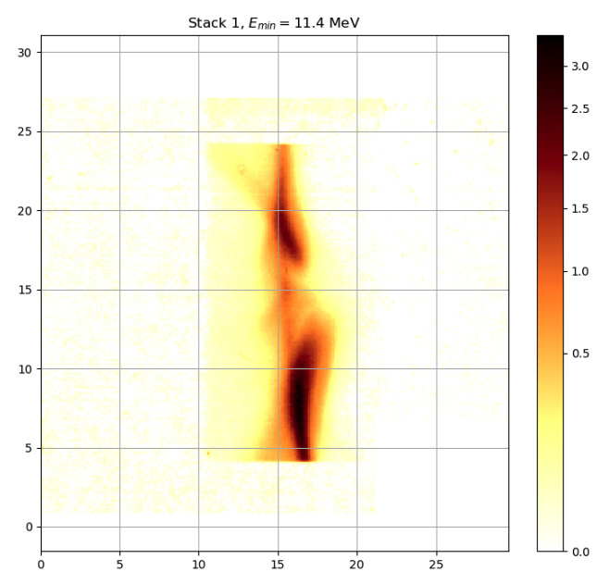
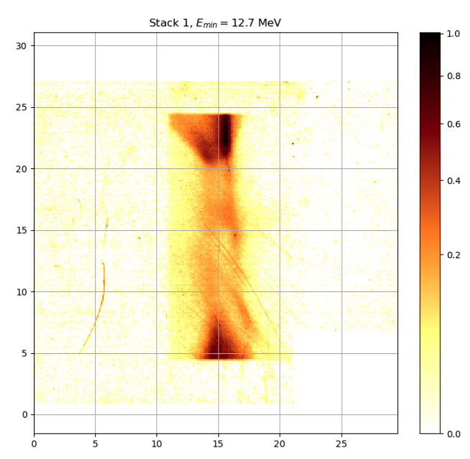
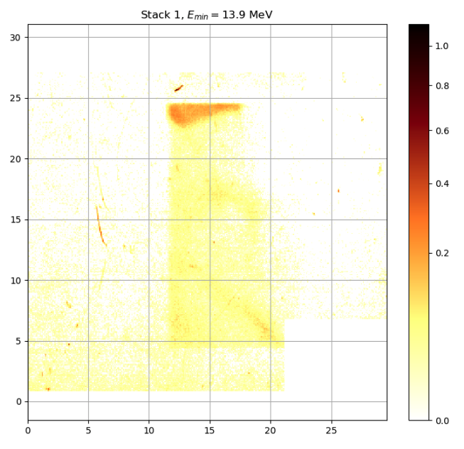







Manually reproduce beam through shifts and tilts of the PMQs
FQ: x = +0.1mm, $α$ = +0.004 rad, $β$ = 0.004 rad, $γ$ = -0.003 rad;
DQ: x = +0.1mm, $α$ = -0.004 rad,$β$ = 0.004 rad, $γ$ = -0.003 rad
Simulation of 1x10⁵ particles
Energy deposited (MeV)
Log(energy deposited (MeV))
${\text{E}}_{\text{min}} \text{=} \text{3.1 }\text{MeV}$
${\text{E}}_{\text{min}} \text{=}\text{ 6}\text{.1 }\text{MeV}$
${\text{E}}_{\text{min}} \text{=}\text{8.2} \text{MeV}$
${\text{E}}_{\text{min}} \text{=}\text{ 9.9} \text{MeV}$
${\text{E}}_{\text{min}} \text{=}\text{ 11.4} \text{MeV}$
${\text{E}}_{\text{min}} \text{=} \text{12.7 }\text{MeV}$
${\text{E}}_{\text{min}} \text{=}\text{ 13.9} \text{MeV}$
Key Observations:
Vertical central line visible
Vertical, curved section of star-shaped arm can be seen in the simulation
LhARA Collaboration Meeting
Calvin Dyson - LhARA Collaboration Meeting
3

Slide 4
Plan for Bayesian Optimisation
Define a metric - Normalised Cross Correlation
Expand the setup to include all four windows
Process the RCF so that it is suitable for optimisation

Slide 5
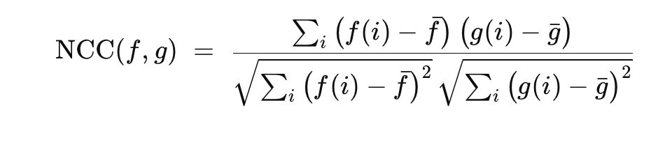
Normalised Cross Correlation (NCC)
  Features
      Range of -1 to 1:
        • 1: Exact Match
        • -1: Exact Opposite
      Scale Invariant

Slide 6
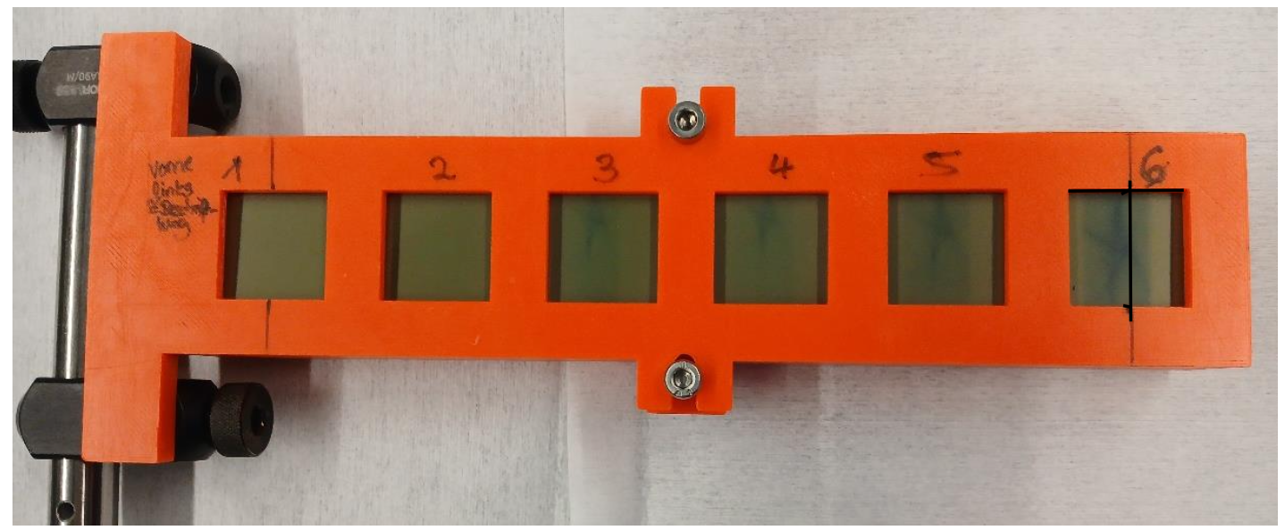
Expand to 4 windows
RCF in Scan
RCF in Holder
20MeV
20MeV
16MeV
12MeV

Slide 7
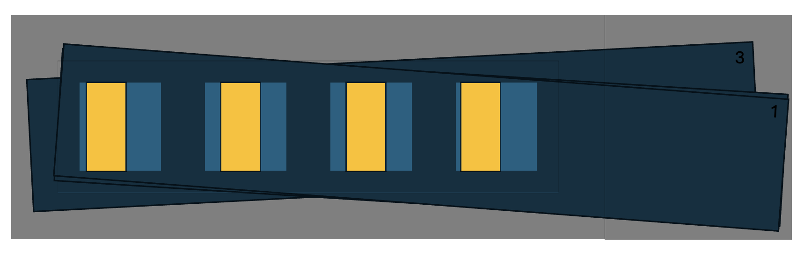
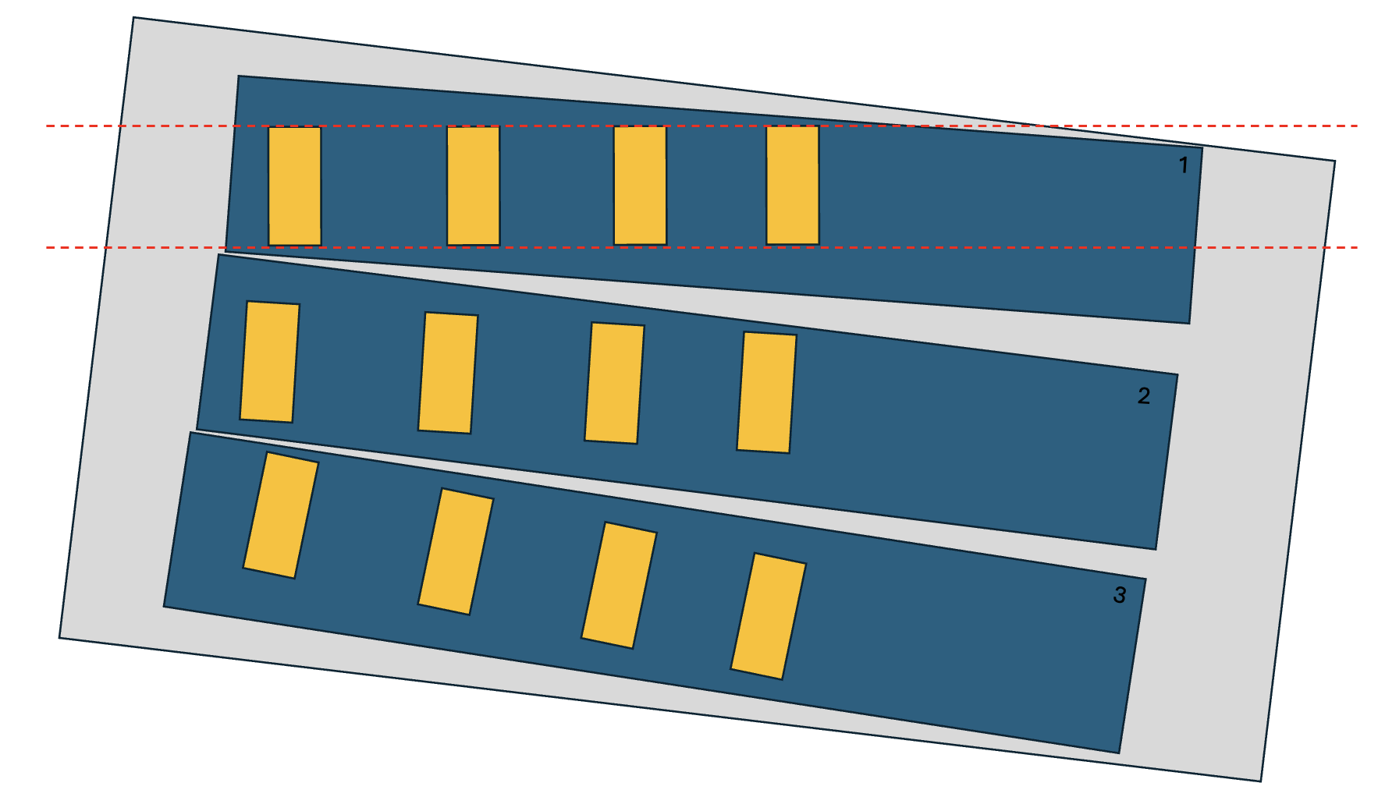
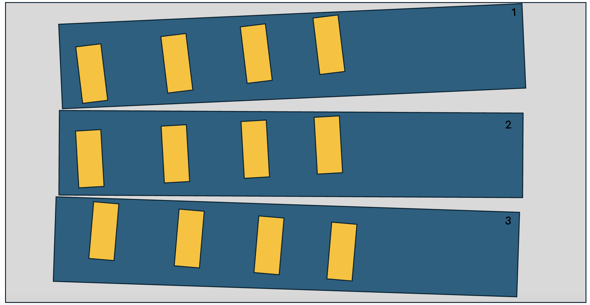
Correct for displacement of RCF
Vertical and Rotational alignment
Aligning the RCF to Windows of Holder
RCF in Holder
RCF in Scan

Slide 8
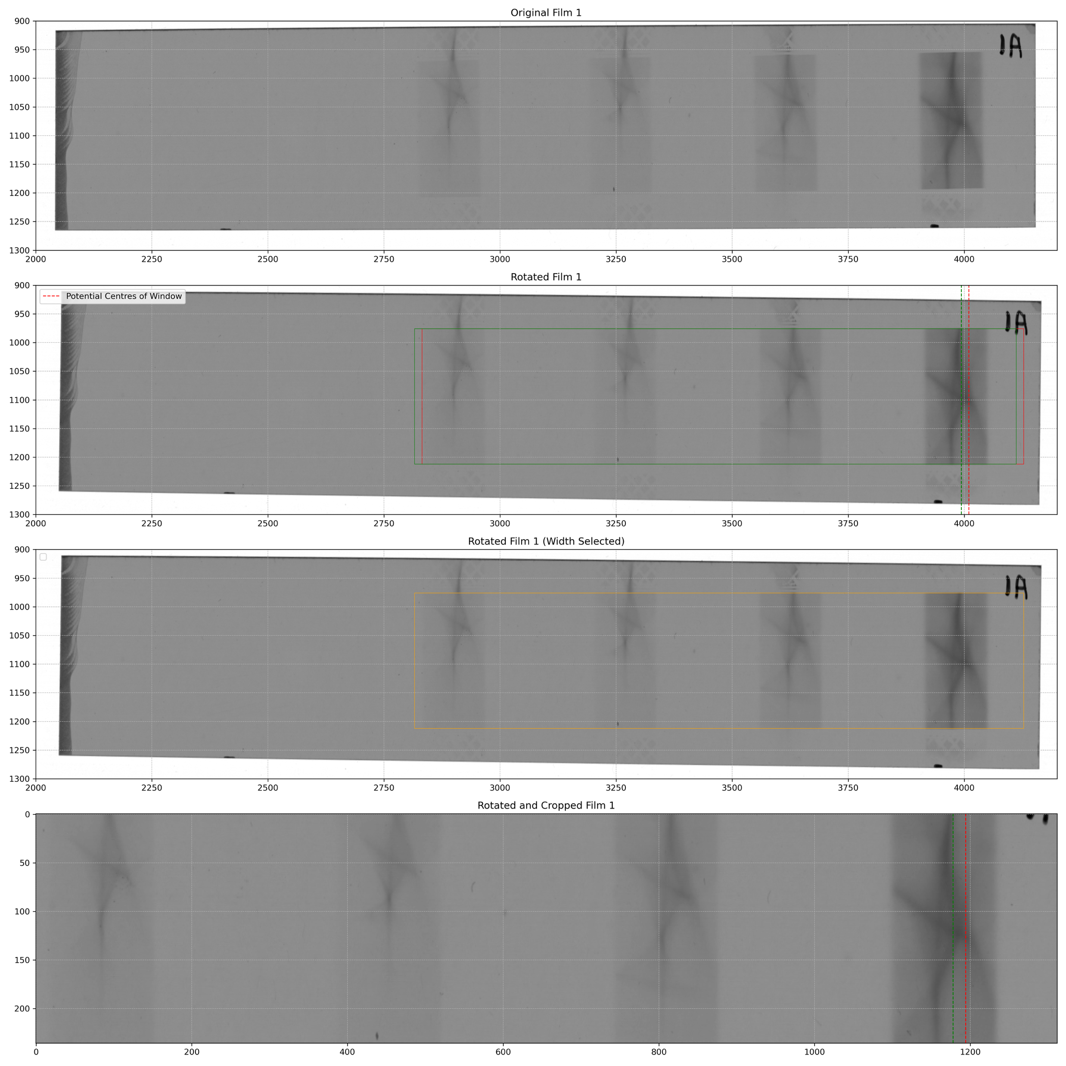
Correct displacement of RCF
Alignment and Cutting of Front Film
Horizontal Alignment – Front Film

Slide 9
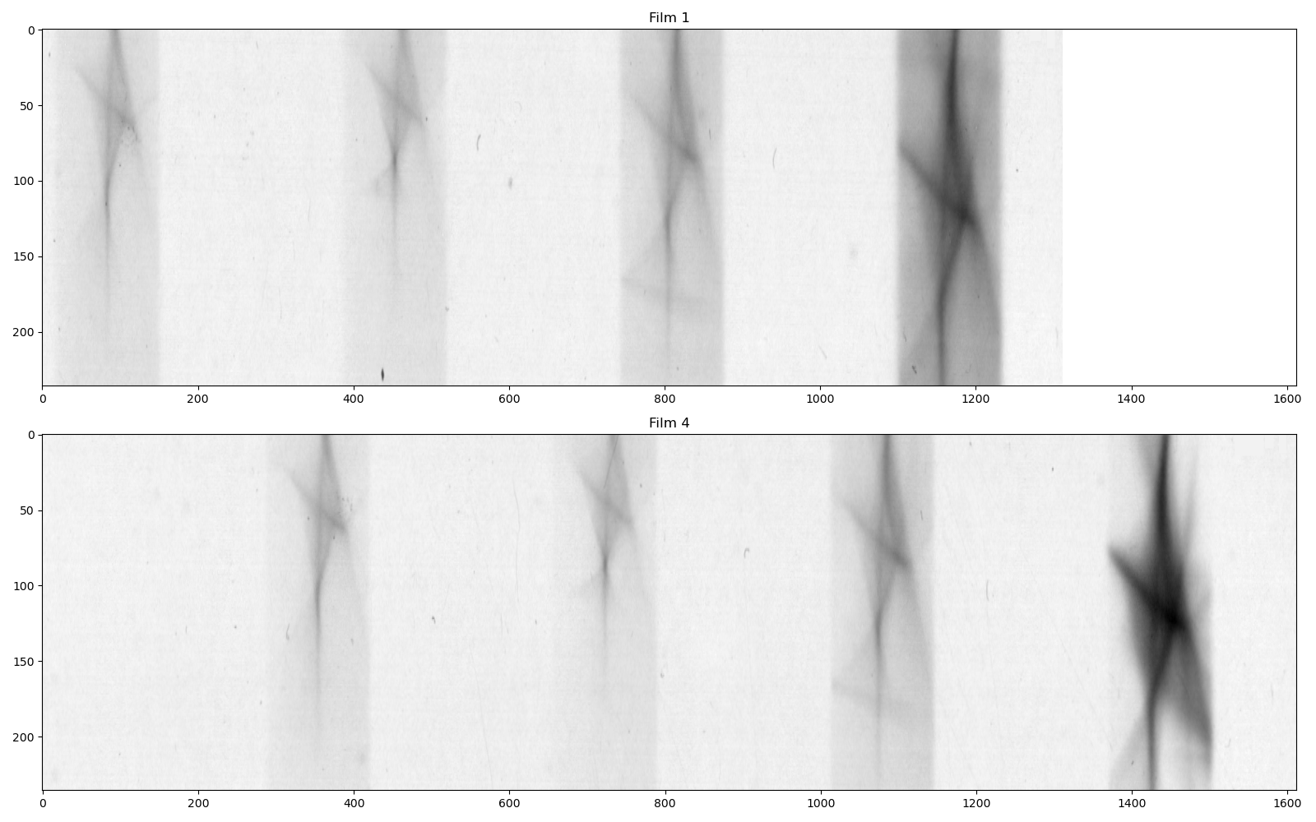
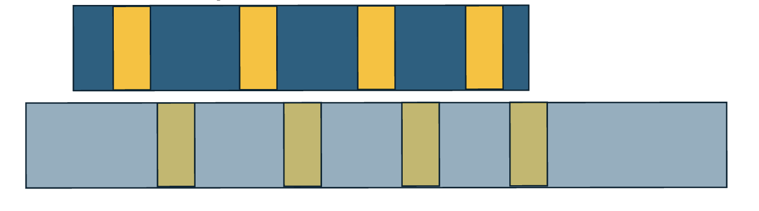
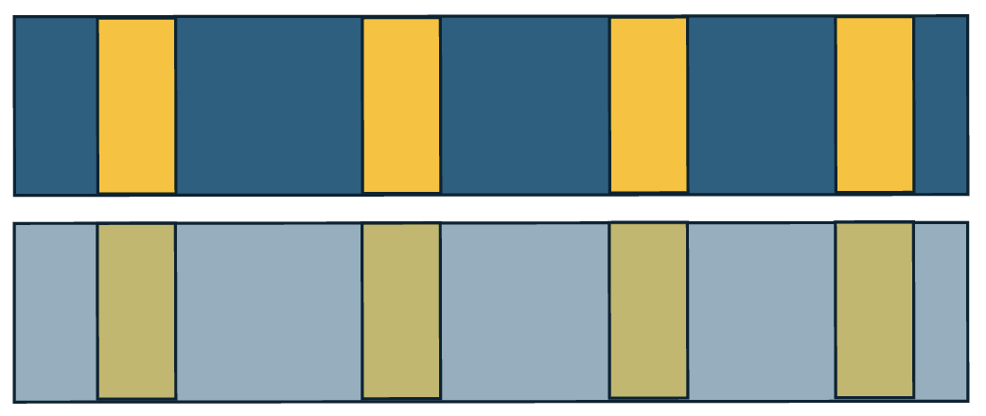
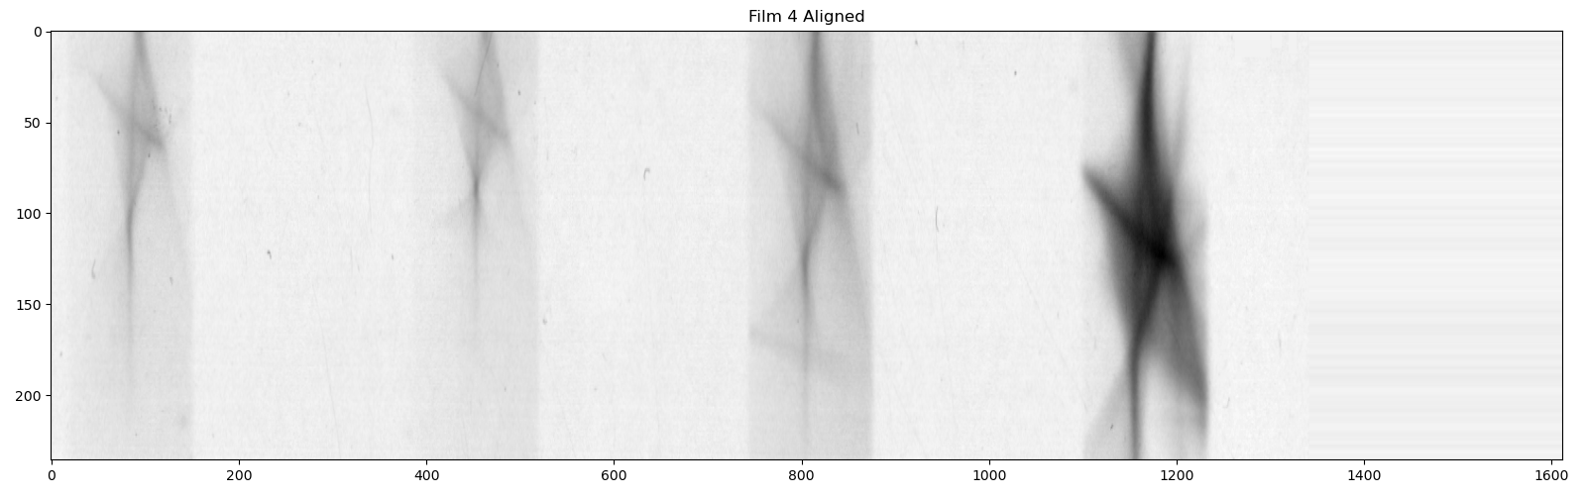
Correct displacement of RCF
Example of Film 4
Horizontal Alignment – Other Films
Cut Front Film vs Uncut Film
Aligned Film with Front Film

Slide 10
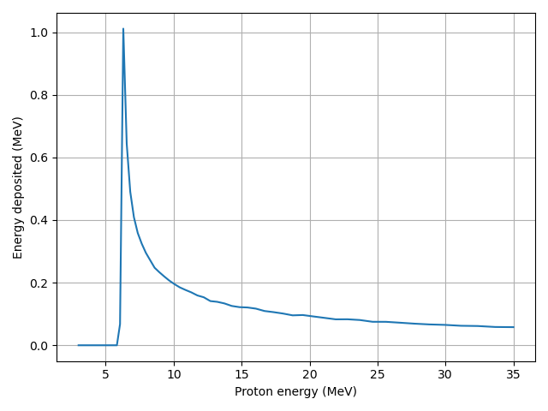
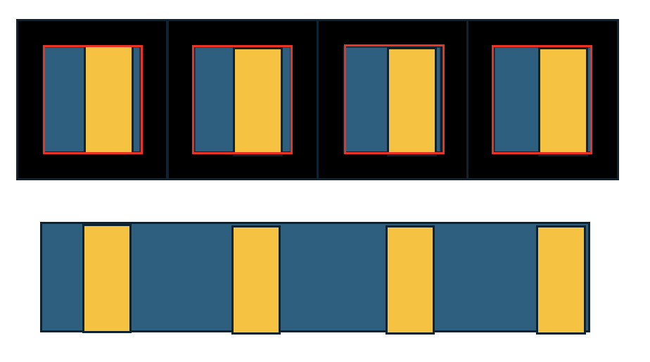
Generating the film in simulation
Basic Principle
20MeV
20MeV
16MeV
12MeV
Response Curve for Second Film

Slide 11
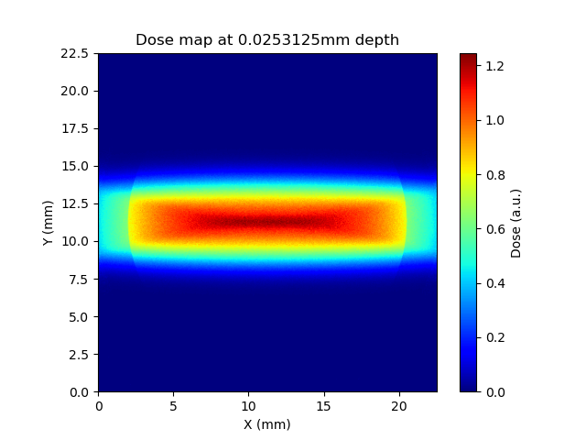
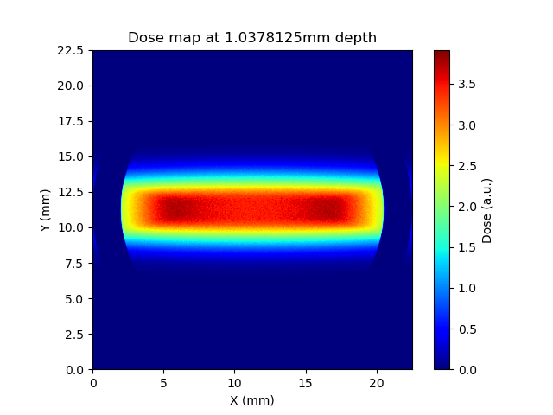
Generating the film in simulation
Chasing the split

Slide 12
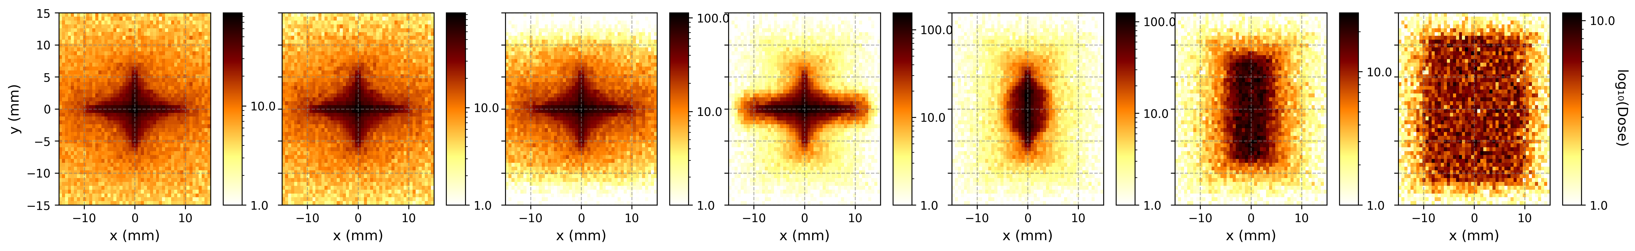
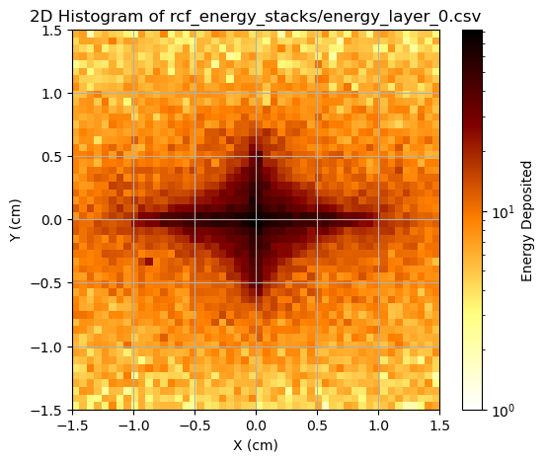
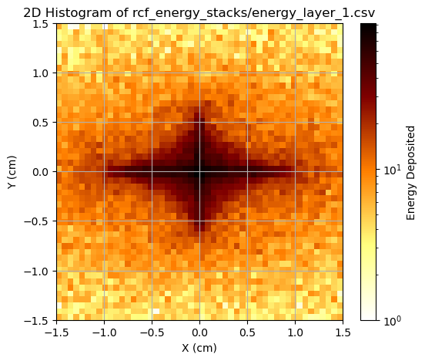
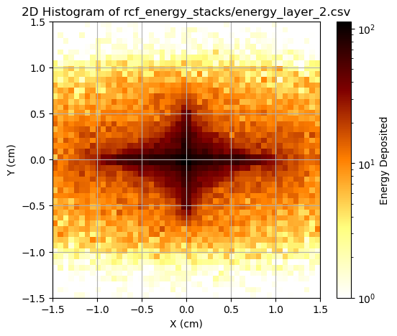
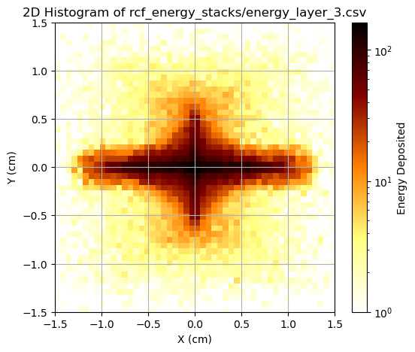
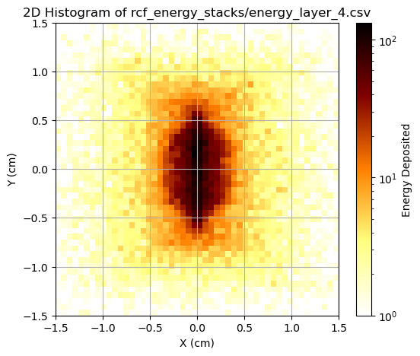
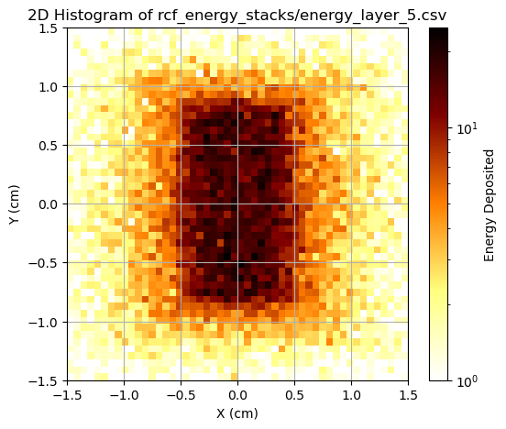
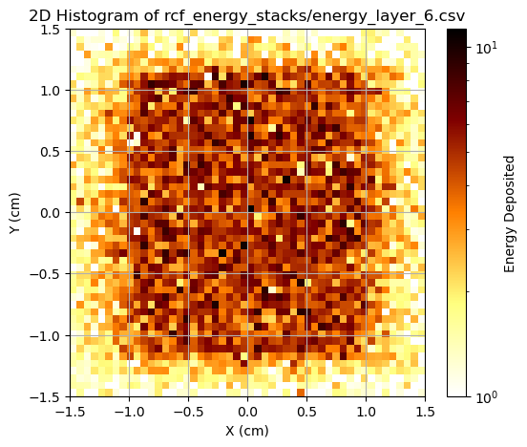
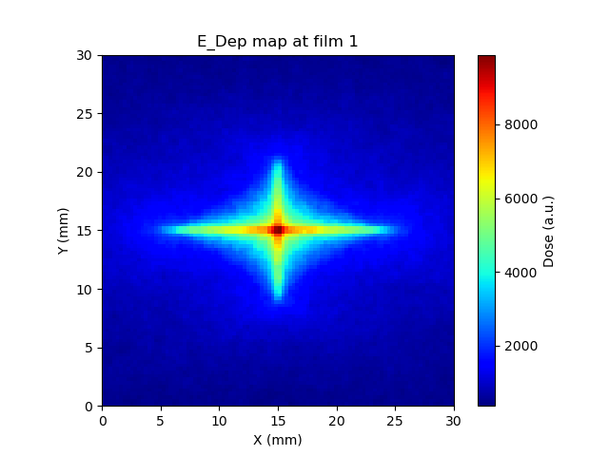
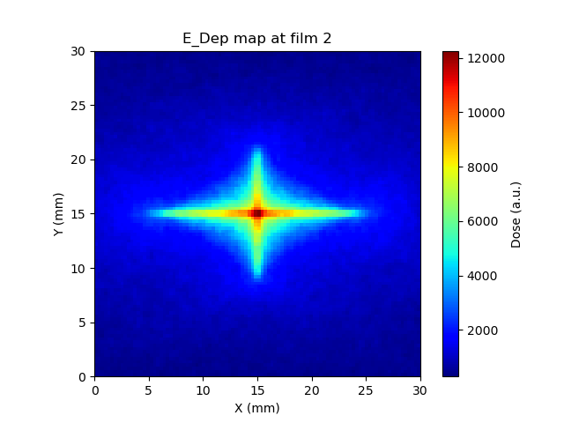
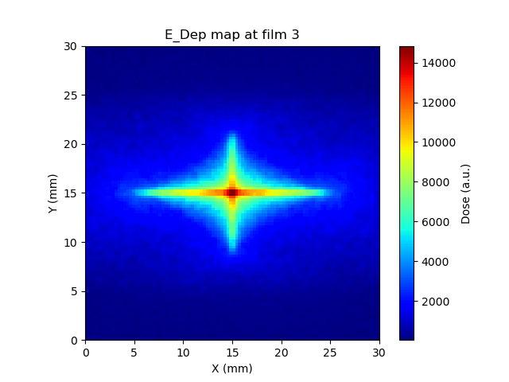
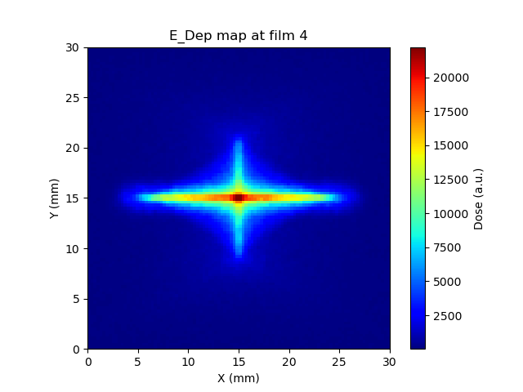
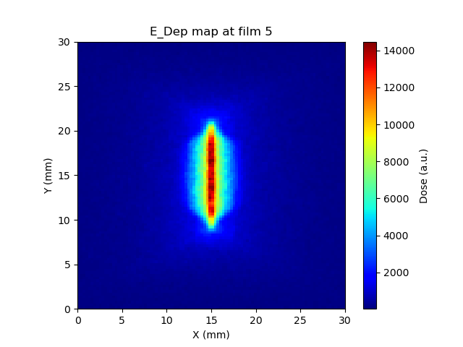
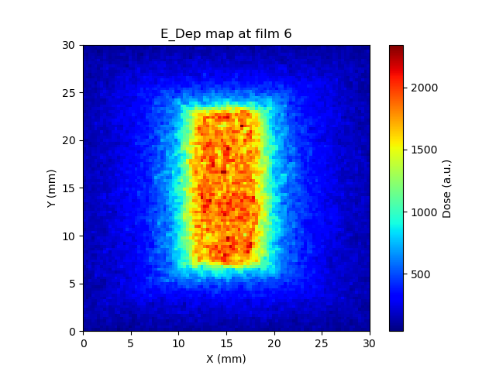
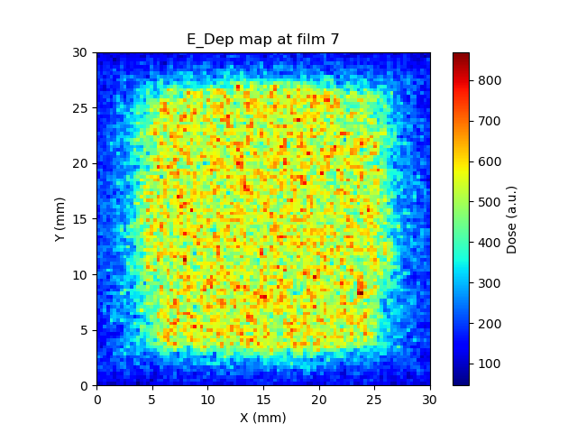
Generating the film in simulation
Chasing the split
LLO
(Response Function)
Geant4
TOPAS

Slide 13
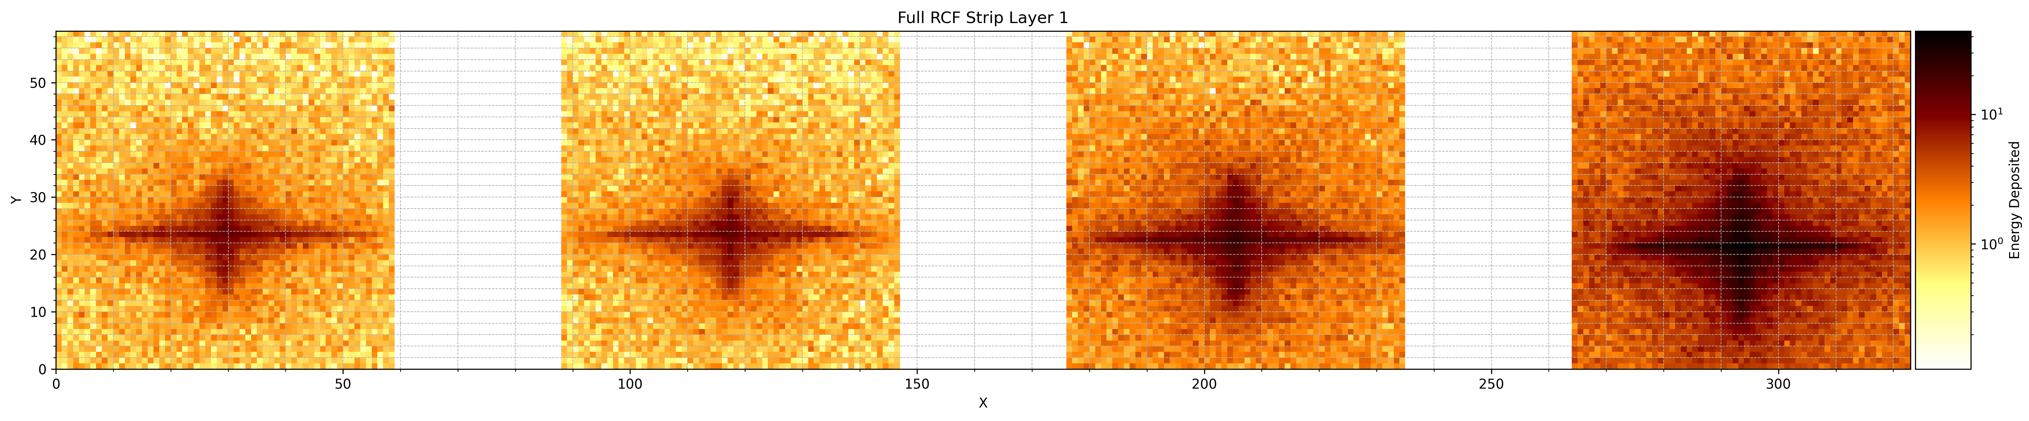
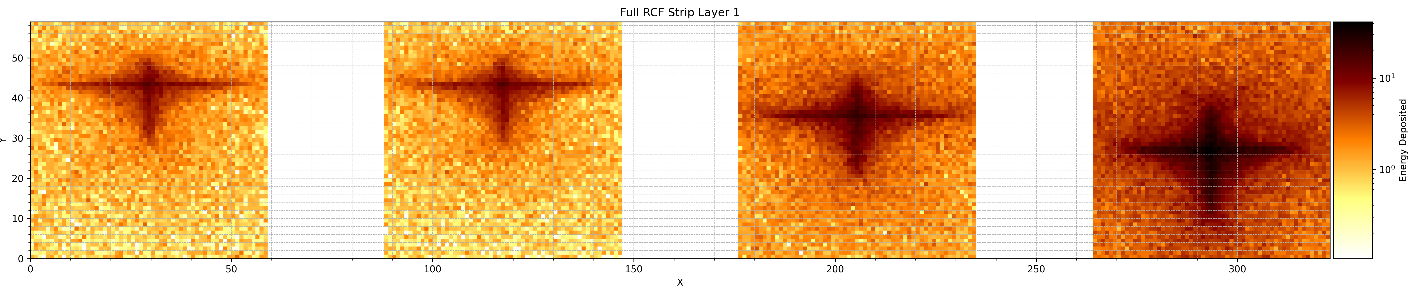
Testing the Optimisation
Key Results
Experimental Data
Shift 1st PMQ in y: 200um
Tilt 1st PMQ about x-axis: 2mrad

Slide 14
Testing the Optimisation
Tilt
Experimental Data
Shift 1st PMQ in y: 200um
Tilt 1st PMQ about x-axis: 2mrad

Slide 15
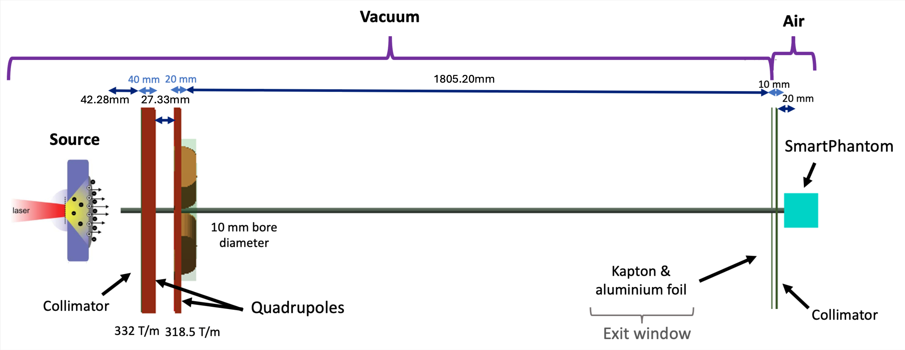
Correcting the Beamline
1705.75mm
32.31mm
46.94mm
32.33mm
RCF Stacks
Before
Circle 40mm diameter
FQ
DQ
Glass Collimator
1705.75mm
32.31mm
46.94mm
32.33mm
RCF Stacks
Now
Rectangular
80mm height
10mm width
334 T/m
DQ
FQ

Slide 16
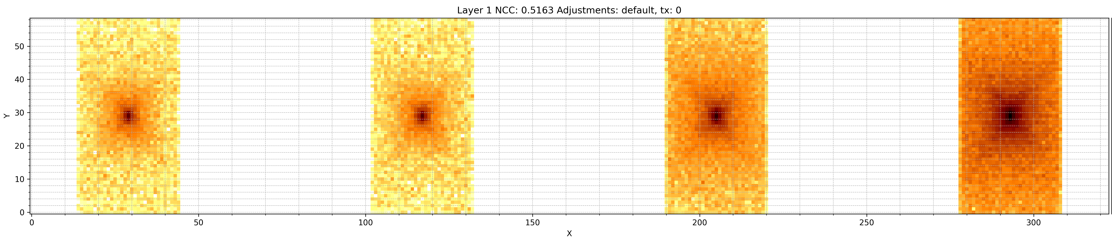
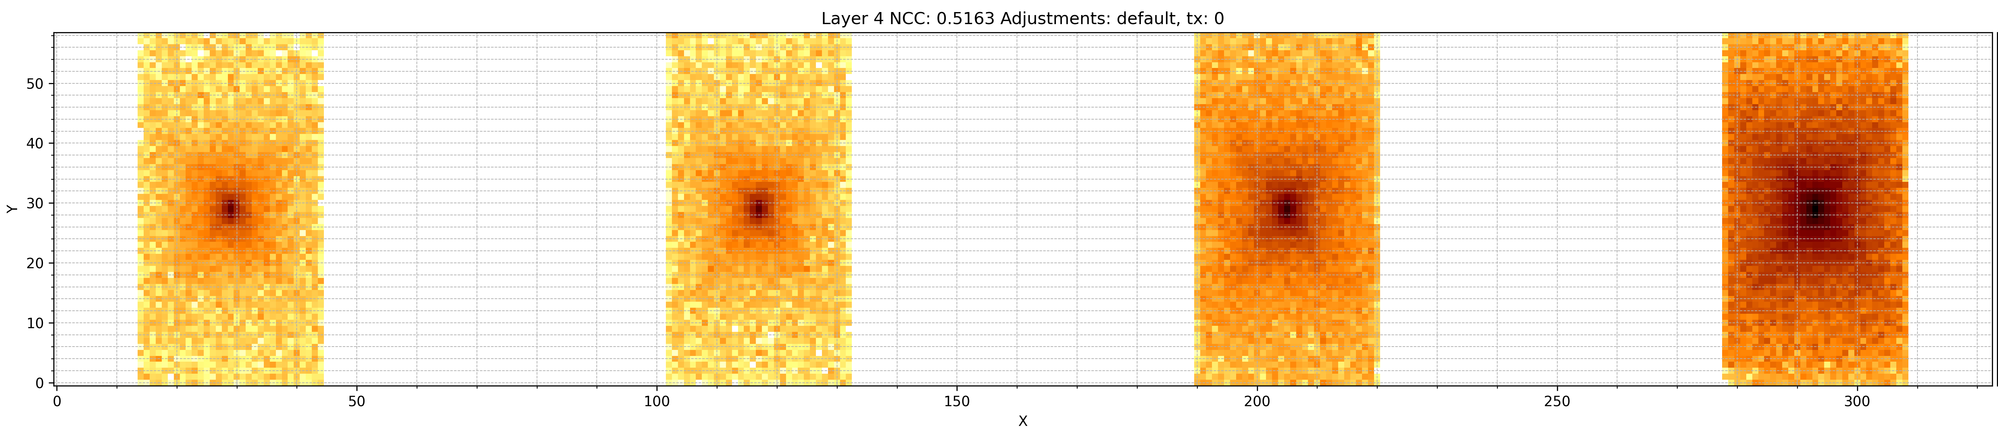
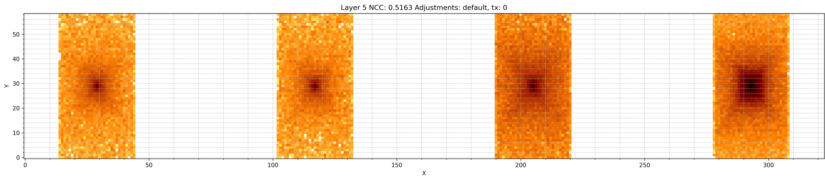


Default Beamline Result

Slide 17





Optimised Result
1st Quad
About x:
344 urad
About y:
985 urad
About z:
-228 urad
2nd Quad
About x:
1995 urad
About y:
1264 urad
About z:
-250 urad

Slide 18
Conclusions and Future
LhARA Linear Optics reproduces realistic effects in the beam due to PMQ offsets
Simulations indicate the star-shape effect is caused by tilting in the PMQs
      Other potential causes will be mentioned later
Optimisation reached a close representation of the beam
      The optimisation process can be refined further

Slide 19
Thank you
Simulation of LION Beam
07/04/2025

