Slide 1
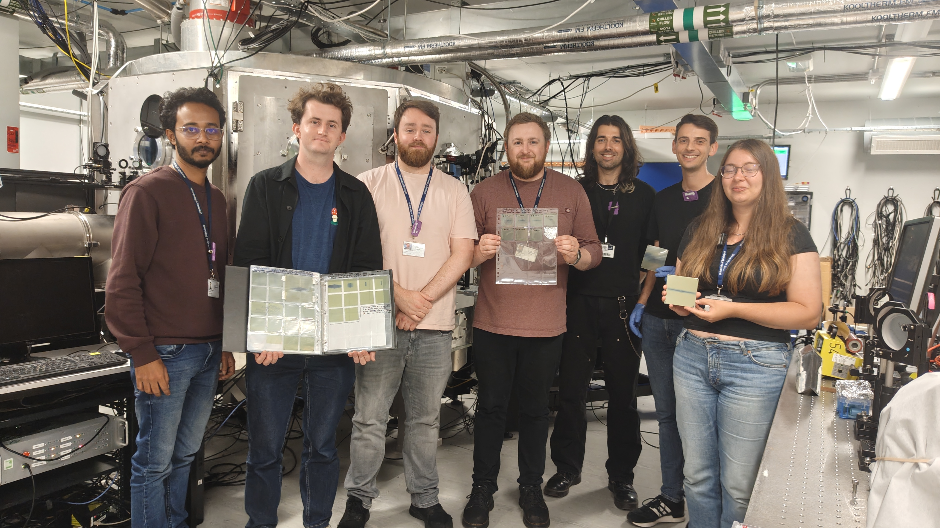
Stars in the PoPLaR beam line on SCAPA

Slide 2
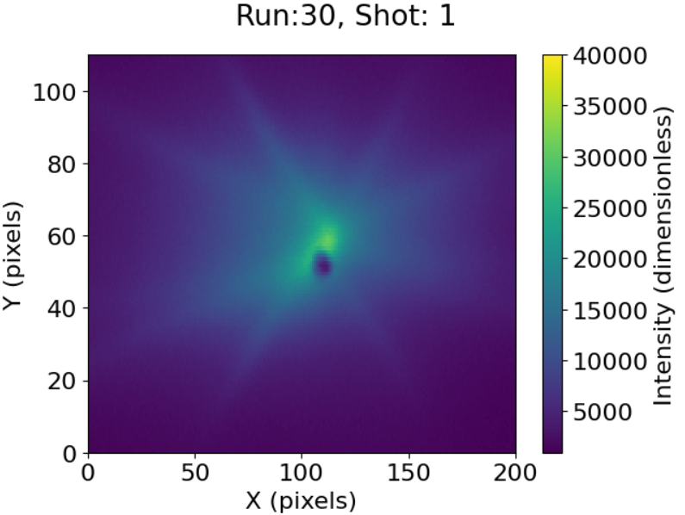
Example star from 30Oct25
Black dot marks centre of beam line on lanex
Count 8 lines radiating from focus:
  Colin “witness lines”
White lines:
  2 drawn “by eye” through witness lines
  Central line drawn at 45º, i.e. through centre of pole tip
Green lines:
  Lines of equal length drawn on top of white lines
Red Line
  Length half of green lines, positioned at end of green lines
Witness lines have angular separation of 30º

Slide 3
Permanent magnet quadrupoles
12 segments: each subtending 30º
4 pole pieces; steel, magnetized by neighbouring magnet blocks
Pole pieces for PoPLaR do not have tuning holes

Slide 4
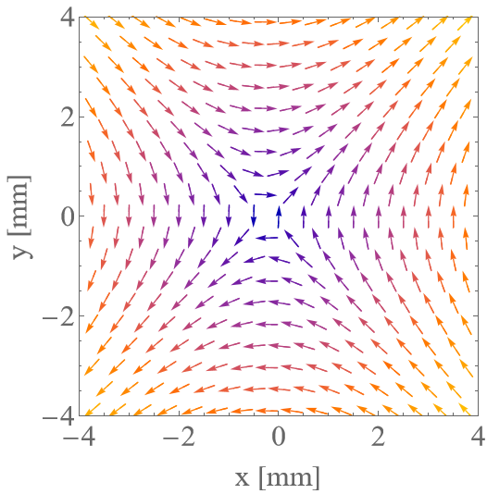
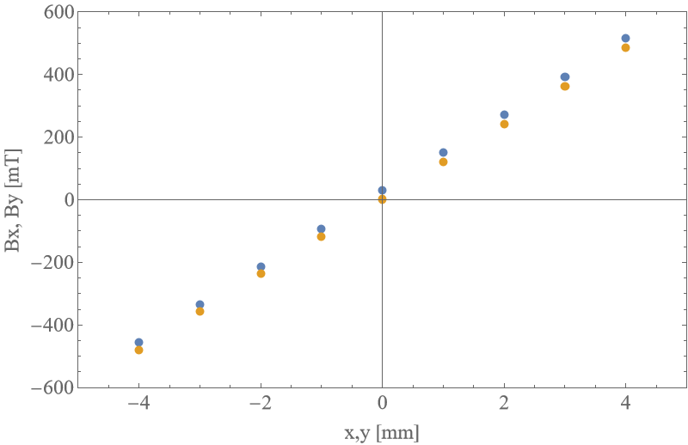
Field maps obtained by fitting measurements at DL
Good quadrupole field out to 4 mm
Bore 10 mm; beam (over-) fills aperture; so, consider impact of field close to pole pieces/magnet blocks
  Calvin’s early insight!

Slide 5
Field close to interface between pole tip and magnet block
In neighbourhood of pole seem to find field tangent to circumference of bore
No present in neighbourhood of magnet blocks because flux contained in material
Causes particles to be bent either into material (and lost) or across bore
8 such locations, would produce witness lines in 4 pairs, each pair separated by 30º

