Slide 1
Data Acquisition System for Munich
22/8/2024

Slide 2
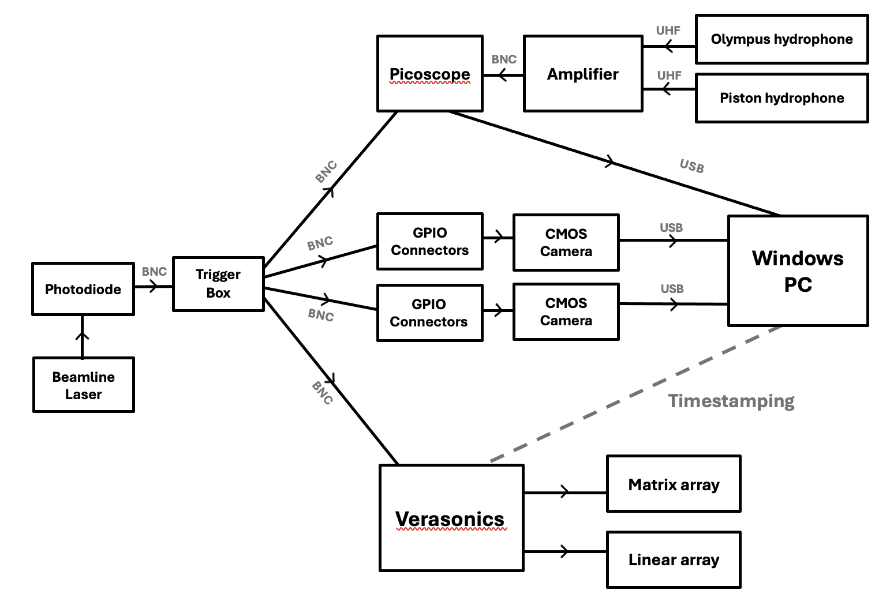
Data Acquisition System

Slide 3
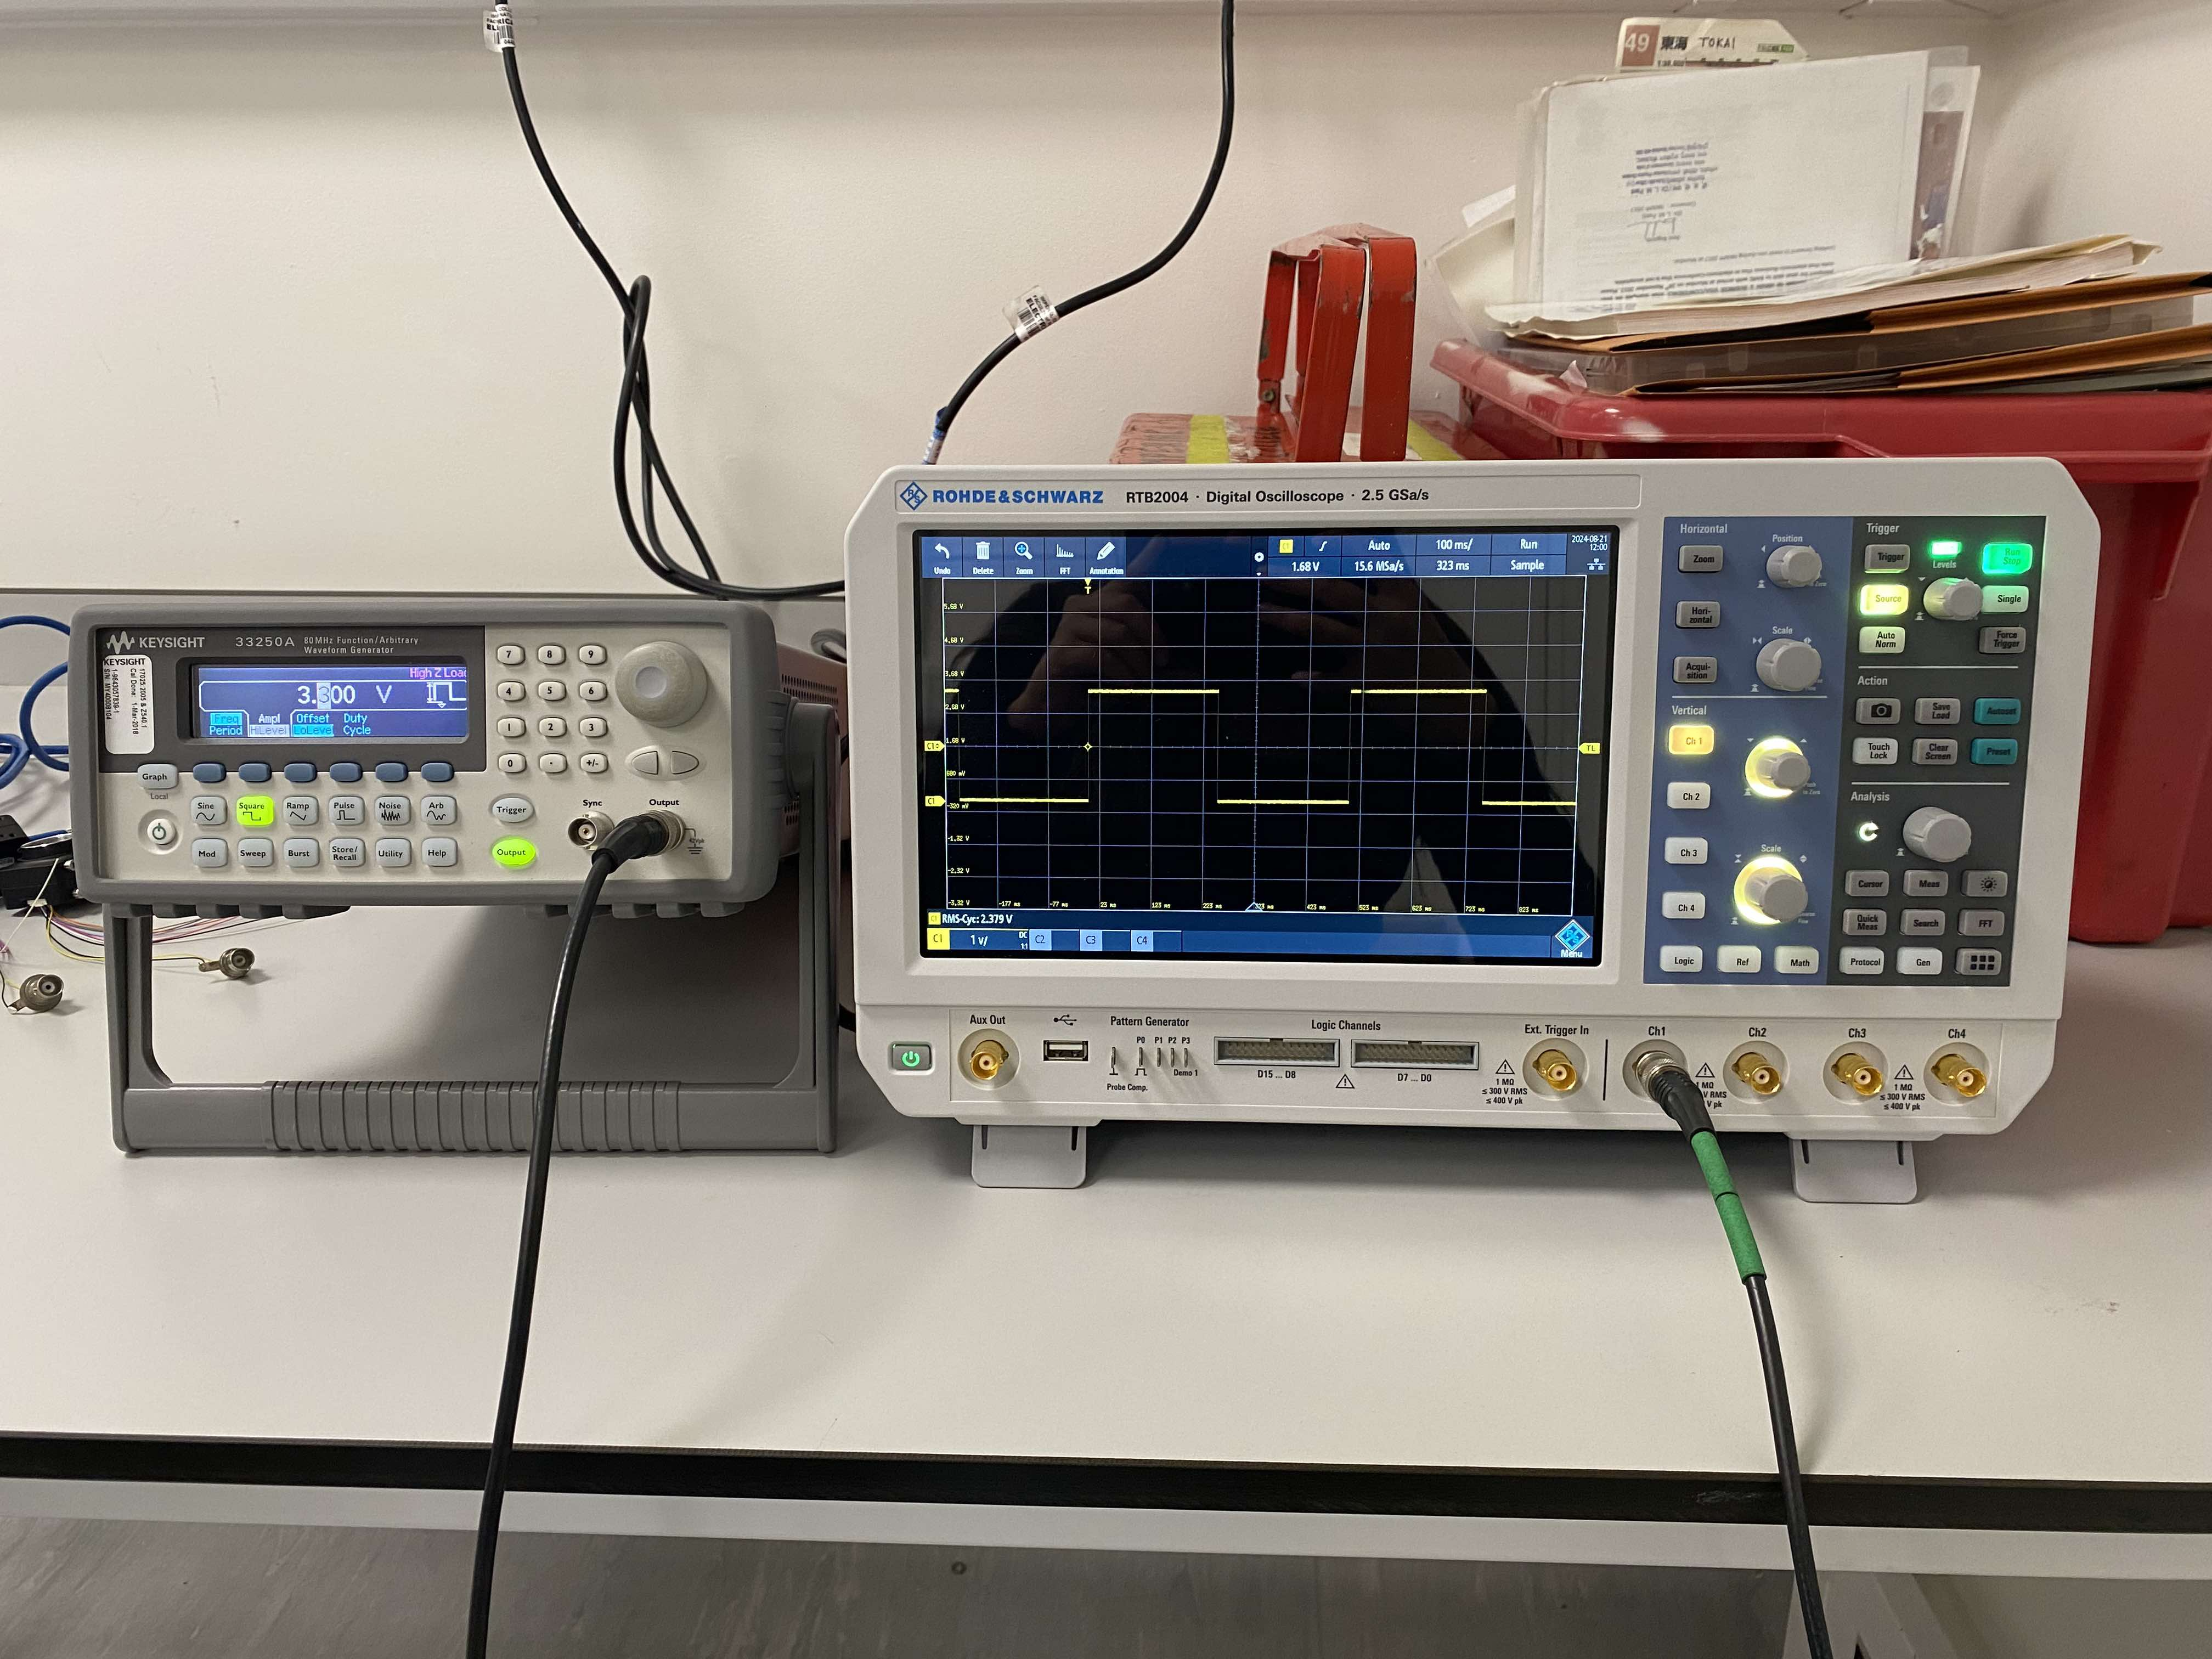
Trigger signal generation
3.3 V square pulse
Signal generator
Oscilloscope

Slide 4
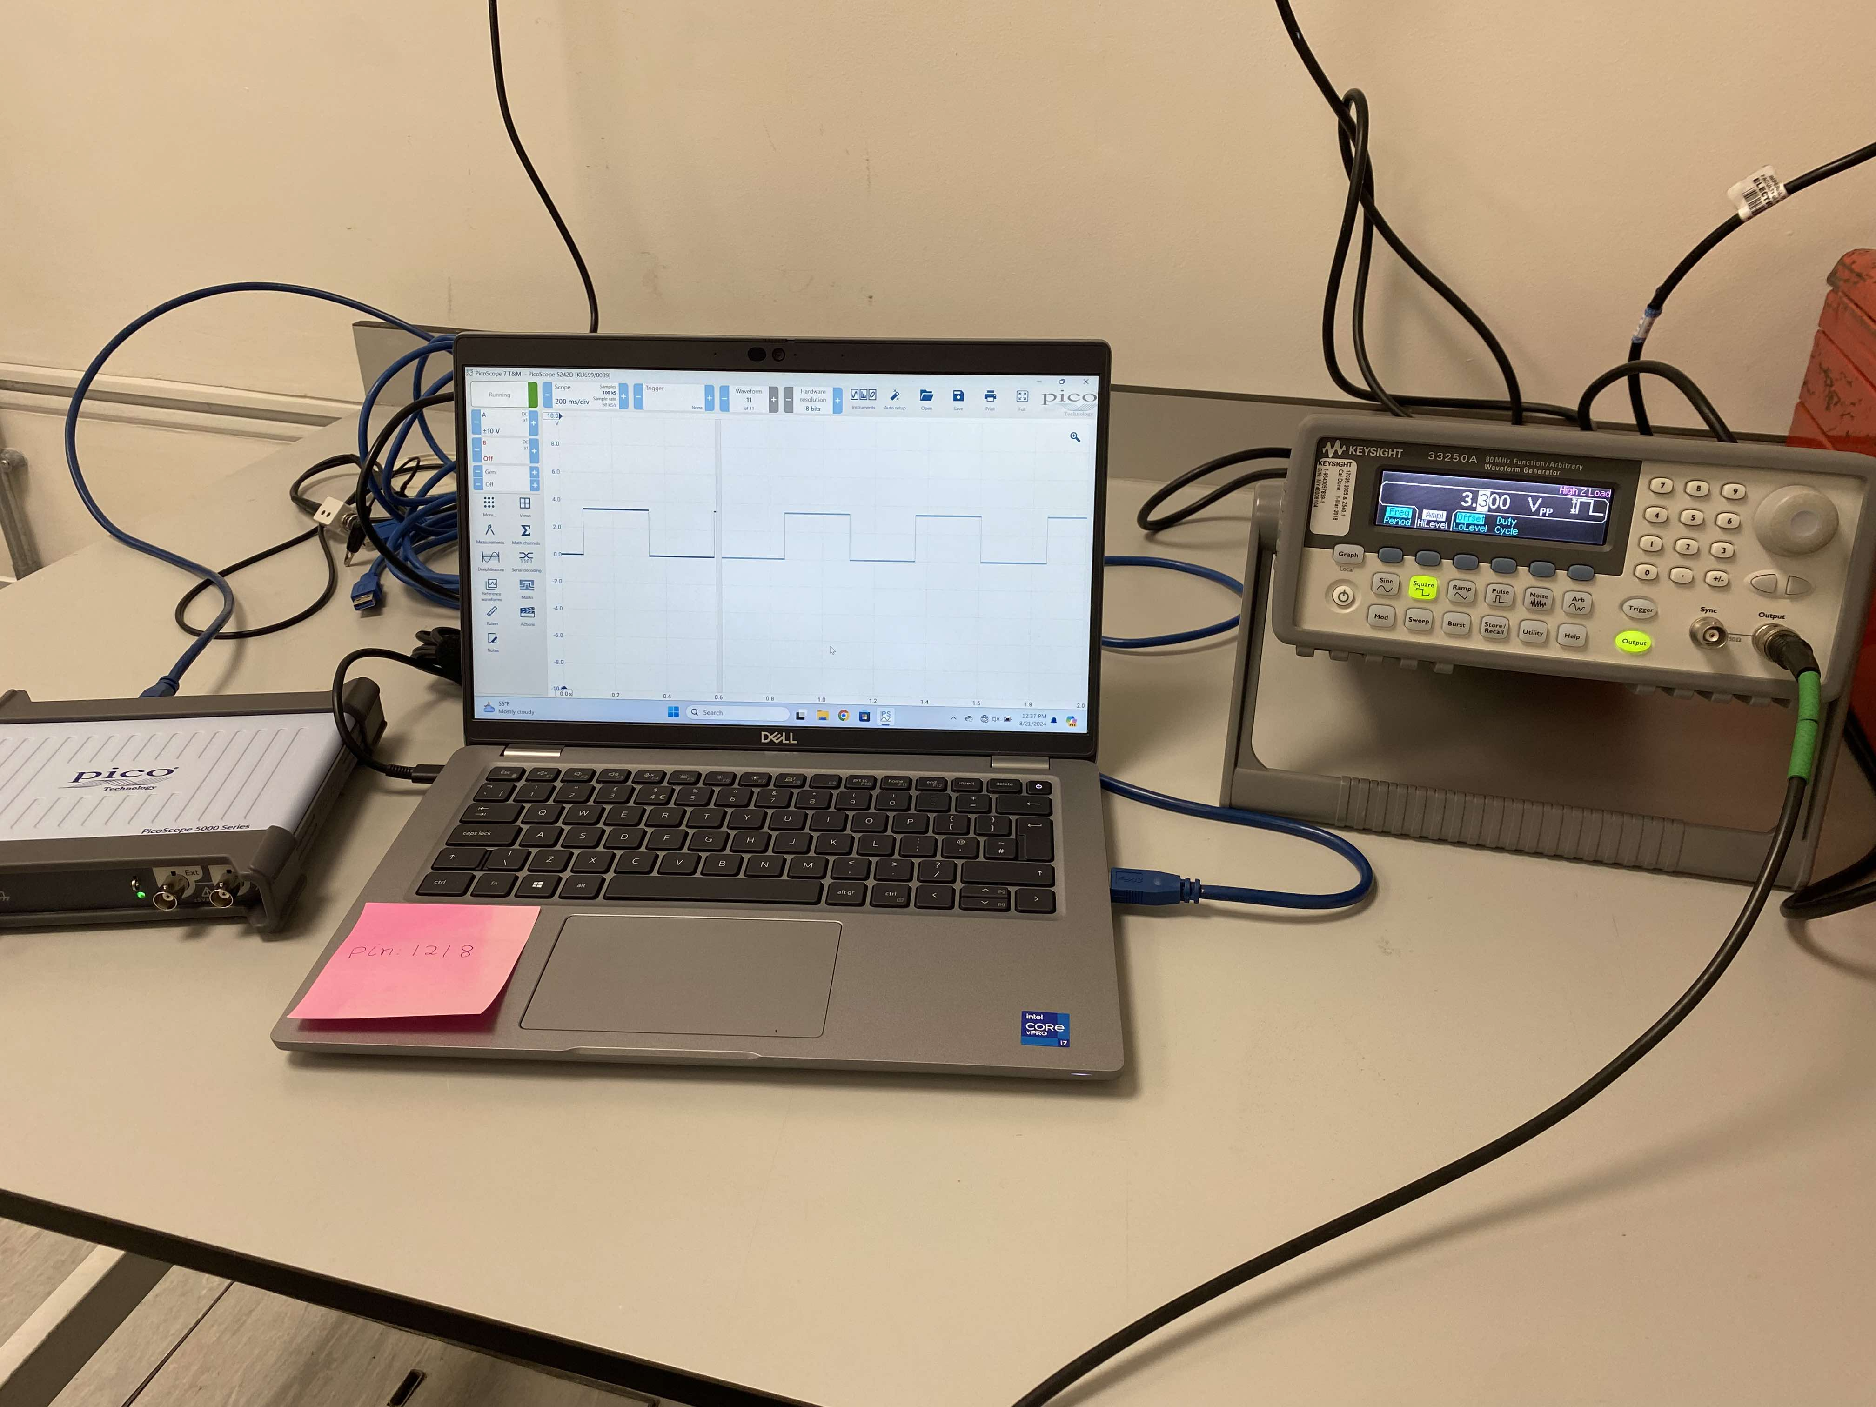
Reading through the picoscope
3.3 V square pulse
Signal generator
Picoscope

Slide 5
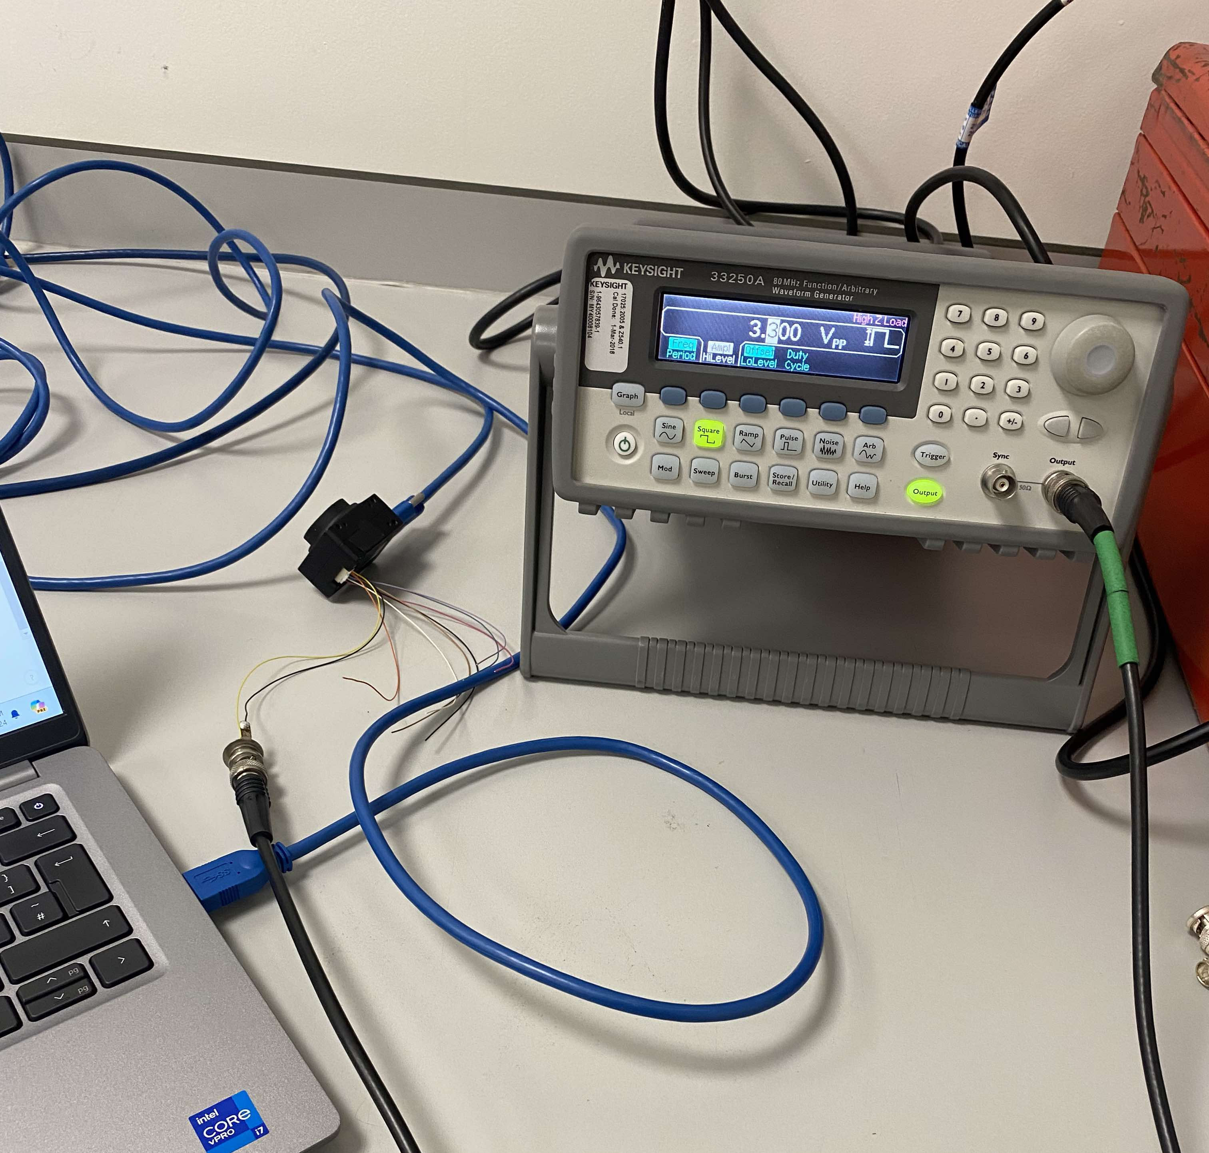
Camera Triggering
Signal generator
Camera
GPIO connector
BNC cable from signal generator

Slide 6
Action List
Cameras: Trigger doesn’t work: either hardware or software issue

