Slide 1

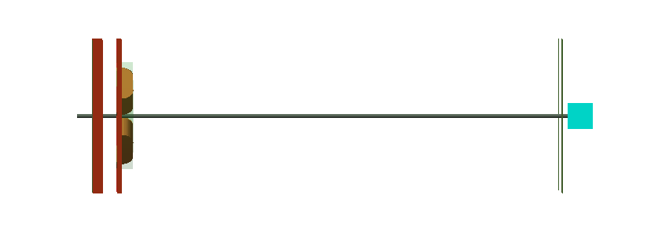
LION beamline
vacuum
air
55.77 mm
1728.59 mm
10 mm
60.34 mm
20 mm
SmartPhantom
10 mm bore diameter
Kapton & aluminium foil
Shielding
2x quadropole magnets for focusing
Collimator
exit window
332 T/m
318.5 T/m

Slide 2

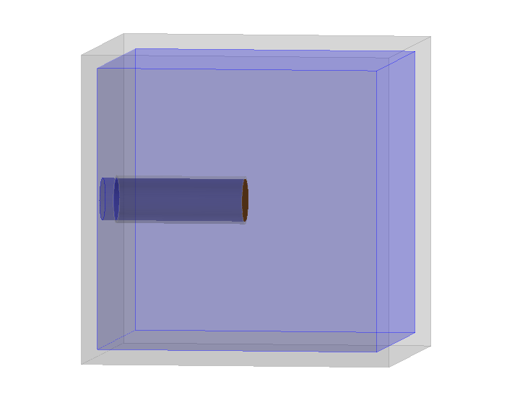
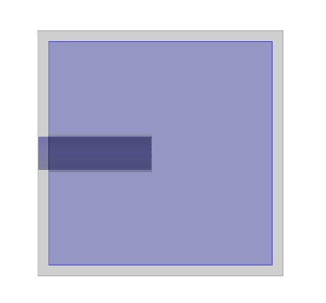
SmartPhantom
Aluminium
5 mm
Kapton entry window
Beam
Y
15 mm
110 mm
15 mm
Water
Z
X
110 mm
110 mm

Slide 3
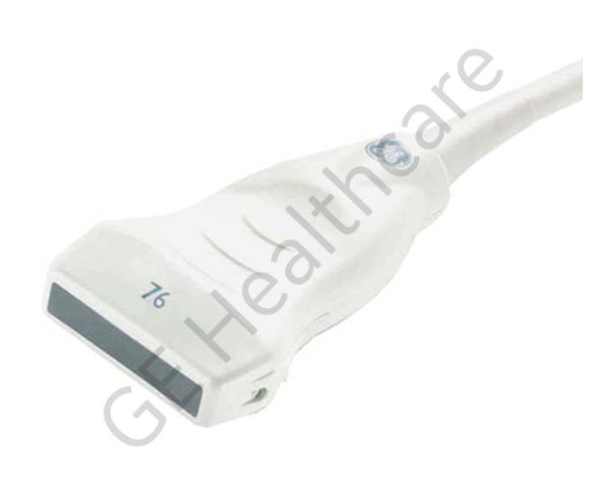
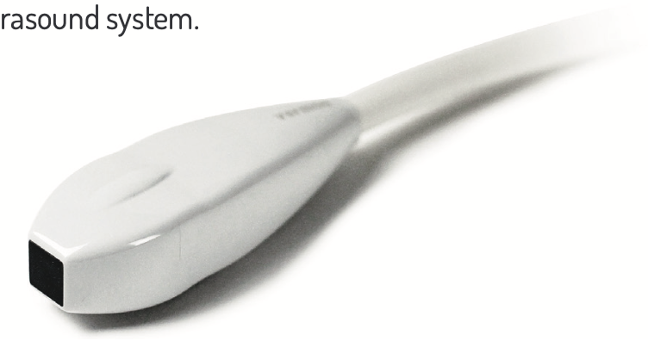
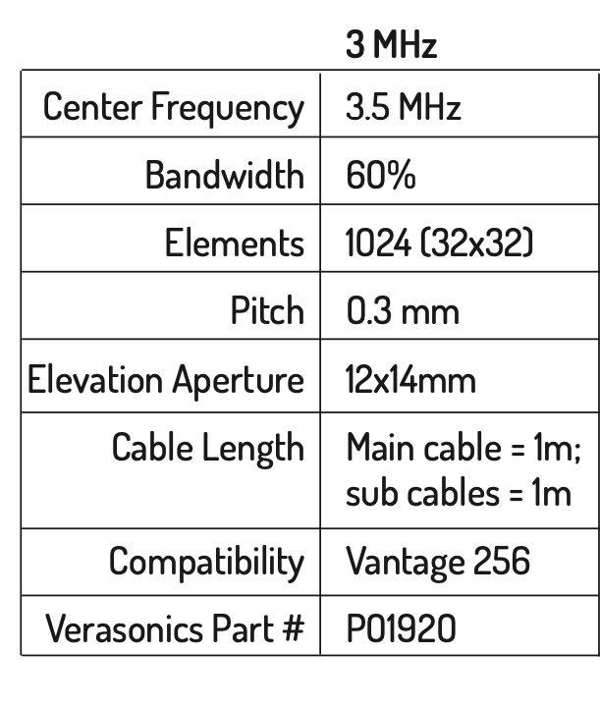
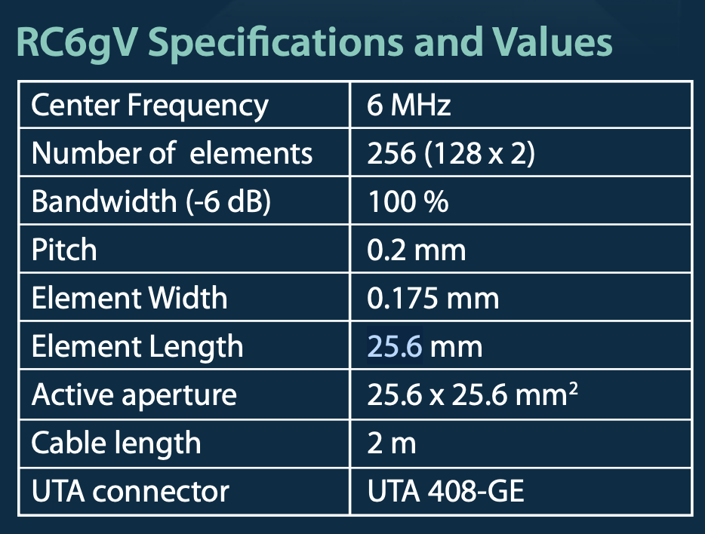
Transducers
?
Immersion transducer

Slide 4
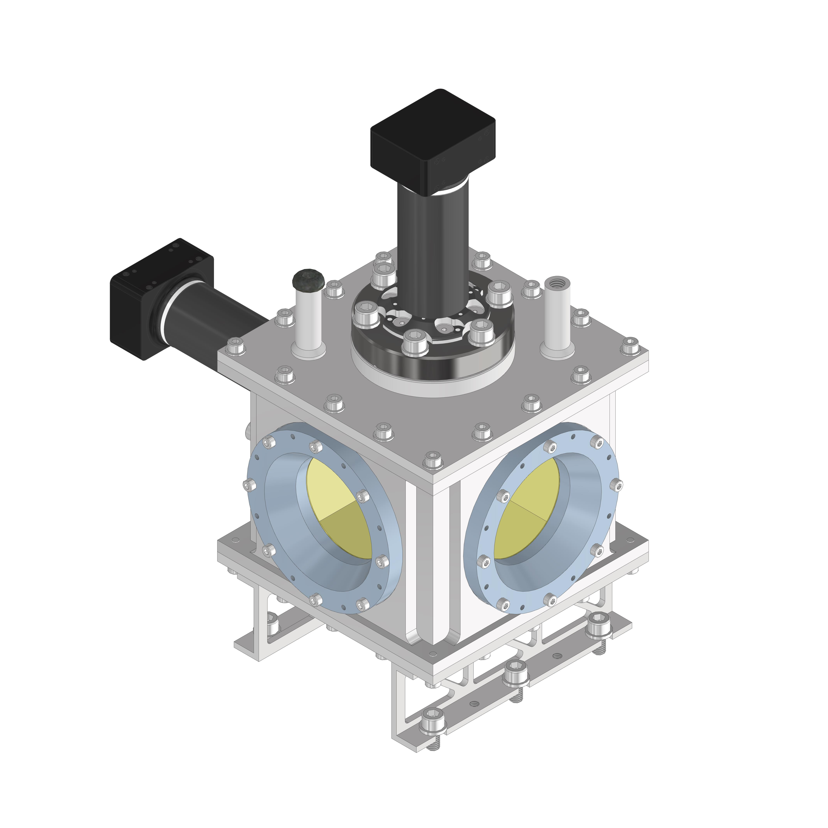
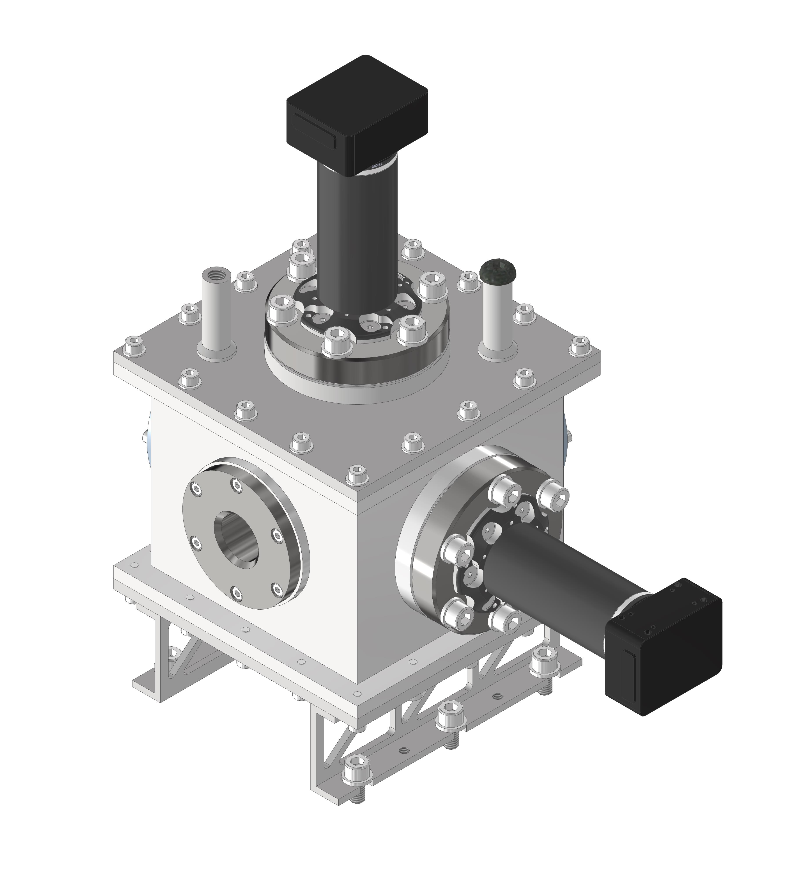
Current Design
Camera
Beam
110 mm
Y
Beam
110 mm
110 mm
X
Z
Camera
Transducer ports

Slide 6
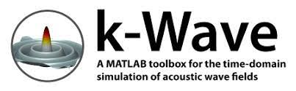
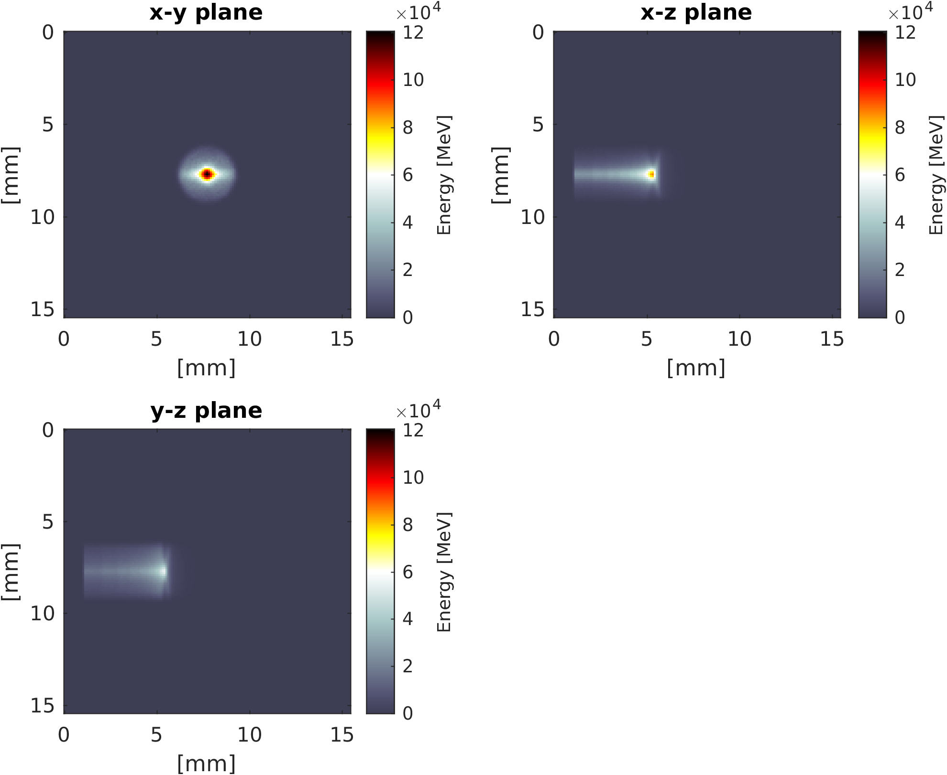
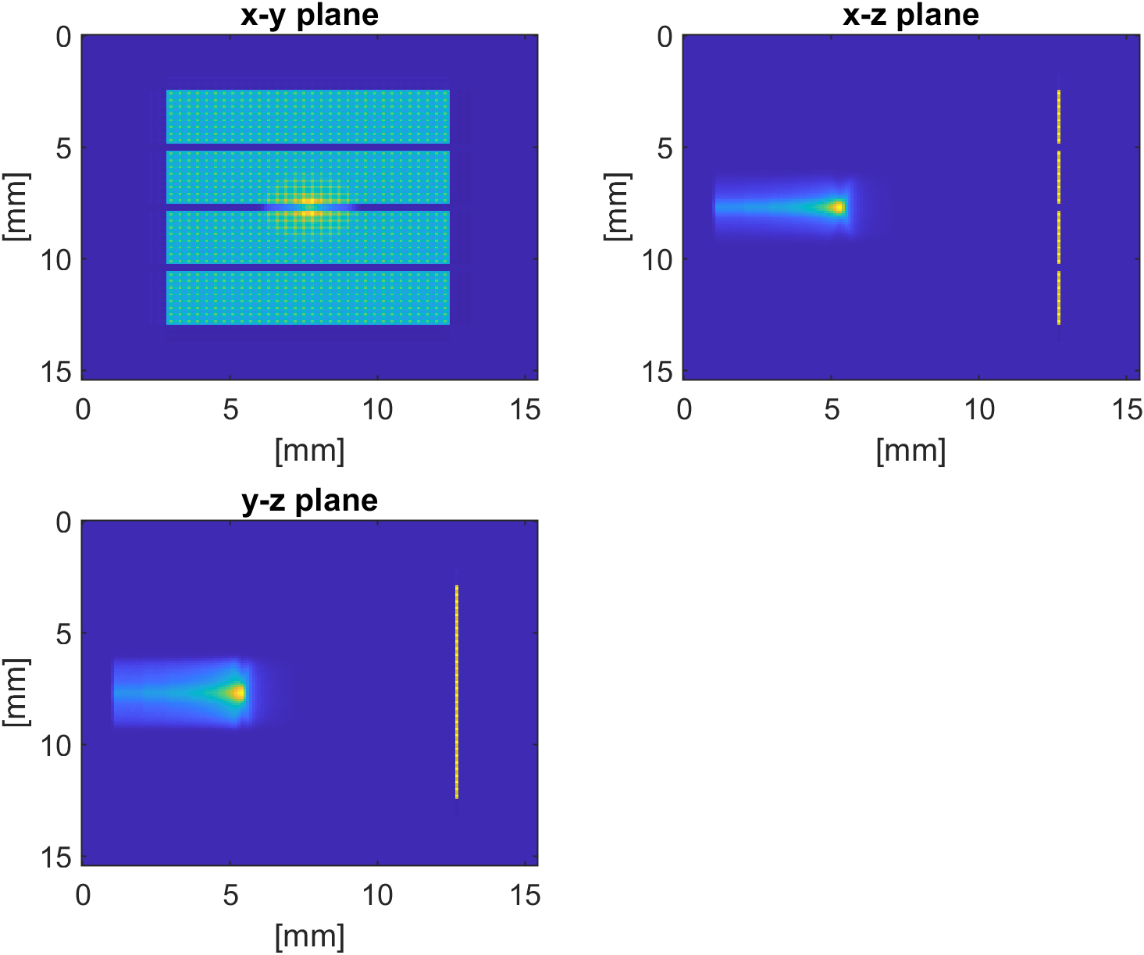
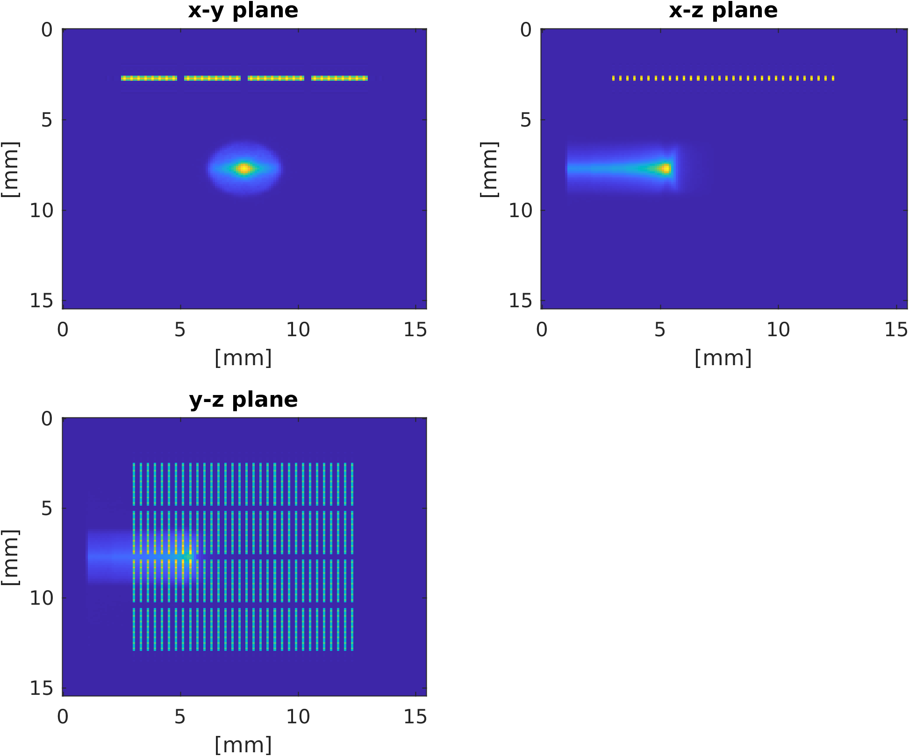
k-Wave Simulation
20 MeV

Slide 7


k-Wave Simulation
Phantom:
Air-Kapton-Water entrance window
Aluminium walls
Matrix Array:
Center frequency: 3.5 MHz
Bandwidth: 60%: Gaussian filter
Distance from the entrance window: 54 mm 12 mm
Noise:
Electrons
Electronic noise, Gaussian filter, σ = 10%

Slide 8
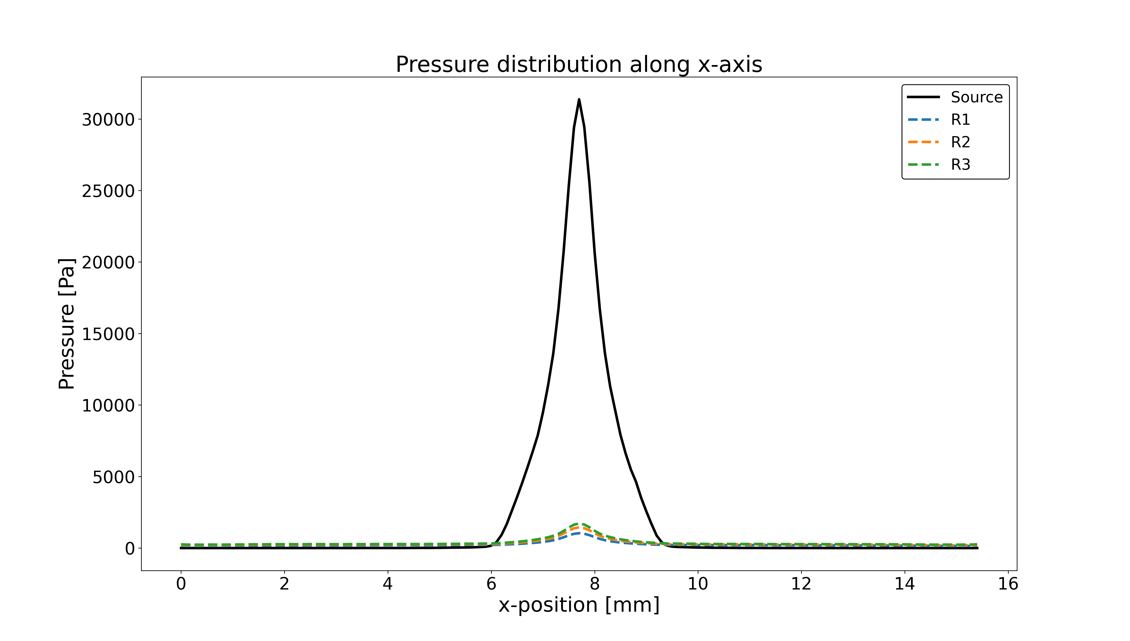
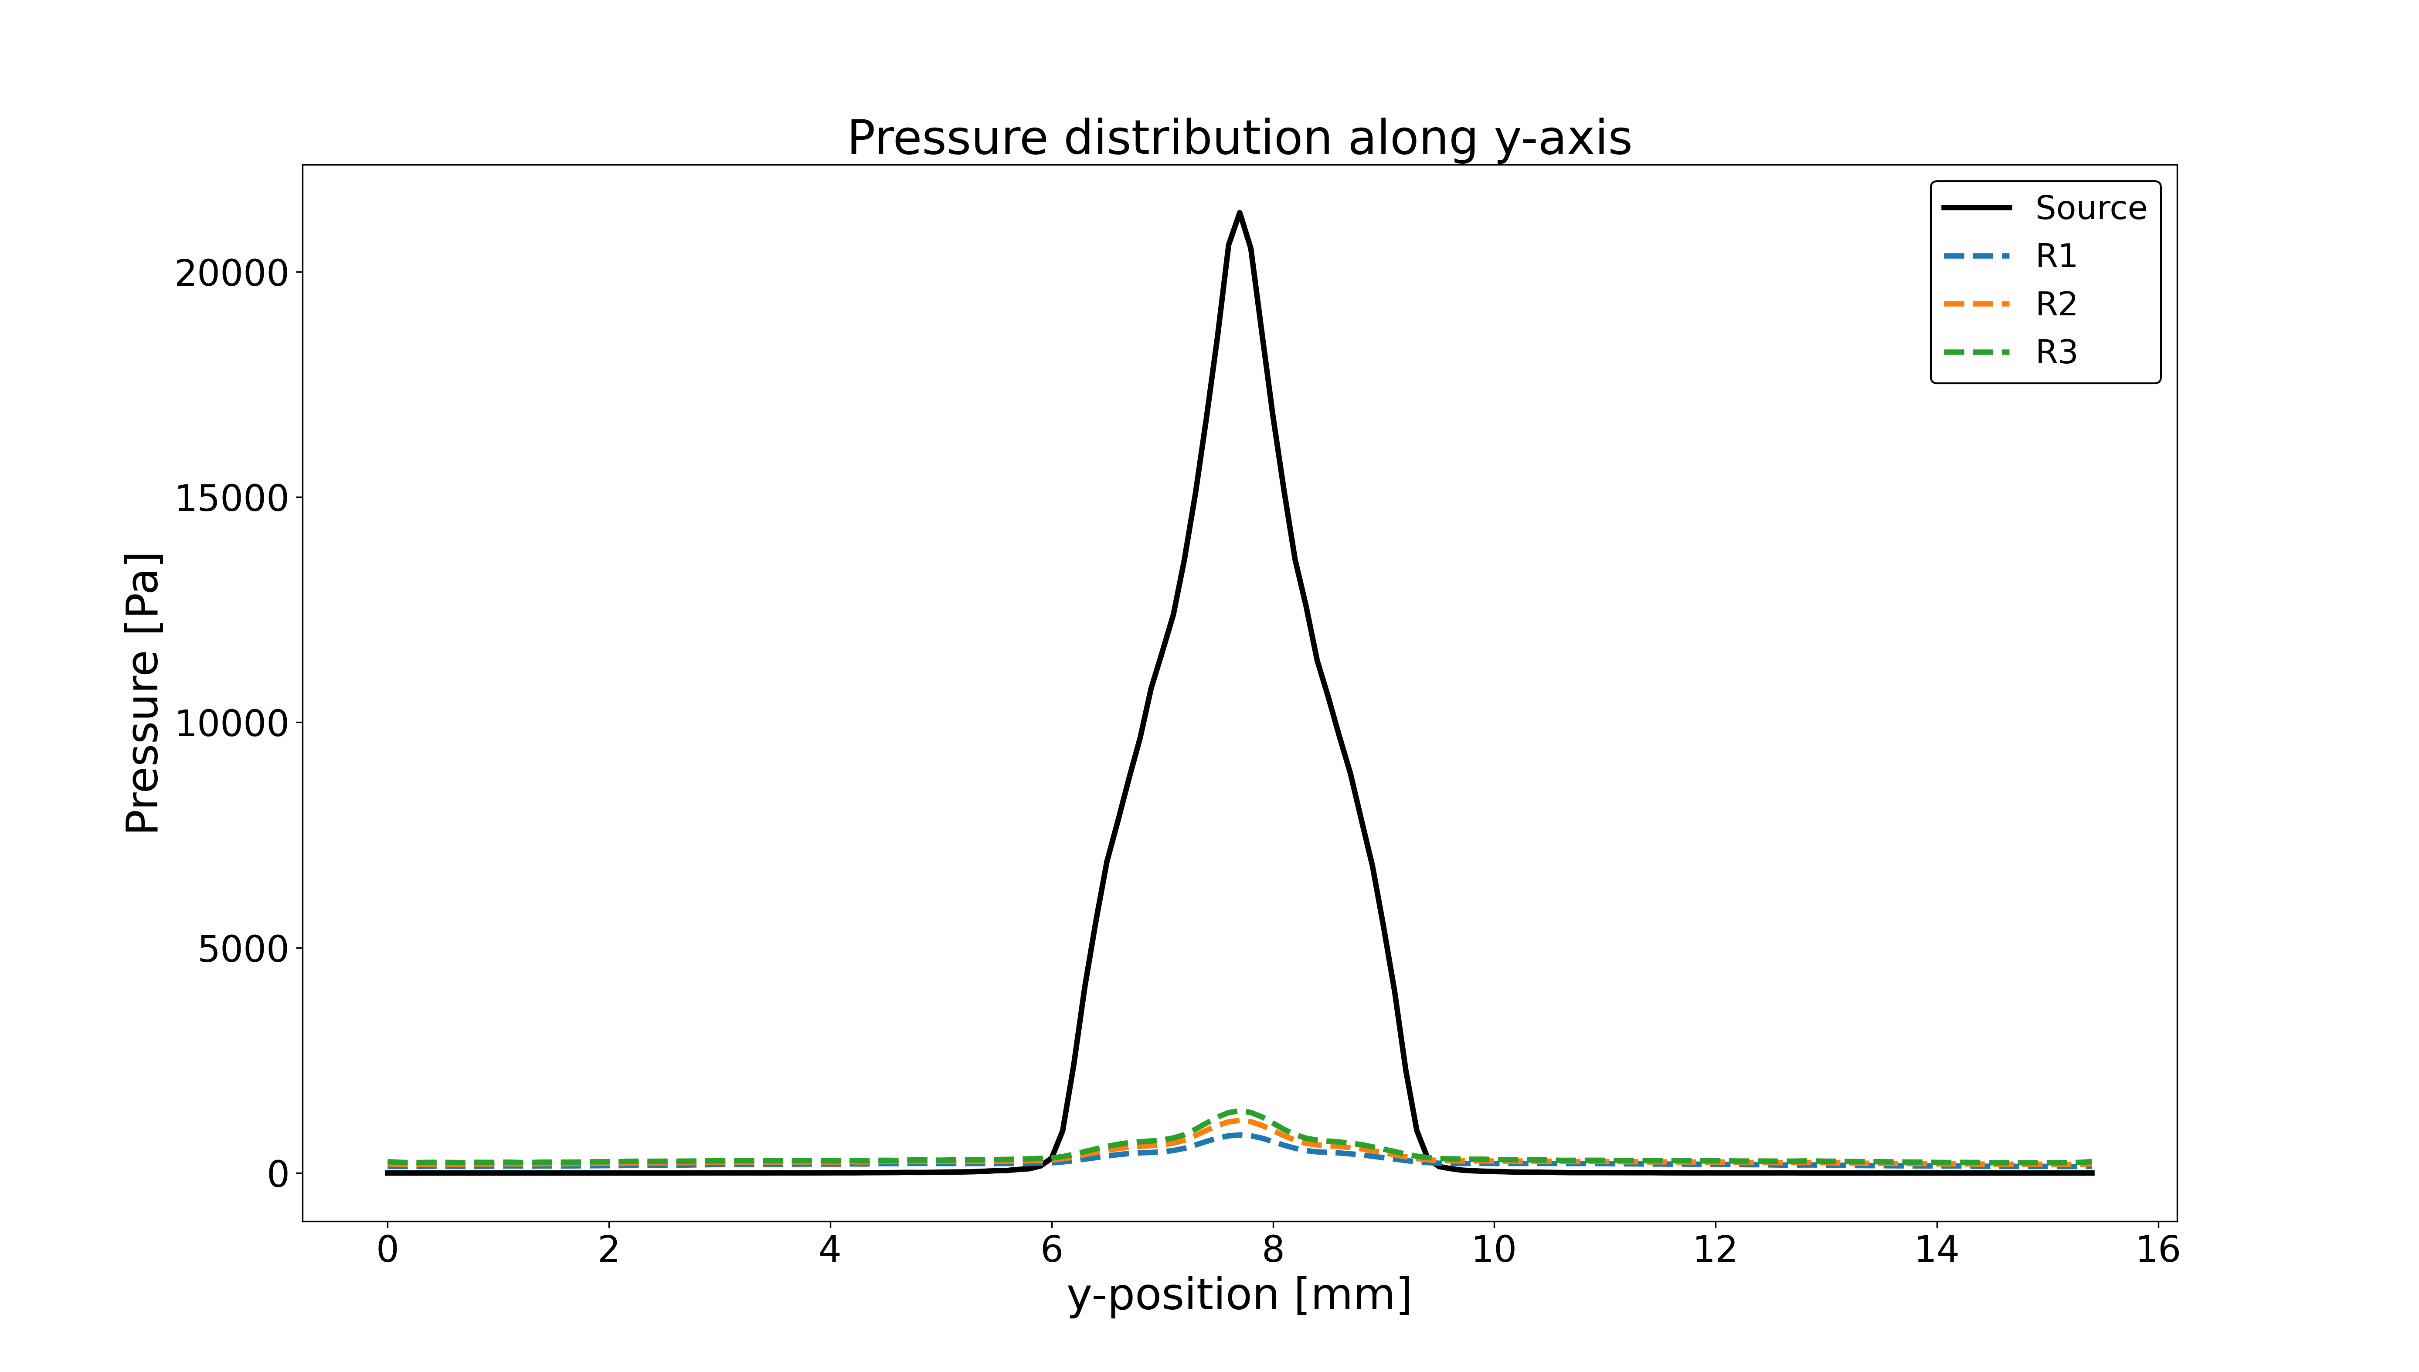
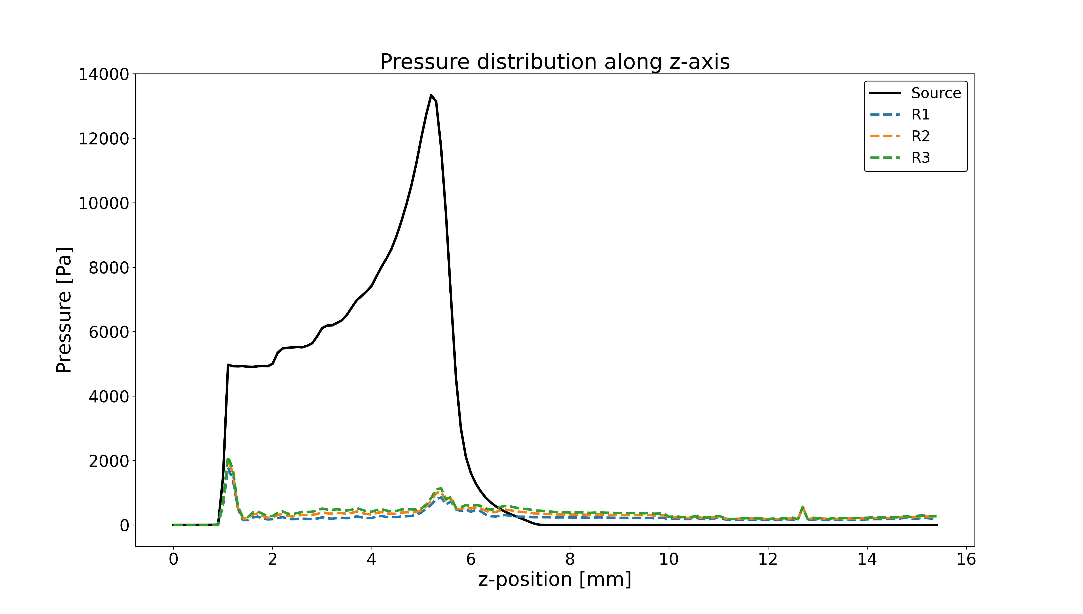

Slide 9
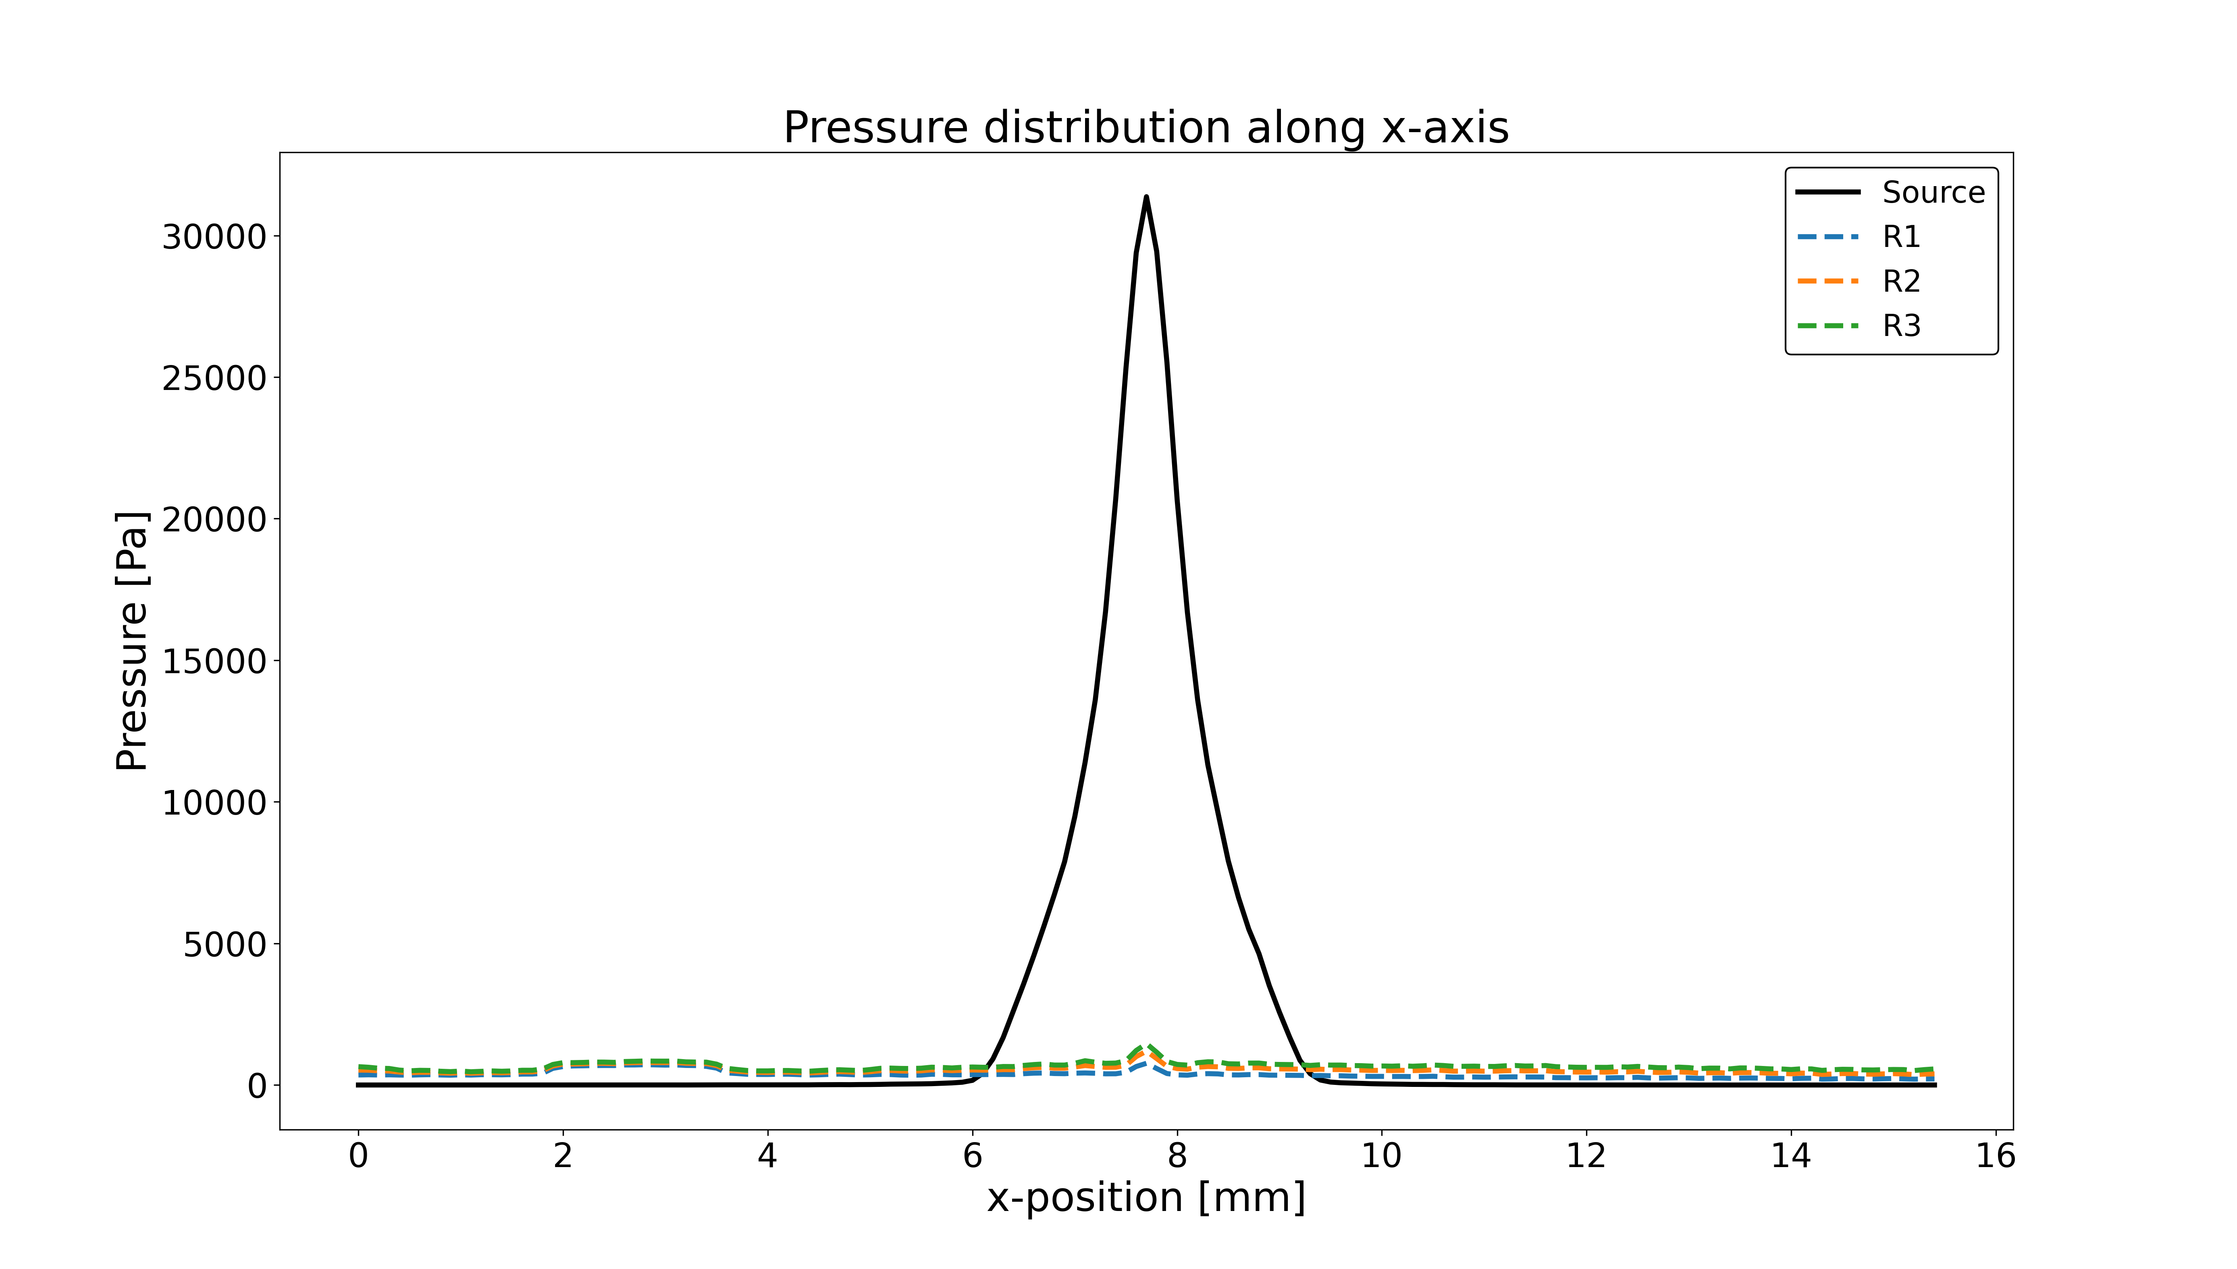

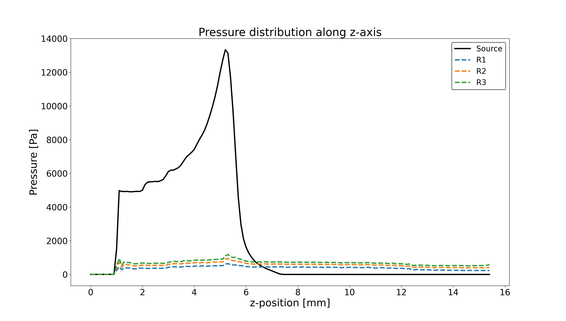

Slide 10
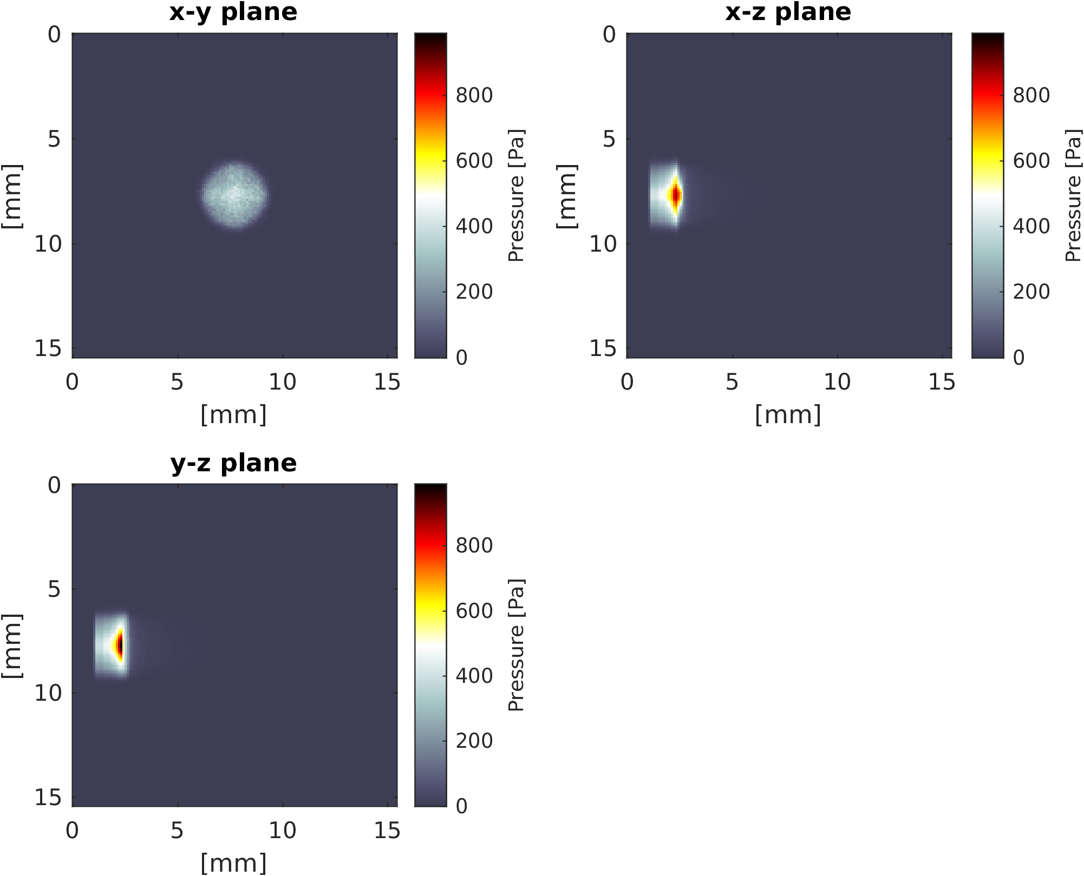
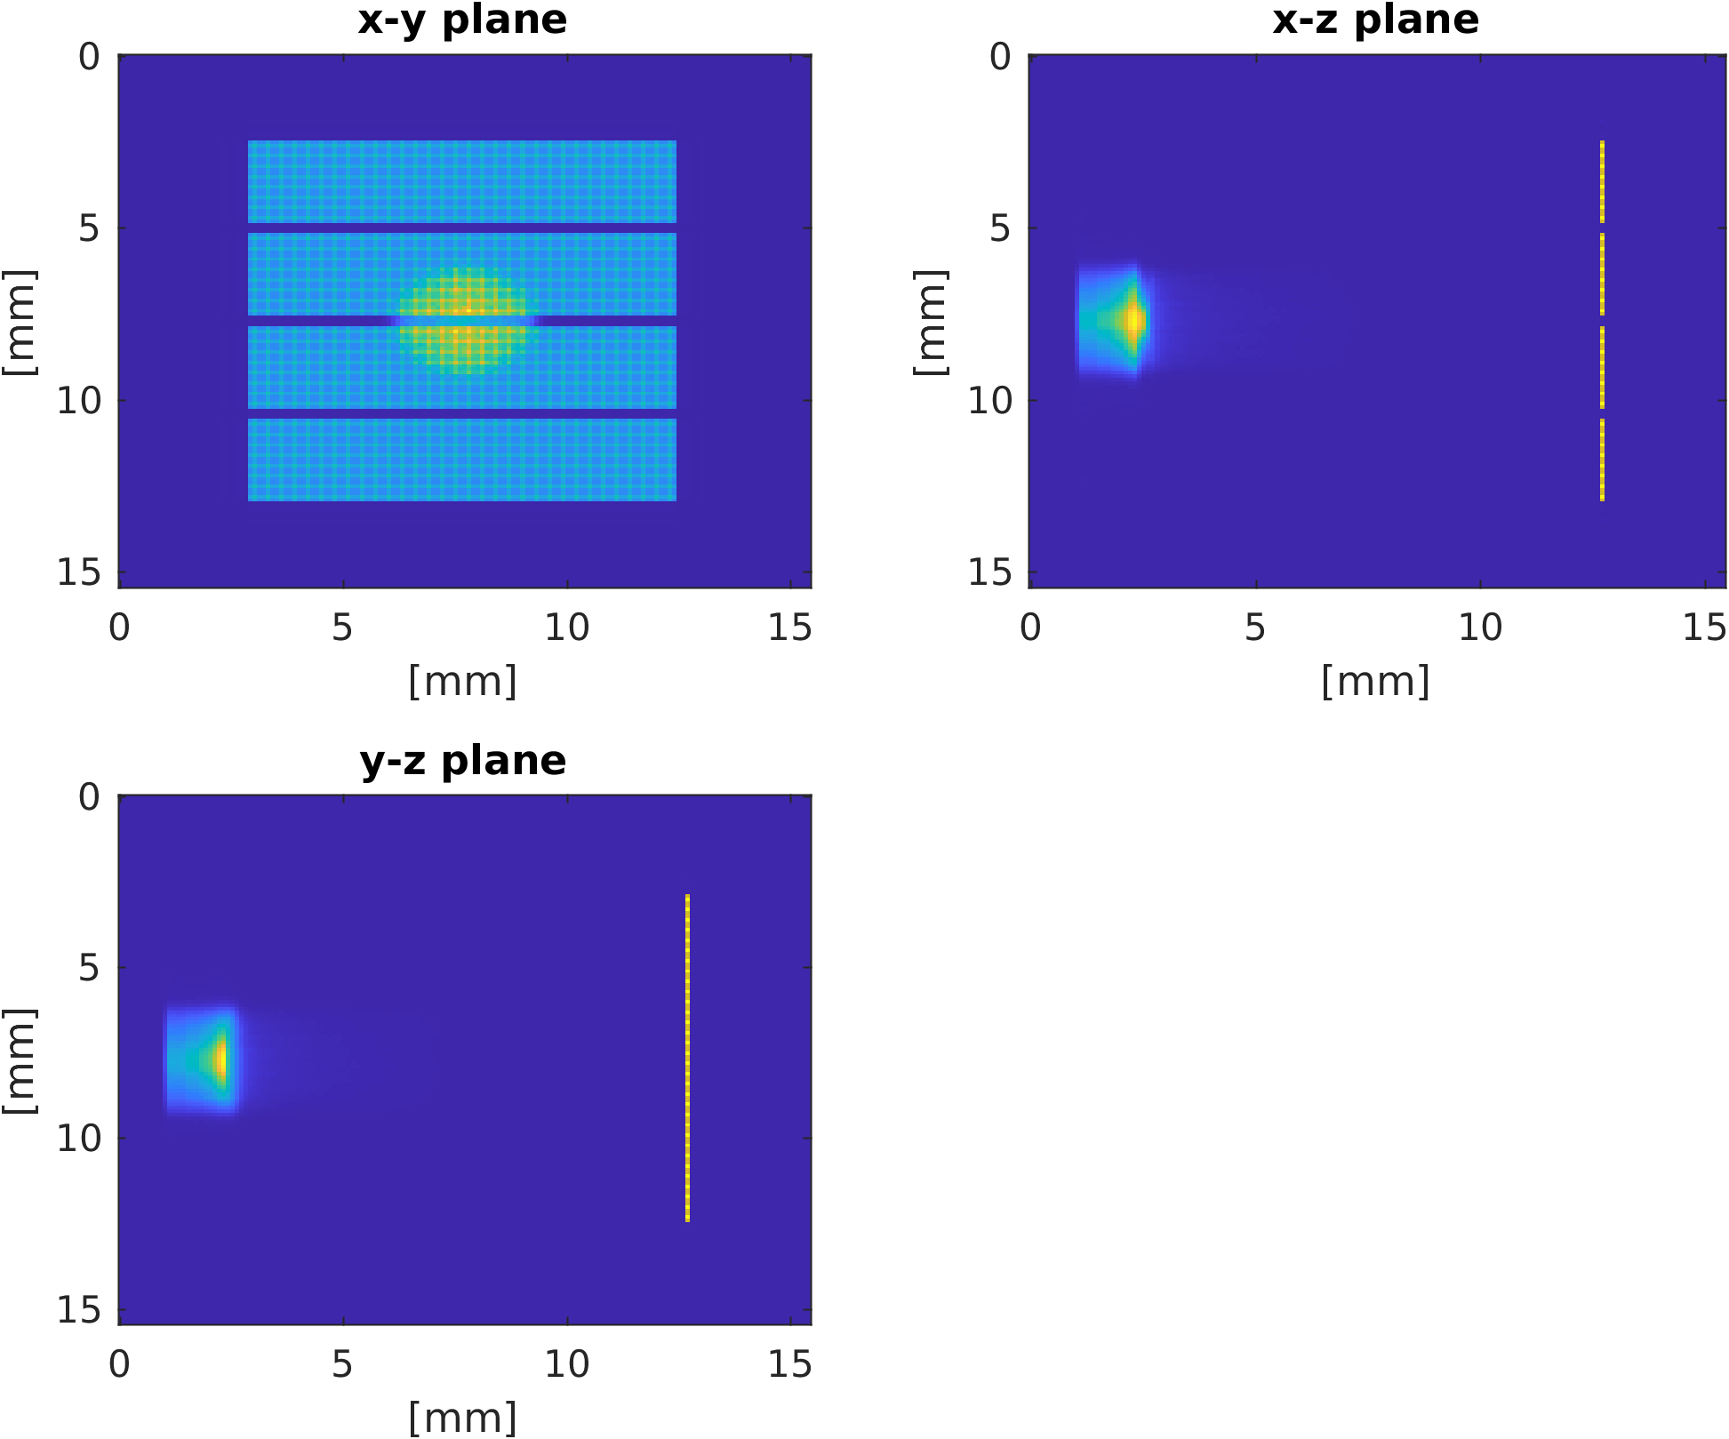
LION beamline: 12 MeV beam

Slide 11
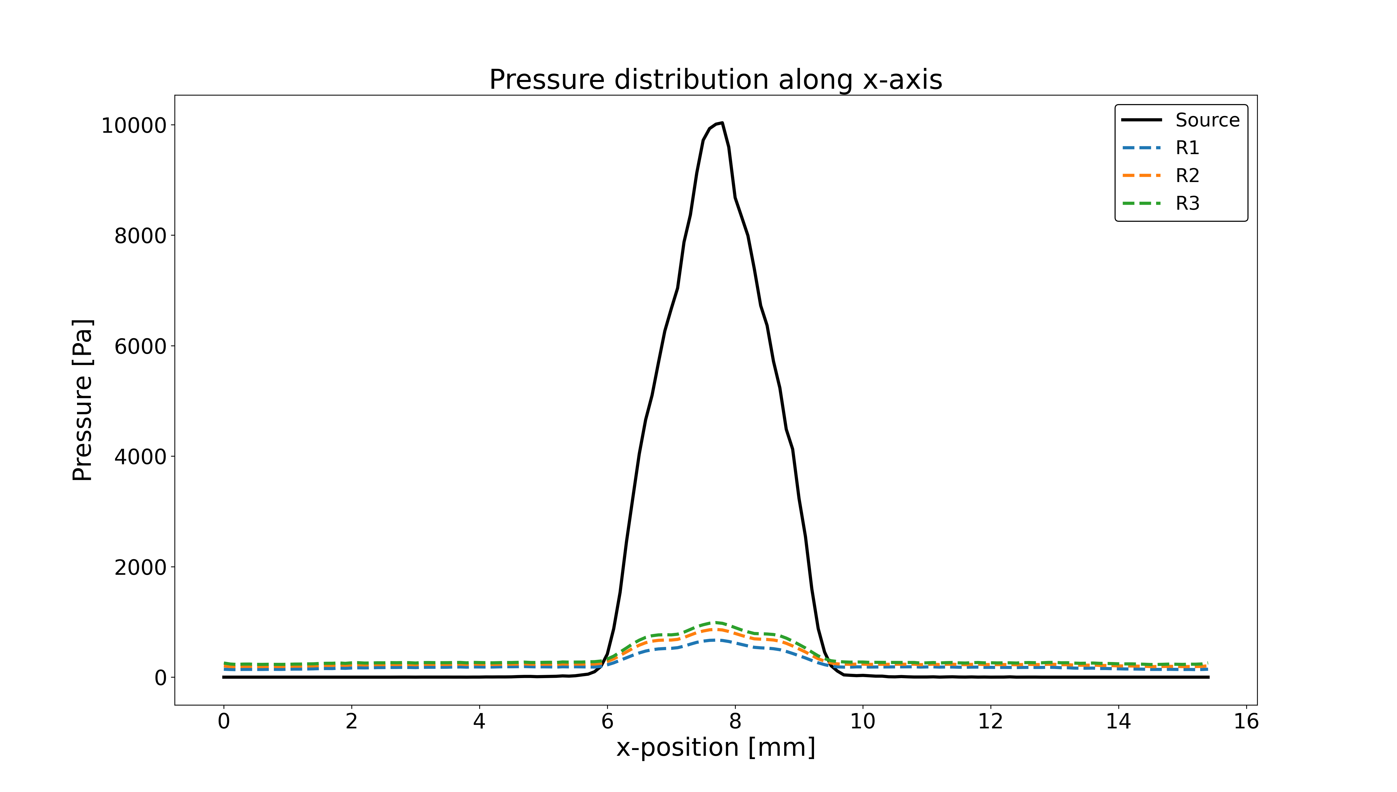
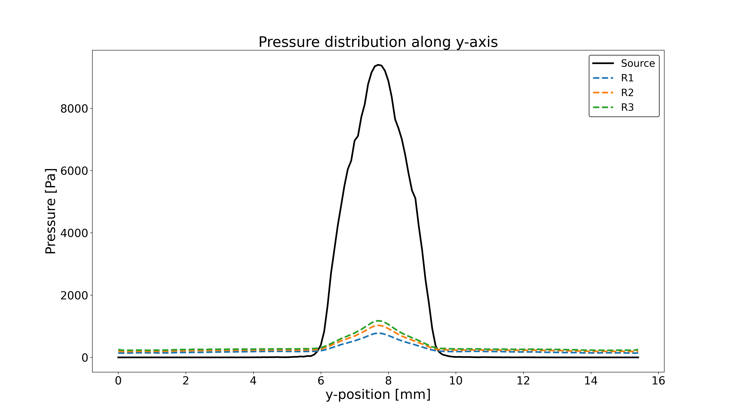
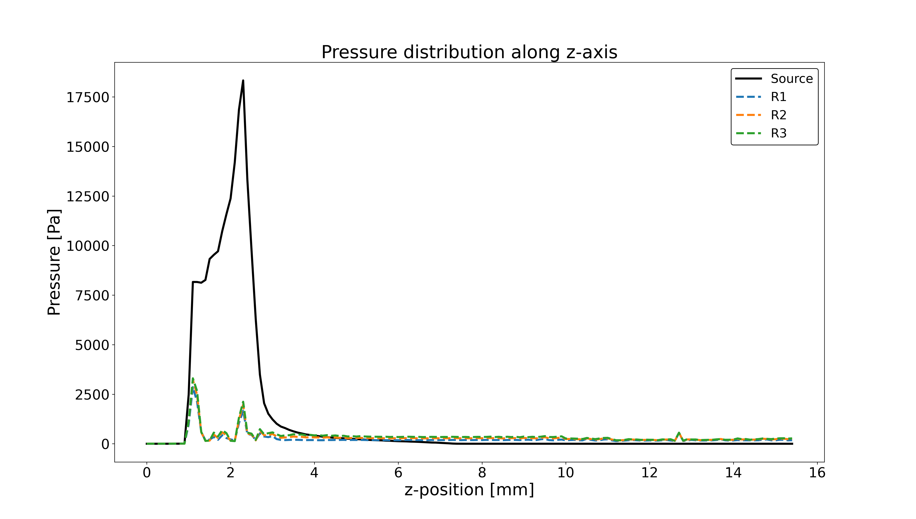
LION beamline 12 MeV beam

Slide 12
LION beamline & Matrix Array
12 MeV
20 MeV

