Slide 1
Introduction

Slide 2
Quick update on LhARA/ITRF
Really for context …
Recently submitted proposal to UKRI Infrastructure Fund:
  Request £21.5M over 5 financial years from Oct24:
    Second “Preliminary Activity”; really pre-construction R&D
  Deliverables:
    Technical Design Reports for the staged implementation of the facility;
    A site study leading to site selection and building implementation plan; and
    A proof-of-principle demonstrator system at an existing pulsed-laser facility.

Slide 3
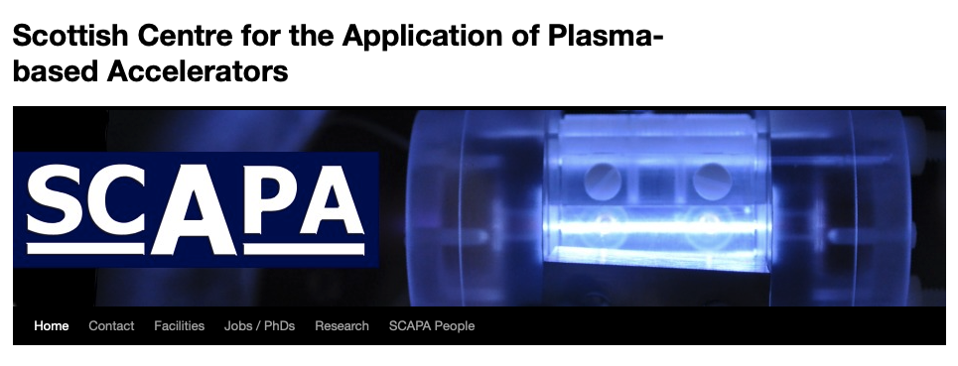
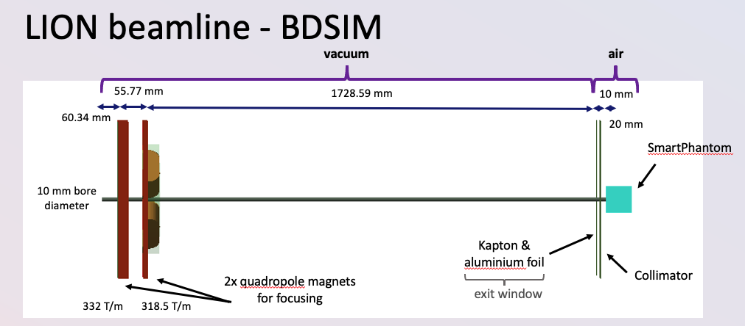
Development of radiation biology programme:
  At existing facilities:
    Novel (e.g. laser driven)
    Conventional
LhARA proof-of-principle experiment:
  “… include as many of key LhARA elements as possible …”
LIGHT

Slide 4
… a future discusion …
Just now starting to discuss what:
  What should rbio programme be?
  What is the PoP experiment and how does it fit into the wider rbio programme?
Be great to come back to this in a separate meeting

