Slide 1
Sci-Fi plane update
Josie McGarrigle, Anthea MacIntosh-LaRocque, Vania Lay

Slide 2
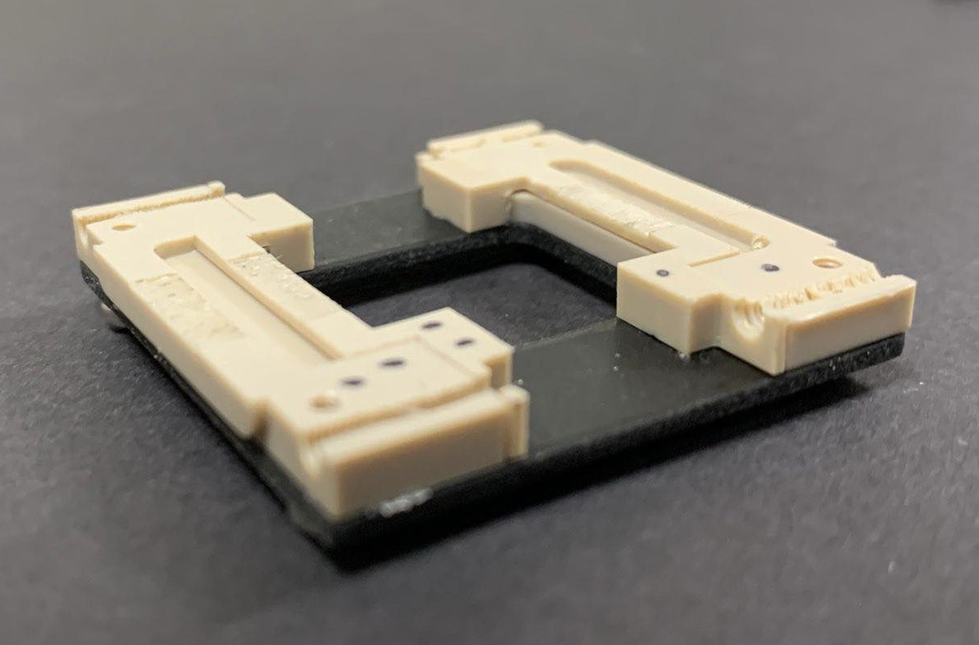
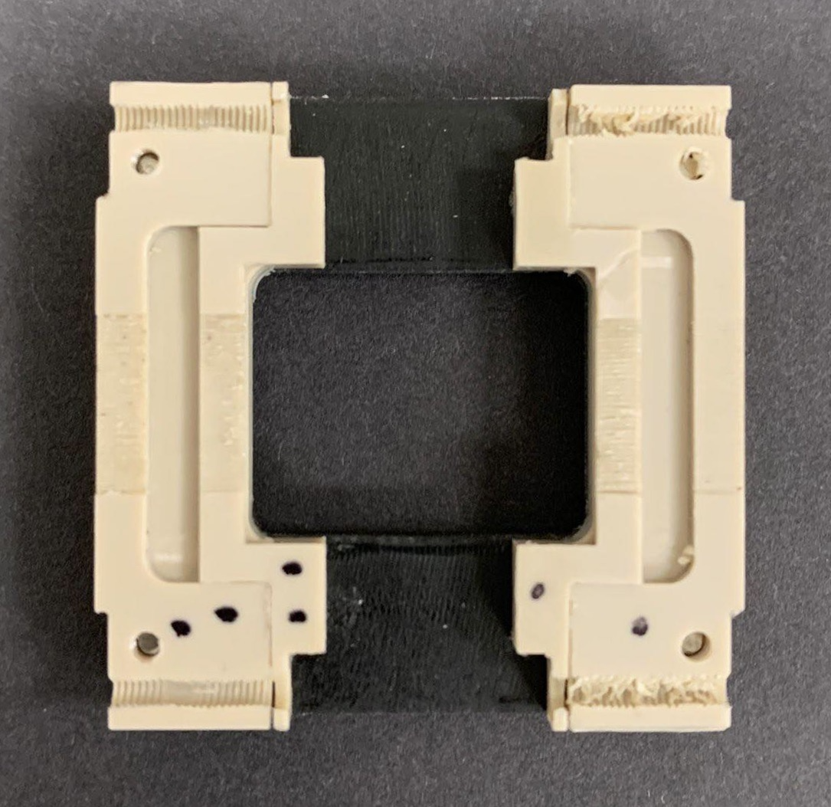
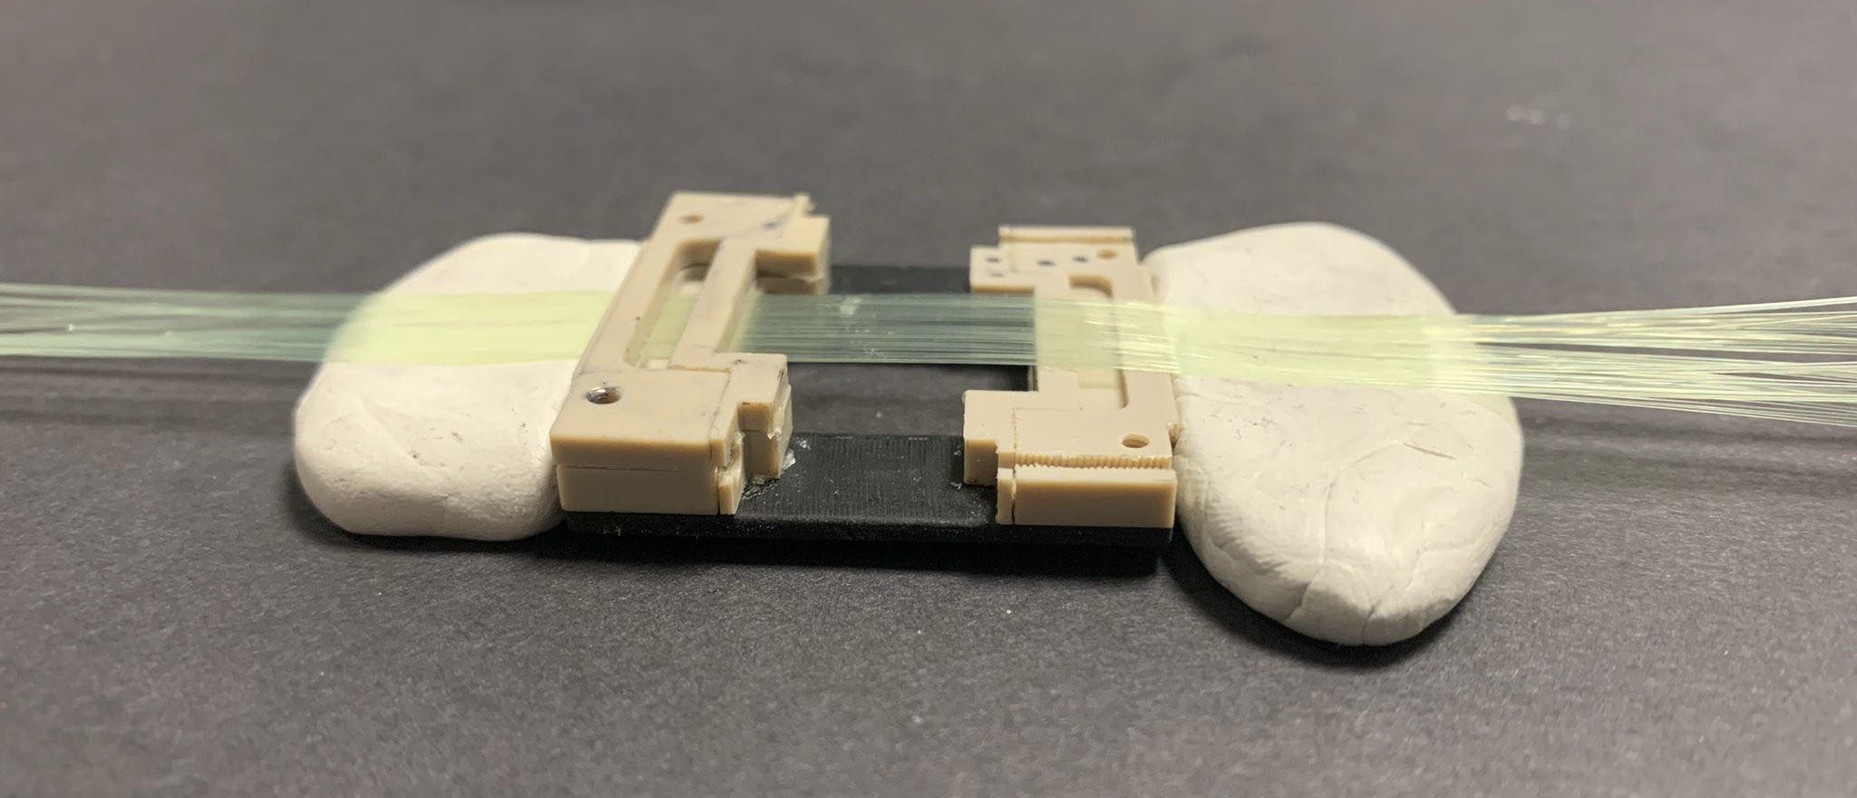
Scintillating Fibre plane: prototype 1
Cavities for epoxy resin
Plastic frame
Grooves for fibres
Figure 2: Fibre plane mid-construction side-view
1 ”top frame” attached to secure fibres
Scintillating fibres
10mm
Backing plate
Blu-tack to hold fibres during construction
Figure 1: Fibre plane mid-construction
Figure 3: Plane mid-construction with 33 fibres in place
2

Slide 3
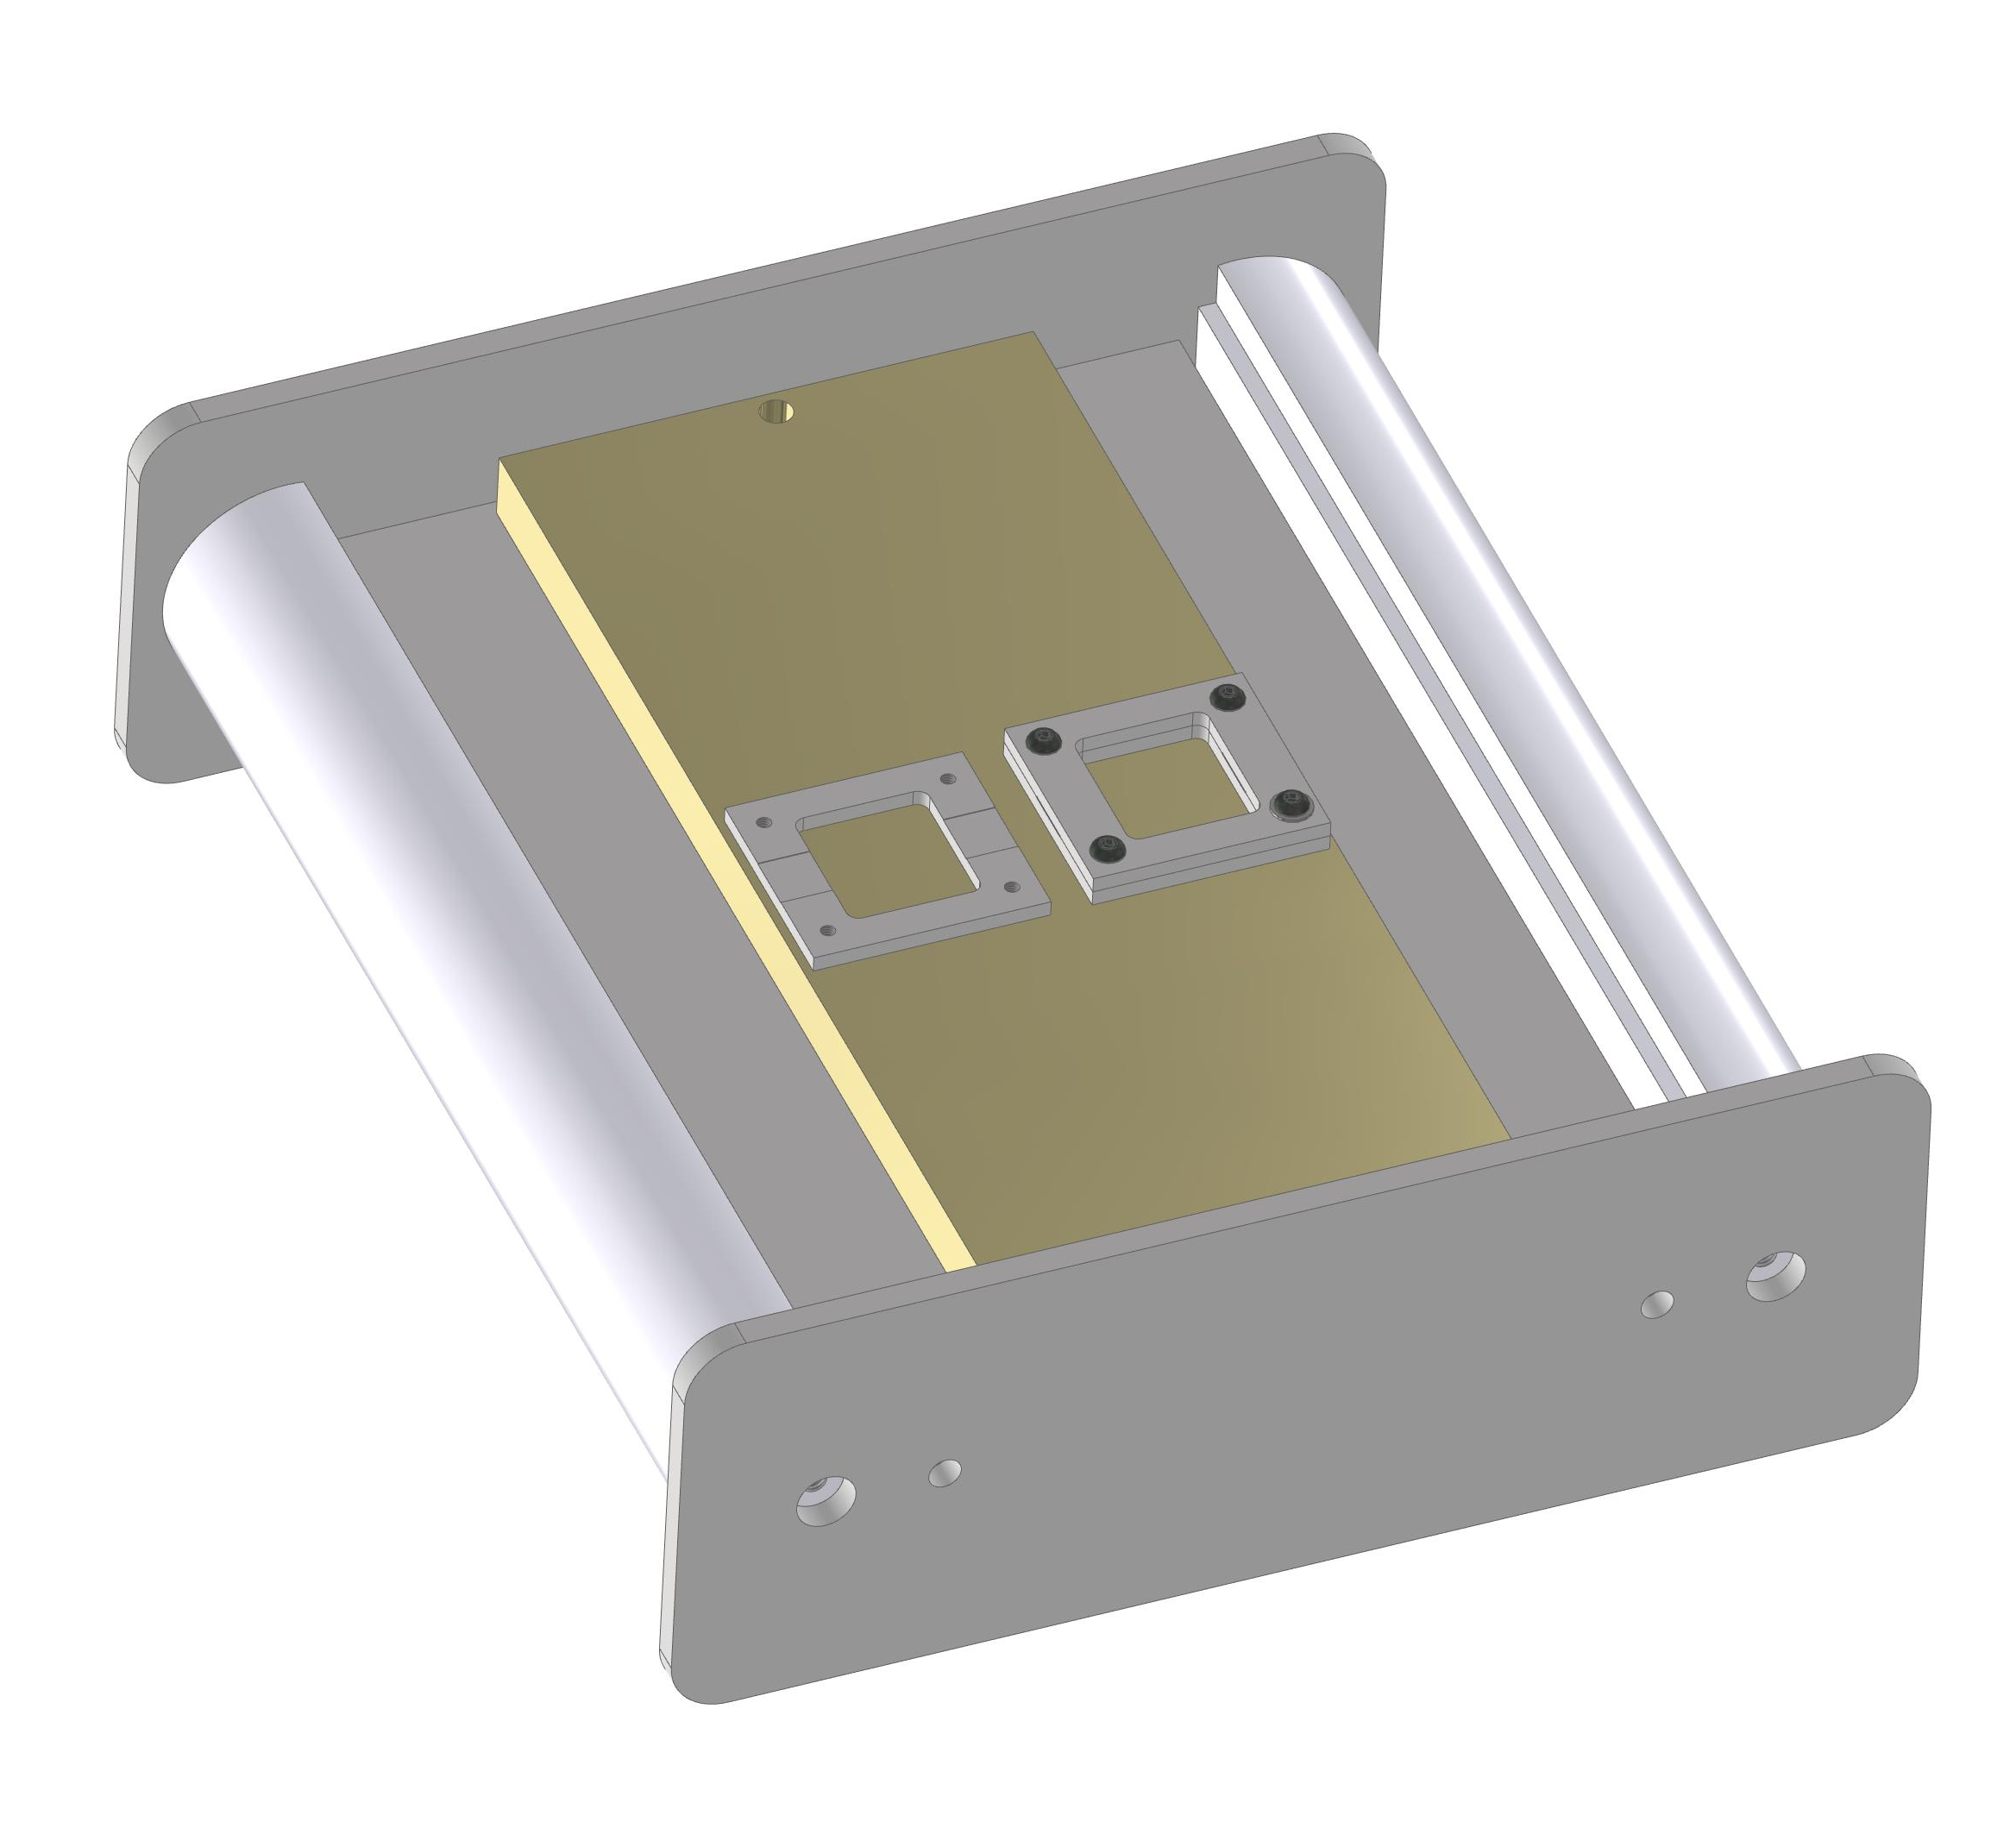
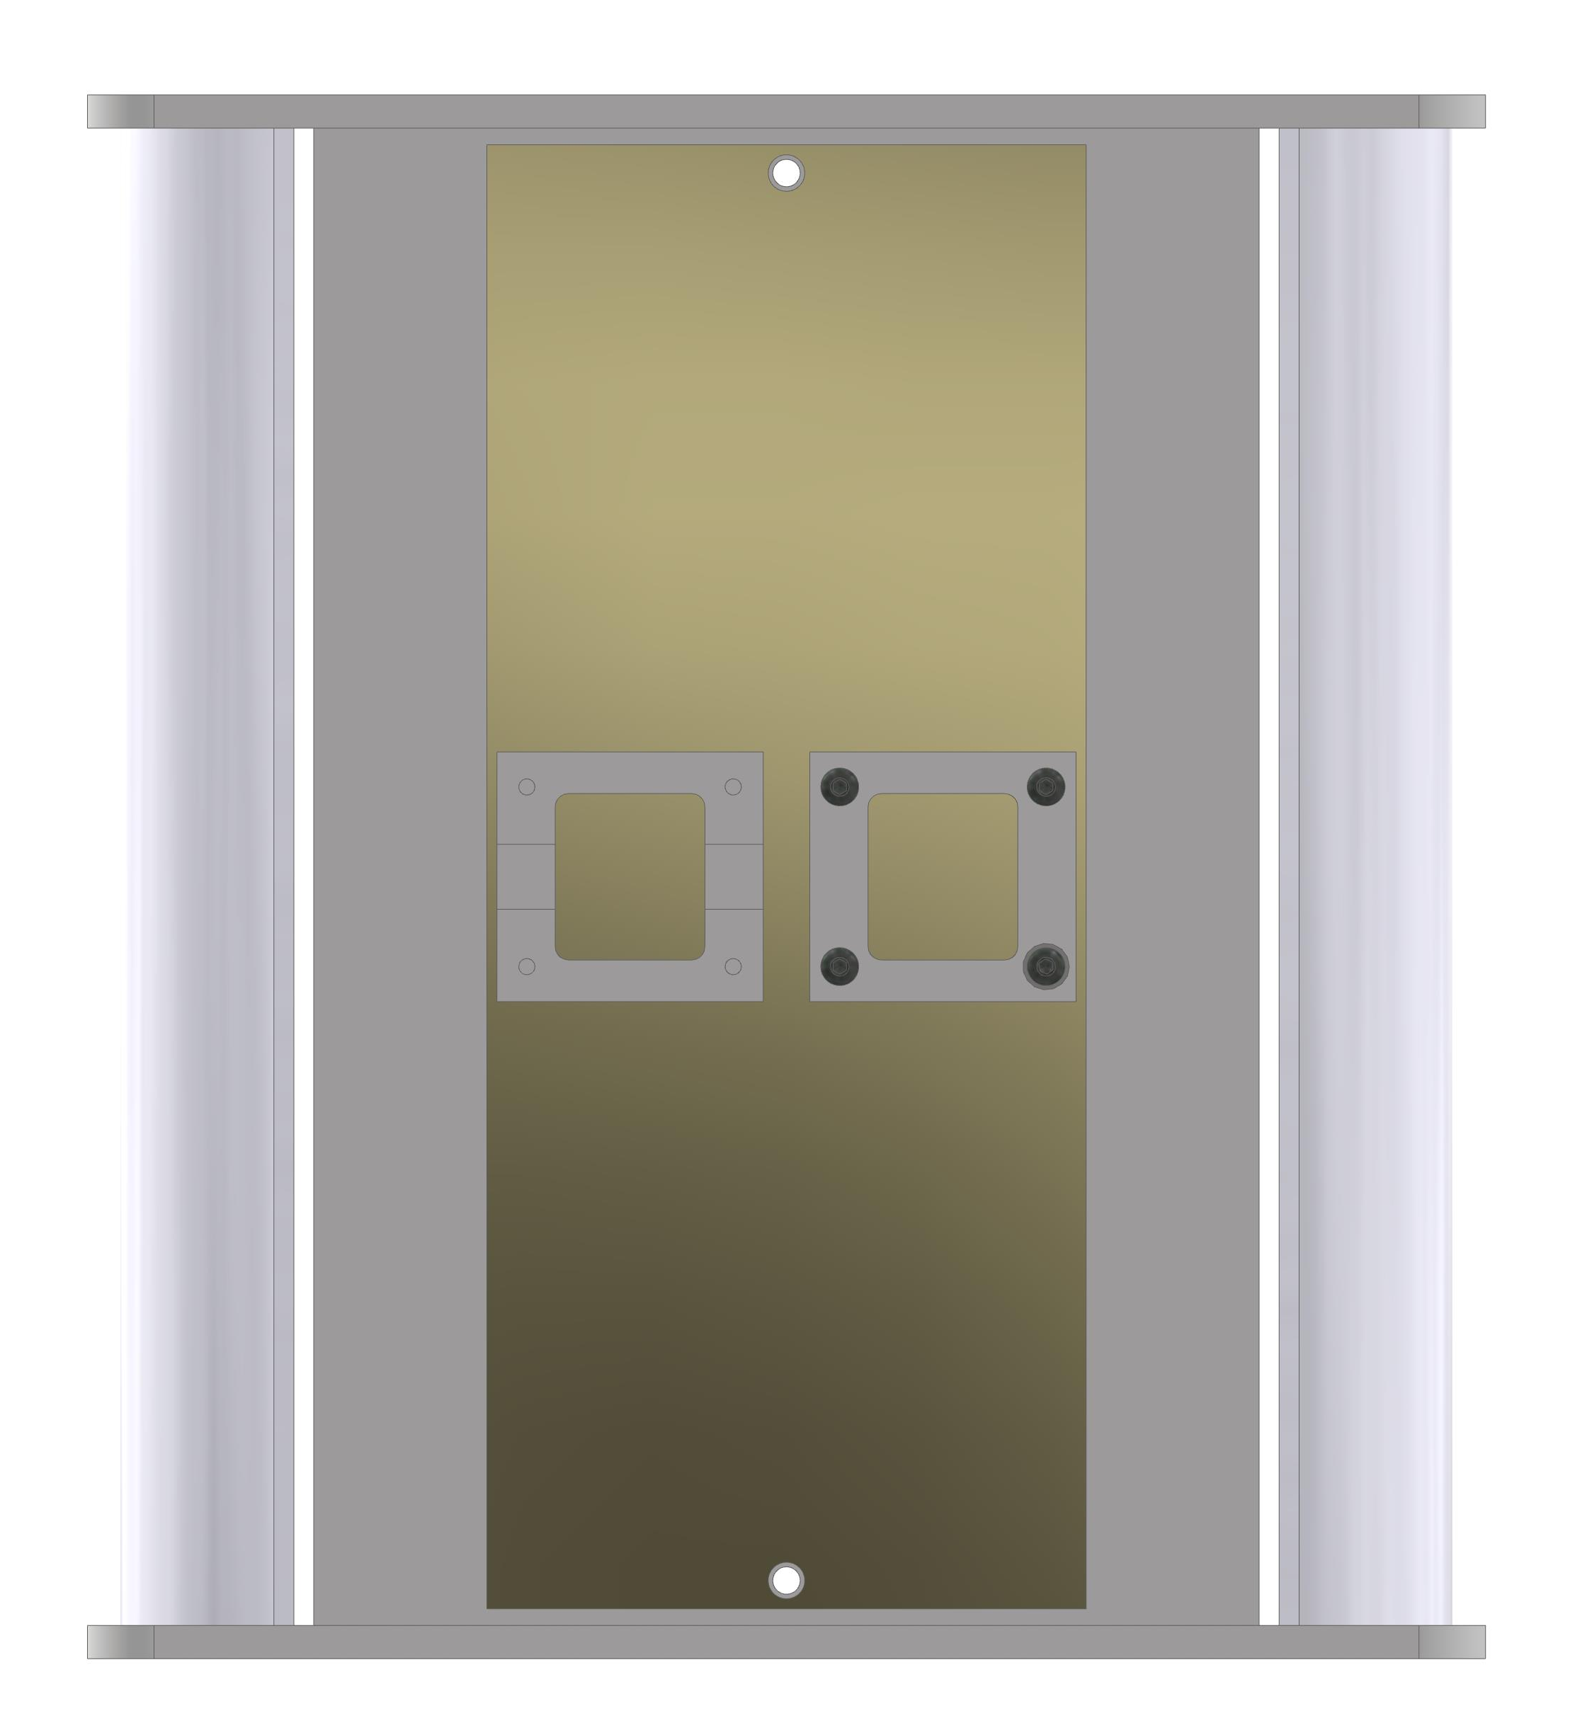
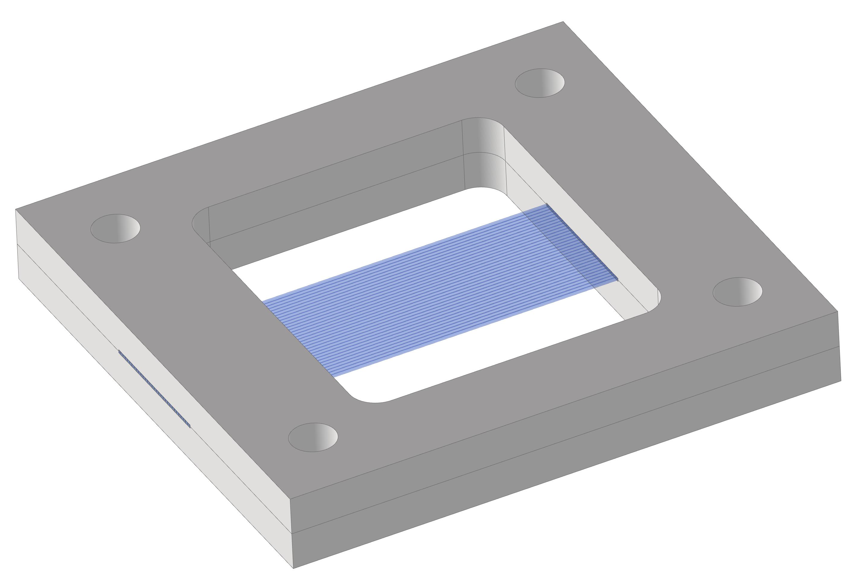
Scintillating Fibre plane: prototype 2
Planes, 2 on top, 2 underneath
'Well' rather than grooves
Grooves for fibres
32 fibres
Bottom plate
Top plate
Figure 4: Winding jig CAD design with planes
Figure 5: Fibre plane CAD design

Slide 4
Next Steps
Plane assembling- wrap planes, add resin, add lids.
Test the fibres readout- one-to-one connection between scintillating fibres and clear fibres will be constructed to transport light between and read out the light.
Add to phantom, record readings and fit Bortfeld approximation!

Slide 5
Liquid Scintillator
Due to worries of potential misalignment, liquid scintillator was proposed.
Water-based solution to put throughout the phantom for uniformity.
Combines the advantages of pure water, including low attenuation, accurate direction reconstruction, and low cost, and those of liquid scintillator, including high light yield and low-threshold detection.
Test both plane and liquid, fit Bortfeld, see which best.

