Slide 1

Resources and Project Plan
Why Gabor lenses?

Slide 2
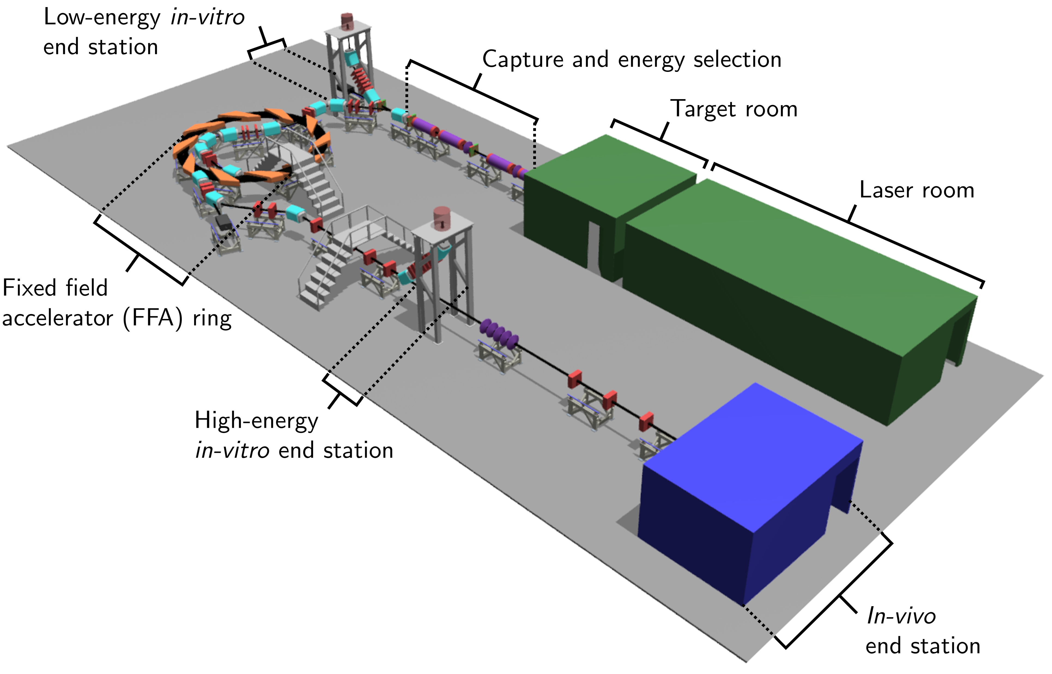
Laser/plasma source
high flux, high energy
minimise space charge effects
Gabor lens capture system
efficient, low focal length lens. Protons & ions
Ion-Acoustic dose measurement
single shot due to unique beam time structure.
Novel end station design and instrumentation – user consultation.
Beam line, accelerator design and Integration – high fidelity particle selection.

Slide 3
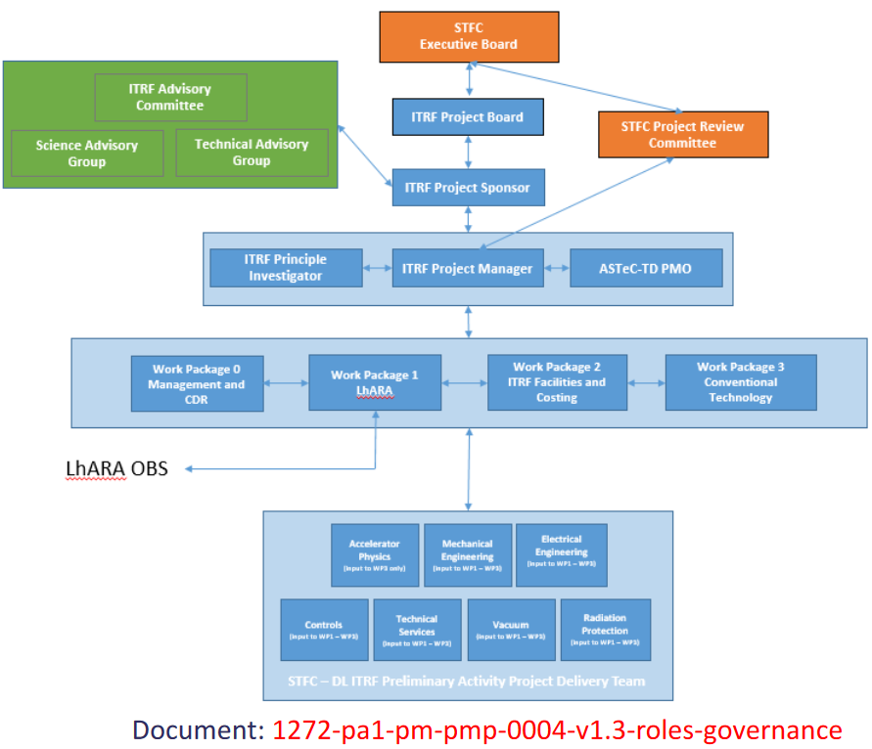
ITRF OBS

Slide 4
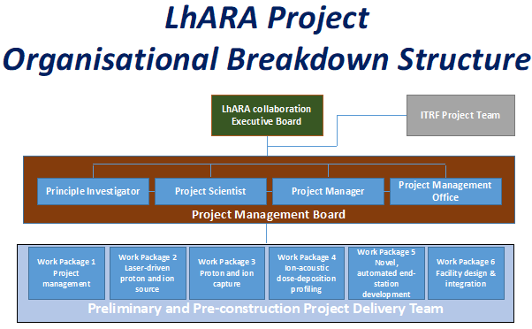

Slide 5
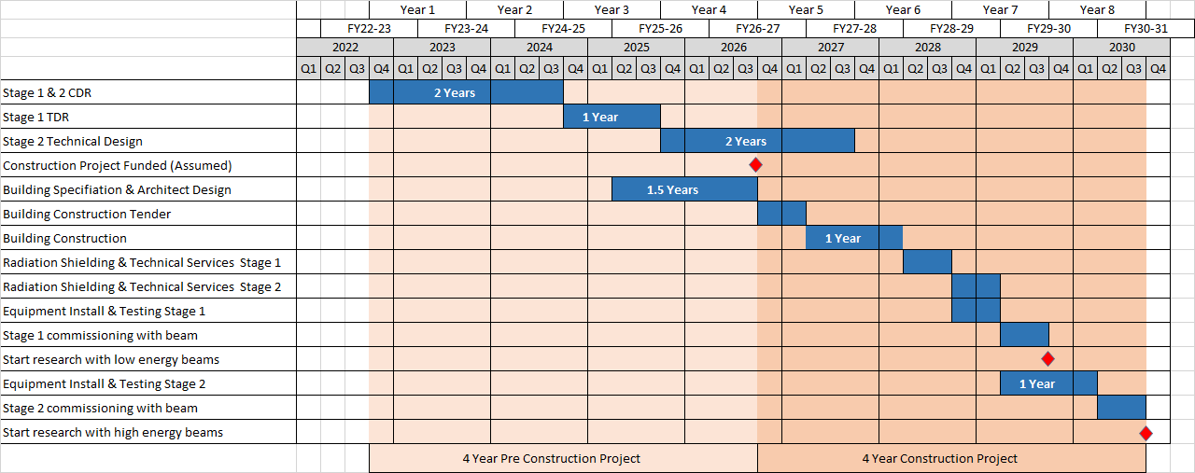
Timeline & Milestones for the Design

Slide 6
LhARA Project Schedules & Milestones
  3 documents:
  1272-pa1-pm-ppl-0005-v1.0 - ITRF CDR milestones and deliverables 2022-10-18
  1272-pa1-pm-ppl-0004-v0.7 - ITRF CDR schedule 2022-09-20
  1272-pa1-pm-ppl-0001-v2.0 - ITRF schedule 2022-07-20 (Covered later in WP6 talk)

Slide 7
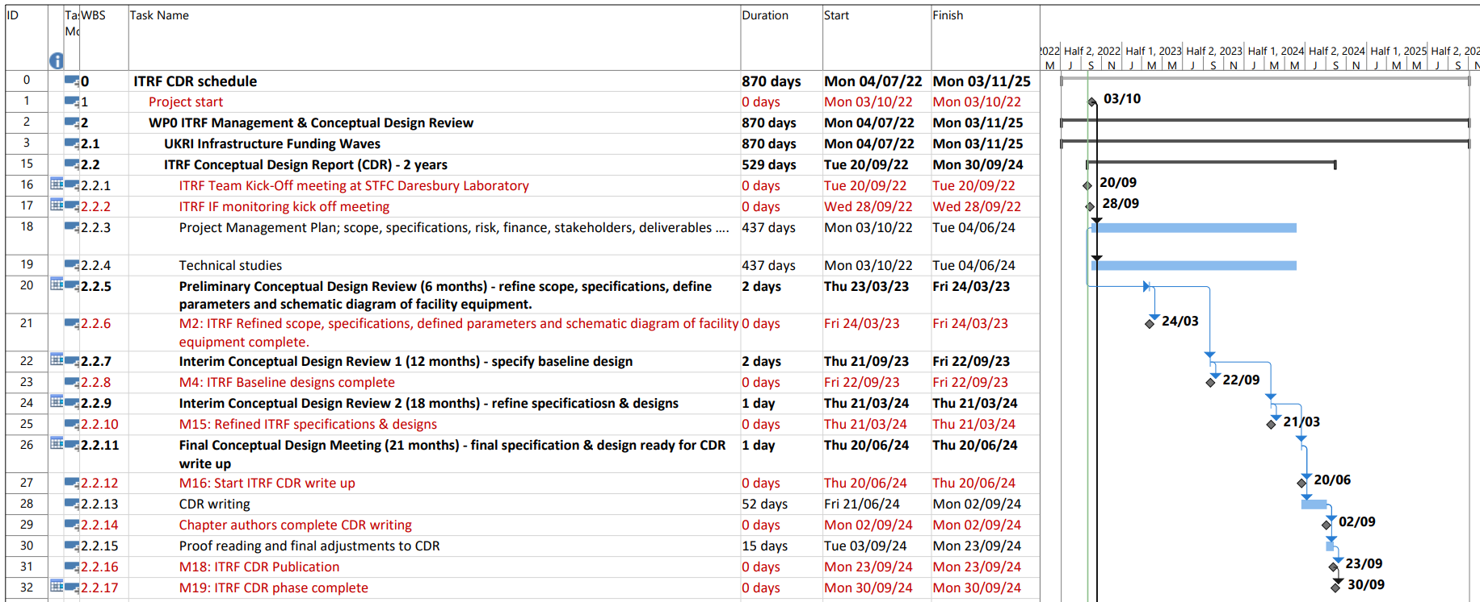
CDR Schedule 1272-pa1-pm-ppl-0004-v0.7 - ITRF CDR schedule 2022-09-20

Slide 8
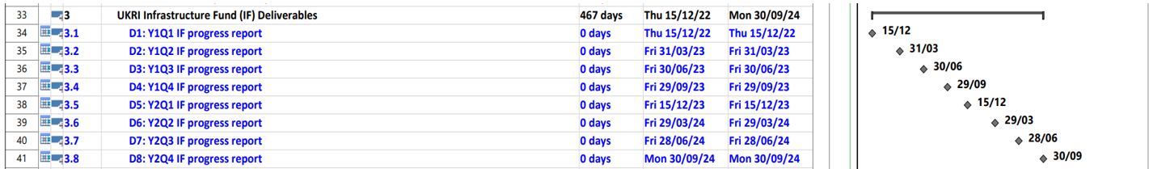
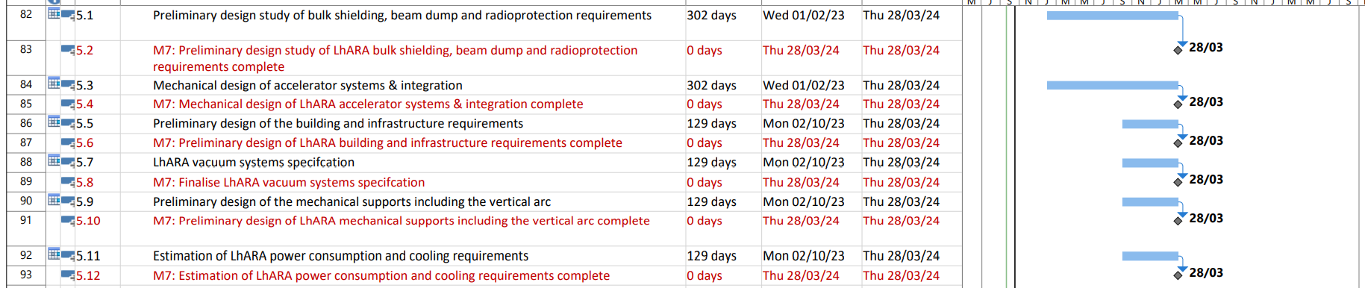
CDR Schedule 1272-pa1-pm-ppl-0004-v0.7 - ITRF CDR schedule 2022-09-20

Slide 9
LhARA - Project organisation
WP1 – Project management
WP2 – Laser Driven proton and ion source
WP3 – Proton and Ion Capture
WP4 – Real-time dose-deposition profiling
WP5 – End station development & Instrumentation
WP6 – Facility design and integration

Slide 10
Project management
All the essential planning and organisation, but also..
Engagement and outreach:
Stakeholder
Peer group
User community
Public
Patient
Diversification of LhARA funding – alternate funding sources

Slide 11
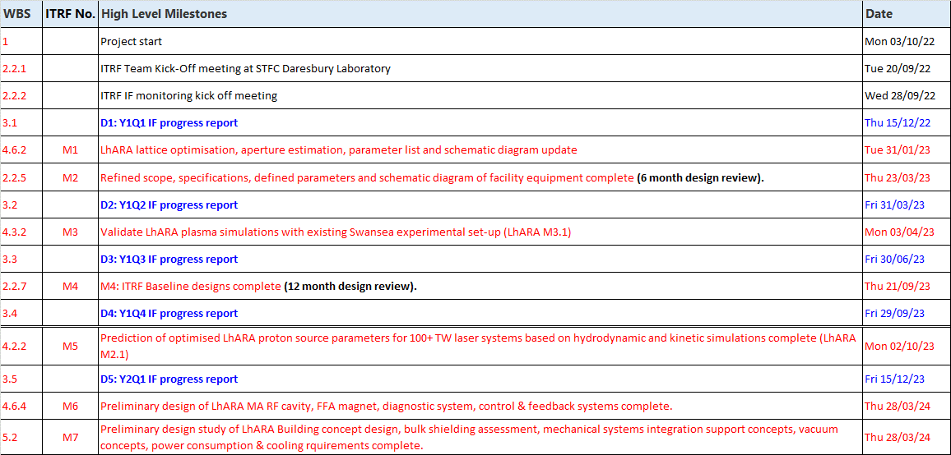
CDR Milestones 1272-pa1-pm-ppl-0005-v1.0 - ITRF milestones and deliverables 2022-10-18

Slide 12
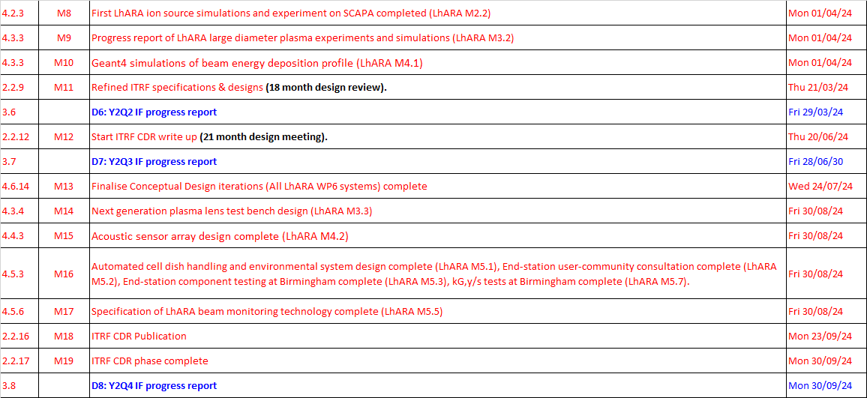
CDR Milestones 1272-pa1-pm-ppl-0005-v1.0 - ITRF milestones and deliverables 2022-10-18

Slide 13
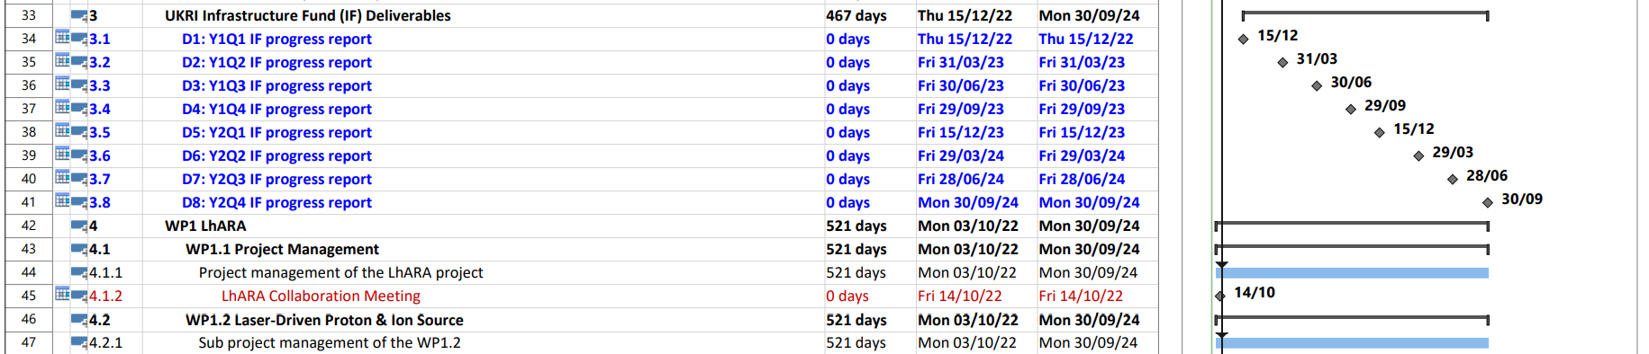
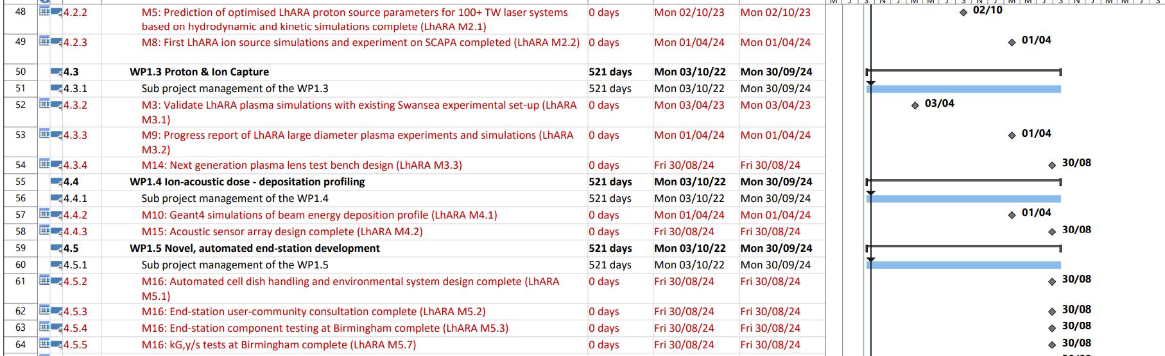
CDR Schedule 1272-pa1-pm-ppl-0004-v0.7 - ITRF CDR schedule 2022-09-20

Slide 14
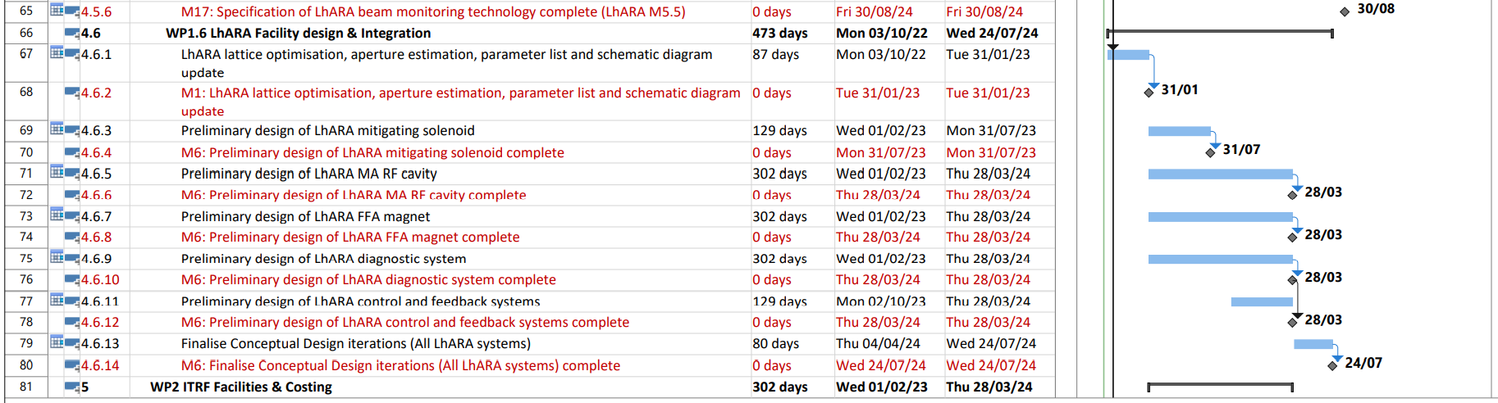
CDR Schedule 1272-pa1-pm-ppl-0004-v0.7 - ITRF CDR schedule 2022-09-20

Slide 15
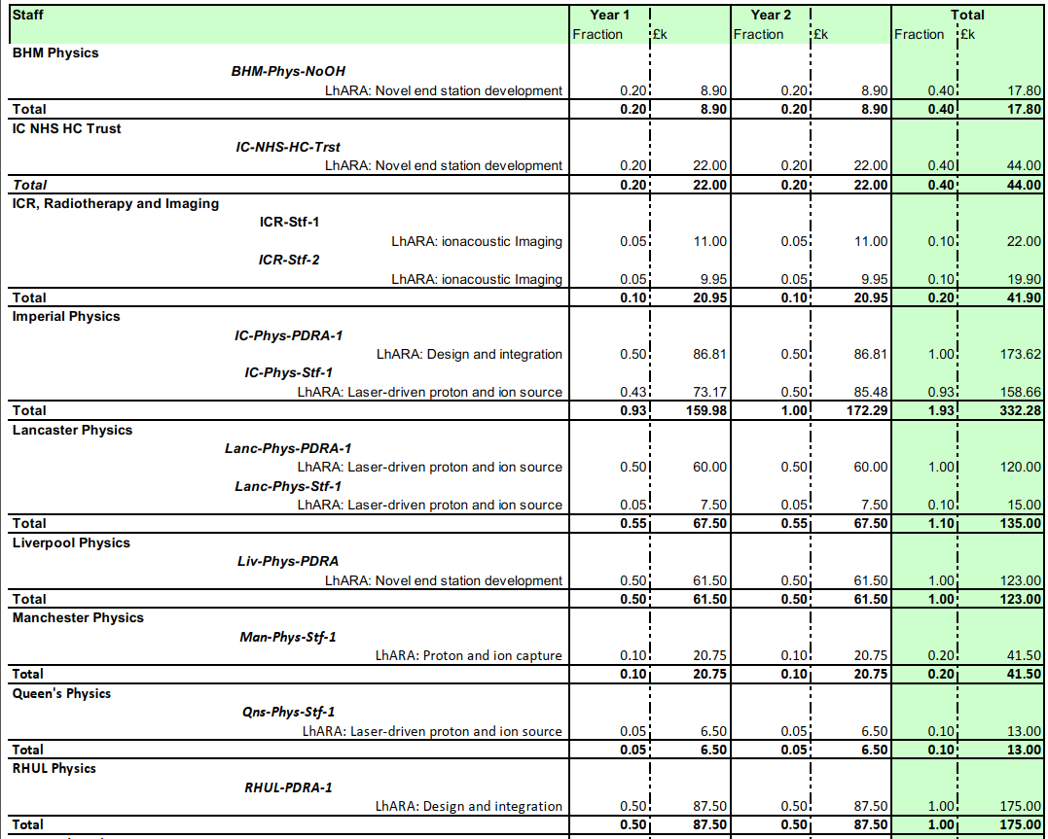
Resources
https://ccap.hep.ph.ic.ac.uk/trac/raw-attachment/wiki/Communication/Notes/CCAP-TN-10.pdf

Slide 16
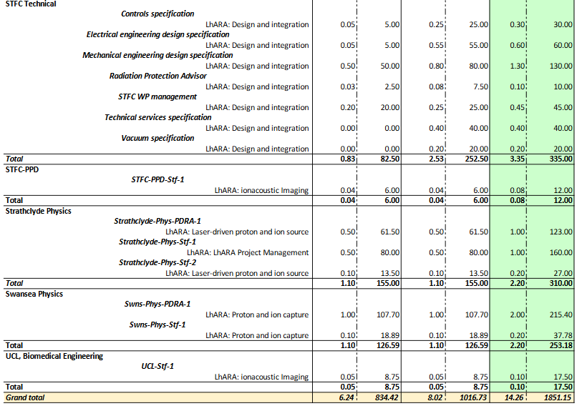
Resources
https://ccap.hep.ph.ic.ac.uk/trac/raw-attachment/wiki/Communication/Notes/CCAP-TN-10.pdf

Slide 17
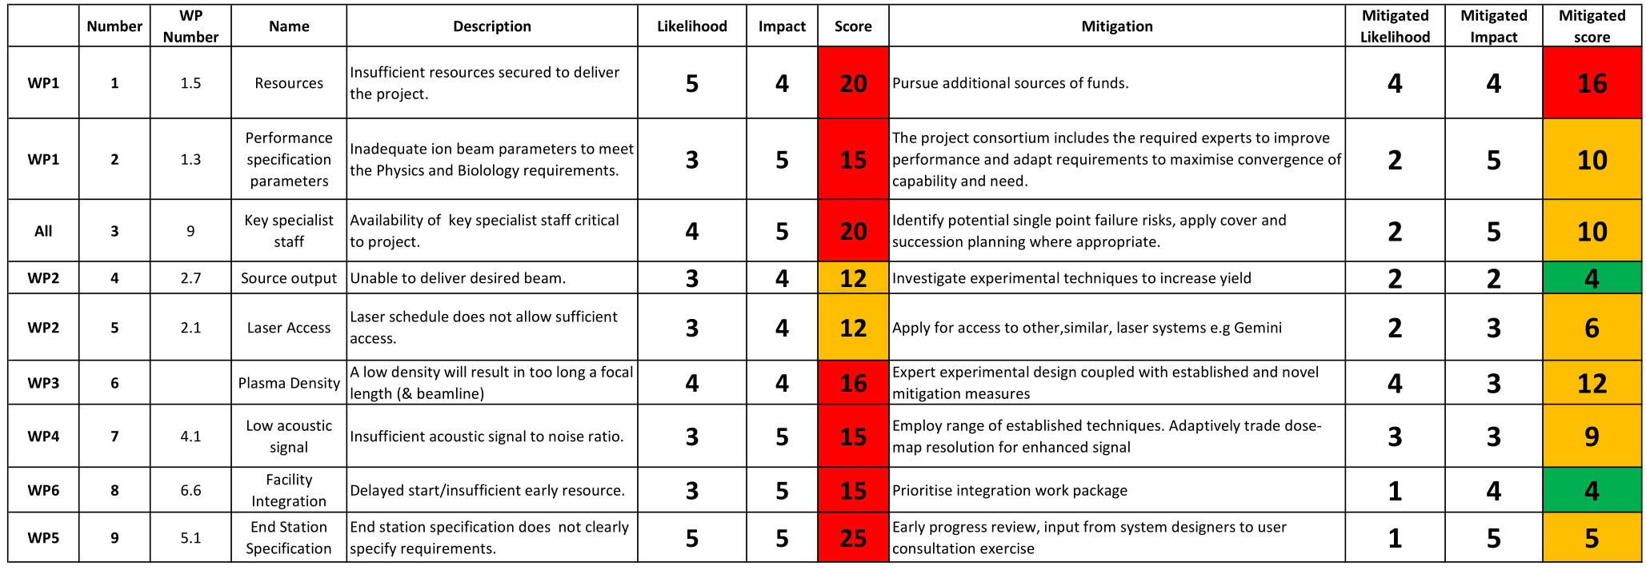
Risk Register

Slide 18
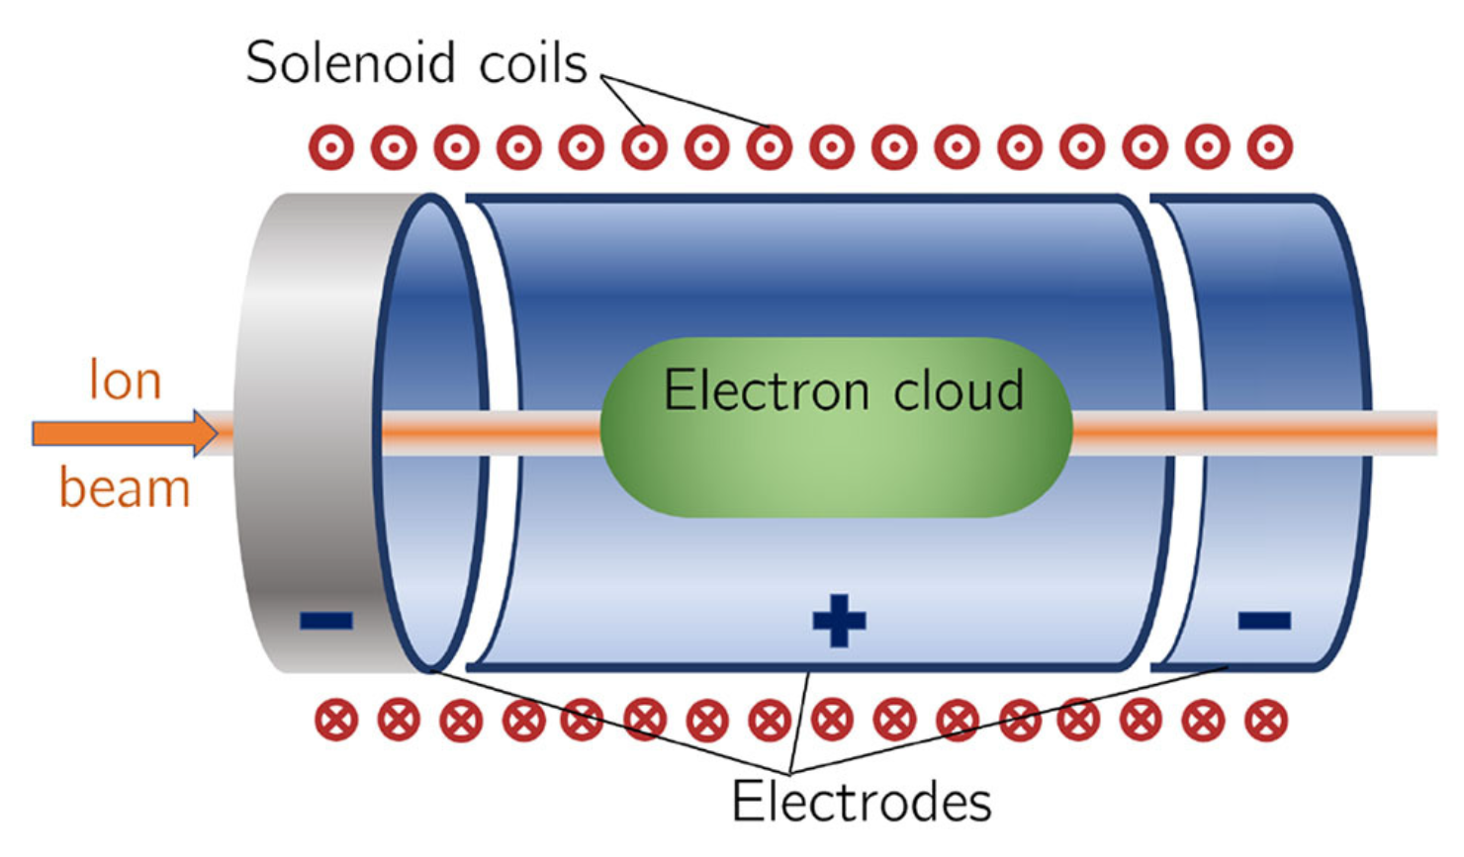
Why Gabor Lenses
Plasma
E_{r}
Power consumption
  B reduced by factor of 5-10.
  Equivalent first solenoid as focussing element ~ 5T weight, 150-200kW.
Electrostatic focussing compared to magnetic
  Force proportional to q compared to qv x B
    Heavier particles will have lower velocity, require higher solenoid field
  Gabor lens has orthogonal E and B fields and so acts as a Wien filter
    select for particle velocity
    used as part of the transmission line particle selection.
Achievable – Swansea/Manchester demonstrated capability in ALPHA.

Slide 19


