Slide 1
Update
K. Long
April 13, 2026

Slide 2
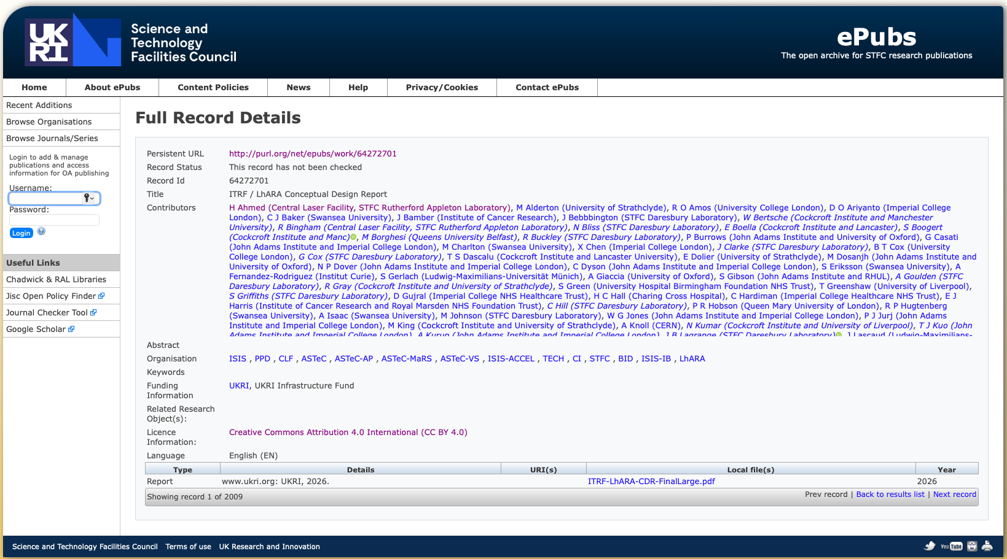
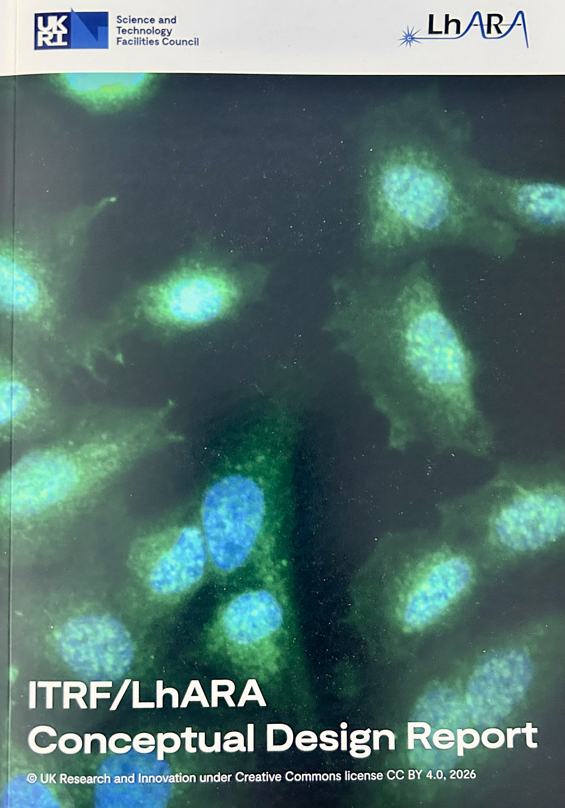
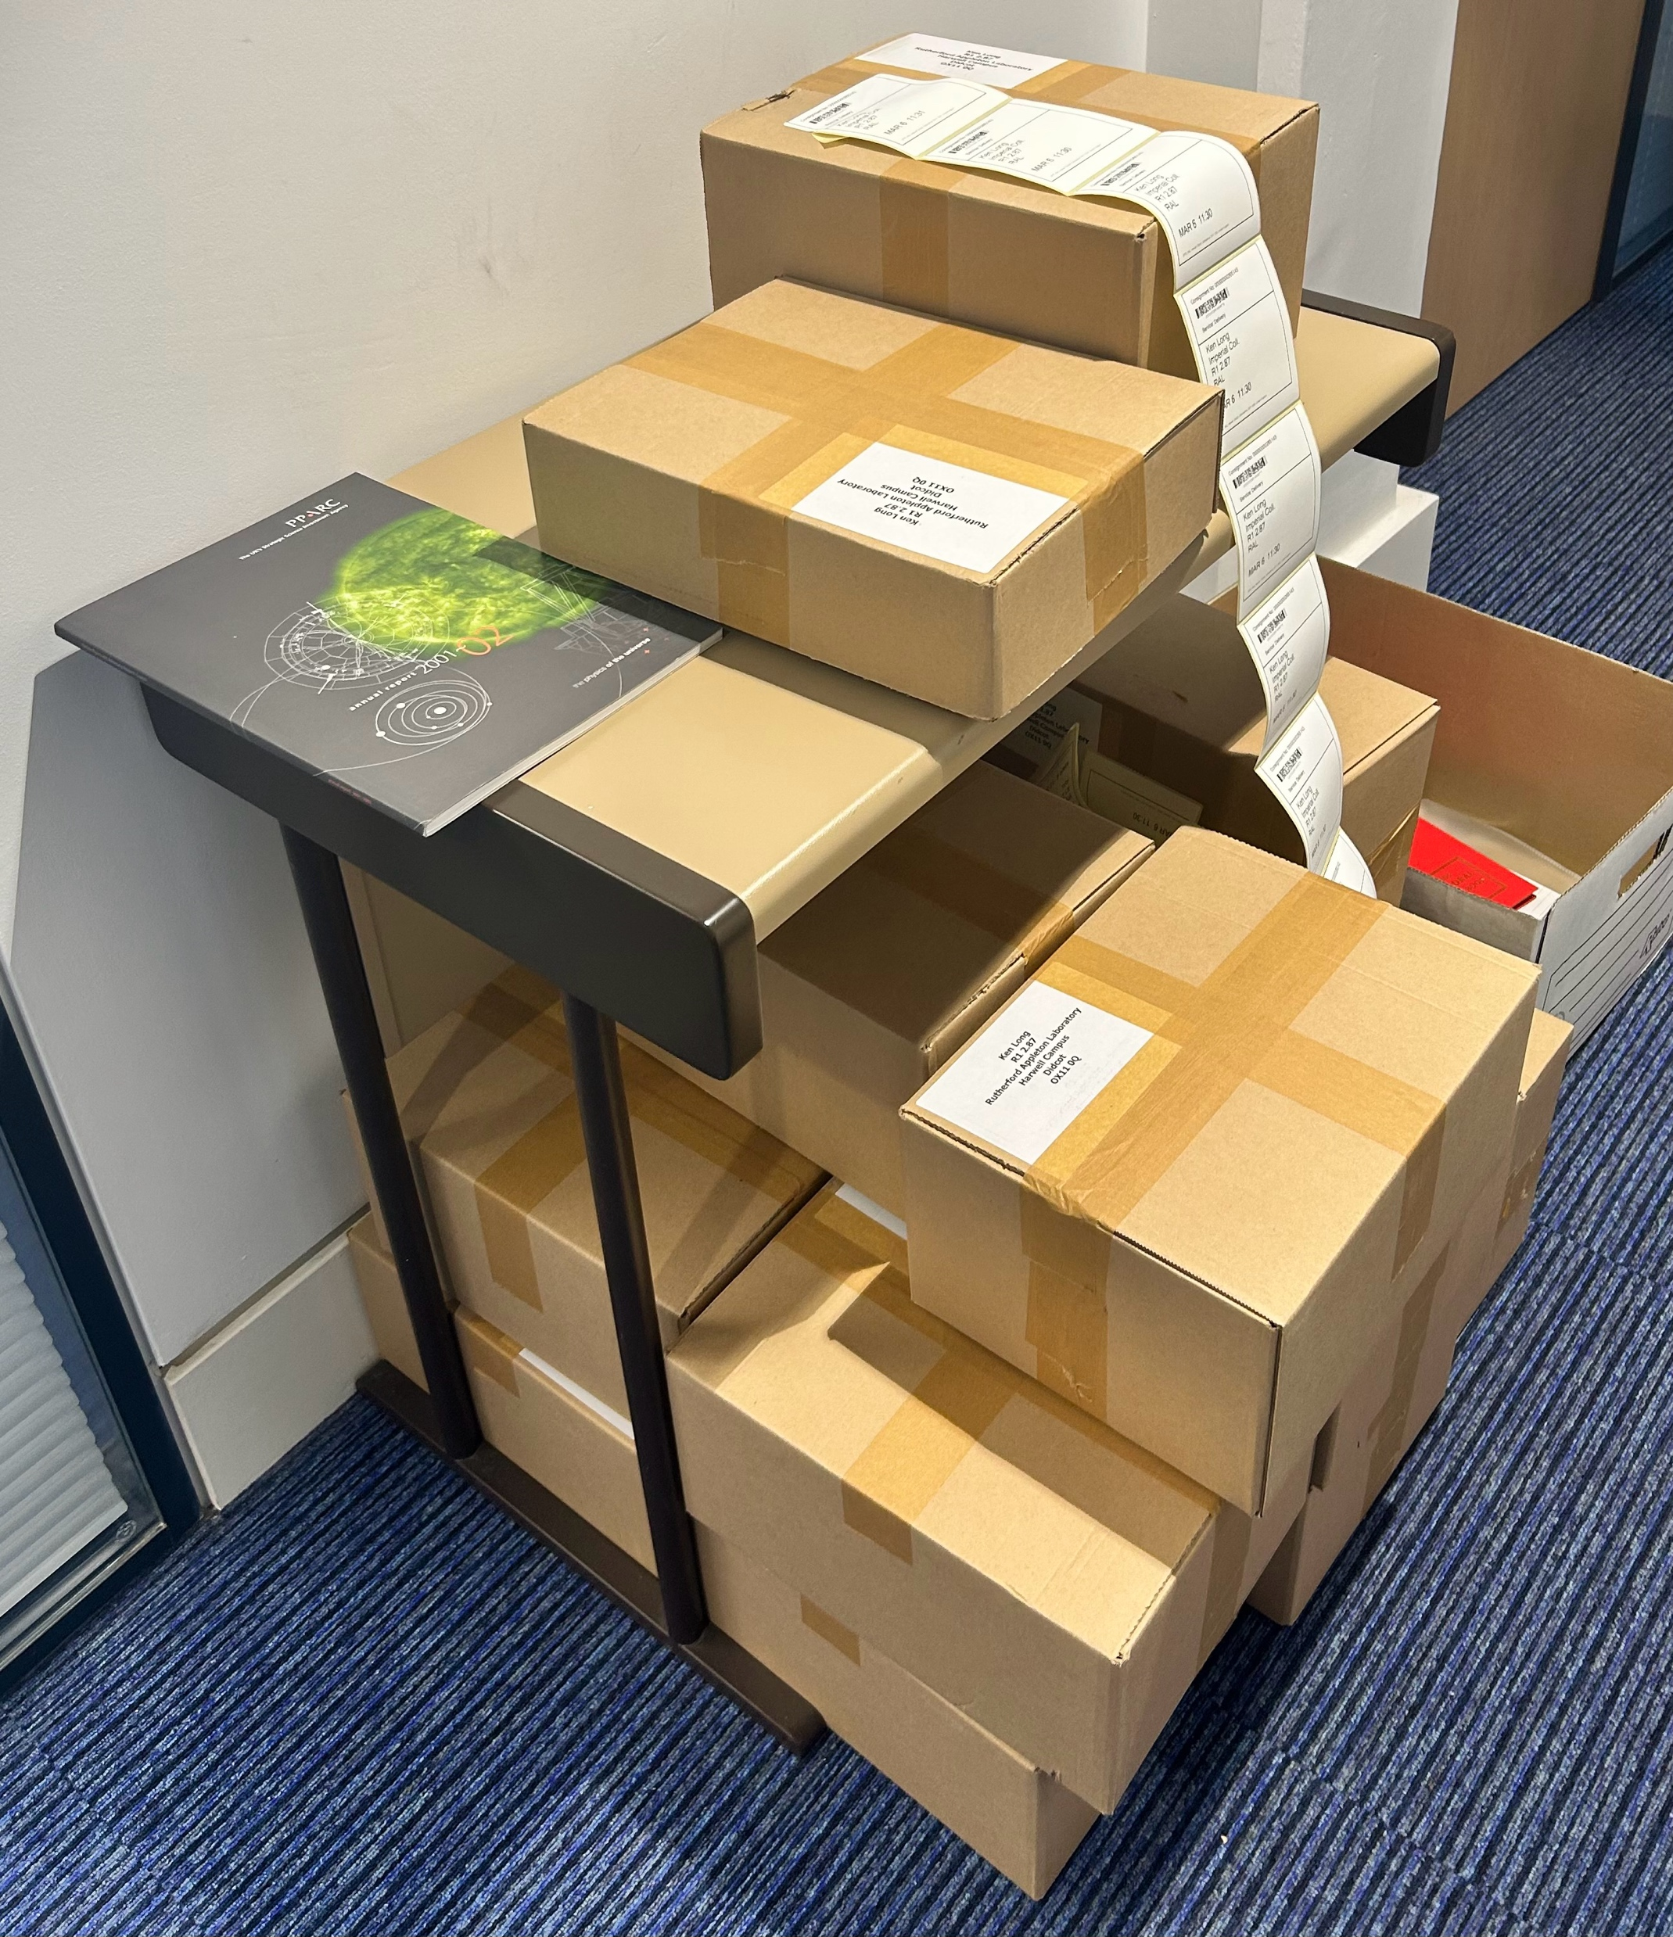
Hywel submitting to arXiv; then can use in
ResearchFish
Enough for all!
Will solicit requests from institutes &
send to “the great and the good”

Slide 4
Success
Long-term:
The construction of a compact, fully-automated laser-driven, high-throughput treatment facility.
Medium term:
The staged construction and operation of LhARA, the Laser-hybrid Accelerator for Radiobiological Applications to:
Prove the feasibility of laser-driven hybrid acceleration in a facility dedicated to the exploration of the vast terra incognita of radiation biology; and to
Lay the foundations for the transformation of ion beam therapy.
Short term:
Develop the nascent radiobiology activity into a systematic programme that leverages the collaboration’s unique mix of skills and capabilities;
Create a co-creation programme with (at least) Leo Cancer Care; and to
Initiate the pre-construction/risk R&D mitigation programme implied by the execution of the LhARA project defined in the CDR.

Slide 5

Building on CDR
PoPLaR
as part of
systematic
programme
Science: radiobiology
Project: LhARA
Impact: co-creation

Slide 6
LhARA collaboration business plan
Vision that encompasses institutional business plans
LhARA
collaboation
Institutes
UKRI
EU/ERC
Industry
partners
Philanthropists
Foundations
…
First drafting discussion!
Long, Parsons, Whyte
Prepare draft ahead of next collaboration meeting

Slide 7

Programme, project and business plans
Agreed to develop business plans; now start “for real” …
Agreed with STFC/RAL/PPD that Christopher Townsley will be our consultant
Begin to prepare for CM#9

