Slide 1



ITRF/LhARA
Project Board No. 10
Chloe Pugh, Hywel Owen, Adele Cook.
7th March 2025
Notes:
The abstract pattern can be removed or repositioned if required. Be careful to ‘Send to Back’ so that it does not obscure any important information.

Slide 2
Contents
Progress
  Key events looking forward
  BP1 Structure
  Work Package Progress
  Proposed BP1 6-month delivery plan
Finance
Resource Management, Schedule & Deliverable
Risks, Issues and Discussion
Image © STFC Alan Ford
Notes:
To replace photo with one of your own. 1) Send the geometric shape overlay to the back – Right-Click > Send to Back > Send to Back. 2) Replace image – use the guides provided to correctly position it. 3) Send your image to the back so that the geometric overlay re-appears over the image. Remember to delete the image credit if using your own image.

Slide 3
Date | Event
October 2024 | Bridging period officially starts
October 2024 | House of Commons engagement event (23rd October, London)
April 2025 | 12th ITRF Advisory Committee meeting (7th – 8th April, London)
May 2025 | Internal project closure & lessons learned
May 2025 | End of IF funding
June 2025 | Great Exhibition Road Festival (8th – 9th June, London)
https://stfc365.sharepoint.com/sites/ITRF

Slide 4



BP1 Project Structure
WPA – Radiobiological Science and Technology
WPB – ITRF/LhARA Risk Mitigation
WPC – Project Management, Outreach & Engagement
WP Leaders: J. Parsons, R. Amos
WP Leaders: R. Gray, W. Shields
WP Leaders: C. Pugh, C. Whyte
Documents: LhARA-Gov-PMB-2024-09.pdf

Slide 5
Design and Engineering Progress
WPA Updates
Research Fellow recruited to aid delivery of radiobiology experiments.
Progress on design and characterisation of SCAPA proton source to serve PoPLAR radiobiology experiments.
Cell sample glass rings and Mylar mounts being prototyped
Preliminary clonogenic survival experiments on Mylar are being performed, as this is likely different from the conventional plastic dishes routinely being used. All cell lines used will need to be optimised on this new media before any laser-based experiments are carried out at SCAPA
Planning cyclotron comparison experiments (Birmingham)
WPB Updates
Integration meetings now underway to progress connection issues in PA1 work packages, particularly S2E from source through Stage 1 beamline and FFA
Task 2: Planning of PoP experiment PoPLAR using SCAPA demonstrated parameters to conduct exemplar radiobiology experiments.
Task 2: Design of PoPLAR well progressed. Delivery beamline designed and quadrupoles delivered and measured; stages and mounting in construction..
Task 3: Milestone plasma density 1x10^15 m^-3 demonstrated with good lifetime. Rotating wall electric field experiments progressing.
Task 6: Exploring uniformity of FFA tune over energy range; increased dynamic aperture obtained – review successfully carried out 26th February
Notes:
HYWEL UPDATE PLS

Slide 6
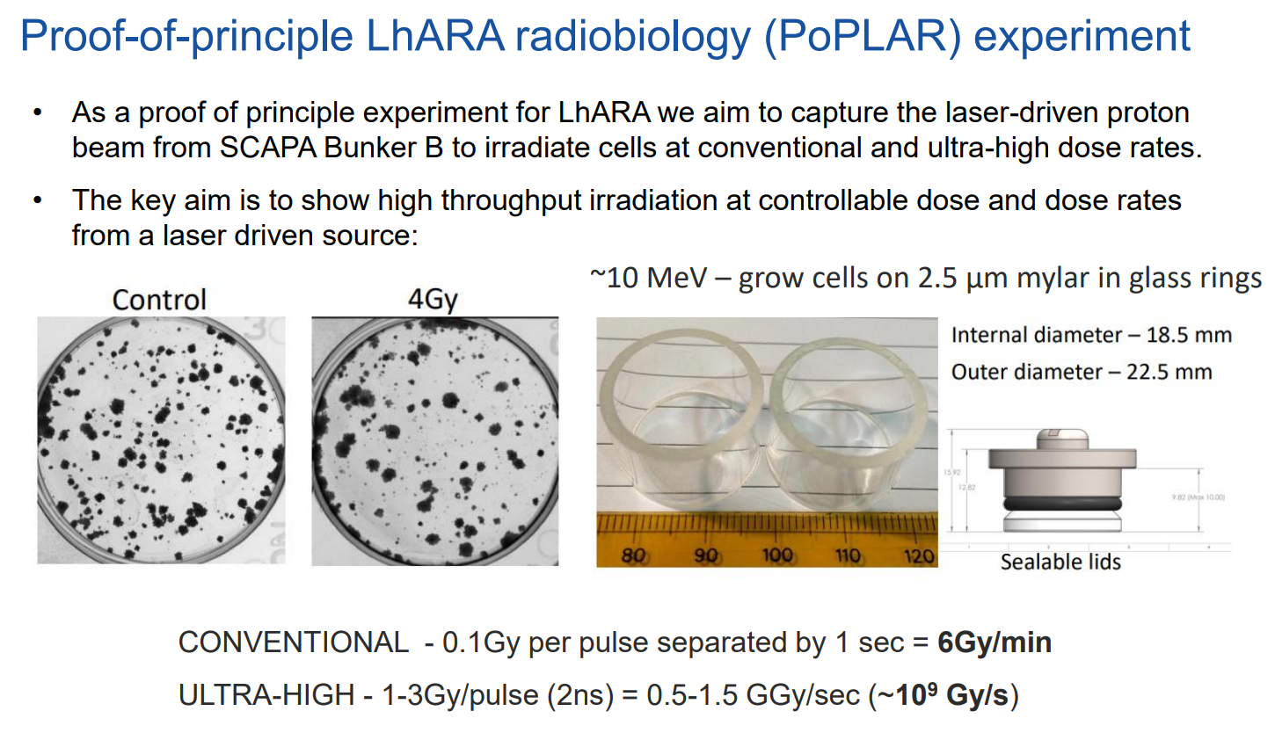

Slide 7
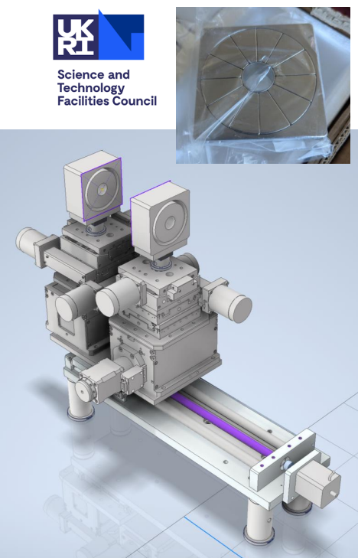
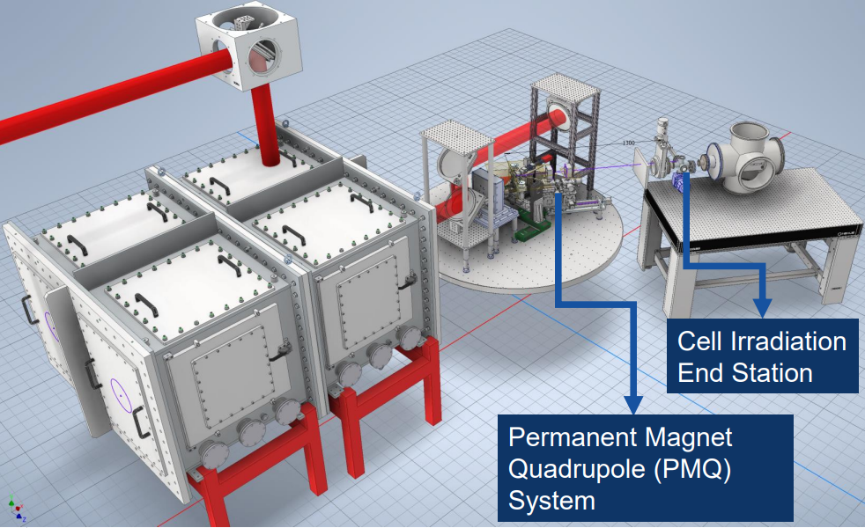
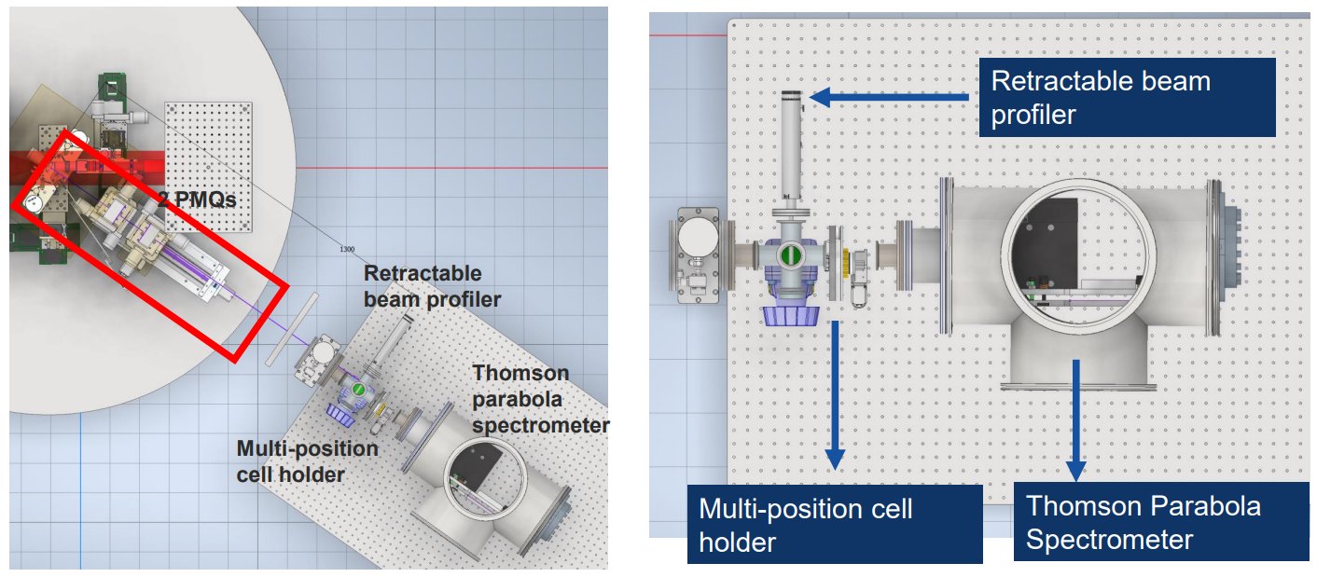
PoPLAR beamline engineering
Magnet measurements and beamline design complete – integration in progress.

Slide 8
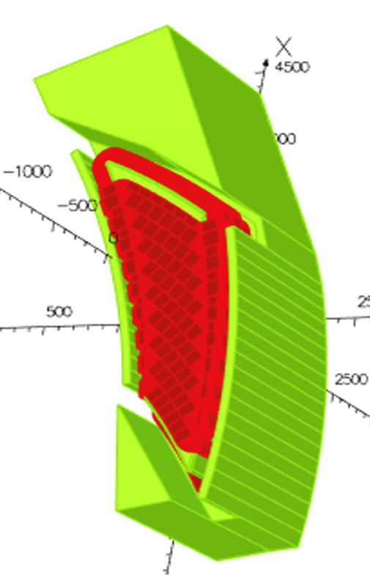
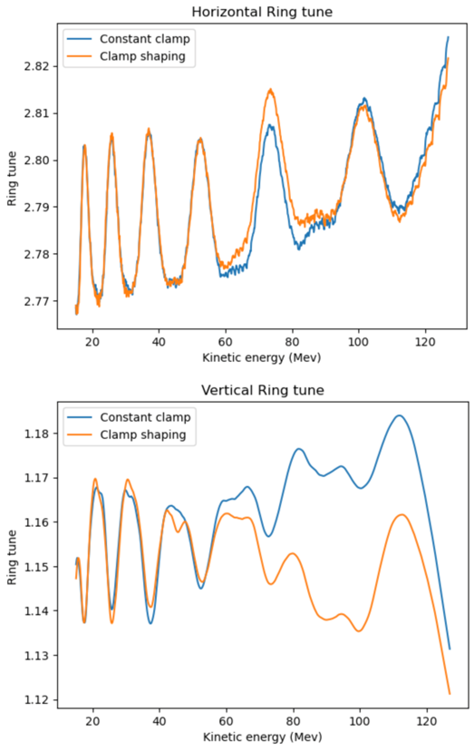
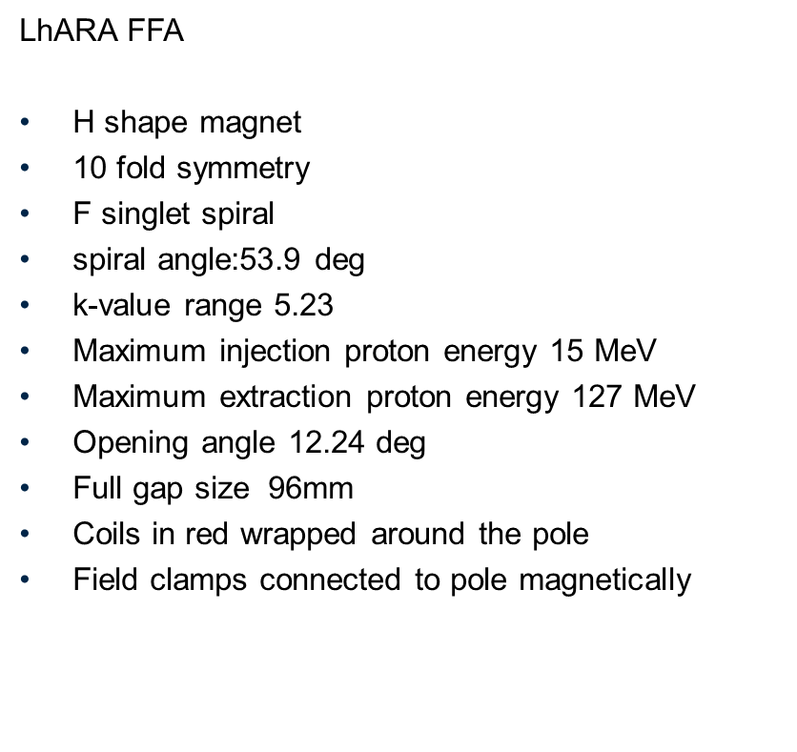
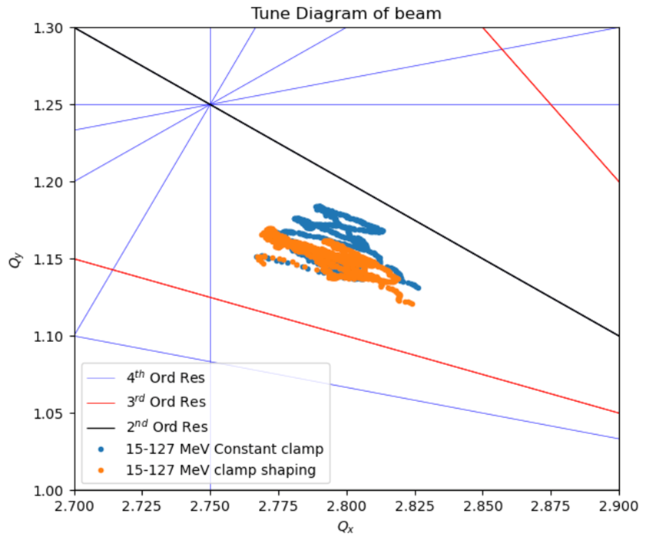
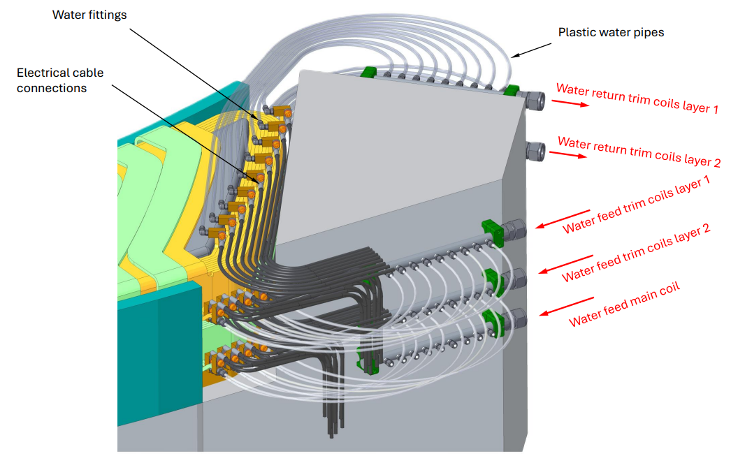
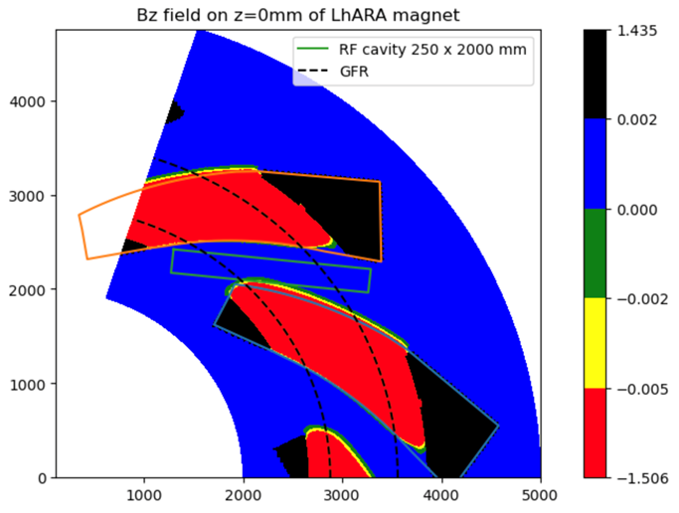
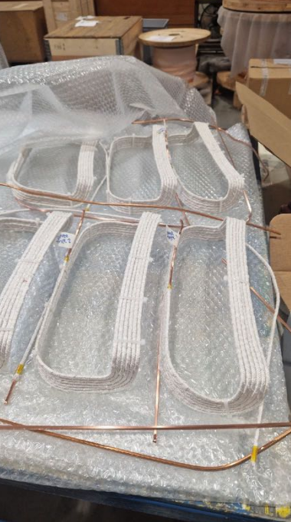
FFA design progress
ISIS-II FETS-FFA prototype will validate design/manufacturing concepts and field performance.
Review on 26th Feb indicated no
showstoppers in design.

Slide 9

Work Package C Update
Task 1
Plans underway for the collaboration meeting (7th – 8th April)
Task 8
Application submitted to STFC Spark Fund (£20k) to develop a roadshow exhibit; outcome expected by end of March 2025.
The collaboration has been successfully awarded a stand at the Great Exhibition Road Festival (8th – 9th June 2025).

Slide 10
ITRF Financial Update
The tables show the progress of the project by financial year and the expected position at the end of the project.
The STFC element of the budget is £0.026m underspent. This underspend has helped to assist with the under allocation on this project.
In the P09 forecast, Finance have included a projected overspend of £0.028m due to the shortfall of PD funding that was expected but not received to fund the inflation on this project. Massimo Noro has discussed the previously agreed transfer with Sinead Farrington. As of 4th December no transfer has been agreed.
With the above adjustment to the forecast the final table shows the confirmed £0.049m overspend on this project in FY24/25. The overspend is driven by the inflation which was not included in the allocation and the re-profiled payments that were not highlighted to Finance. Finance has been advised for forecast this overspend.
Note that the final full project cost (over financial years and including the 28k) is matches the budget allocation. It is the phasing that has caused the issues in year.
Notes:
Council is the generic term for the 9 constituent bodies of UKRI (7 old councils plus IUK and RE).

Slide 11
ITRF Budget Profile Update
The table shows details of the requested re-profile change and the movement of the budget profile since the start of the project.
The final table shows the forecast outturn including the £28,000
The change to profile on grants has highlighted to Finance the need/risk to review the grant profiles on the next stage on this funding to ensure the grant profile are reflected in the payment profile. This should then reduce the need to re-profile in later years.
Notes:
Council is the generic term for the 9 constituent bodies of UKRI (7 old councils plus IUK and RE).

Slide 12
Grant Payment Profile - Update
The table above highlights the variance between the total ITRF grant allocation and the fixed grant payment profile of £43,100. This value is currently unfunded (although the 28k from PPD would help to cover some of that)
As discussed in the last meeting, a review of the expected grant payments has identified an approved extension on the grant profile for Swansea University. There are payments planned for FY25/26 and no ITRF allocation available in that year. The award was extended to cover a delayed Post Doc recruitment period.
In July, a re-profile request was submitted for a no cost extension of £53,275 into FY25/26. Unfortunately, the Infrastructure fund are under portfolio management restrictions imposed by UKRI. They are hoping for an update end December.
.
Notes:
Council is the generic term for the 9 constituent bodies of UKRI (7 old councils plus IUK and RE).

Slide 13
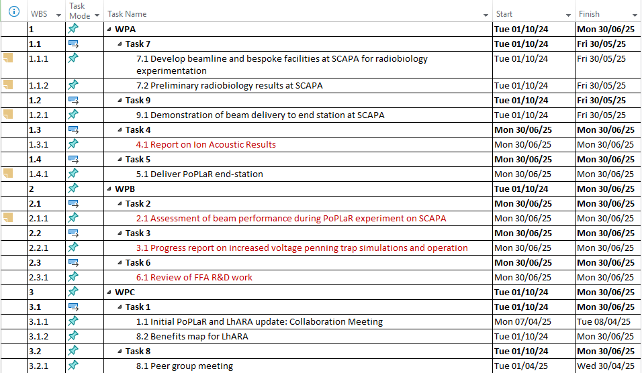
Milestones & Deliverables
Significant reduction in the number of milestones and deliverables, with a lot of resource redirected towards the PoPLaR radiobiology experimentation. Deliverables for many tasks are not focused on reporting of work completed to date.
WPA
- Removal of some longer-term experimental work, including cell survival experiments, and accelerated
- Reduction to report on ion acoustic results to date
- No report on stage 1 beam monitoring system
WPB
- Removal of 10 Hz debris and damage challenges
- Removal of final report on penning trap operation
- Reduction to only reviewing FFA R&D work completed to date by the end of the funded period
WPC
- Removal of de-risk updates and instead ‘final report’ will be from the collaboration meeting in April 2025
- Reduction for public engagement, removing content and website creation,

Slide 14
Resource planning
Two-year Plan: 3.57 FTE
Department | FY24/25 | FY25/26 | FY26/27
ASTeC | 0.29 | 0.58 | 0.30
TD | 0.35 | 0.70 | 0.35
ISIS | 0.25 | 0.50 | 0.25
TOTAL | 0.89 | 1.78 | 0.90
Eight-month Plan: 1.01 FTE
Department | FY24/25 | FY25/26 | FY26/27
ASTeC | 0.25 | 0.063 | 0
TD | 0.35 | 0.025 | 0
ISIS | 0.25 | 0.083 | 0
TOTAL | 0.84 | 0.171 | 0
Reductions required from nearly all collaborators to enable redirection of funds to the PoPLaR experimental work at Strathclyde.
Daresbury have accommodated the reduction in funding by:
- TD PME will no longer be providing any engineering support for FY 25/26, final day on the project will be 28th March.
- ASTeC vacuum support has been removed from ITRF.
ASTeC magnet support has been reduced, coming to a complete stop by the end of FY 24/25.

Slide 15
Risk Management Plan
Ref No. ​ | Risk title​ | Risk Description​ | Actions completed ​ & current controls in place​ | Impact​ | Probability​ | Rating​ | Next planned action​
3 | Technology choices | Technology is still in the development phase, and therefore may not be appropriate for the desired end specification. Failure to meet the ion beam specification parameters may lead to delivery failure. | Work completed during PA1 has highlighted several issues with the original FFAG design, and addressed concerns around the Gabor Lens. Work will continue to address the concerns around the magnetic coils for the FFAG. Review meetings will be held at 6, 12 and 18 month intervals of the project to make informed decisions on the technology choice to carry forward into the TDR phase. | Moderate | Likely | 12 | Simulate the proton and ion production from the target, capture and delivery line to the Fixed Field Accelerator (FFA), FFA and Gabor lenses. Conduct engineering design studies of the Target chamber, Gabor lenses and FFA. Consider alternative technology choices as a mitigation if specification or engineering solutions cannot be delivered in the project timescale.
8 | Schedule | Poor project planning could lead to an overrun of estimated project timescale leading to late delivery. | Develop a work breakdown structure and Gantt chart schedule containing resources against tasks, review gates, key milestones and critical path. Monitor and update the schedule during the project lifecycle and act when necessary to address issues to keep the project on track. | High | Moderate | 12 | Update 11/11/2024: The current project plan is based on having funding in place until 30/09/2027. Project plans now need to be adapted and refocused to deliver the project to a 'clean close' in the next six months. Update 13/01/25: Adjusted project plan is under development. The IF have already indicated a no cost extension is possible to accommodate any delays in delivery.
3 | Project direction & governance | Poor project governance and a lack of direction between collaborators could lead to disagreement, unclear aims or deliverables, unclear priorities and delays in decision making processes. This could create risk to project deliverables, poor delivery or withdrawal of | Establish a community, advisory committee and project board to provide advice, senior project management and governance throughout the project lifecycle. | Moderate | Moderate | 9 | STFC team have been invited to the LhARA project board and executive board and actively participate. Udpate 13/01/25: Project direction has shifted in light of new funding, therefore governance has altered slightly to accommodate these changes.
5 | Key specialist staff | Key staff are working across several projects and may be unable to provide the time required to support the project. Could lead to significant delays or potential failure to deliver. | Identify potential single point failure risks, implement cover and succession planning where appropriate. | Moderate | Moderate | 9 | Mitigate by scheduling key collaboration and review meetings when key staff are not heavily loaded. Update 11/11/2024: Loss of key specialist staff highly likely due to funding no longer being available. Update 13/01/25: Several key specialist staff members have been withdrawn from STFC on the ITRF project to support redirection of funds. Project expenses have been reserved for key staff for the bridging period given the change in project scope.
Documents: 1272-bp1-pm-risk-0001-v4.0-ITRF-Bridging-Risk.xlsx

Slide 16
Discussion – Risks, Issues & Project benefits
Next steps:
  Ken Long upcoming meeting with Michele Dougherty
  Evolving ITRF – mitigating weaknesses and emphasising our strengths
  Future non-financial MRC support
Final ITRF project board meeting

Slide 17
