Slide 1
Stage 1 Energy Selection
14/09/26

Slide 2
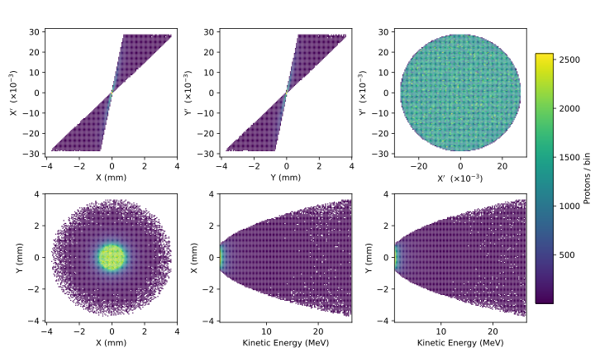
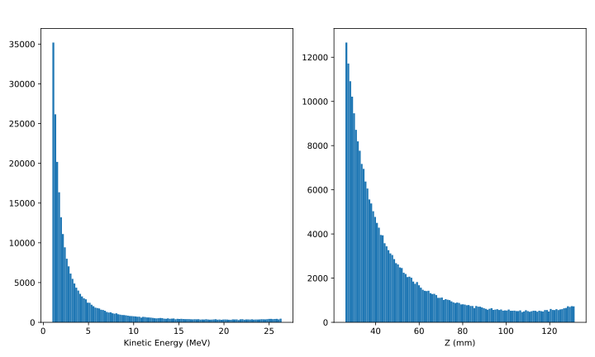
Stage 1 Full Spectrum Beam
Source parameters taken from LhARA CDR for LhARA Linear Optics
Source-Nozzle region simulated in RF Track with space charge
Particle coordinates at the nozzle exit as input to BDSIM tracking of the Stage 1 lattice
(Shown on this slide)
3M protons at source generation
~29,000 protons in 15±2% MeV band (~1% of total pop.)
250k protons survive the nozzle
~1230 protons in 15±2% MeV band (~0.5% of total pop.)

Slide 3
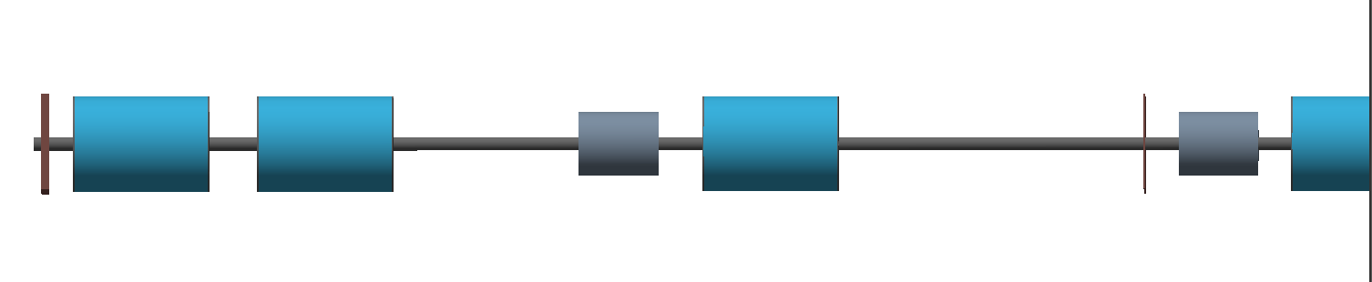
Stage 1 Energy Selection
Cavity 01
LEL Drift 03
Cavity 02
TR Drift 04
LEL Drift 02
Collimator 01
TR Drift 02 + 03
TR Drift 05
Gabor Lens 3
Gabor Lens 4
Gabor Lens 1
Gabor Lens 2
TR Drift 01
Cavity 1 – Increase the population of the nominal energy band at Collimator 1
Collimator 1 – Energy Cleaning at a hard focus
Cavity 2 – Longitudinal Phase Space rotation for bunch length compression

Slide 4
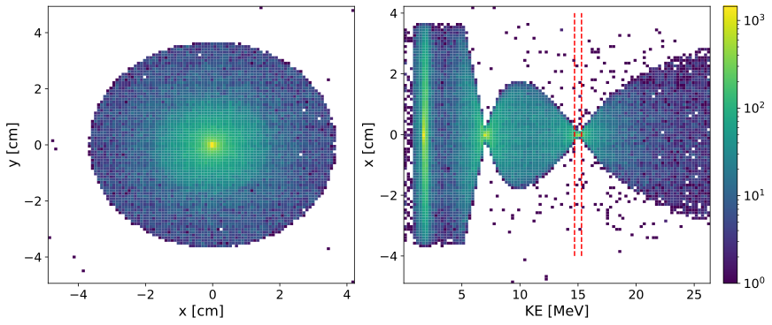
Full Spectrum Beam at the Collimator
BDSIM Tracking
Physical aperture of 3.65cm
No RF or Collimation simulated
Three regions of transverse focusing due to the broadband nature of the beam through three chromatic lenses
94k protons at the collimator
~1230 protons in 15±2% MeV band
~37% total beam survival but population of band maintained from nozzle to collimator
Cavity 01
LEL Drift 02
LEL Drift 03
Collimator 01
TR Drift 04
LEL Drift 00 + 01
TR Drift 02 + 03
TR Drift 05
Gabor Lens 3
Gabor Lens 1
Gabor Lens 2
TR Drift 01

Slide 5
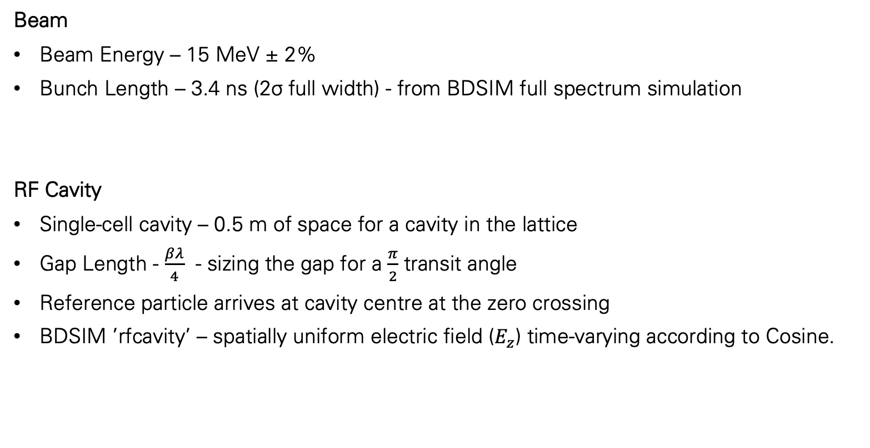
RF Cavity Assumptions and Parameters
Beam
Beam Energy – 15 MeV ± 2%
Bunch Length – 3.4 ns (2σ full width) - from BDSIM full spectrum simulation
RF Cavity
Single-cell cavity – 0.5 m of space for a cavity in the lattice
Gap Length - $\frac{βλ}{4}$ - sizing the gap for a $\frac{π}{2}$ transit angle
Reference particle arrives at cavity centre at the zero crossing
BDSIM ’rfcavity’ – spatially uniform electric field ($E_{z}$) time-varying according to Cosine.

Slide 6
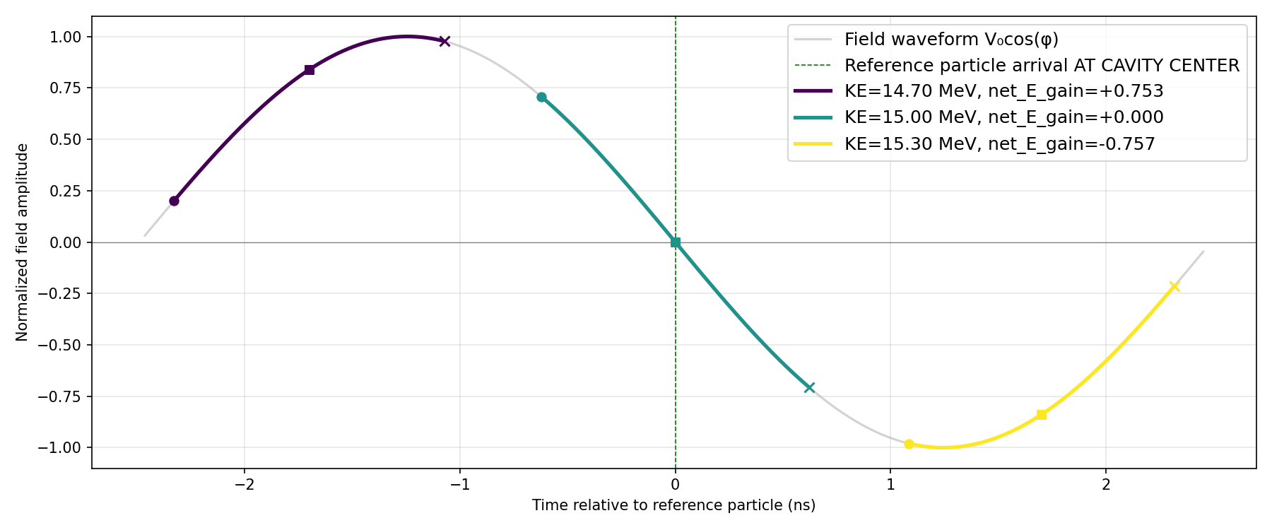
201 MHz
Gap Length – 6.6 cm
Extents of the nominal bunch see the non-linear region of the RF cycle – This is only for +/- 2%
Presents difficulty in calculating an ‘ideal’ voltage.

Slide 7
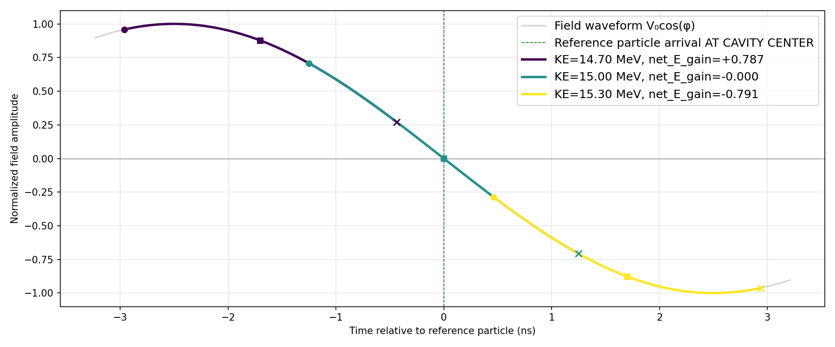
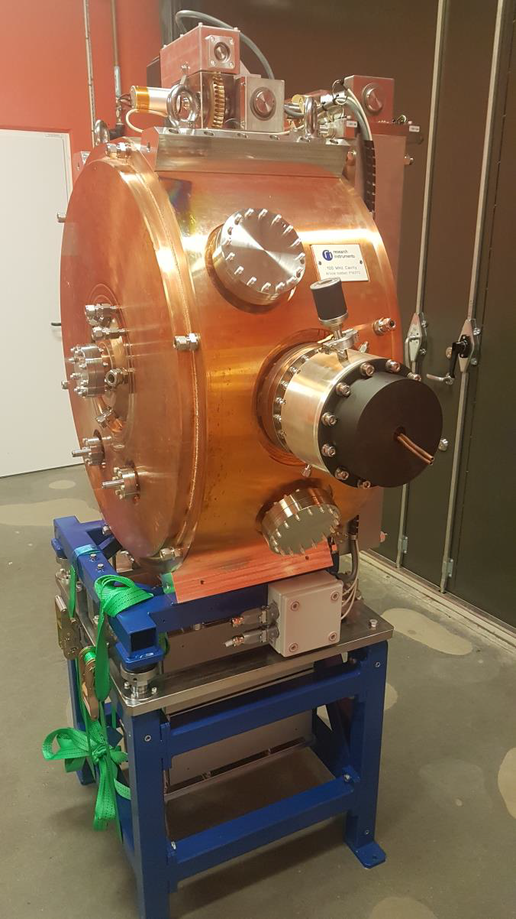
100 MHz
Nominal bunch closer to the linear response
’ideal’ voltage calculation would still be an approximation but closer to real response.
Example of 100 MHz cavity – MAX IV 3 GeV Storage Ring at Lund
Capacitance loaded design – diameter 0.82 m (3x smaller than pillbox)

