Slide 1
LhARA Source-Nozzle in RF Track
Space Charge Neutralisation with Copropagating Electrons
03/08/26

Slide 2
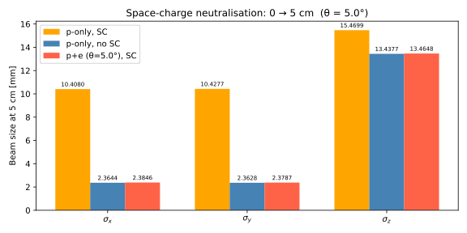

Slide 3
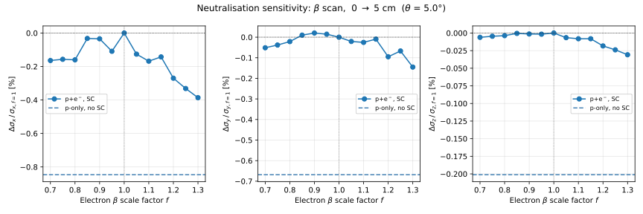

Slide 4
