Slide 1
LhARA Stage 1 Source Capture
06/02/26

Slide 2
Source Capture Optimisation
Proposed Solution: A permanent magnet quadrupole system between the source and the start of the stage 1 beamline
Objectives:
Minimise angular divergence
Maximise transmission
Minimise asymmetry
Free Parameters:
Quadrupole Lengths (varies integrated field) – bounds(0.02, 0.05)
Quadrupole apertures (scales inversely with quadrupole gradient) – bounds(0.01, 0.03)
Drift Lengths (adjustments to quadrupole positions) - bounds(0.0, 0.25)
F
D
F
F
D
F
GL1

Slide 3
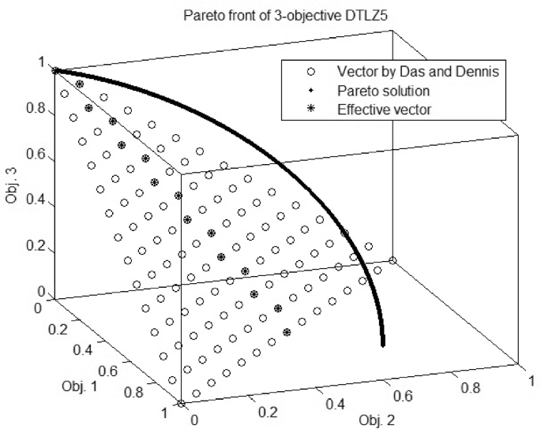
Optimisation Method
Multi-Objective Bayesian Optimisation with a Pareto Front
Reduces the number of expensive BDSIM runs by learning surrogate behaviour
Highly parallelisable - Batch BDSIM runs lead to greater improvements per step
Each objective is modelled separately – handles competing objectives and removes manual tuning of weights
Returns a Pareto front of non-dominated solutions – insights into the intrinsic trade-offs of the beamline and feasibility of present designs
Notes:
Hua Y, Jin Y, Hao K, Cao Y. Generating multiple reference vectors for a class of many-objective optimization problems with degenerate Pareto fronts. Complex & Intelligent Systems. 2020 Jul;6(2):275-85.

Slide 4
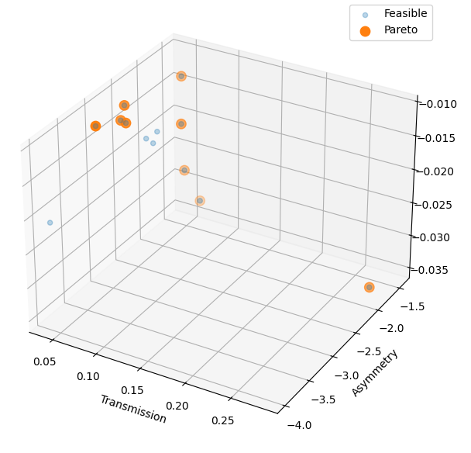
Staged Optimisation
Staged Approach
Optimise the first triplet with soft constraint
T > 4.1% (headroom for second triplet losses)
Objectives: minimise A and D
Select a small set of configurations from the pareto front
Best overall balance: T=7.4%, A=2.0, D=0.17
Lowest Divergence: T=4.5%, A=2.6, D=0.012
Lowest Asymmetry: T=6.3%, A=1.4, D=0.032
Optimise the second triplet parameters with the first triplet parameters fixed and constraints set
T ≥ 4.1%, A ≤ 0.5, D ≤ 0.015
Examine the pareto fronts of the second stage simulations for feasible solutions

Slide 5
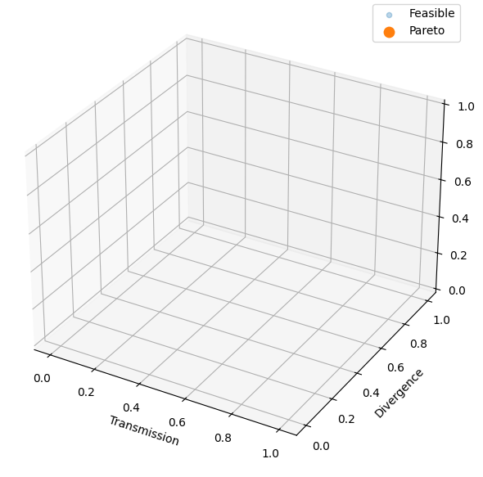
Staged Optimisation
Staged Approach
Optimise the first triplet with soft constraint
T > 4.1% (headroom for second triplet losses)
Objectives: minimise A and D
Select a small set of configurations from the pareto front
Best overall balance: T=7.4%, A=2.0, D=0.17
Lowest Divergence: T=4.5%, A=2.6, D=0.012
Lowest Asymmetry: T=6.3%, A=1.4, D=0.032
Optimise the second triplet parameters with the first triplet parameters fixed and constraints set
T ≥ 4.1%, A ≤ 0.5, D ≤ 0.015
Examine the pareto fronts of the second stage simulations for feasible solutions

Slide 6
Staged Optimisation
No Solutions Found
Trade-off between the three objectives is too competitive to find a solution satisfying all three
Main reason a given simulation is deemed infeasible is the transmission constraint
The aperture bounds for these runs were left fairly wide and still there were no solutions
Divergence cannot be controlled in time to ‘save’ transmission losses from the apertures
?

Slide 7
Summary and Next Steps
No physically feasible solution for beam capture using one or two PMQ triplets under realistic constraints
Reducing initial divergence is not a possible method of mitigating Gabor Lens emittance growth
Next: Begin studies on RF bunch control and collimator performance
Potential for impact on the chromatic component of GL emittance growth

