Slide 1
FFA Magnets 3D
04/02/25
Ta-Jen Kuo
Supervisor: Jaroslaw Pasternak, Jean-Baptiste Lagrange
Imperial College London, STFC

Slide 2
LhARA FFA

Slide 3
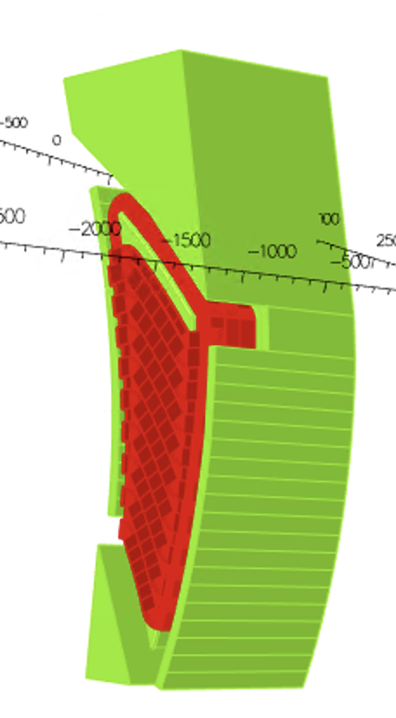
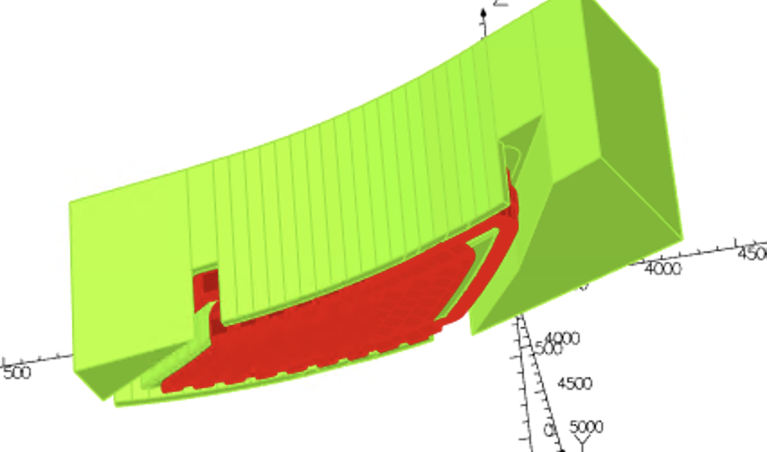
Previously, gaps between clamp and yoke to give space
For current connections

Slide 4
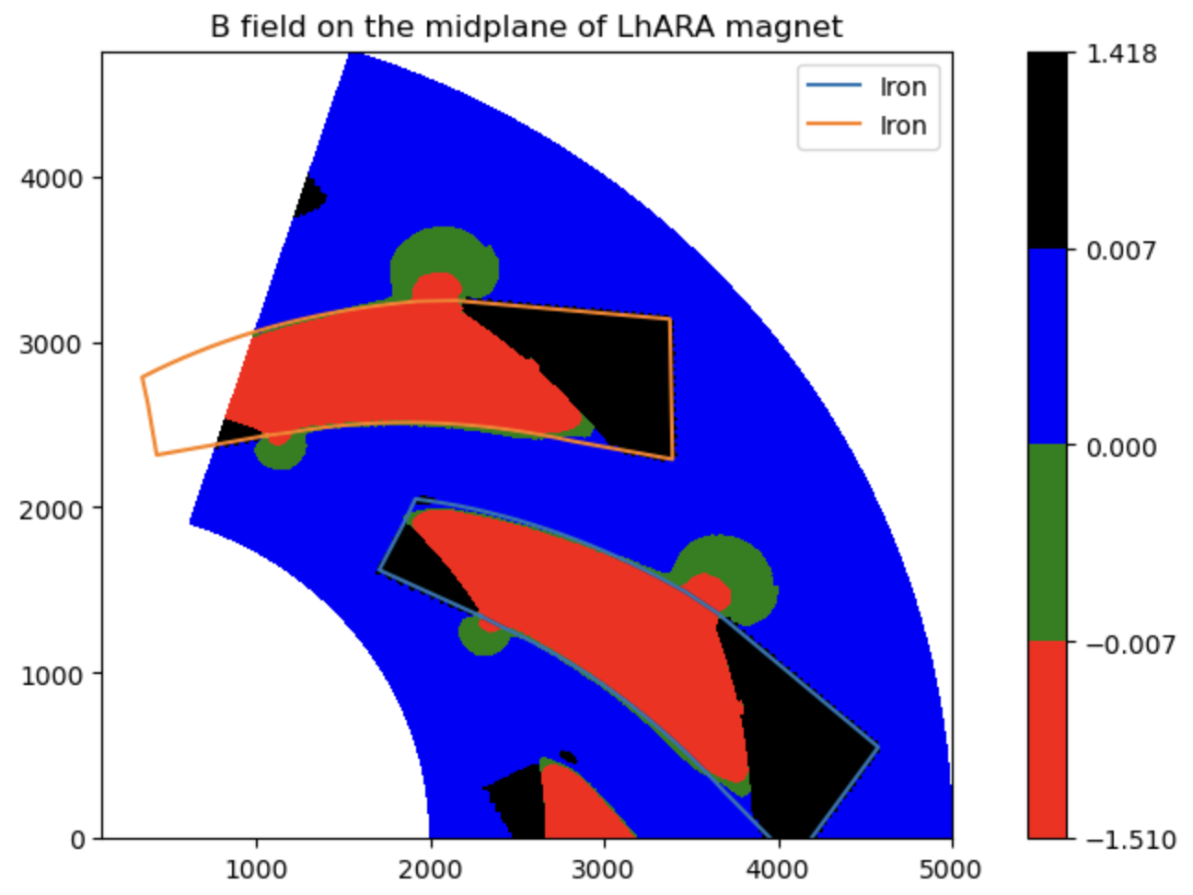
Leakage field in straight section

Slide 5
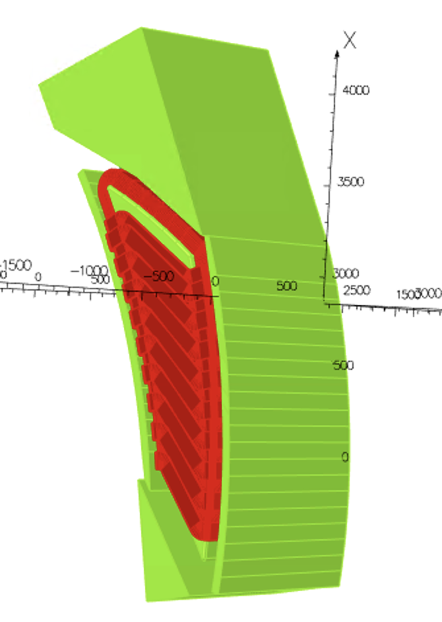
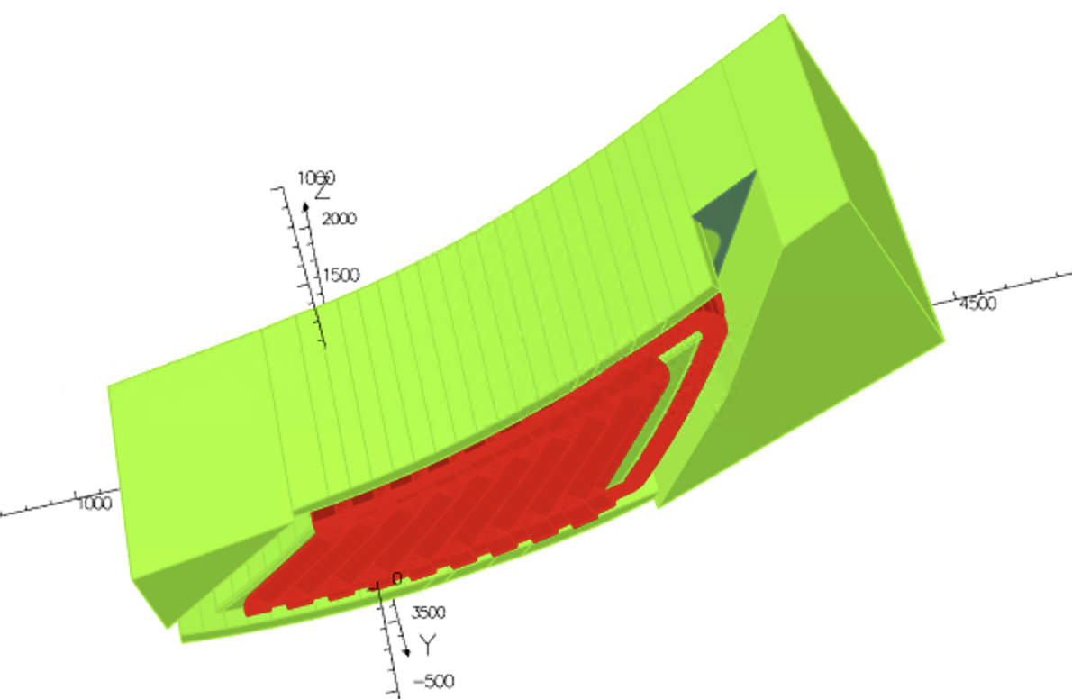
Close the two gaps where there were large field leakage

Slide 6
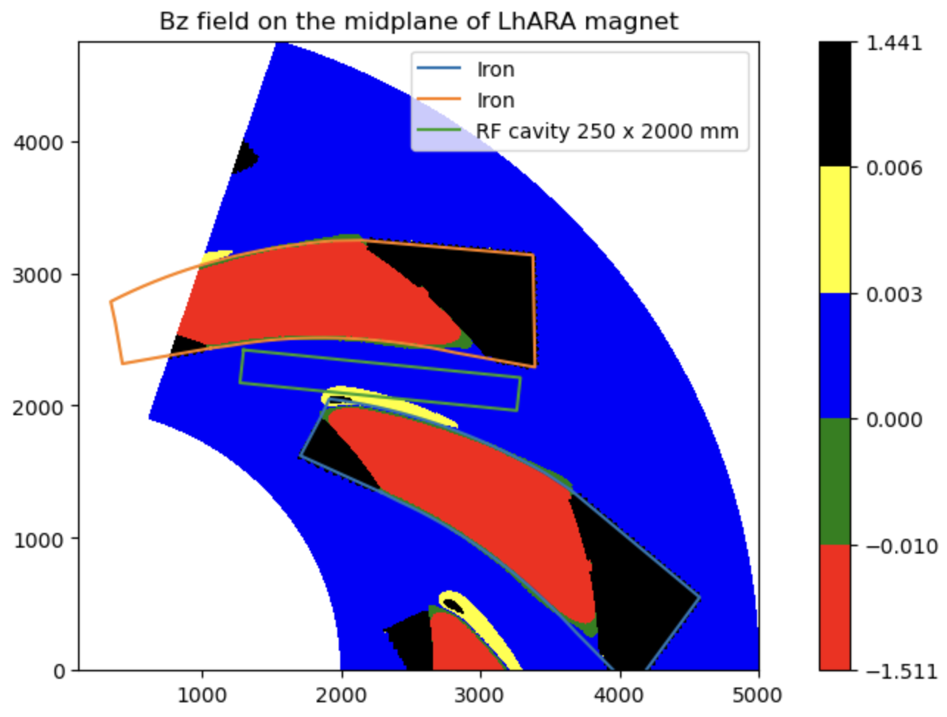

Slide 7
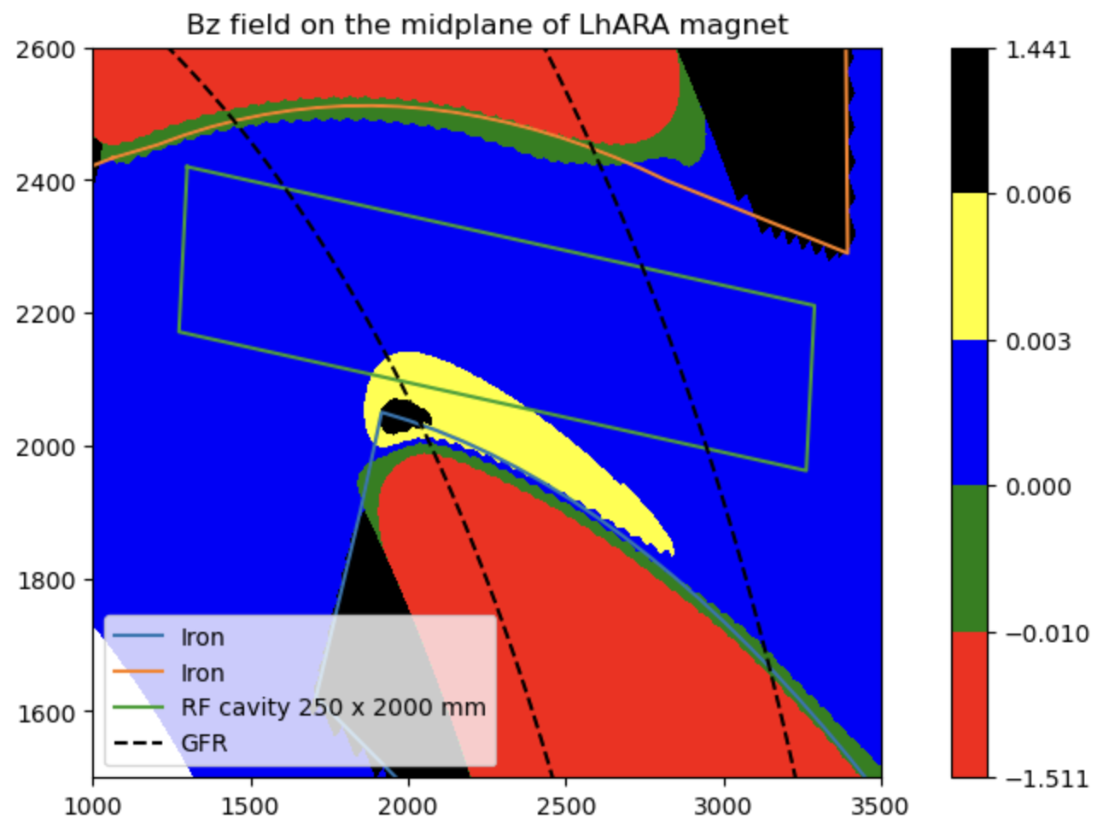
RF cavity of size 250mm x 2000 mm fits between the magnets with about 45mm margain
On either side

Slide 8
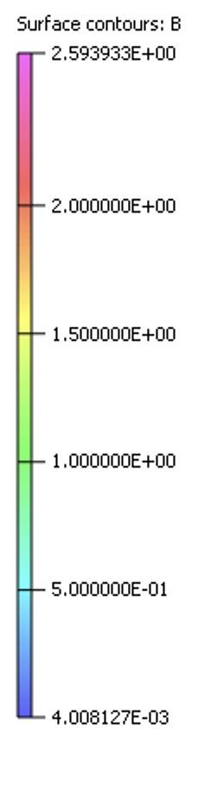
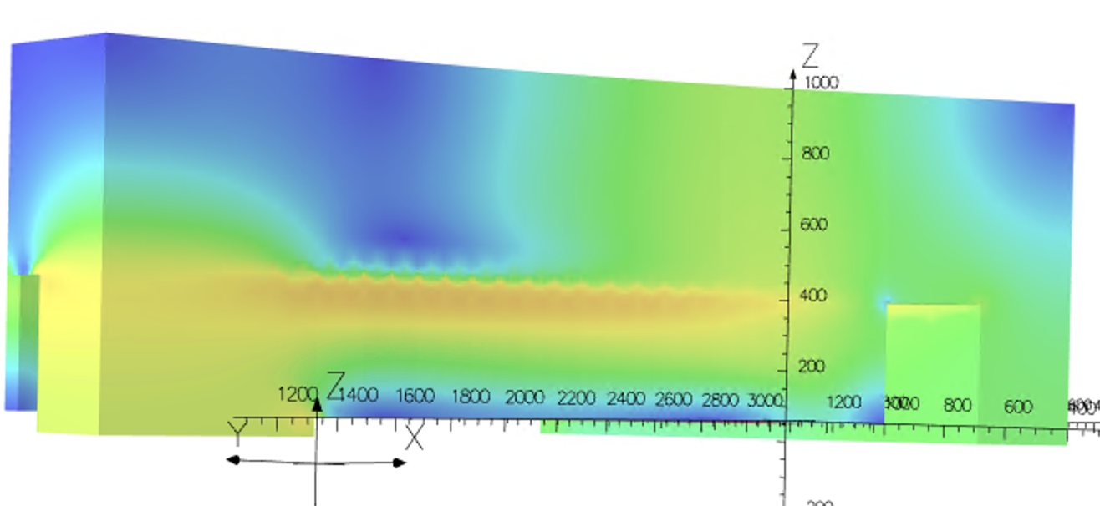
Saturation on the clamps seems high around z=400mm

Slide 9
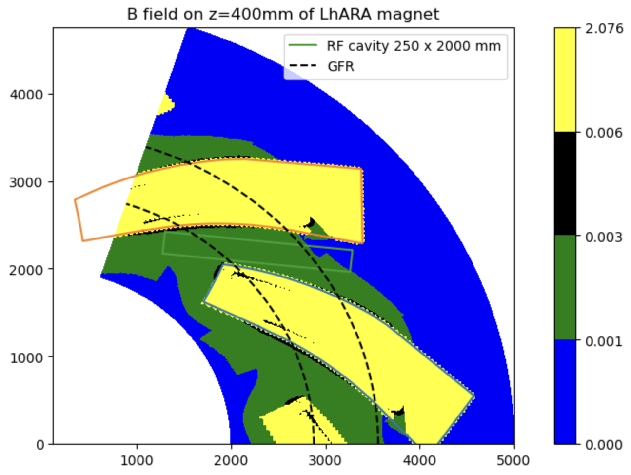

Slide 10
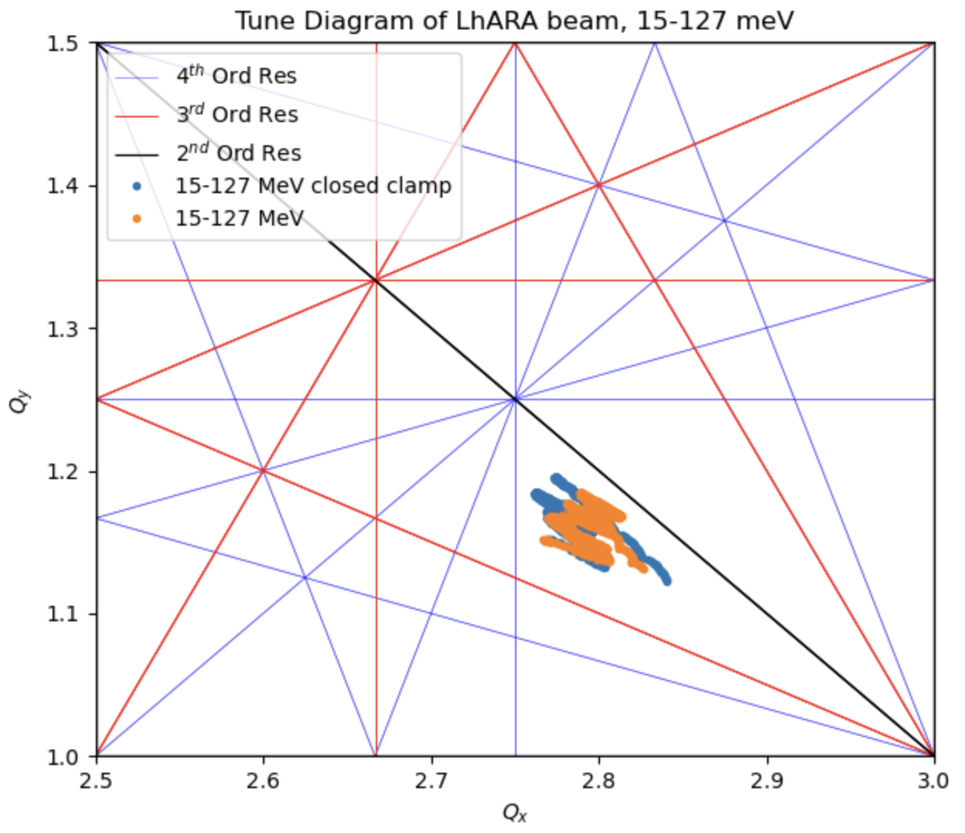
Tracking performance seems to be similar but slightly worse
Warning: Straight coils were accidently
used in the closed clamp study. Could
Have a big affect on the tune

Slide 11
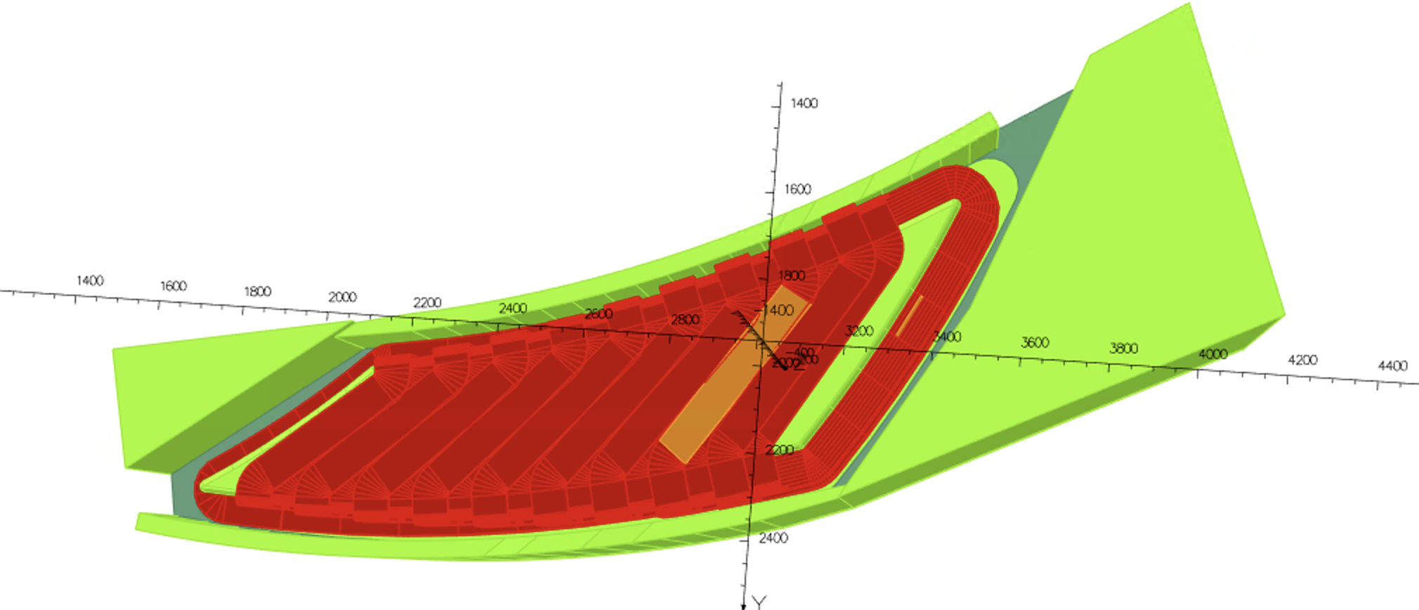
Coils are straight and slightly overlapping in the middle

