Slide 1


ITRF Project
Mechanical Engineering Design
FFA Ring
Clive Hill
16/07/24
1272-pa1-meng-prs-0021 v1.0
Notes:
The abstract pattern can be removed or repositioned if required. Be careful to ‘Send to Back’ so that it does not obscure any important information.

Slide 2
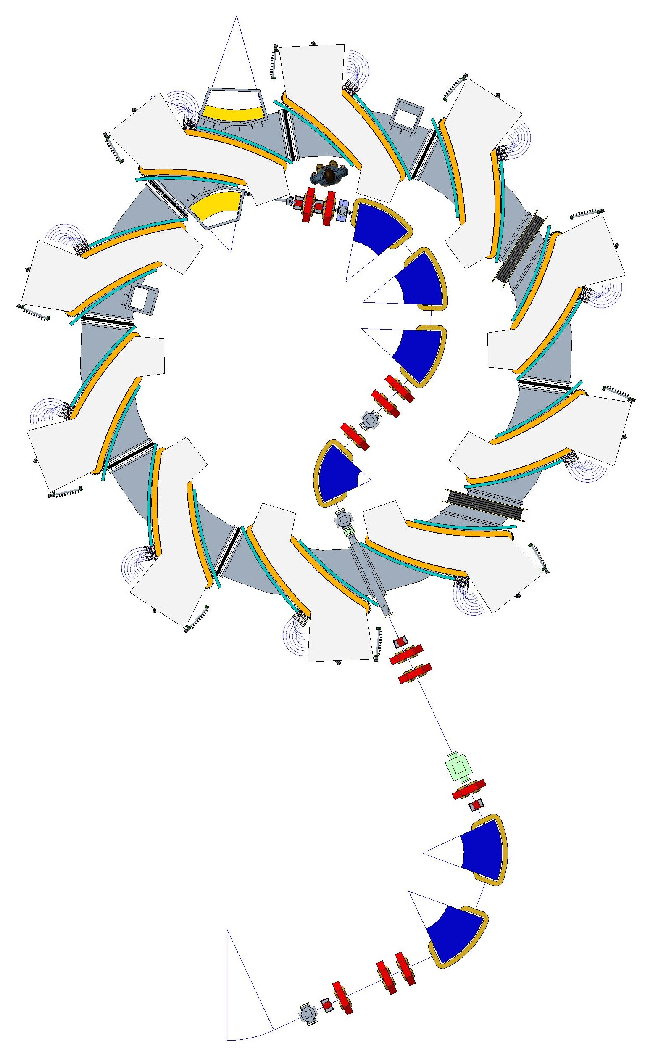
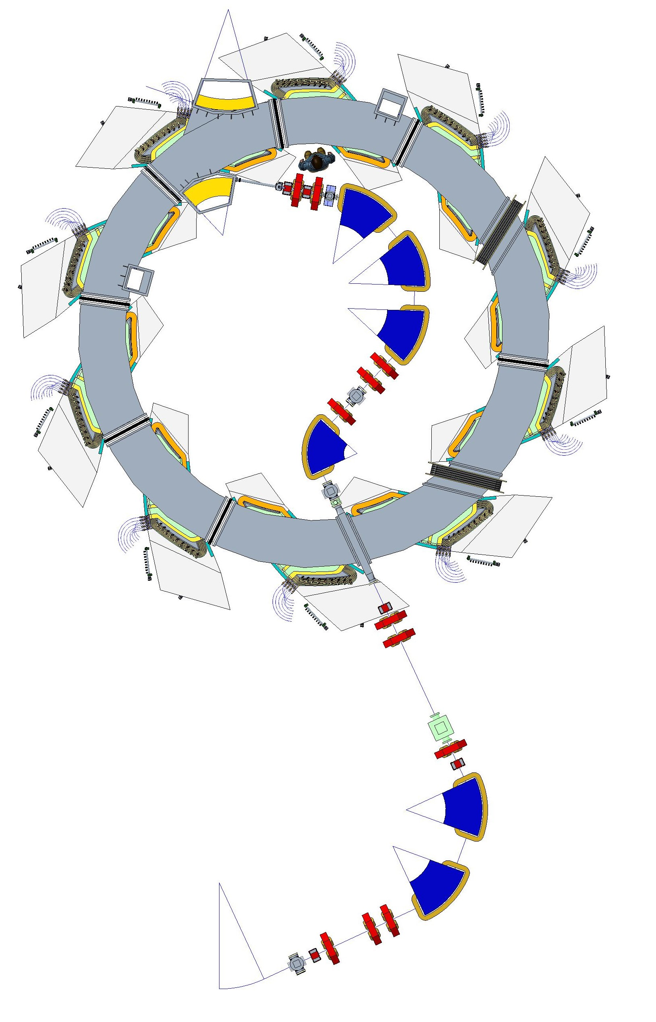
FFA Ring with Injection Line
Magnet Option 1
Magnet Option 2

Slide 3
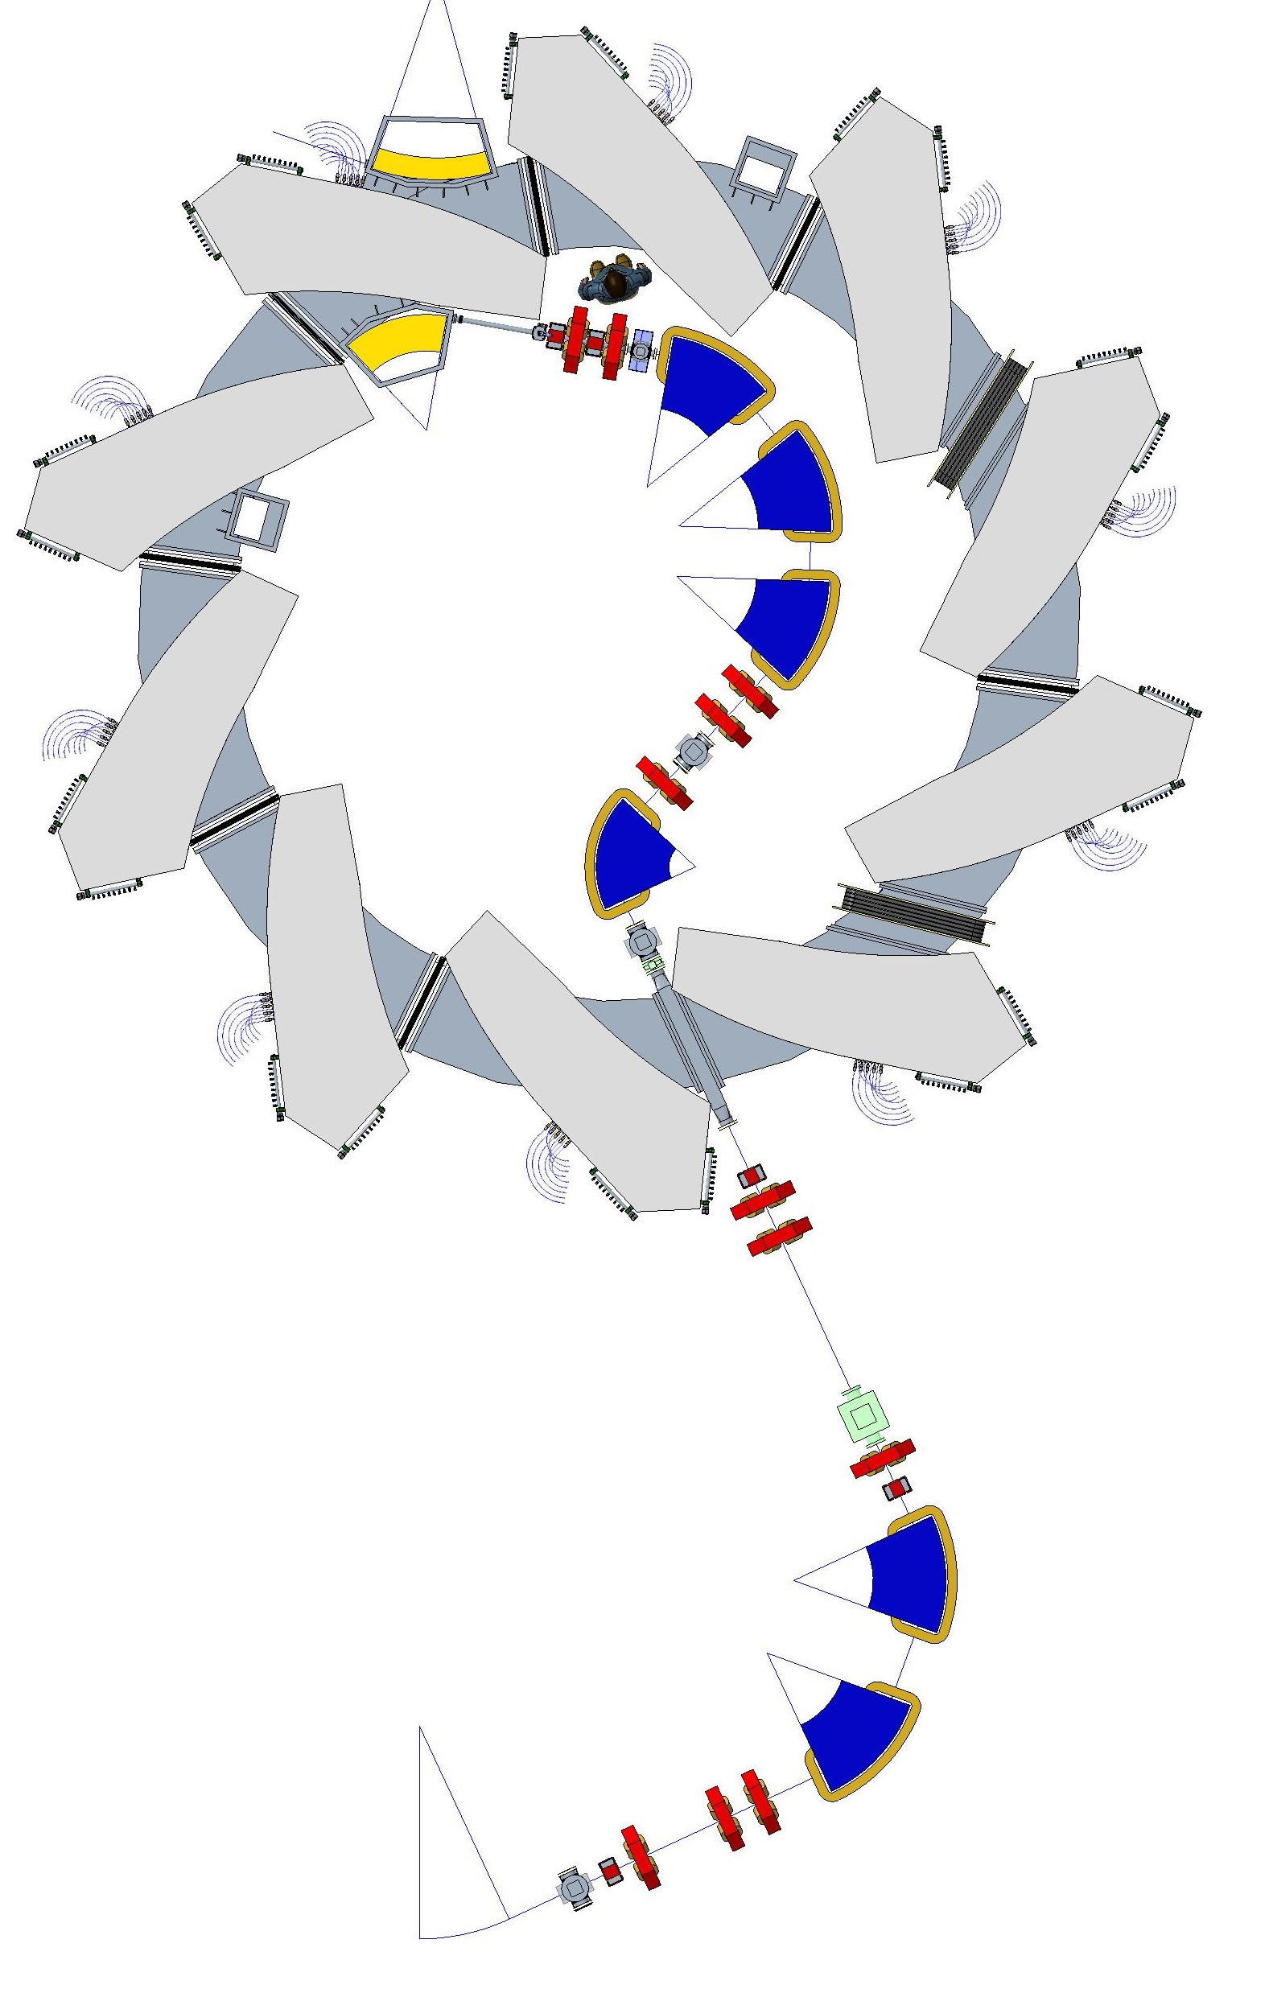
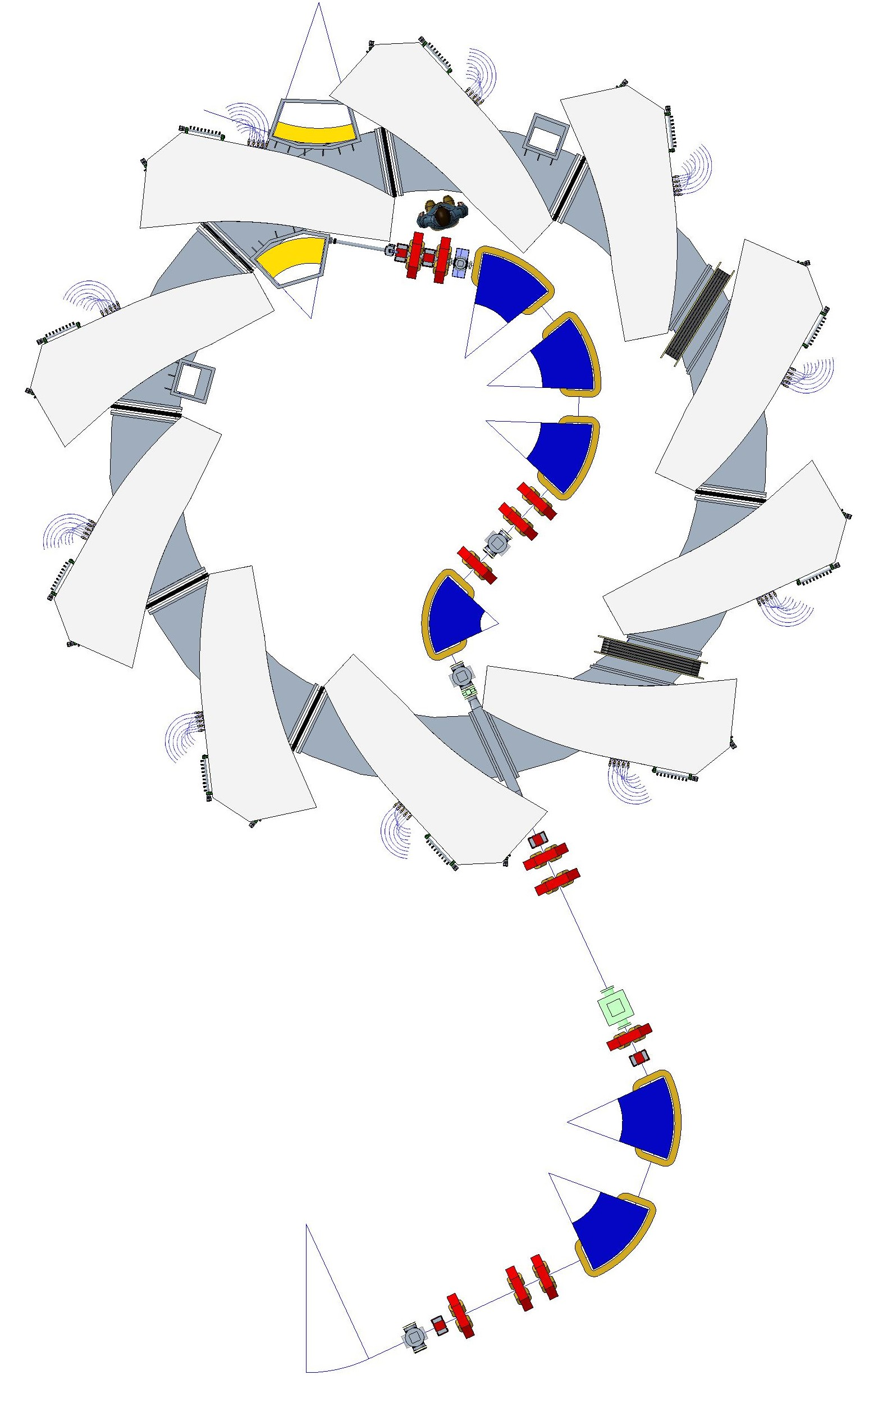
FFA Ring with Injection Line
Magnet Option 3
Magnet Option 4

Slide 4
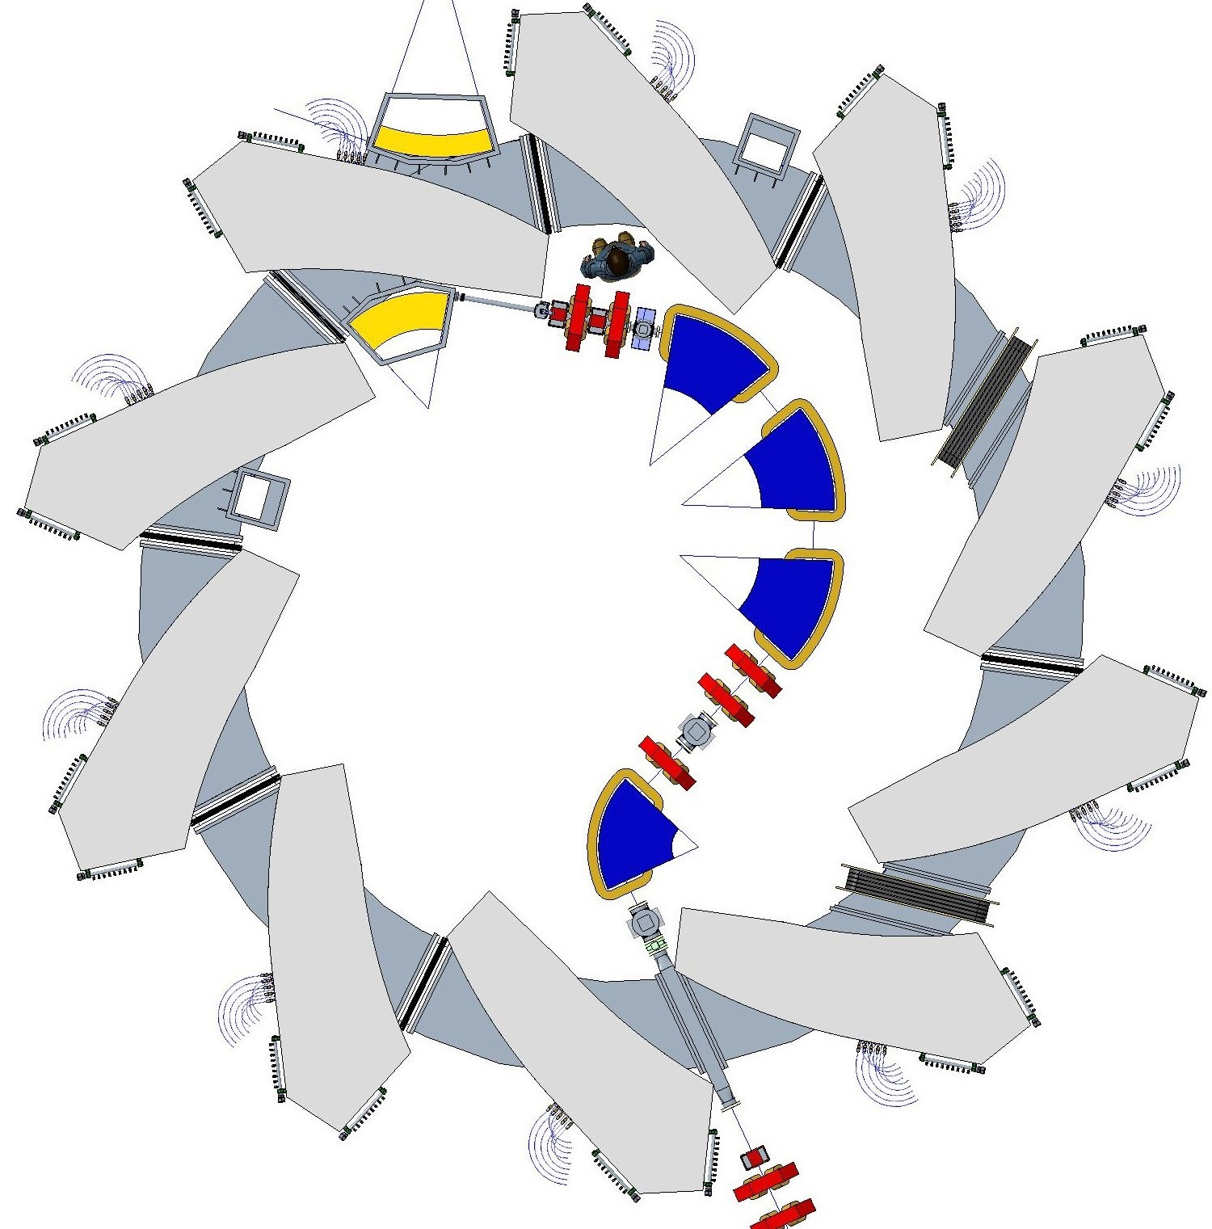
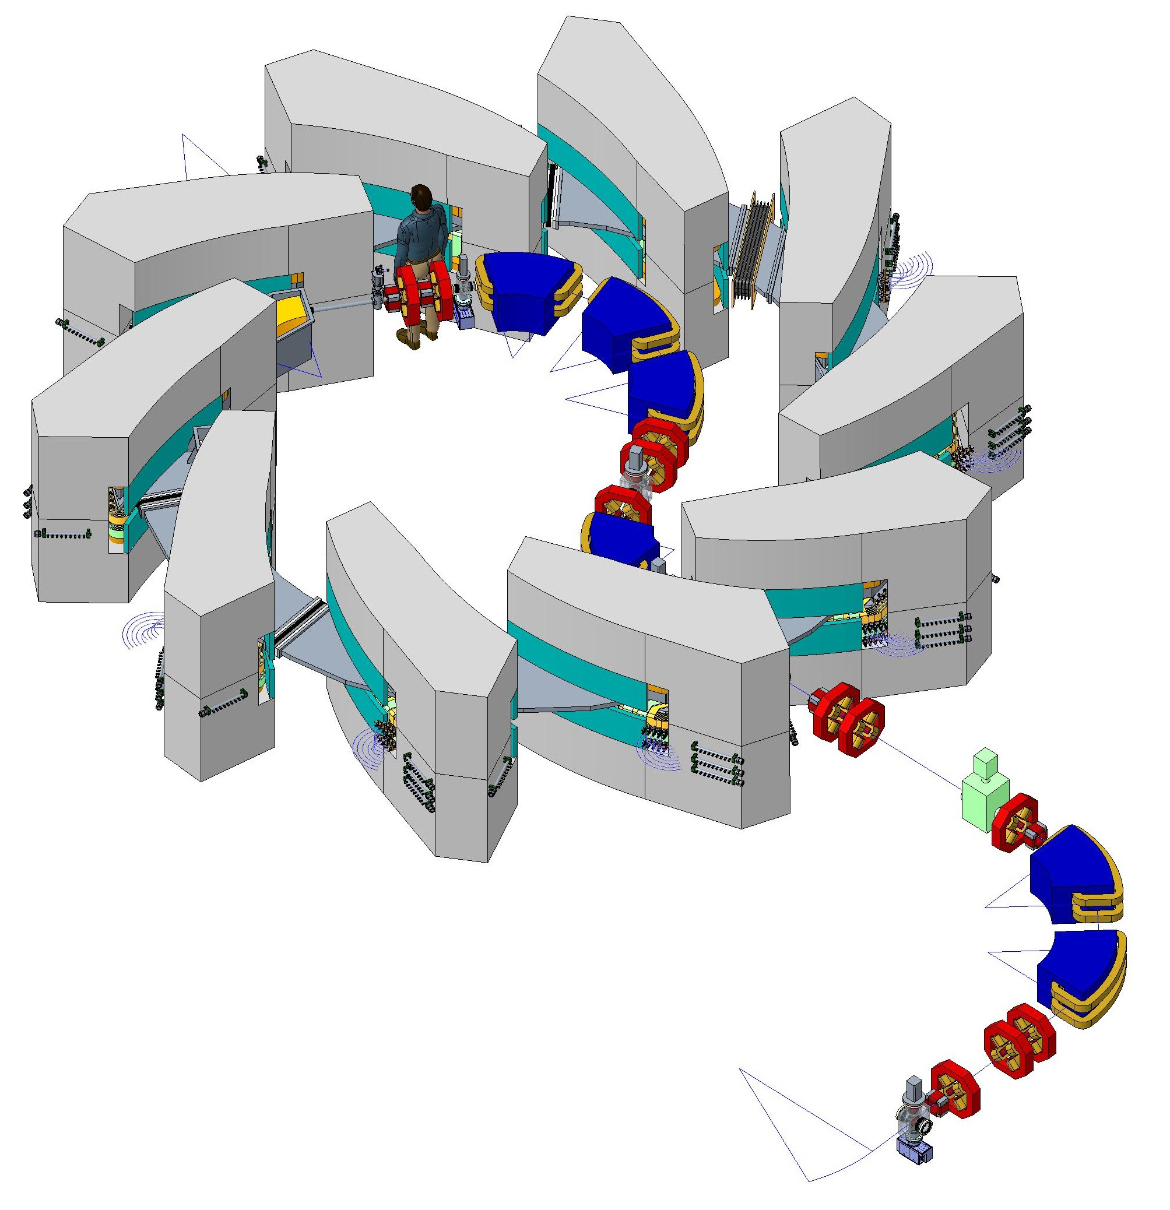
LhARA FFA Injection Line & Ring Magnet Yoke Option 3

Slide 5
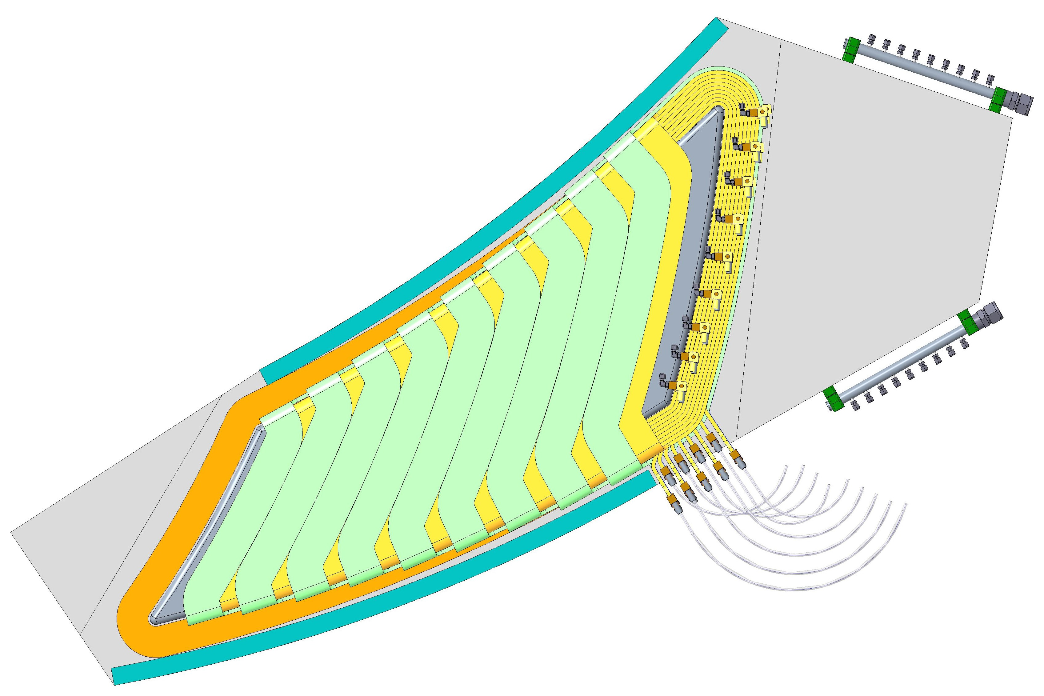
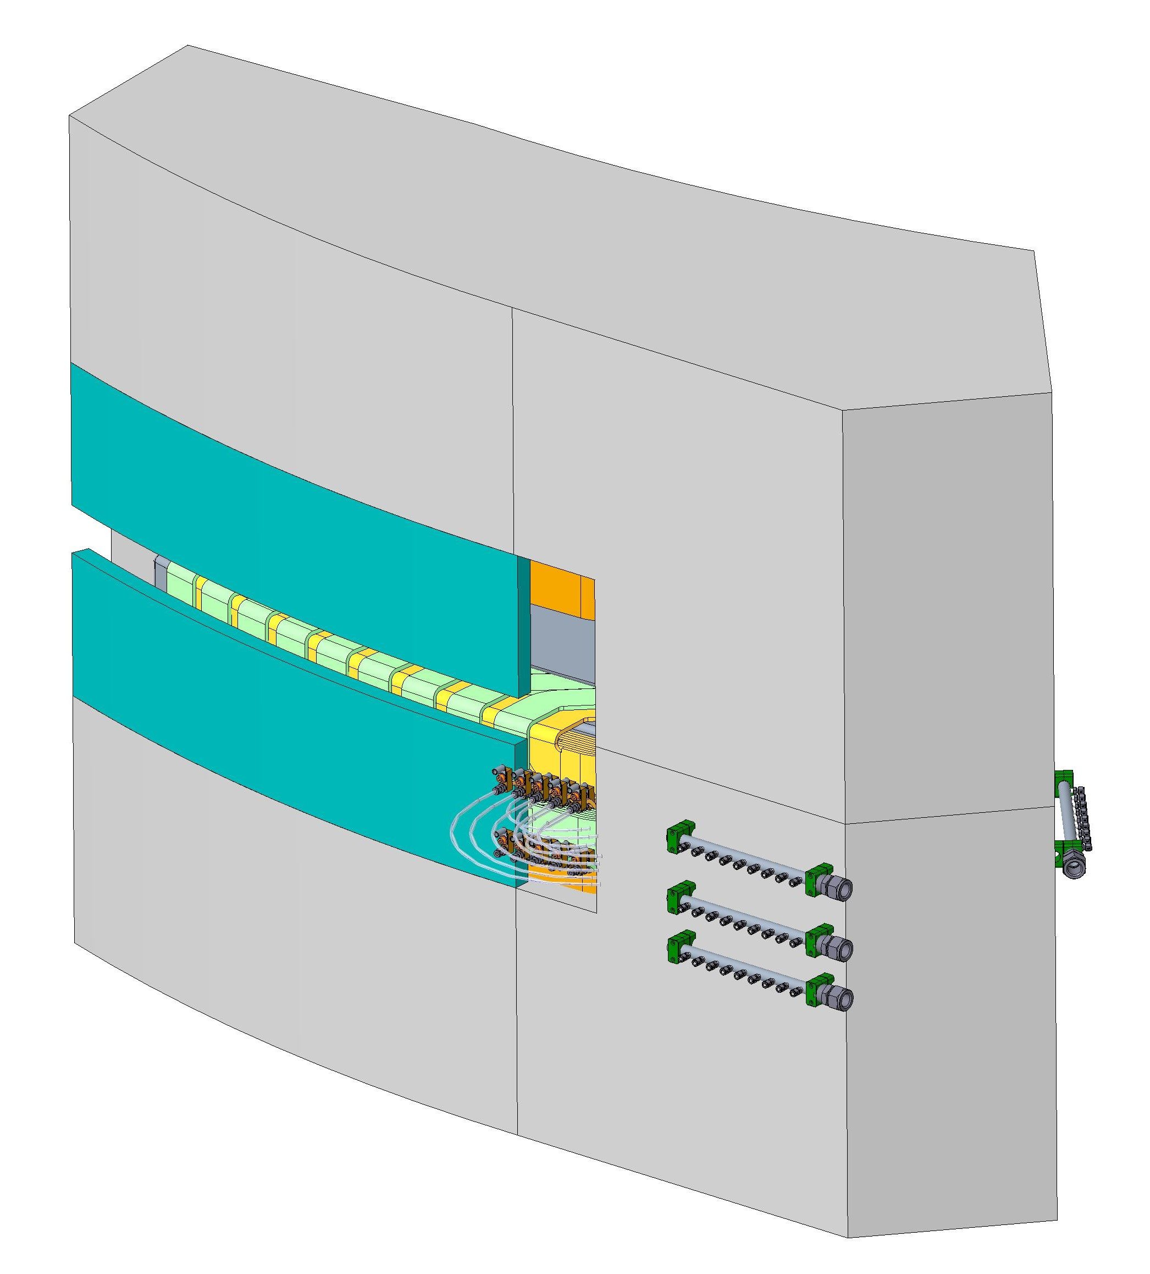
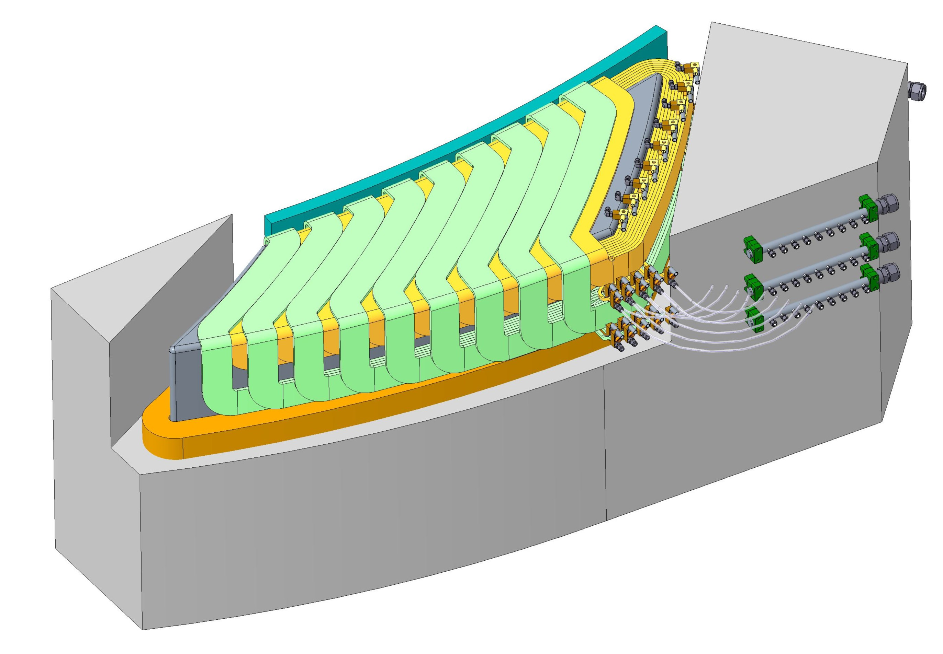
FFA Magnet
Steel yoke
Trim coils
Field clamp plate
Water cooling manifold
Main coil

Slide 6
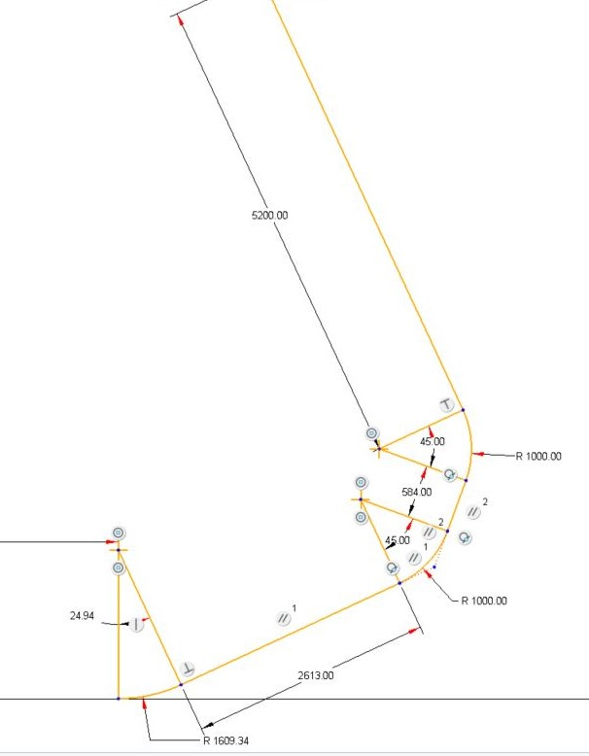
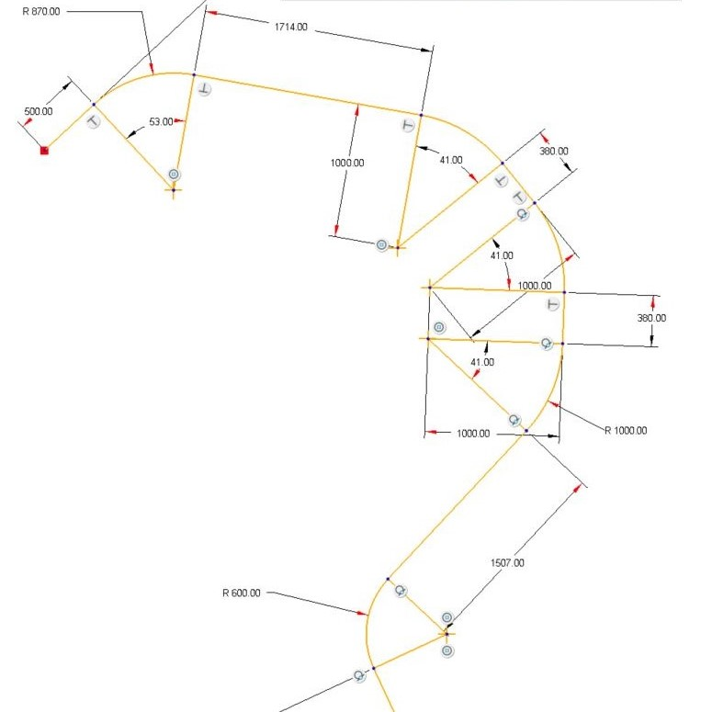
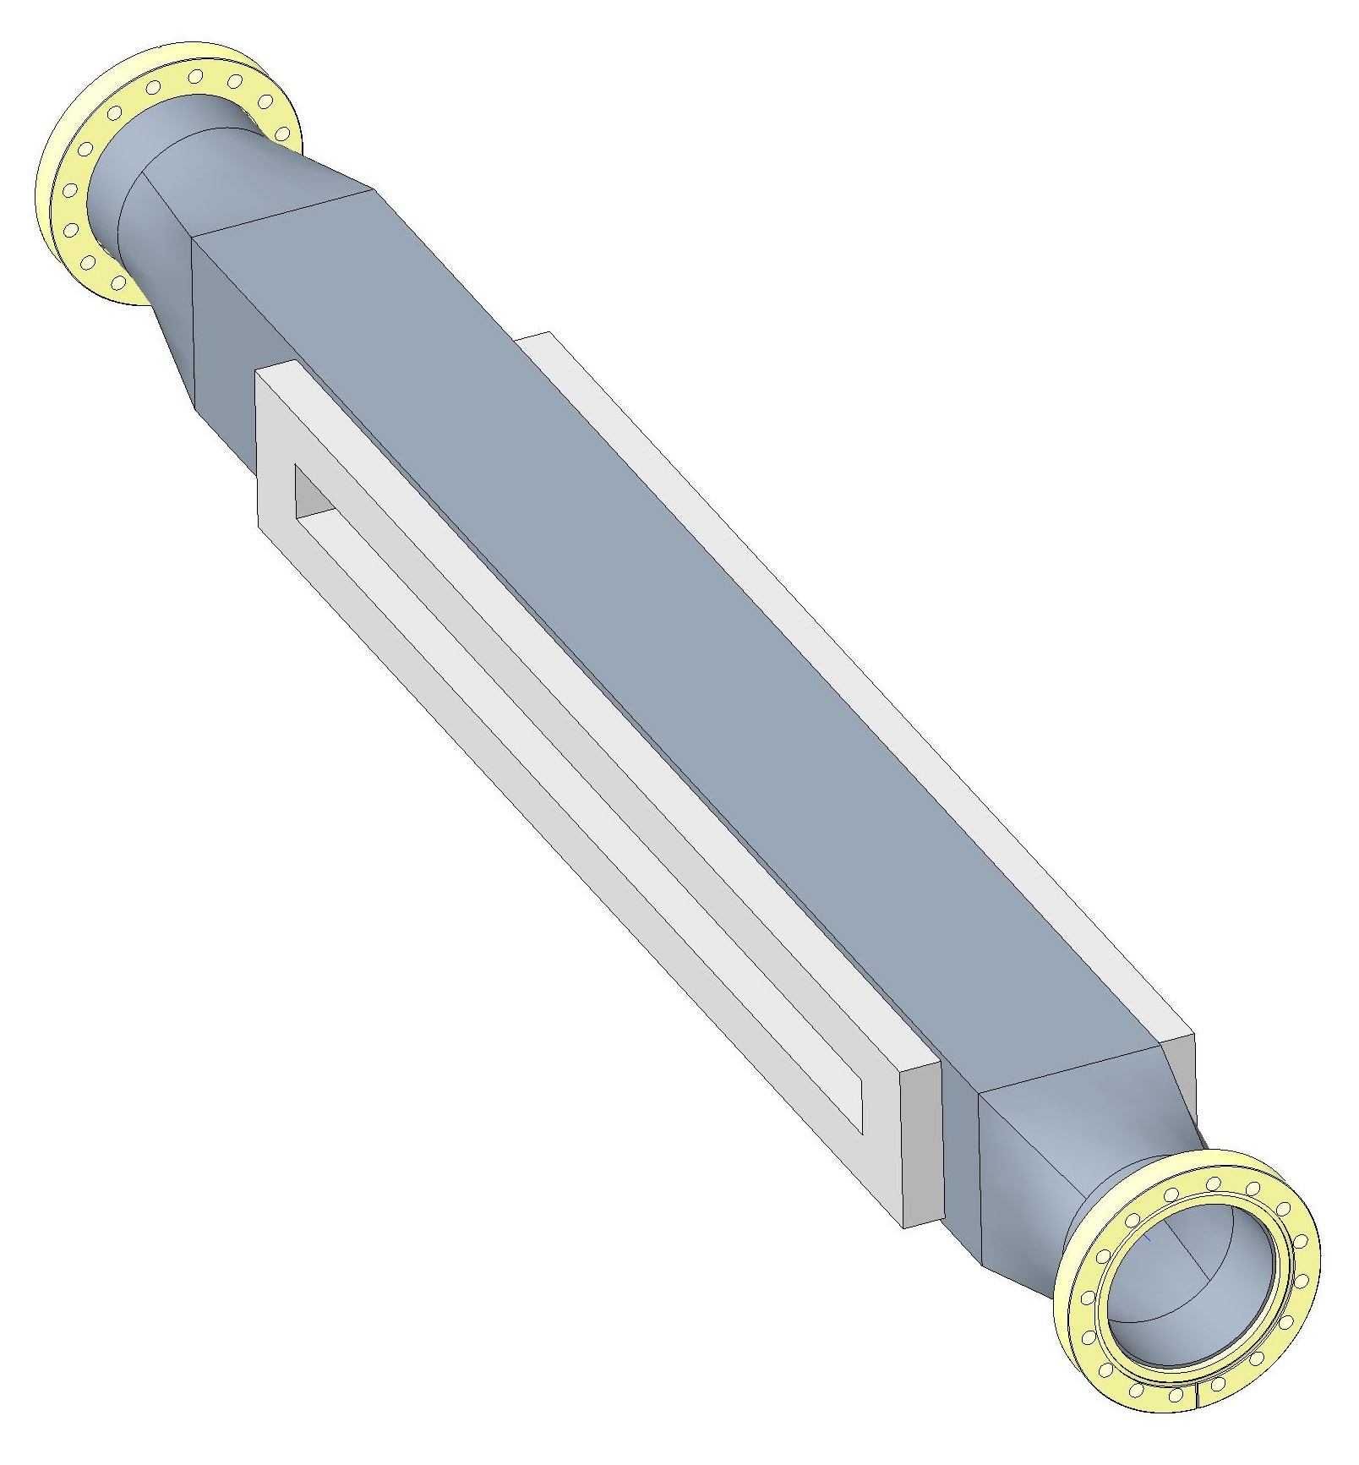
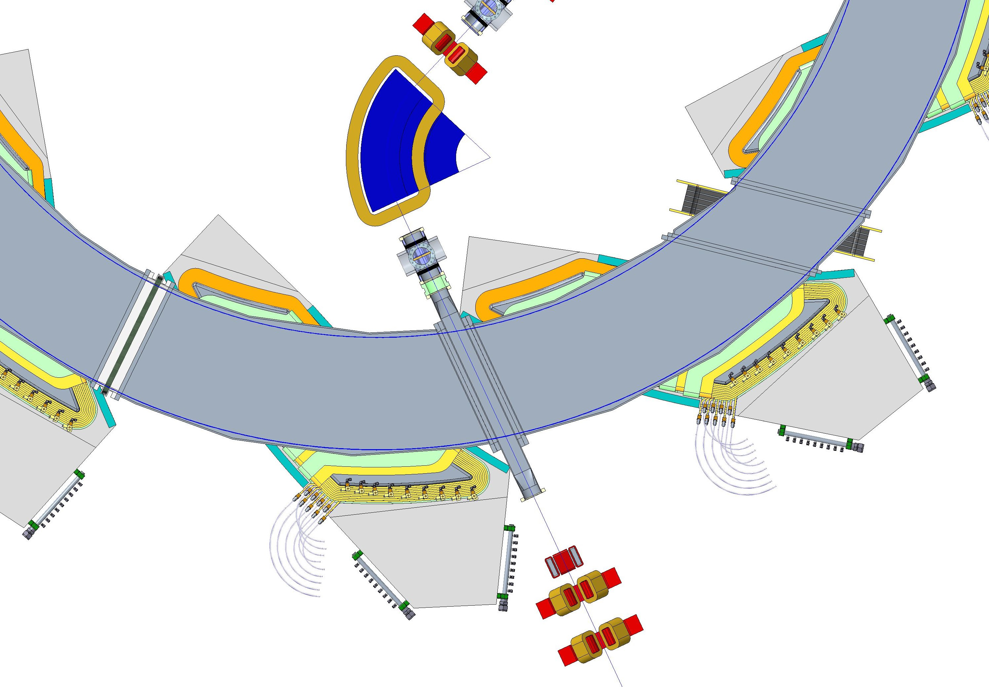
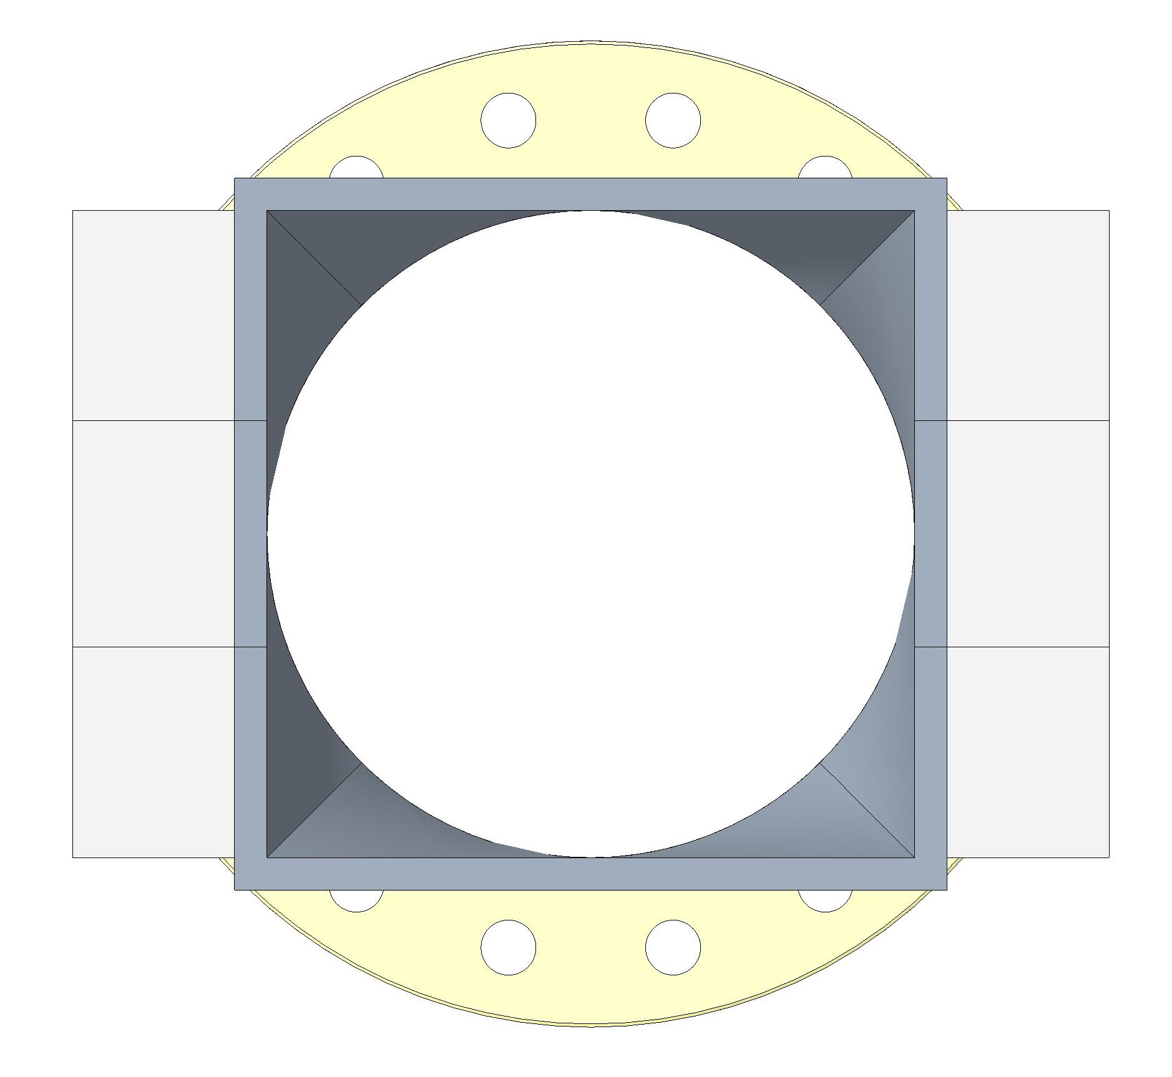
Injection Line
Slide 6
Q1 Are injection line parameters shown ok?
100mm
35mm
115°
Ø100mm
100mm

Slide 7
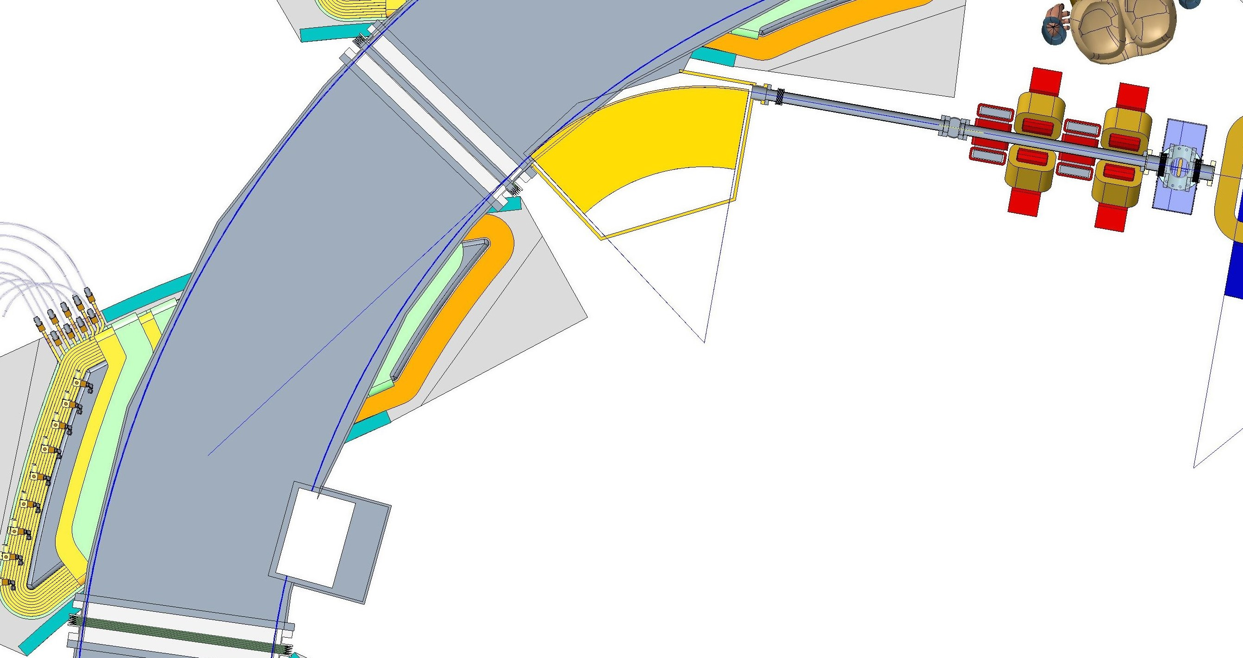
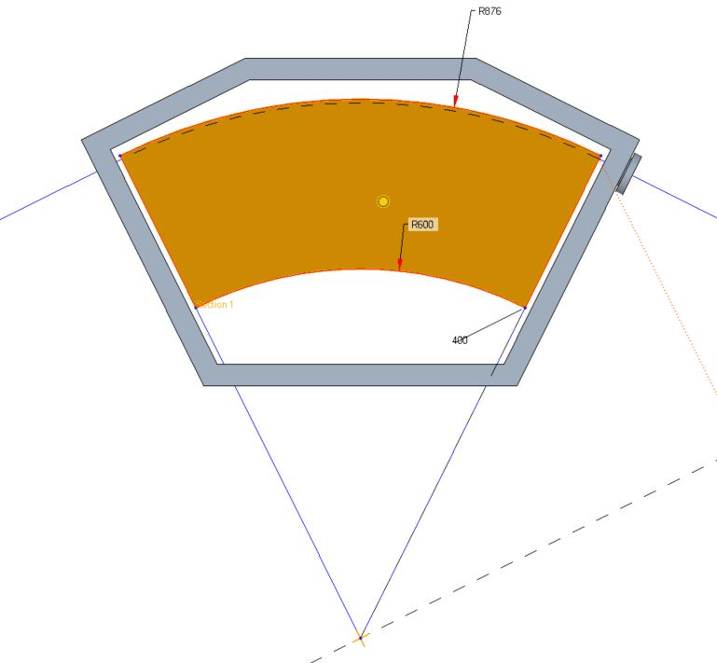
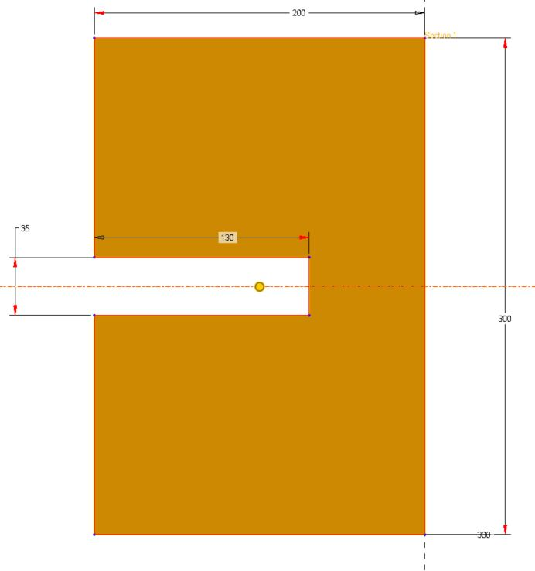
Injection Septum and Kicker Magnets
Injection pipe Ø35mm
Vacuum valve
Injection septum magnet
200mm
Slide 7
Q1 Injection pipe ID 35mm?
Q2 Injection septum magnet parameters?
Q3 Injection kicker magnet parameters?
Q4 What is the beam trajectory septum to kicker?
R870mm
35mm
130mm
300mm
53°
Injection C shaped kicker magnet
Injection septum magnet

Slide 8
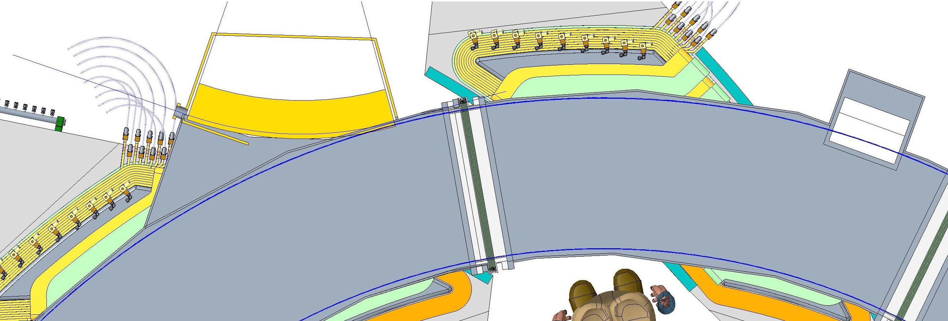
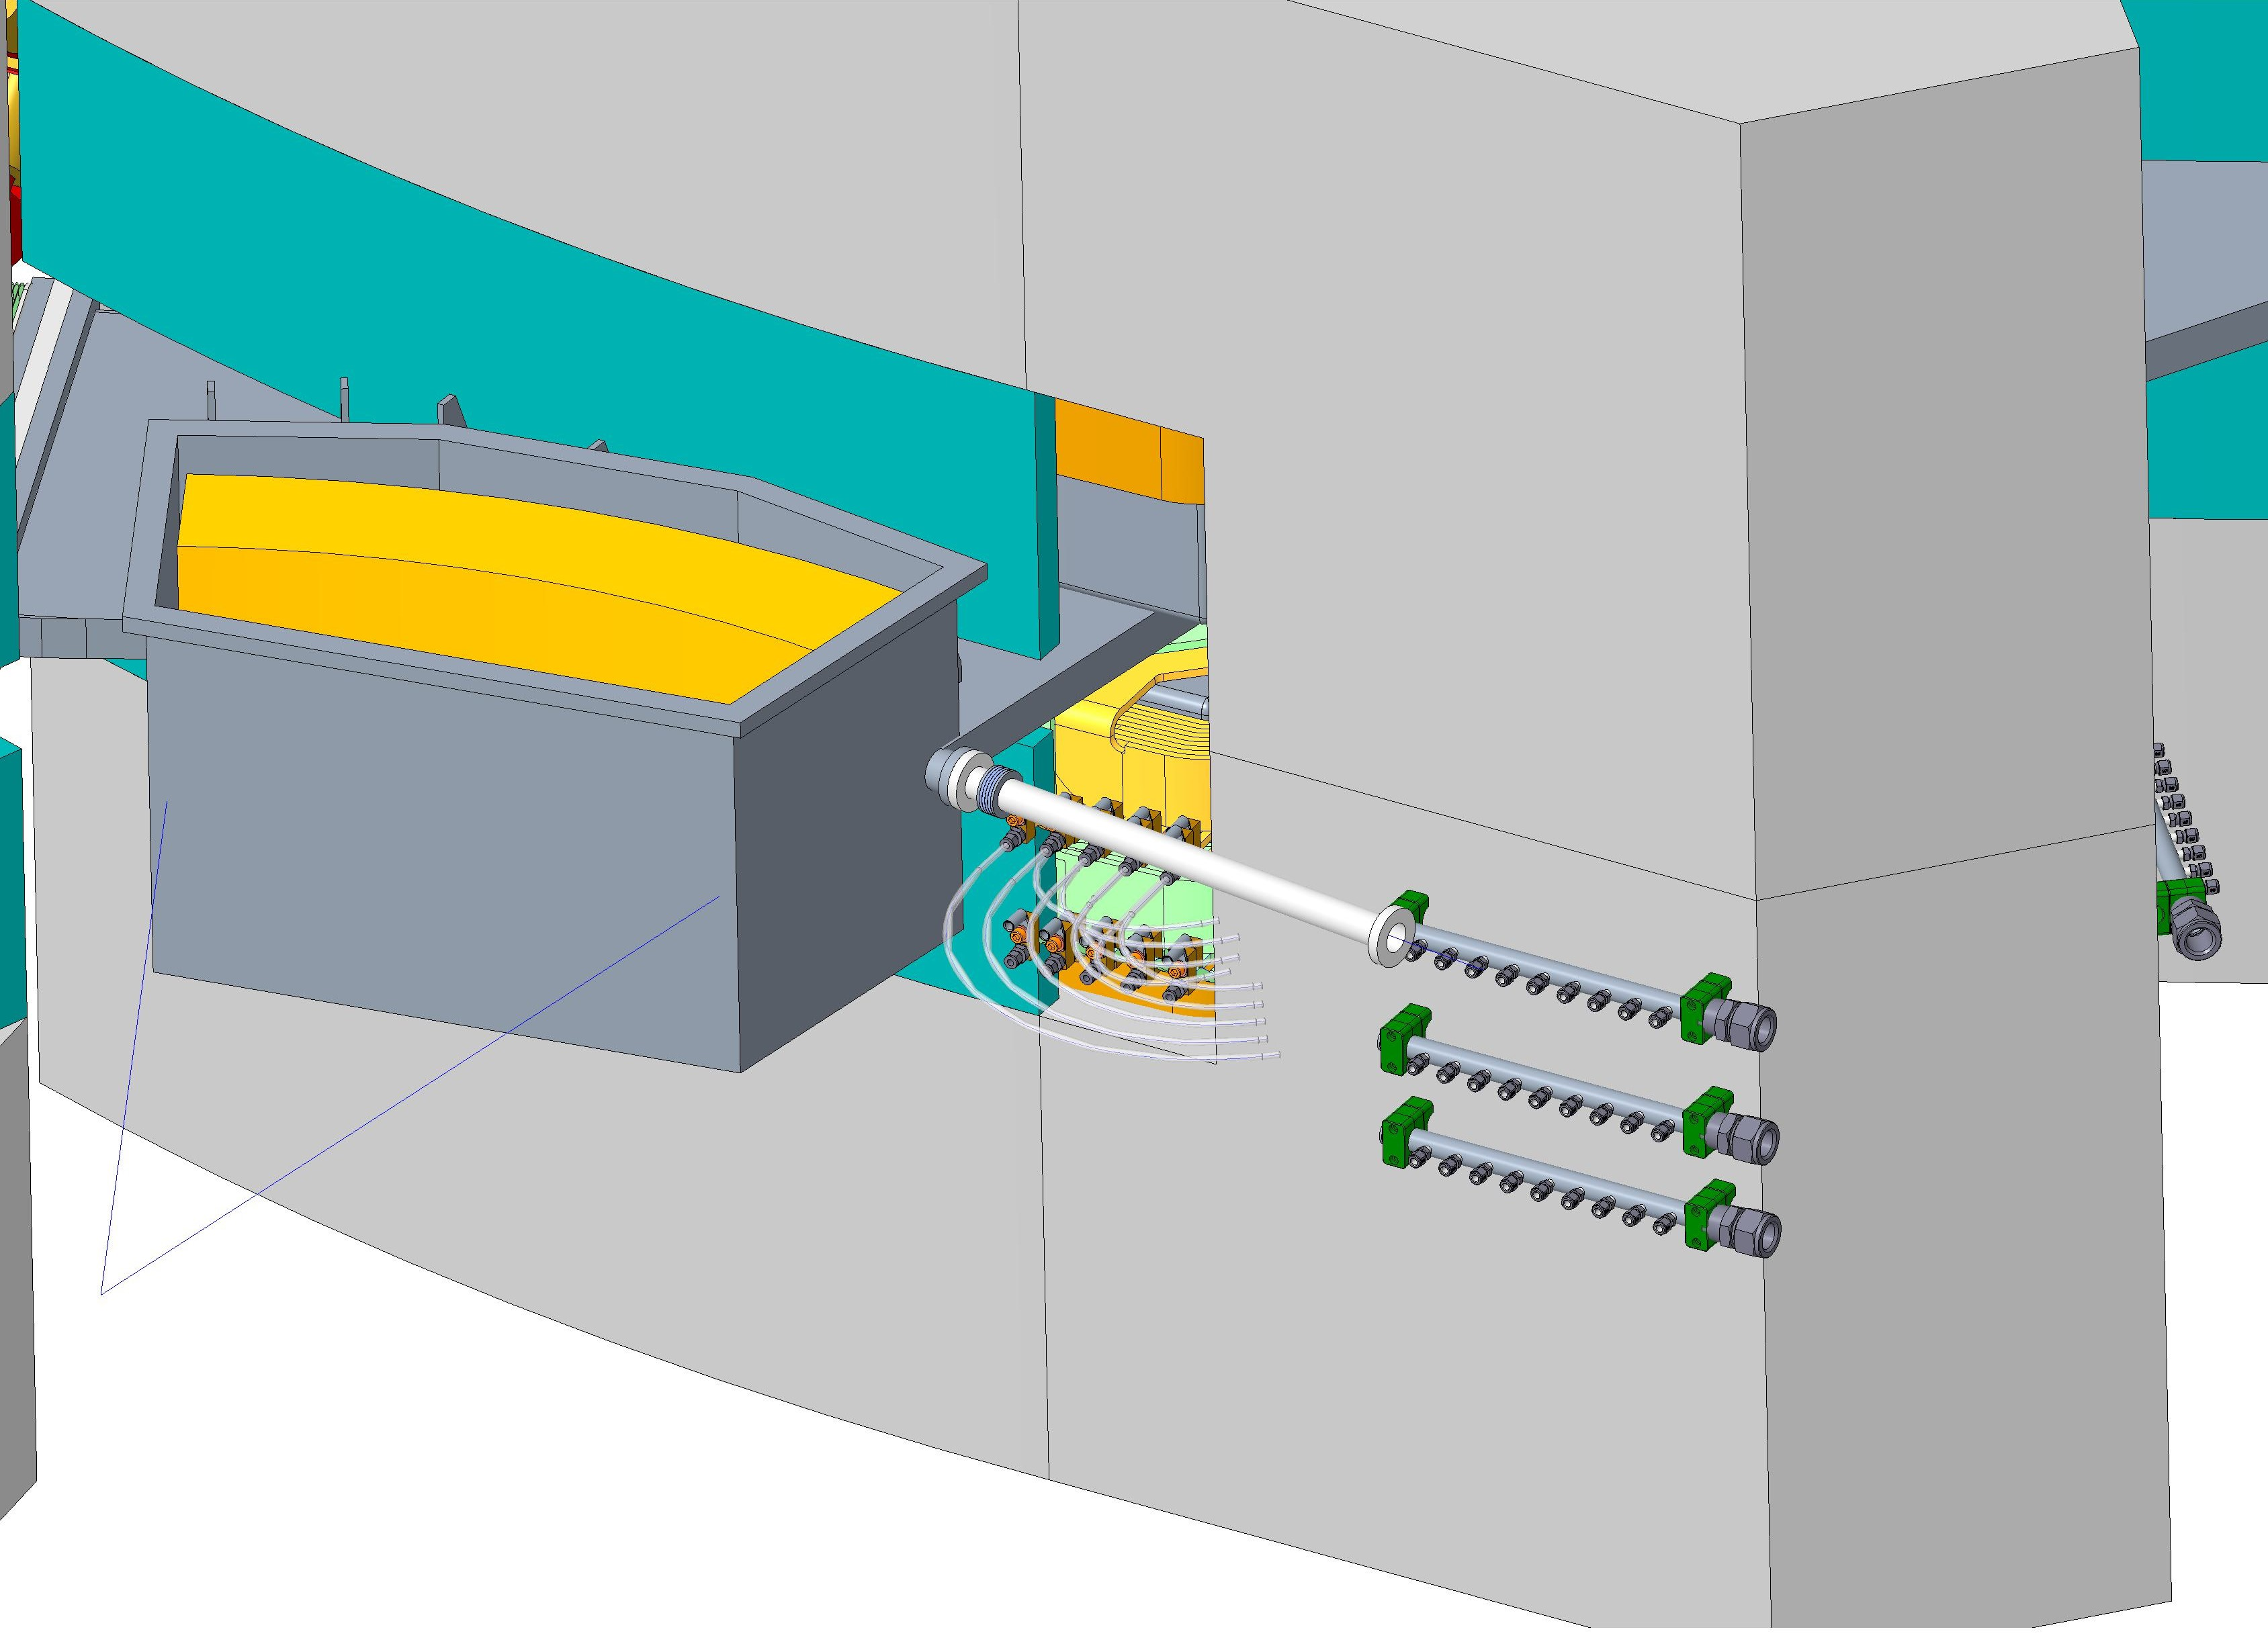
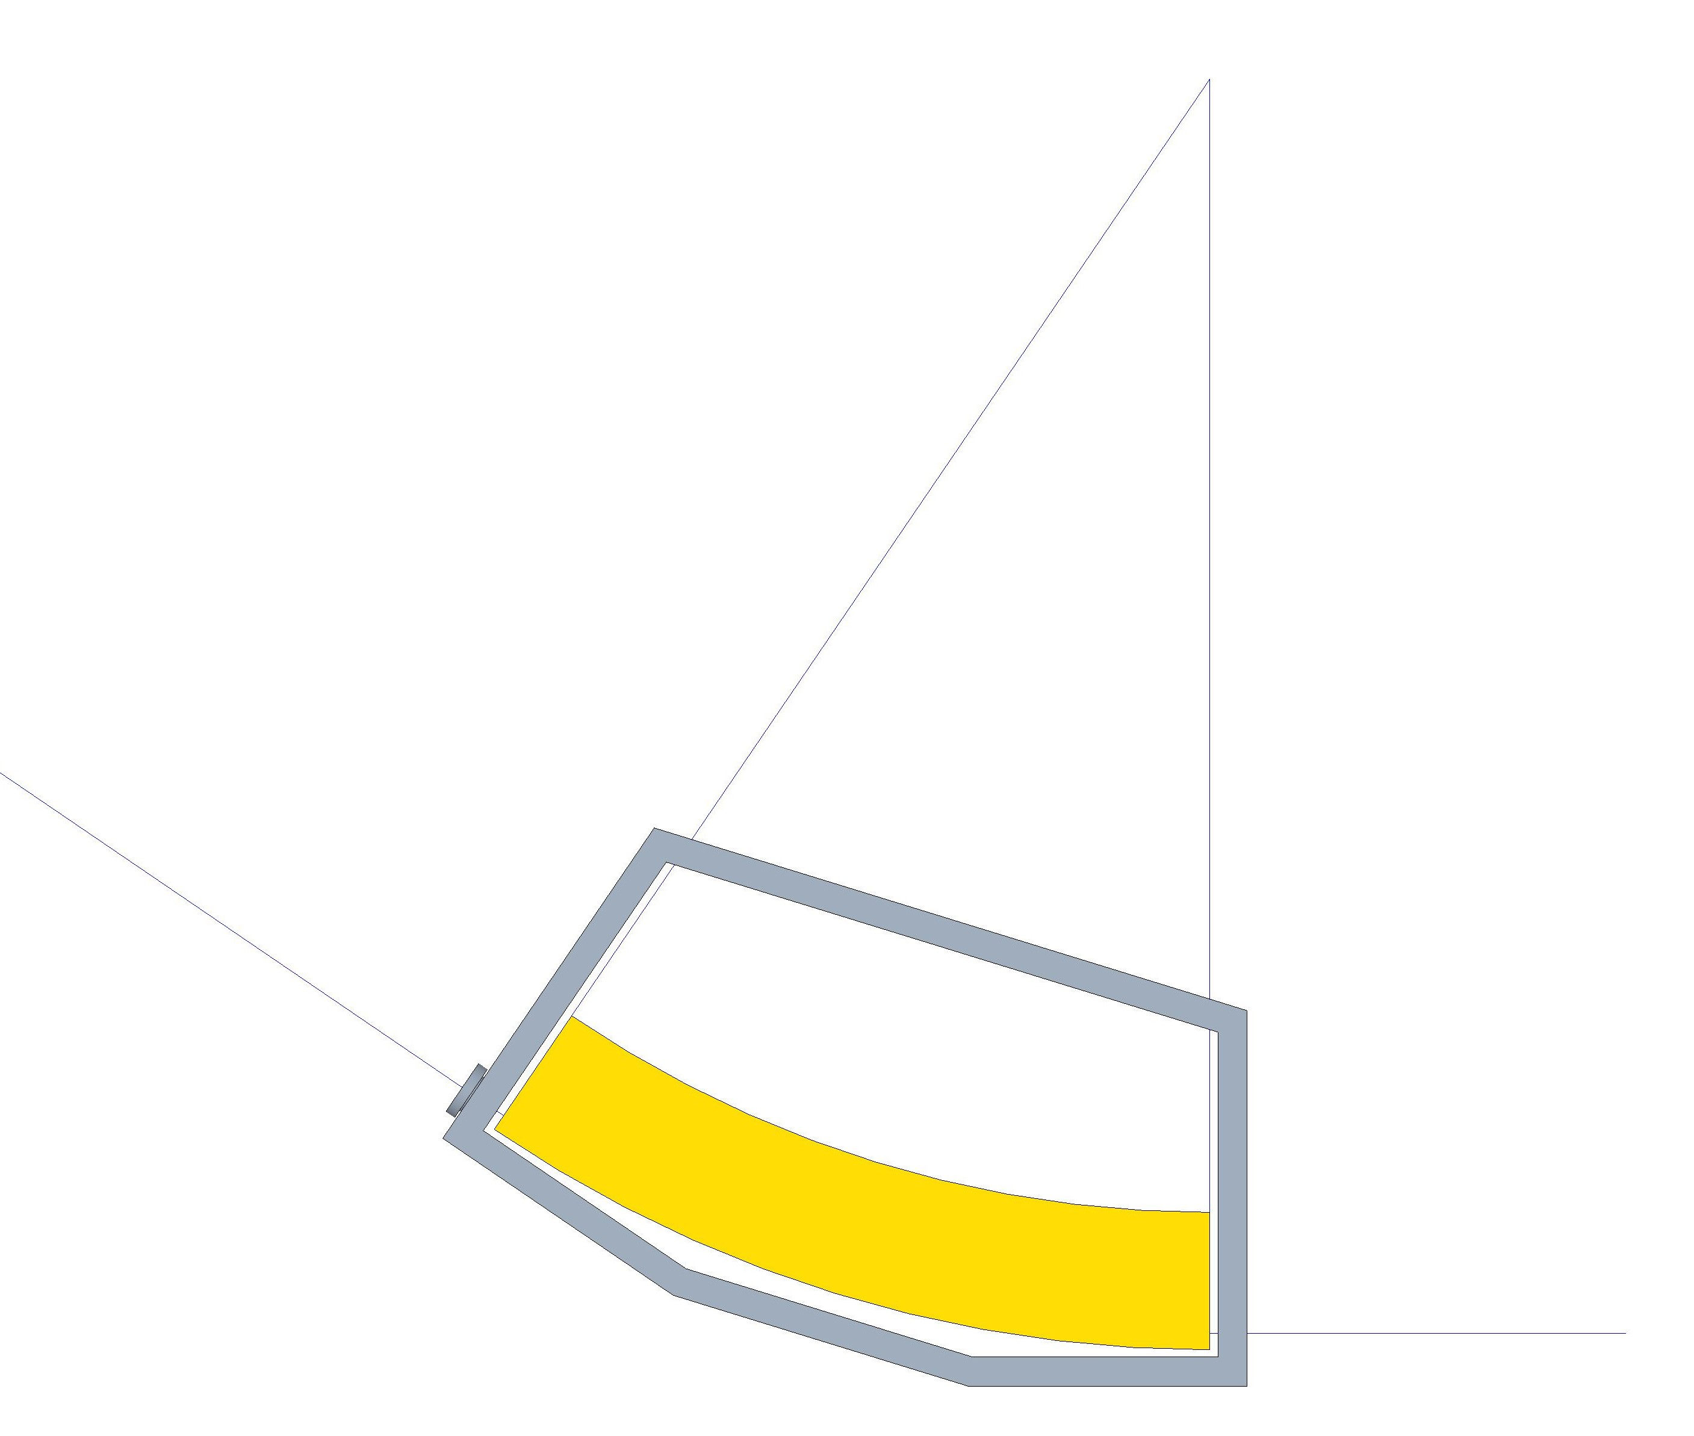
Ring Magnet with Inner Yoke
Extraction septum magnet
Bellows
Extraction kicker magnet
Slide 8
Q1 Extraction pipe ID 35mm?
Q2 Extraction septum magnet parameters?
Q3 Extaction kicker magnet parameters?
Q4 What is the beam trajectory kicker to septum?
200mm
34.25°
35mm
130mm
300mm
R1500mm
Extraction C shaped kicker magnet
Extraction pipe
Extraction septum magnet

Slide 9
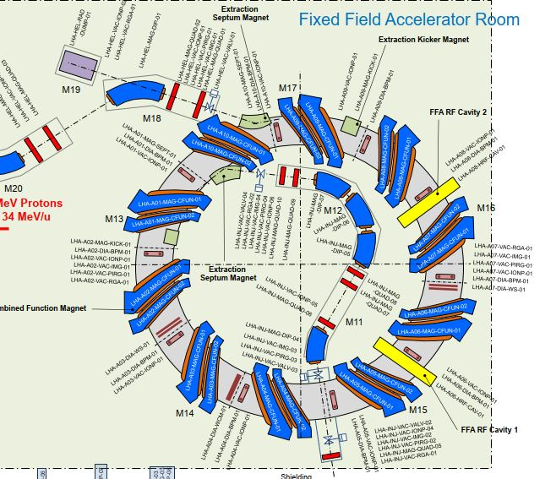
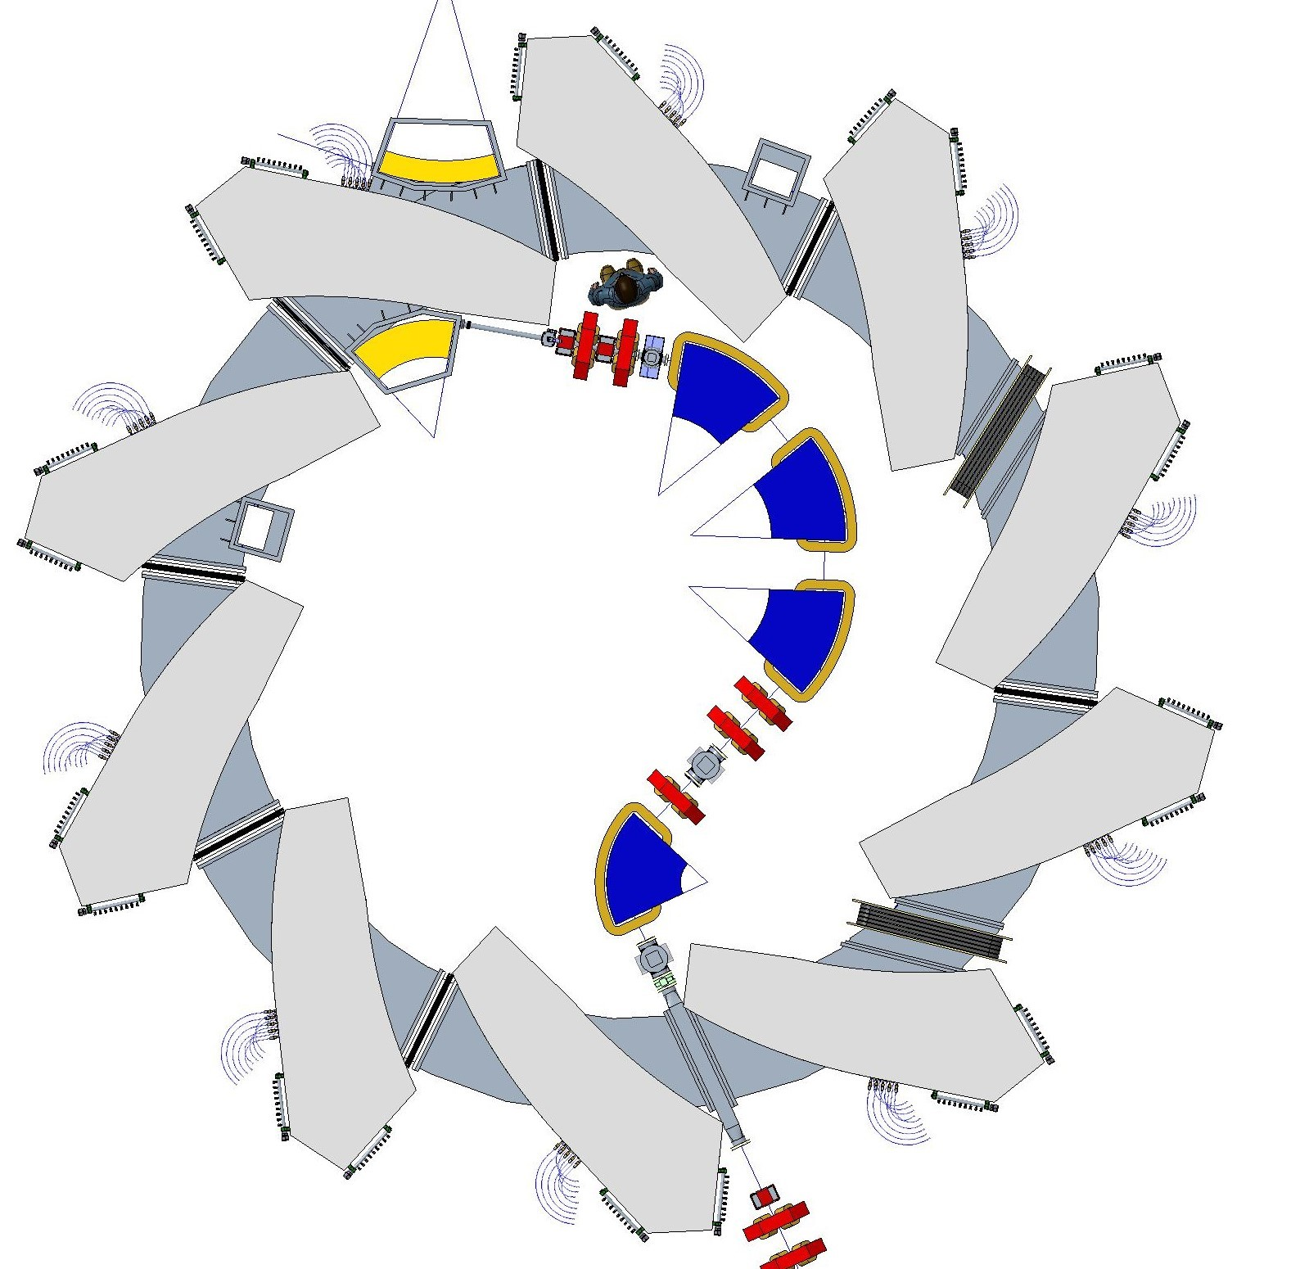
FFA Ring Diagnostics and Cavity Positions
Slide 9
Q1 Are all diagnostics specified still required?
Q2 Do any other diagnostics need to be included?
BPM
BPM
BPM
BPM
Cavity
BPM
BPM
WS
WS
BPM
BPM
Cavity
WCM
BPM
BPM

Slide 10
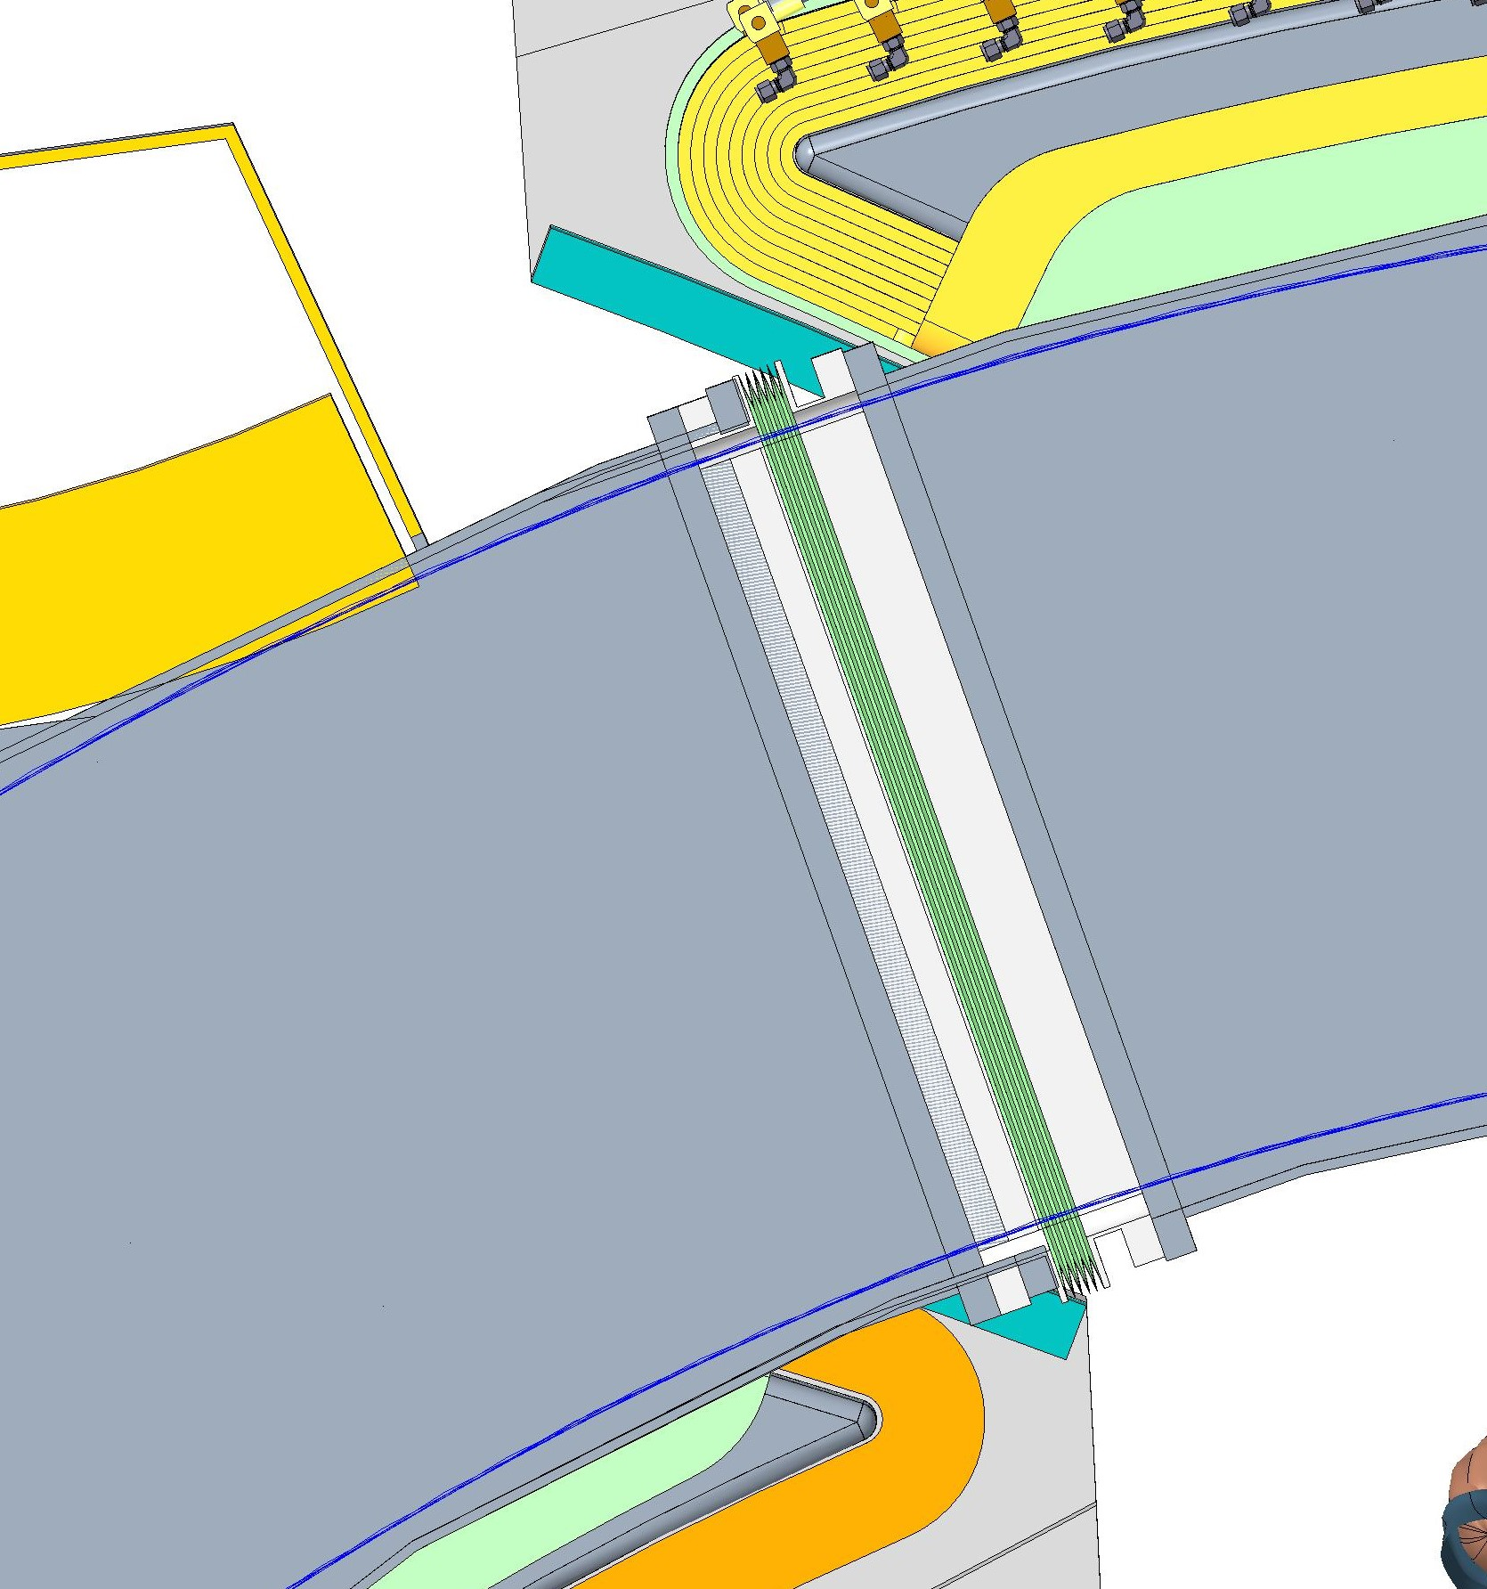
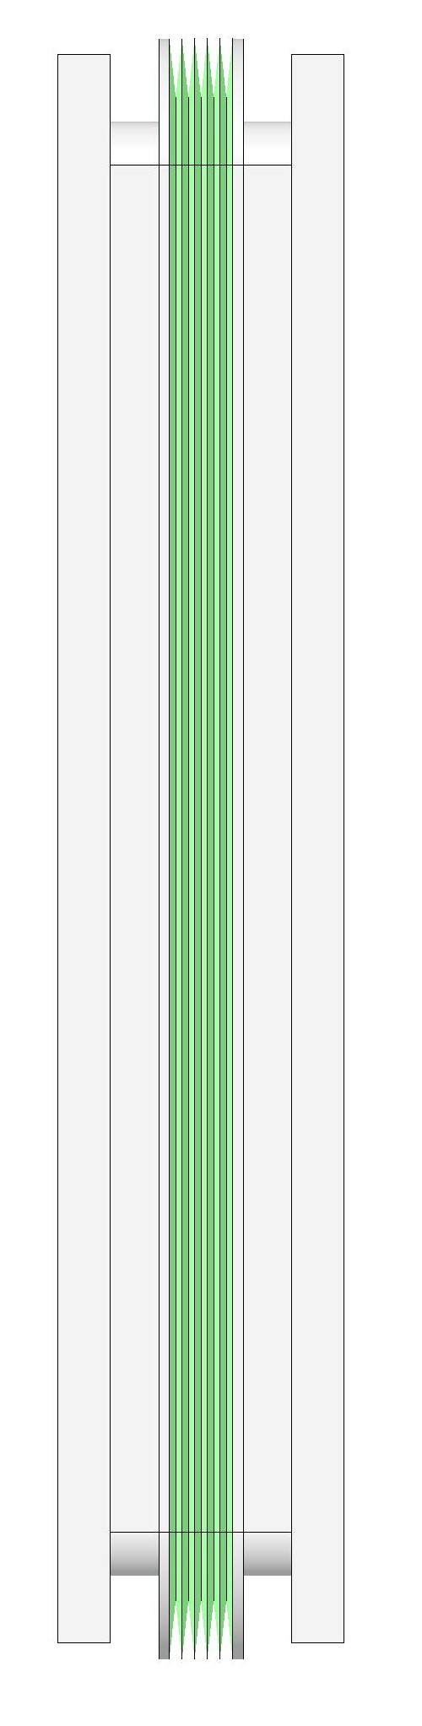
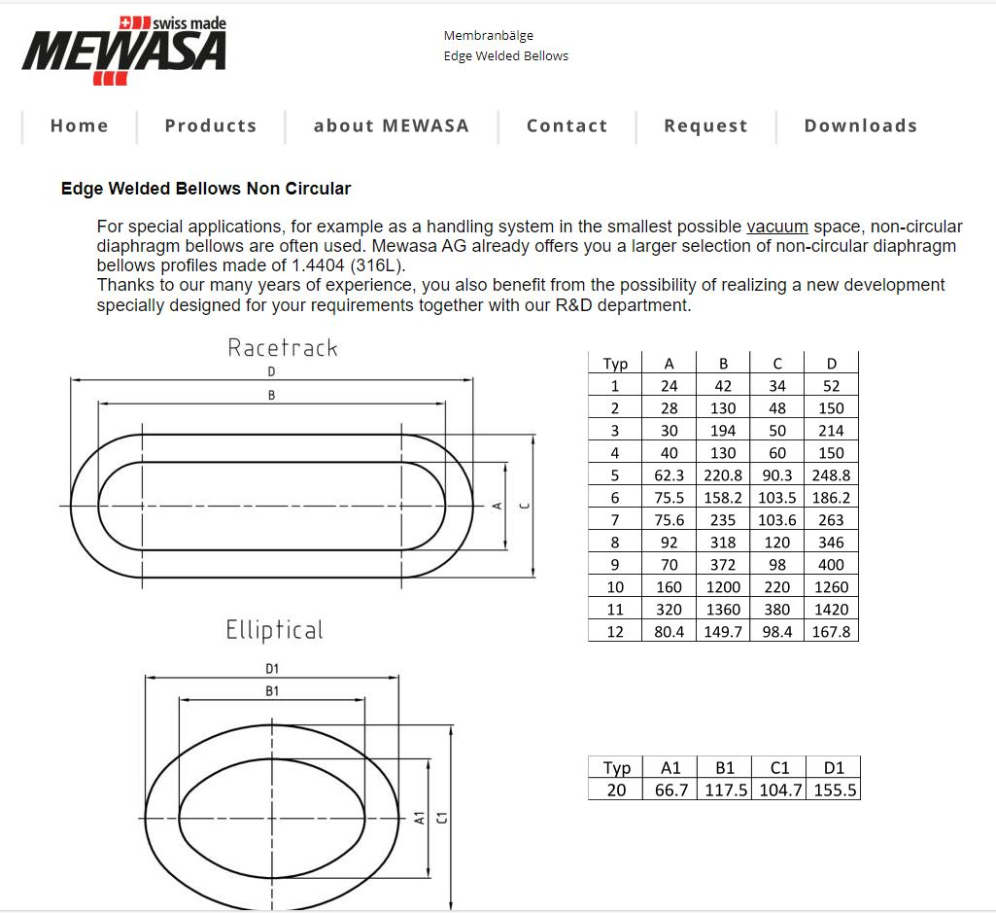
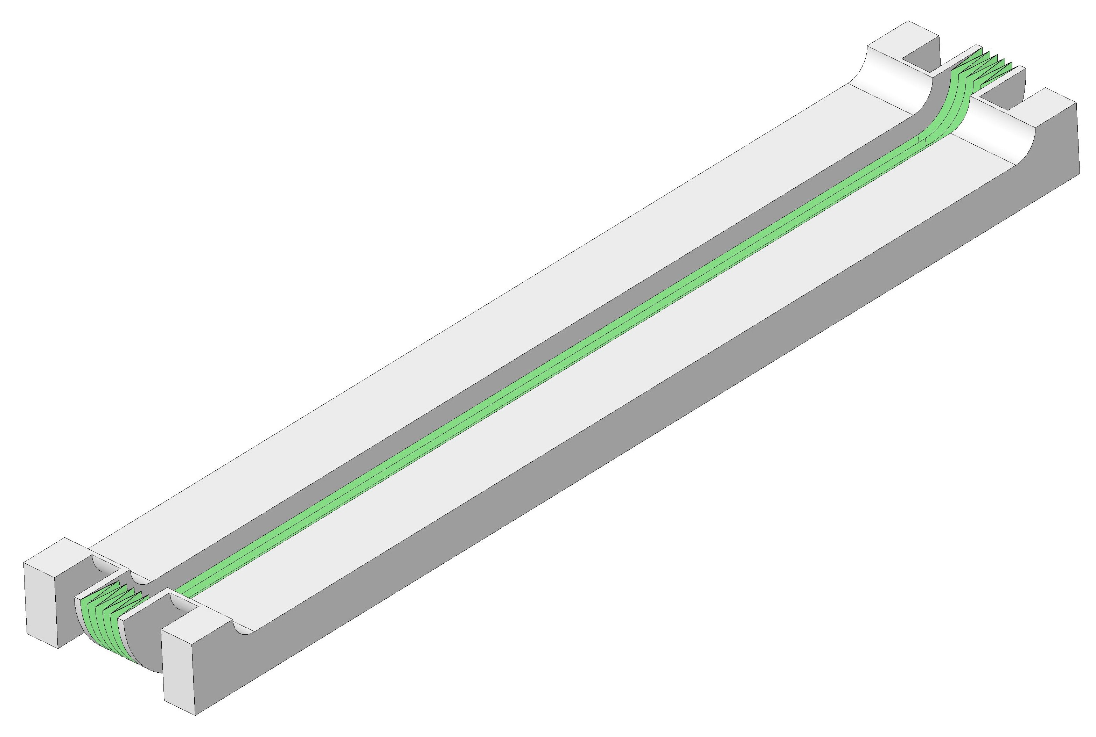
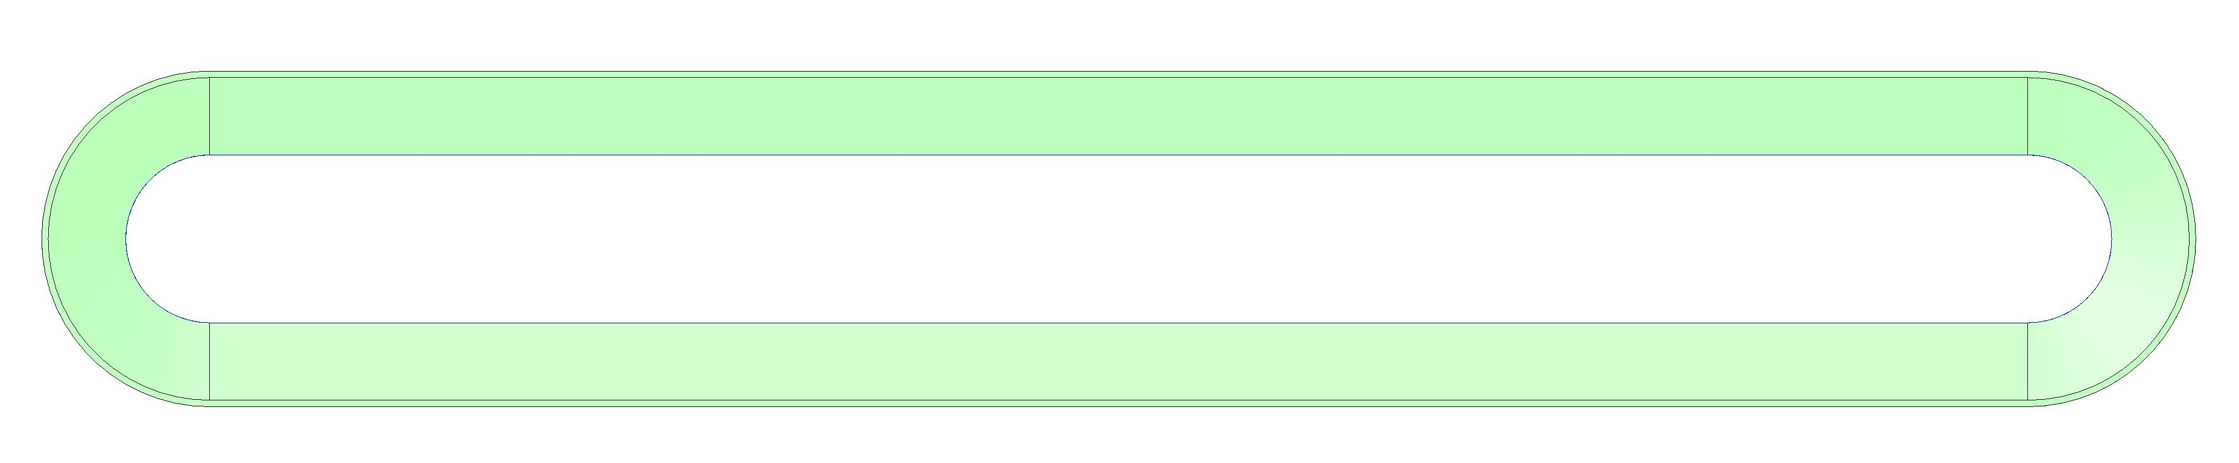
Non Circular Bellows
136mm
Slide 10
Q1 Bellows unit has 65mm vertical aperture. Is this ok if so is the aperture required to be tapered on each side of bellows?
30mm
5 bellows convolutions
Mewasa Bellows (Bespoke)
5 convolutions
10mm axial translation
0mm lateral translation
£70k tooling cost
770mm
65mm
710mm
120mm

Slide 11
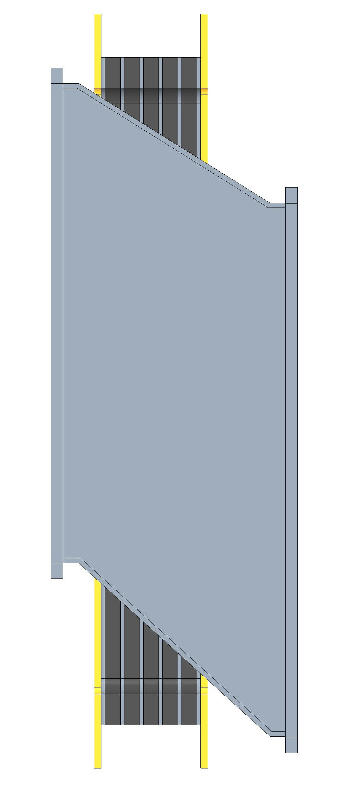
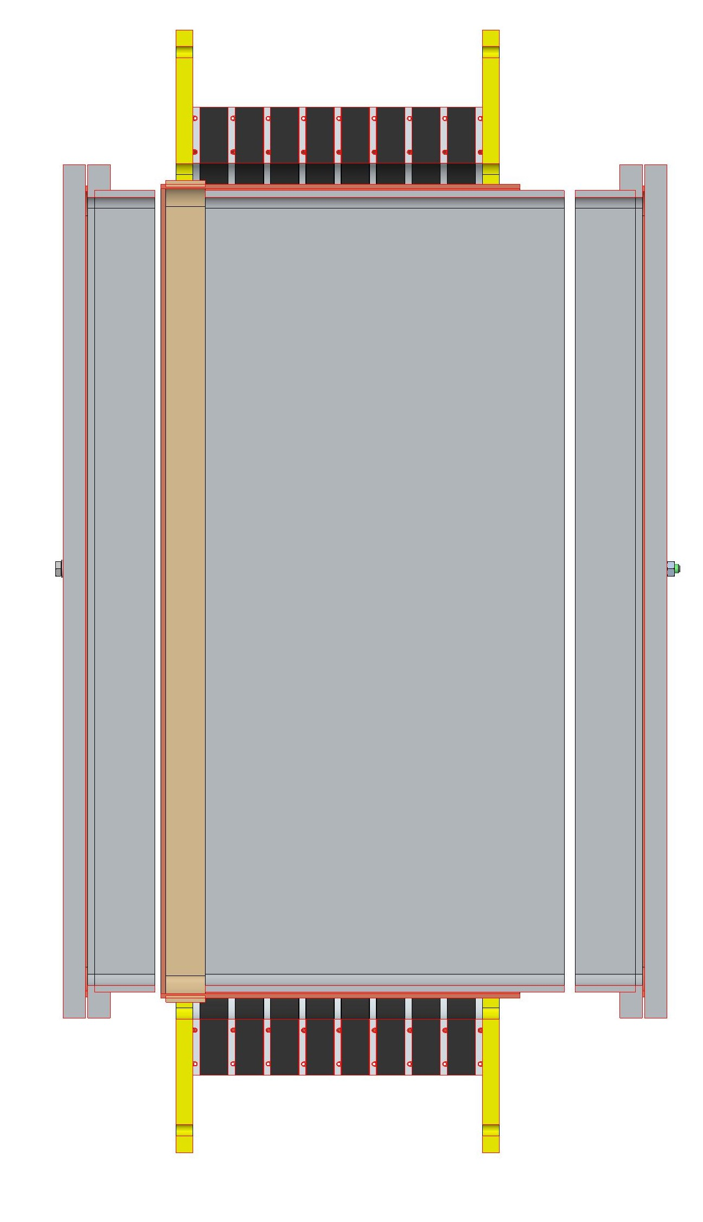
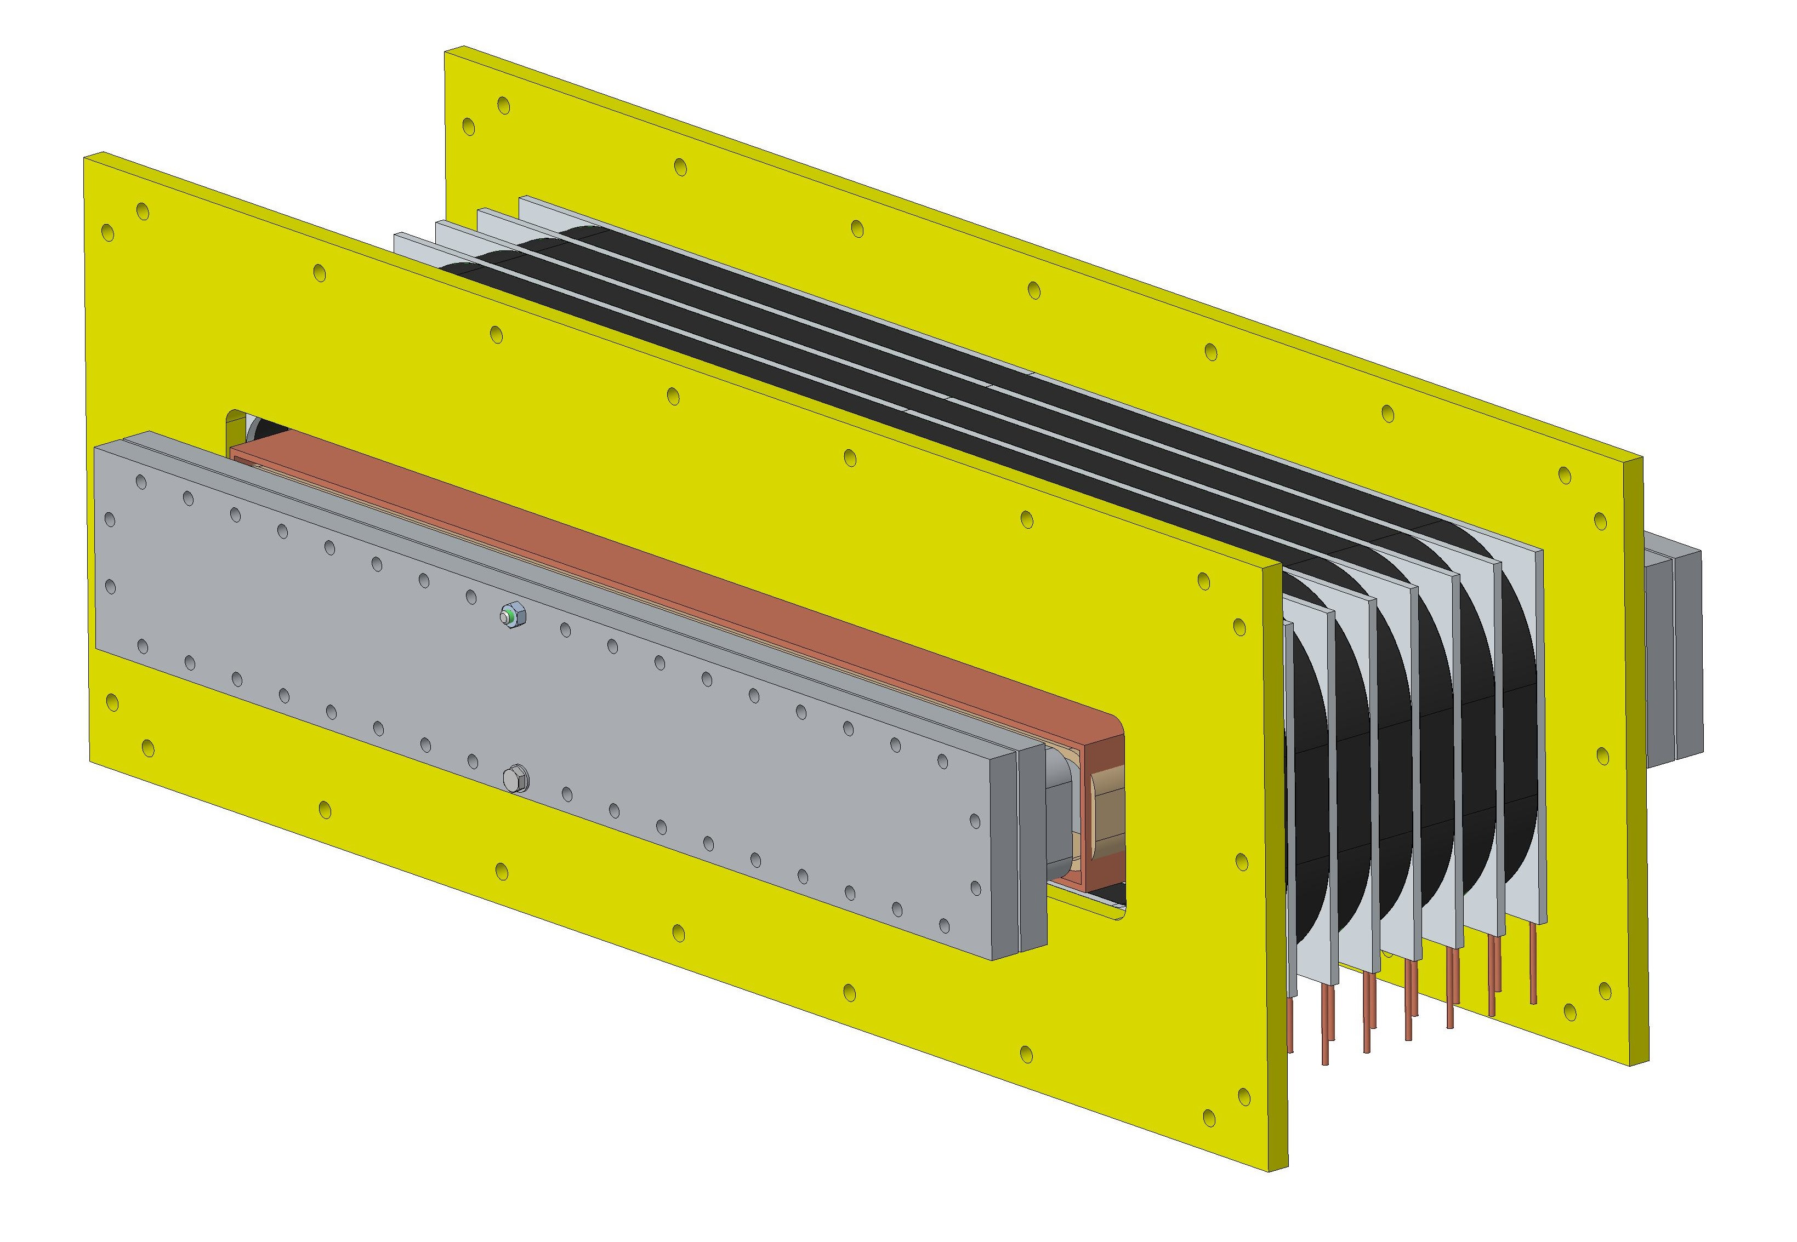
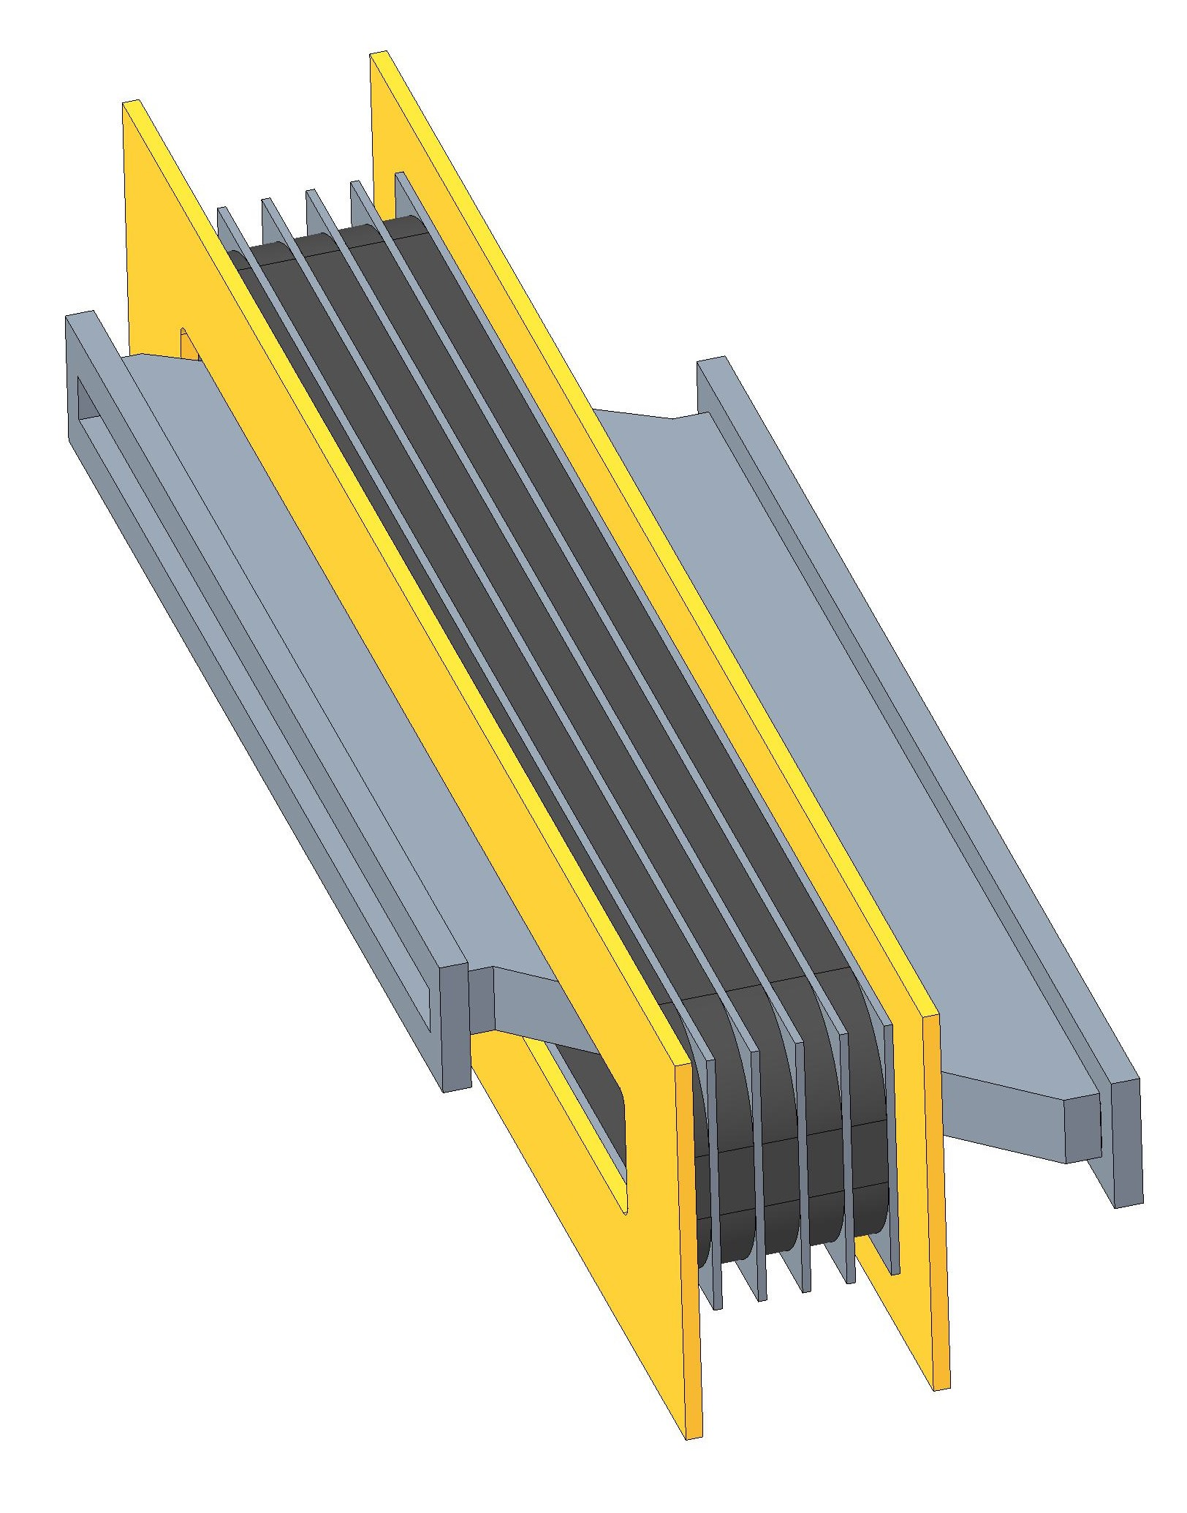
RF Cavity
400mm
5 cores 25mm thick
494mm
Slide 11
Q1 Parameters for cavity?
760mm
915mm
FETS FFA MA Cavity (for reference)
FETS FFA Ferrite Cavity (for reference)

Slide 12
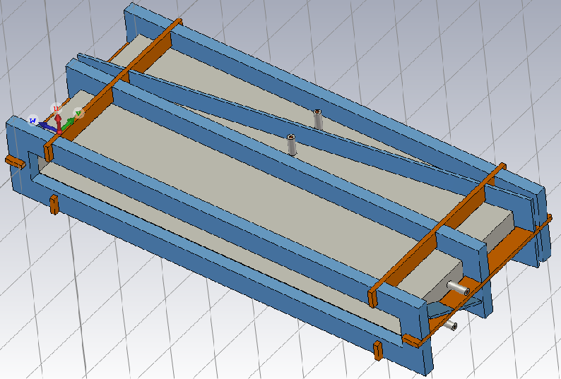
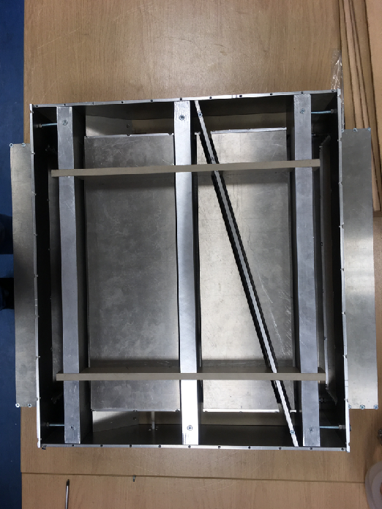
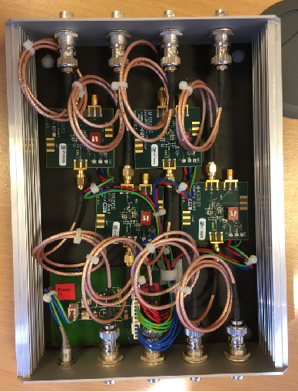
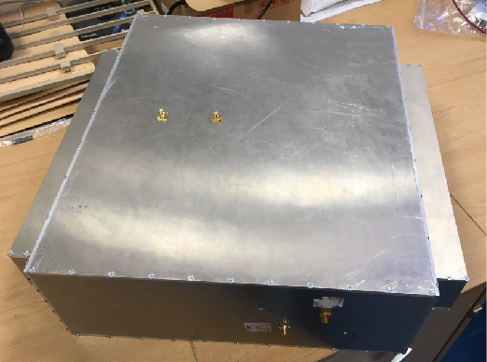
FETS-FFA BPM
Take from FETS-FFA diagnostics talk by Emi Yamakawa
Slide 12
Q1 Is this design relevant for ITRF?
Q2 What are the required parameters?
A pair of electrodes (grey components in Fig.1), separated with a diagonal cut are placed along the beam direction.
Earthed rings (blue components in Fig.1) are placed between adjacent electrodes to prevent electrical coupling between electrodes, improving position sensitivity.
To demonstrate feasibility of preliminary design, half size prototype FETS-FFA BPM (Fig.2) has been manufactured and tested at ISIS Diag. Lab.
Signal amplifier has been also provided with gain of 30dB with 70MHz bandwidth (Fig.3).
778mm
317mm
Fig.1. Preliminary design of FETS-FFA BPM.
477mm
120mm
98mm
436mm
360mm
146mm
Fig.2. Half size prototype FETS-FFA BPM.
Fig.3. Signal amplifier assembly.
317mm

Slide 13
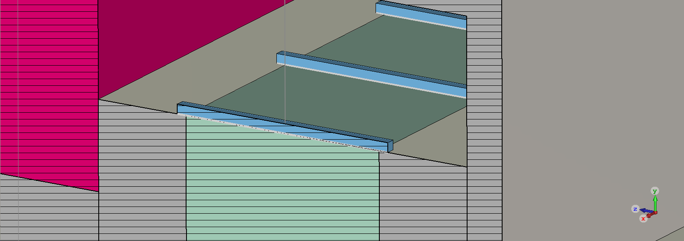
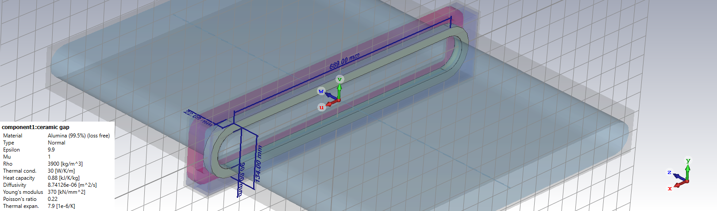
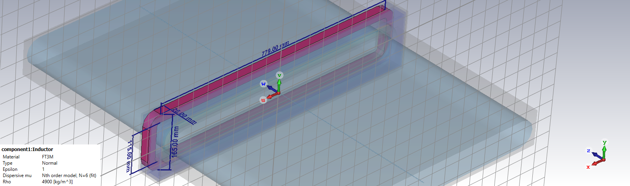
FETS FFA-WCM model in CST
Take from FETS-FFA diagnostics talk by Emi Yamakawa
Core
Vacuum box
Ceramic
Spacer
Chamber
Lumped Element (R)
Slide 13
Q1 Is this design relevant for ITRF?
Q2 What are the required parameters?

Slide 14
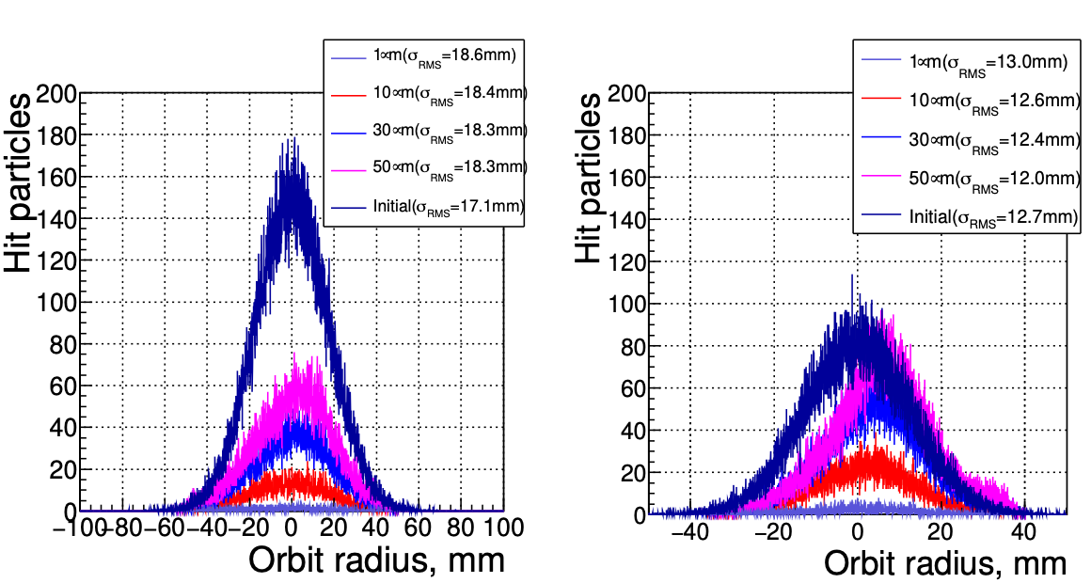
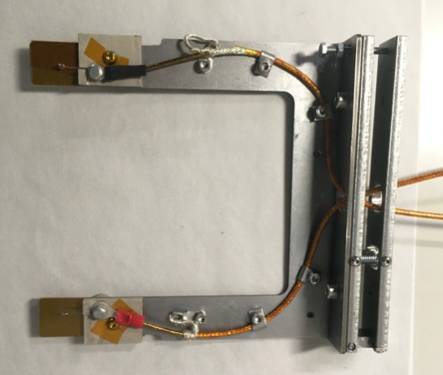
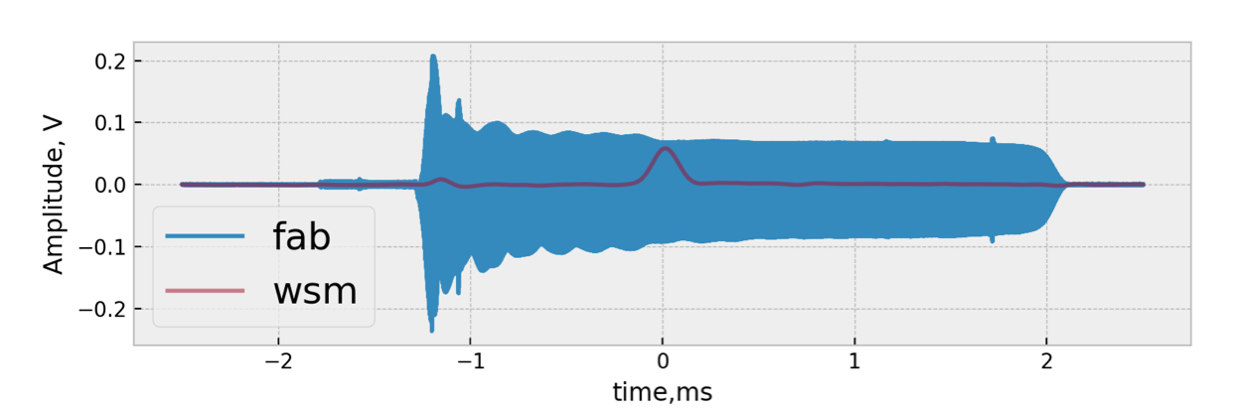
S-WSM:Demonstration at KURNS
Take from FETS-FFA diagnostics talk by Emi Yamakawa
Simulation was performed with vFFA parameters (Fig.1).
To demonstrate monitor concepts, beam tests were performed at KRNS FFA ring.
  Test probe and wire frame were designed and manufactured.
  φ10um was tested at 13.5 MeV orbit, where turn separation of about 30umm.
  Pulse signal was measured by test monitor, which is within same order of the one measured by scraper.
Fig. 1. Estimated beam profile at around 3MeV (left) and 12MeV (right) with vFFA parameters. Average turn separations are 64um for 3MeV and 25um for 12MeV. Scattering angle and energy loss of particle at wires are neglected.
Slide 14
Q1 What is the requirement for the WS?
When turn separations are smaller than wire thickness, the wire does not destroy whole beams and can estimate profile in the acceleration.

Slide 15
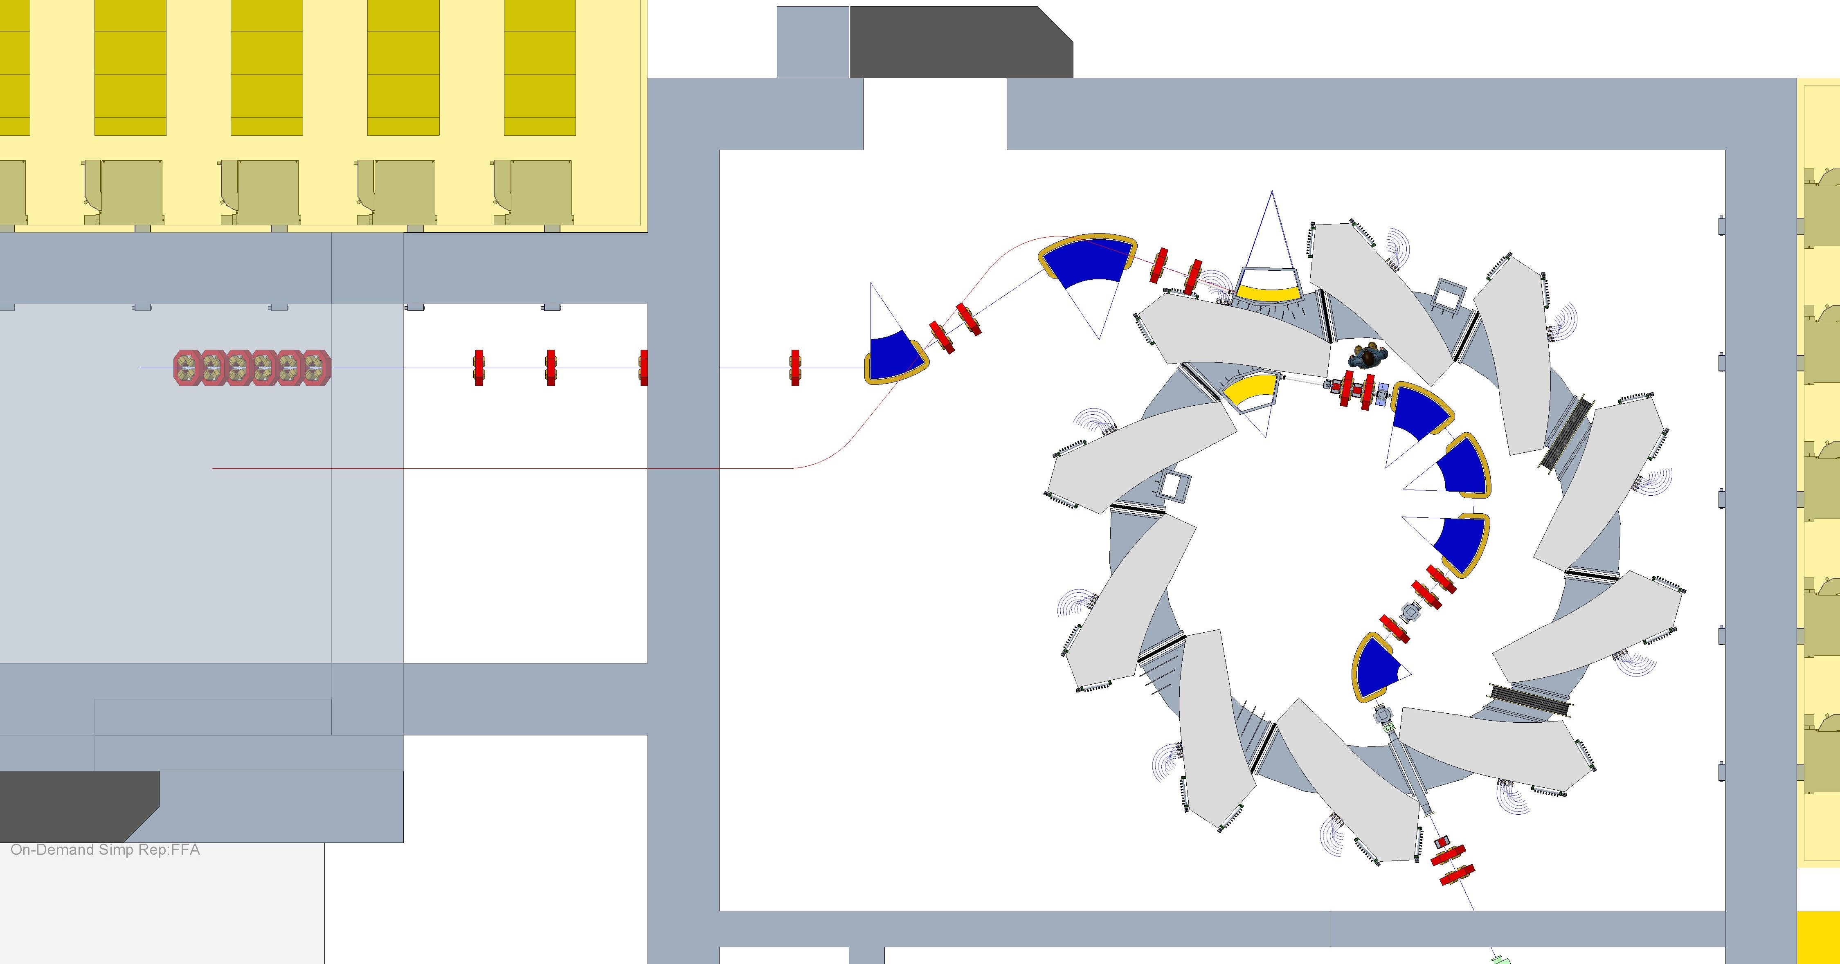
High Energy Line
Magnet positions shown as defined on spreadsheet LhARAGeometrySurvey-v4.6.2
High energy In-vitro
Slide 15
Q1 Propose to adjust this extraction line?

