Slide 1


ITRF Project
Mechanical Engineering Design
FFA Ring Injection
Clive Hill
18/06/24
1272-pa1-meng-prs-0020 v1.0
Notes:
The abstract pattern can be removed or repositioned if required. Be careful to ‘Send to Back’ so that it does not obscure any important information.

Slide 2
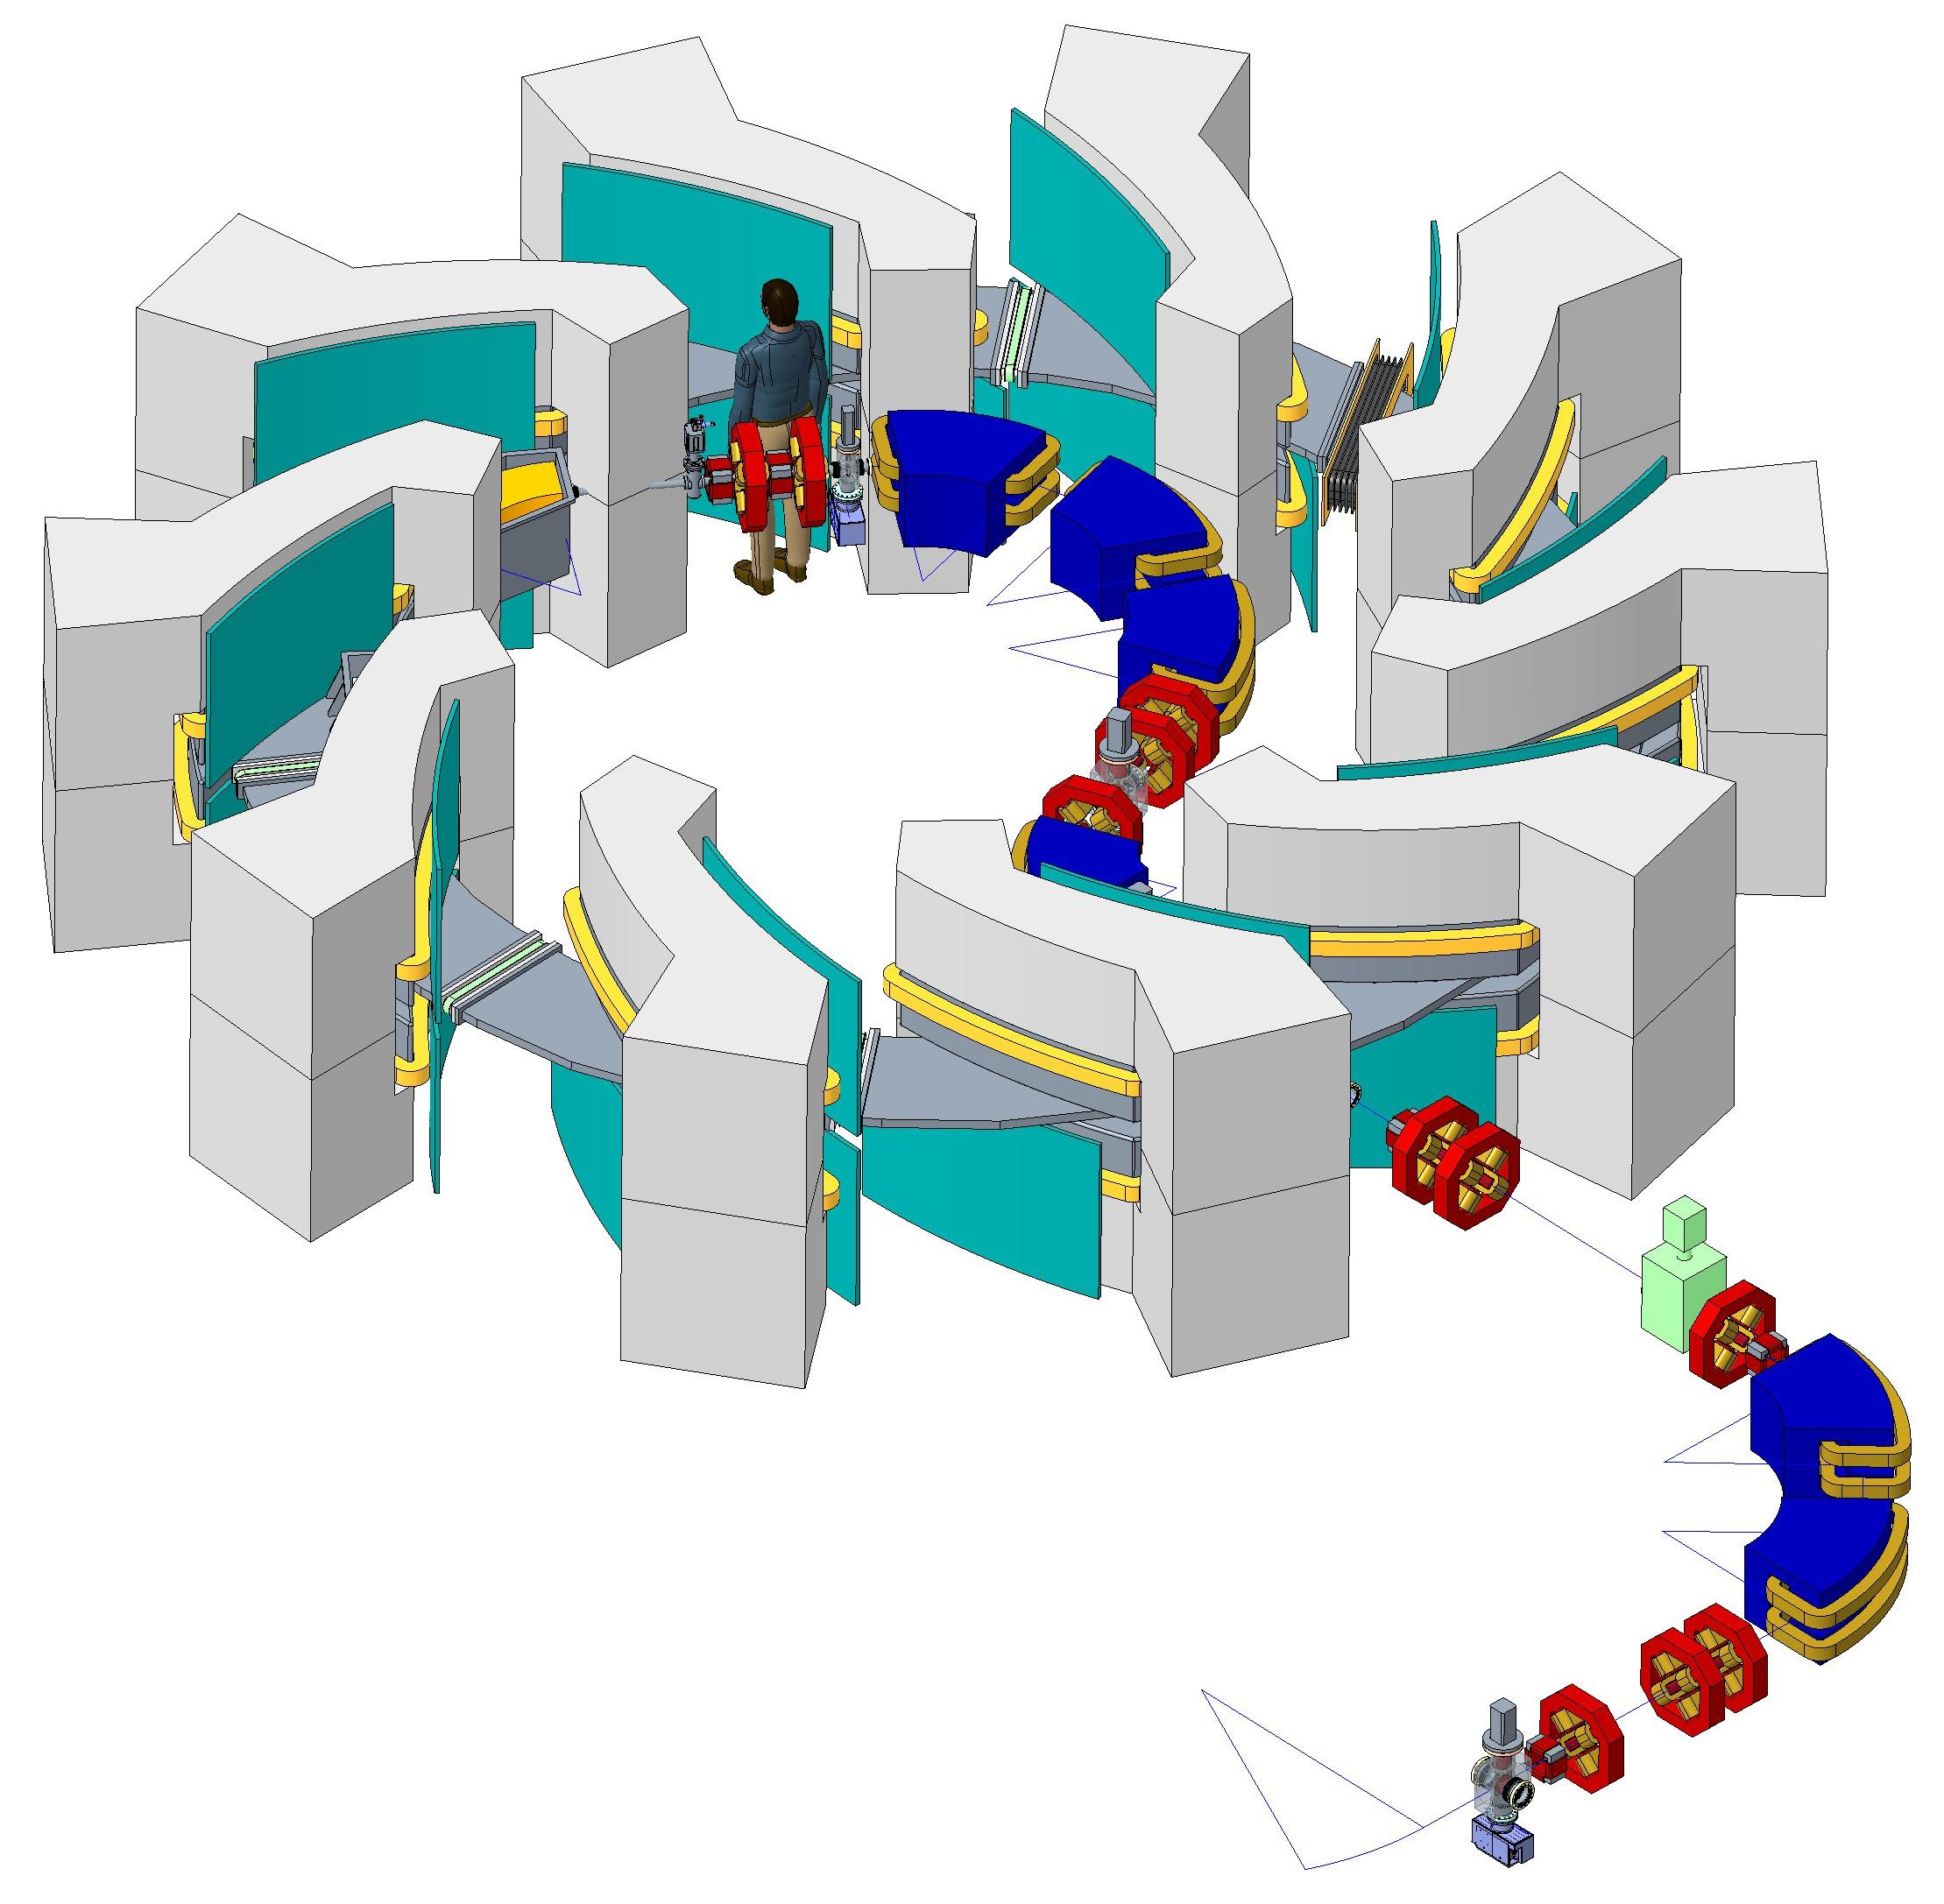
ITRF/LhARA FFA Injection Line & Ring

Slide 3
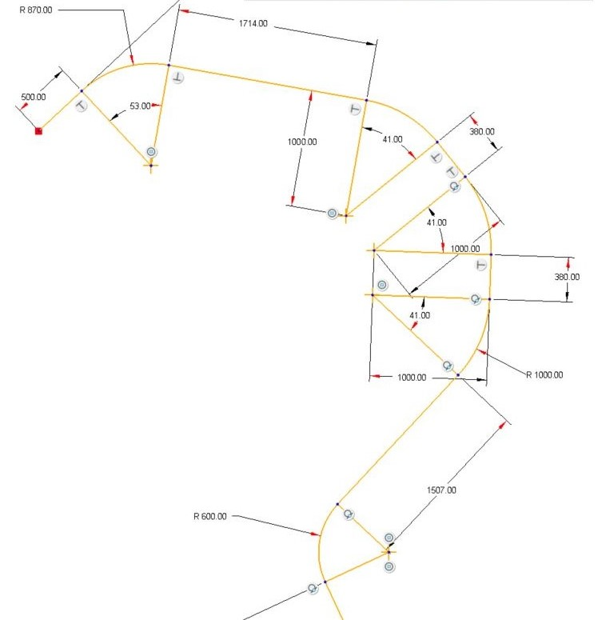
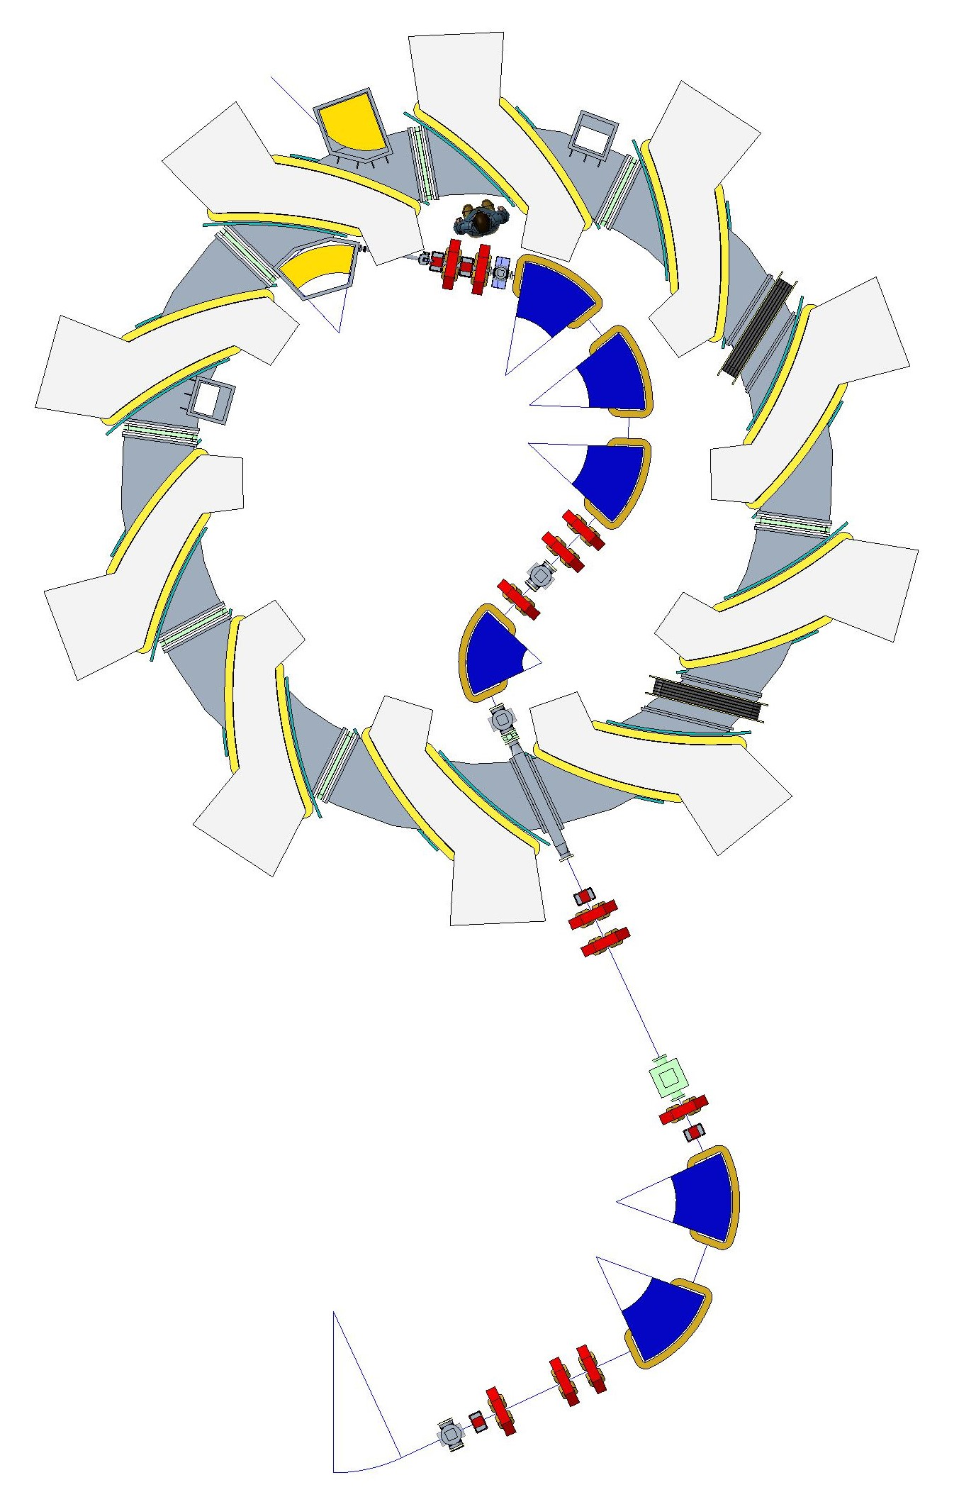
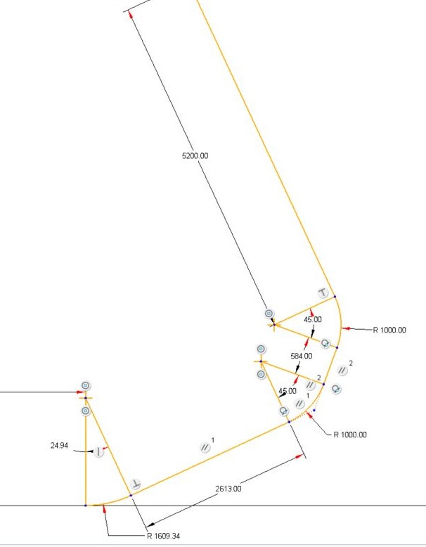
Injection Line

Slide 4
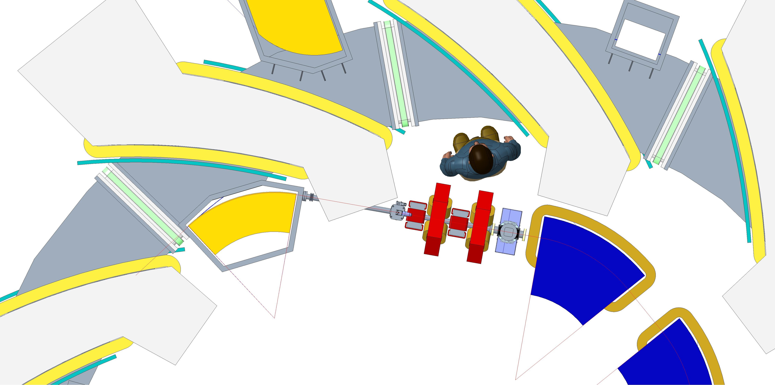
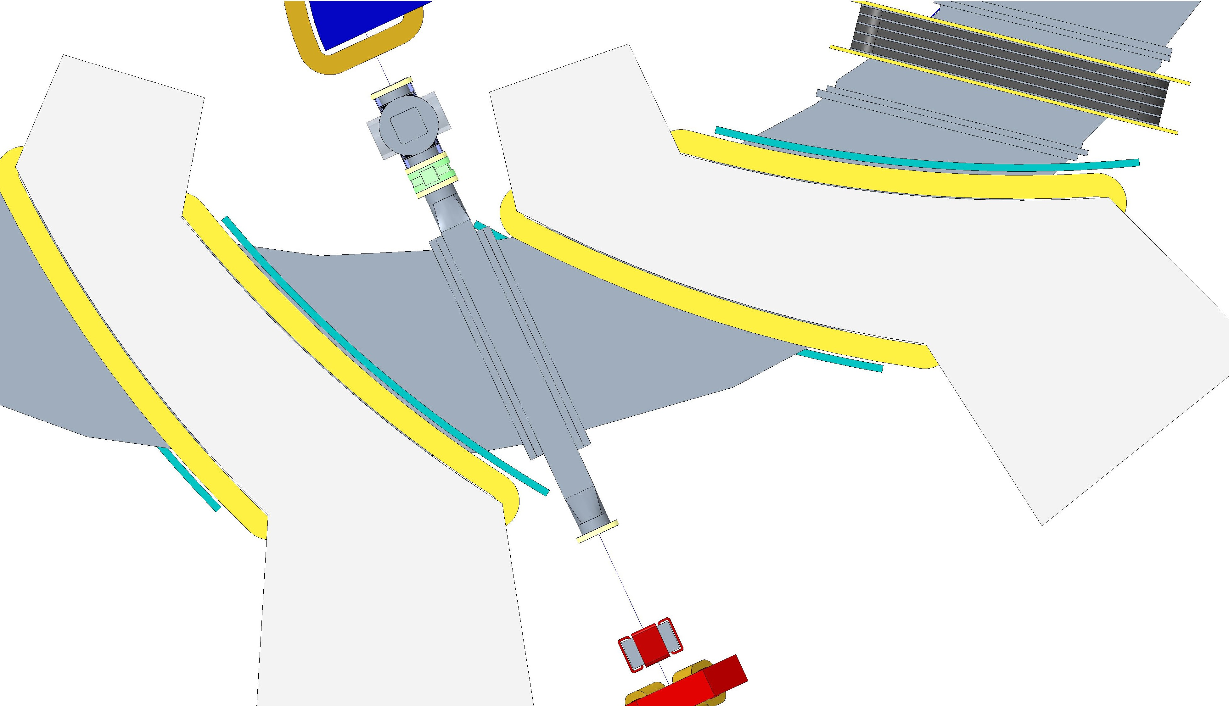
Ring Magnet with Inner Yoke
Extraction septum magnet
Extraction kicker magnet
Injection septum magnet
Bellows
53°
Injection pipe Ø35mm
Vacuum valve
Vacuum valve
RF Cavity
Injection chamber □100mm

Slide 5
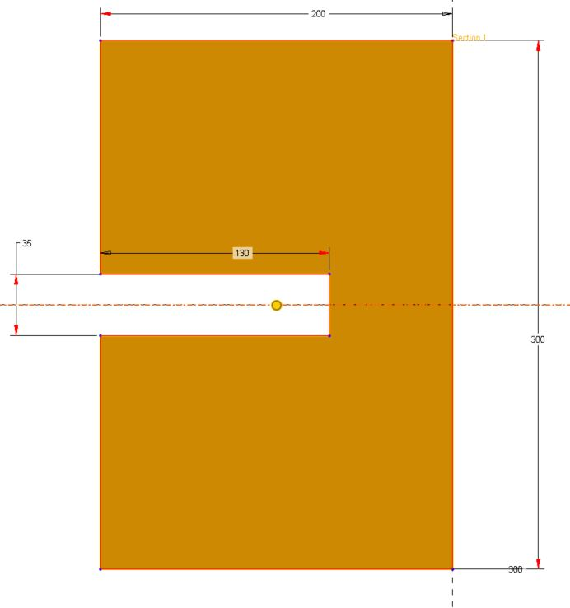
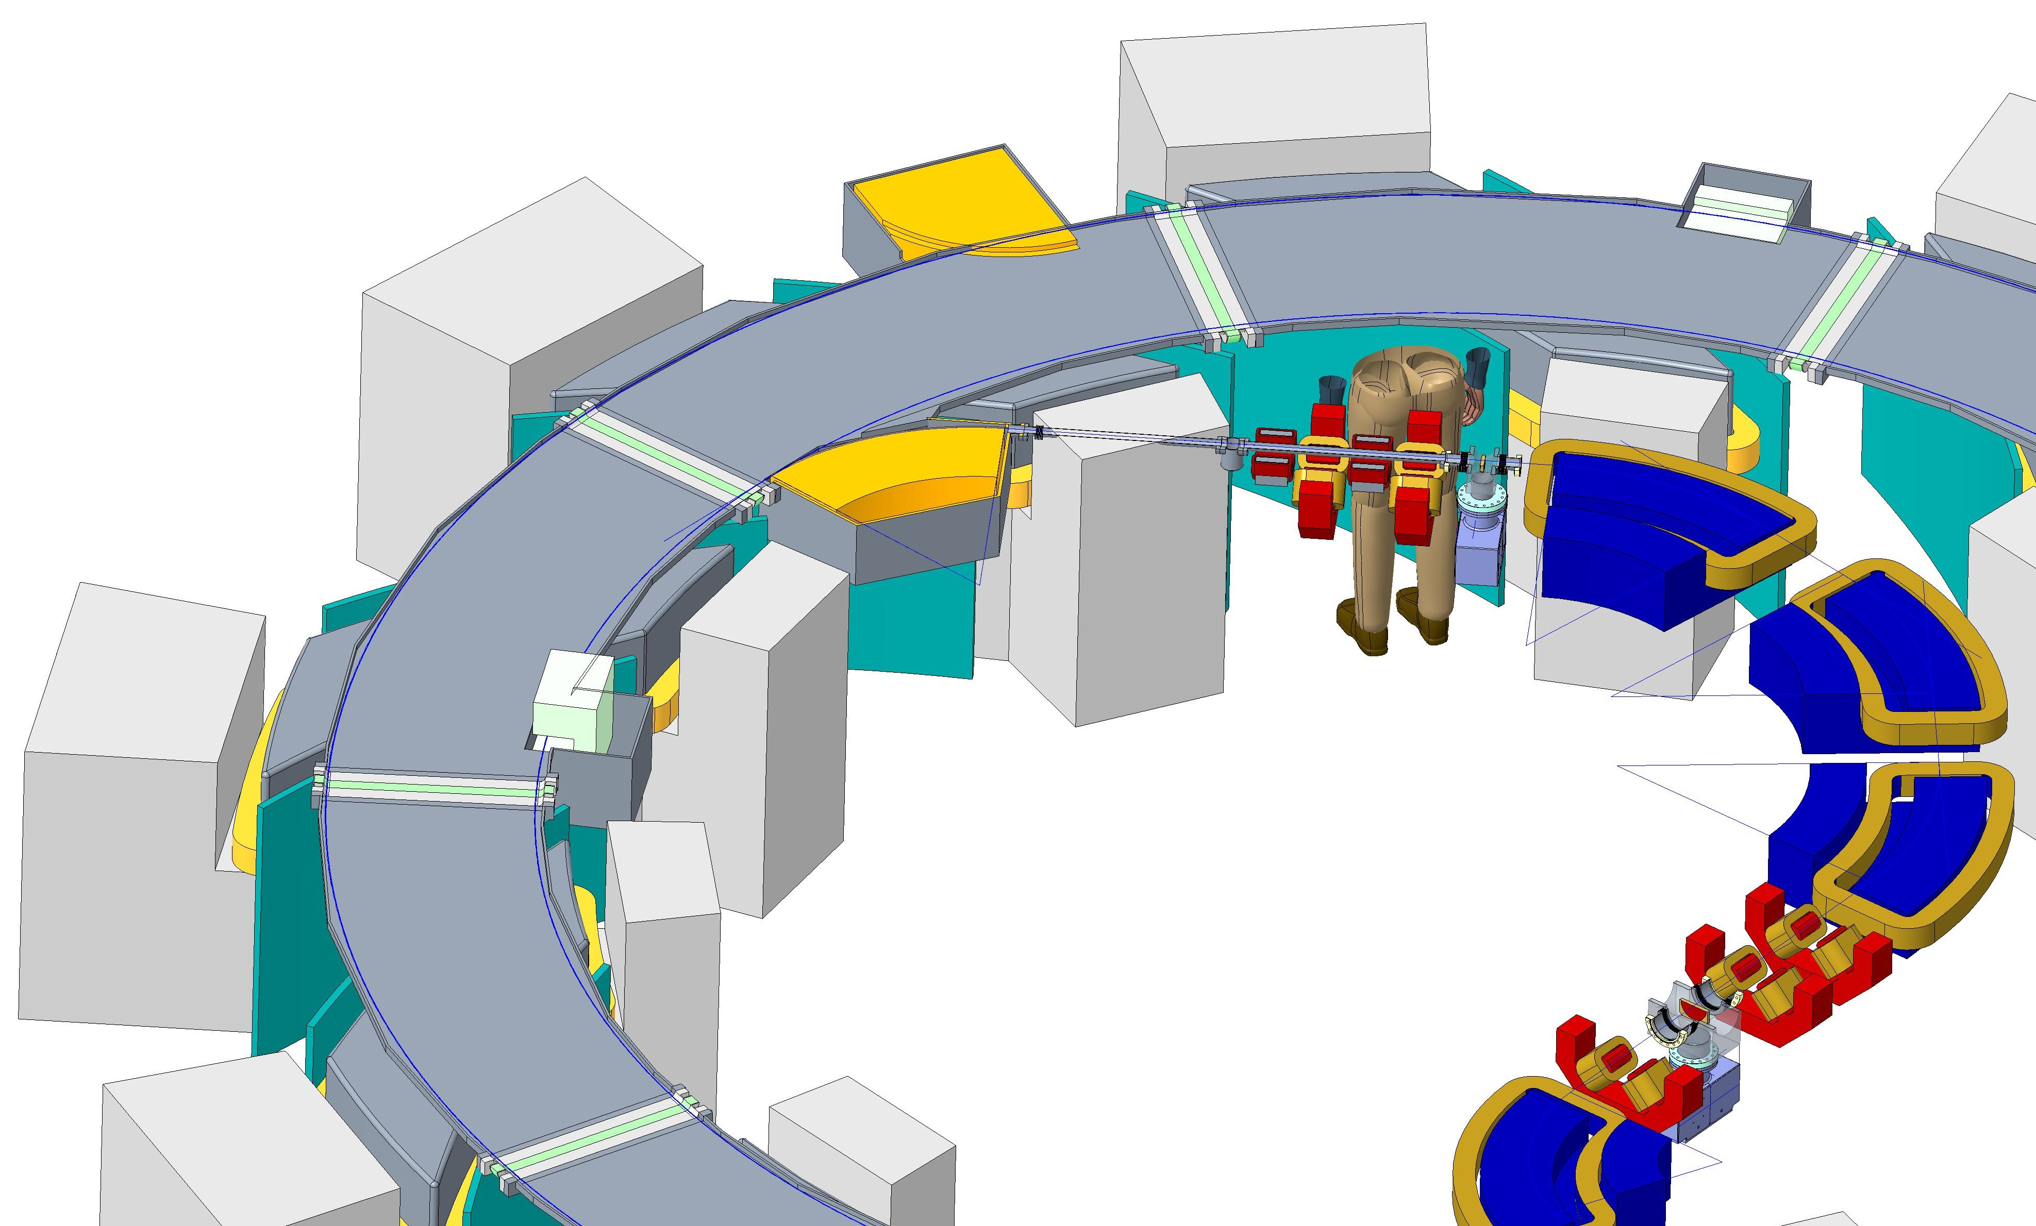
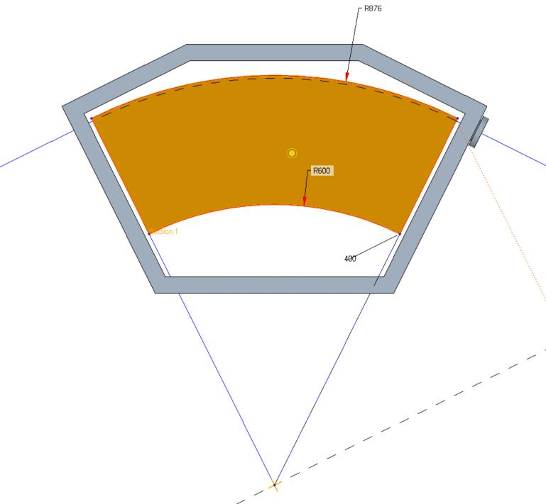
Injection Septum and Kicker Magnets
200mm
35mm
130mm
300mm
Injection C shaped kicker magnet
R870mm
Injection septum magnet
R600mm
Injection C shaped kicker magnet
53°
Injection septum magnet

Slide 6
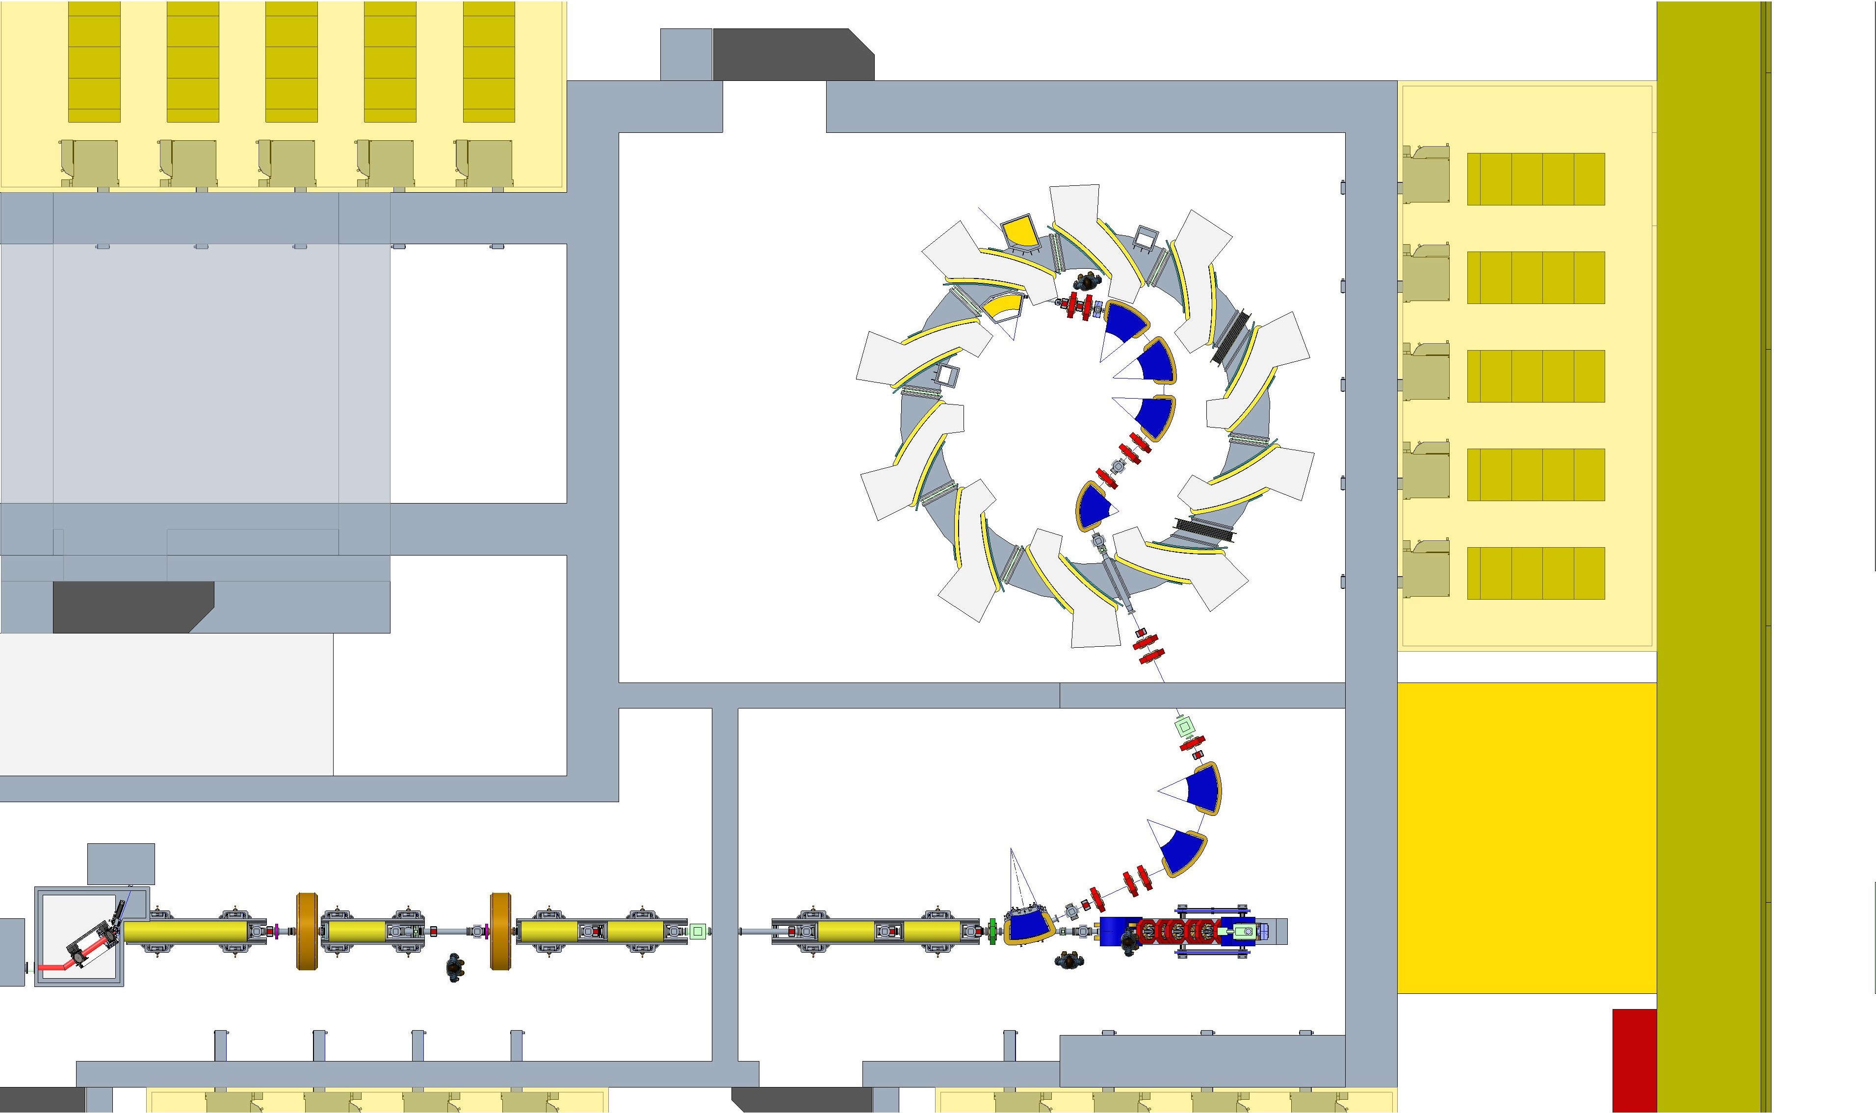
Door moved
Wall moved out

Slide 7
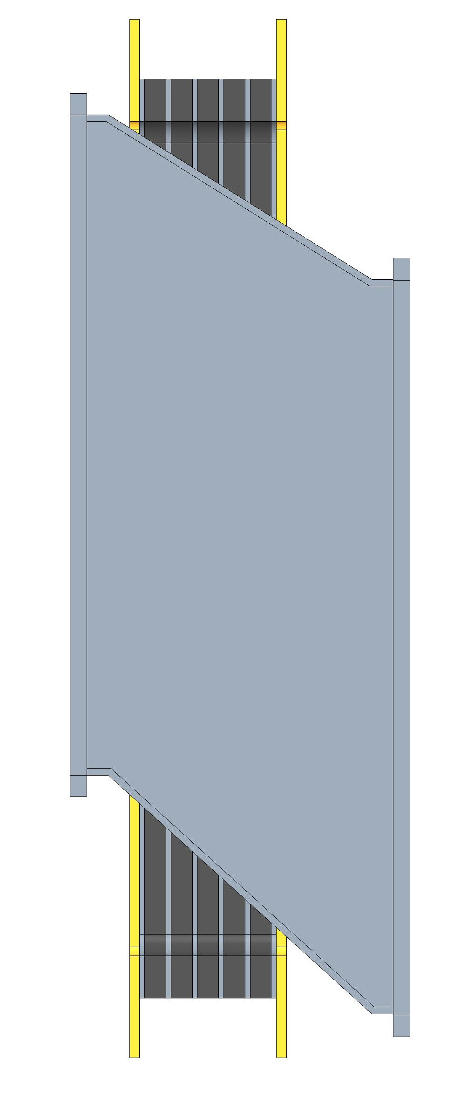
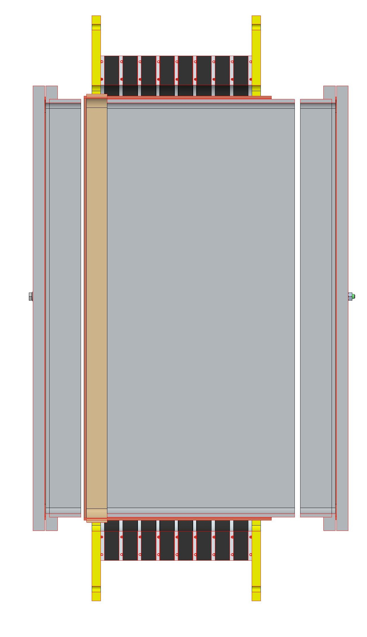
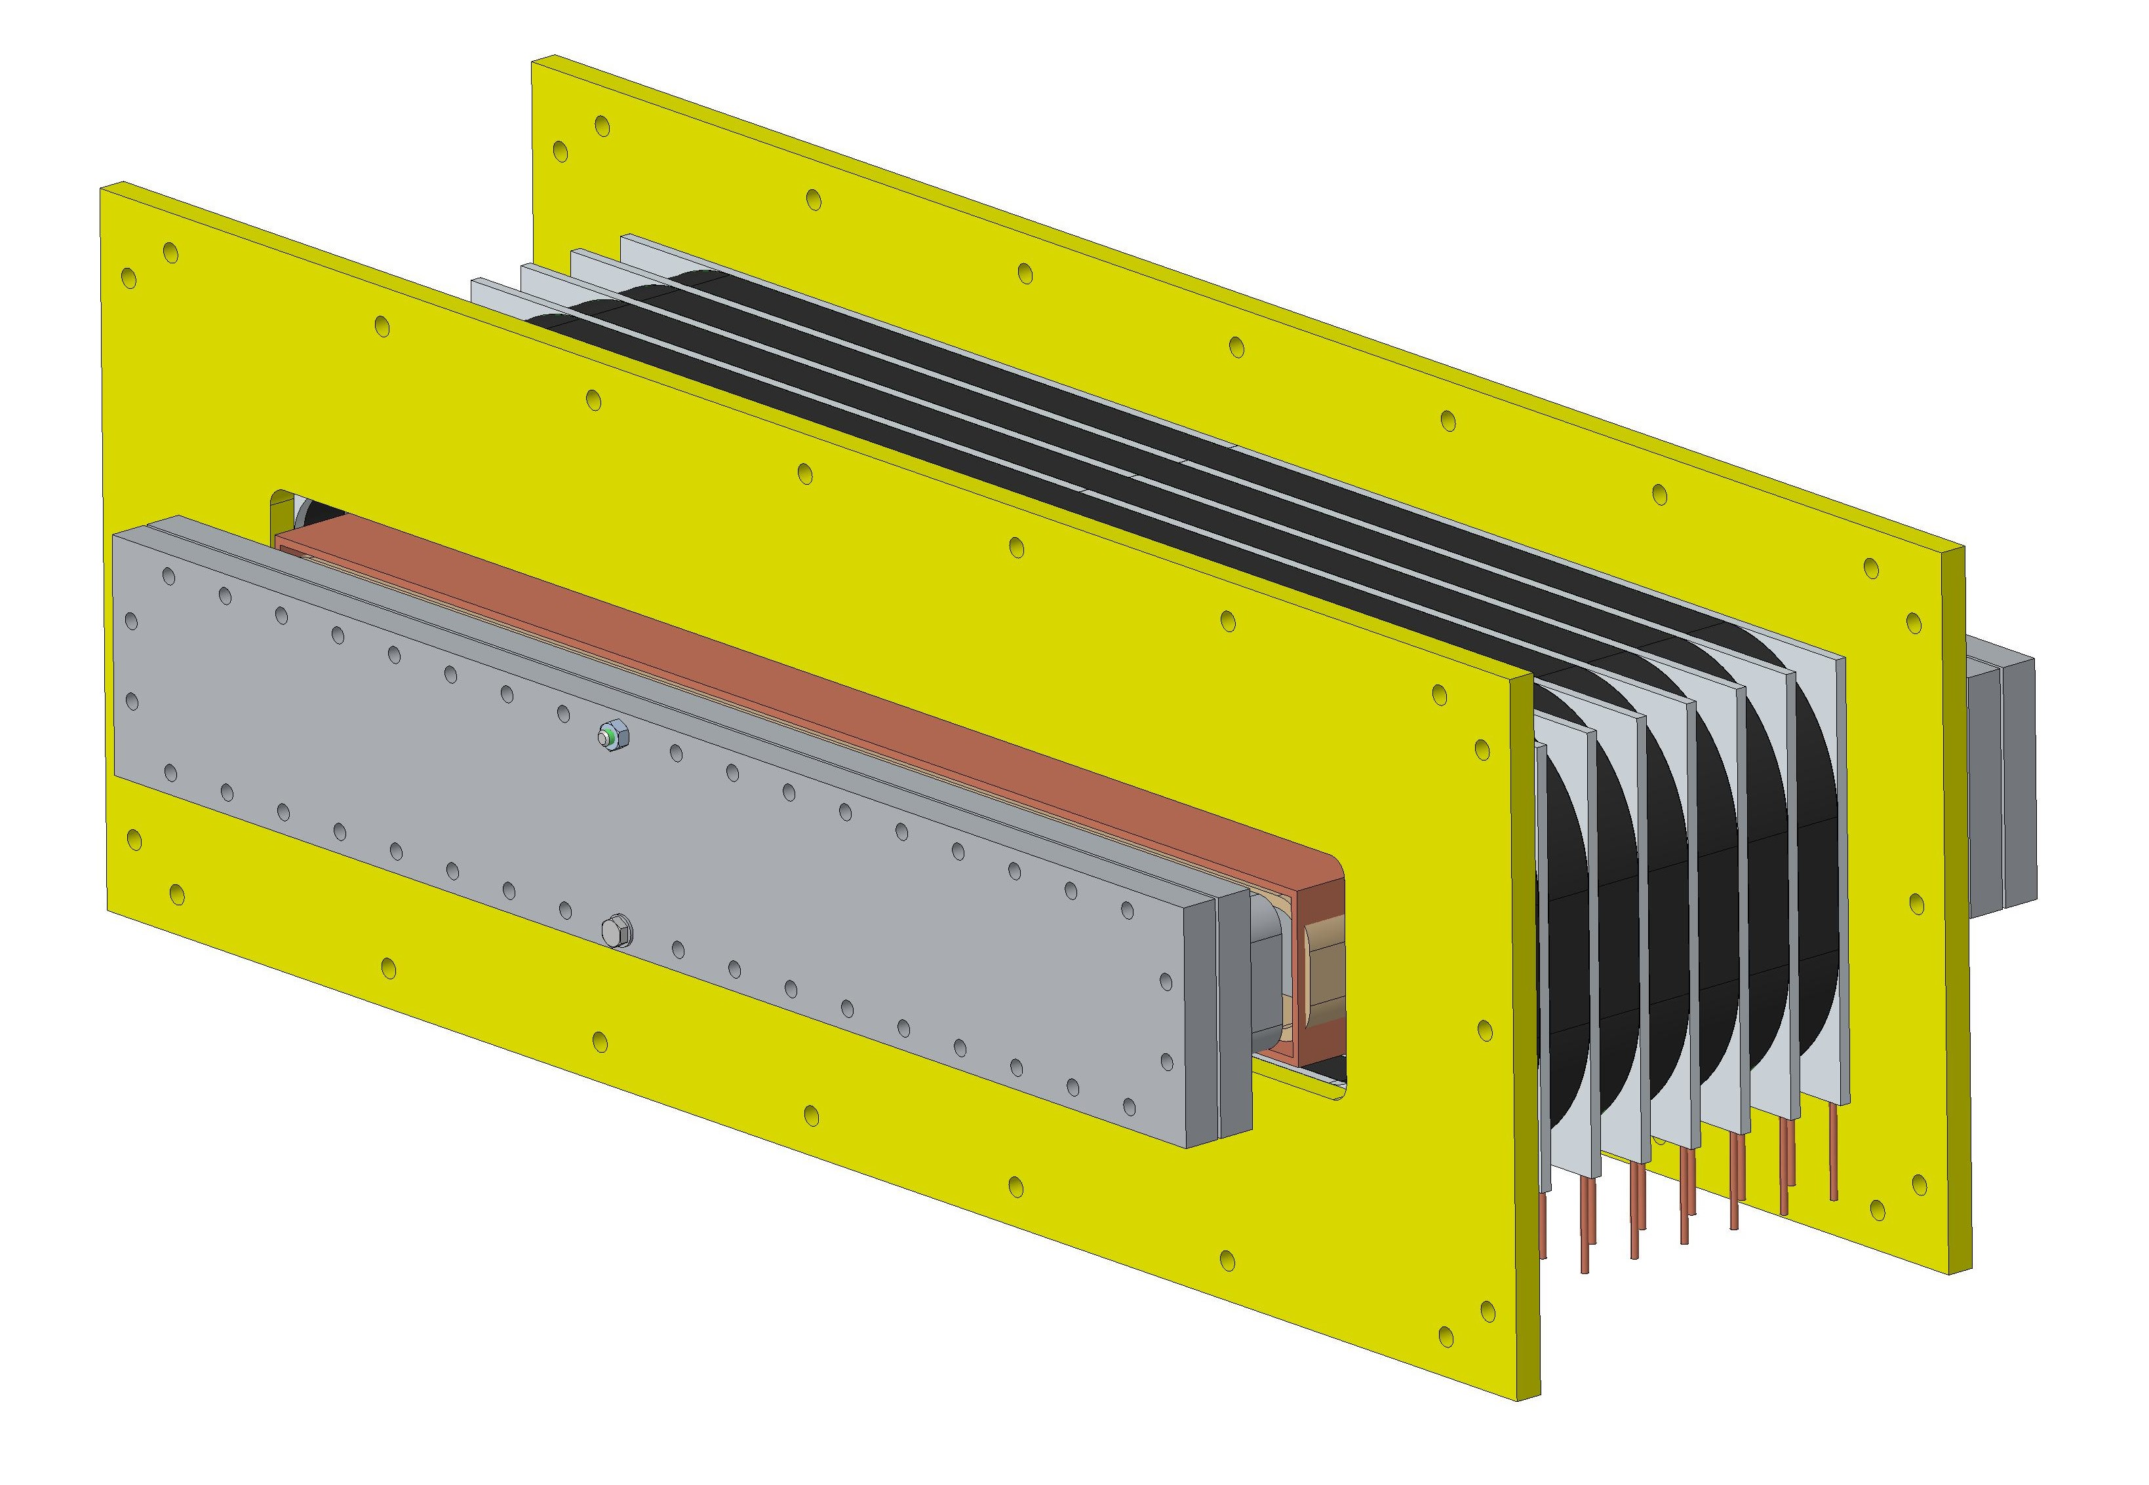
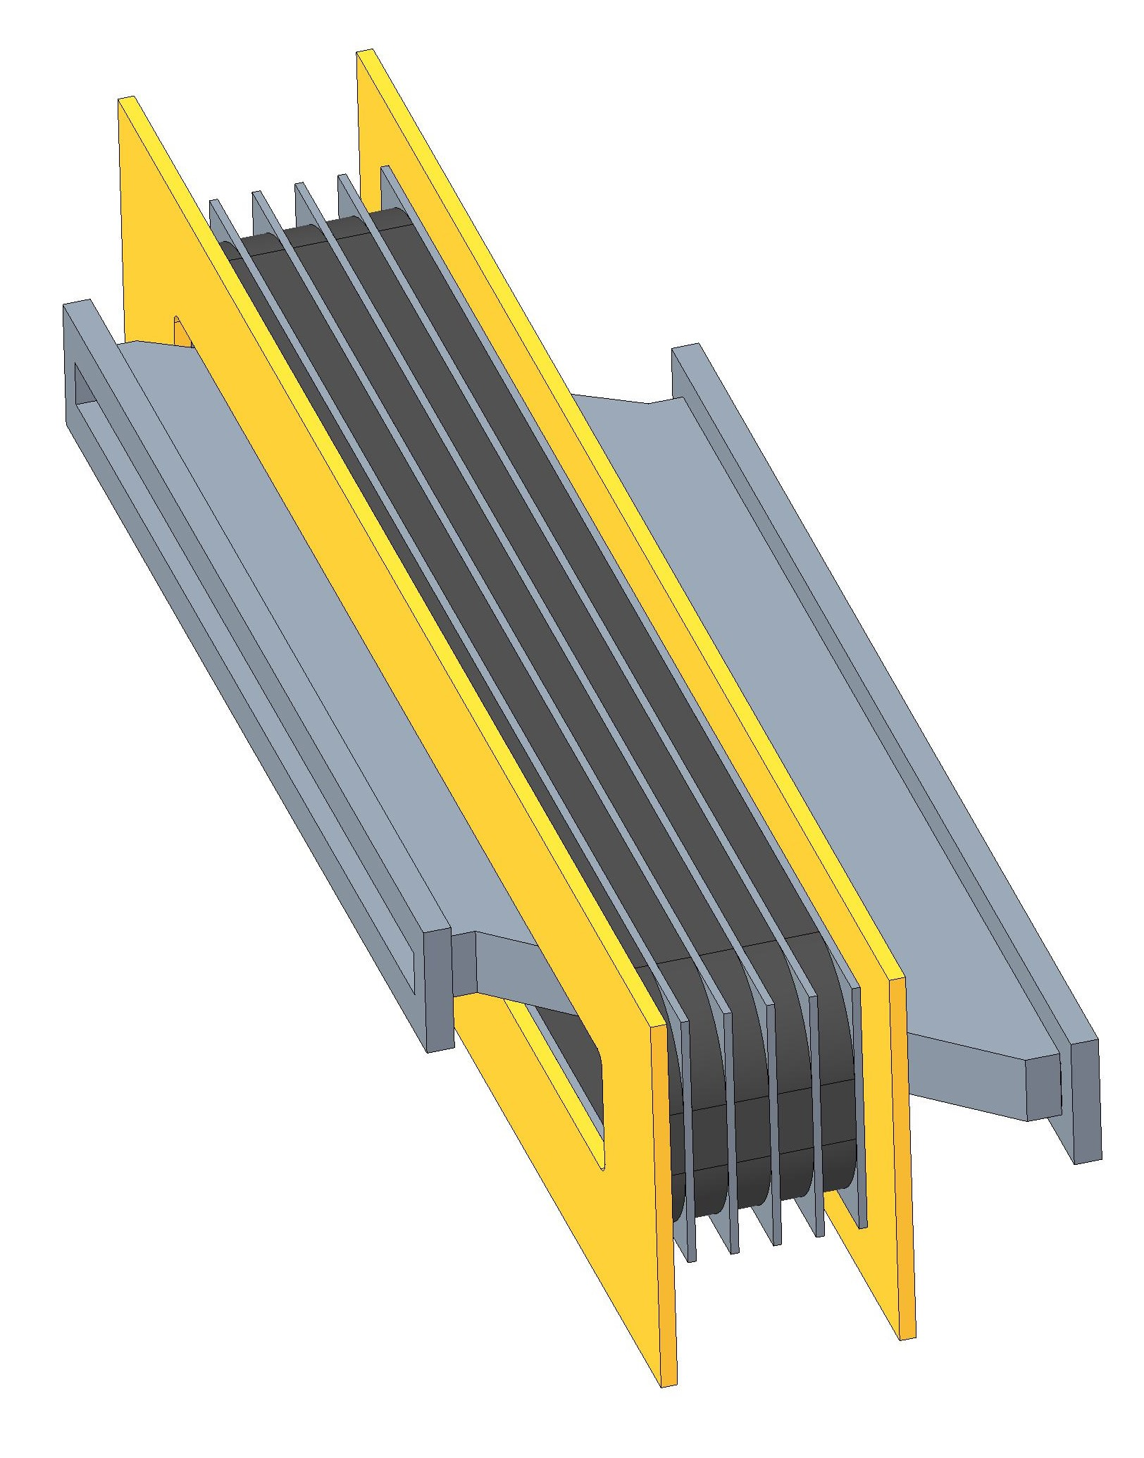
400mm
494mm
5 cores 25mm thick
760mm
915mm
FETS FFA MA Cavity (for reference)
FETS FFA Ferrite Cavity (for reference)

Slide 8
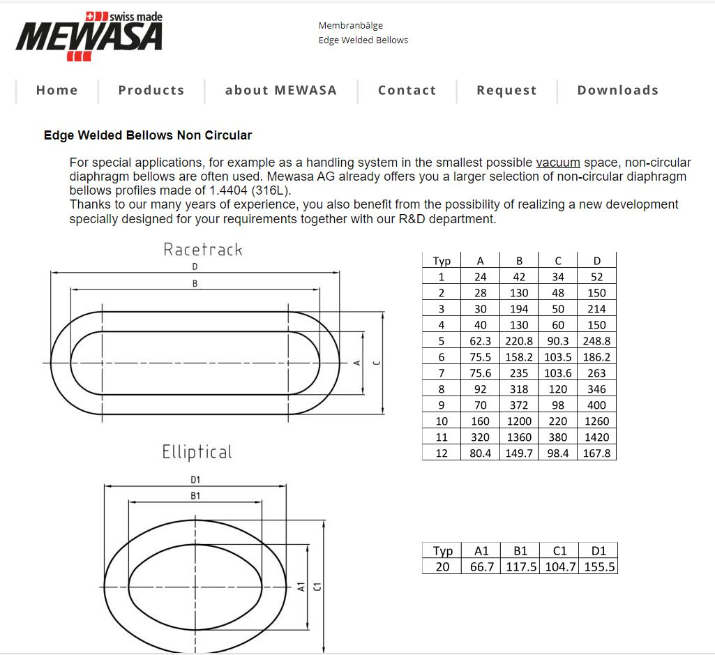
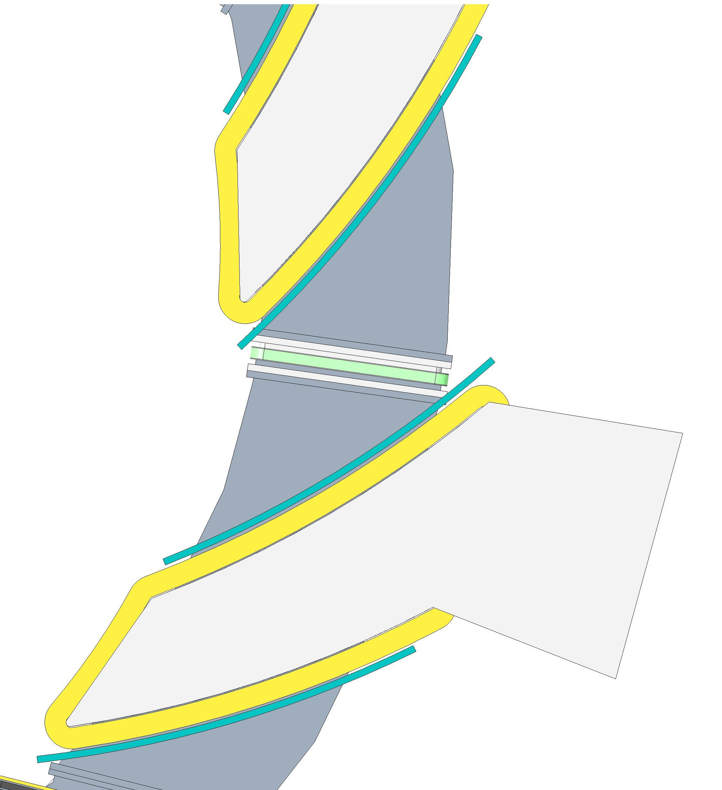
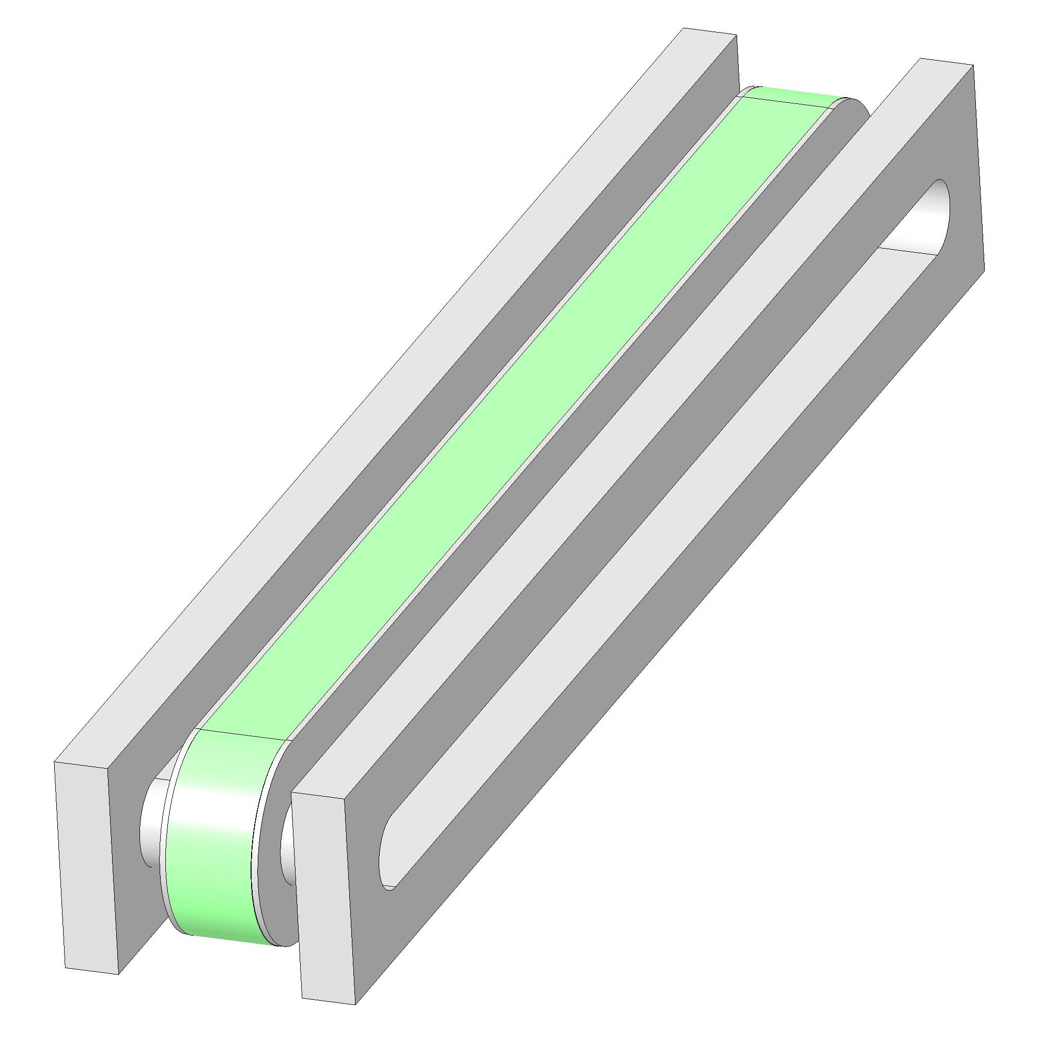
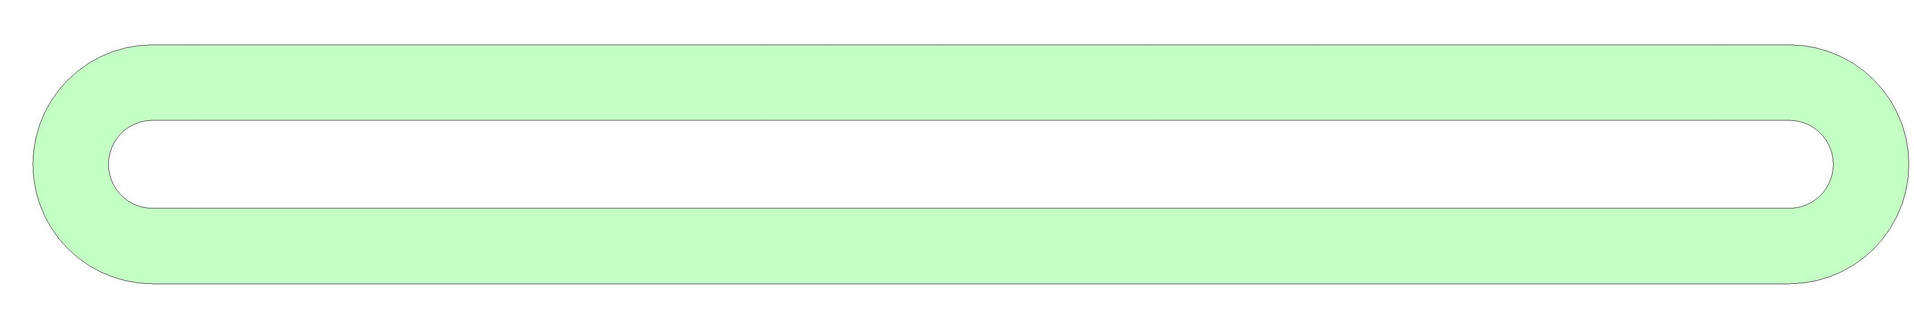
745mm
685mm
35mm
95mm

