Slide 1


ITRF Project
Mechanical Engineering Design
LhARA Target Chamber
Clive Hill
31/10/23
1272-pa1-meng-prs-0014 v1.0
Notes:
The abstract pattern can be removed or repositioned if required. Be careful to ‘Send to Back’ so that it does not obscure any important information.

Slide 2
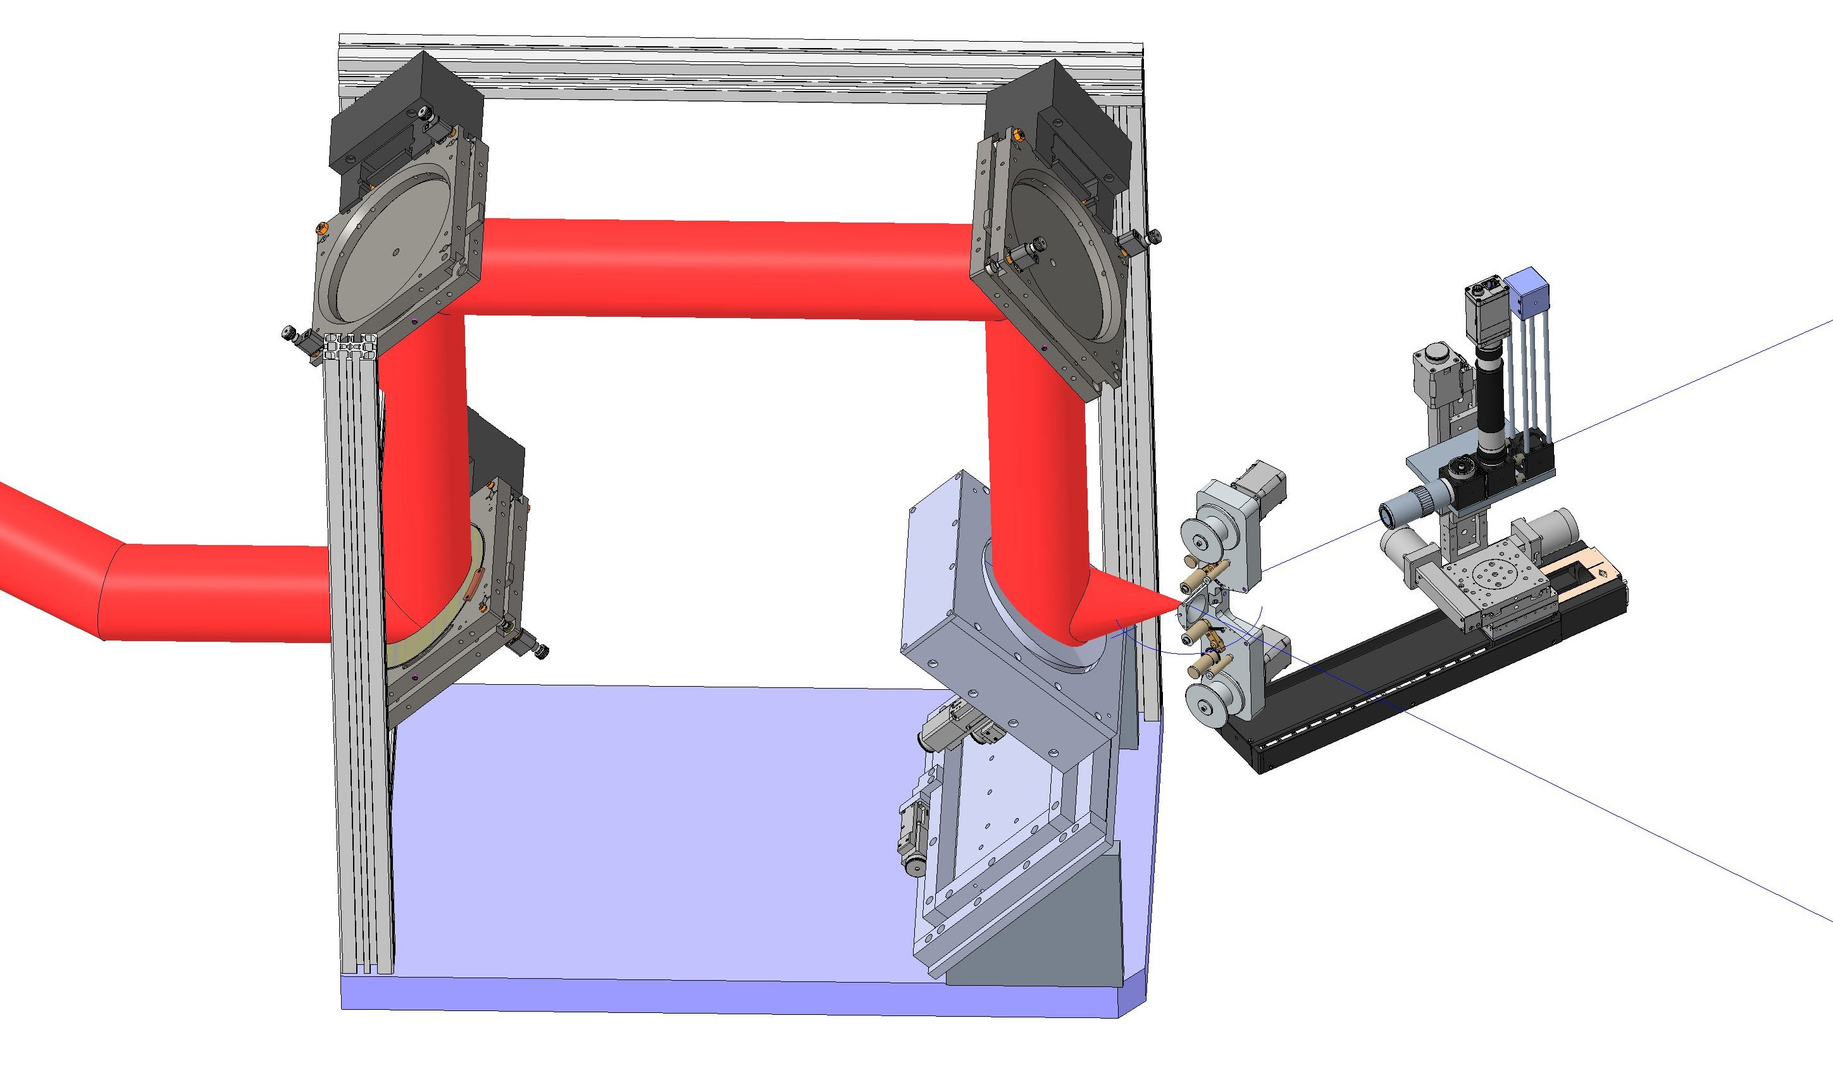
Diagnostics
35°
35°
Beamline
Rotate target

Slide 3
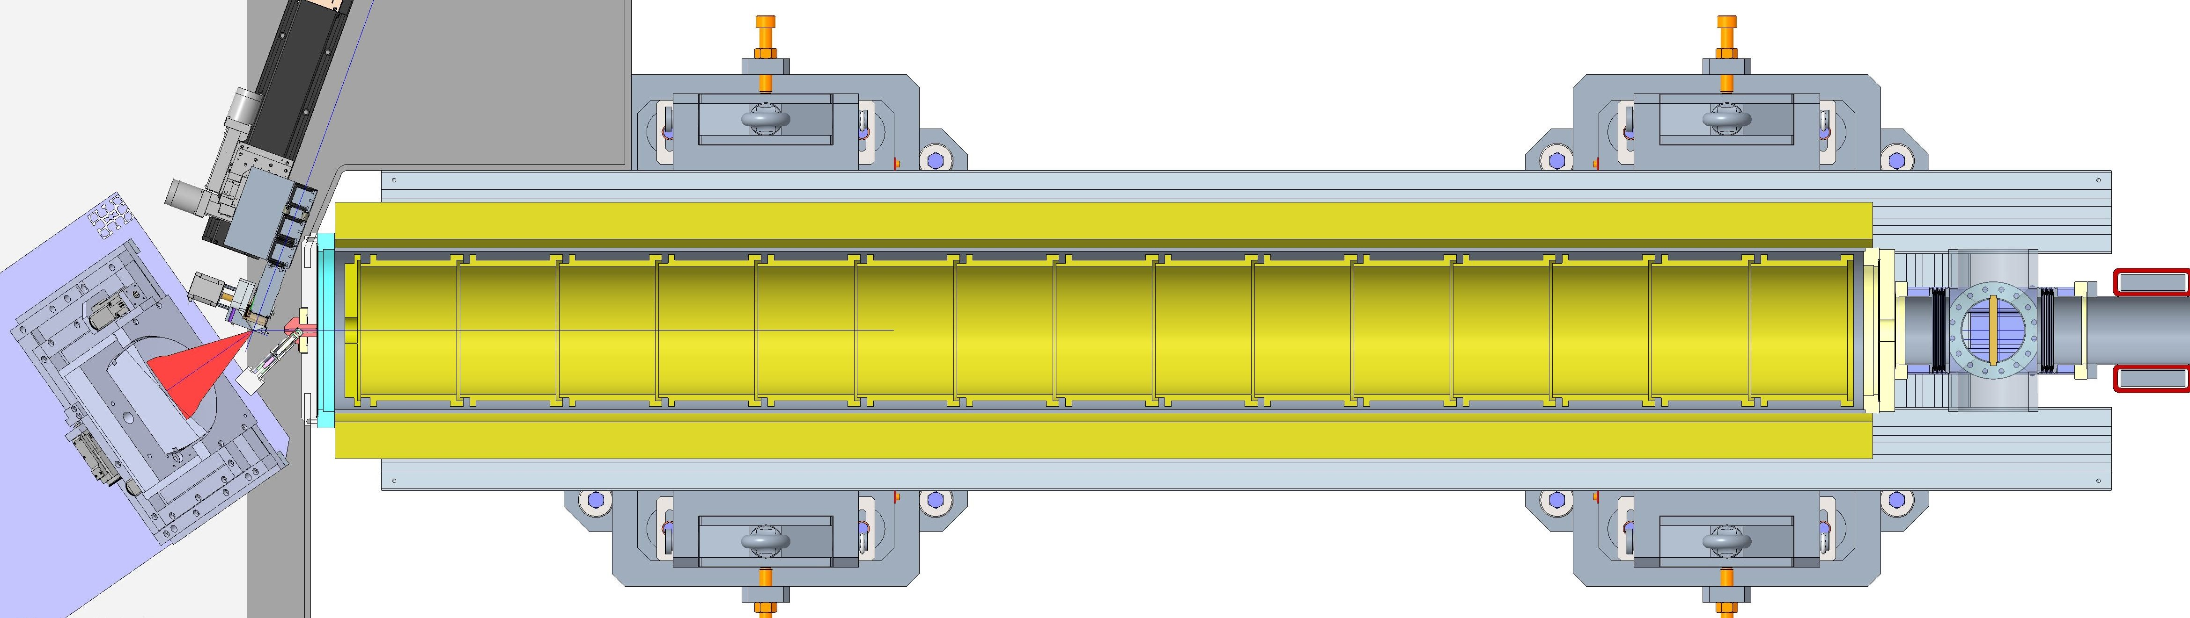
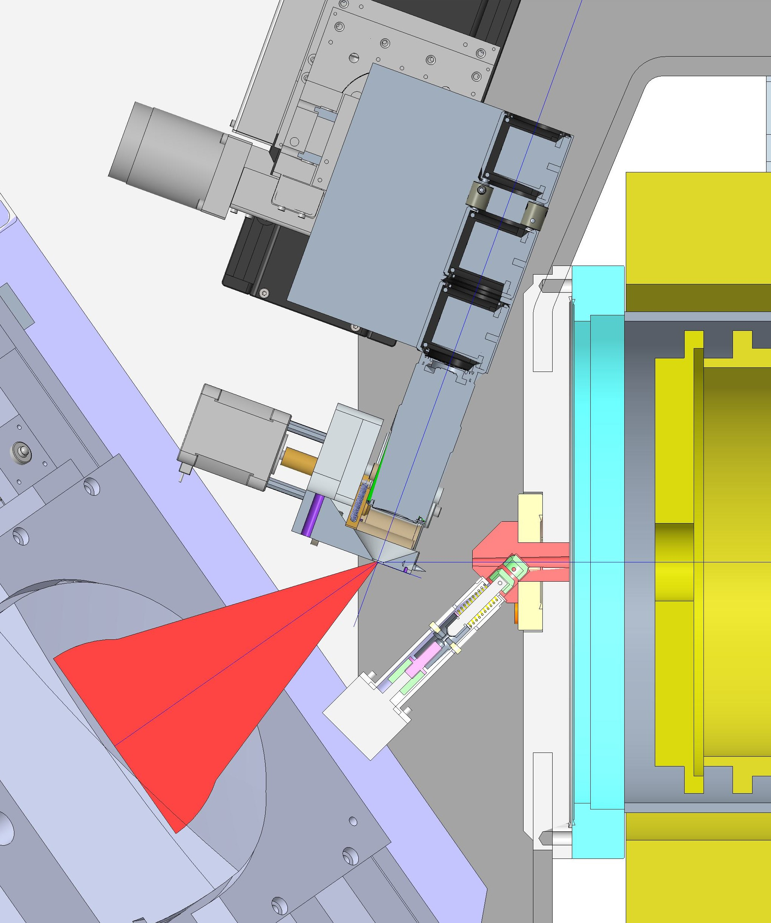
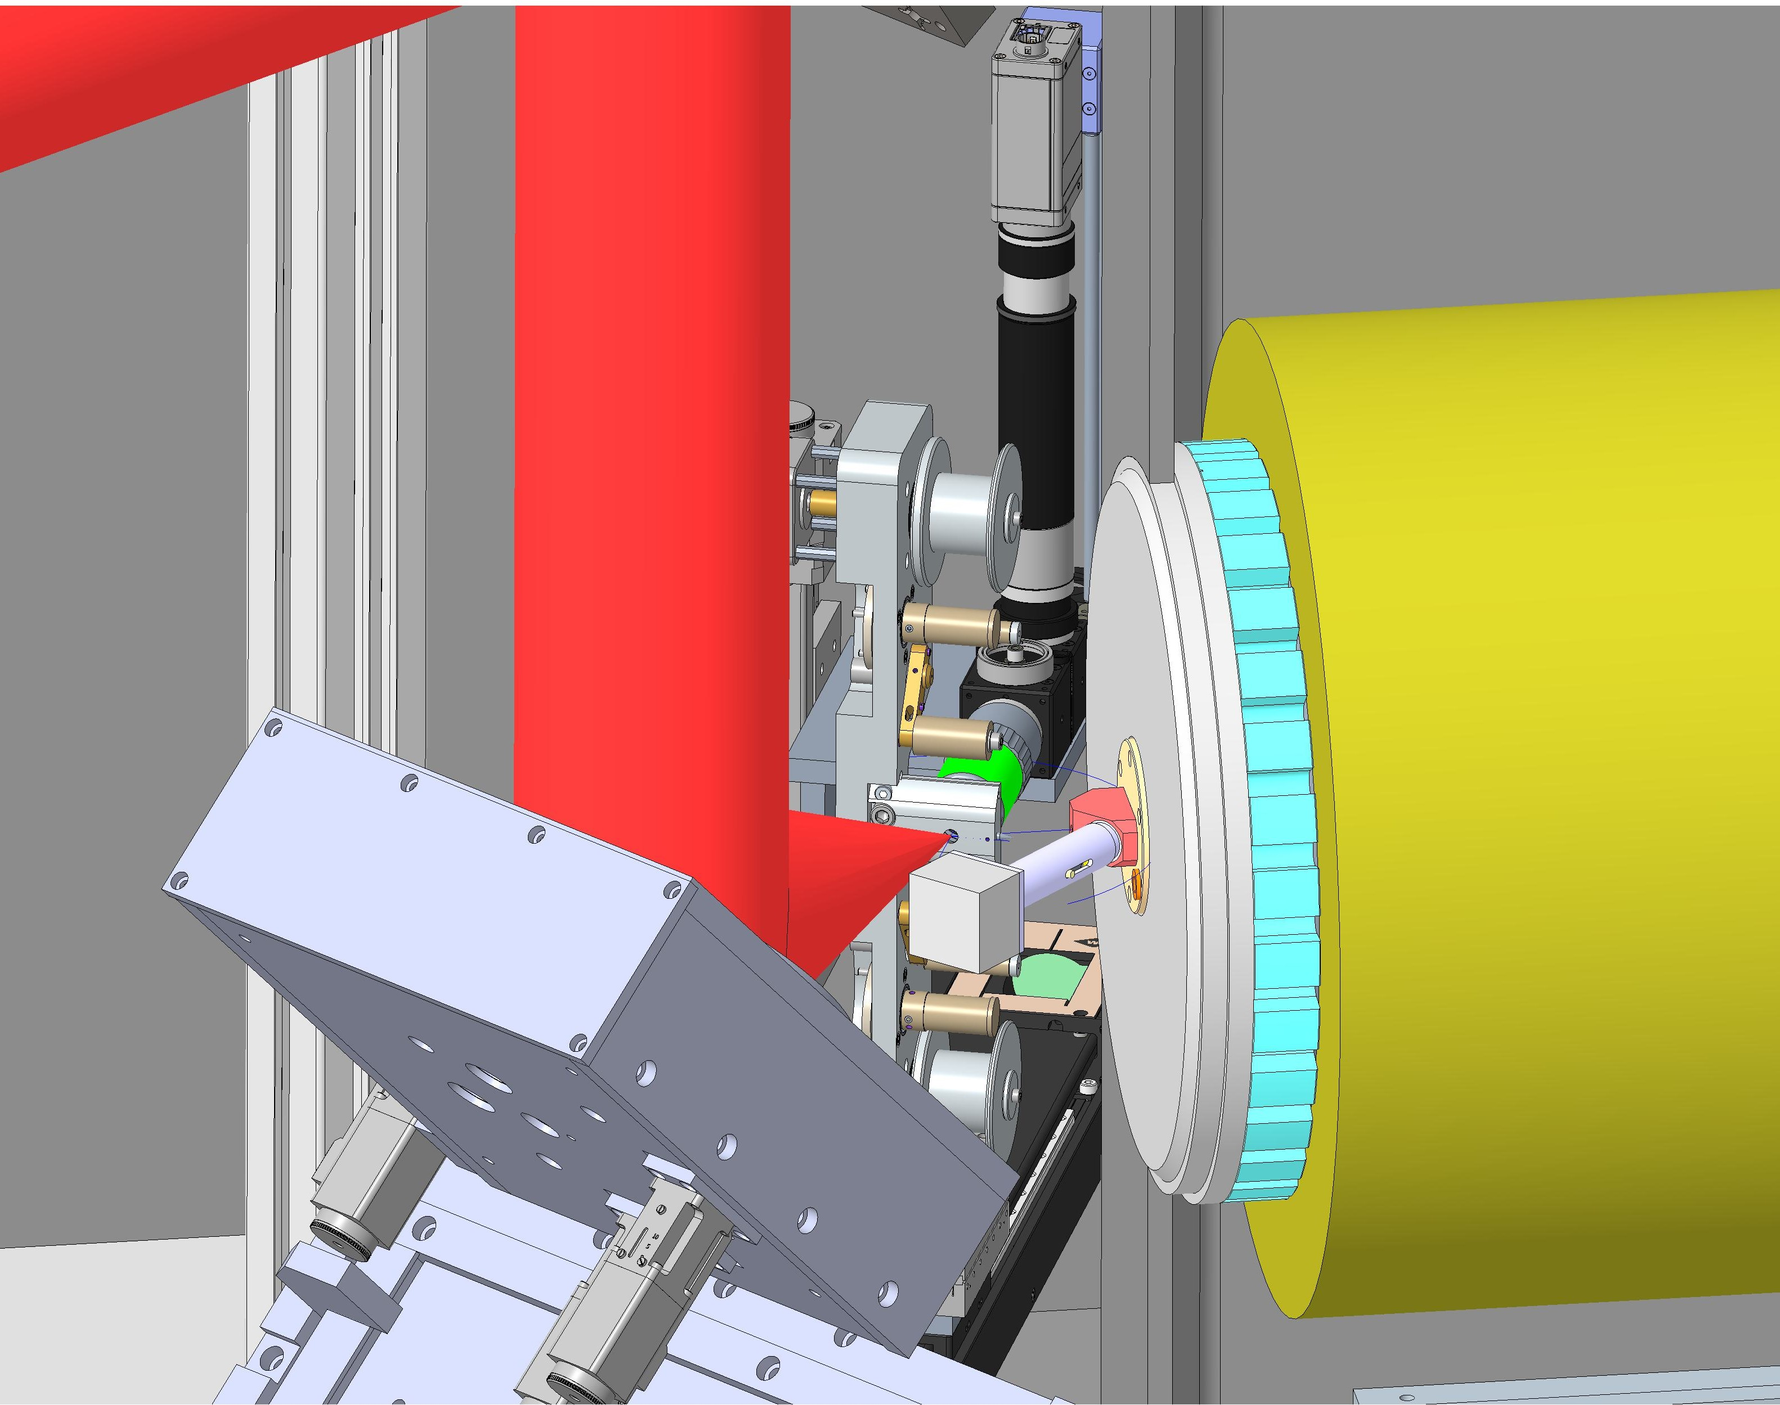
Ø305
Ø254
35°
35°
25.5
100
Nozzle and vacuum valve

Slide 4
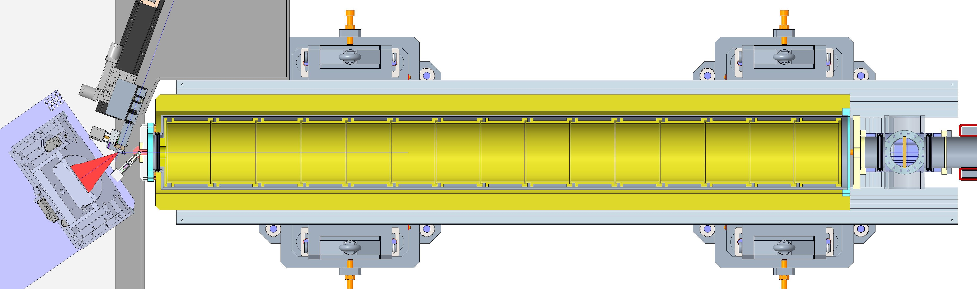
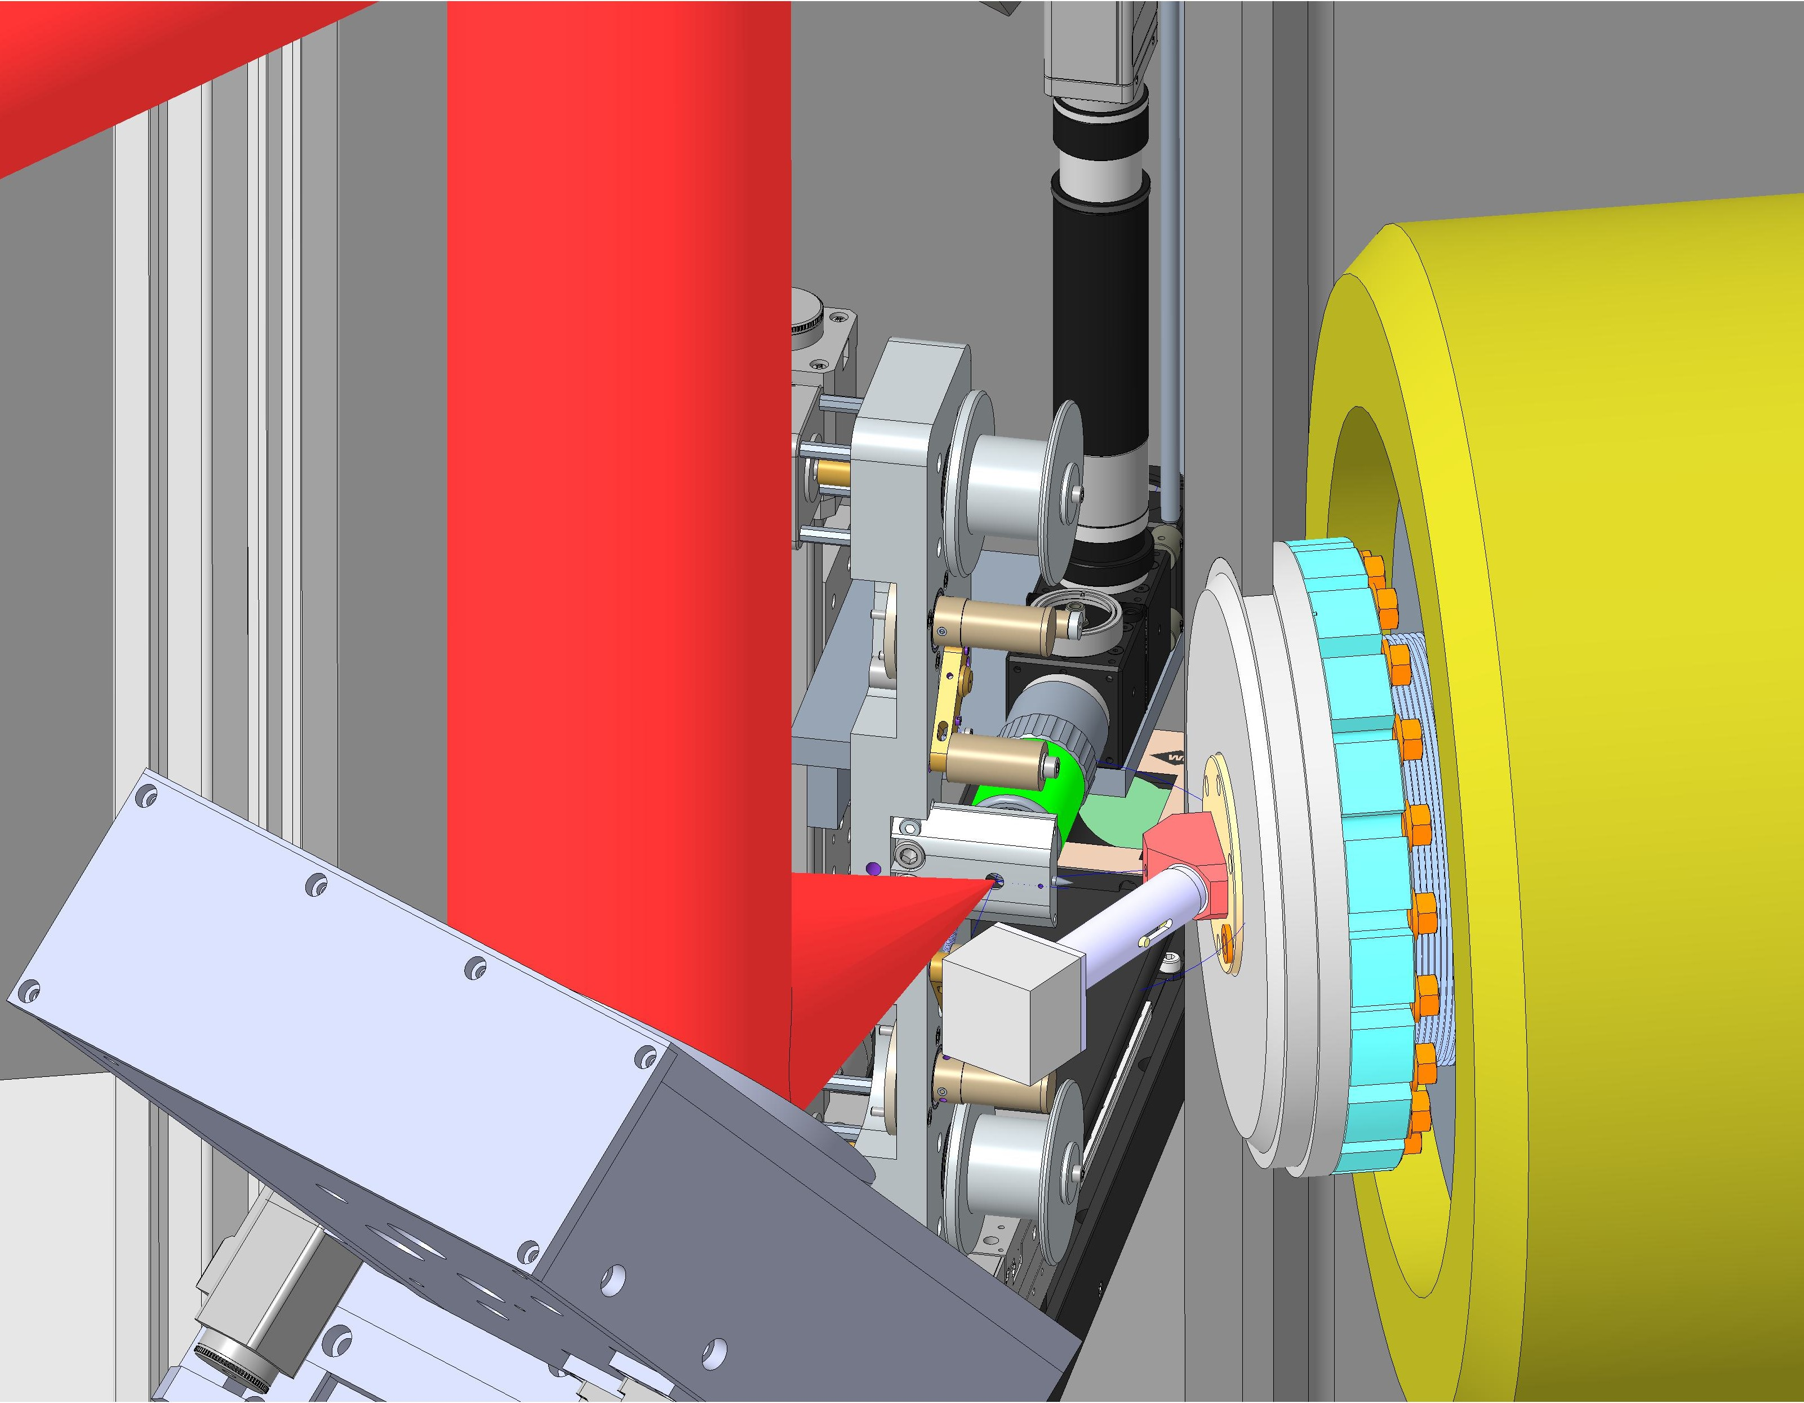
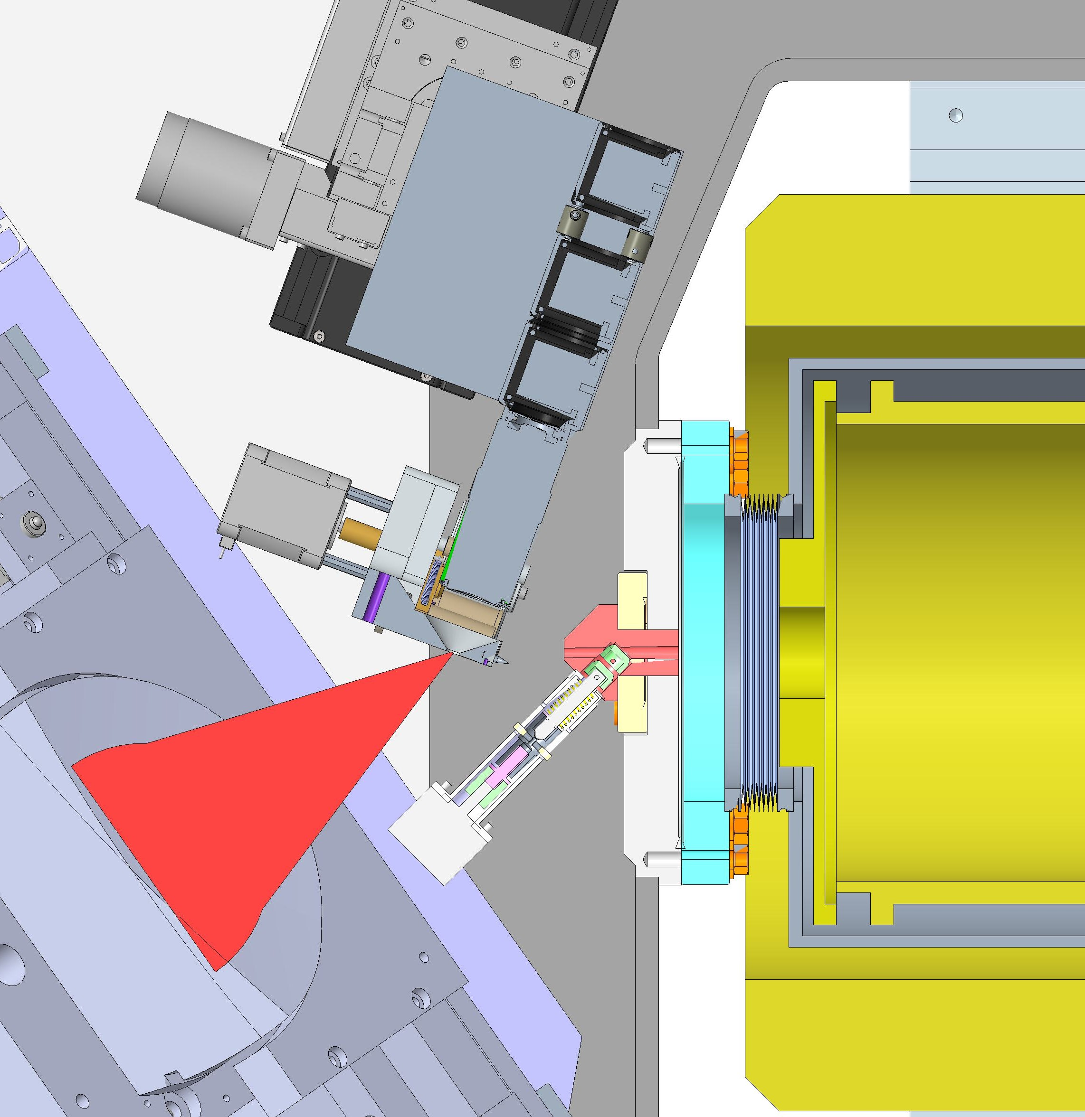
Flange Ø203
Flange Ø305
35°
Camera
35°
25.5
Nozzle and vacuum valve
100
Bellows

Slide 5
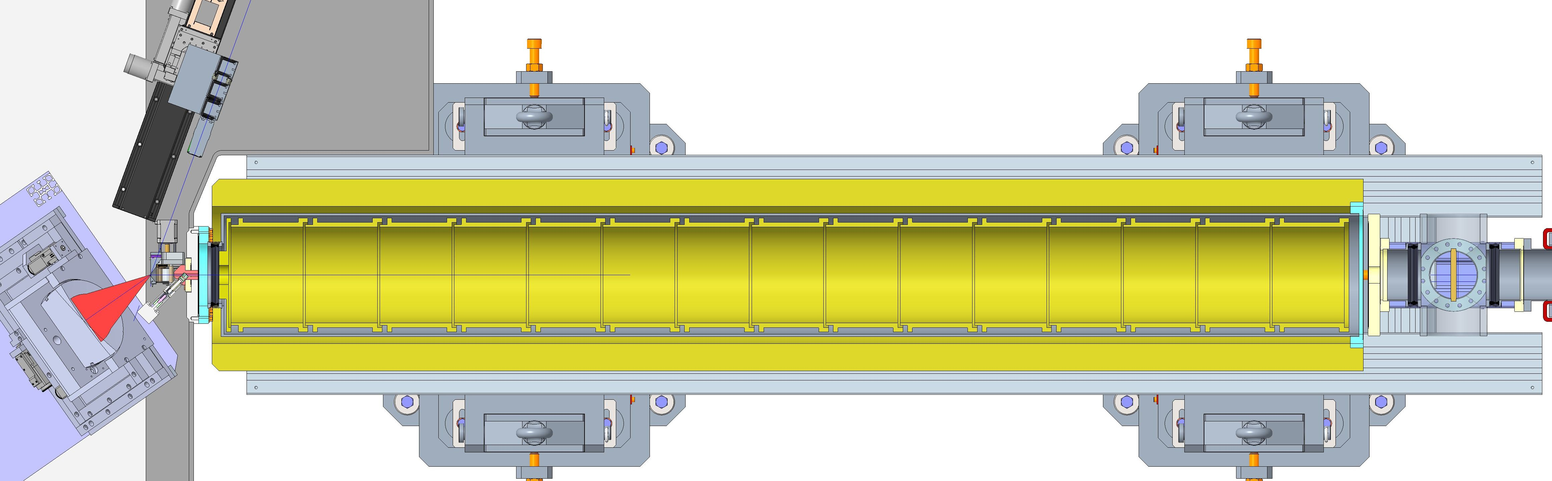
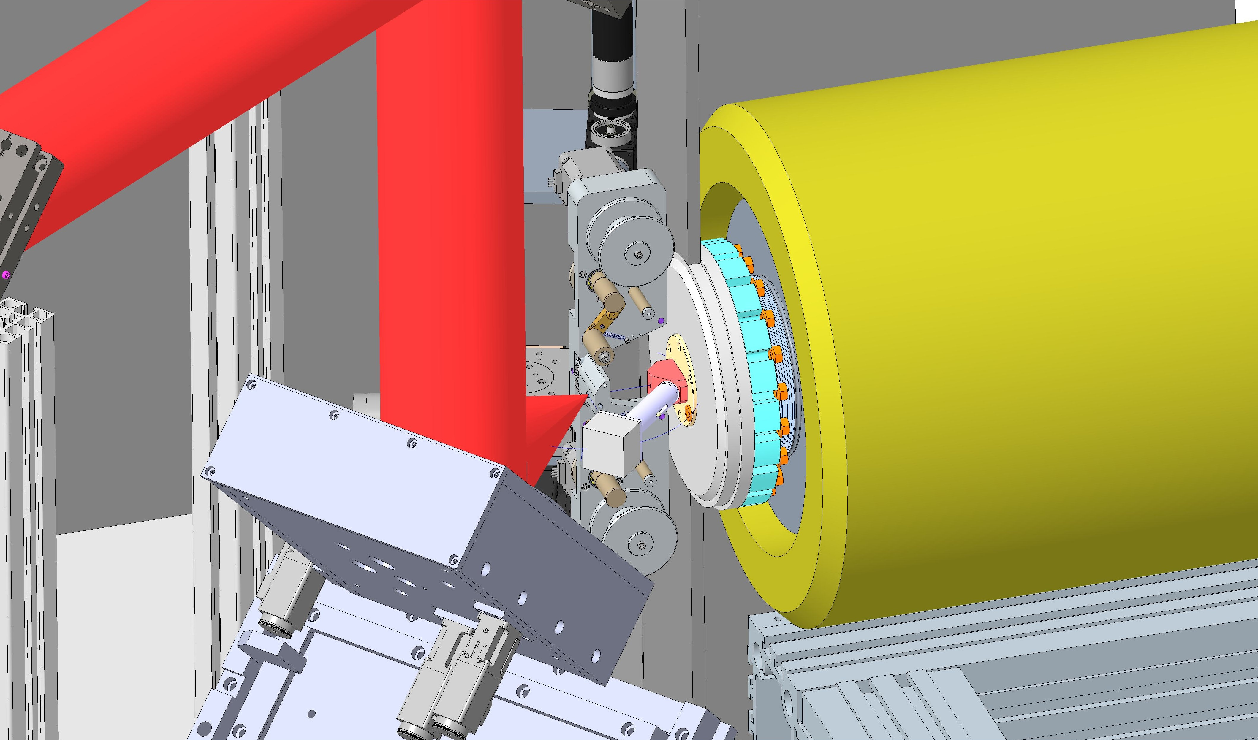
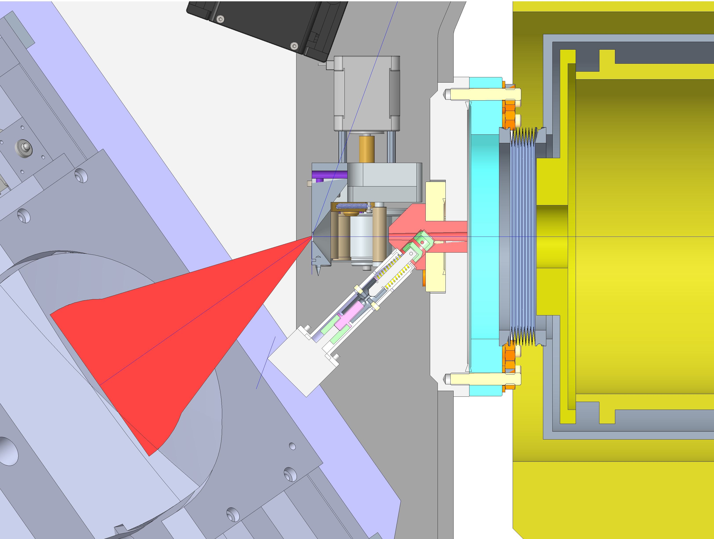
Flange Ø203
Flange Ø305
35°
Tape Target
Tape Target
35°
Vacuum valve and nozzle
100
Bellows

Slide 6
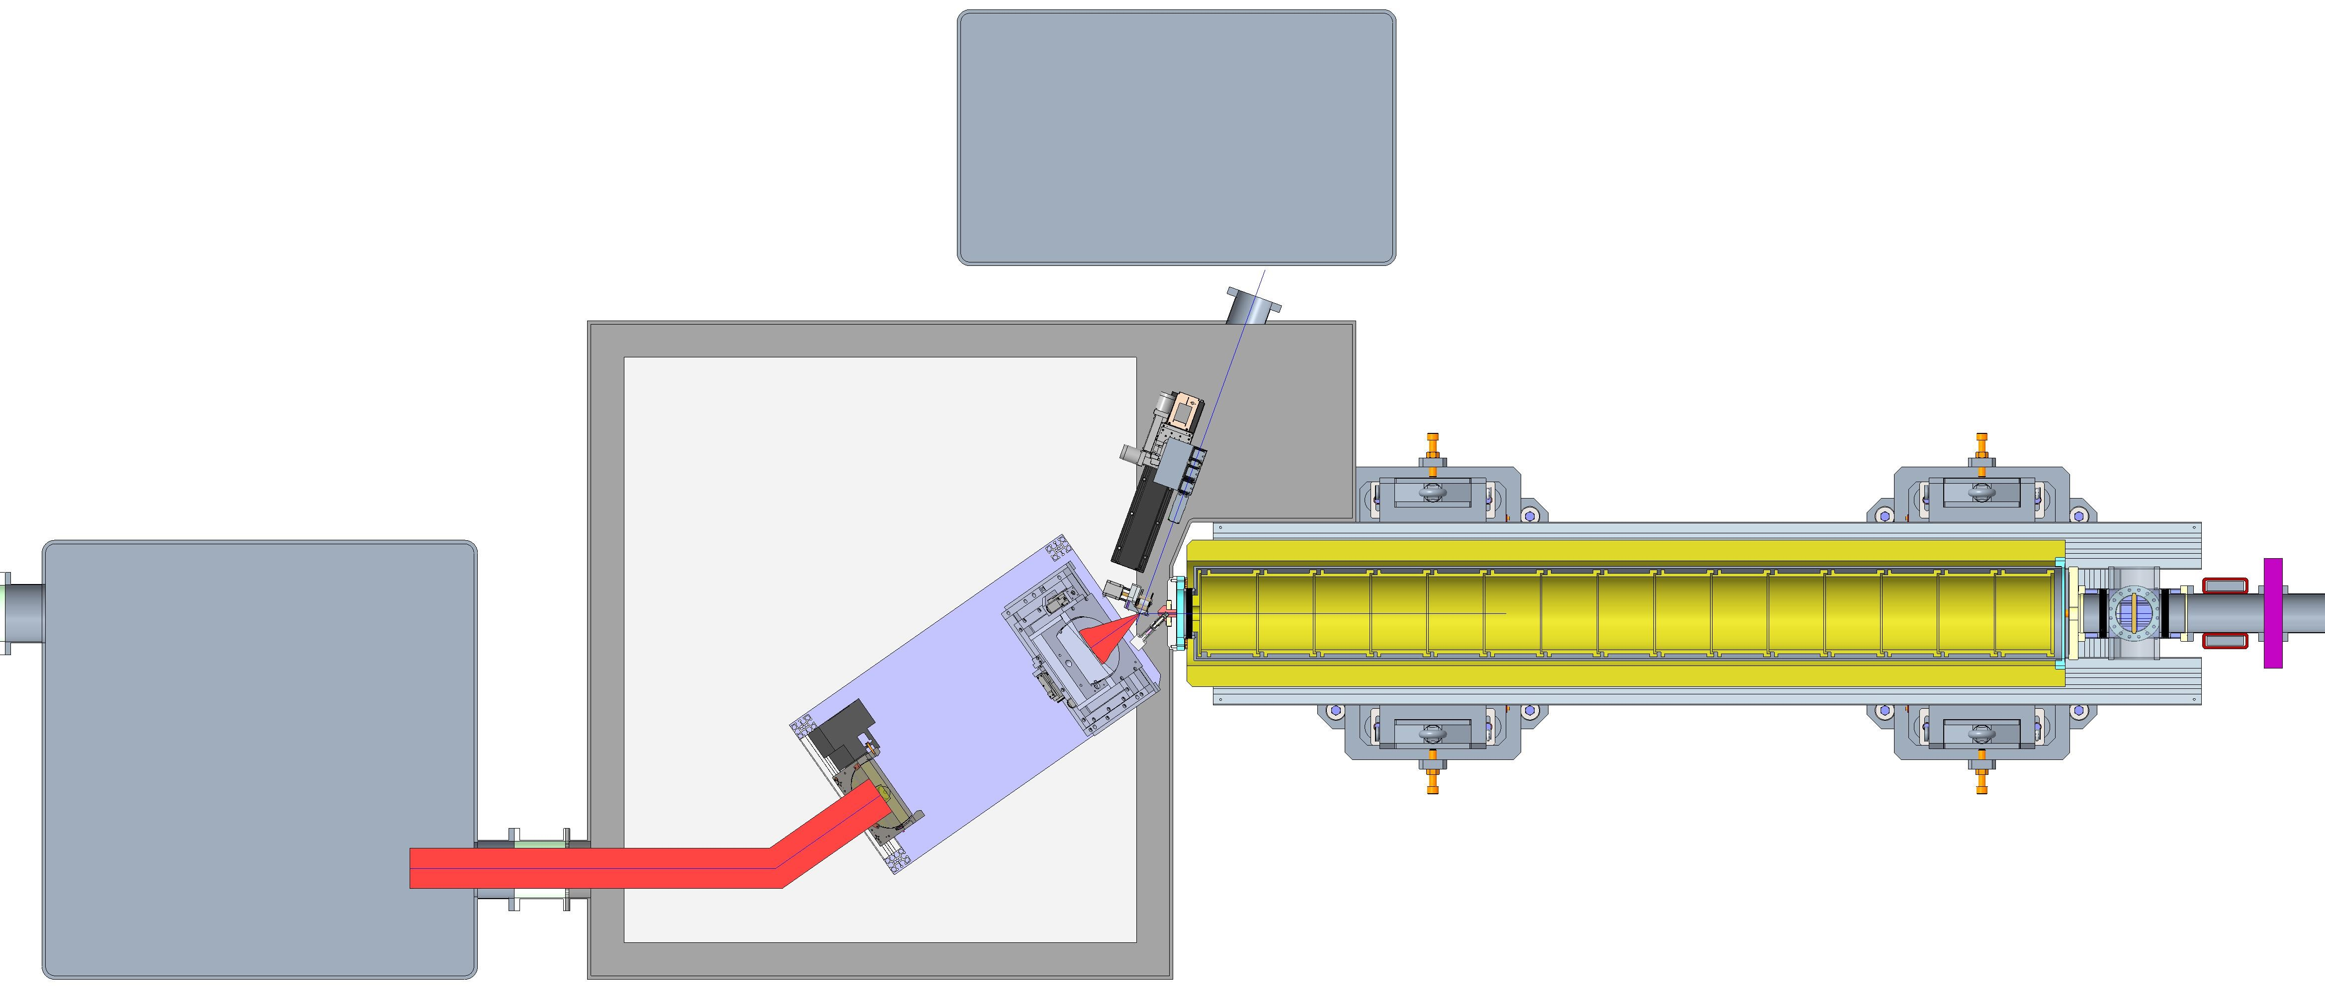
Diagnostics chamber
35°
35°

