Slide 1
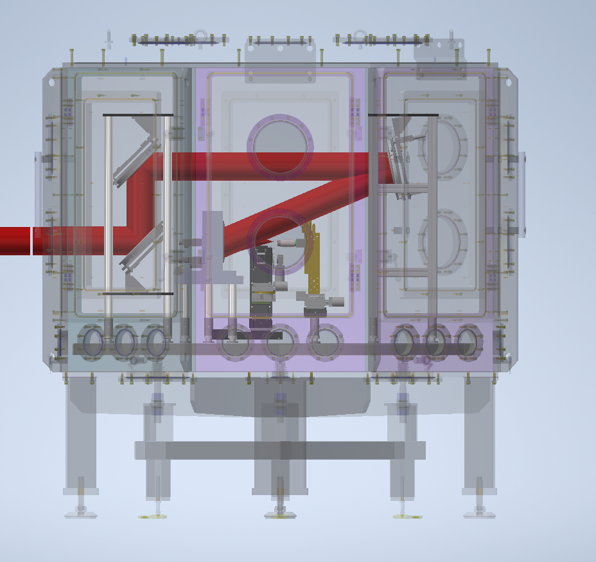
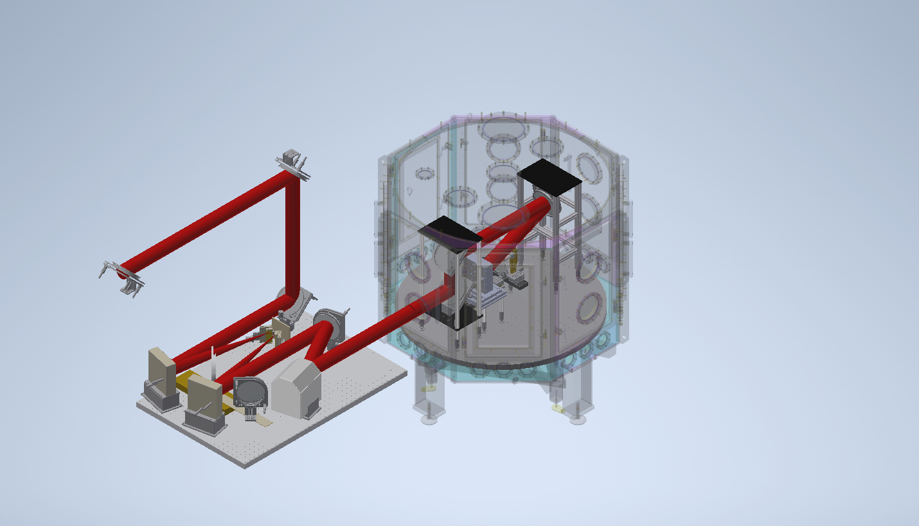
SCAPA beam layout…

Slide 2
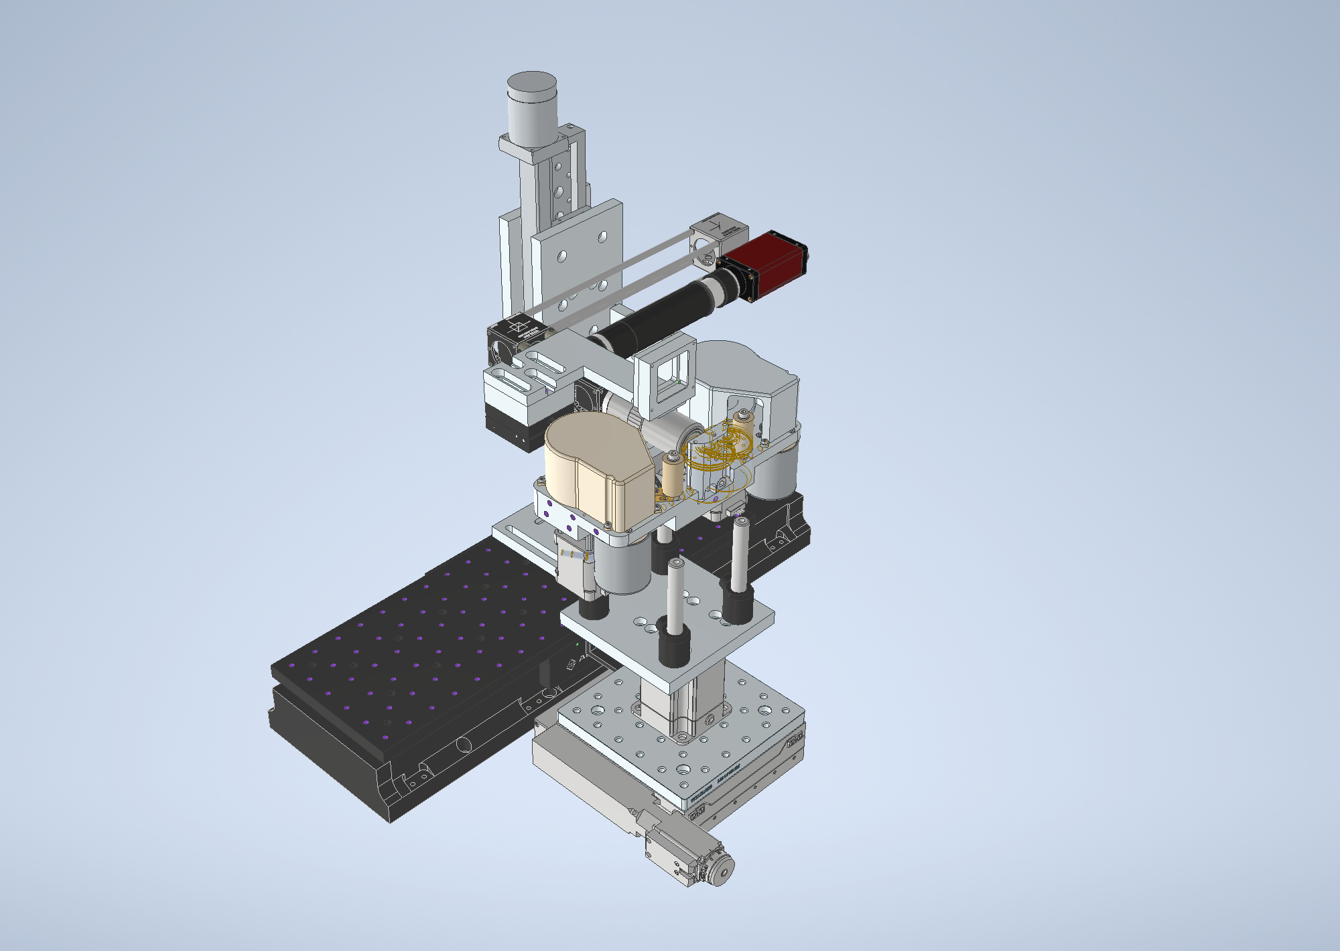
AO measurement line
Focal spot/target alignment camera
Tape Drive
Translation stage to move focal spot camera
XYZ translation for Tape

Slide 3
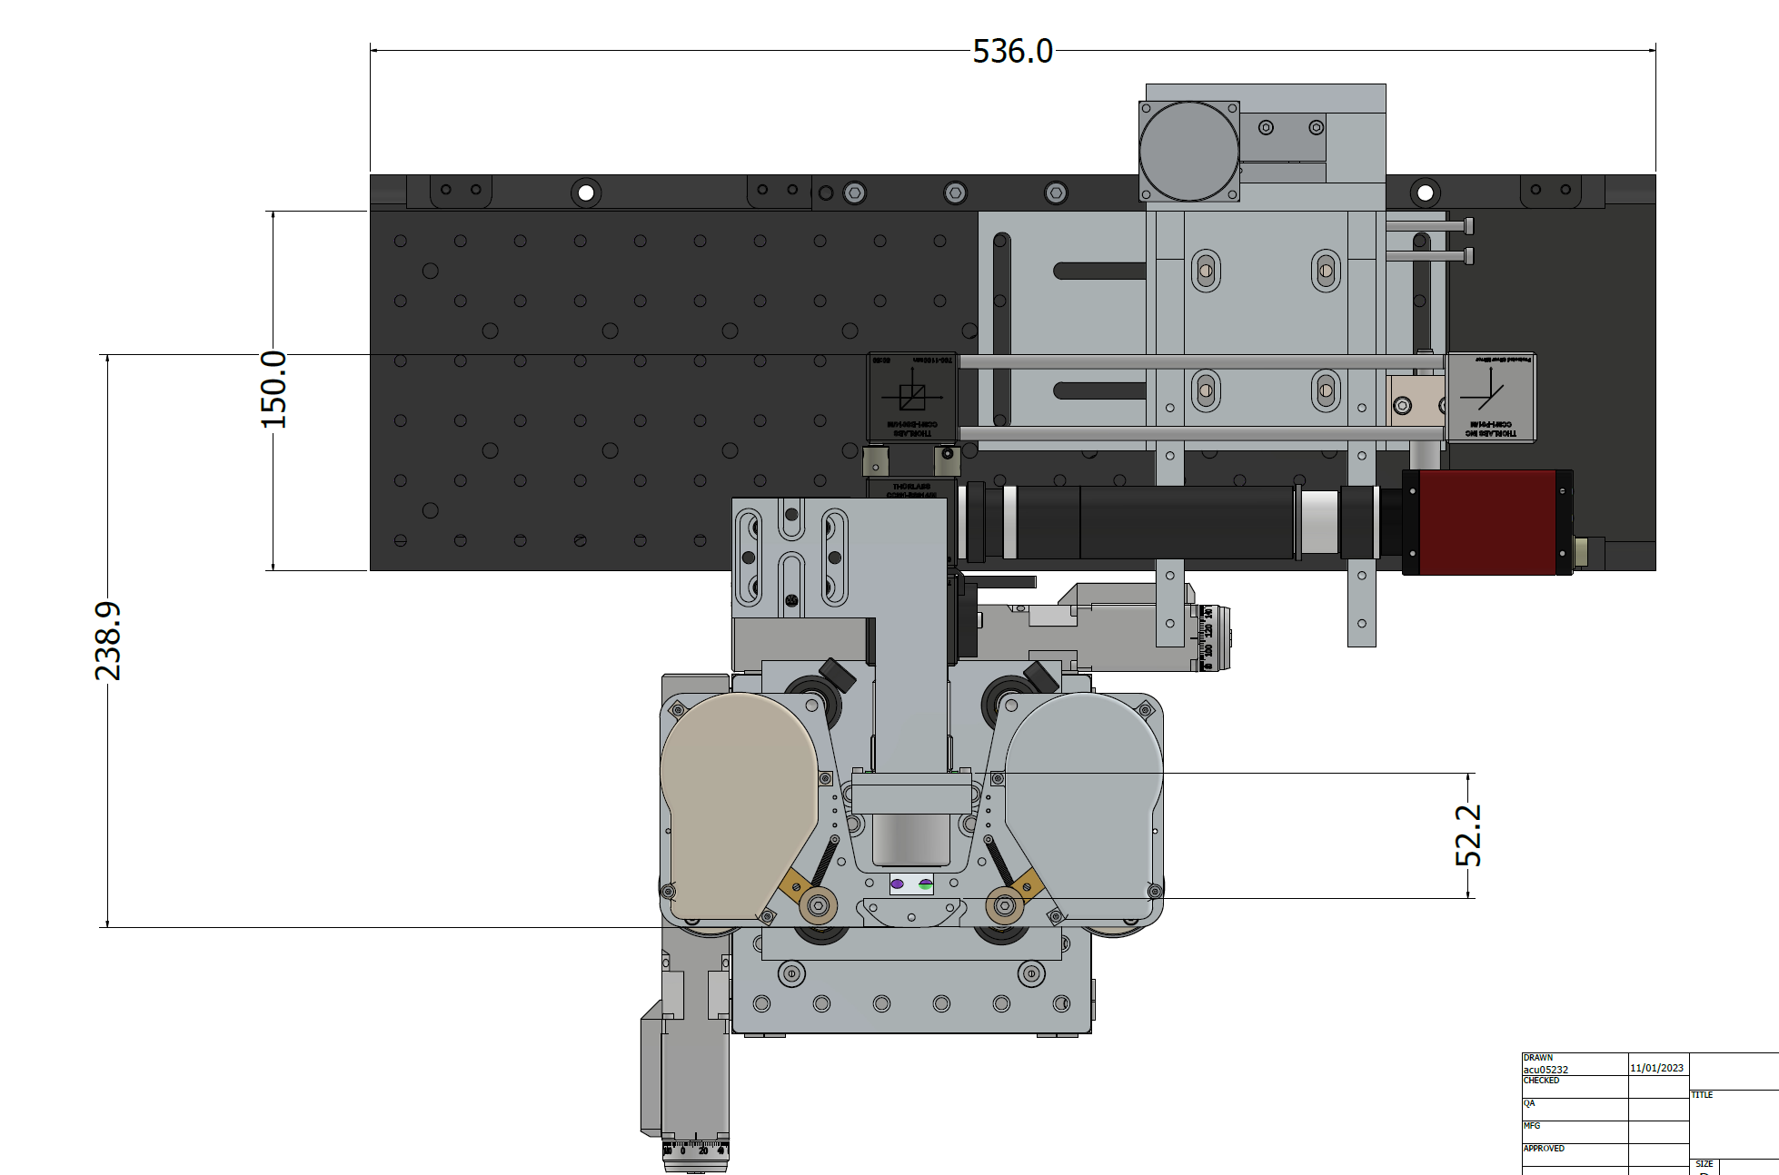
Example Tape drive/Focal Spot camera setup used on recent Gemini Campaign

Slide 4
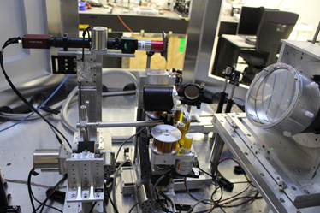
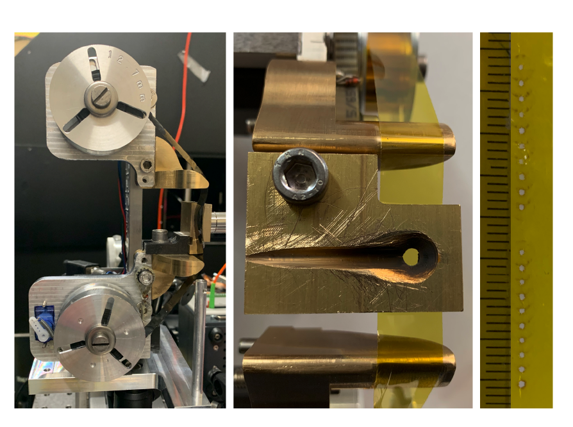
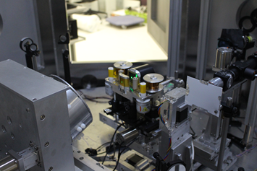
Example Tape drive/Focal Spot camera setup

Slide 5
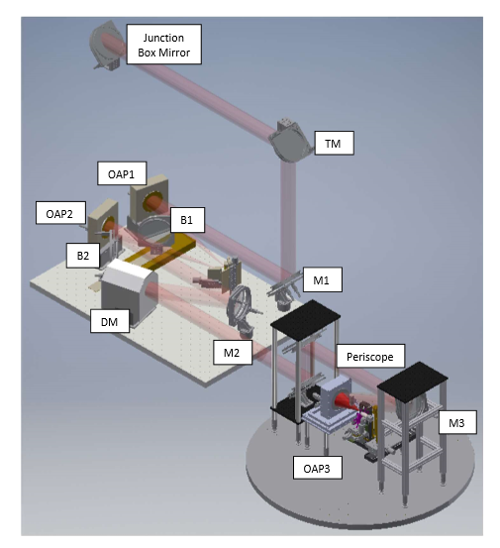
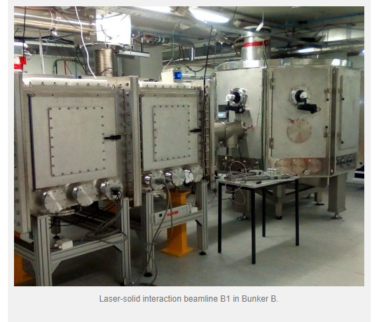
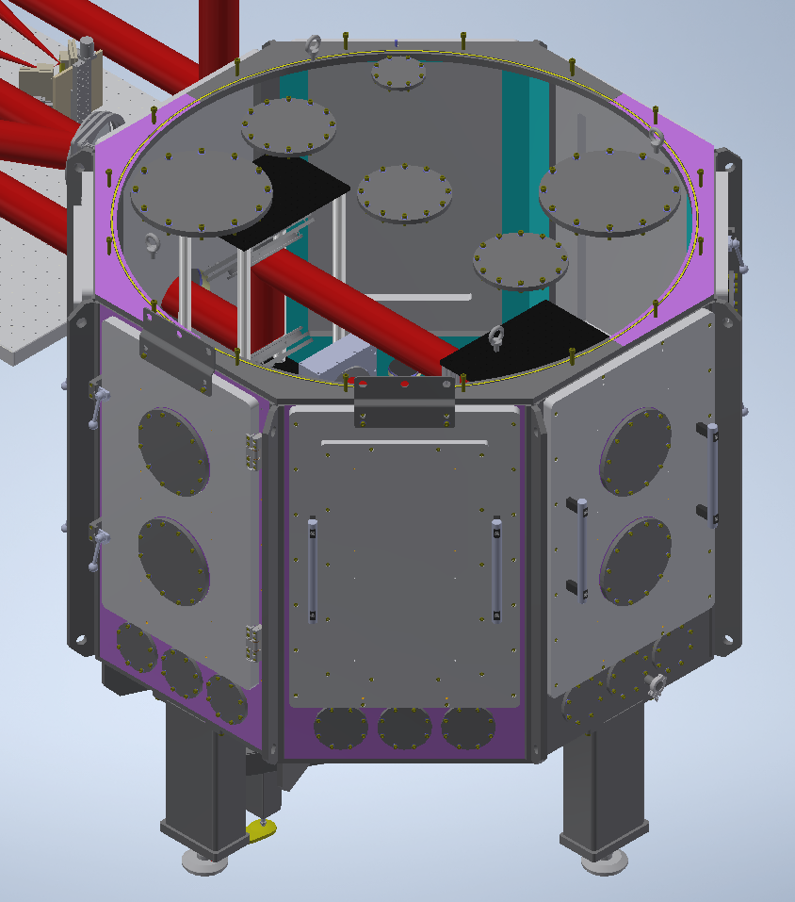
Vacuum considerations:
Main vacuum chamber on SCAPA ~= 1x10⁻⁶ – 1x10⁻⁷ mbar
Shot to shot changes in the pressure have yet to be measured but this data could be recorded if useful
Possible to operate as high as ~ 1x10⁻⁴ mbar ….. Lower pressures than 1x10⁻⁷ mbar would need investment and design

Slide 6
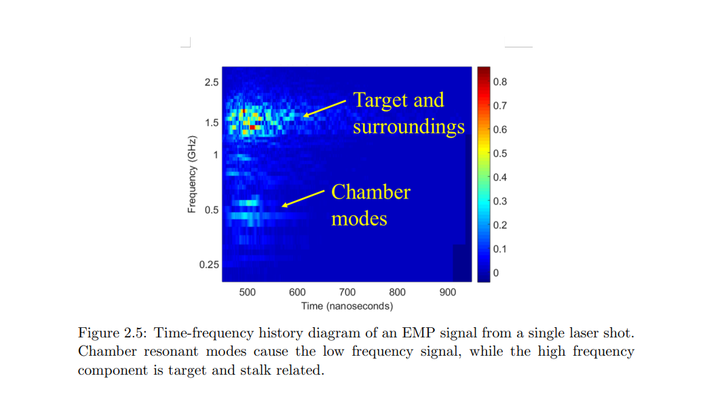
Magnetic field
Very strong magnetic fields close to TCC could affect operation of tape drive
Could consider some early tests placing a magnetic field (comparable to expected fringe fields) close to the interaction to check impact on systems and particle trajectory.
We generate relatively strong EMP on the shot and are the investigation of mitigations for this is an active area of study.

Slide 7
Desirable Changes
Largest possible solid angle for capture would help ease our ion number requirement
Flexible position of the nozzle so that the imaging diagnostics and be brought in
Space for an active diagnostic in front of the nozzle would enable online monitoring of the system performance (immediately after the target)
We need to consider solid angle for a second beam on the rear surface that might be used for contaminant control
We may also need access for a Thomson parabola spectrometer to give a detail spectral measurement for each ion species (could this be done at the end of the Gabor lens system when it is not operating?)

