Slide 1
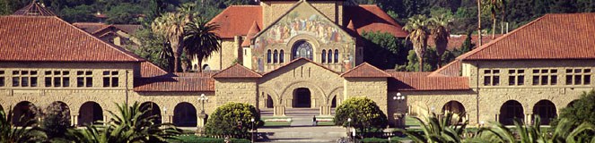
Hadron Therapy-UK
Stanford Oxford

Slide 2
Hadron Therapy
Conventional radiation therapy
  = photons (x- or γ rays) + electrons
Hadron therapy = Particle radiation therapy (particles heavier than electrons)
  Protons
  Carbon ions
  Other ions (helium, neon, silicon, iron, etc)

Slide 3
There is a strong rationale for the clinical benefit of proton and carbon therapies, but current evidence is limited
Therapy
Rationale for clinical benefit
Proton
  Deliver a higher, targeted radiation dose with decreased toxicity to surrounding tissue compared with photon therapy, especially near critical structures
Carbon
  Further increase target tissue damage with decreased secondary tissue affected compared with proton
  Specific potential benefit with intractable radio-resistant tumors

Slide 4
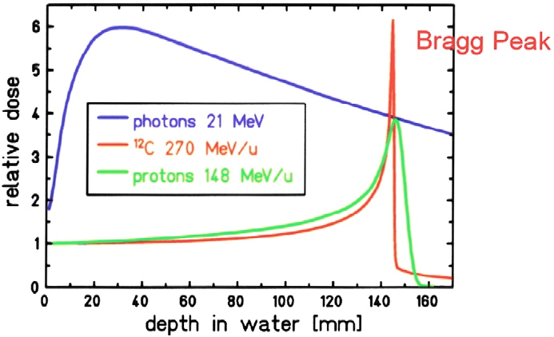

Dosimetry
Photons vs. Protons vs. Carbon

Slide 5
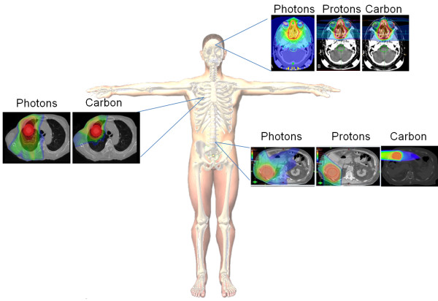
Superior Dose Distribution of Carbon Ions Compared to Protons and Photons

Slide 6
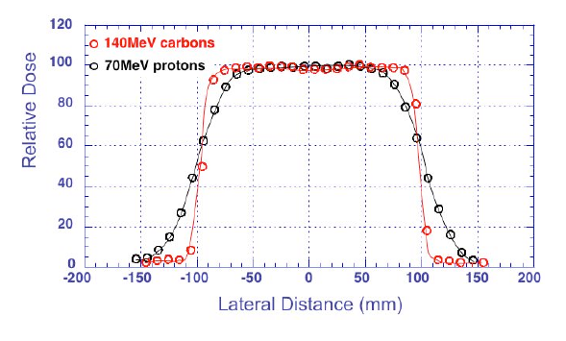
Carbon Ions Provide Highly Localized Tumor
Deposition of Dose (Sharper Transverse Edge)
Better Localization
  Tighter deposition in depth (Bragg peak is narrower)
  Transverse deposition is more narrowly collimated
  Less dose to the healthy tissue

Slide 7
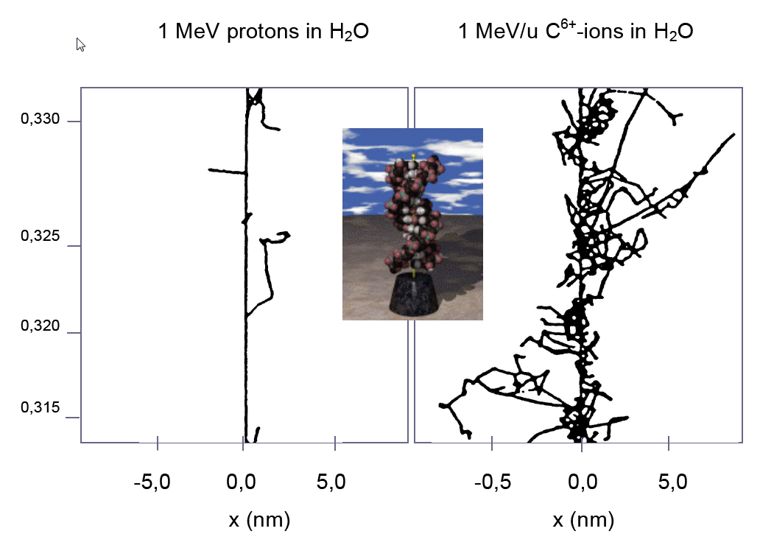
Carbon Ions Induce More Lethal Damage Per Unit Dose
than Photons or Protons
Increased Biological Effectiveness:
Relative Biological Effectiveness is 3 times protons
  Reduces # fractionations by ~ 2: greater patient throughput/compliance
  Countermands radio-resistance: non-repairable, double-strand breaks
Production of positrons permits active monitoring using PET

Slide 8
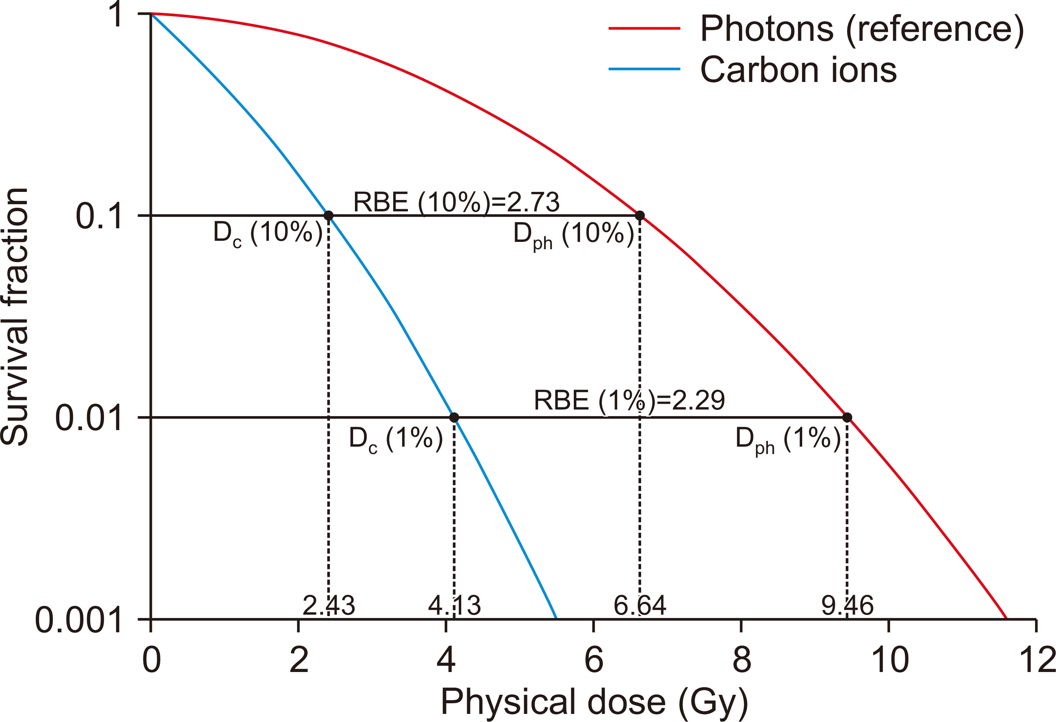
Cell Survival Based on the LQ model
Progress in Medical Physics 2020;31:1-7
Notes:
The photons and carbon ions are considered to be isoeffective when the survival fractions are identical. The ratio of isoeffective photon and ion dose is determined to be RBE. For instance, fixing the survival fraction to 10%, carbon ion RBE is 2.82 whereas fixing to 1%, respective RBE is 2.25. RBE, relative biological effectiveness; LQ, Linear Quadratic.

Slide 9
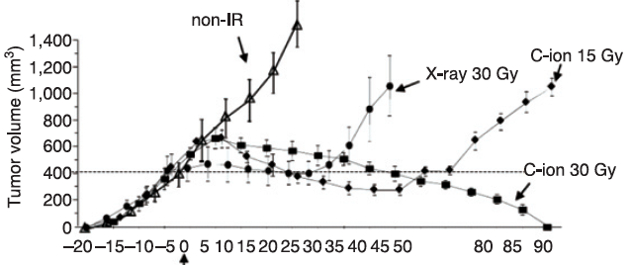
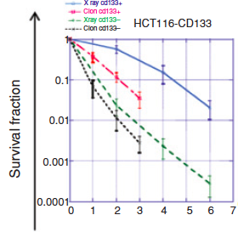
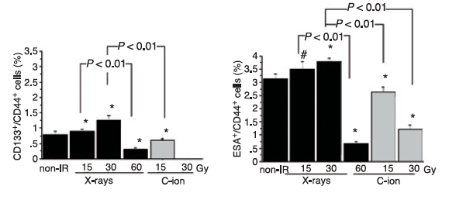
Carbon is More Effective In Killing Cancer Stem Cells
In vivo growth by beam type and dose
In vitro clonogenic survival
% putative CSC- like in vivo after RT
Cui X et al, Cancer Research 2011

Slide 10
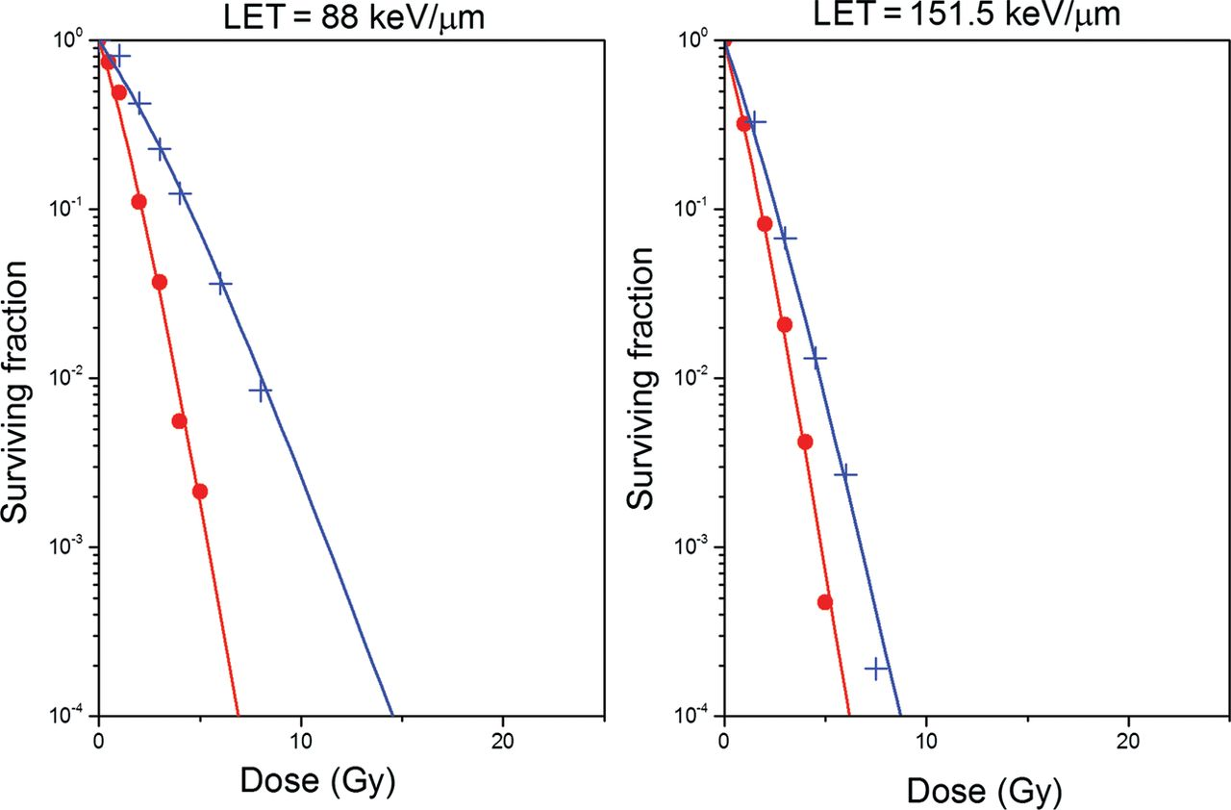
Survival of Cells Irradiated with Carbon Ions
in Oxic (red curves) and Hypoxic conditions (blue curves)
for Two Different LETs
Antonovic L et al. J Radiat Res 2013;54:18-26
Notes:
Survival curves for V79 cells irradiated with carbon ions in oxic (red curves) and hypoxic conditions (blue curves) for two different LETs predicted by the RCR parameterized model described by Equations 2–7.

Slide 11
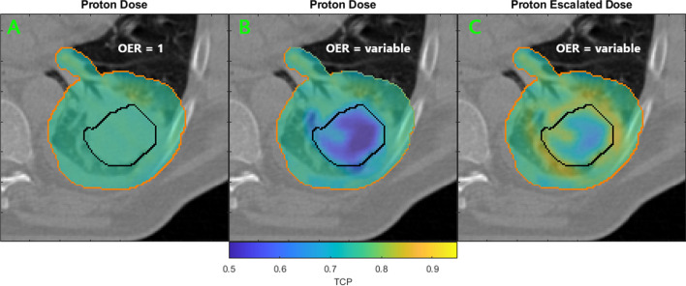
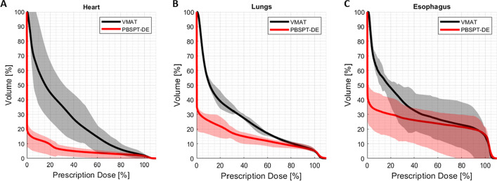
Example of Escalating Dose to Treat Hypoxic Tumor Regions
Kothe et al, 2021

Slide 12
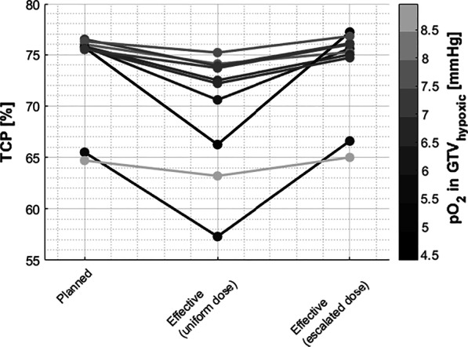
TCP for Patients with Uniform Dose vs Escalated Dose
Kothe et al, 2021

Slide 13
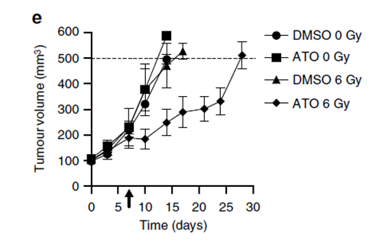
Effect of Mitochondrial Complex 1 and 3 Inhibitors on
Increasing Tumor RadiosensitivityBy Making tumors
more Oxic
How does combining LhARA proton/ion radiation with metabolic inhibitors radiosensitise
tumours?

Slide 14
Nrf2-Keap1 Pathway
Notes:
Nrf2/Keap1 signaling pathway. Under basal conditions, Nrf2 binds to Keap1 by its two motifs (ETGE and DLG) and activates Cul3‐mediated ubiquitination followed by proteasomal degradation. Under stress conditions, due to the modification of Keap1 cysteine residues, Nrf2 dissociates from Keap1 and translocates into the nucleus. Nrf2 then forms a heterodimer with sMaf protein and binds to ARE to initiate the transcription of various downstream genes

Slide 15
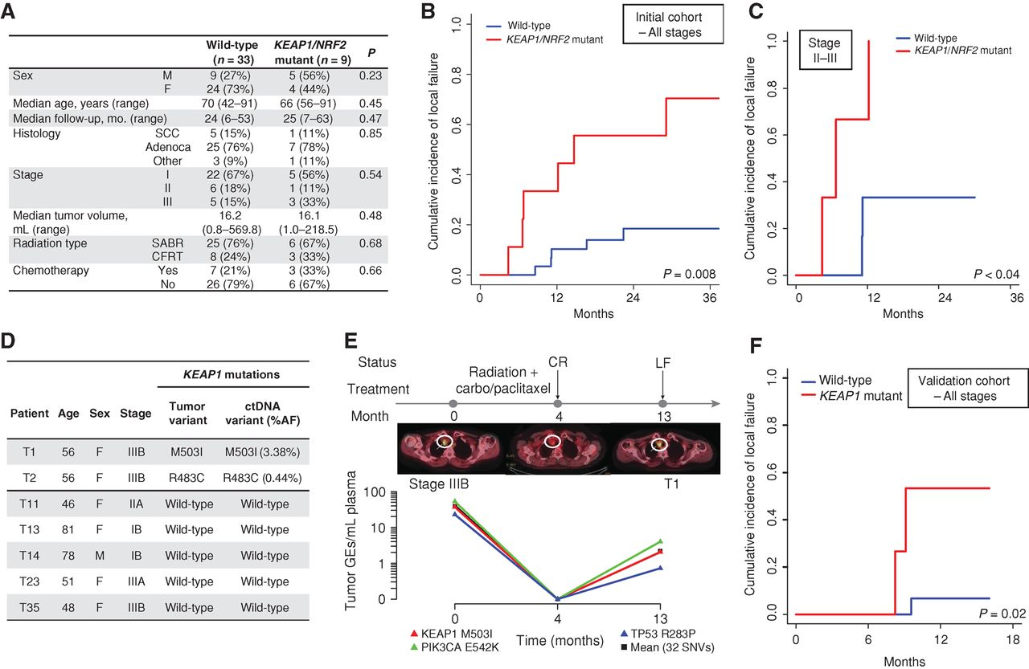
KEAP1/NRF2 Mutation Status Predicts Local Failure after Radiotherapy in Human NSCLC
Youngtae Jeong et al. Cancer Discov 2017;7:86-101
Notes:
KEAP1/NRF2 mutation status predicts local failure after radiotherapy in human NSCLC. A, Clinical characteristics of a cohort of patients with stage I–III NSCLC treated with curative intent RT and analyzed for KEAP1/NRF2 mutation status using targeted next-generation sequencing. B and C, Association of KEAP1/NRF2 mutations with local failure in patients with NSCLC treated with RT. B, Entire cohort. C, Stage II–III patients treated with conventionally fractionated radiotherapy or chemoradiotherapy. D, Noninvasive identification of KEAP1 mutation status in ctDNA isolated from pretreatment plasma samples of 7 patients from the cohort in A using CAPP-Seq. E, Monitoring of ctDNA in a KEAP1-mutant patient from D treated with chemoradiation. CR, complete response; LF, local failure; carbo, carboplatin. F, Clinical characteristics of a validation cohort of patients with stage I–III NSCLC treated with curative intent RT and analyzed for KEAP1/NRF2 mutation status using targeted next-generation sequencing.

Slide 16
Combining Ion Therapy with Immune Checkpoint Inhibitors
Notes:
Ionizing radiation increases the release of cytokines and pro-inflammatory molecules from tumor cells that recruit antigen presenting cells and immune effector cells to the tumor microenvironment. In addition, ionizing radiation increases the release and presentation of tumor antigens that can trigger tumor-specific immune responses. Immune checkpoint inhibitors such as anti-PD-1 and anti-CTLA-4 antibodies synergize with radiation by blocking T cell inhibitory signals. Immune cells can help to kill tumors at the site of radiation, and radiation may trigger systemic tumor-specific immune responses that could lead to regression of metastatic disease outside of the radiation field.

Slide 17
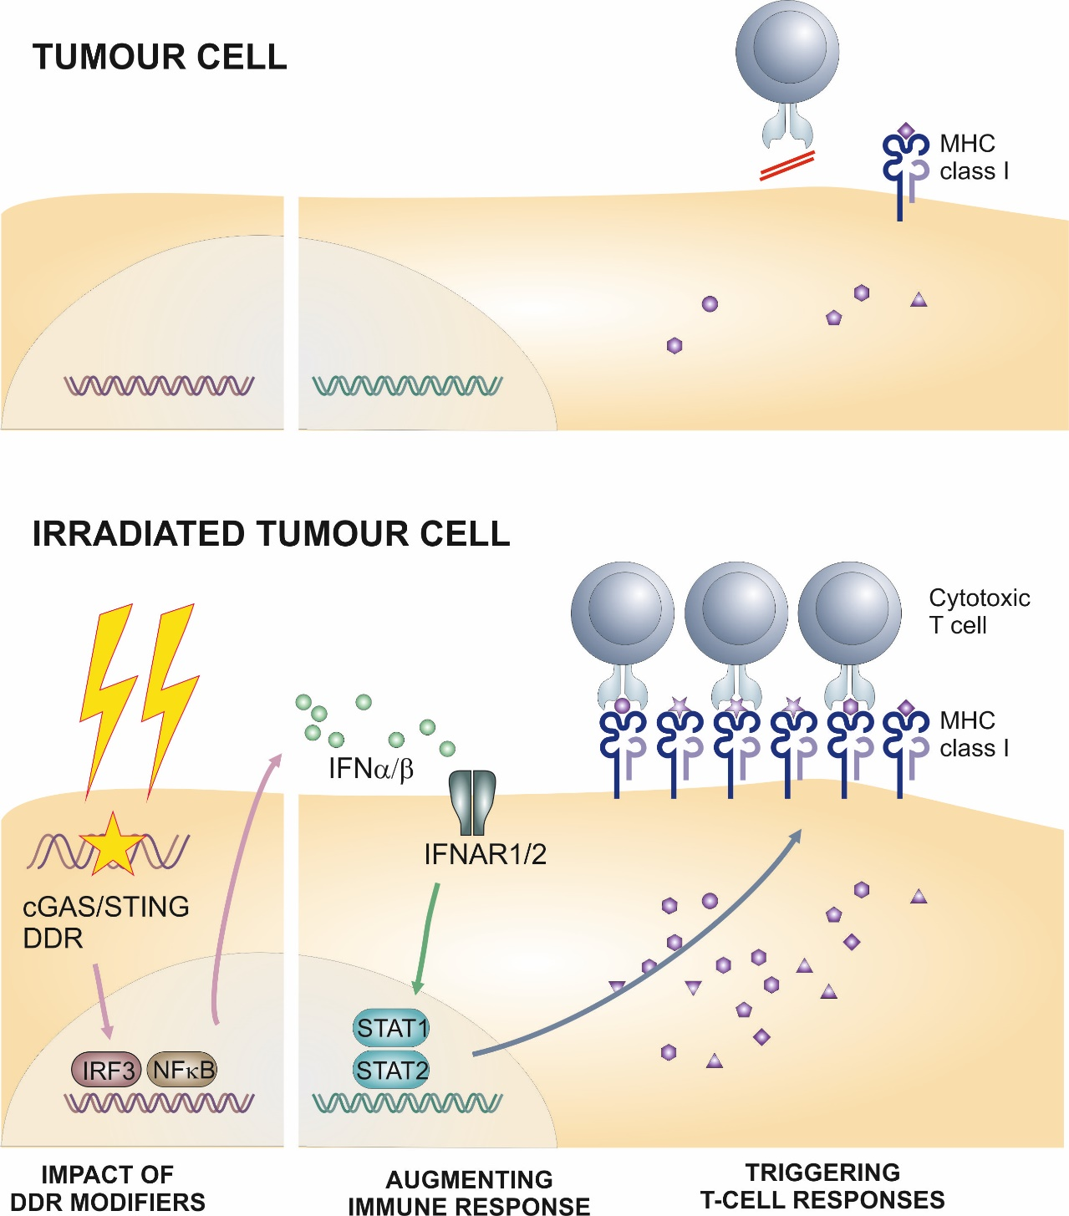
Increasing Tumor Antigen/Neoantigen Formation after Heavy
Ion Exposure

Slide 18
  Objective: To Increase the Therapeutic Index of Radiotherapy
(Temozolomide)
(SBRT)
(Hadron Therapy)
100
75
Tumor
Probability of Tumor Control
or Normal Tissue Damage (%)
Normal Tissue
50
(Amifostine)
(Hadron Therapy)
(FLASH)
25
0
A
B
C
Cumulative Dose
Hall and Giaccia, 2019

Slide 19
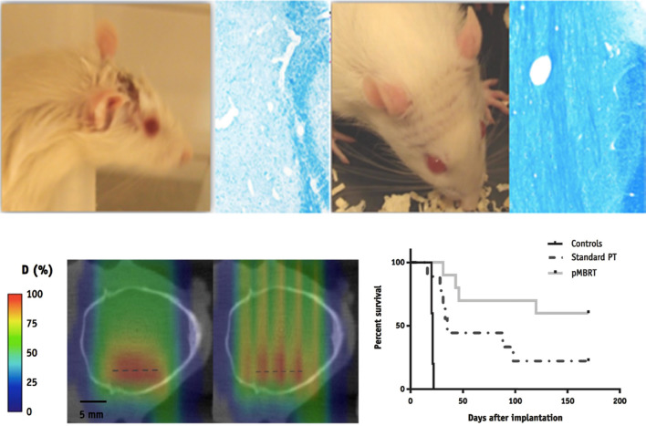
Response to Proton Minibeam Irradiation
Br J Radiol. 2020 Mar; 93(1107)
Notes:
Response to minibeam irradiations : (a) normal tissues: while there is a moist desquamation and a permanent epilation with conventional irradiation, there is no skin damage and a reversible epilation with minibeams (Prezado, personal comm.), In blue: destruction of the myelin after conventional irradiation and normal myelin organization after minibeams irradiation¹⁰⁴ . (b) evaluation of tumour control: coronal 2D dose distributions in the computed tomography images of a rat’s head corresponding to a conventional (seamless) irradiation (left) and a proton minibeam radiation therapy (pMRBT) irradiation (right). (c) Survival curves for the controls, standard PT and pMBRT irradiated tumour-bearing rats.
“proton minibeam radiation therapy” (pMBRT)⁹⁵ offers the possibility to (a) maintain the spatial fractionation of the dose at the entrance of the beam and in the beam path; (b) produce a more uniform dose than synchrotron radiation in a target at depth (where the multiple scattering of protons makes a wider minibeam); (c) achieve a higher dose at any depth than in the path; and (d) preserve tissues after the target by the inherent property of a determined range of proton beams^{95–98}

Slide 20
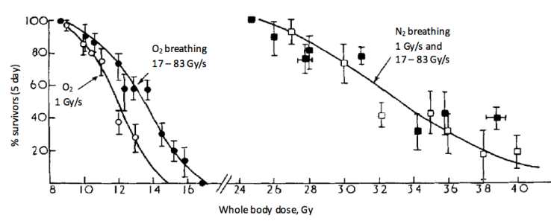
Hornsey S, Bewley DK. Hypoxia in mouse intestine induced by electron irradiation at high dose-rates. Int J Radiat Biol Relat Stud Phys Chem Med. 1971;19(5):479-483.
The Origins of FLASH Radiotherapy
Notes:
Fraction of mice surviving 5 days after whole-body irradiation delivered at different dose rates while animals breathing oxygen or nitrogen.

Slide 21
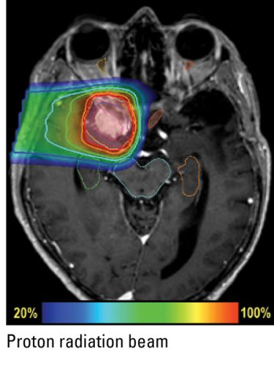
Treating Deep-Seated Tumours with Proton-FLASH
Problems/challenges:
    Scanning/scattering needed to cover the target volume
      Dose rate decreases!
    Several beam energies needed to cover the target volume in depth
      Dose rate decreases!
    Several beams needed for dose conformity
      Dose rate decreases!
      Takes time to change beam angle.

Slide 22
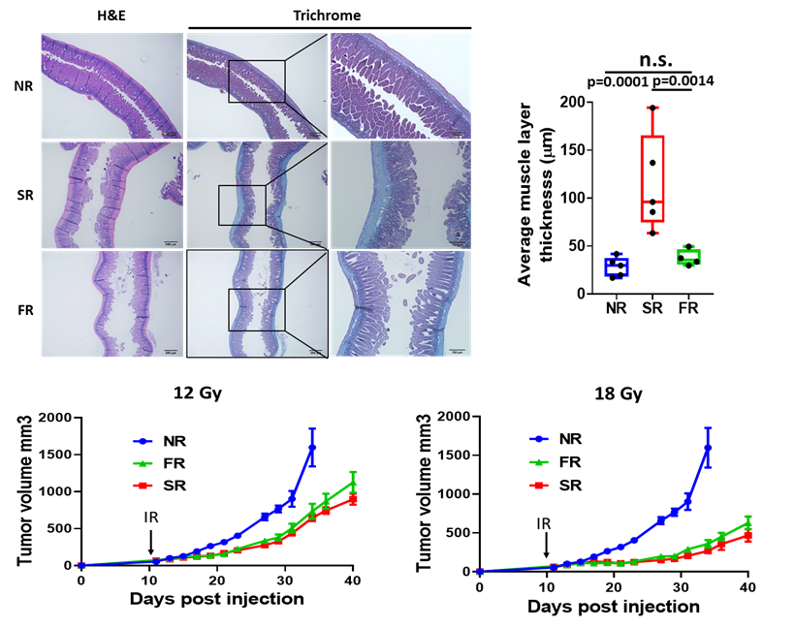
Flash-Proton Radiotherapy Highly Effective in Controling Pancreatic Tumor Growth and Reduces Normal Tissue Toxicity
Koumenus et al, unplublished

Slide 23
Clinical Data for Carbon
Tumor Site | # Studies | # Pts | Results
Occular | 2 | 114 | Similar to proton
CNS | 4 | 218 | Similar to proton
Prostate | 3 | 1384 | Excellent results for high risk, less toxicity than proton/photon
HCC | 1 | 64 | High local control
Lung (NSCLC) | 2 | 129 | Maybe better than proton
HNC | 1 | 236 | High LC – ACC, melanoma
Chordomas | 3 | 38 | Similar to proton

Slide 24
Ongoing Trials for Carbon
Tumor | Phase | N | Design | Endpoint | Site
Prostate | II | 90 | Carbon vs. Proton | Toxicity | Heidelberg
Skullbase Chondrosarc | III | 154 | Carbon vs. Proton | LPFS | Heidelberg
Skullbase Chrodoma | III | 319 | Carbon vs. Proton | LPFS | Heidelberg
Salivary Gland CA | I | 54 | IMRT + Carbon boost | Safety | Heidelberg
HCC | I | 33 | Carbon | MTD | Heidelberg
GBM | II | 150 | CRT + Carbon vs. Proton boost | 1 yr OS | Heidelberg, RTOG
HNC | II | 50 | TPF + RT + Cetux + Carbon Boost | LRC | Heidelberg

Slide 25
Summary: Clinical Data for Hadron Therapy
For most tumors, carbon ion therapy results in improved local control and decreased toxicity in comparison to photons or protons.
In some intermediate- and high-risk cancers, the clinical data suggests a survival advantage for carbon ion.

Slide 26
What Does Hadron Mean to UK
UK is a unique place that could lead by bringing a laser driven technology to produce ions to the clinic: strengths in physics, engineering, science, and medicine
Hadrons can solve the problem of how to deliver a higher RBE particle, increase tumor control & spare normal tissue at the same time
If we don’t embark on this opportunity now, we risk missing the opportunity to be leaders in the revolution of particle therapy for solid tumors & will struggle to be passengers
Strategically, we would be in a more advantageous position than relying solely on protons, which may ultimately may be best suited for pediatric and certain tumors

Slide 27
Superior Dose Depth Distribution
& Physical Beam Characteristics
Increasing the
Patient Experience
-Higher LET
-Superior RBE
-Low OER
-Narrow penumbra
-New Lhara Ion therapy
-Less toxicity
-Given in short period of time
-Cost effectiveness research
Physics
Clinical Biology Research
-Beam characterization
-Beam heterogeneity
-Dose limitations
-Toxicity
-Which tumor histologies benefit most
-Does it overcome tumor microenvironment
-Development of new clinical trial design
Multidisciplinary
UK
Lhara- Ion
Therapy
Program
Radiobiological Research
-Development of radioprotectors
-Carbon ion interaction with diff tissues
-Metabolism
-Microenvironment
-CSCs
Clinical Physics Research
-Dose and treatment planning
-Development of IMCT
-Absorbed Dose Calculations
-Modeling RBE
Engineering
-Gantry design
-Miniaturization
STFC/UKRI/ITRF
Material Science
Radiology
-Beam Production
-Beam Delivery
-Accelerator miniaturization
-Active and Passive Beam Shaping
-Target Production
-Substance lighter than
concrete, but just as effective
-Ionacoustic Imaging
-Positron imaging
-Dose distribution

Slide 29
Carbon Ion Therapy Overcomes Radiation Resistance of Hypoxic Tumors?
Nakano et al, 2006

