Slide 1
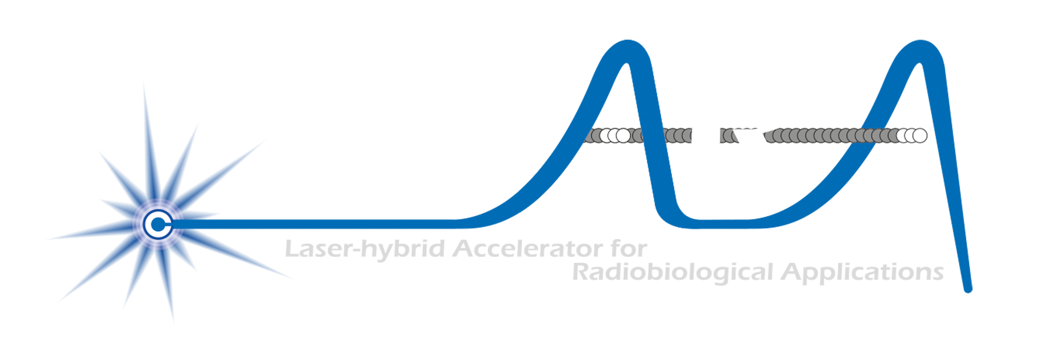
The Laser-hybrid Accelerator for Radiobiological Applications (LhARA)
C Whyte for the ITRF/LhARA Collaboration
ITRF
/

Slide 2
Radiotherapy; the challenge
Cancer: second most common cause of death globally
  Radiotherapy indicated in half of all cancer patients
Significant growth in global demand anticipated:
  14.1 million new cases in 2012 ⇢ 24.6 million by 2030
  8.2 million cancer deaths in 2012 ⇢ 13.0 million by 2030
Scale-up in provision essential:
  Projections above based on reported cases (i.e. high-income countries)
  Opportunity: save 26.9 million lives in low/middle income countries by 2035
Provision on this scale requires:
  Development of new and novel techniques … integrated in a
  Cost-effective system to allow a distributed network of RT facilities
Atun, Lancet Oncol. 2015 Sep;16(10):1153-86

Slide 3
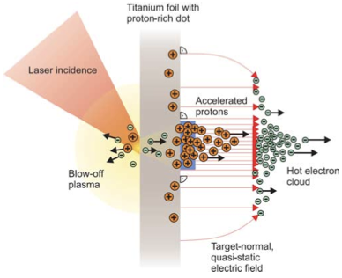
Our ambition is to:
Deliver a systematic and definitive radiation biology programme
Prove the feasibility of laser-driven hybrid acceleration
Lay the technological foundations for the transformation of PBT
  automated, patient-specific proton and ion beam therapy

Slide 4

The case for fundamental radiobiology
Relative biological effectiveness:
  Defined relative to reference X-ray beam
Known to depend on: Energy, ion species, Dose & dose rate, tissue type, biological endpoint
Yet: p-treatment planning uses 1.1
  Effective values are used for C⁶⁺
Maximise the efficacy of PBT now & in the future: Develop systematic programme of radiobiological measurements
Paganetti, van Luijk (2013) SemRadOncol

Slide 5
What is LhARA?
Laser-driven, high-flux proton/ion source
  Overcome instantaneous dose-rate limitation
    Capture at >10 MeV
  Delivers protons or ions in very short pulses
    Bunches as short as 10—40 ns
  Triggerable; arbitrary pulse structure
Novel “electron-plasma-lens” capture & focusing
  Strong focusing (short focal length) without the use of high-field solenoid
Fast, flexible, fixed-field post acceleration
  Variable energy
    Protons: 15—127 MeV
    Ions: 5—34 MeV/u
Front. Phys., 29 September 2020; DOI: 10.3389/fphy.2020.567738

Slide 7
Source: simulation
PhysRevLett.90.185002
R&D objectives:
“Full-scale” tests in conditions approaching LhARA specification
LhARA-focused diagnostic and targetry development
High-repetition rate, automation and longevity studies
Accurate numerical modelling 3D simulation codes
Realistic, 2-stage simulation on ARCHER2 using accurate “pre-plasma” profile
Study proton production as a function of angle of incidence, spot size, proton-layer thickness
Seek to benchmark against data

Slide 8
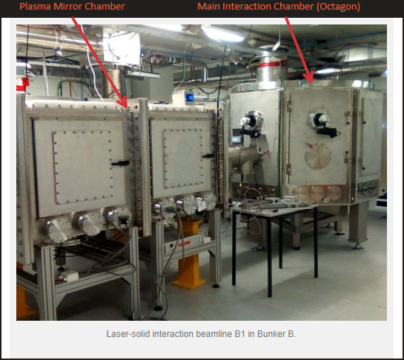
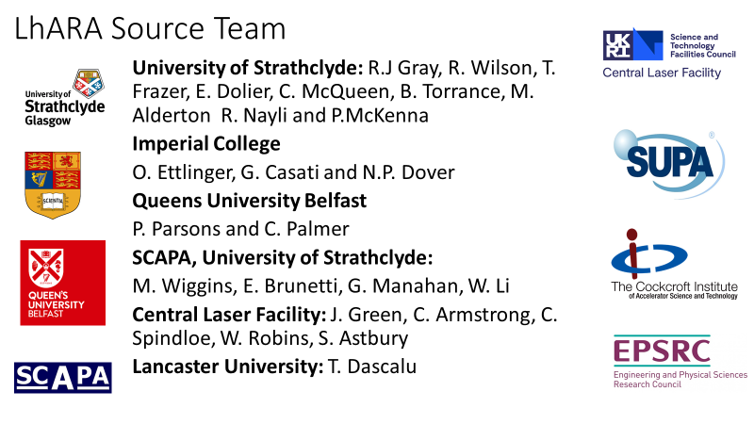
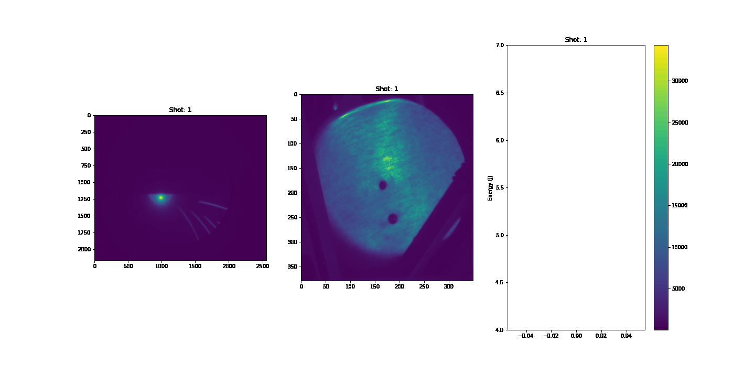
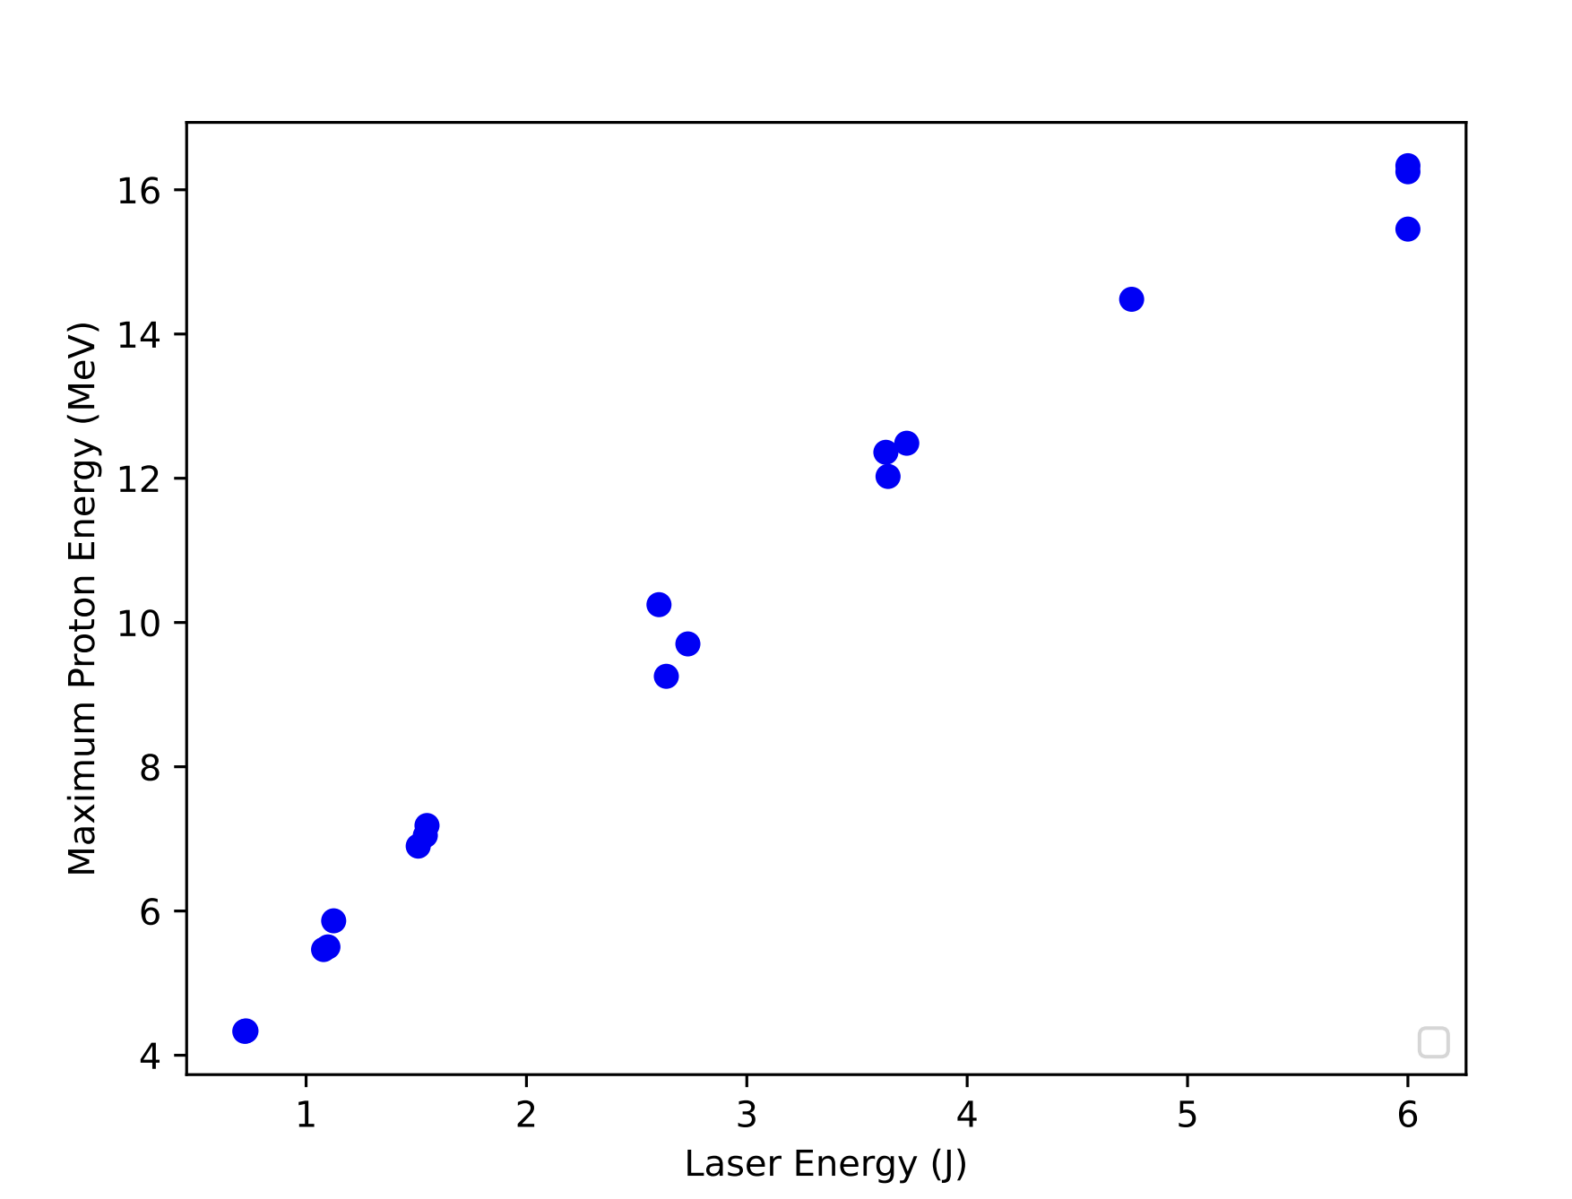
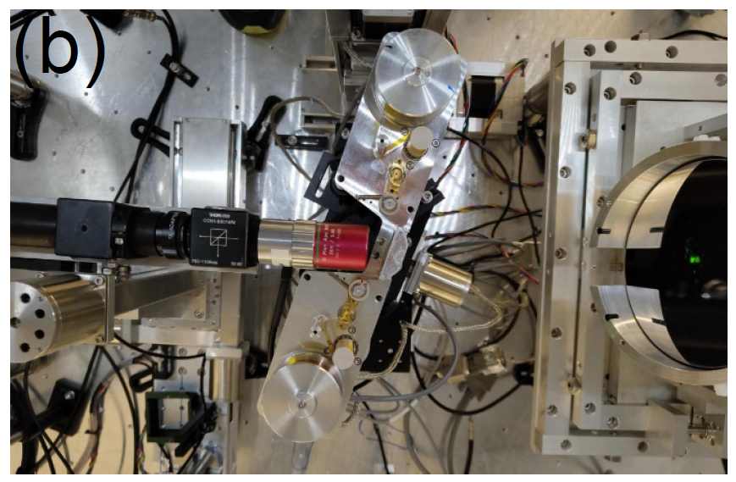
Source: experiment
Laser energy
R. Gray

Slide 9
Source: diagnostics & high rep-rate
Diagnostics
High-rep rate / longevity …
Scintillators: key for high rep rate operation
Dedicated calibration effort led by
N. Dover (ICL):
  Birmingham MC40 cyclotron

Slide 10
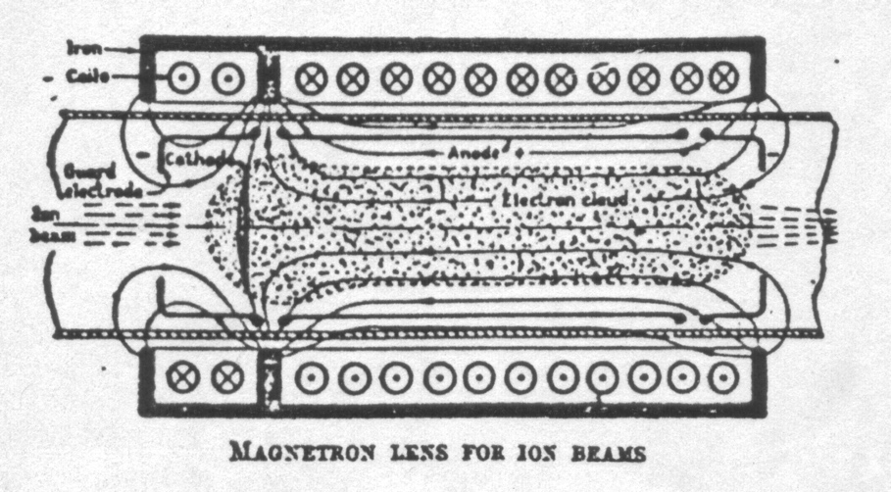
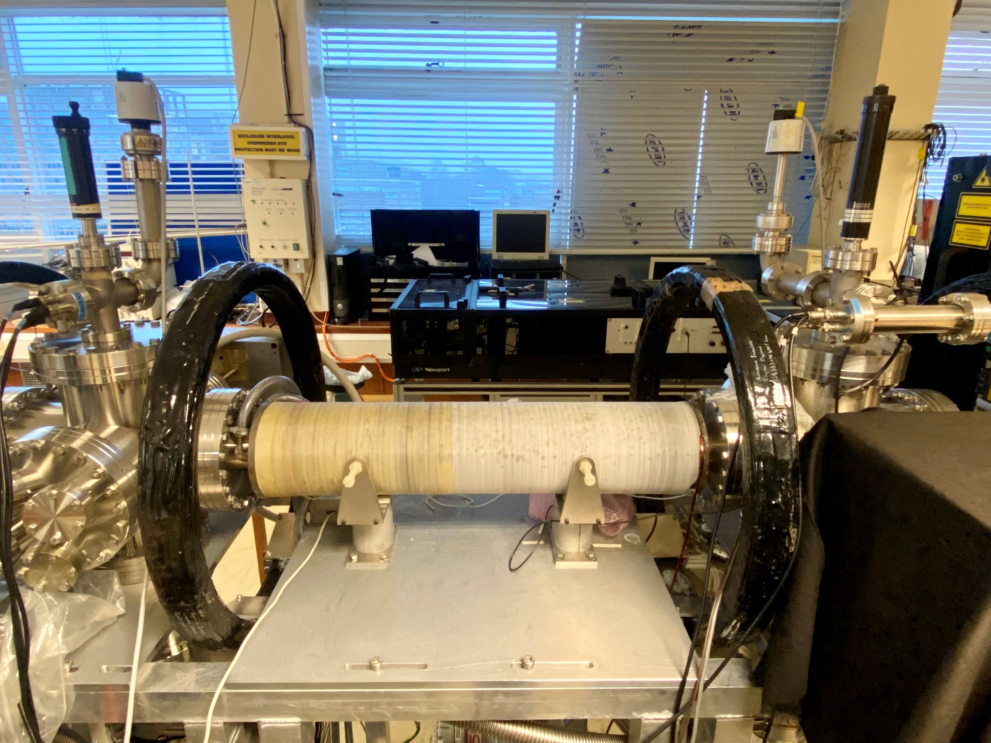
Capture
“Electron-plasma” (Gabor) lens:
  Strong focusing exploiting electron
  gas in “Penning/Malmberg” trap
Gabor
1957

Slide 11
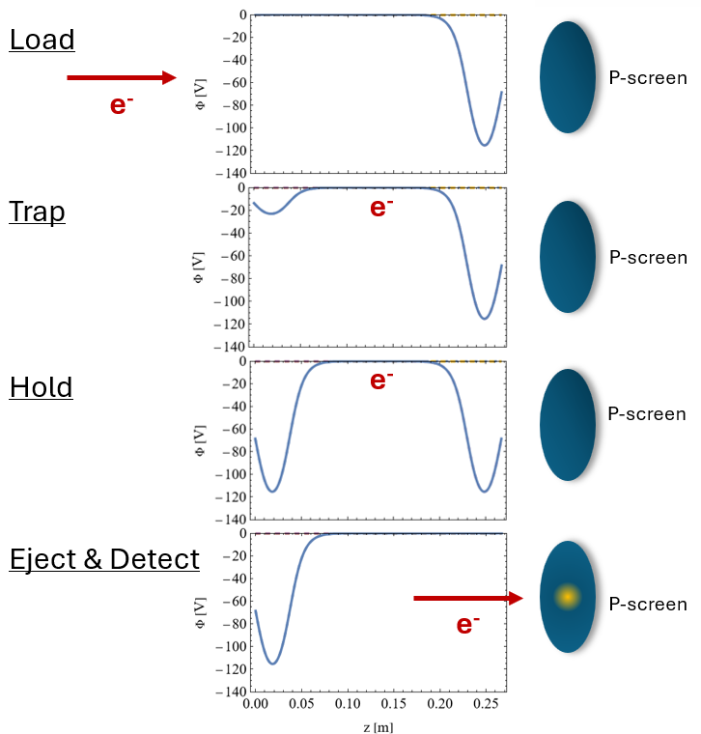
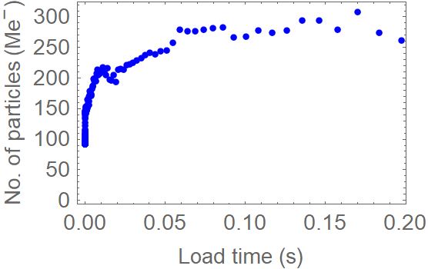
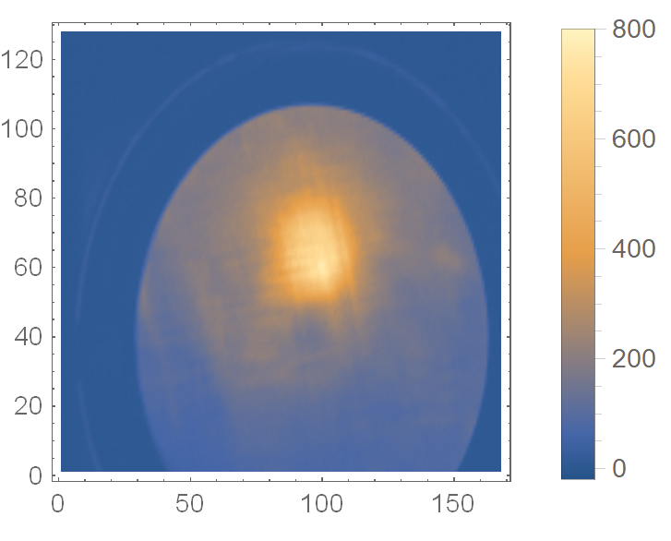
Capture
Key issues:
  Electron density, plasma stability
Penning-Malmberg trap at Swansea University
  “Rotating wall” to “spin-up” plasma to gain stability
  Improved diagnostics
  Numerical analysis to interpret and optimise experiments

Slide 12
Real-time dose measurment

Slide 13
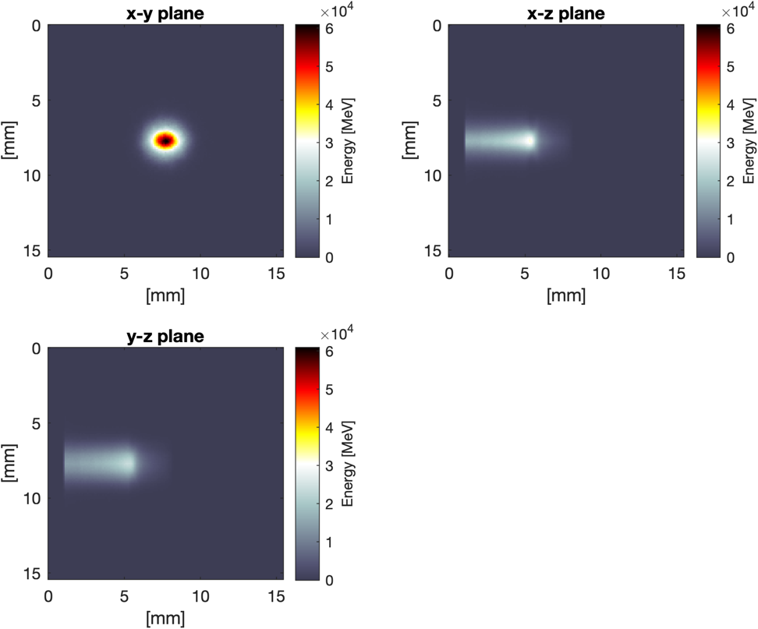
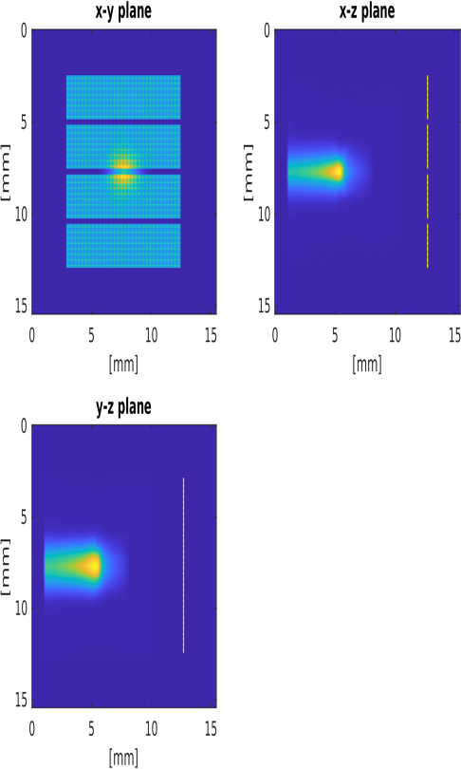
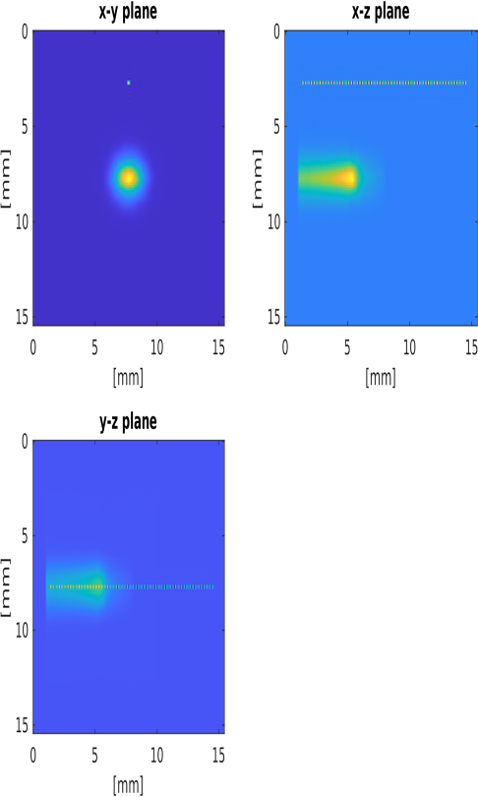
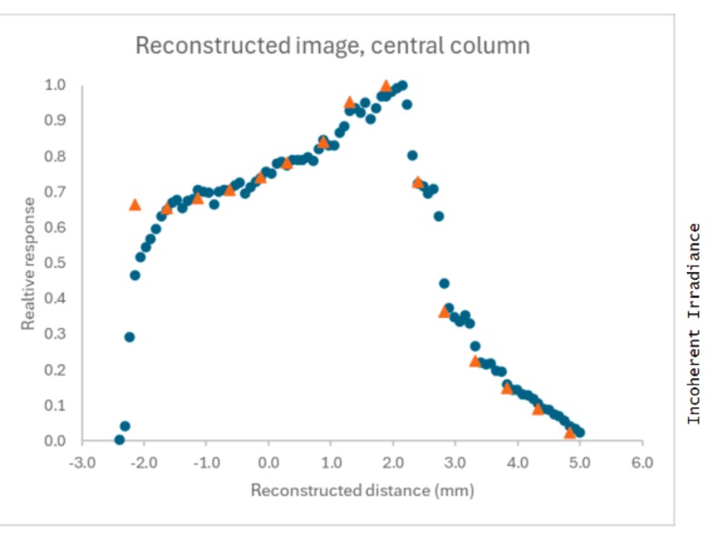
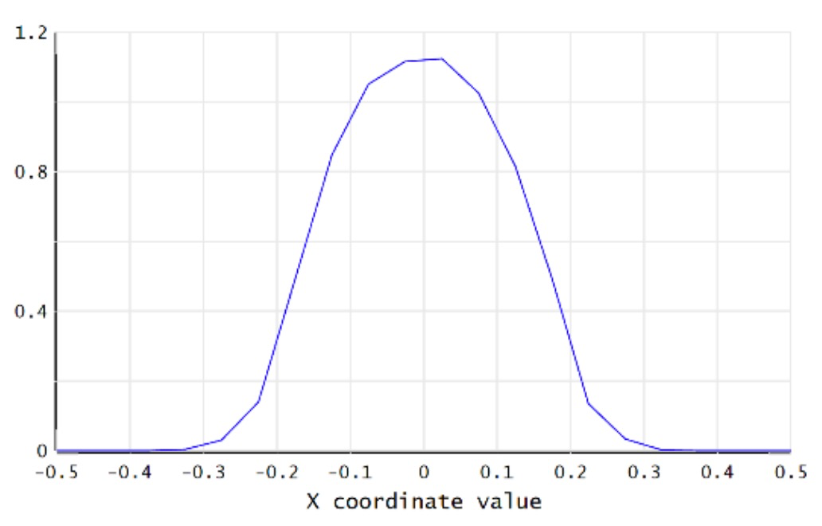
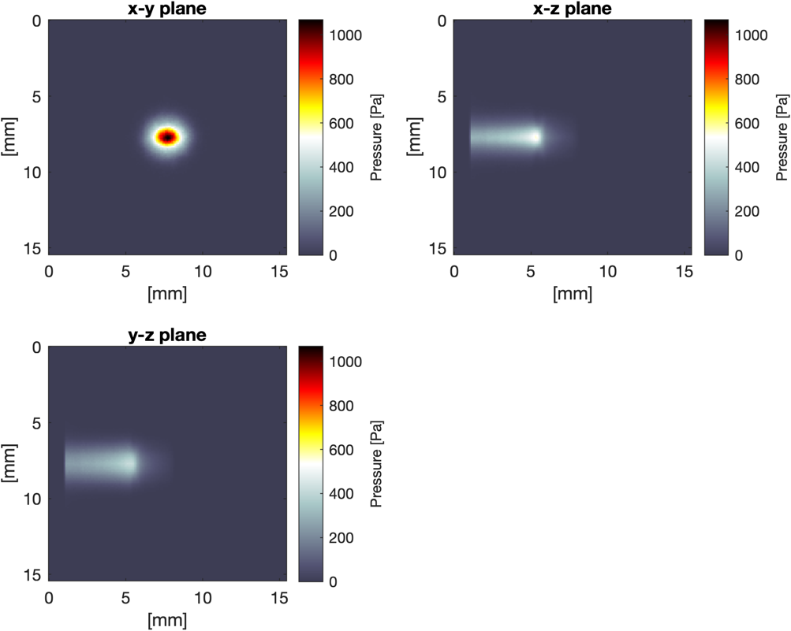
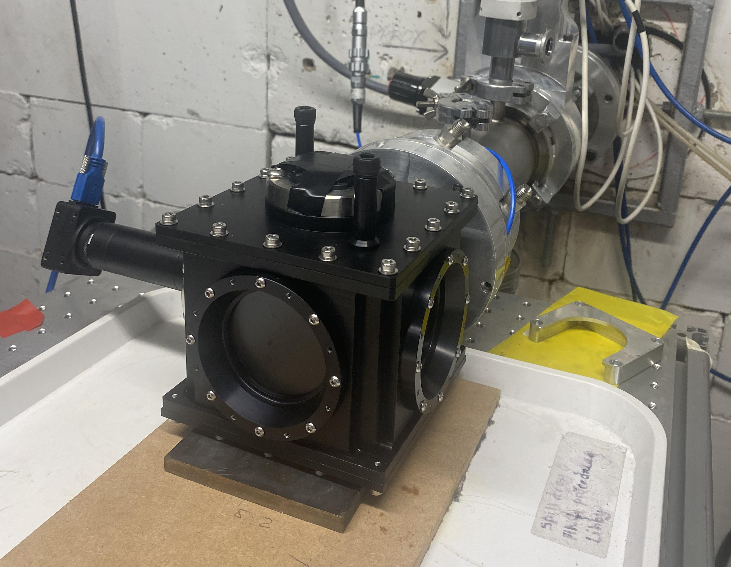
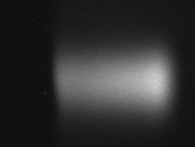
Real-time dose measurement

Slide 14
Stage 2: FFA & FFA magnet
FFA magnet
T.J. Kuo
Emerging collaboration with ISIS u/g team

Slide 15
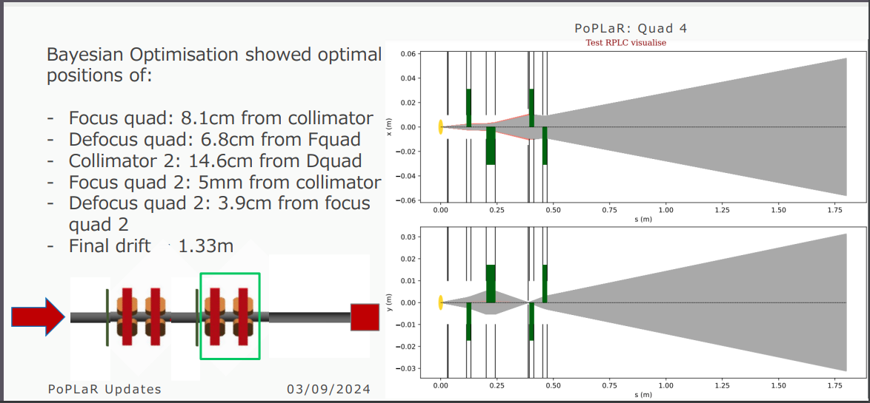
PoPLaR Experiment
Halbach permanent magnet quadruple beamline

Slide 16
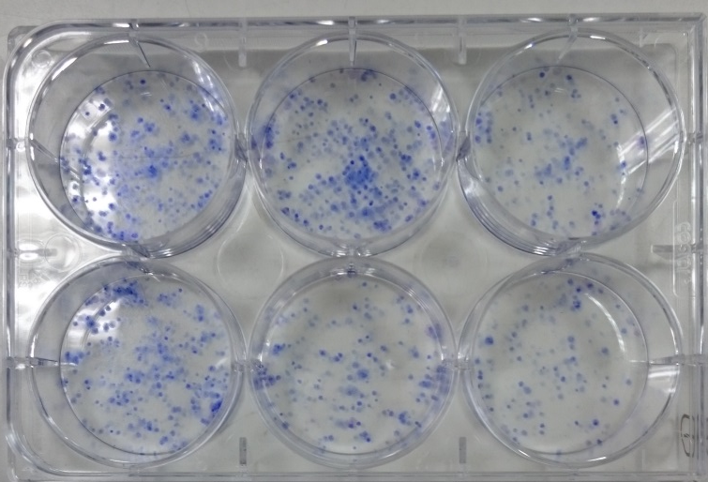
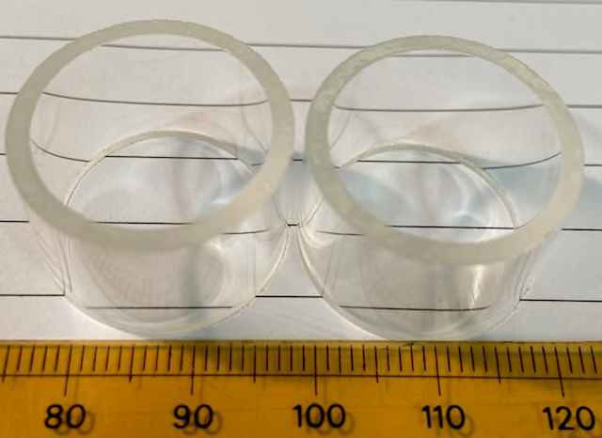
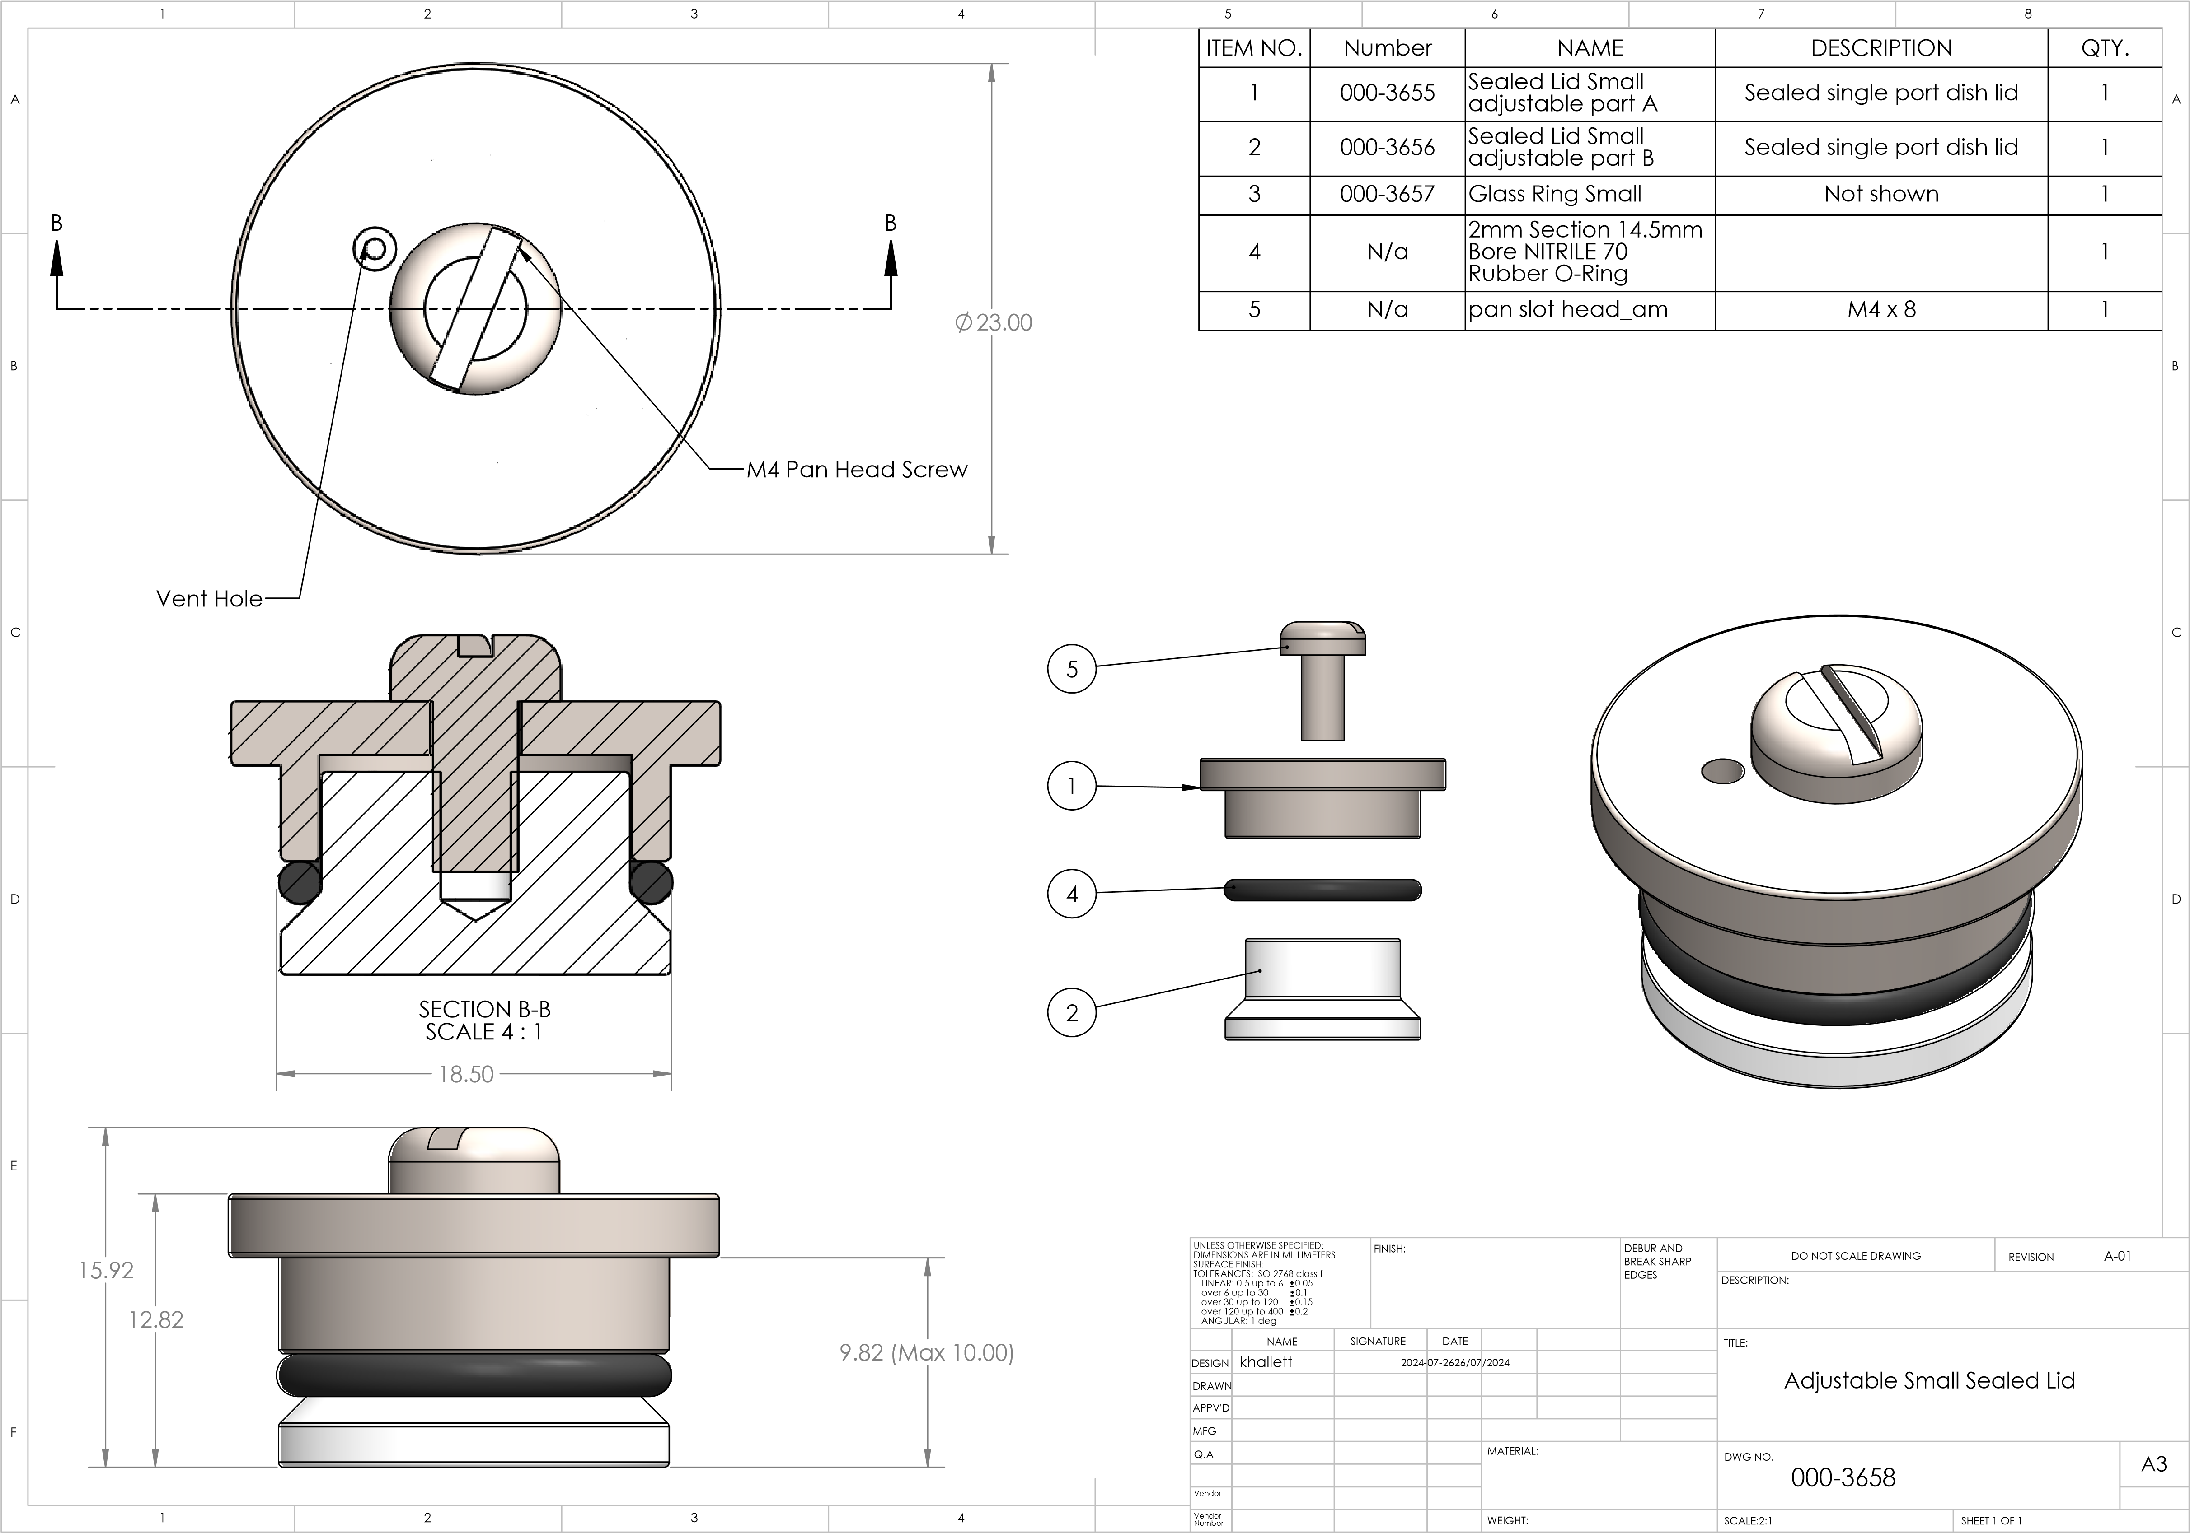
Initial radiobiology experiments at SCAPA - Clonogenic assays
~10 MeV – grow cells on 2.5 µM Mylar in glass rings
Internal diameter – 18.5 mm
Outer diameter – 22.5 mm
Utilise several cancer (HeLa and HNSCC/GBM) and normal cell lines.
Irradiate at multiple doses (0-8 Gy, + 15 Gy), most likely at a single shot (highest dose rate; ~10⁹ Gy/s).
Need at least 3 independent biological repeats.

Slide 17
Conclusions
Significant progress in ITRF/LhARA:
  Initial characterisation of laser-driven source
  Progress on understanding and stablisation of plasma for Gabor lens
  Design of ion-acoustic proof-of-principle experiment
  Peer-group consultation leading to specification of end-station
  Beamline design and optimization, initial engineering studies of FFA magnet
  Design and specification of proof-of-principle experiment as part of radiation-biology programme
  Bridging Project for next two years defined and funding awarded
Looking forward:
  Staged build / TDR project.

