Slide 1
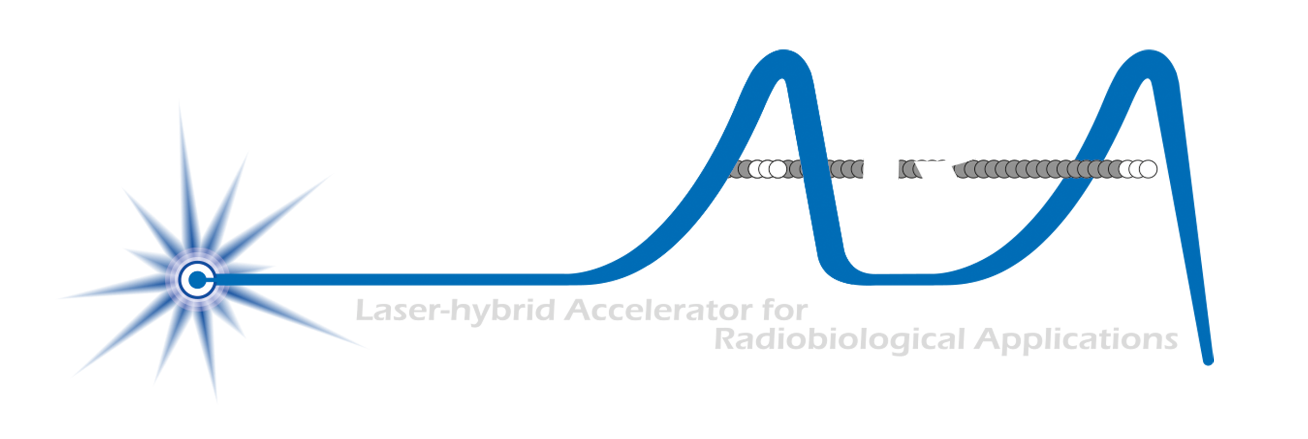
Development of a laser-hybrid approach to the delivery of ion beams for biomedical application
Laser-hybrid Accelerator for Radiobiological Applications to serve the Ion Therapy Research Facility
ITRF
/

Slide 2
Radiotherapy; the challenge
Cancer: second most common cause of death globally
Radiotherapy indicated in half of all cancer patients
Significant growth in global demand anticipated:
14.1 million new cases in 2012 ⇢ 24.6 million by 2030
8.2 million cancer deaths in 2012 ⇢ 13.0 million by 2030
Scale-up in provision essential:
Projections above based on reported cases (i.e. high-income countries)
Opportunity: save 26.9 million lives in low/middle income countries by 2035
Provision on this scale requires:
Development of new and novel techniques … integrated in a
Cost-effective system to allow a distributed network of RT facilities
Atun, Lancet Oncol. 2015 Sep;16(10):1153-86

Slide 3
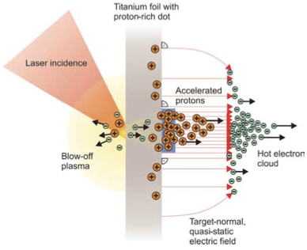
Our ambition is to:
Deliver a systematic and definitive radiation biology programme
Prove the feasibility of laser-driven hybrid acceleration
Lay the technological foundations for the transformation of PBT
automated, patient-specific proton and ion beam therapy

Slide 4
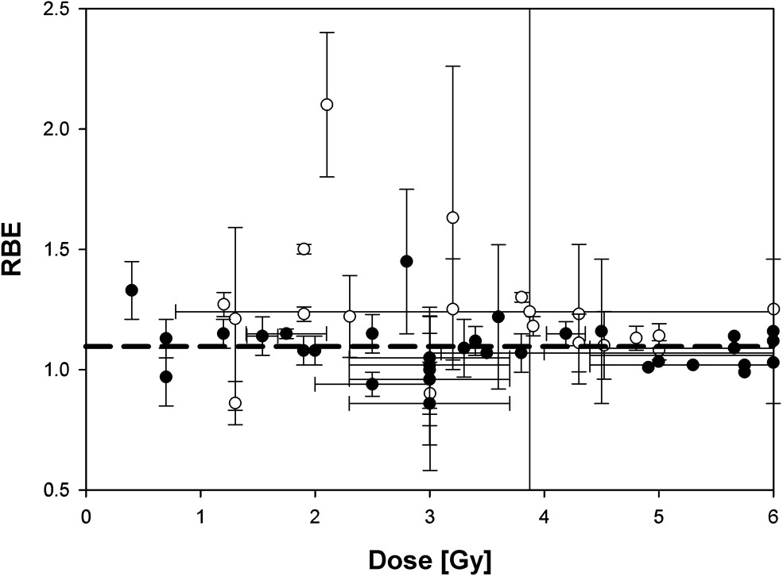
The case for fundamental radiobiology
Relative biological effectiveness:
Defined relative to reference X-ray beam
Known to depend on:
Energy, ion species
Dose & dose rate
Tissue type
Biological endpoint
Yet:
p-treatment planning uses 1.1
Effective values are used for C⁶⁺
Maximise the efficacy of PBT now & in the future:
Develop systematic programme of radiobiological measurements
Paganetti, van Luijk (2013)
SemRadOncol

Slide 5
What is LhARA?
A novel, hybrid, approach:
Laser-driven, high-flux proton/ion source
Overcome instantaneous dose-rate limitation
Capture at >10 MeV
Delivers protons or ions in very short pulses
Bunches as short as 10—40 ns
Triggerable; arbitrary pulse structure
Novel “electron-plasma-lens” capture & focusing
Strong focusing (short focal length) without the use of high-field solenoid
Fast, flexible, fixed-field post acceleration
Variable energy
Protons: 15—127 MeV
Ions: 5—34 MeV/u
Front. Phys., 29 September 2020; DOI: 10.3389/fphy.2020.567738

Slide 6
C. Hill et al; ASTeC/TD DL

Slide 7
Source: simulation
Dascalu, Dover, Gray
R&D objectives:
“Full-scale” tests in conditions approaching LhARA specification
LhARA-focused diagnostic and targetry development
High-repetition rate, automation and longevity studies
Accurate numerical modelling 3D simulation codes
PhysRevLett.90.185002
Realistic, 2-stage simulation on ARCHER2 using accurate “pre-plasma” profile
Study proton production as a function of angle of incidence, spot size, proton-layer thickness
Seek to benchmark against data

Slide 8
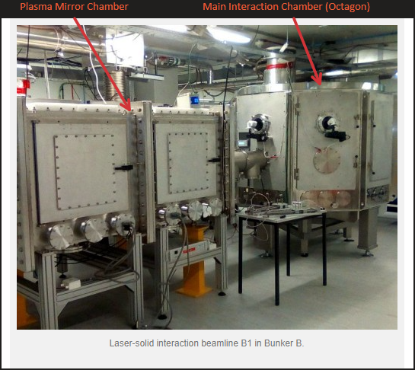
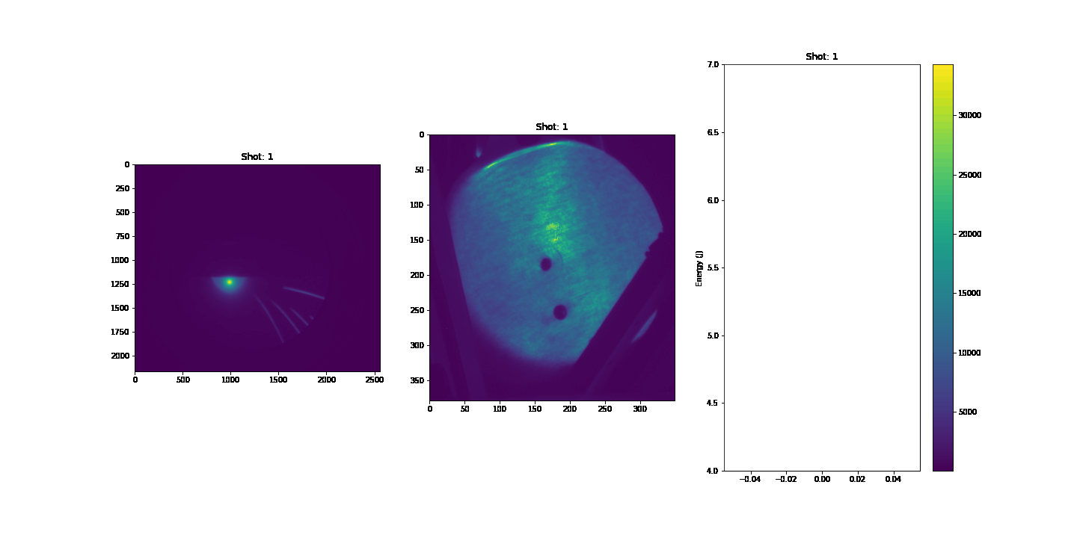
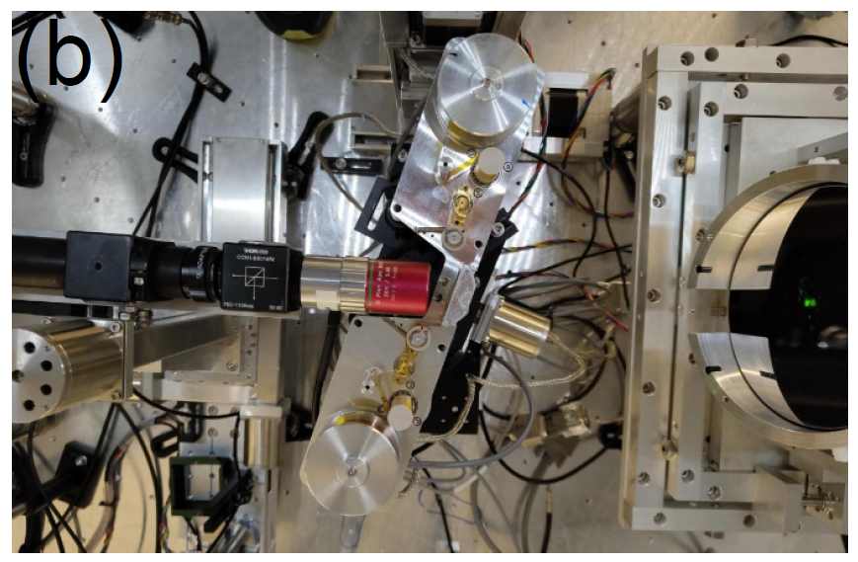
Source: experiment
Laser energy
R. Gray

Slide 9
Source: diagnostics & high rep-rate
Diagnostics
High-rep rate / longevity …
Scintillators: key for high rep rate operation
Dedicated calibration effort led by N. Dover (ICL):
Birmingham MC40 cyclotron

Slide 10
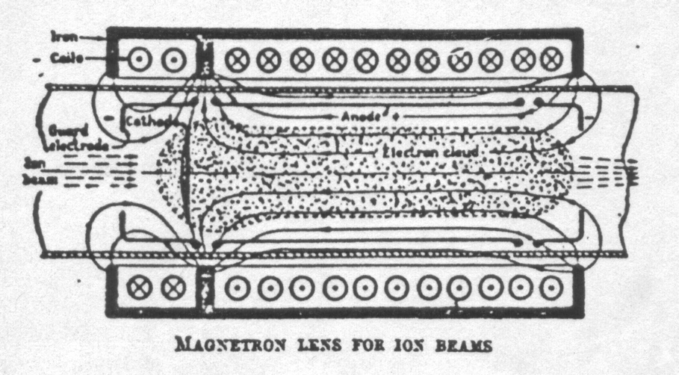
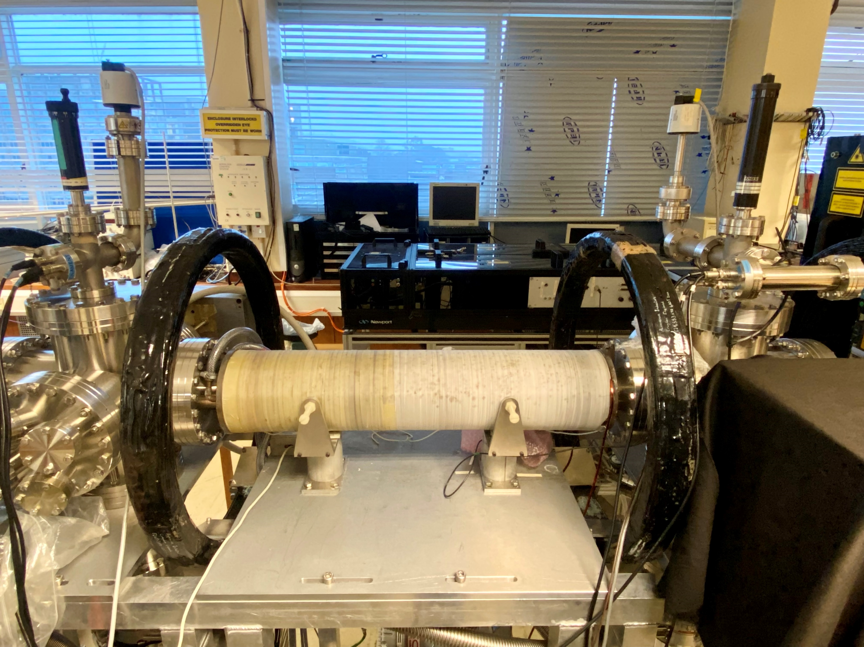
Capture
Ruksasakchai, Isaac, Eriksson, Bertsche
“Electron-plasma” (Gabor) lens:
Strong focusing exploiting electron gas in “Penning/Malmberg” trap
Gabor
1957

Slide 11
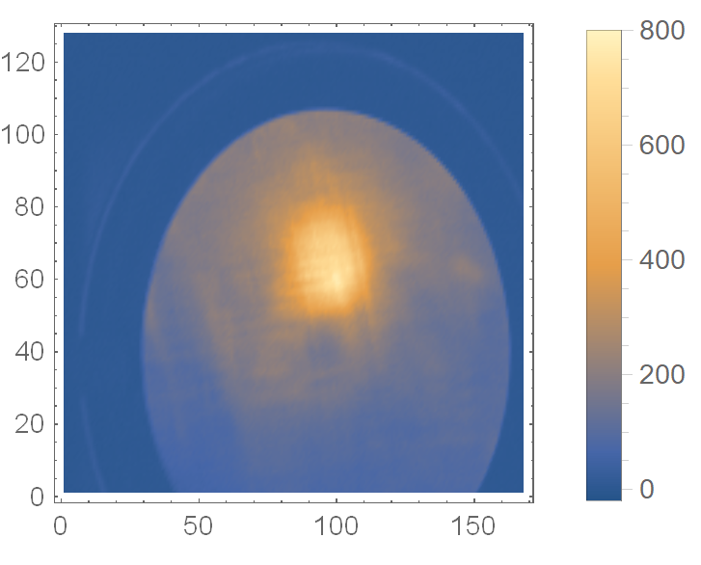
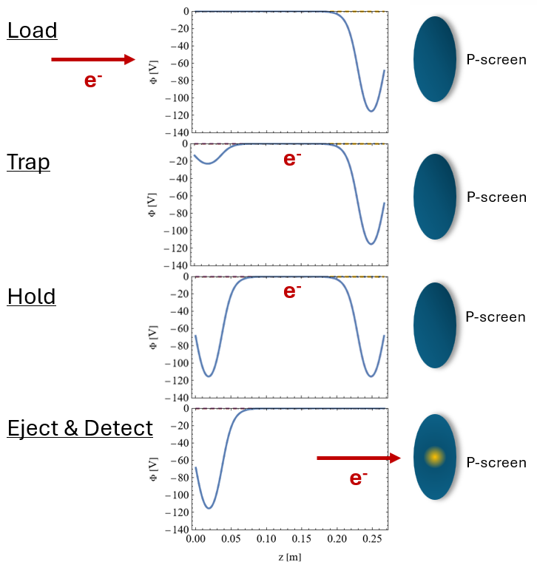
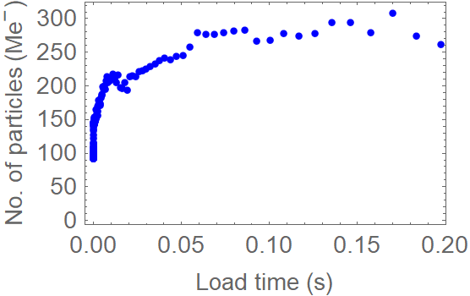
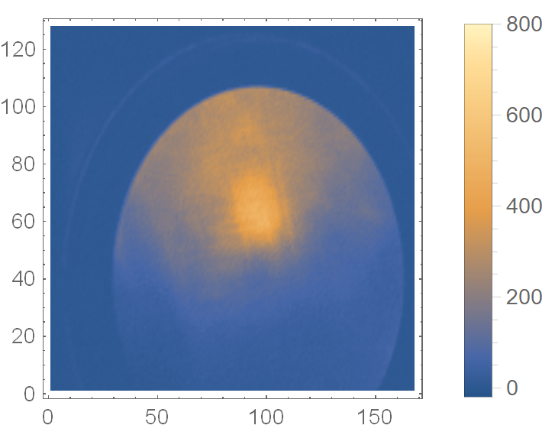
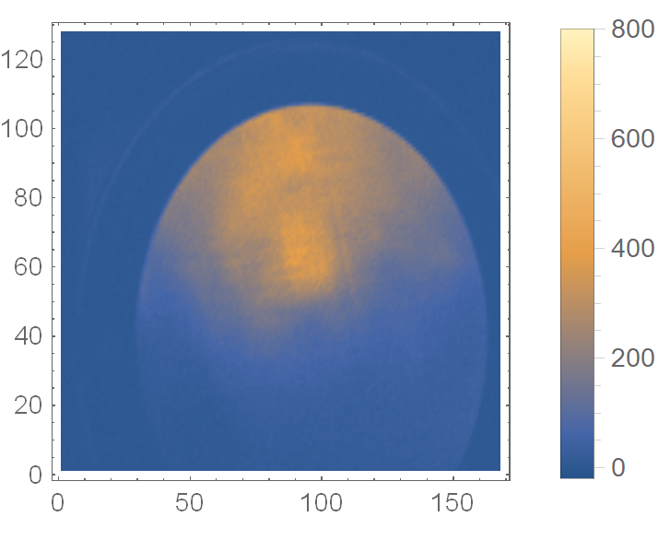
Capture
Key issues:
Electron density, plasma stability
Measurements on Penning-Malmberg trap at Swansea University
“Rotating wall” to “spin-up” plasma to gain stability
Ongoing campaign:
Improved diagnostics
Numerical analysis to interpret and optimise experiments
Ruksasakchai, Isaac,
Eriksson, Bertsche

Slide 12
Real-time dose measurment
Maxouti, Bamber, Cox, Hobson

Slide 13
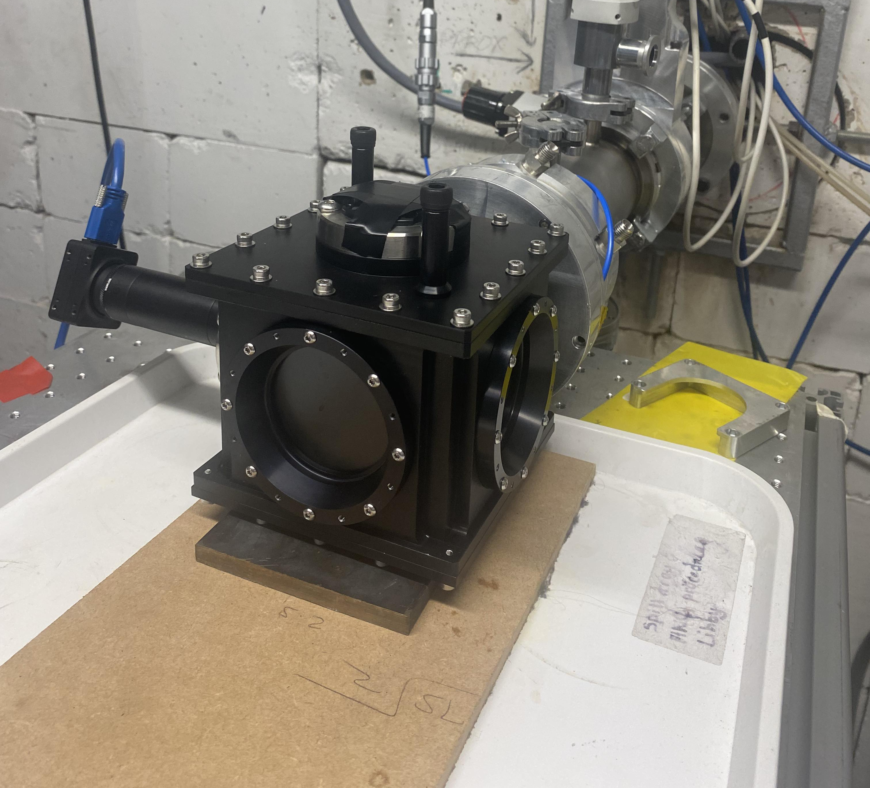
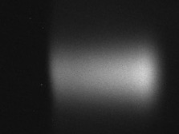
Real-time dose measurement
Maxouti, Bamber, Cox, Hobson

Slide 14
Stage 2: FFA & FFA magnet
Pasternak, Shields, Kuo, Kurup, Hill
FFA magnet
T.J. Kuo
Emerging collaboration with ISIS u/g team

Slide 15
Conclusions
Significant progress in ITRF/LhARA:
Beamline design and optimisation
Engineering, initial studies of FFA magnet
Initial characterisation of laser-driven source
Progress on understanding and stablisation of plasma for Gabor lens
Design of ion-acoustic proof-of-principle experiment
Peer-group consultation leading to specification of end-station
Looking forward:
Recognition of importance of development of biological programme:
First steps in design and specification of proof-of-principle experiment as part of broader radiation-biology programme
Project programme for next two years defined
Exciting programme, but, clear need to make the case!

Slide 17
Backup

Slide 18
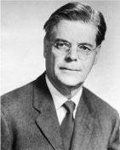
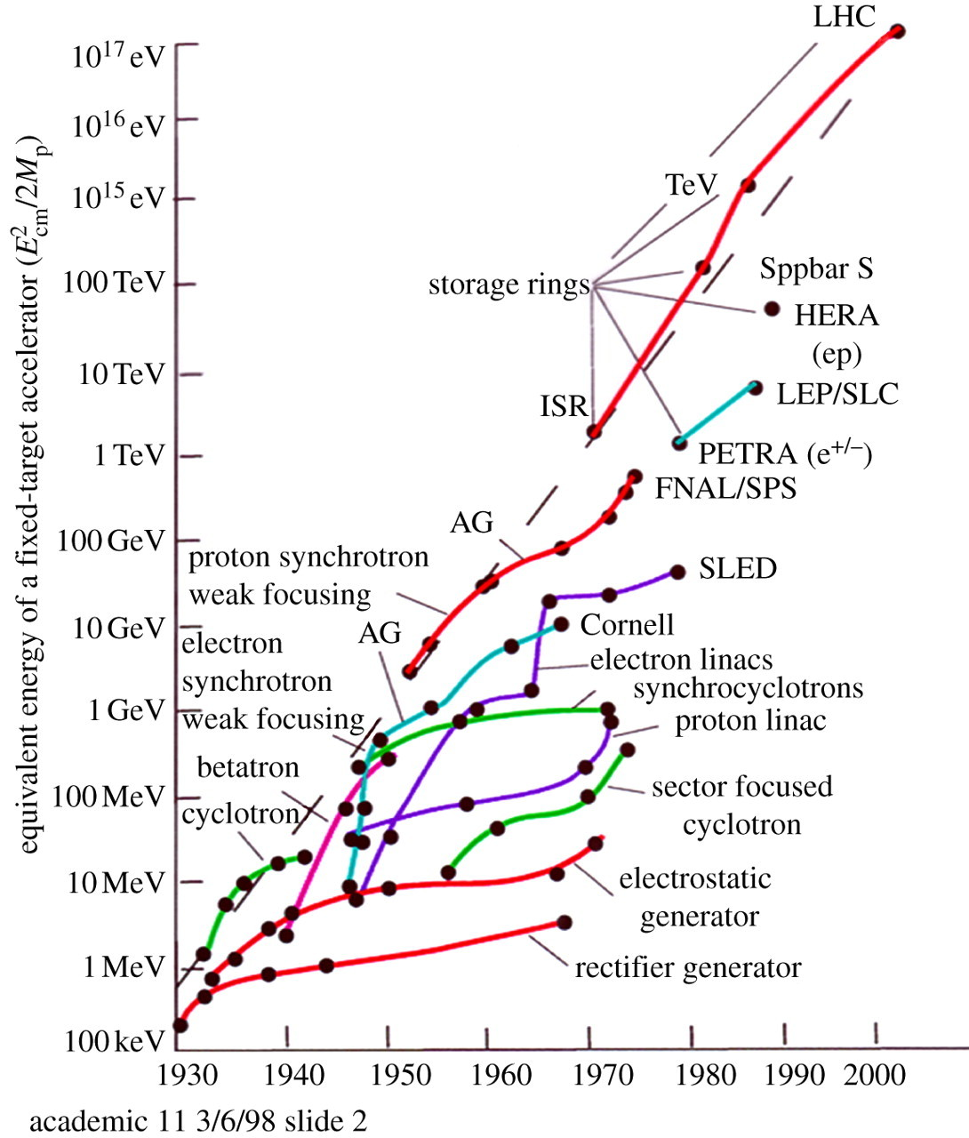
Learning from history
Radiology 47:487–91 (1946)
Wilson, then at Harvard designing 150 MeV cyclotron:
Identified benefits and properties of proton beams for RT
Pointed out potential of ions (carbon) and electrons
@BioTech:
Develop the system!
@ energy frontier:
Innovate through applications:
Can take greater technical risk
Reduced timescales, more & more novel machines
Recruitment & retention, education, and training

