Slide 1
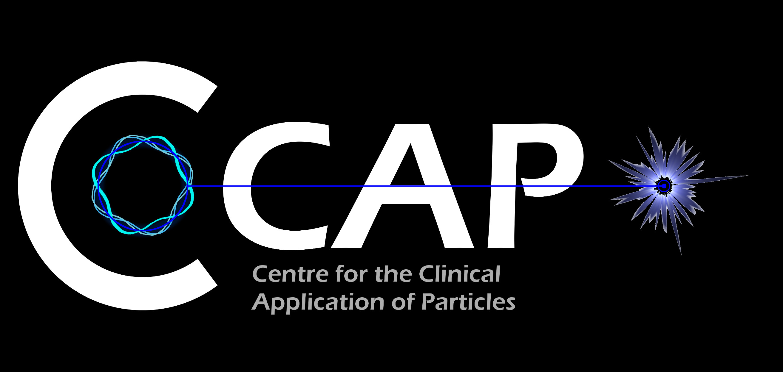
Particle beam therapy
Developing Photoacoustic Imaging to Address Industry Challenges
Imaging with sound and light theme meeting; RS; 18Nov19
Research at the forefront of …
… at the RFI?

Slide 2
Present multidisciplinary collaboration
Further interest from:
Groups in the UK and overseas
The International Biophysics Collaboration [spokespeople: Patera, Prezado]

Slide 3
Radiotherapy; the challenge
Cancer: second most common cause of death globally
Radiotherapy indicated in half of all cancer patients
Significant growth in global demand anticipated
Today, most radiotherapy delivered with X-rays
But, interest in proton and ion beam therapy is increasing

Slide 4
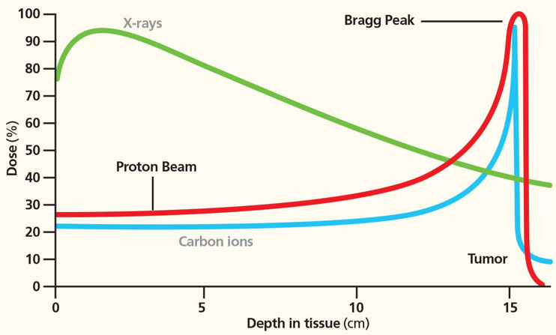
Particle-beam therapy
Proton and ion-beam therapy:
Bulk of dose deposited in Bragg peak
Significant normal-tissue sparing (entry)
Almost no dose beyond the Bragg peak

Slide 5
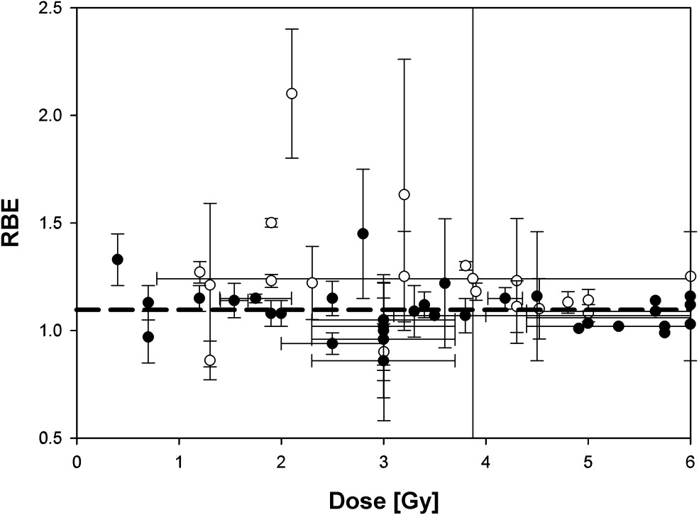
The radiobiology needs to be understood
RBE:
Ratio of dose required to gain same biological response as reference photon beam
Treatment planning:
Based on ‘Relative Biological Effectiveness (RBE)
Proton-treatment planning uses RBE = 1.1
Effective values are used for C⁶⁺
Paganetti, van Luijk Sem. Rad. Oncol (2013)
RBE known to depend on:
Energy, ion species
Dose & dose rate
Tissue type
Biological endpoint
Essential: improved, fundamental, understanding of radiobiology

Slide 6
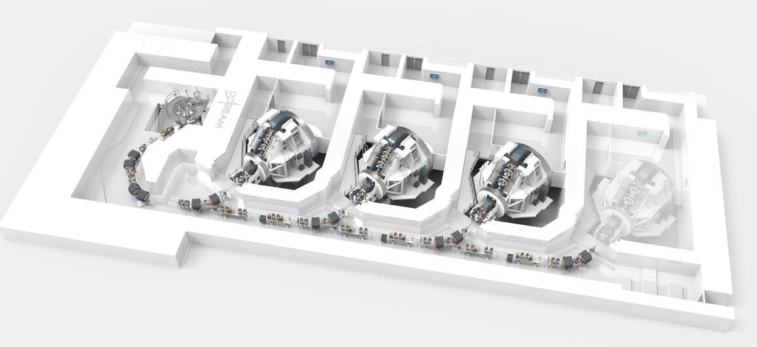
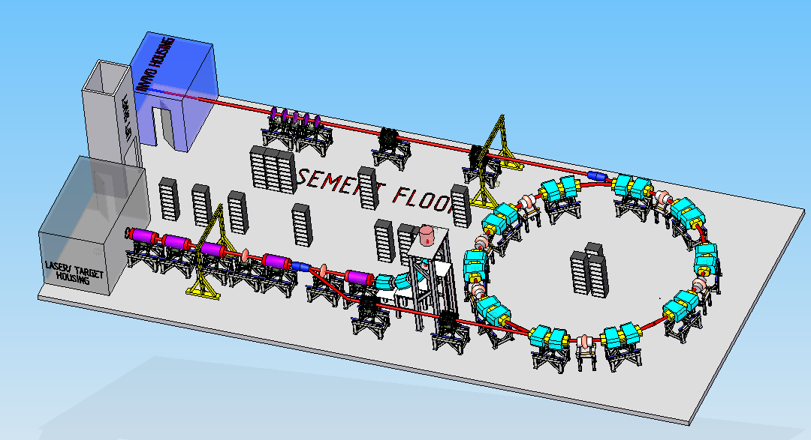
Particle beam therapy today
Cyclotron based:
Limitations:
Energy modulation
Instantaneous dose rate
Synchrotron based:
Limitiations:
Complexity
Instantaneous dose rate
⇒ reduce footprint, cost and complexity
‘PBT for the many’!
Christie Hospital Manchester
⇒ increase flexibility
optimize treatments
MedAustron Austria

Slide 7



The Rosalind Franklin Institute
interdisciplinary constitution, scientific mission and capabilities to deliver science at scale
Optimum UK institution to deliver this new infrastructure and ultimately its societal impact.
Because a system-level approach is required to deliver:
Fully automated, personalised, multi-ion therapy
Requires real-time / on-couch:
Patient/tissue imaging capable of tracking movement
Dose-deposition imaging
Treatment review and re-planning:
Based on improved understanding of fundamental radiobiology

Slide 8
Laser-hybrid Accelerator for Radiobiological Applications
LhARA; a novel, hybrid, approach:
High-flux, laser-driven proton/ion source:
Overcome instantaneous dose-rate limitation
Delivers protons or ions in very short pulses:
Pulse length 10 – 40 ns
Can provide arbitrary pulse structure
Novel plasma-lens capture & focusing
Fast, fixed-field post acceleration
⇒ compact, uniquely flexible facility
LhARA consortium

Slide 9
Radiobiology in new regimens
Time
domain
Space
domain
LhARA the ideally flexible beam facility that can deliver it all!
⇒ substantial opportunity for a step-change in understanding!
Ion
species
Energy
In combination and with chemo/immuno Therapies

Slide 10
Our vision and our ambition
Vision:
LhARA will be a uniquely-flexible, novel system that will:
Deliver a systematic and definitive radiobiology programme
Prove the feasibility of the laser-driven hybrid-accelerator approach
Lay the technological foundations for the transformation of PBT
automated, patient-specific: implies online imaging & fast feedback and control
Ambition:
Develop:
necessary techniques, technologies, and systems
Exploit:
system approach to novel bring techniques into clinical practice as they mature
Integrate:
production prototypes in a production system for radiobiological research
Engage:
industry and clinical PBT centres
during development of techniques, technologies, and systems

Slide 11
Opportunity/proposal
Through the STFC Opportunities 2019 call, the LhARA consortium is funded to:
Deliver a ‘pre-CDR’ for LhARA:
Due date April 2020
Enormous opportunity to engage with the Rosalind Franklin Institute to:
Identify areas of common interest
Implement LhARA development at RFI in collaboration with STFC laboratories
Establish radiobiology programmes at partner network laboratories
Enable complementary PBT research that does not subtract from clinical PBT delivery
My conviction: together the LhARA consortium and the RFI can:
Deliver a step-change in technological capability for PBT and radiobiology
Establish technology for a paradigm shift in clinical particle-beam therapy
more accessible (lower cost, more compact); more precise; more personalised, …

Slide 13
Expression of Interest and support
Recent studies suggest that the beam structure (bunch width, repetition rate, etc) could have a major impact in the response of tissues to radiation. The biochemical and biological mechanisms are yet unknow.
The unique features of LhARA hybrid accelerator, able to change the structure of the beam, will open new possibilities for radiobiology research. Similar to Flash therapy, where extremely high dose rates were shown to significantly reduce normal tissue damage, and which is reaching patients only 5 years after its discovery, the exploration of distinct dose delivery modes departing from the ones used in conventional RT could lead to a step-change in RT treatments.
The International Biophysics Collaboration look with great interest at the development of the LhARA initiative both for the intrinsic scientific potential but also for the future possible synergy that could be established.
Vincenzo Patera and Yolanda Prezado
IBC spokes and deputy spokepersons

Slide 14
Radiotherapy; the challenge
Cancer: second most common cause of death globally
Radiotherapy indicated in half of all cancer patients
Significant growth in global demand anticipated:
14.1 million new cases in 2012 ⇢ 24.6 millionby 2030
8.2 million cancer deaths in 2012 ⇢ 13.0 millionby 2030
Scale-up in provision essential:
Projections above based on reported cases (i.e. high-income countries)
Opportunity: save 26.9 million lives in low/middle income countries by 2035
Provision on this scale requires:
Development of new and novel techniques … integrated in a
Cost-effective system to allow a distributed network of RT facilities
Atun, Lancet Oncol. 2015 Sep;16(10):1153-86

Slide 15
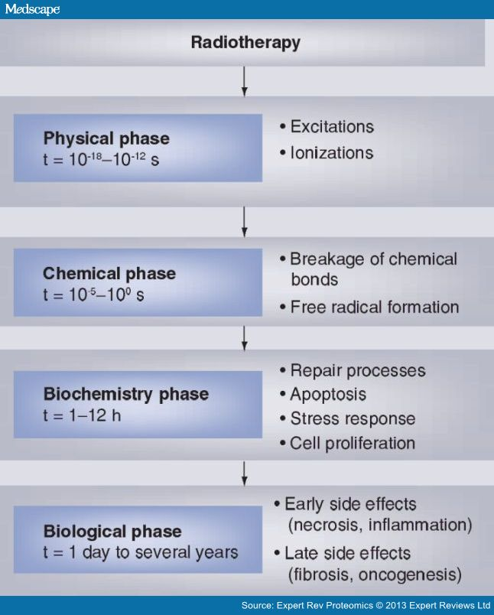
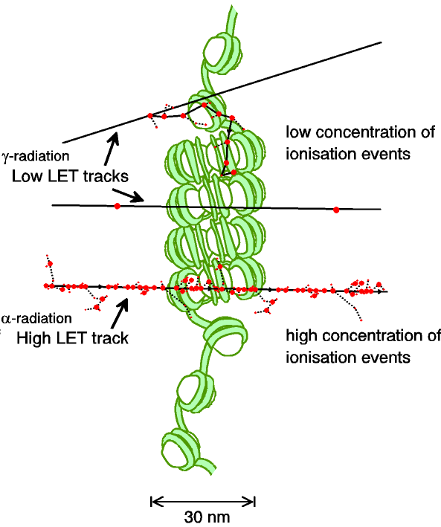
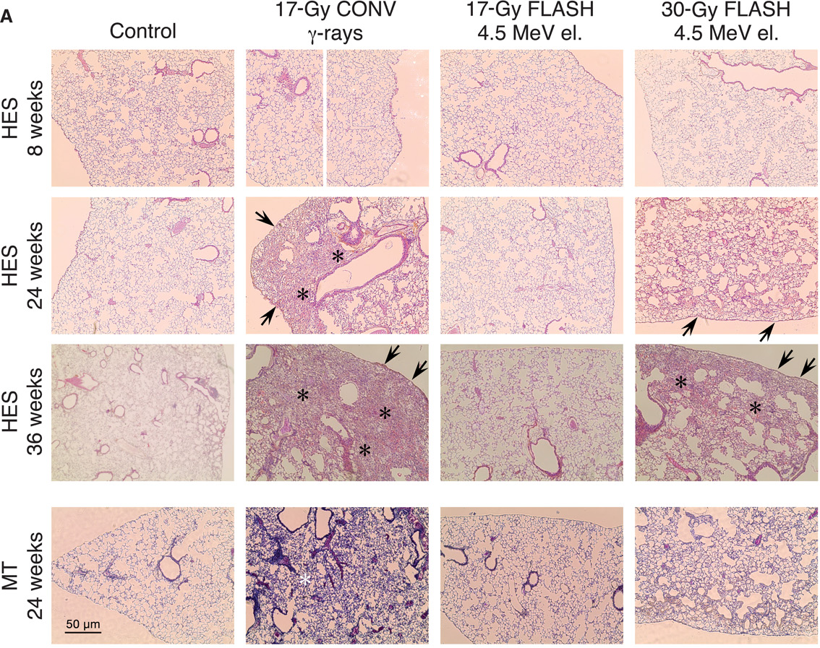
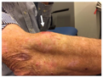
A complex, multi-facetted problem
Carter et al, and Parsons (2018) IJROBP & (2019) IJROBP
Multidisciplinary approach essential
The Rosalind Franklin Institute
through its interdisciplinary constitution, its scientific mission and expertise is ideally well placed to drive the programme forward
Time

Slide 16
Radiobiology in new regimens
Worked example: FLASH
Conventional regime : ~2 Gy/min
FLASH regime : >40 Gy/s
Evidence of normal-tissue sparing while tumour-kill probability is maintained:
i.e. enhanced therapeutic window
Time line:
Initial reports: 2014 (e.g. Flauvadon et al, STM Jul 2014)
Confirmation in mini-pig & cat: 2018 (Clin. Cancer Research 2018)
First treatment 2019 (Bourhis et al, Rad.Onc. Oct 2019)

