Slide 1
Space charge effects in LhARA
Théo Keseman

Slide 2
Plan
Space charge effects
Aperture and number of mesh lines
Matching of the arc with MAD-x
Matching with GPT
Conclusion

Slide 3
Space charge effects – Method
Simulated 10000 macroparticles in GPT for different intensities with and without space charge
Beam trajectory
Phase space
Emittance

Slide 4
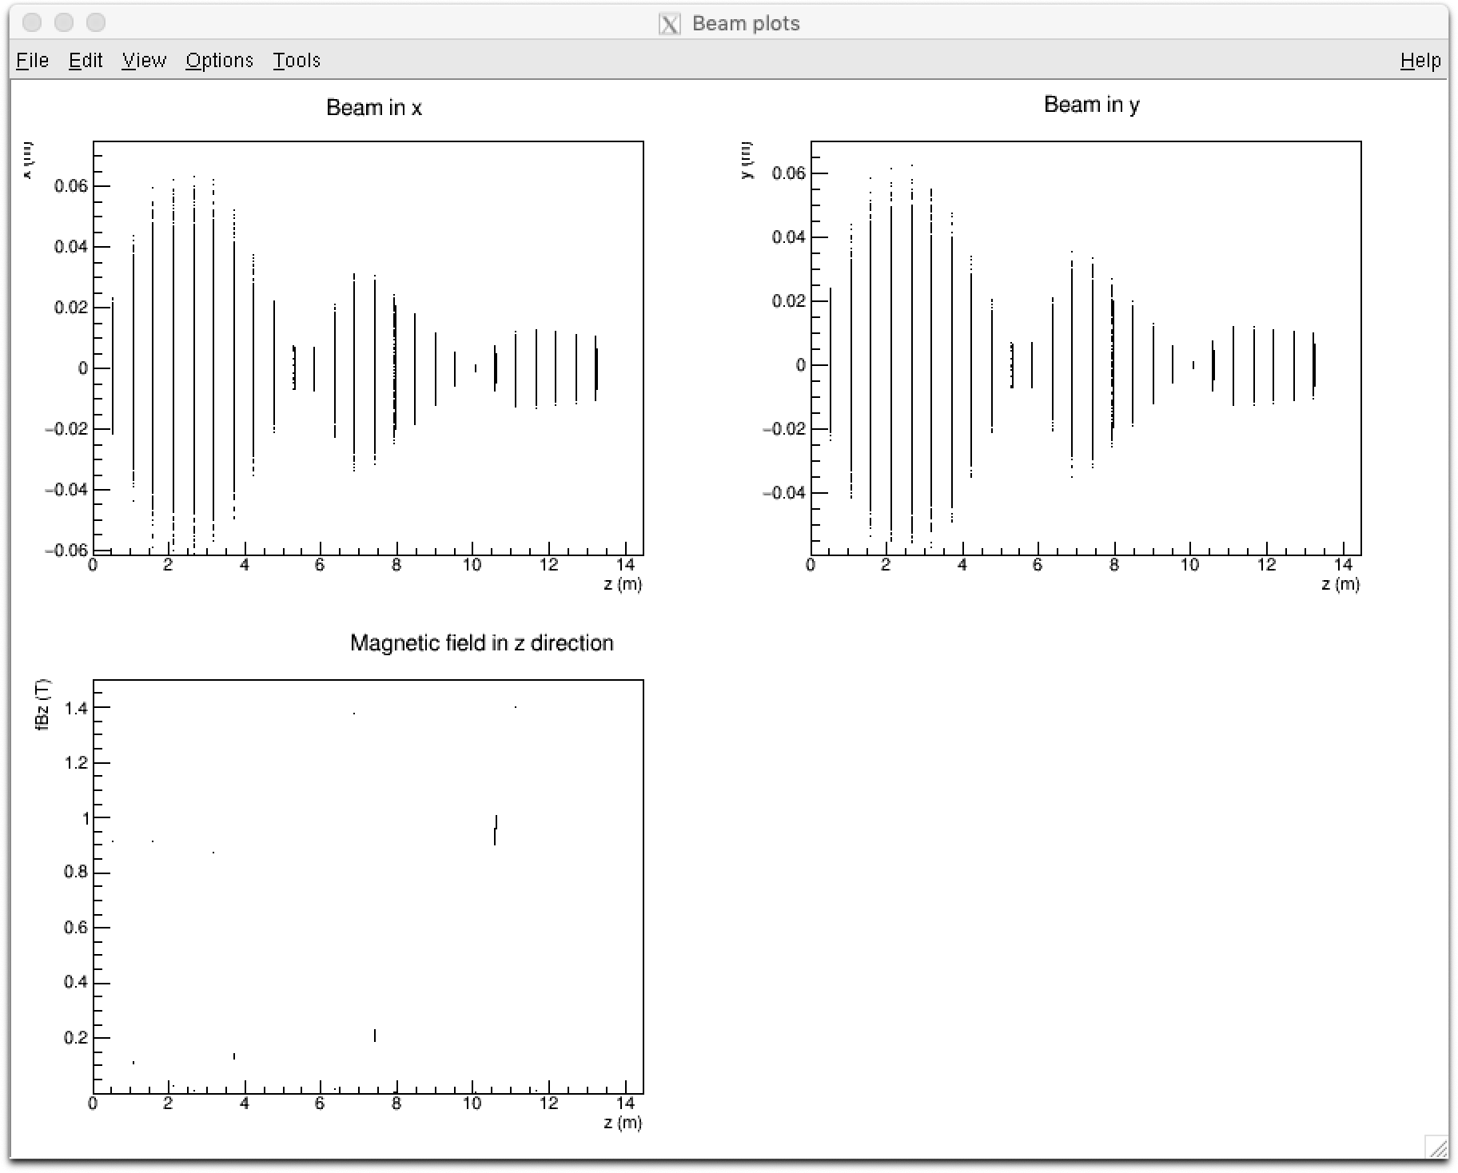
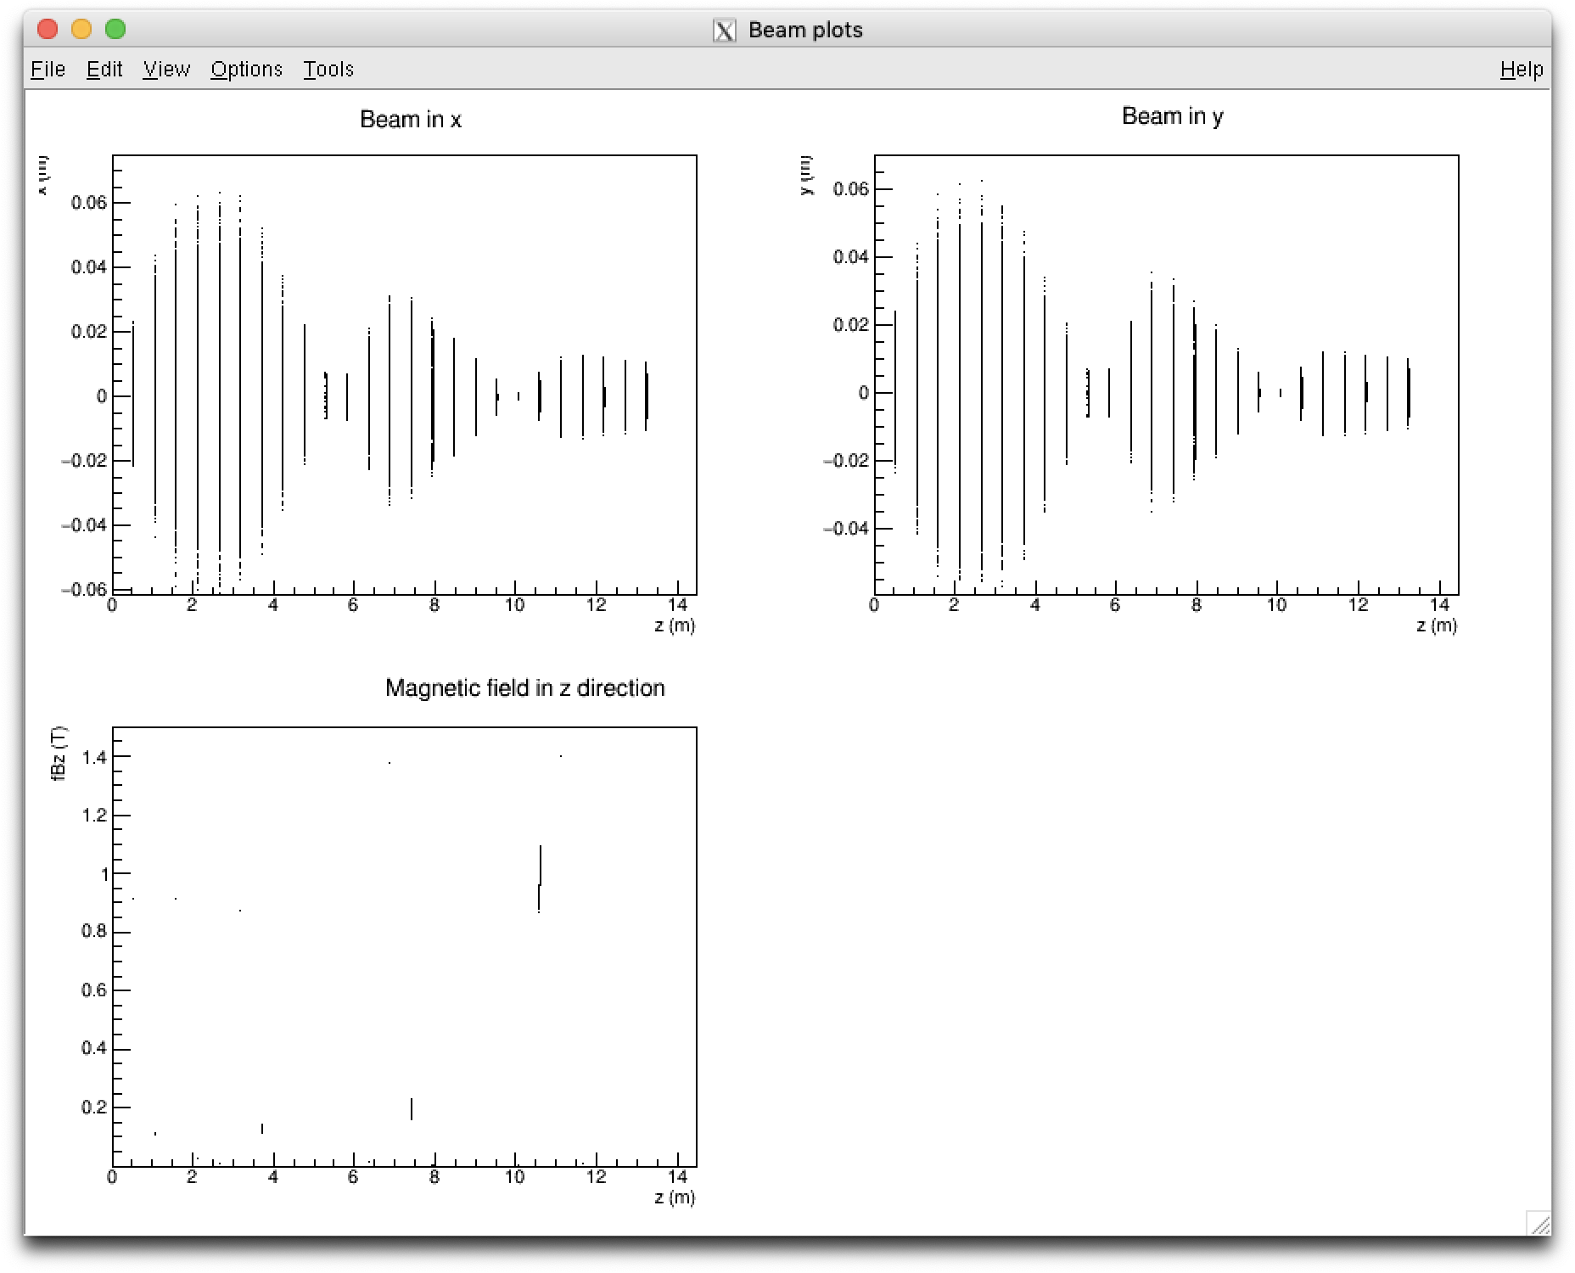
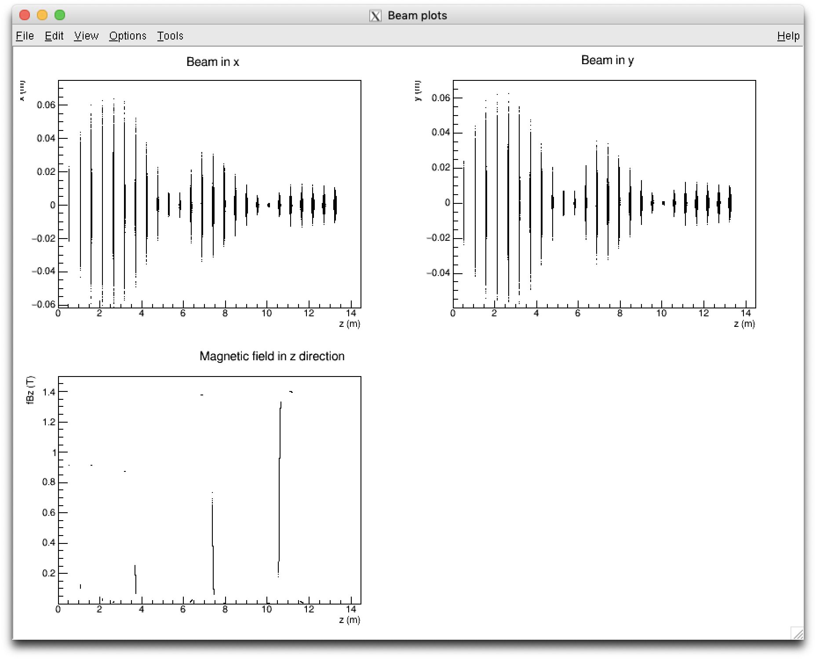
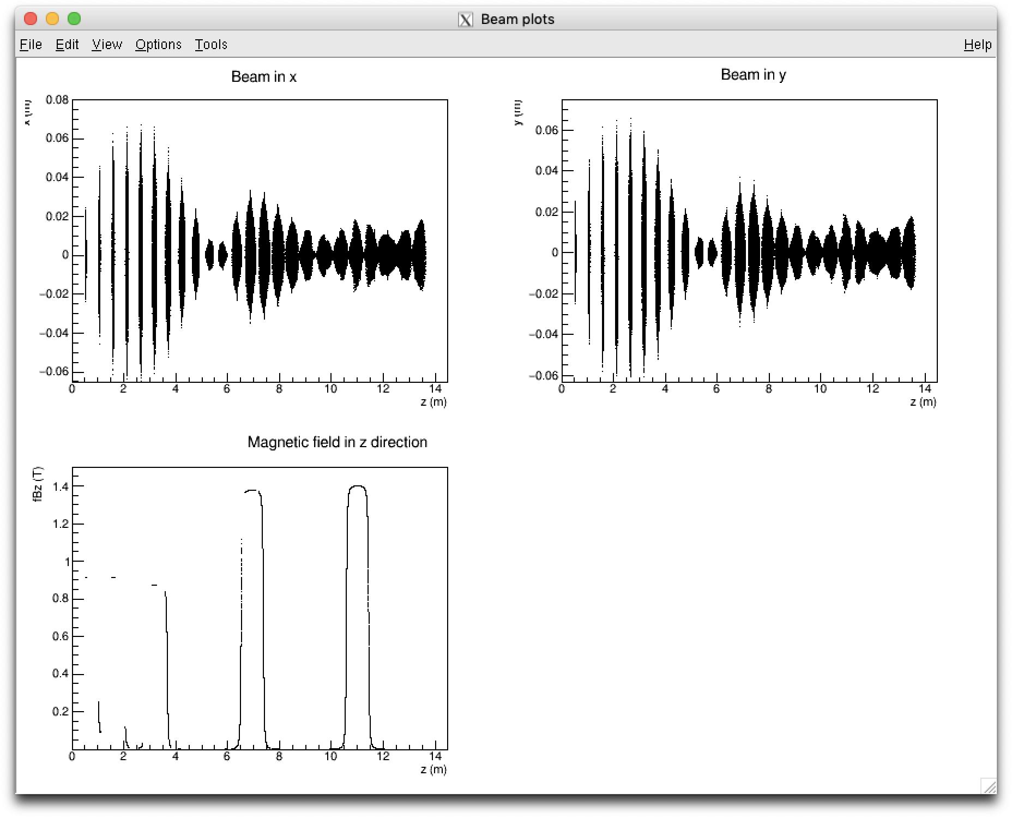
Space charge effects – Trajectory

Slide 5
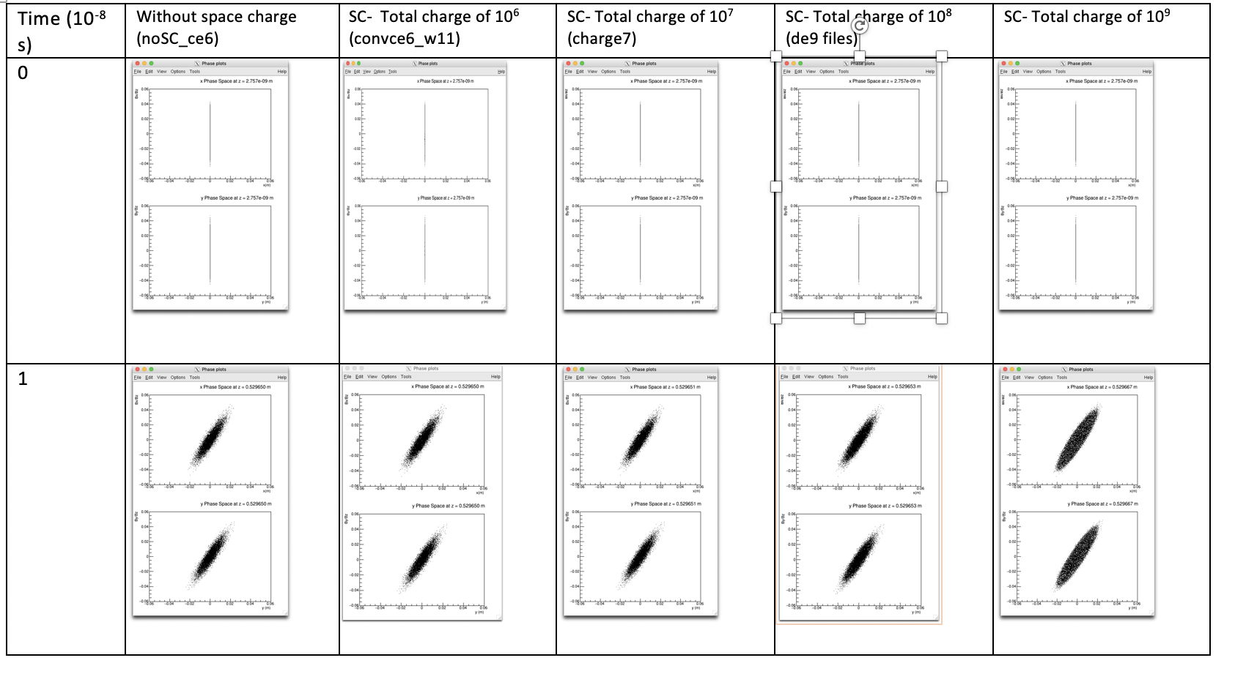
Space charge effects – Phase space plots

Slide 6
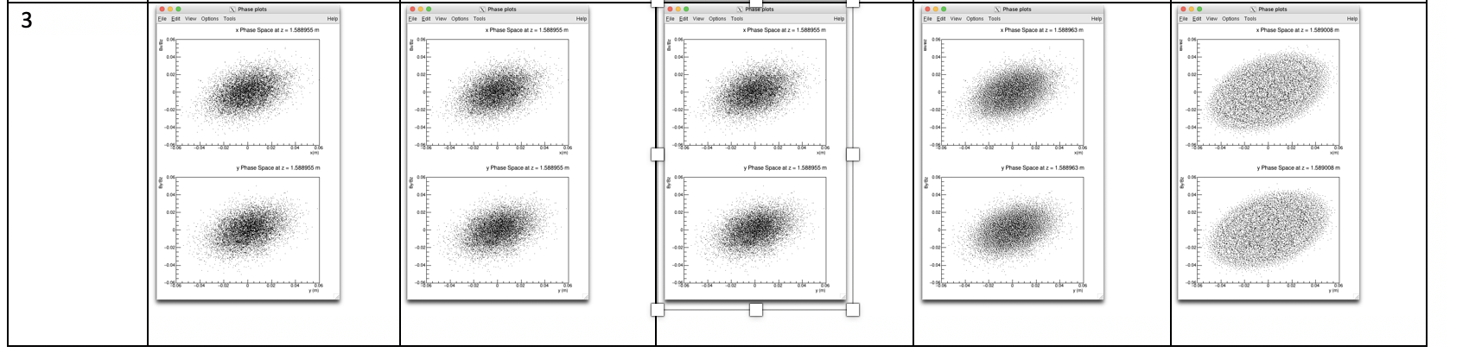
Space charge effects – Phase space plots

Slide 7
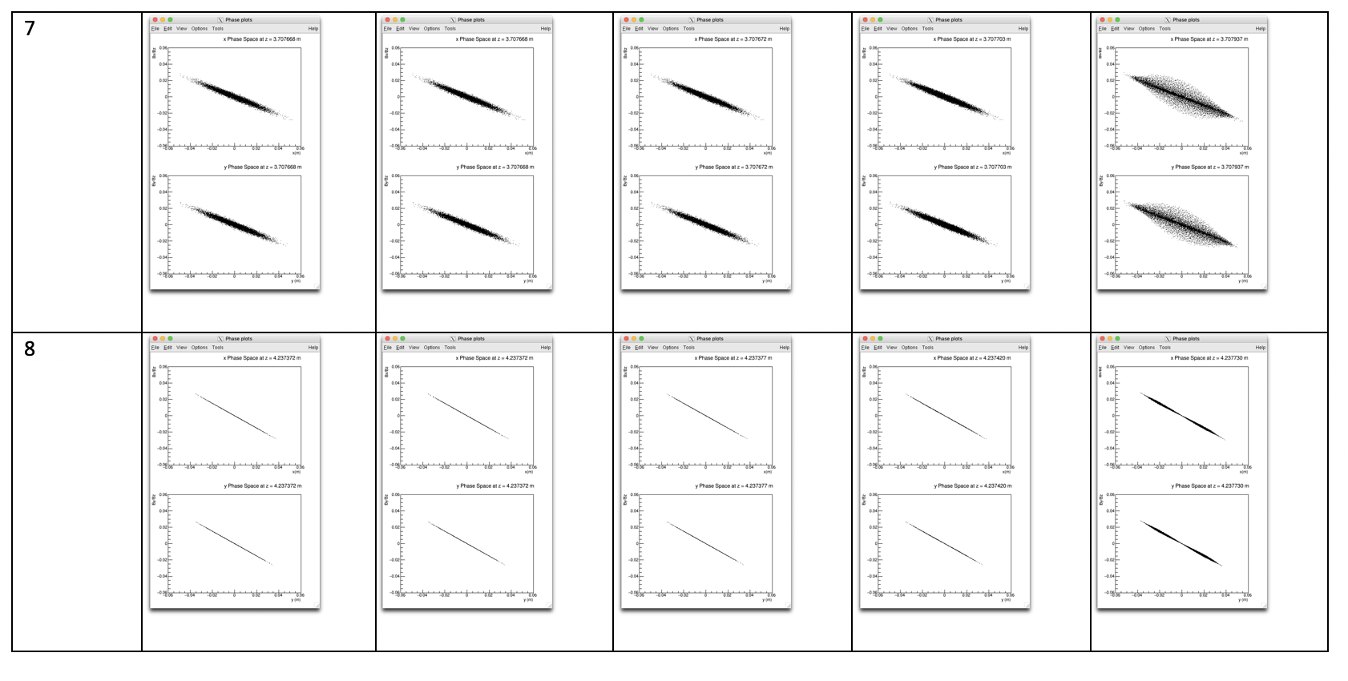
Space charge effects – Phase space plots

Slide 8
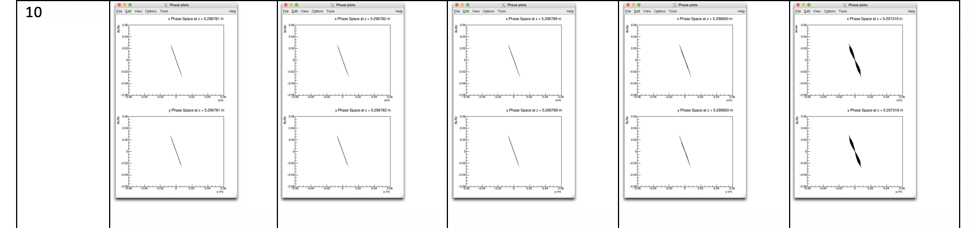
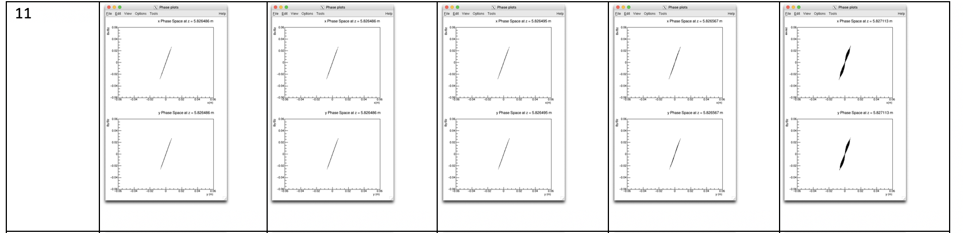
Space charge effects – Phase space plots

Slide 9
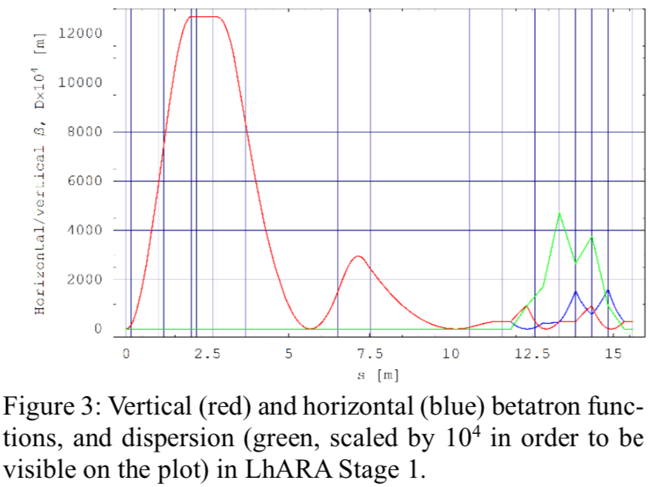
Space charge effects – Phase space plots

Slide 10
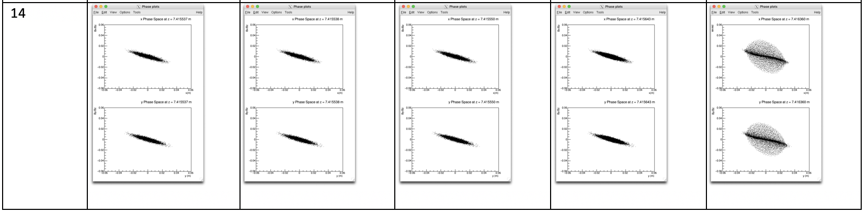
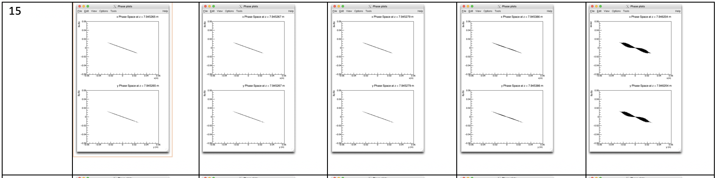
Space charge effects – Phase space plots

Slide 11
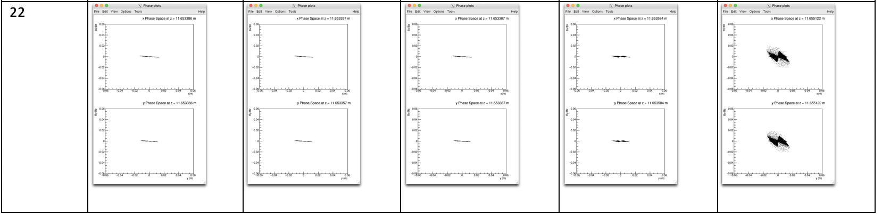
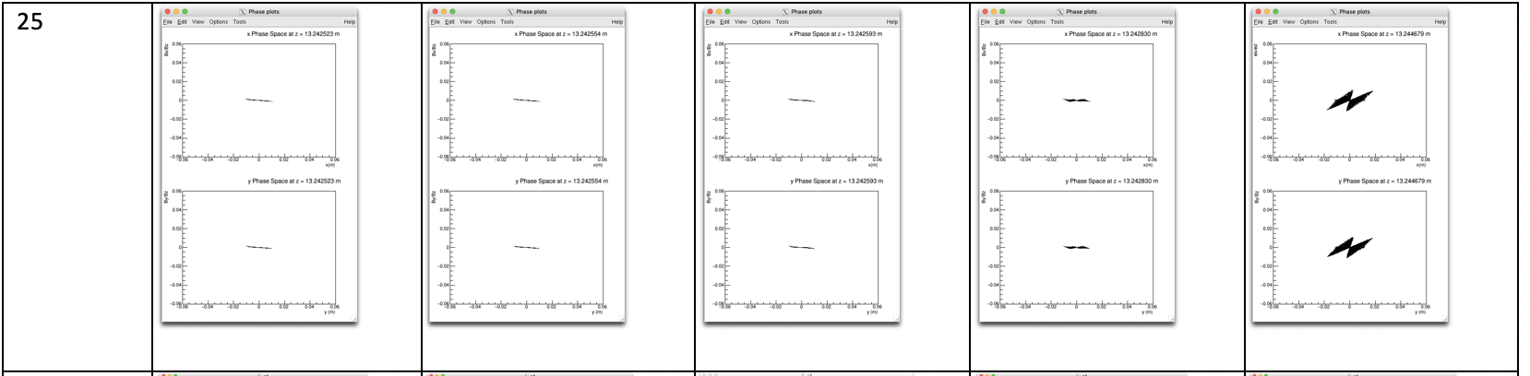
Space charge effects – Phase space plots

Slide 12
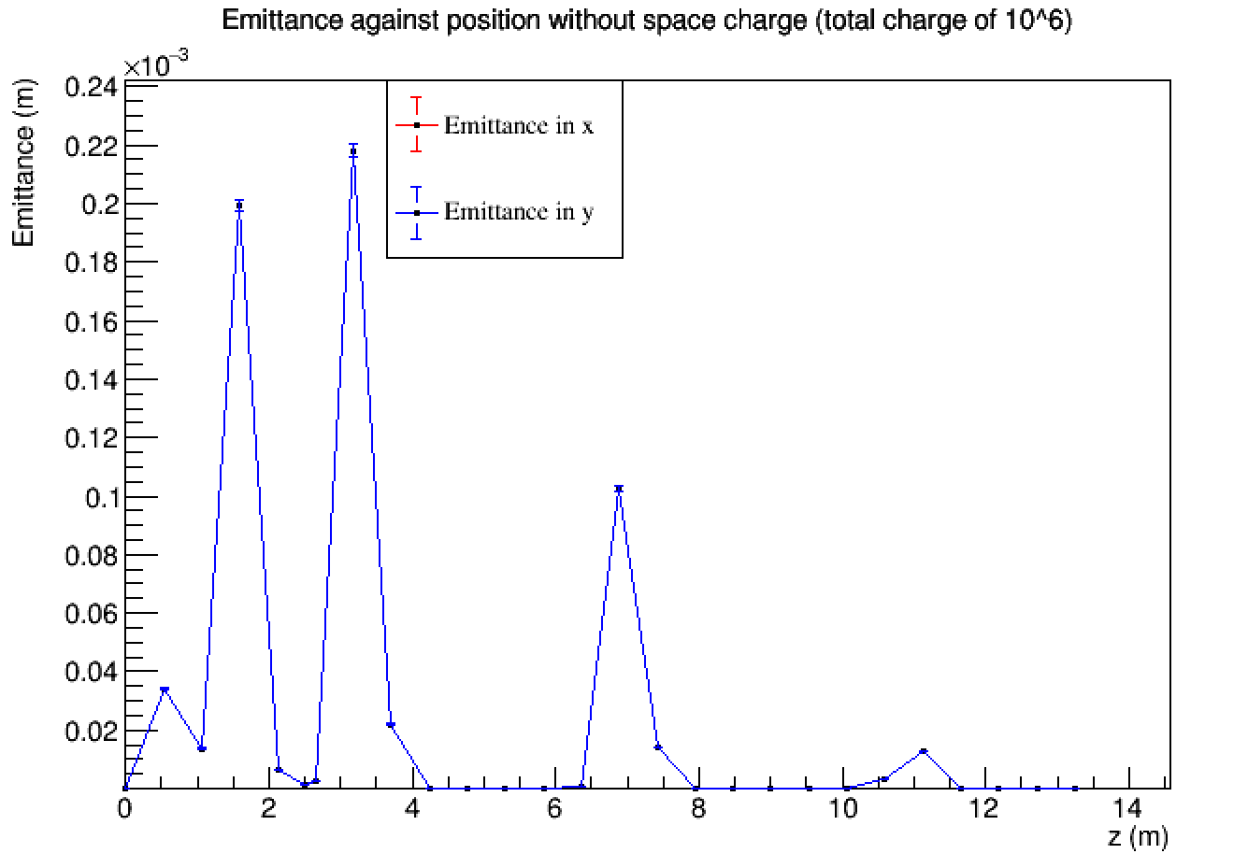

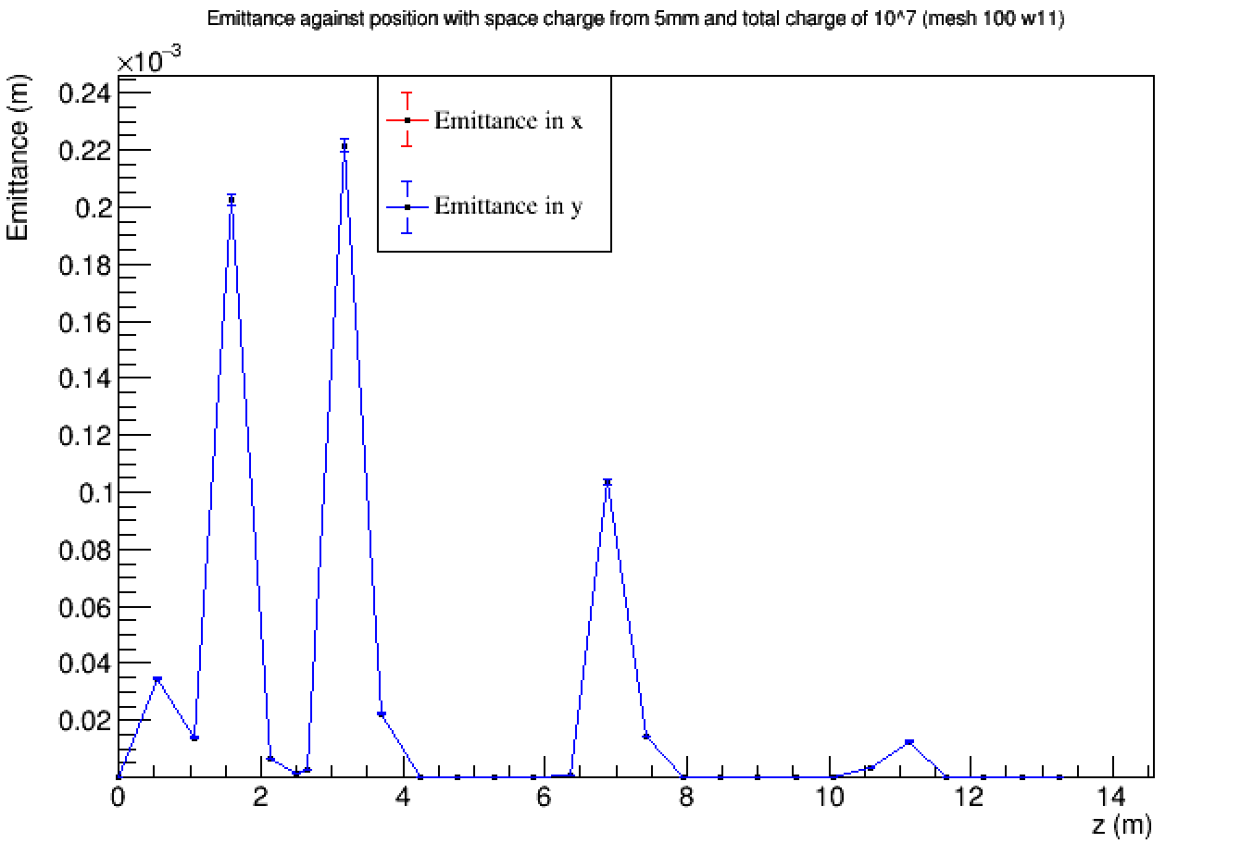
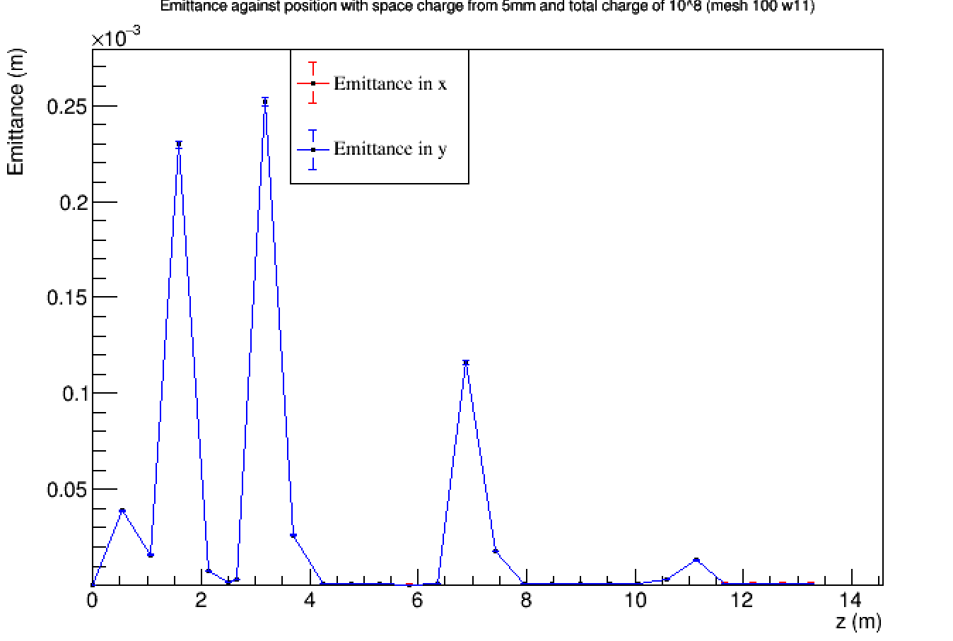
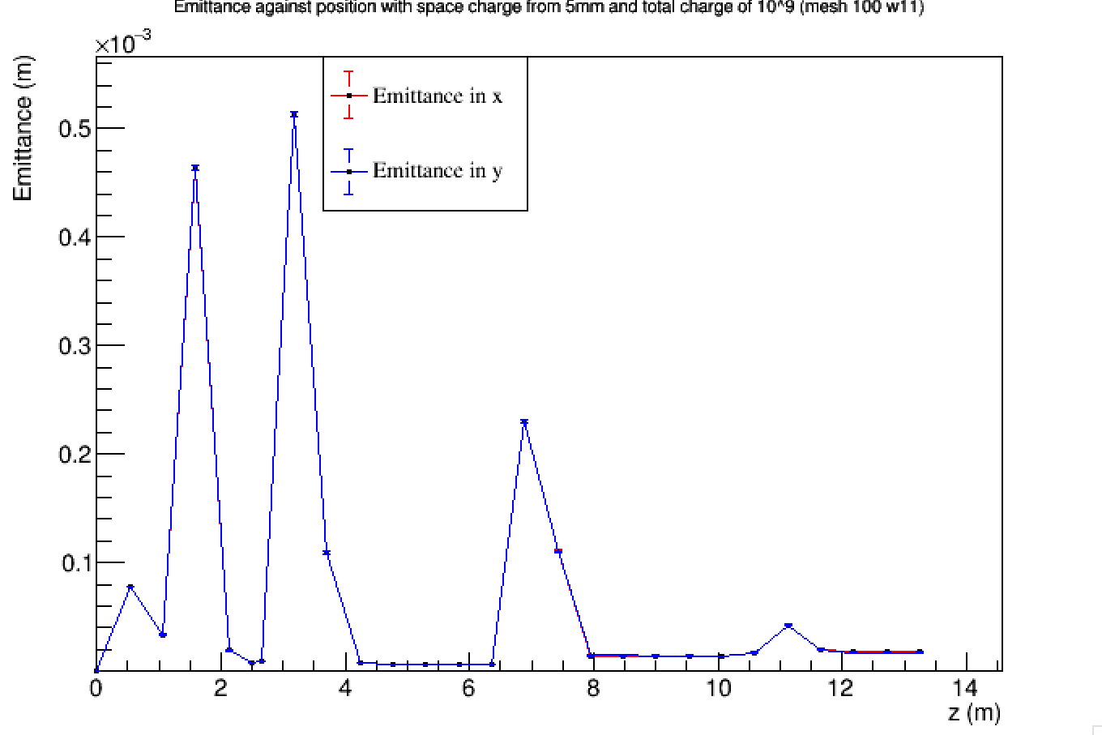
Space charge effects – Emittance plots

Slide 13
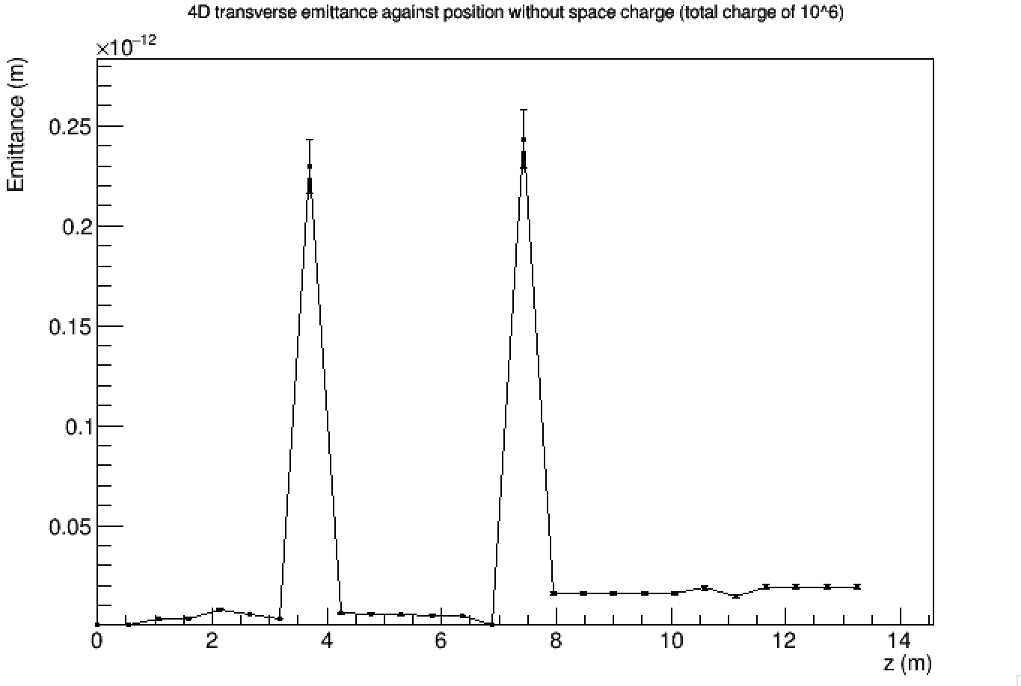

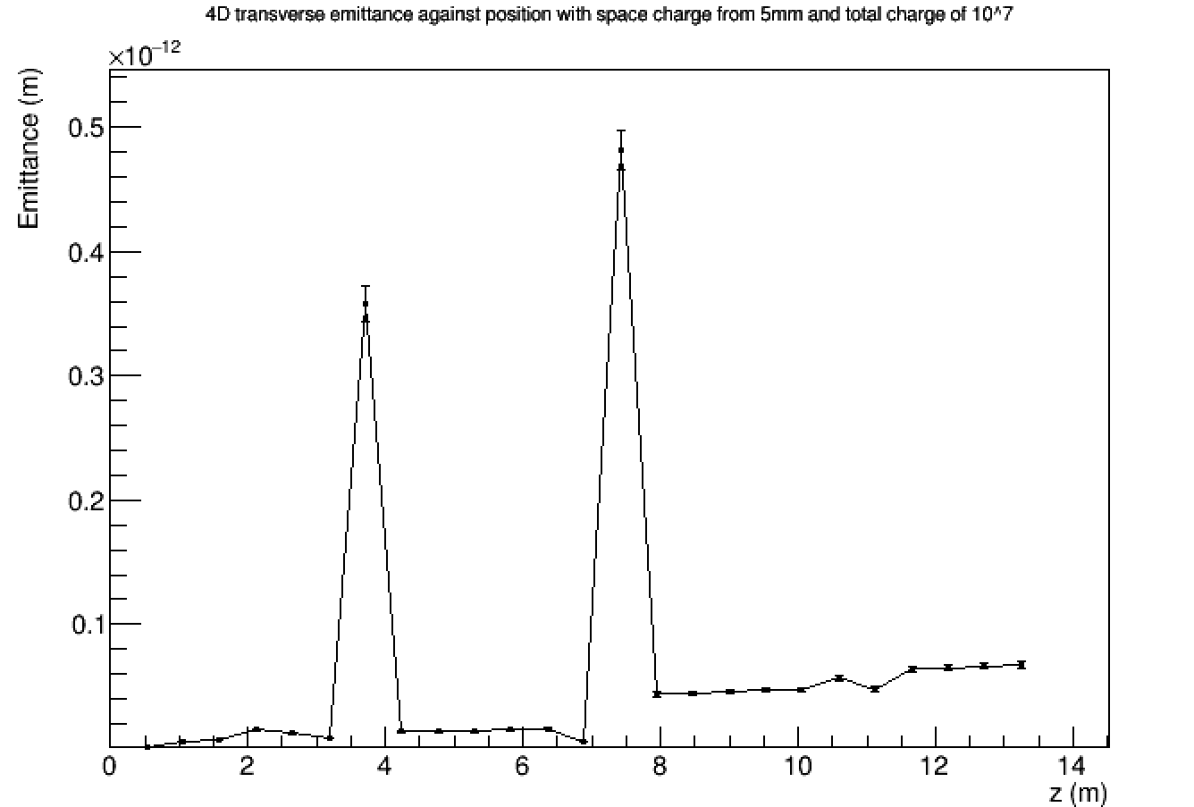
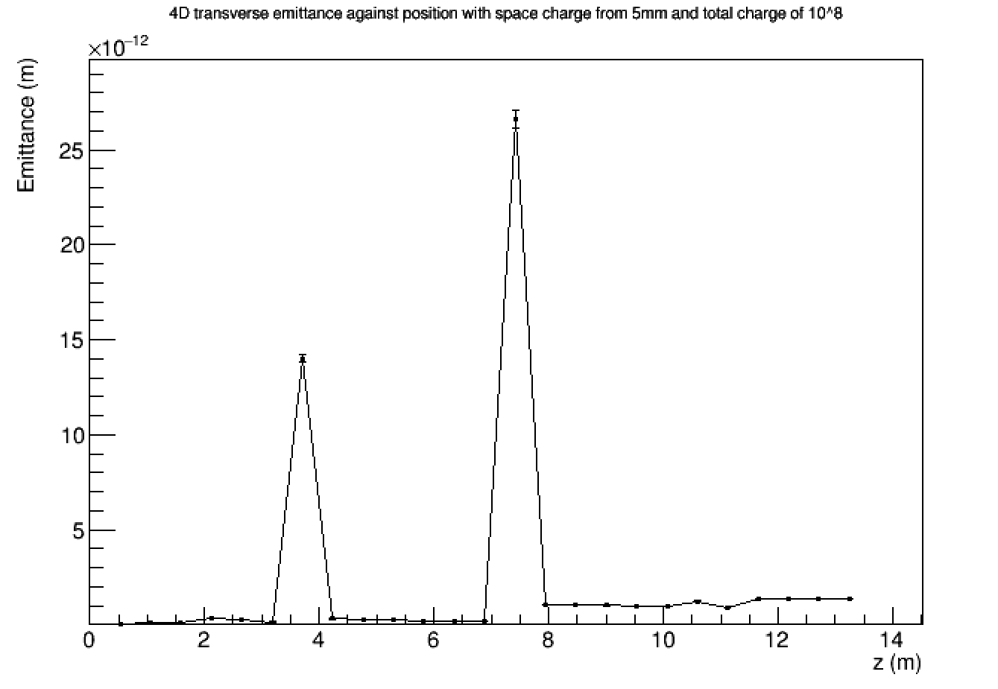
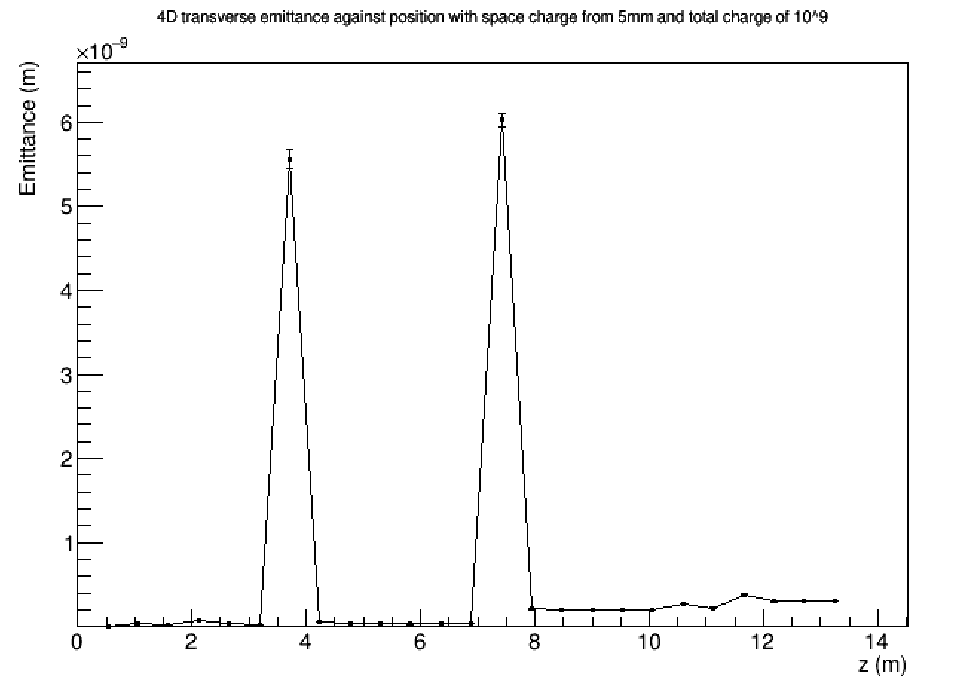
Space charge effects – Emittance plots

Slide 14
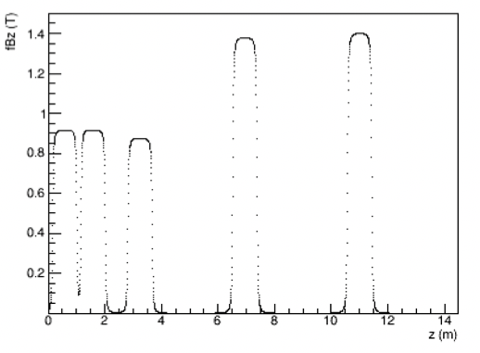
Space charge effects – Emittance plots

Slide 15
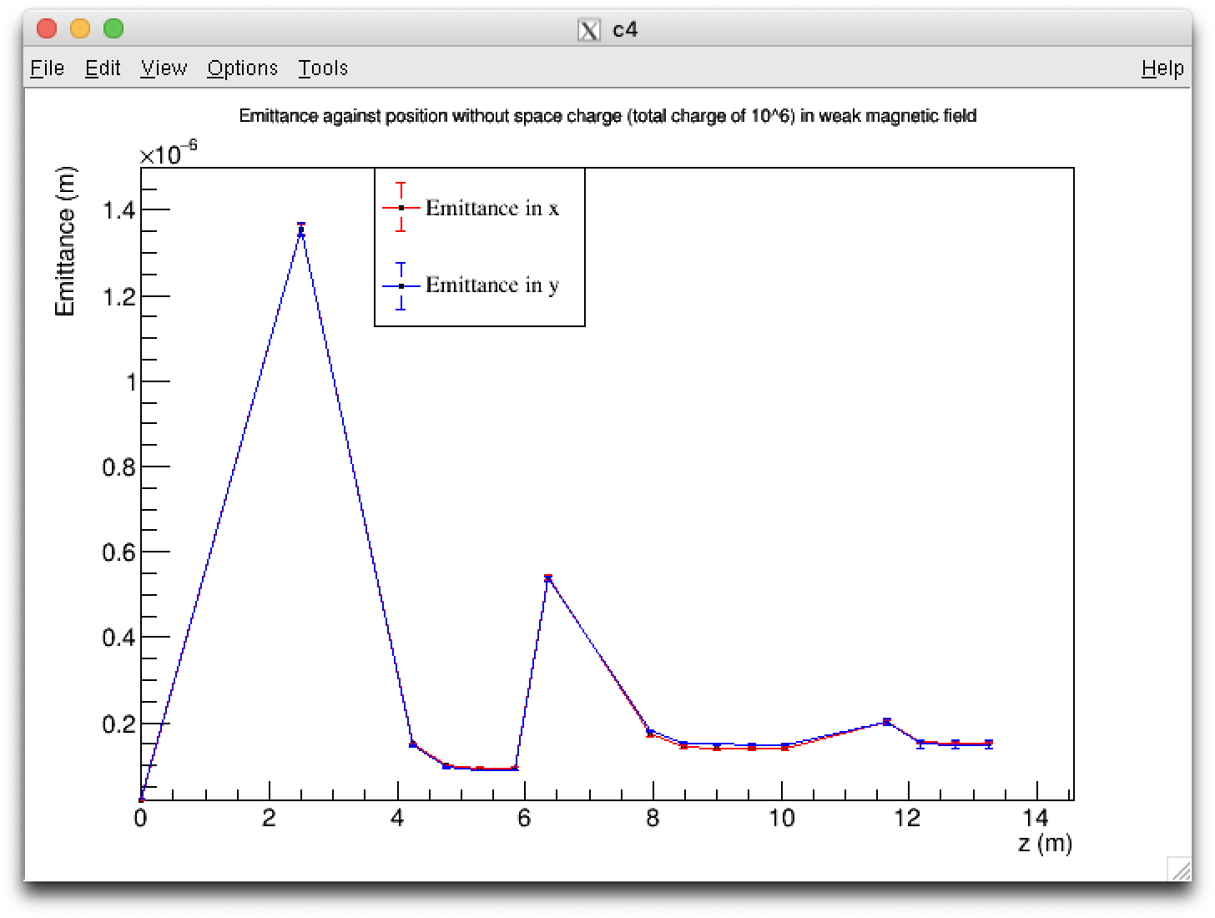
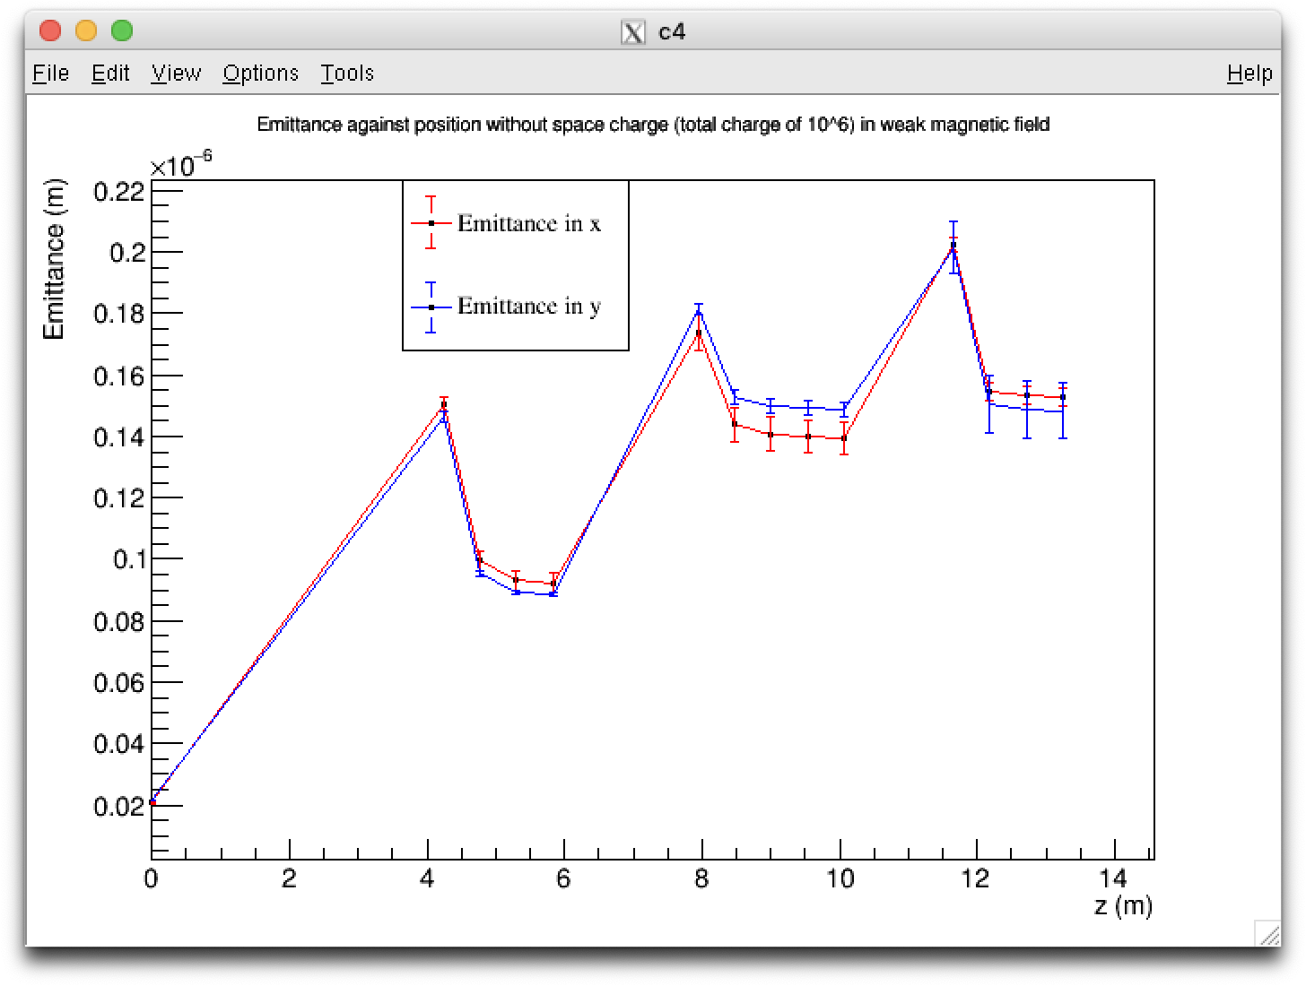
Space charge effects – Emittance plots

Slide 16
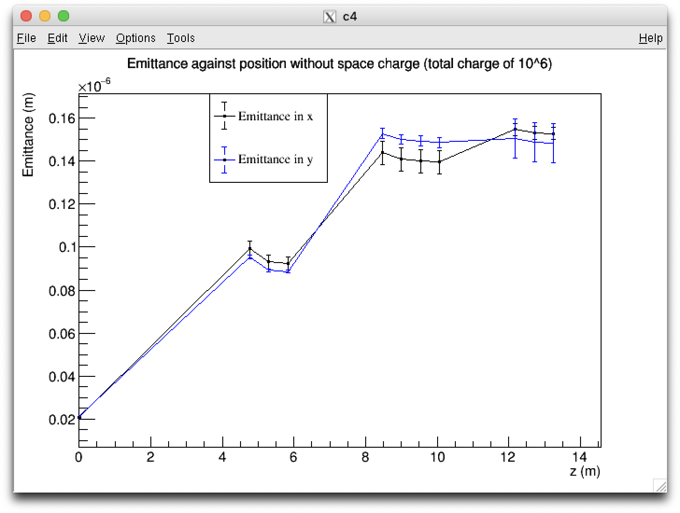
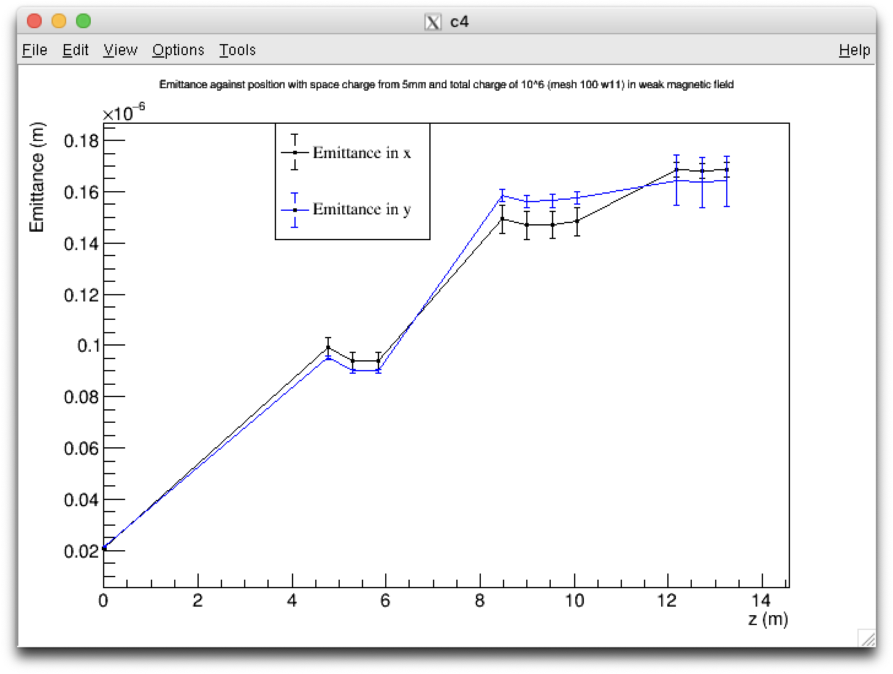
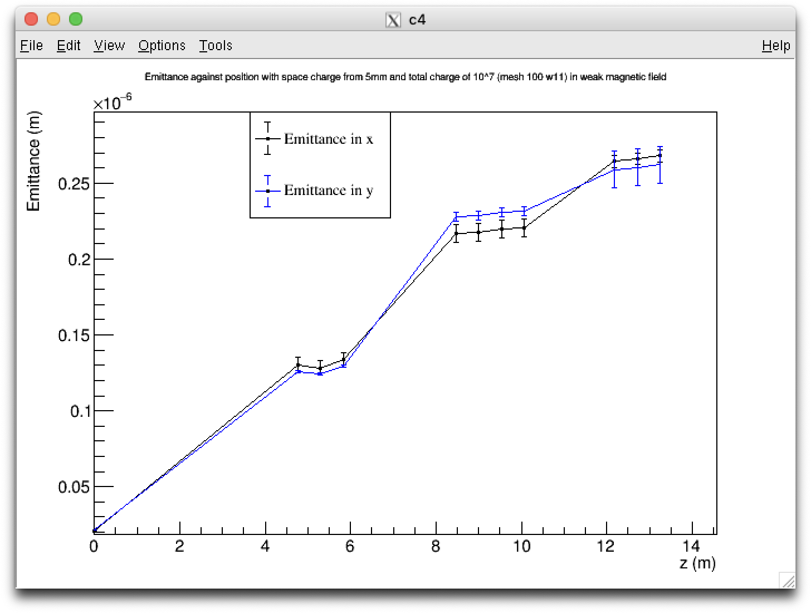
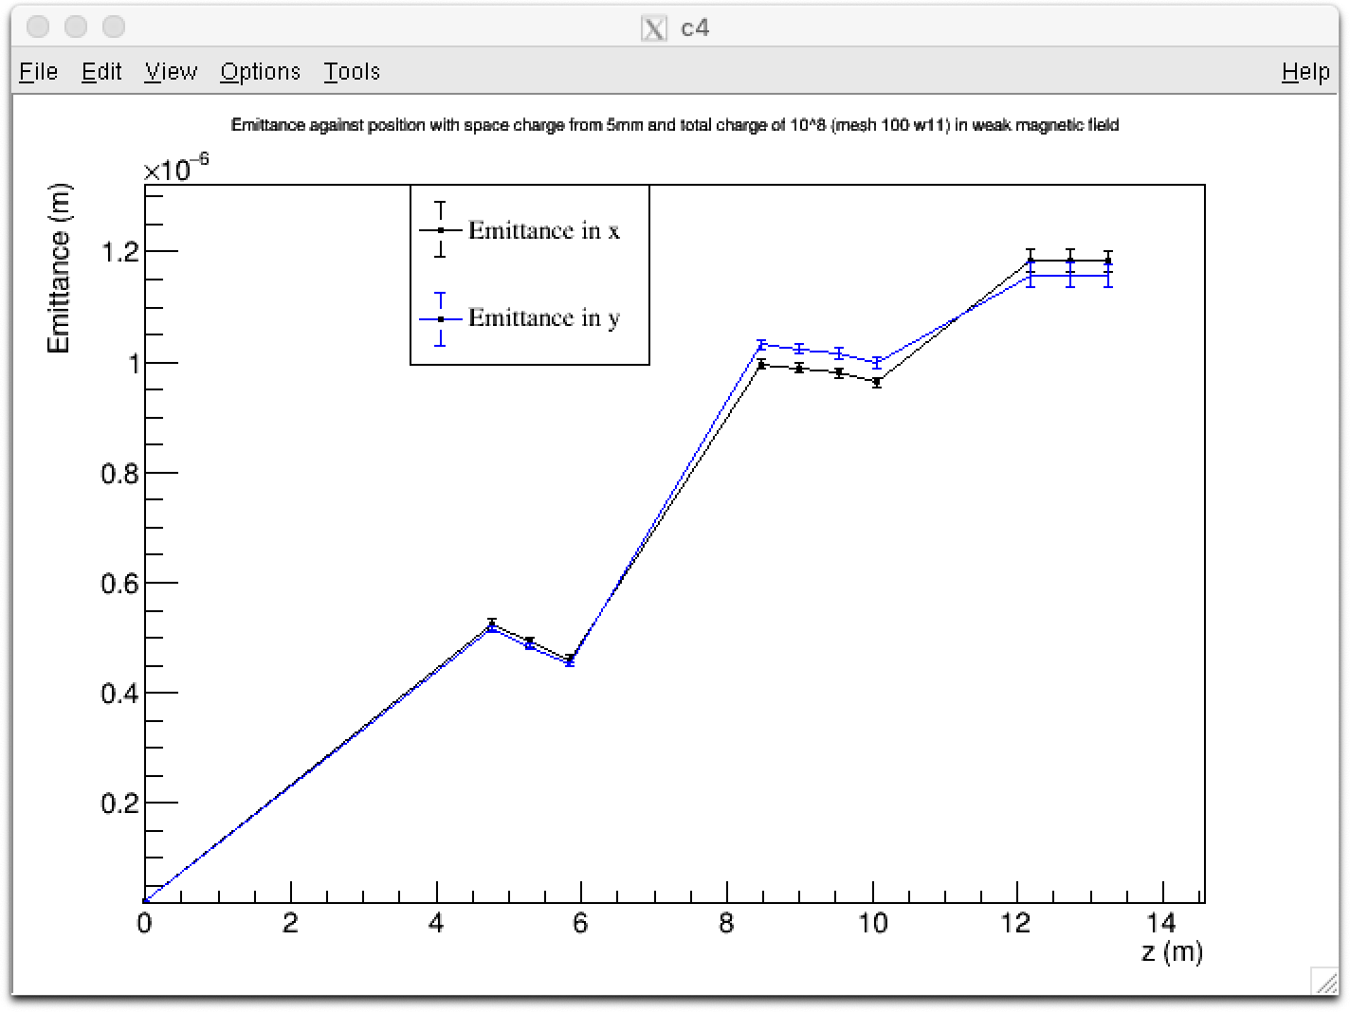
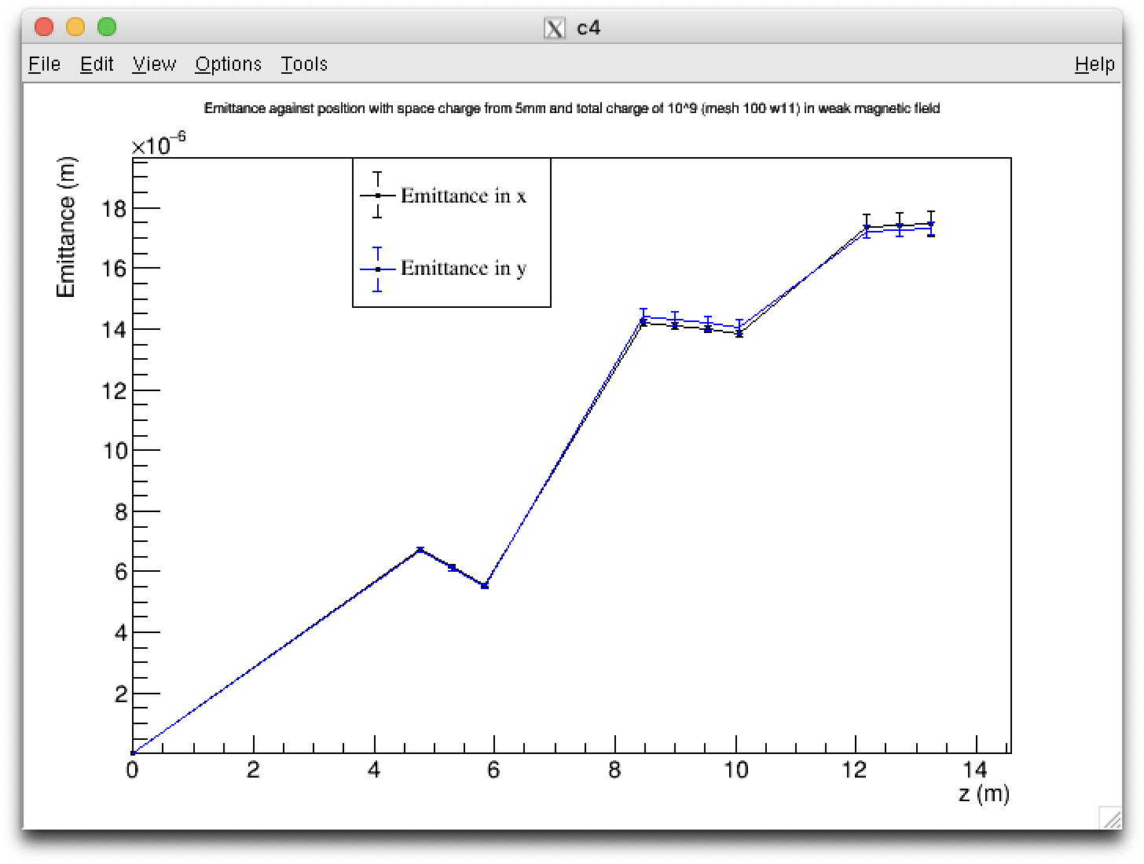
Space charge effects – Emittance plots

Slide 17
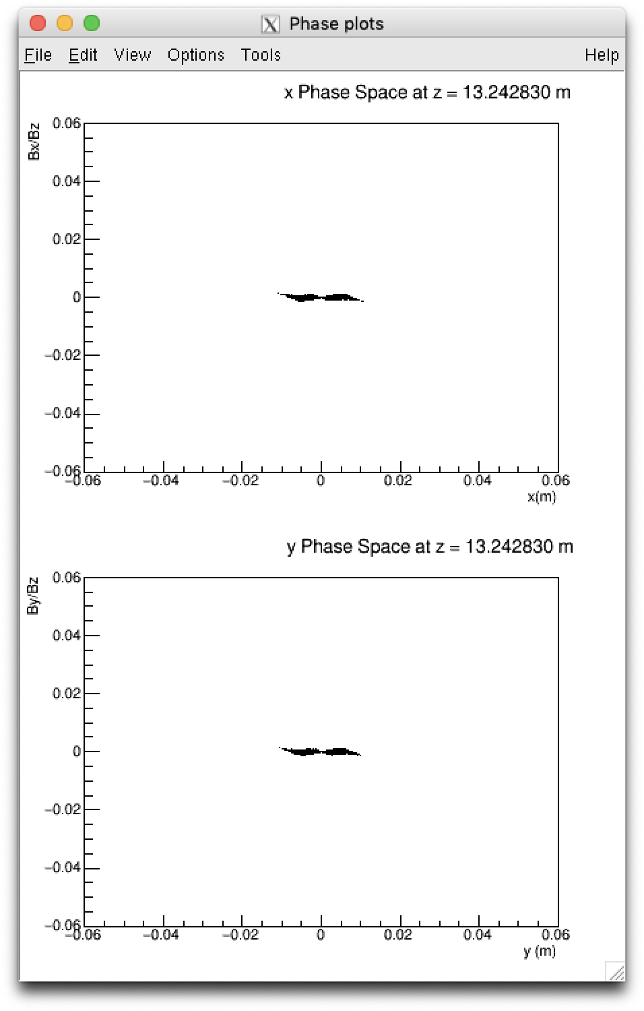
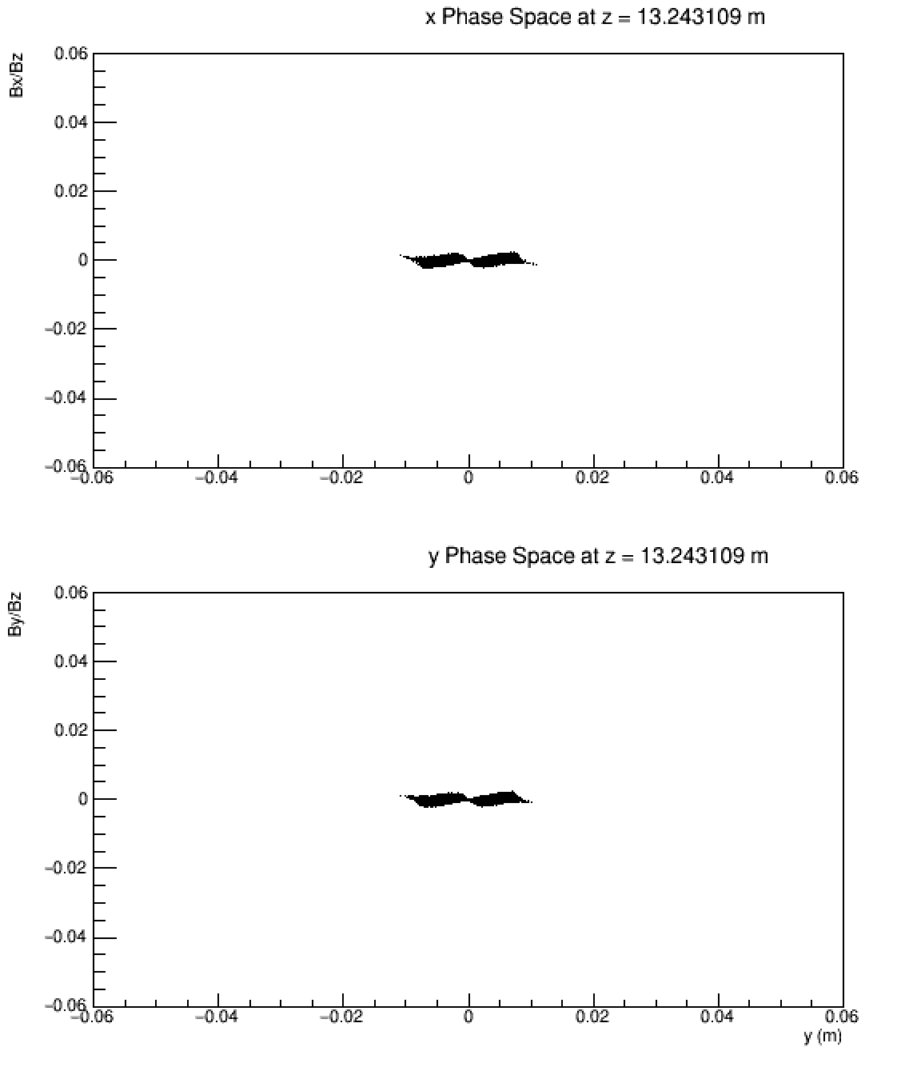

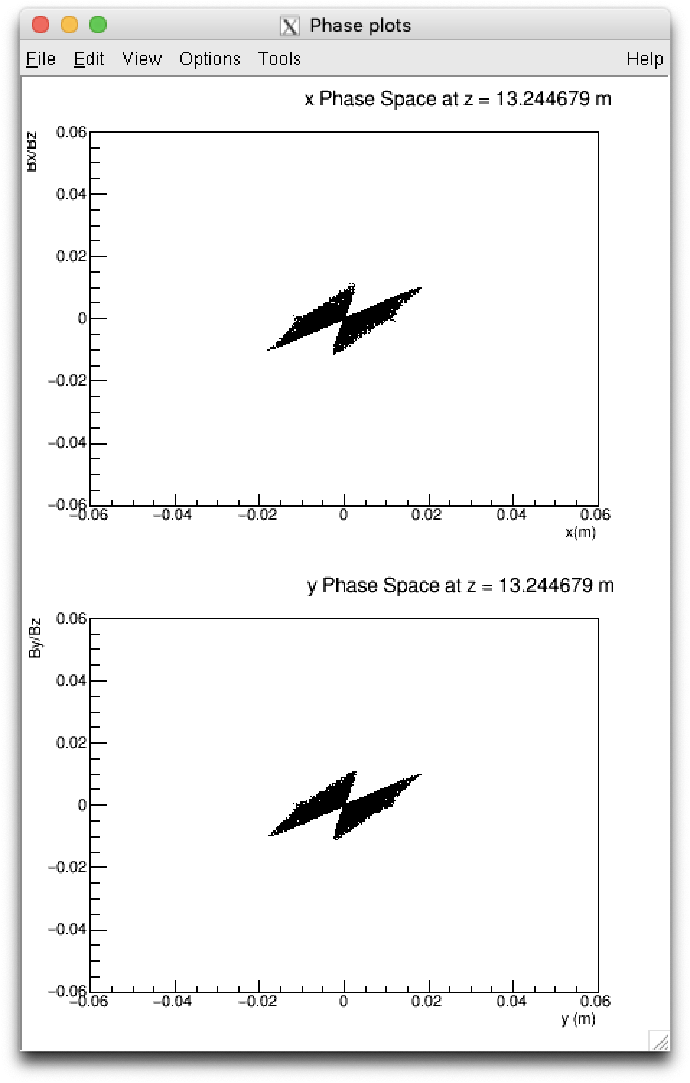
Space charge effects – Testing intermediate intensities

Slide 18
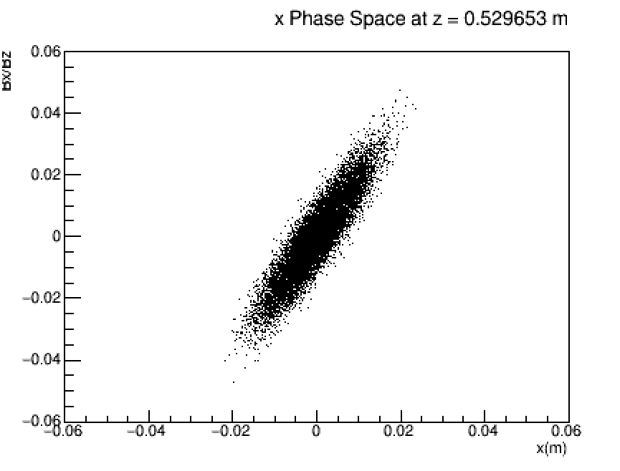
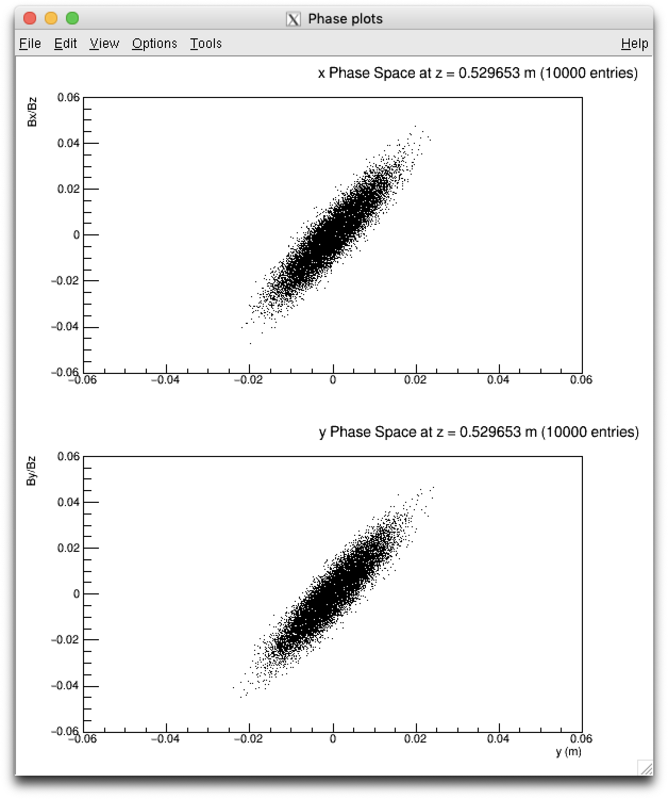
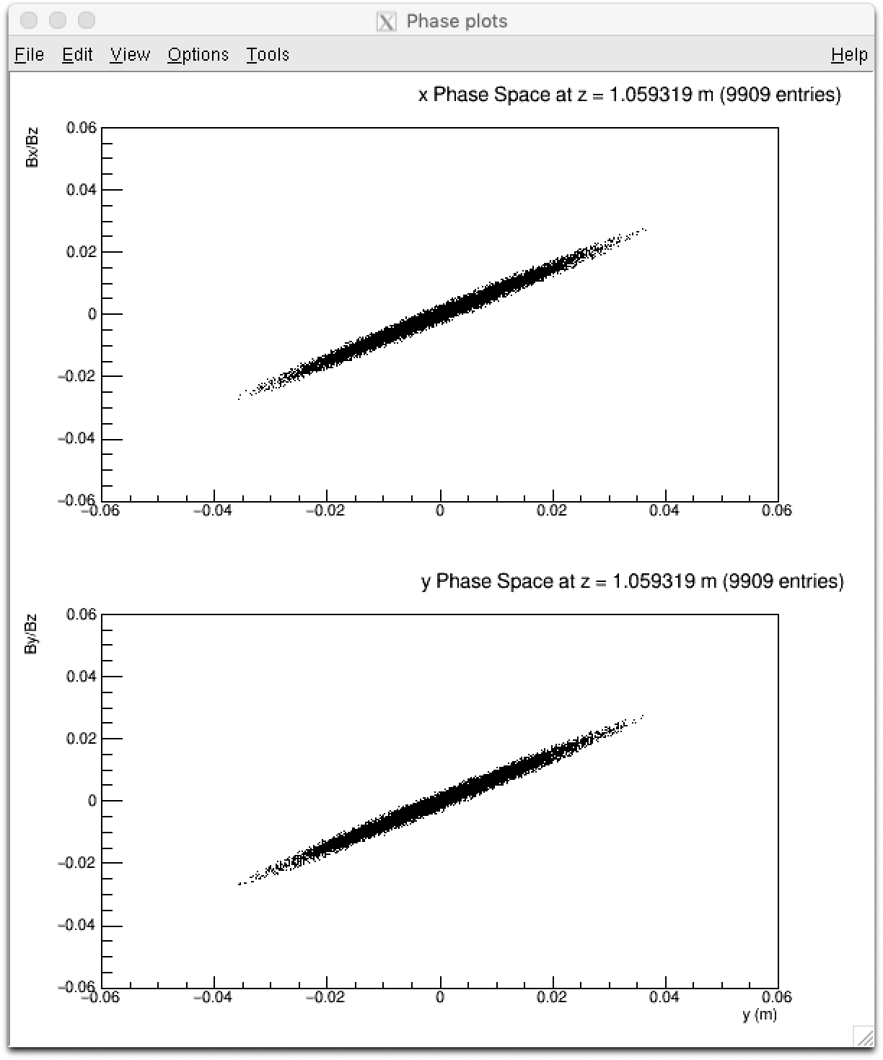
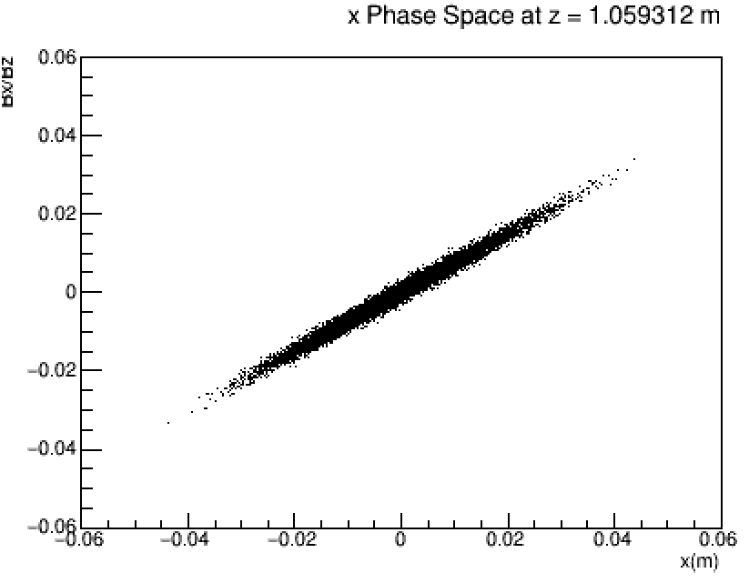
Aperture – Intensity of 10⁸ particles
t (10⁻⁸ s)
Aperture of 1 m
Aperture of 3.75 cm
1
2

Slide 19
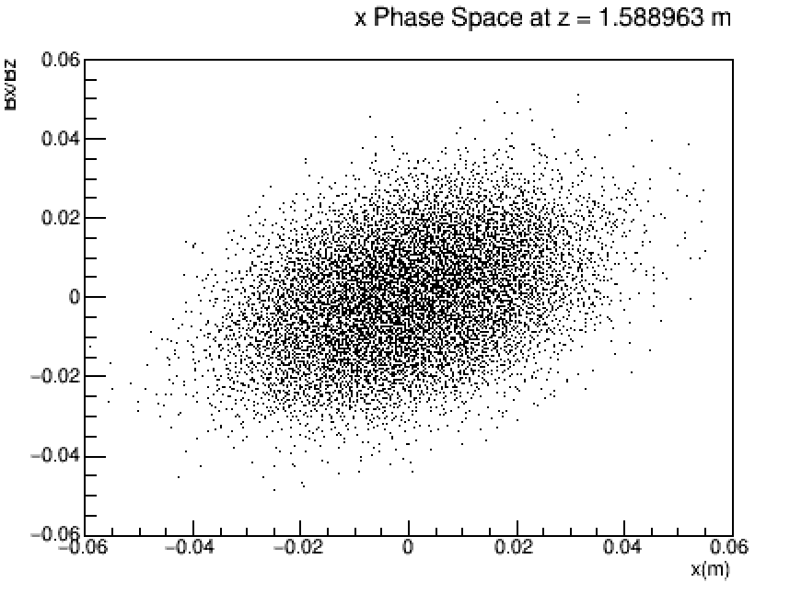
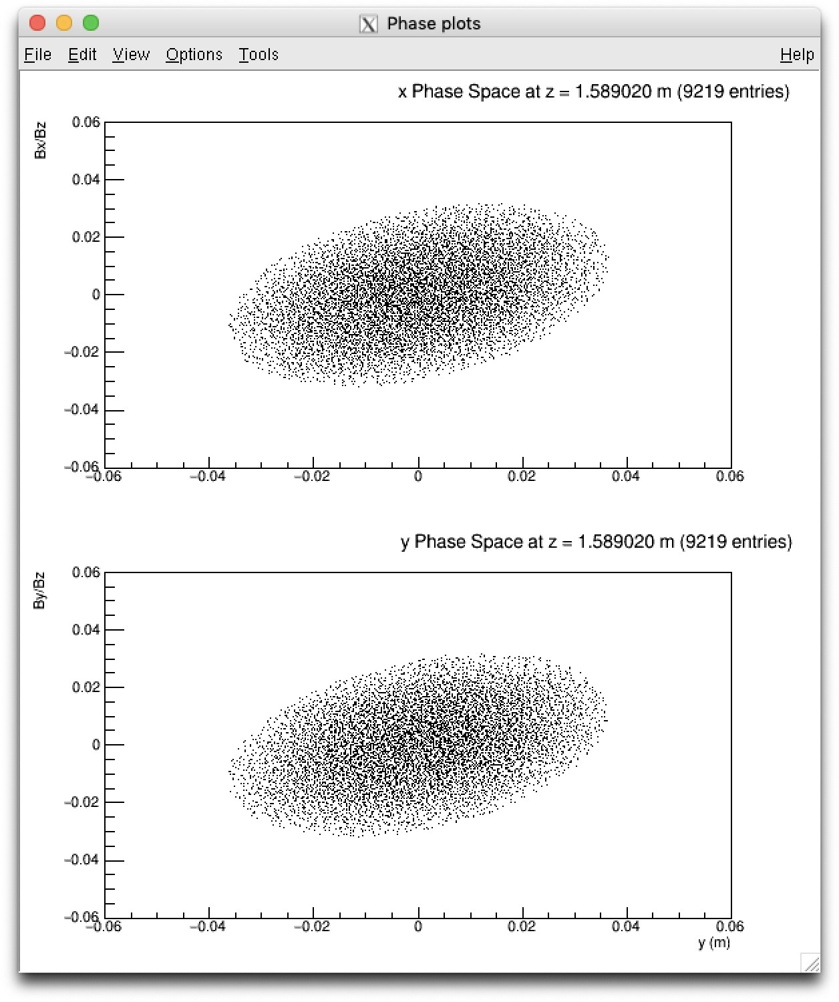
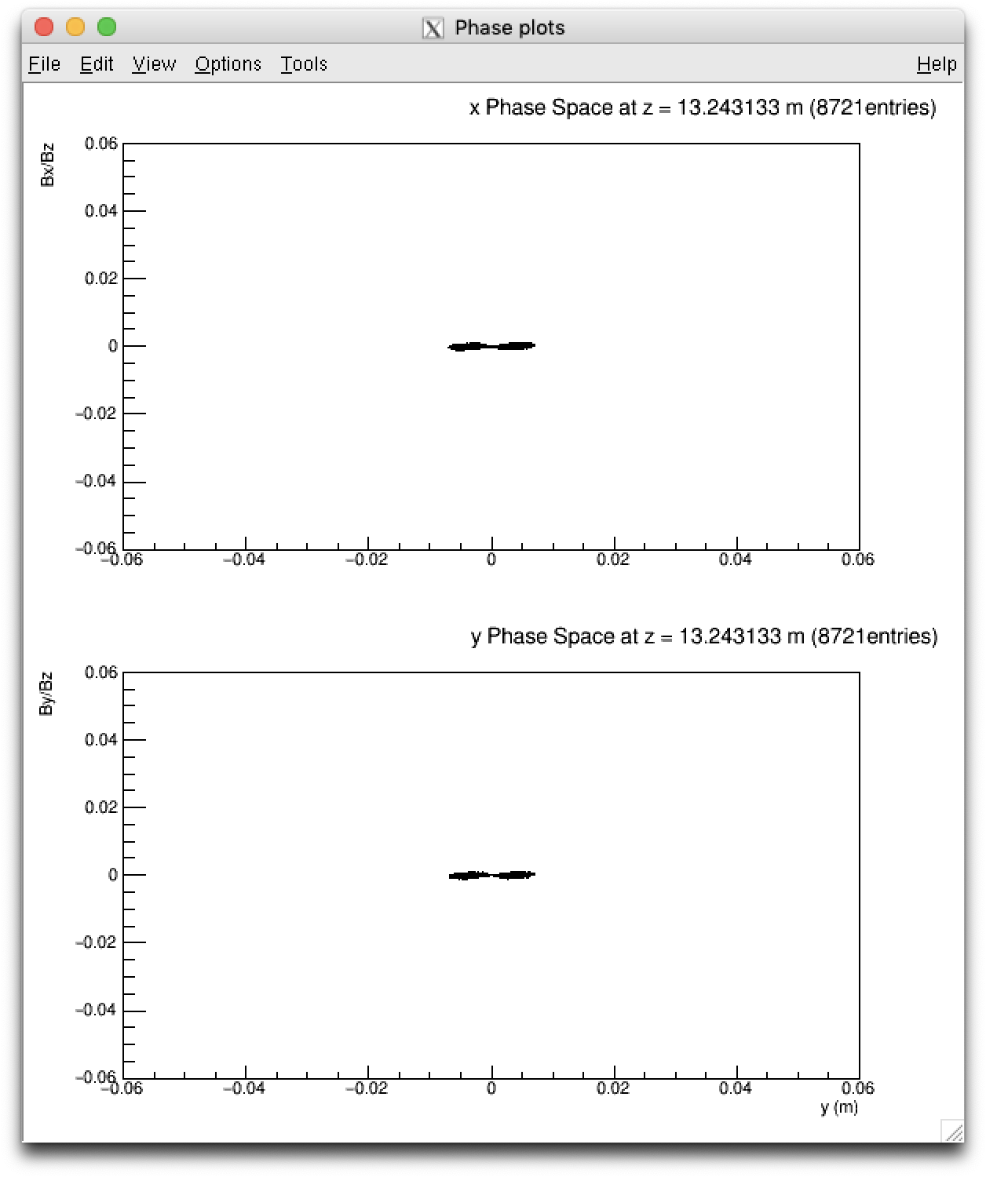
Aperture – Intensity of 10⁸ particles
t (10⁻⁸ s)
Aperture of 1 m
Aperture of 3.75 cm
3
25

Slide 20
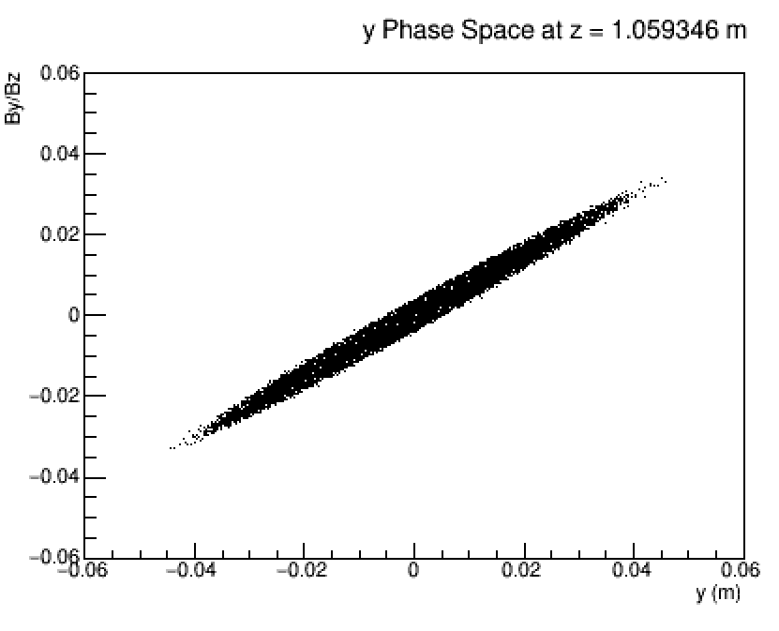
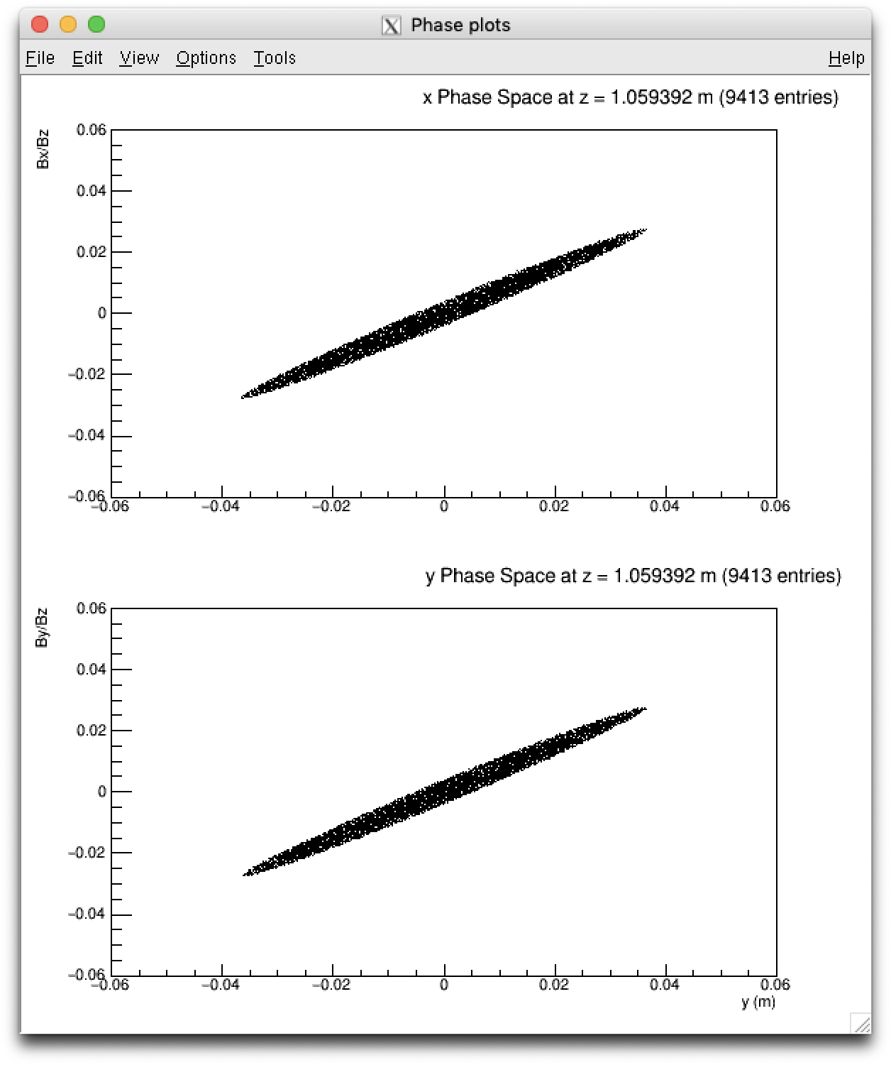
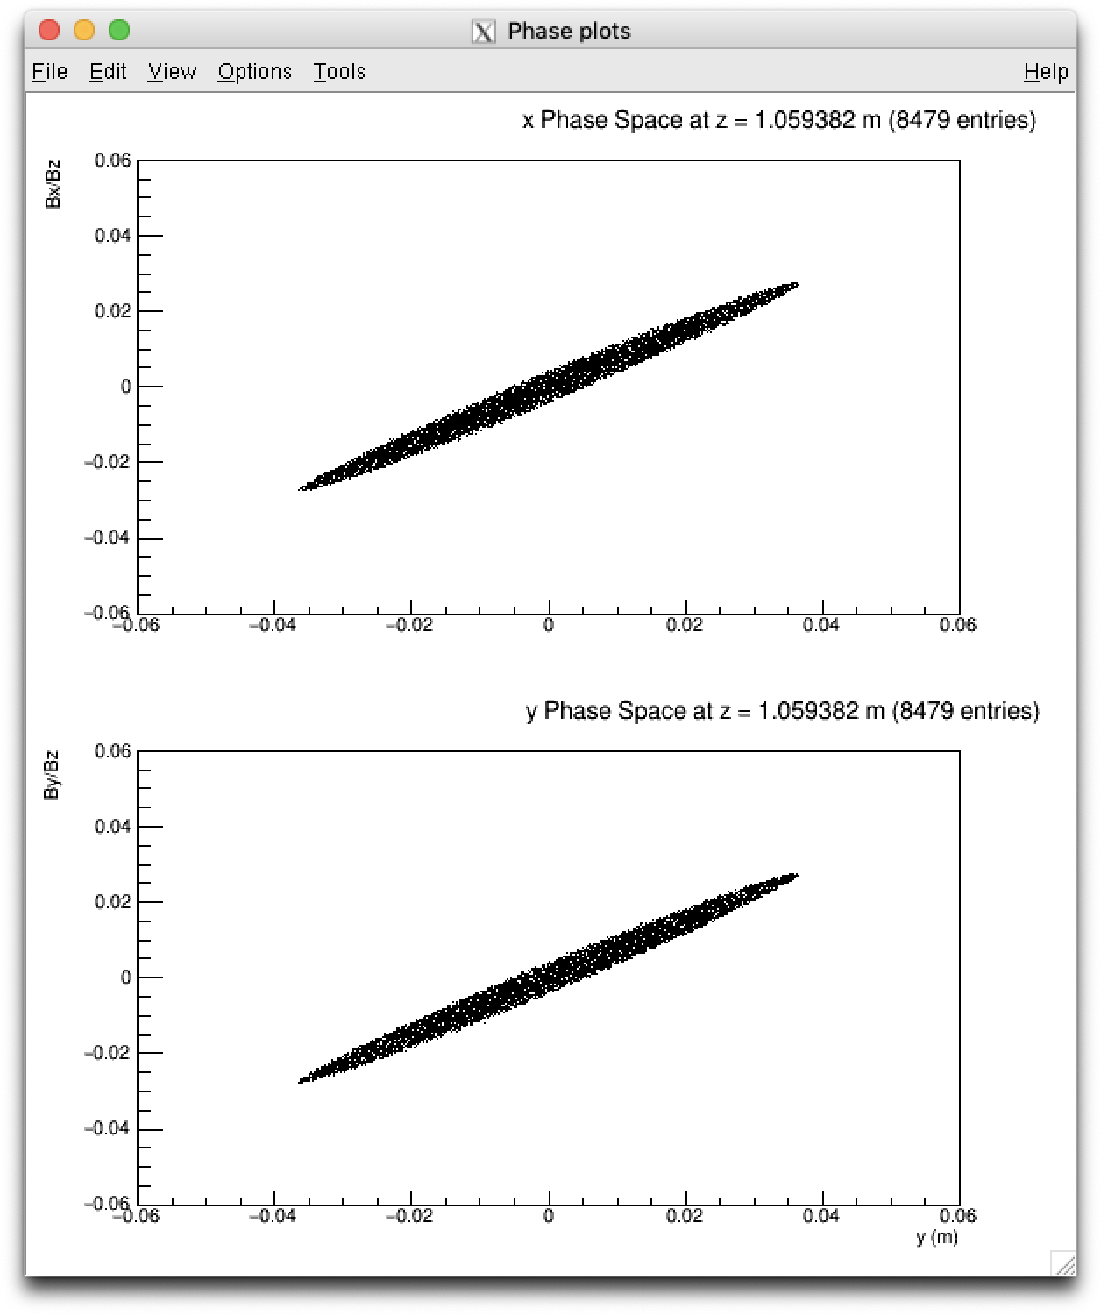
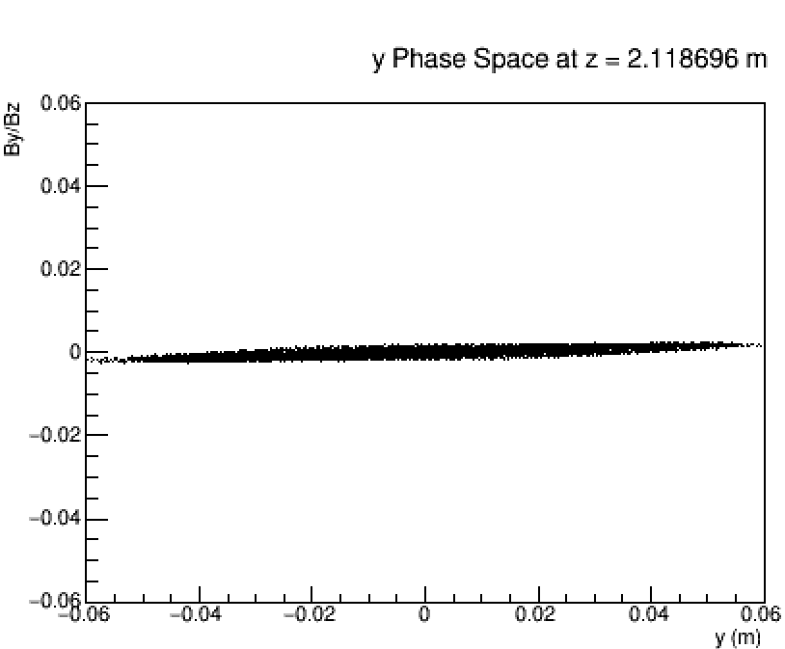
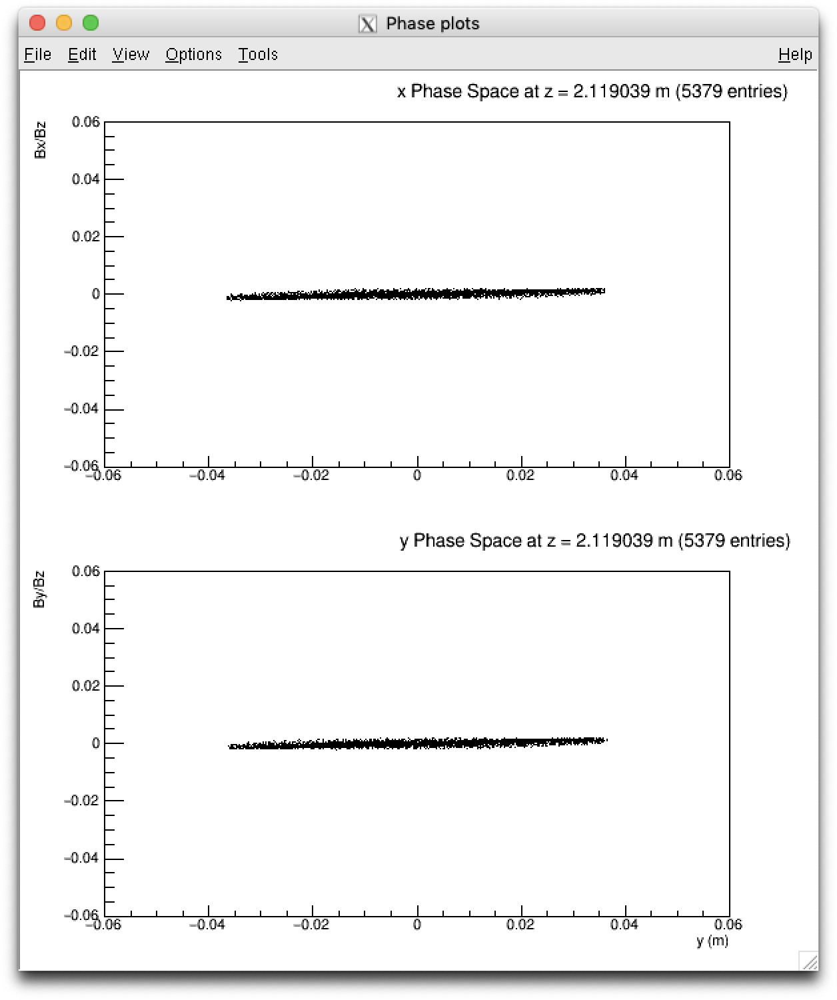

Aperture – Intensity of 10⁹ particles
t (10⁻⁸ s)
Aperture of 1 m
Aperture of 3.75 cm
Aperture of 3.75 cm (no mesh lines)
2
4

Slide 21
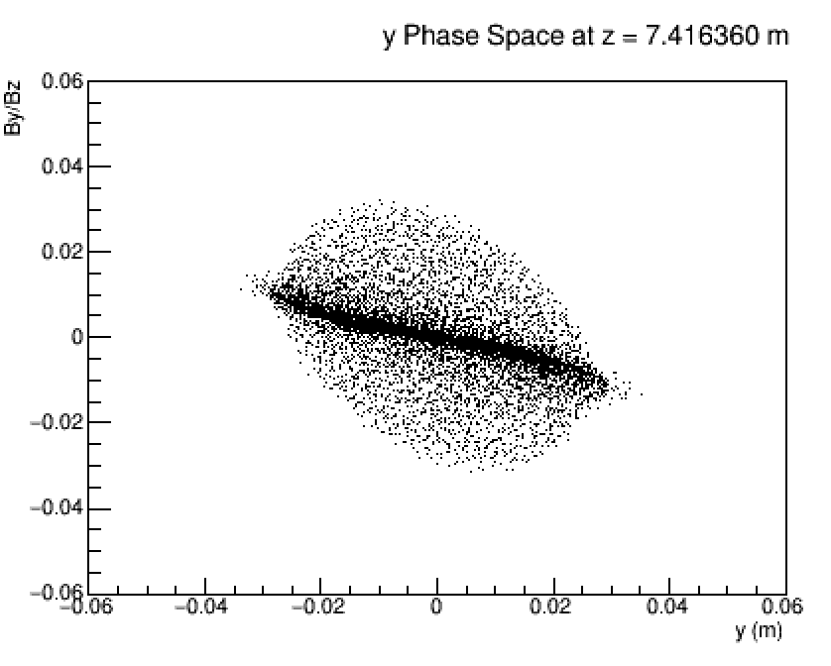
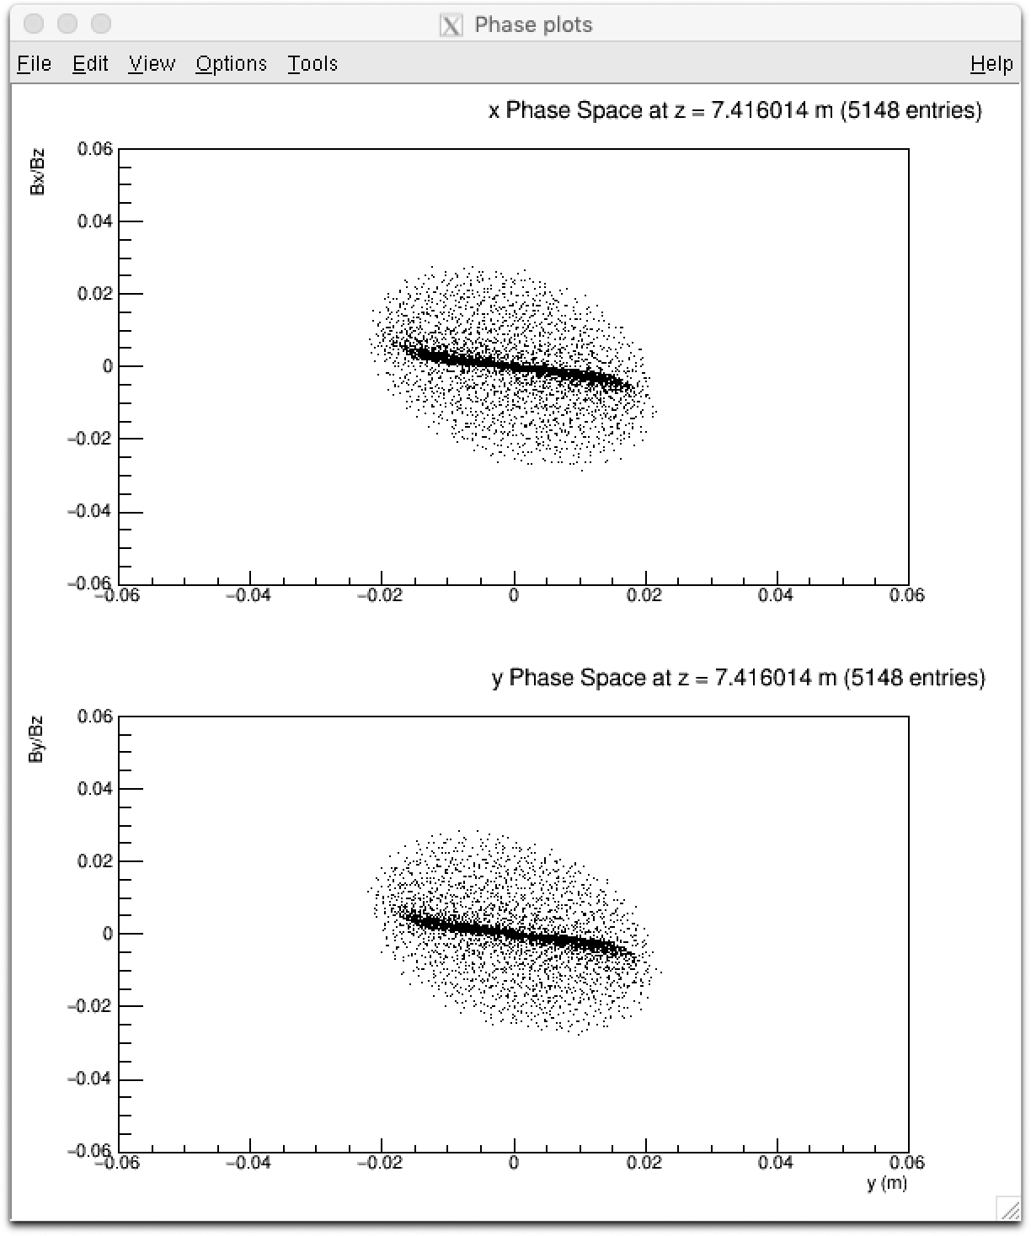
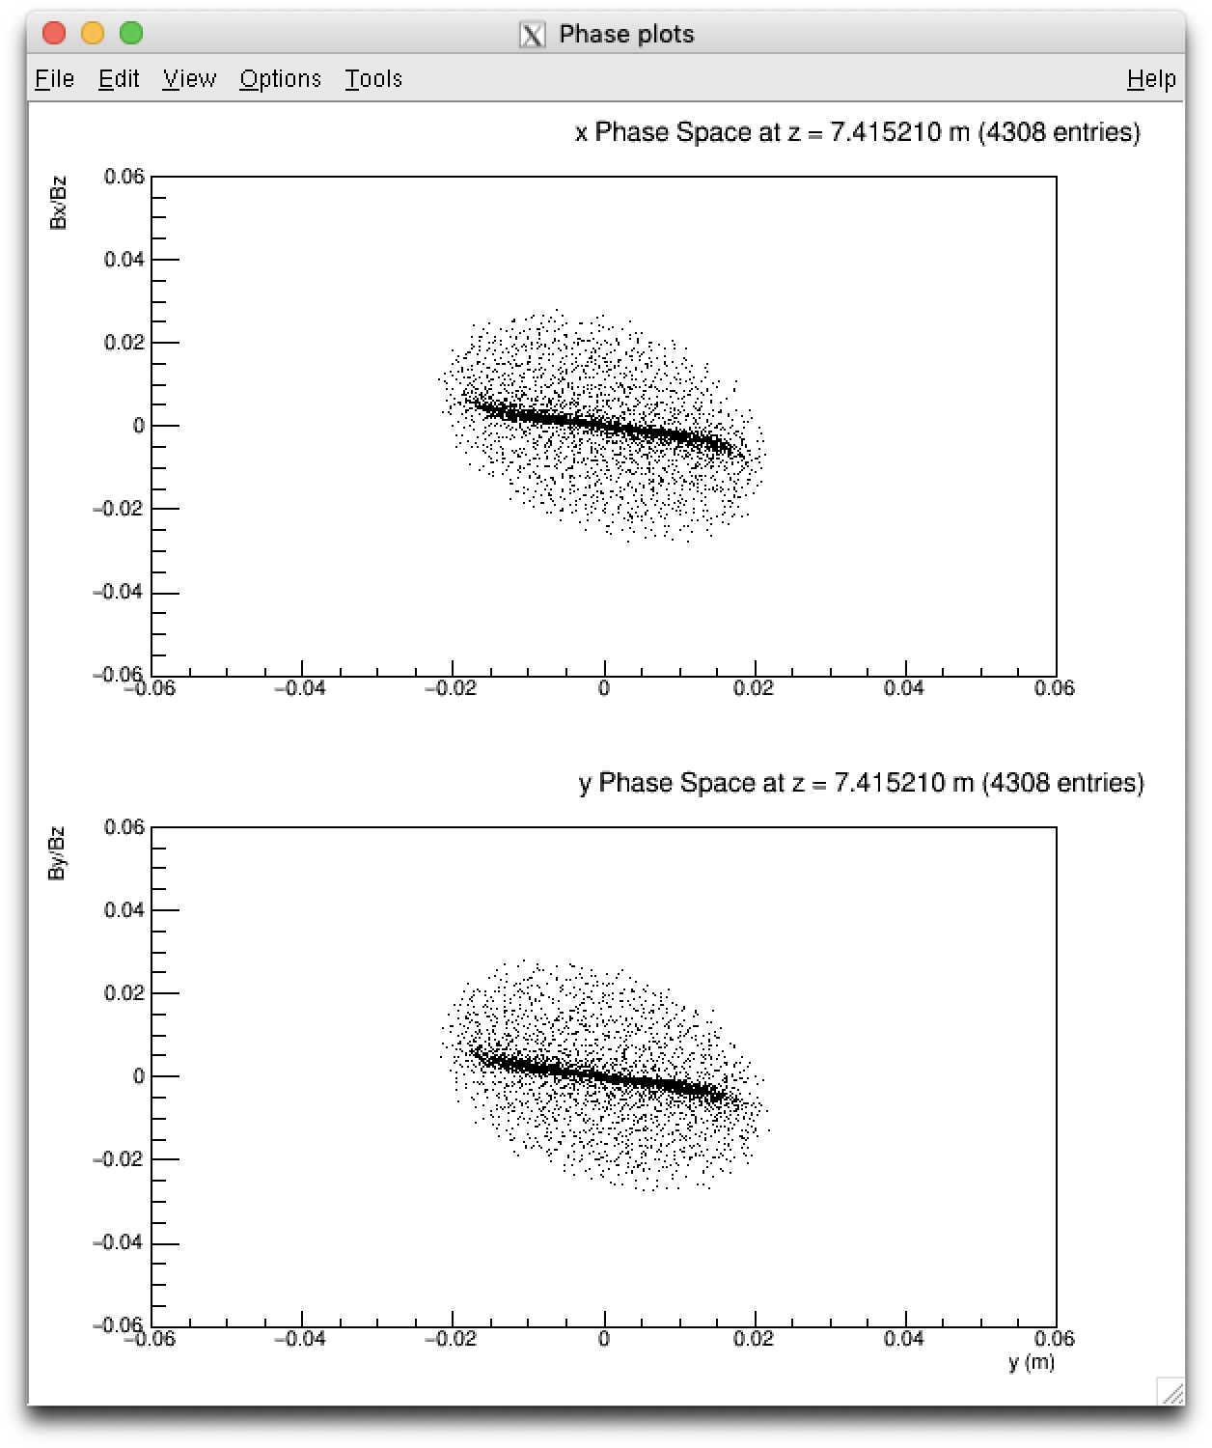
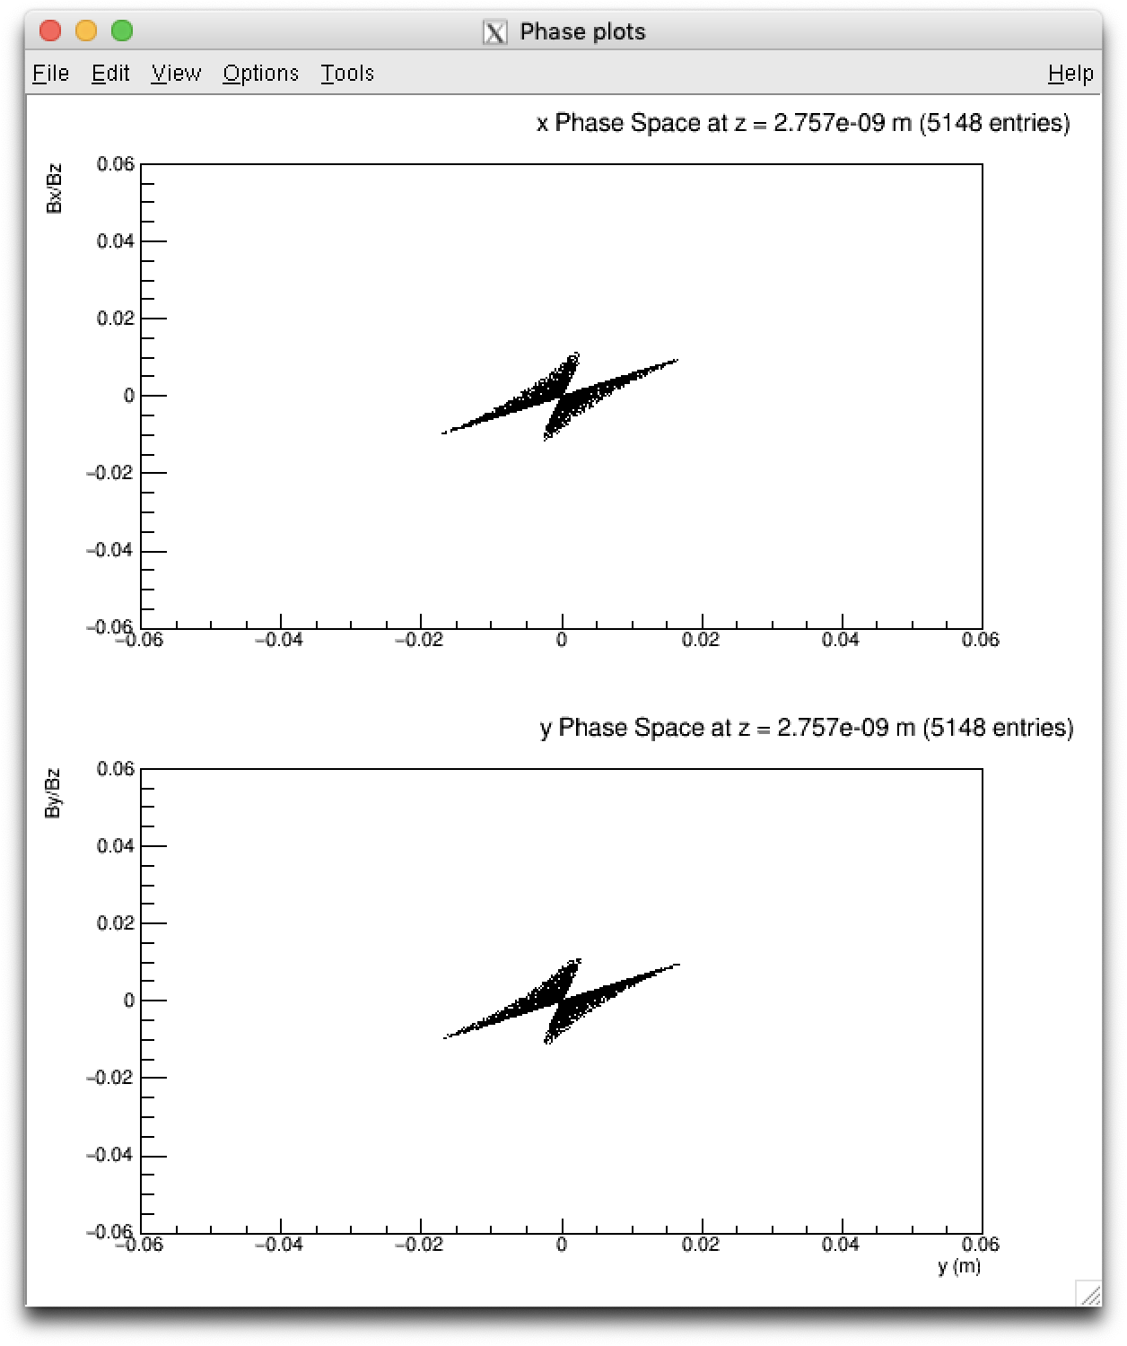
Aperture – Intensity of 10⁹ particles
t (10⁻⁸ s)
Aperture of 1 m
Aperture of 3.75 cm
Aperture of 3.75 cm (no mesh lines)
14
25

Slide 22
Number of mesh lines
Percentage difference in the mean emittance
Number of mesh lines | 100x100x250
40x40x100 | 1.21 %
60x60x150 | 0.753 %
80x80x200 | 0.300 %

Slide 23
Number of mesh lines
Percentage difference in the mean emittance
Number of mesh lines | 100x100x250
40x40x100 | 1.21 %
60x60x150 | 0.753 %
80x80x200 | 0.300 %
Discrepancy of 4.82 % between the “spacecharge3Dmesh” and “spacecharge3D” routines

Slide 24
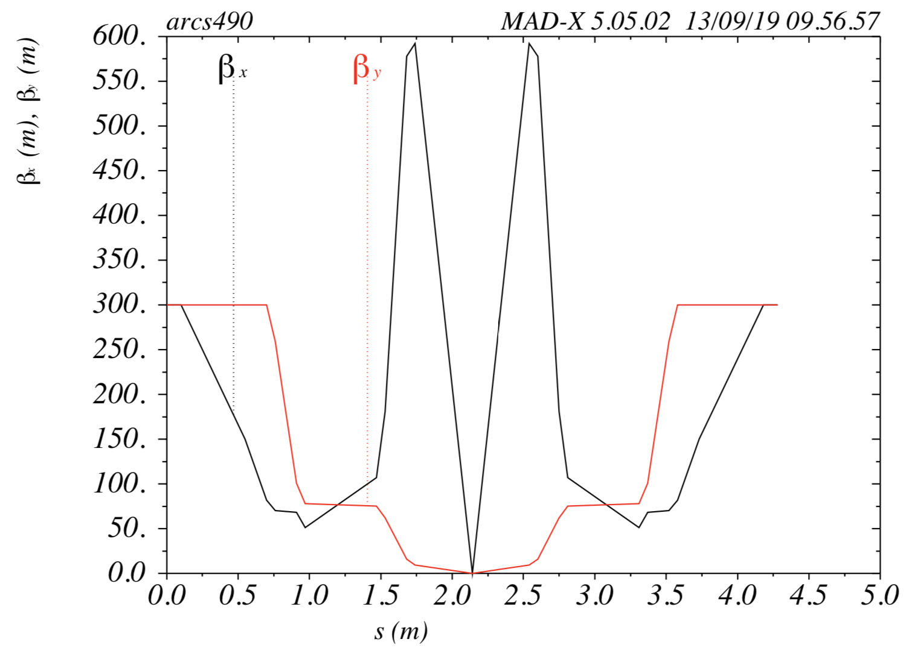



Matching of the arc with MAD-x – 8 quadrupoles

Slide 25




Matching of the arc with MAD-x – 6 quadrupoles

Slide 26

Matching with GPT – 50 percent change

Slide 27

Matching with GPT – 50 percent change

Slide 28



Matching with GPT – Results at t = 3 s
No space charge:
Original magnetic fields
Space charge effect with 10⁹ particles:
Original magnetic fields
Space charge effect with 10⁹ particles:
B₁ = 1.373 T, B₂ = 0.5 T

Slide 29
Conclusion
Phase space plots show no large difference between no space charge and bunch intensities of 10⁸ particles
Emittance plots in weak magnetic fields show a noticeable (but small) difference with smaller intensities as well
Half of the particles are lost with an aperture of 3.75 cm for an intensity of 10⁹ particles
Arc matched with MAD-x but need to see the effect of the focus point

