Slide 1
Time to traverse Bragg peak
… & …
Characteristic frequency
KL, building on code written by Anthea MacIntosh-LaRocque
28 September 2021

Slide 2
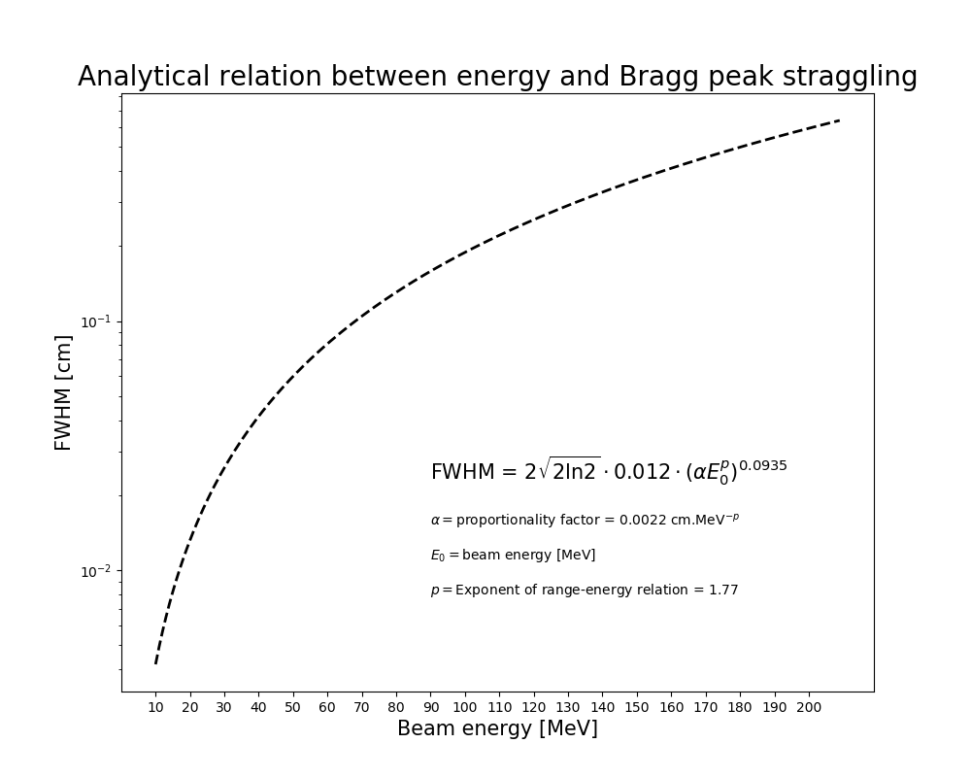
Process – analytical distributions
Bortfield (1997) paper outlines analytical approximation of Bragg curve for proton beams in water
Used this analytic relation, based off code from HT Lau, to predict the energy deposition as a function of z in a water phantom
Produced plots of the Bragg peak FWHM as a function of energy
Presented at ionacoustic meeting
Python files: \amlr_urop\Code\BortfieldApproximation\
Characteristic length ~ 100 μm

Slide 3
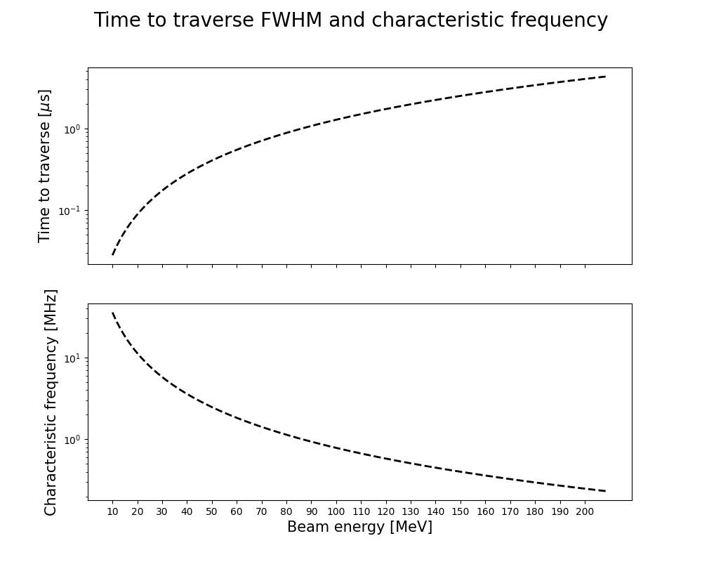
Time to traverse FWHM and characteristic frequency
Take speed of sound to be 1481 m/s (at 20ºC)
  https://www.engineeringtoolbox.com/sound-speed-water-d_598.html
Δt = FWHM / (speed of sound)
Characteristic frequency = 1/Δt
Looks like characteristic frequency generated by Bragg peak is:
  ~20 MHz

Slide 4
Discussion and questions

