Slide 1
Progress update
11 August 2021
Anthea MacIntosh-LaRocque, Josie McGarrigle, Karis Kungsamutr

Slide 2
Specifying particle parameters
Initially simulation allowed the variation of initial x-y position, momentum, and calculated z-momentum.
Energy distribution was coded into the simulation – but not read out of an input file.
Now, simulation takes initial:
X-Y position
X-Y momentum
Energy
Temporal delay
From an input file, allowing for these to be tuned/varied as we wish.

Slide 3
Checks
Cross-checked position and momentum distributions fed into simulation with that of the first energy deposition given by simulation
Also crossed checked with TOPAS – matches (although distributions are slightly different)

Slide 4
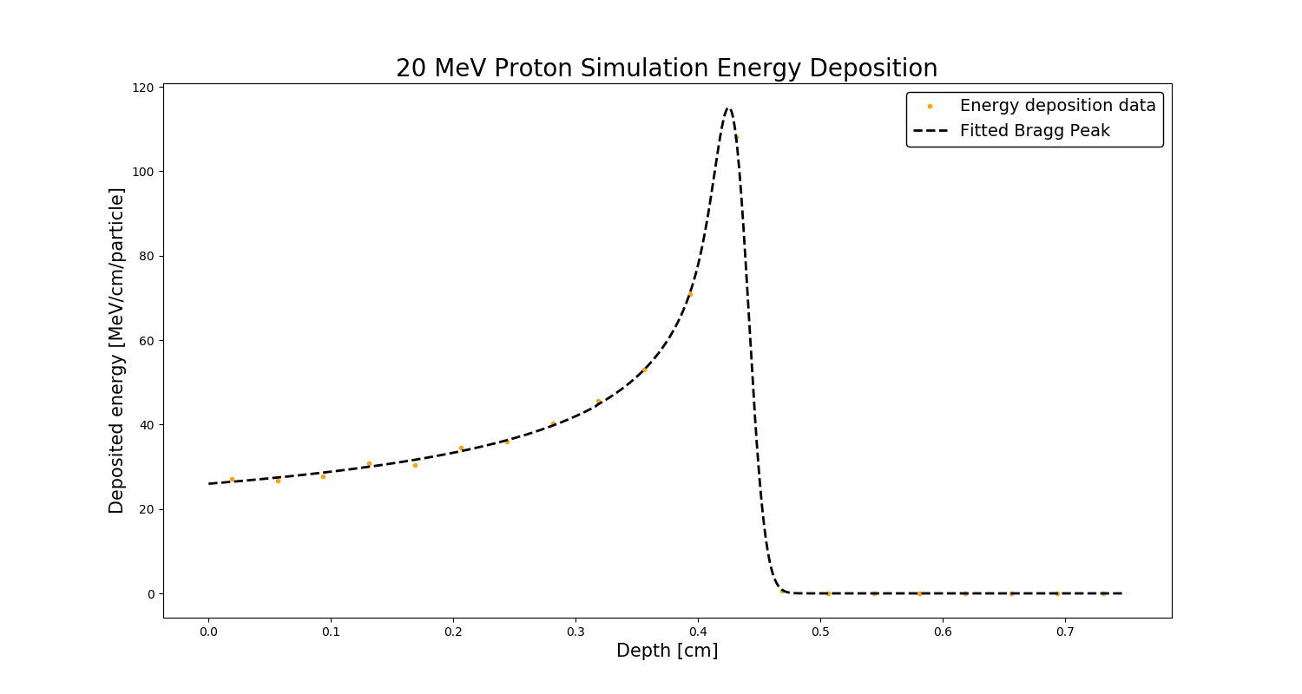
Checks
Beam energy [MeV] | Expected dE/dx [MeV/cm] from NIST data set
20 | 26.26
80 | 8.678
200 | 4.517
Varied particle energy between 10 MeV and 200 MeV
Checked against energy/cm plots given from NIST data (https://physics.nist.gov/PhysRefData/Star/Text/PSTAR.html)
Fit to analytical equation – Bortfeld T. An analytical approximation of the Bragg curve for therapeutic proton beams. Med Phys. 1997

Slide 5
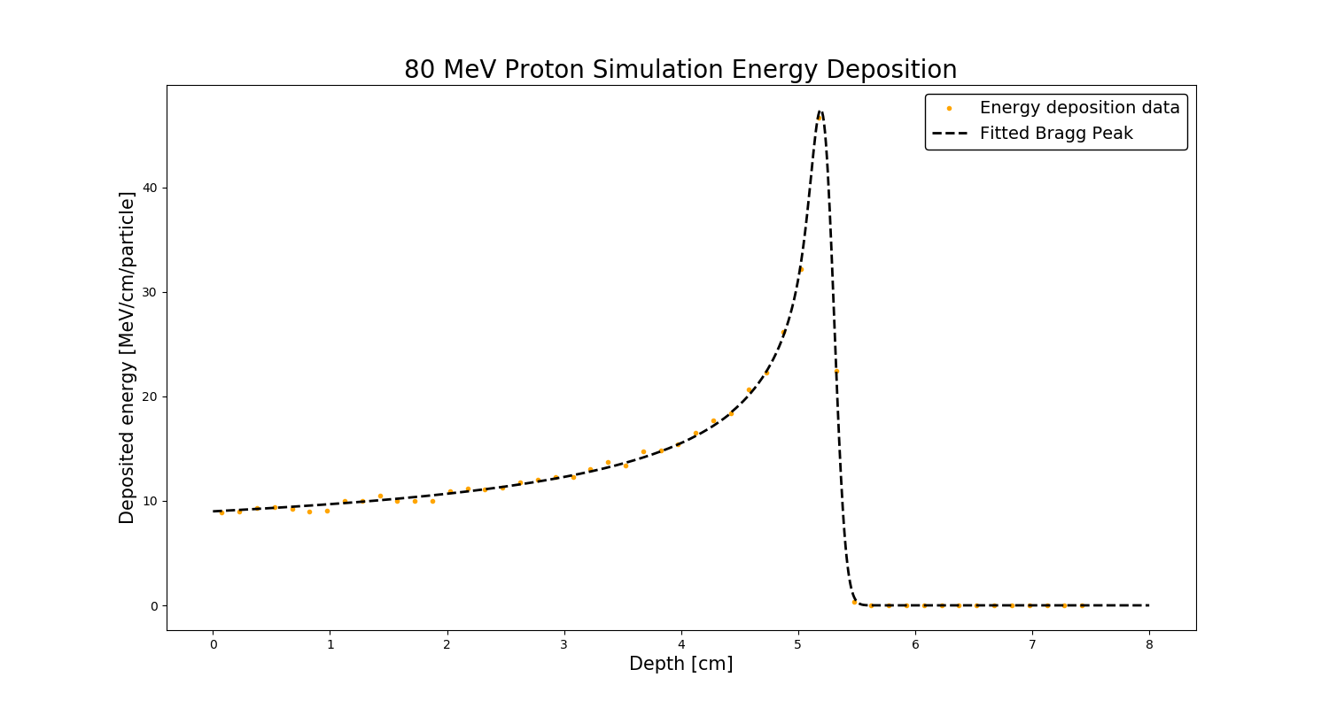
Checks
Beam energy [MeV] | Expected dE/dx [MeV/cm] from NIST data set
20 | 26.26
80 | 8.678
200 | 4.517
Varied particle energy between 10 MeV and 200 MeV
Checked against energy/cm plots given from NIST data (https://physics.nist.gov/PhysRefData/Star/Text/PSTAR.html)
Fit to analytical equation – Bortfeld T. An analytical approximation of the Bragg curve for therapeutic proton beams. Med Phys. 1997

Slide 6
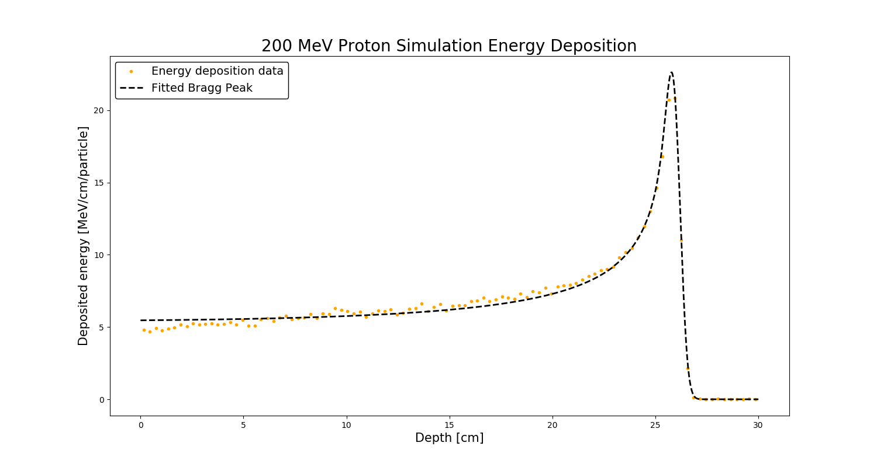
Checks
Beam energy [MeV] | Expected dE/dx [MeV/cm] from NIST data set
20 | 26.26
80 | 8.678
200 | 4.517
Varied particle energy between 10 MeV and 200 MeV
Checked against energy/cm plots given from NIST data (https://physics.nist.gov/PhysRefData/Star/Text/PSTAR.html)
Fit to analytical equation – Bortfeld T. An analytical approximation of the Bragg curve for therapeutic proton beams. Med Phys. 1997

Slide 7
Input files
With checks now in hand…
Created 4 additional sets, “batches”, of files which vary different parameters independently:
X- and y-position spread ----- cut off points for parabolic distribution
Normalised x- and y- momentum spread ----- cut off points for parabolic distribution
Standard deviation of energy spread
Standard deviation of entry time

Slide 8
Into simulation
Feed these values into the simulation
Output: “waterhits.dat” which tells us information about all energy depositions in run:
StationName --------------- (Always WaterBox)
EventNum --------------- (which particle caused the energy deposition)
Total Energy Deposit [MeV] X, Y, Z position
Global Time [ns]
Delta Time [ns] --------------- (time since last deposit for this event)
Particle type --------------- (e.g. proton, electron, etc….)
Plotted dose profiles for each run.

Slide 9
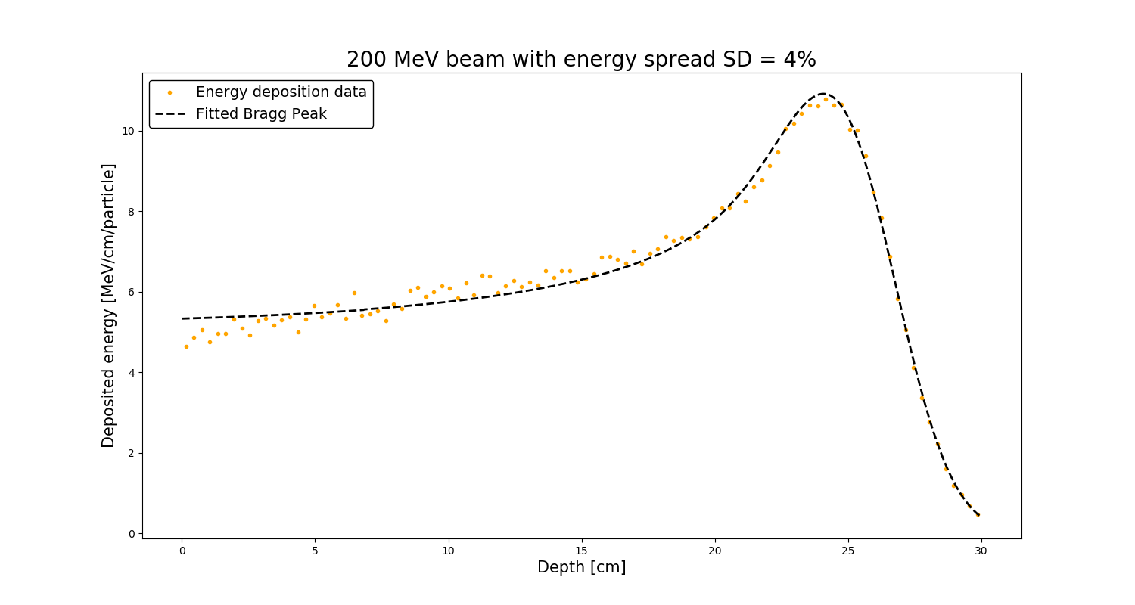
Dose profiles

Slide 10
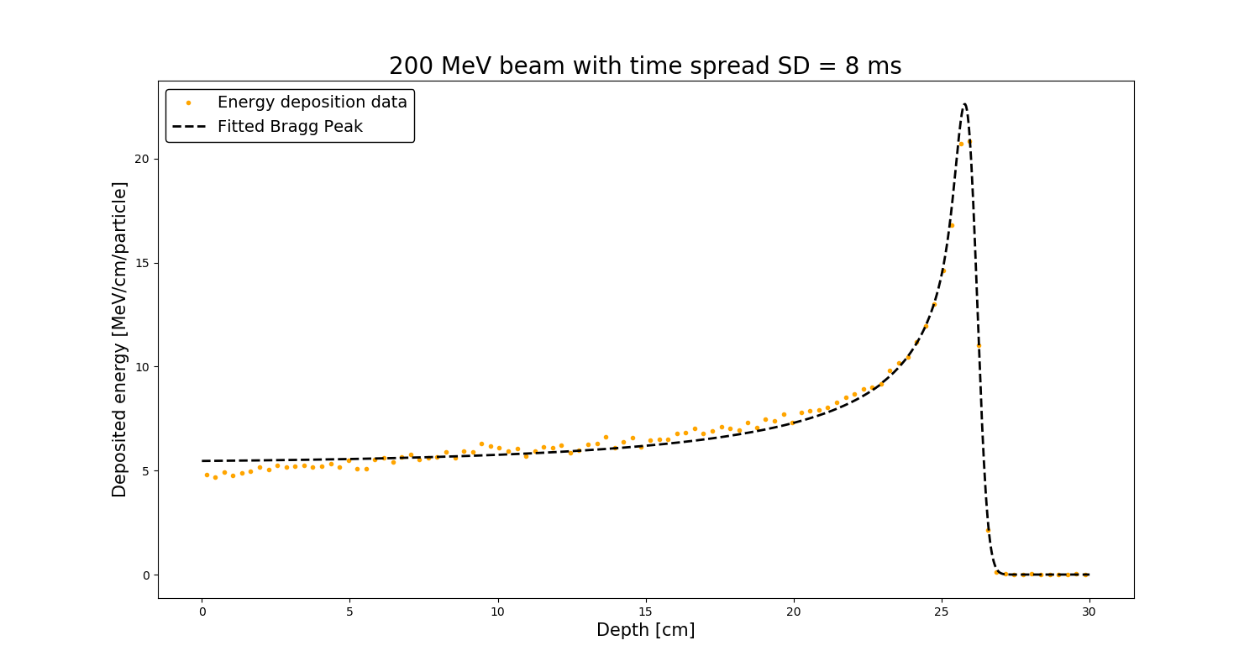
Dose profiles

Slide 11
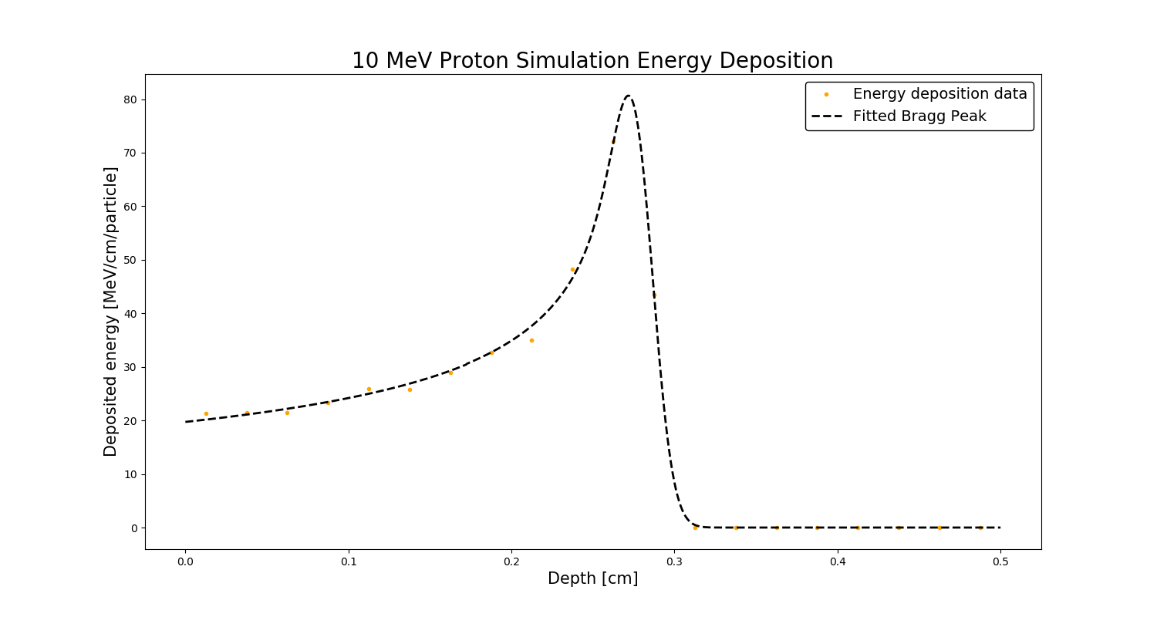
Next steps/current work
Simulation outputs → k-wave
10 MeV dose deposition discrepancy, dE/dx should be 45.67 MeV/cm
Tailoring of beam parameters to continue running through simulation

Slide 12
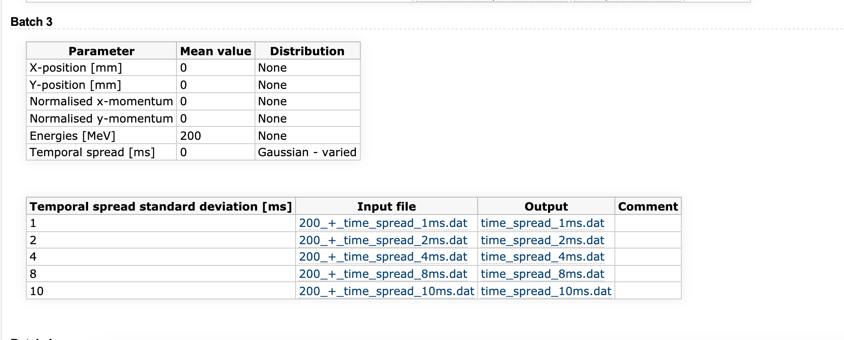
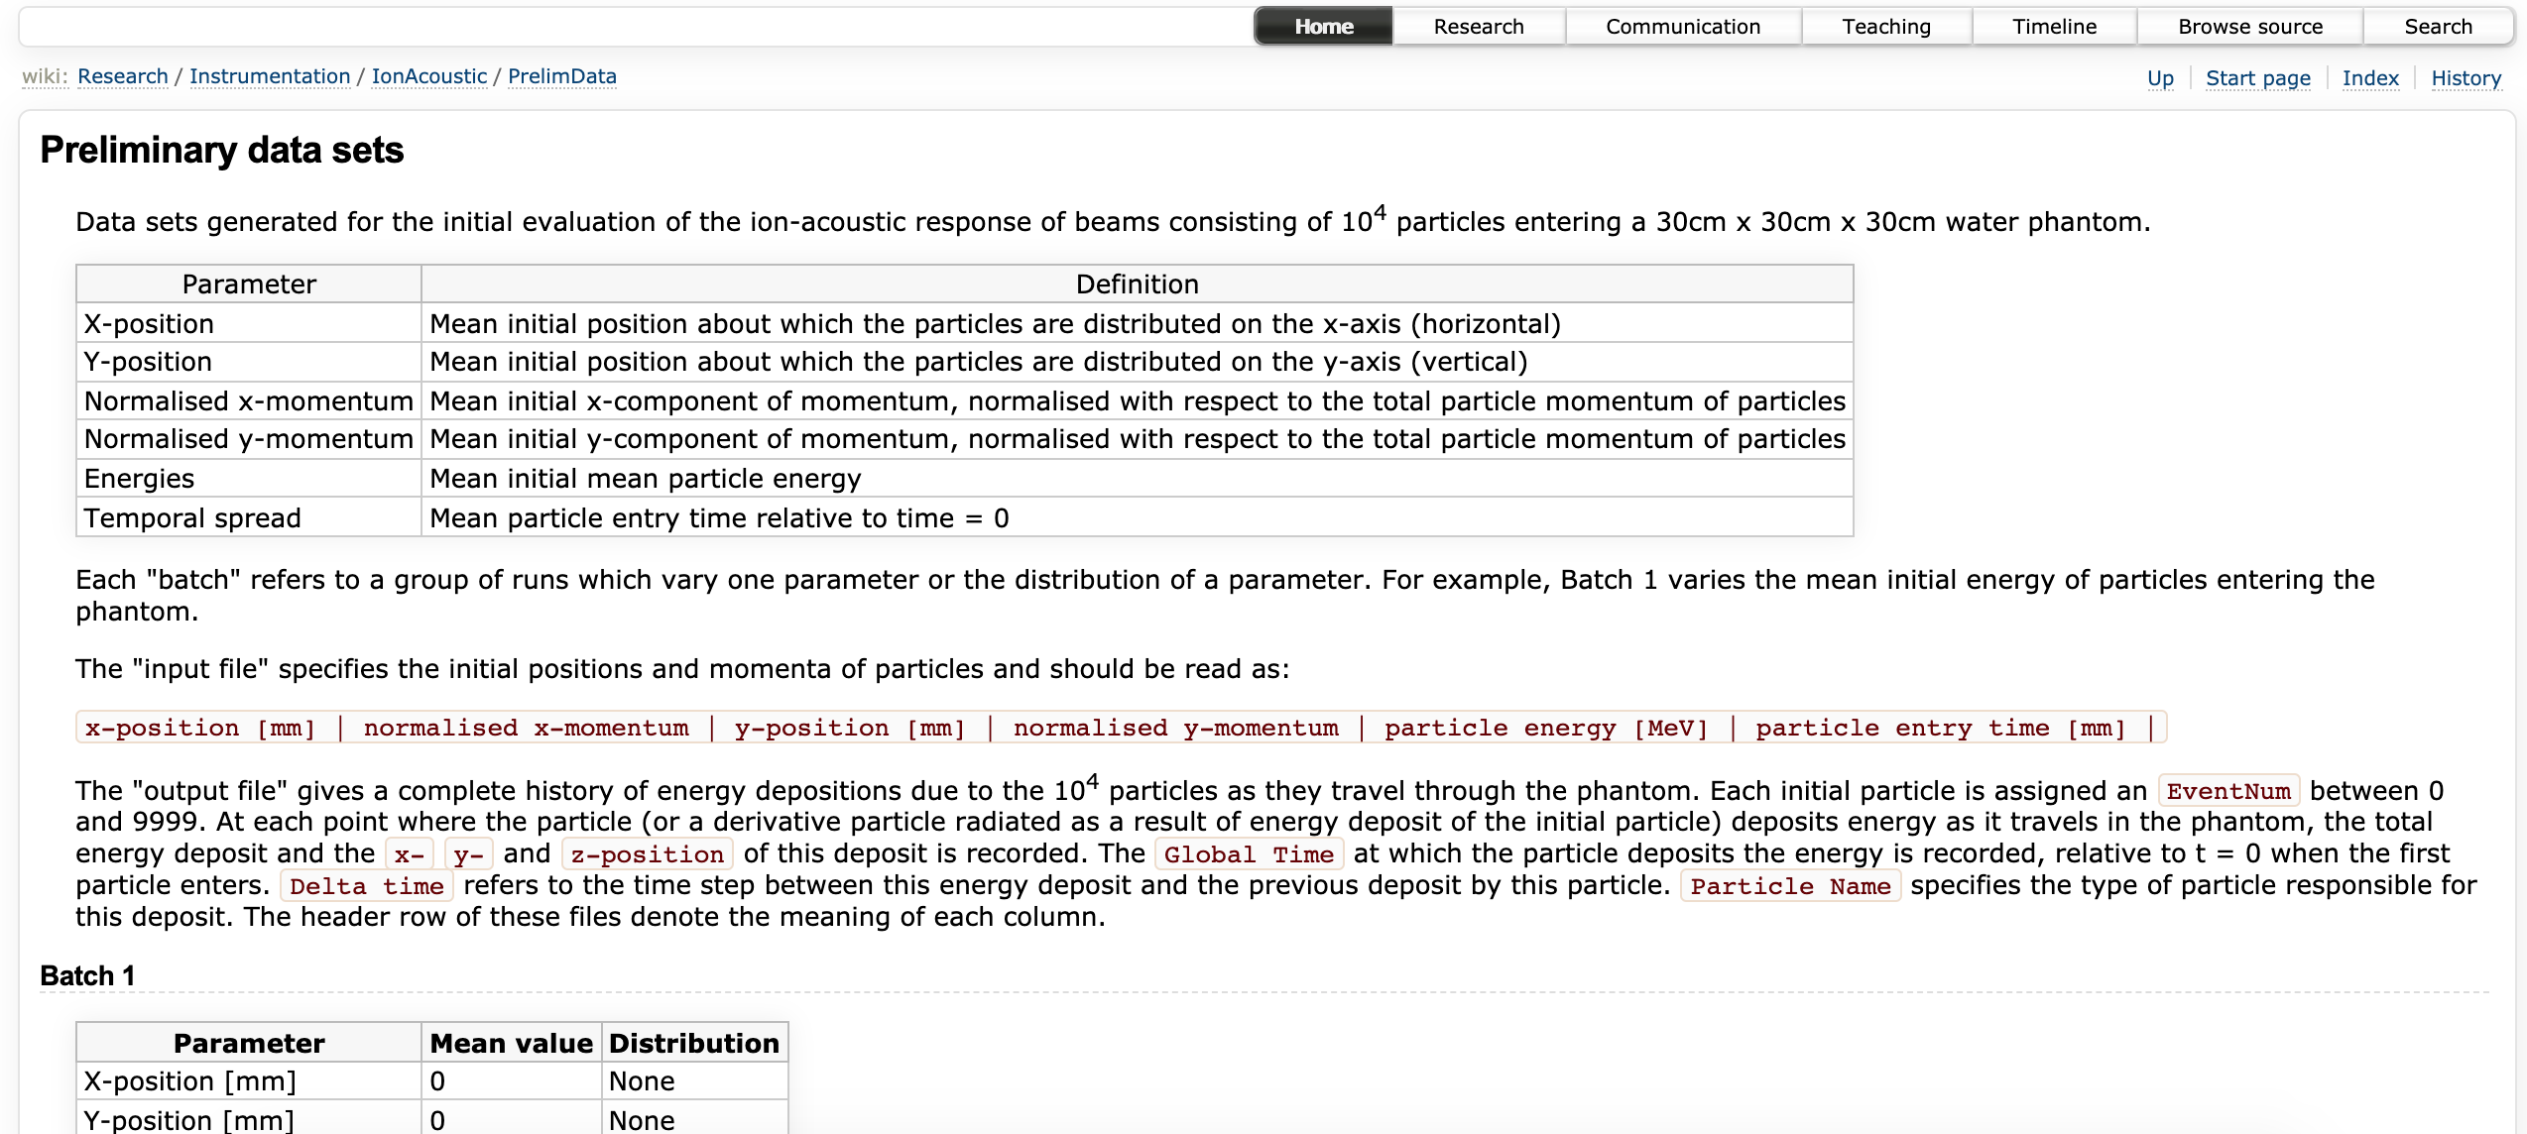
Wiki page for files
All files, explanations of what everything means can be found on wiki page.

